Slide 1

SRI VENKATESWARA COLLEGE OF ENGINEERING
Karakambadi Road, Tirupati-517507 2022-2023
DEPARTMENT OF COMPUTER SCIENCE AND ENGINEERING
Predicting Employee Under Stress Using Machine Learning
Presented By
Project Batch- 11
P. Bindhu
N. Hruthik Sai
P. Madhumitha
Muni Balaji . A
19BF1A05D0 19BF1A05C2 19BF1A05D9 19BF1A05B3
Under the Guidance of
S.Mrudula M.Tech.,
Assistant Professor,
CSE Department,
SVCE, Tirupati

Slide 2
OUTLINE
Abstract
Introduction
Literature Survey
Existing System
Drawbacks of Existing System
Proposed System
Advantages of proposed solution
System Requirements
System Analysis
UML Diagrams
Testing
Future Enhancement
Conclusion
References

Slide 3
ABSTRACT
Due to the COVID-19 pandemic, business and organizations have adapted to unconventional and different working styles and patterns, like working from home, working with limited employees in the office premise, etc. Employees may feel stressed when they are unable to cope with the prolonged uncertainty and pressure. Other factors leading to stress may include feeling isolated while working remotely, lower wages or salaries, unmanageable workload, extended working hours, unsatisfactory work environment, lack of connect with the team, lack of ability and skill to cope with the work apart from the fear of catching the virus. Spotting early signs of stress among employees will help employers identify and address the scenario, and hence help in reducing its impact on the employee and on the organization.

Slide 4
INTRODUCTION
The COVID-19 pandemic has caused a global downturn in various sectors including stock markets, leading to increased stress among employees.
Several studies have shown that stress is one of the most prevalent occupational disorders.
Machine learning can help organizations identify patterns of employee behavior that may indicate stress or other mental health issues.
Data from surveys and social media can be analyzed using machine learning algorithms to identify factors contributing to employee stress, such as workload, job insecurity, and lack of support.
Personalized interventions can be developed for at-risk employees based on individual characteristics and behavior patterns.
By addressing the underlying factors that contribute to stress, organizations can create a healthier and more productive work environment for their employees

Slide 5
Literature Survey
Ref no | Title | Author’s name | Journal
1 | Predicting Employee Stress using machine learning | 1.Garlapati Anusha 2.Doredla Radha Krishna 3.Kavya Garlapati | 2020 International Conference on Recent Trends on Electronics, Information, Communication & Technology (RTEICT)
2 | Prediction of stress levels in the workplace using surrounding stress | 1.Sergio Muñoz 2.Carlos Á. Iglesias 3.Oscar Mayora | Fondazione Bruno Kessler Research Institute, Trento, Italy

Slide 6
EXISTING SYSTEM
Employee stress is a growing concern for organizations worldwide, and machine learning algorithms are increasingly being used to predict and manage it. One such algorithm is XGBoost, which has been shown to be highly effective in predicting employee stress levels.
XGBoost is a decision tree-based algorithm that uses a gradient boosting framework to optimize model performance. It has become one of the most widely used machine learning algorithms due to its scalability, efficiency, and high level of accuracy.
In employee stress prediction, XGBoost can take into account a variety of factors such as workload, job satisfaction, and physical health
The algorithm can be trained on large datasets, enabling it to detect trends and patterns that might not be visible to human analysts.
Overall, XGBoost is a powerful tool for predicting employee stress levels and can help organizations take proactive steps to manage employee wellbeing.

Slide 7
DRAWBACKS OF EXISTING SYSTEM
Need for large datasets: While XGBoost can handle large datasets, it may not perform as well with small or imbalanced datasets, which could limit its usefulness in some applications.
Computationally intensive: XGBoost can require significant computational resources to train, especially for complex models or large datasets, which could make it less accessible to organizations with limited computing resources.
Difficulty in tuning hyperparameters: XGBoost has many hyperparameters that need to be tuned to optimize model performance, which can require significant time and computational resources.
Time Consuming: XGBoost requires a huge amount of time to train and test models,which may limit its usefulness in some applications.

Slide 8
PROPOSED SYSTEM
LightGBM is a gradient boosting framework that uses tree based learning algorithms.
Comparison experiments on public datasets show that LightGBM can outperform existing boosting frameworks on both efficiency and accuracy, with significantly lower memory consumption.
It is designed to be distributed and efficient for any datasets.
We are using this algorithm to train the model and it has very high accuracy (>97%).
Also to further more improvise our website we are introducing new features like Data Exploration, Feature Analysis and Stress Management Strategies.
Using Data Exploration and Feature Analysis we can Analyze the Datasets and make any comparisions if necessary
The Stress Management Strategies page will give us a detailed information about the measures which can be taken to counter stress also there are videos on employee stress management techniques and finally the webpage also gives us contact information about nearby therapist if the user needs one.

Slide 9
ADVANTAGES OF PROPOSED SYSTEM
Improved efficiency: LightGBM is designed to be highly efficient and can be faster than XGBoost when training models on large datasets or when using multiple threads.
Lower memory usage: LightGBM uses a histogram-based approach to binning data, which can reduce the memory footprint of the algorithm compared to XGBoost's approach.
Better handling of categorical features: LightGBM has built-in support for categorical features, which can reduce the need for data preprocessing and improve model accuracy.
Improved accuracy on imbalanced datasets: LightGBM's gradient-based approach can be better suited to imbalanced datasets than XGBoost's decision tree-based approach.
Improved generalization ability: LightGBM's approach to regularization can improve model generalization ability, making it more robust to different contexts and datasets..
Good community support: LightGBM has a growing user community and is actively maintained, which can provide support and resources for organizations using the algorithm.

Slide 10
SYSTEM REQUIREMENTS
Processsor --- INTEL (R) Core (TM) i3 or higher
RAM --- 4GB or Higher
Hardisk --- 128 GB or higher
OS --- Windows 8.1 or higher
IDE --- Mircrosoft VSCode
Libraries --- pandas, sklearn, lightgbm, node.JS, joblib,matplotlib.
Programming language --- PYTHON 3.8 or higher, HTML, CSS ,JavaScript.

Slide 11
SYSTEM ANALYSIS MODULES OF PESML
Service Provider : The functionalities of this module are as follows
1. Login
2. View About Existing Algorithm
3. Navigate To Stress reduction techniques page
4. Learn about The employee dataset
5. Train and Test model using dataset
6. Give new input and Test the model
7. Debug and analyze internal program flow through console
8. Logout

Slide 12
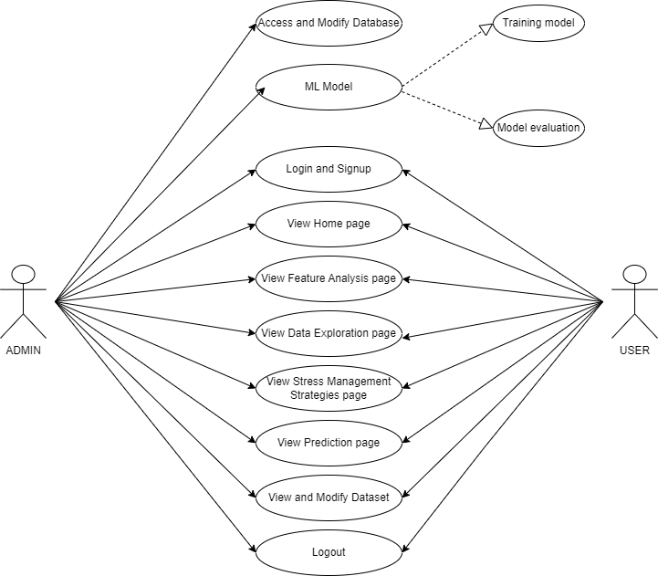
Use case Diagram of PESML

Slide 13
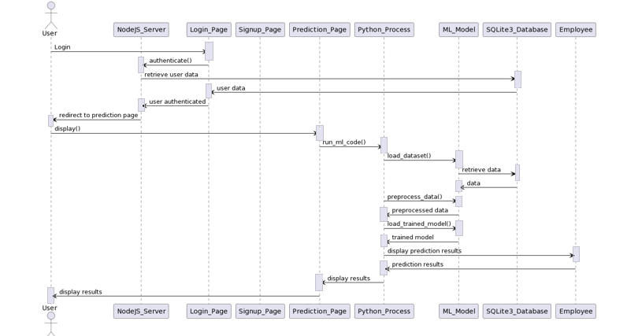
Sequence Diagram of PESML

Slide 14
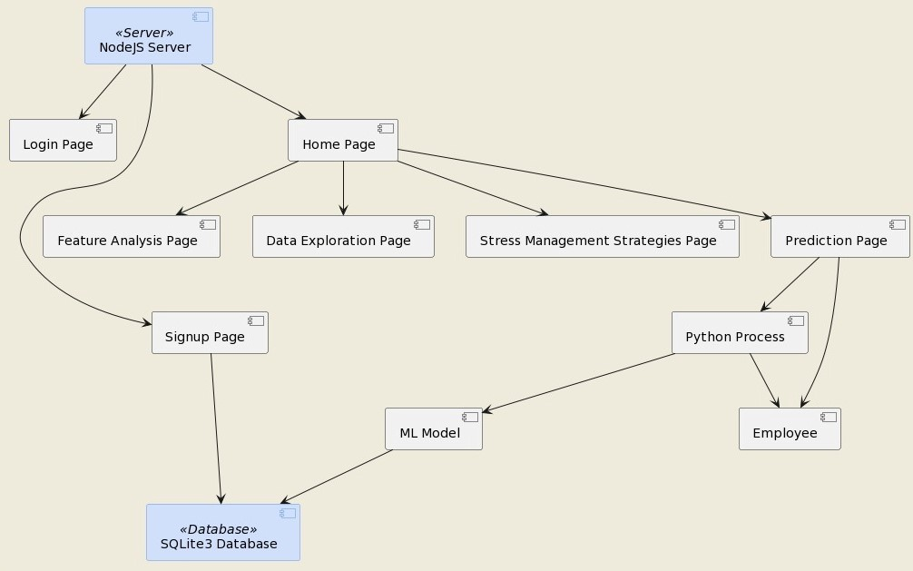
Component Diagram of PESML

Slide 15
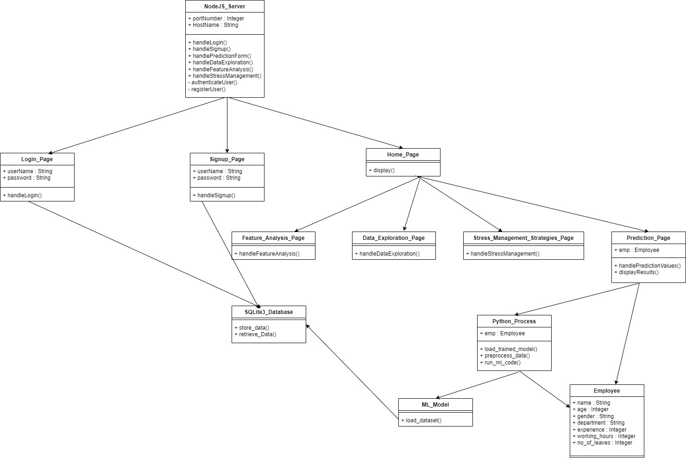
Class Diagram of PESML

Slide 16
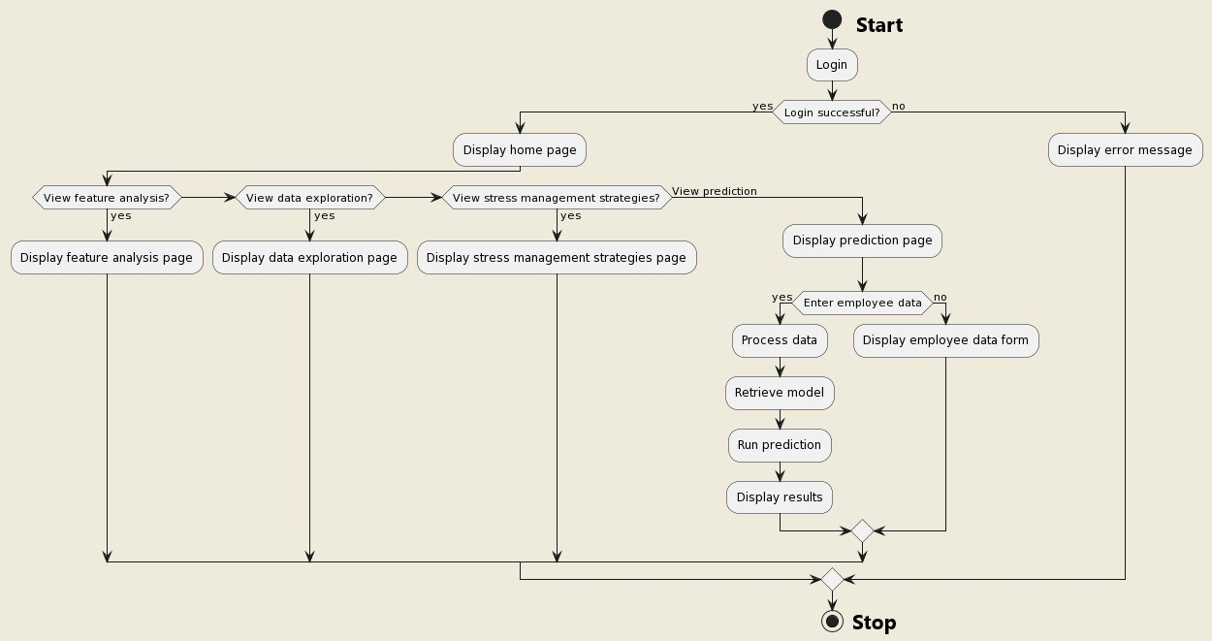
Activity Diagram of PESML

Slide 17
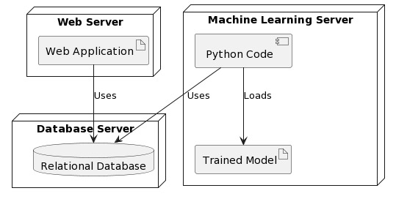
Deployment Diagram of PESML

Slide 18
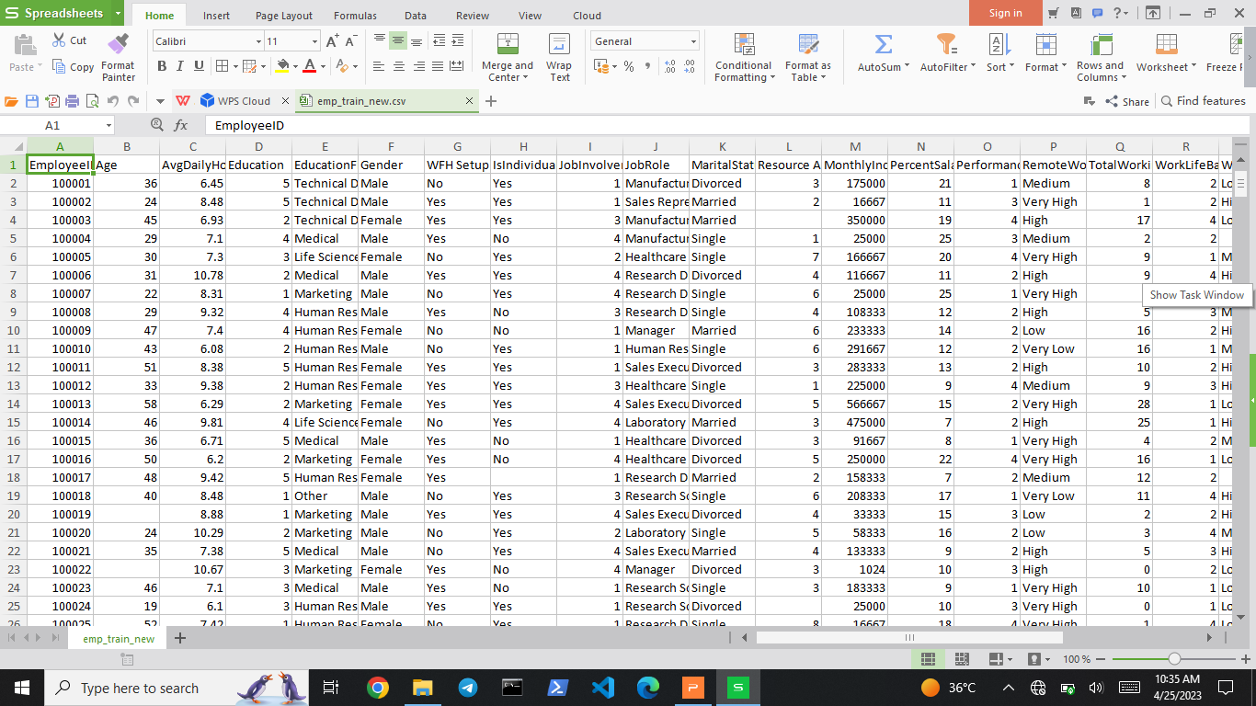
Screenshot of DataSet

Slide 19
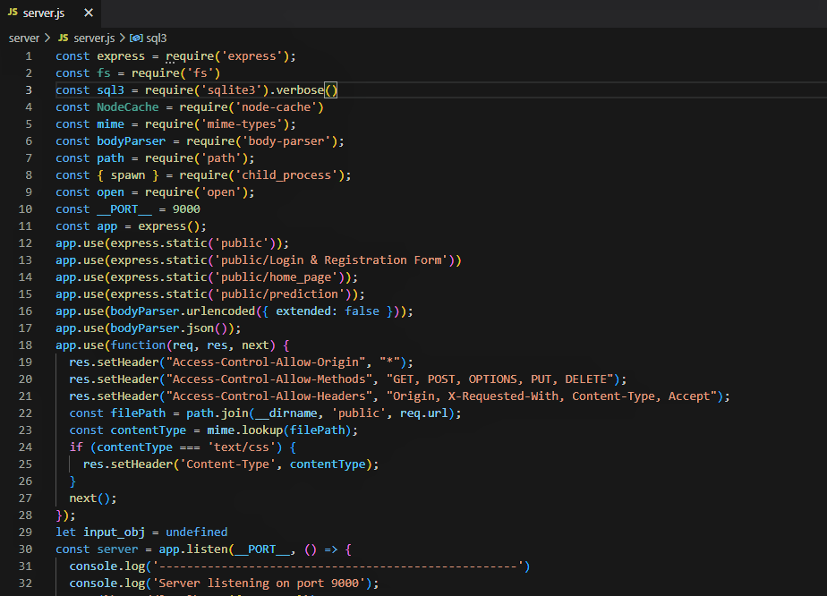
SOURCE CODE

Slide 20
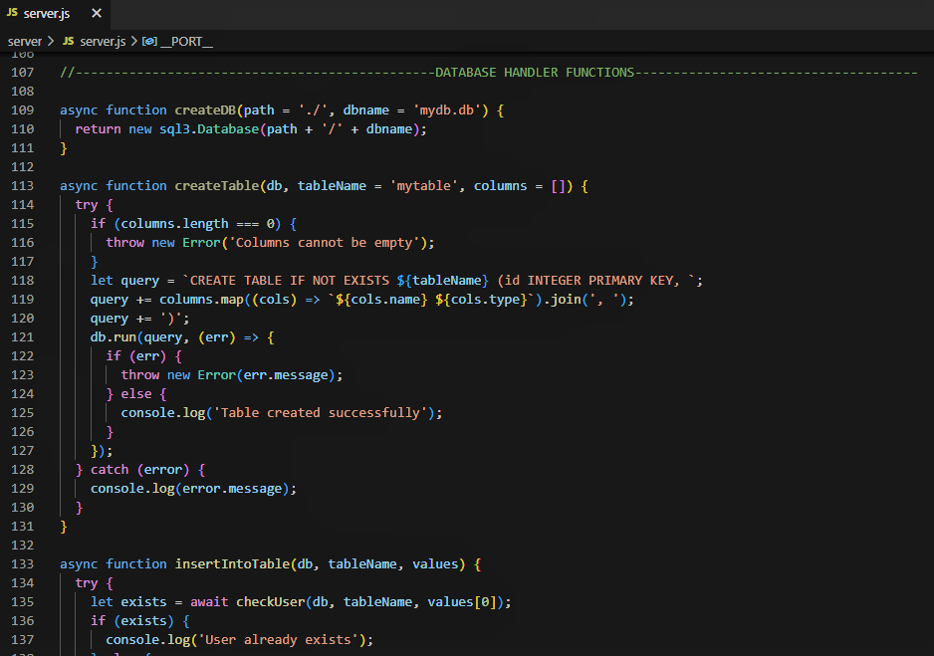
SOURCE CODE Contd...

Slide 21
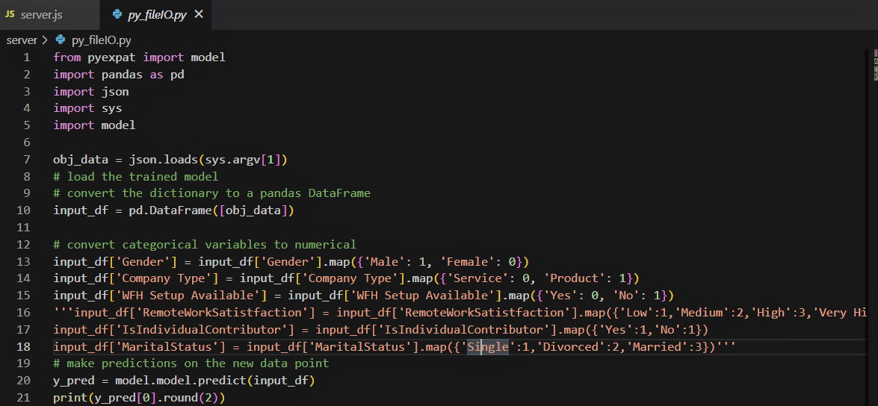
SOURCE CODE Contd...

Slide 22
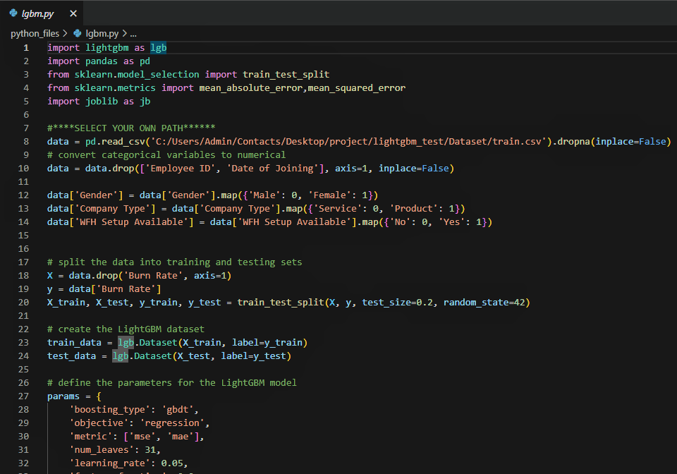
SOURCE CODE Contd...

Slide 23
CODE TESTING
UNIT TESTING:
Unit testing is usually conducted as part of a combined code and unit test phase of the software
lifecycle, although it is not uncommon for coding and unit testing to be conducted as two distinct
phases.
Test strategy and approach:
Field testing will be performed manually and functional tests will be written in detail.
Test objectives:
All field entries must work properly.
Pages must be activated from the identified link.
The entry screen, messages and responses must not be delayed.

Slide 24
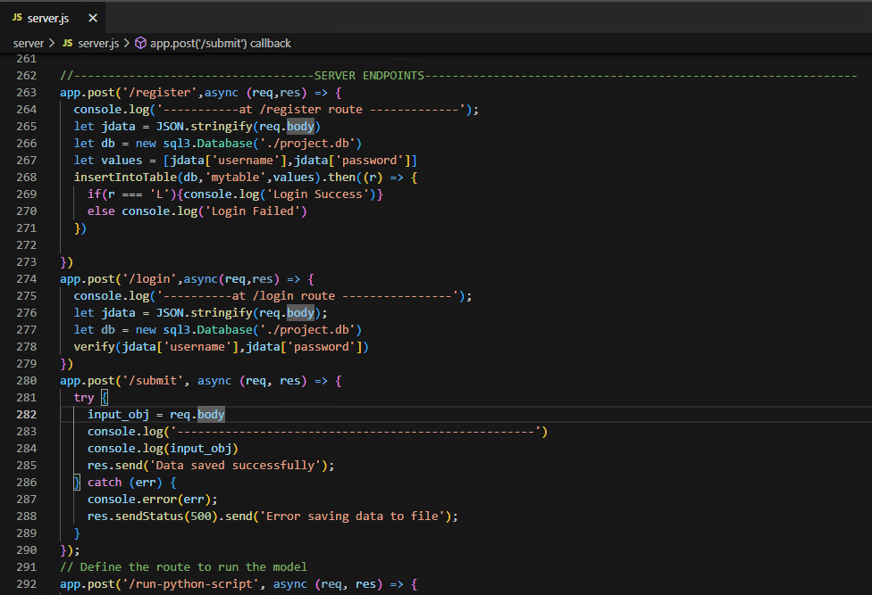
SCENARIO OF CODE

Slide 25
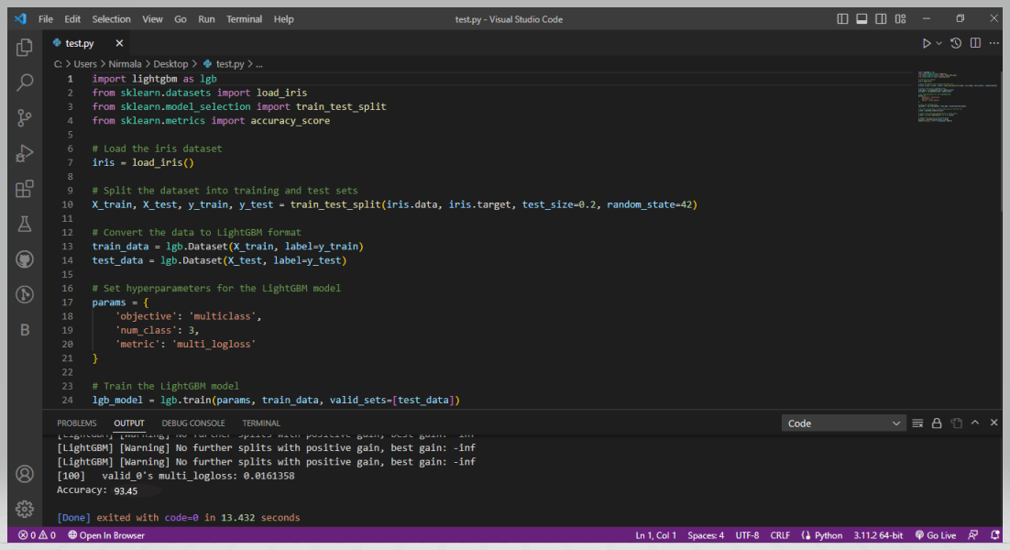

Slide 26
INTEGRATION TESTING
Software integration testing is the incremental integration testing of two or more integrated software components on a single platform to produce failures caused by interface defects.
The task of the integration test is to check that components or software applications, e.g. components in a software system or – one step up – software applications at the company level – interact without error.
Test Results: The transaction is predicted to be Normal transaction

Slide 27
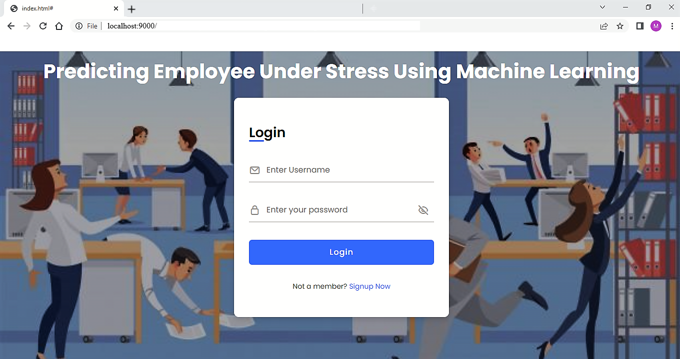
SCREENSHOTS OF OUTCOMES

Slide 28
SYSTEM TESTING
System Testing evaluate the overall functionality and performance of a complete and fully integrated software solution.
Complete system is tested which includes the models used in ML and User Interface.
This type of testing is performed after the integration testing and before the acceptance testing.
This tests the entire project so that we will easily detect the errors which were not identified in the other testings.

Slide 29
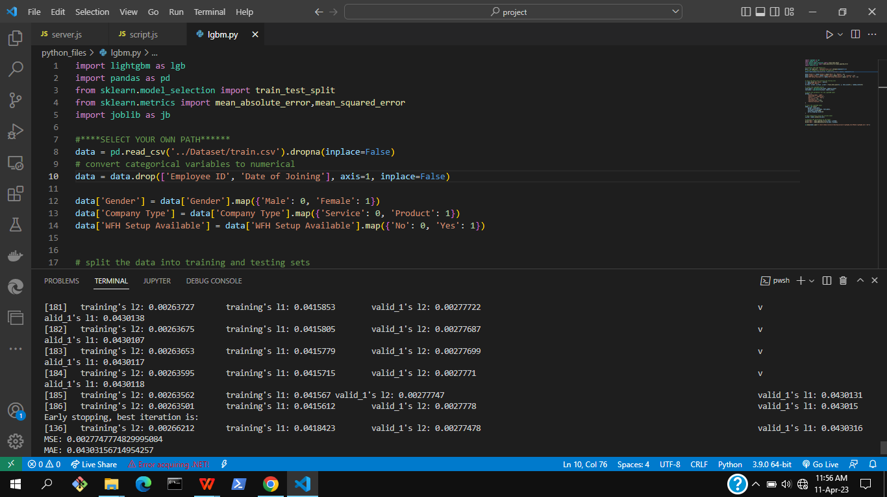
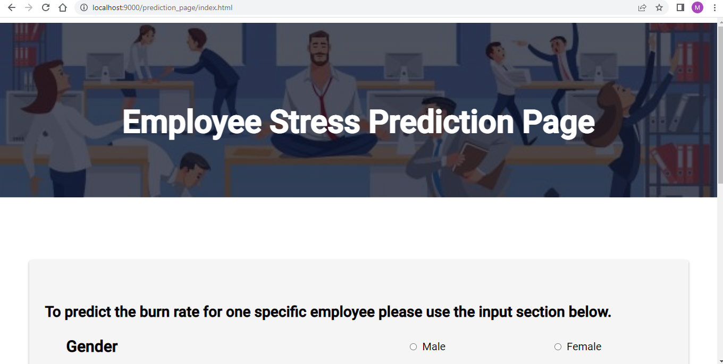
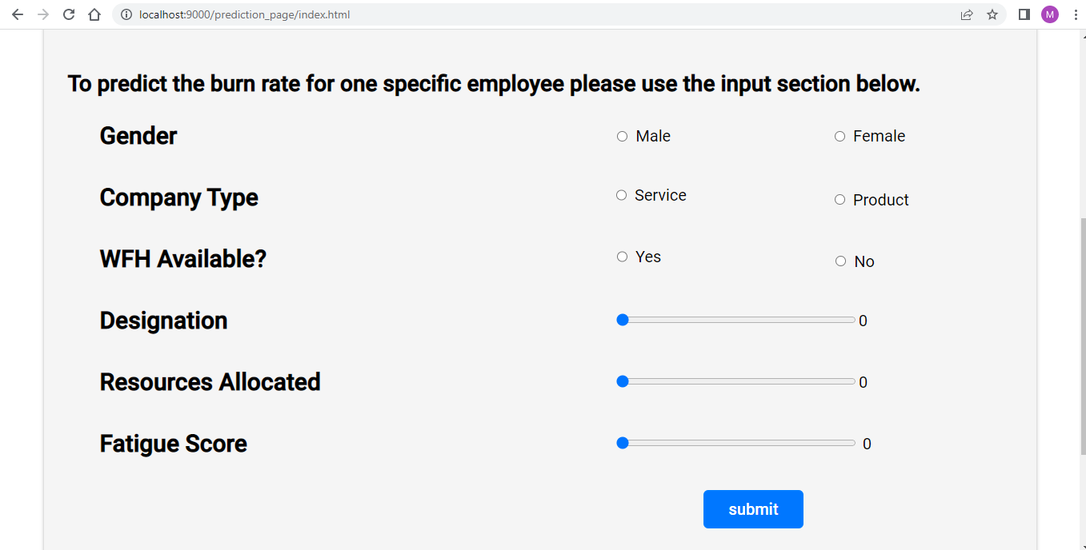
Screenshots of Prediction Page

Slide 30
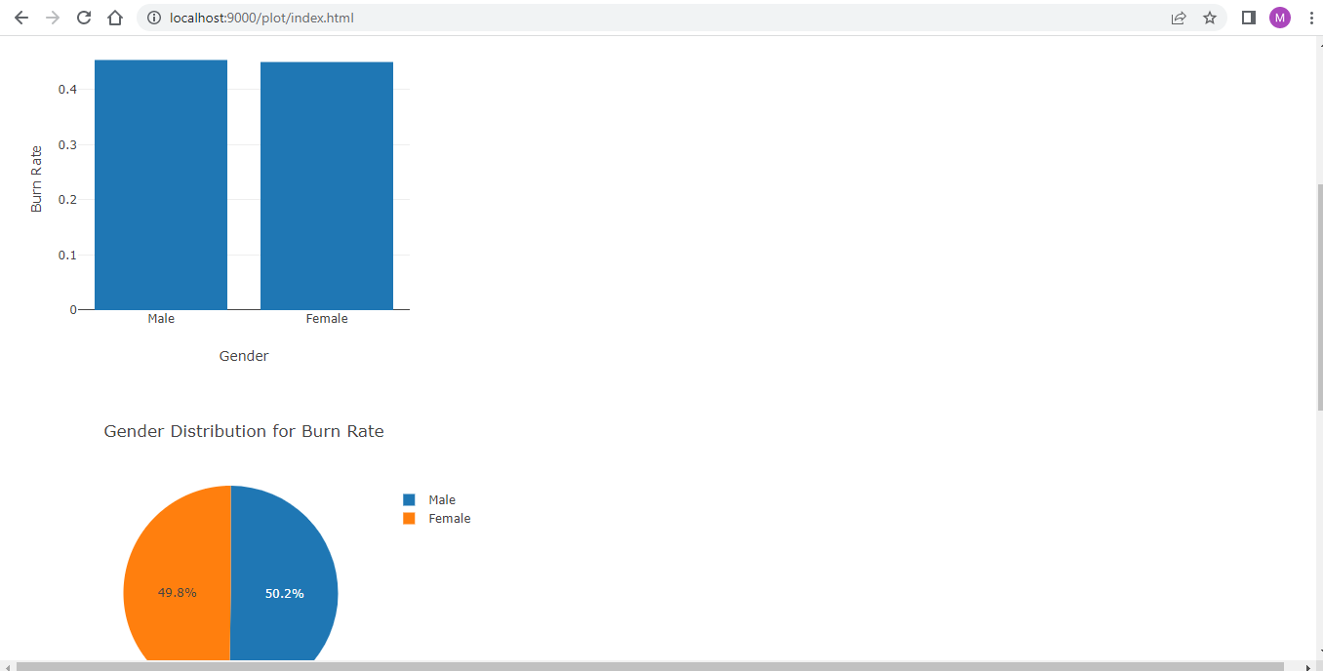
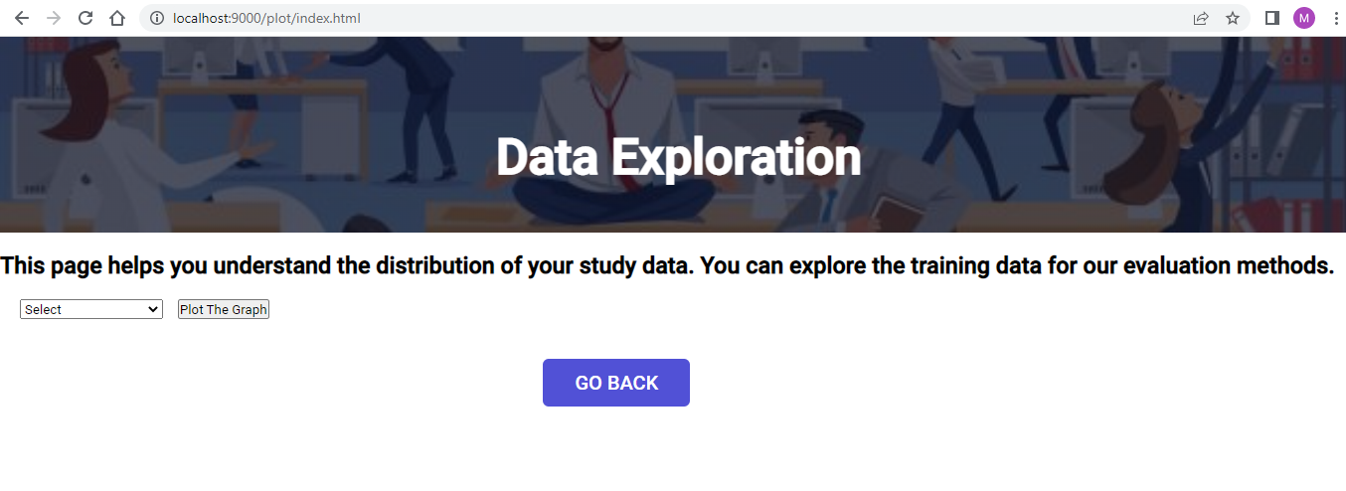
Screenshots of Data Exploration Page

Slide 31
FUTURE ENHANCEMENT
The web application can be upgraded with AI algorithms that collect data on employee stress levels and workload.
Machine learning models can analyze this data to predict when employees are at risk of burnout and provide personalized recommendations and real-time support to manage stress levels and promote well-being.
Continuous improvement: Continuously gather feedback from employees and use it to improve the application's accuracy and usefulness. This could involve adding new features, adjusting existing ones, or refining the algorithm to better predict stress levels and suggest appropriate interventions.
This can benefit employers by creating a more supportive and proactive work environment, leading to increased employee retention, job satisfaction, and productivity..

Slide 32
CONCLUSION
The development of a web application for predicting employee stress using machine learning algorithms is a promising approach for promoting employee well-being and maintaining a healthy work environment.
By using the LightGBM algorithm to analyze data on employee stress levels and workload, the application can accurately predict when employees are at risk of burnout and suggest appropriate interventions to reduce stress levels.
The project demonstrates the potential of machine learning algorithms in predicting and managing employee stress, and highlights the importance of using data-driven approaches to promote employee well-being in the workplace.

Slide 33
REFERENCES
A. T. Ginty, A. T. Tyra, D. A. Young, N. A. John-Henderson, and J. A. C. Tsang, “State gratitude is associated with lower cardiovascular responses to acute psychological stress: a replication and extension,” International Journal of Psychophysiology, vol. 158, no. 6, pp. 238–247, 2020.View at: Publisher Site | Google Scholar
M. Stoffel, E. Abbruzzese, S. Rahn, U. Bossmann, and B. Ditzen, “Covariation of psychobiological stress regulation with valence and quantity of social interactions in everyday life: disentangling intra- and interindividual sources of variation,” Journal of Neural Transmission, vol. 205, p. 02359, 2021.View at: Google Scholar
N. Kupper, M. Jankovic, and W. J. Kop, “Individual differences in cross-system physiological activity at rest and in response to acute social stress,” Psychosomatic Medicine, vol. 83, no. 2, pp. 138–148, 2020.View at: Publisher Site | Google Scholar
J. Chen, N. Zhang, and B. Li, “Low-pass digital filter with amplitude 1/f 2 attenuation based empirical mode decomposition of vortex signal processing method,” Review of Scientific Instruments, vol. 92, no. 4, Article ID 045002, 2021.View at: Publisher Site | Google Scholar

Slide 34


