Slide 1
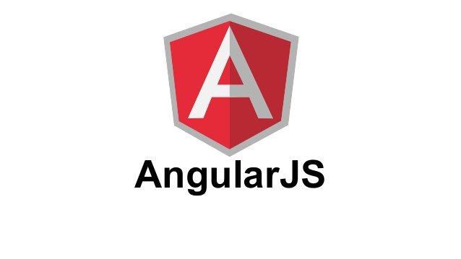
Prepared By: Muniba Javaid

Slide 2
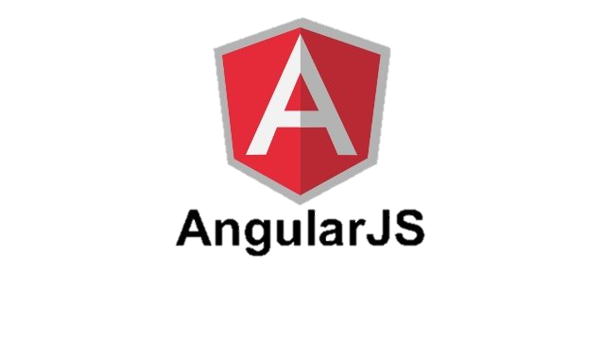
OBJECTIVES
Describe what Angular JS is
Explain why we choose Angular JS
Analyze MVC architecture concept
Describe where Angular JS is used

Slide 3
WHAT IS ANGULAR JS
Angular JS is a powerful JavaScript framework
It is developed by Google in 2009.
It is open source and free.
It is very useful for developing Dynamic and interactive web application.
It is very useful for Single Page Application (SPA)

Slide 4
WHY ANGULAR JS FEATURES
MVC (Model View Controller)
Cross browser support
Open Source and completely free.
Routing
Services
Two way Data Binding
Testing
Filters

Slide 5
ANALYZE MVC ARCHITECTURE
MVC (Model View Controller).
It is a software design pattern.
MVC is popular because it separate the application logic from the user interface layer.
It consist three parts:
1) Model 2) View 3) Controller

Slide 6
Cont.…..
MODEL
Model is the lowest level of the pattern responsible for maintaining data.
VIEW
View it is responsible for displaying all or a portion of the data to the user.
CONTROLLER
It is a software code that controls the interactions between the model and view.

Slide 7
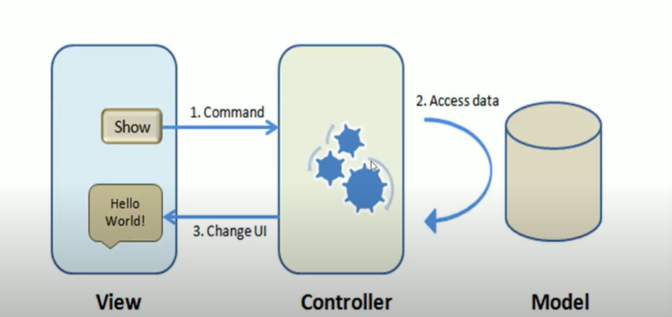
MODEL VIEW CONTROLLER

Slide 8
ANGULAR JS ENVOIRNMENT SETUP
There are two ways to use Angular JS.
Local Installation − You can download Angular JS library on your local machine and include it in your HTML code.
CDN Based Version − You can include Angular JS library into your HTML code directly from Content Delivery Network (CDN).
Local Installation
Go to the https://angularjs.org/ to download the latest version available.
Now put downloaded jquery-3.2.0.min.js file in a directory of your website, e.g. /jQuery.

Slide 9
ANGULAR BASIC DIRECTIVES
Angular JS directives are used to extend HTML. These are special attributes starting with ng-prefix.
ng-app: These directive start with Angular JS application.
ng-model: These directive binds the value of Angular JS application data to HTML input controls.
ng-bind: These directive binds the content of the html element with Angular JS application.
ng-init These directive initializes AngularJS application variables.

Slide 10
ANGULAR DIRECTIVES EXAMPLE 1
<div ng-app=""> <p>Name: <input type="text" ng-model="name"></p> <p ng-bind="name"></p> </div>
Example explained:
AngularJS starts automatically when the web page has loaded.
The ng-app directive tells AngularJS that the <div> element is the "owner" of an AngularJS application.
The ng-model directive binds the value of the input field to the application variable name.
The ng-bind directive binds the content of the <p> element to the application variable name.

Slide 11
ANGULAR DIRECTIVES EXAMPLE 2
<div ng-app="" ng-init="firstName='John'"> <p>The name is <span ng-bind="firstName"></span></p> </div>

Slide 12
ANGULAR DIRECTIVES DETAILS
IMPORTANT ANGULAR JS DIRECTIVES LIST
ng-app
ng-model
ng-bind
ng-include
ng-src
ng-show
ng-hide
ng-init
ng-repeat
ng-click

Slide 13
ANGULAR JS EXPRESSION
AngularJS expressions can be written inside double braces: {{ expression }}.
AngularJS expressions can also be written inside a directive: ng-bind="expression".
AngularJS will resolve the expression, and return the result exactly where the expression is written.
AngularJS expressions are much like JavaScript expressions: They can contain literals, operators, and variables.
Example {{ 5 + 5 }} or {{ firstName + " " + lastName }}

