Slide 1

ANGULAR JS
Made by: Ayman Naeem

Slide 2
WE WILL LEARN
What is module
What is controller
Relationship between module and controllers
How MVC is implemented in Angular JS
How to create module
How to create controller
How to link controllers to module
How to use modular and controllers in html (view)

Slide 3
What is module
Angular JS supports modular approach for development
Modules are used to separate logic from view
We define modules in separate JS file
Module is like a container of different parts like directives, controllers etc.
Recommendations:
Separate module for each feature(maintenance becomes easy)

Slide 4
What is controller
A controller is a JavaScript object containing attributes/properties and functions
Controller defines the functionality of module

Slide 5
Relationship between module and controller
The module is a container for the application controllers
Controllers always belong to a module
Controllers define the functionality of the module
Every module must have at least one controller or it can be more than one

Slide 6
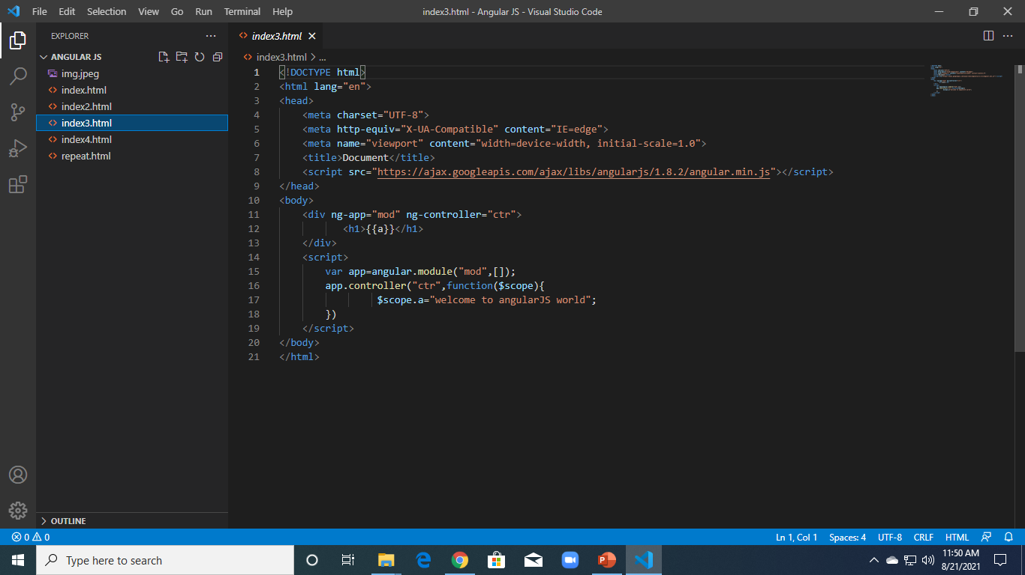

Slide 7
Ng-show / ng-hide
ngShow and ngHide allow us to display or hide different elements.
This helps when creating Angular apps since our single page applications will most likely have many moving parts that come and go as the state of our application changes.
The great part about these directives is that we don't have to do any of the showing or hiding ourselves with CSS or JavaScript.
It is all handled by good old Angular.

Slide 8
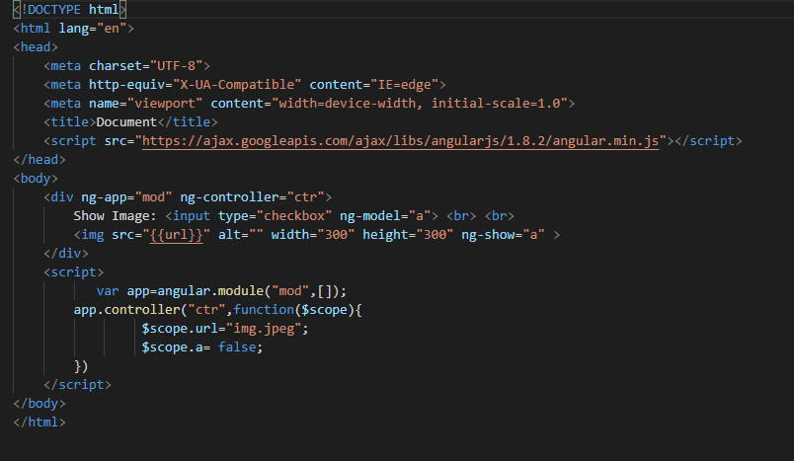

Slide 9
NG-repeat
The ng-repeat directive repeats a set of HTML, a given number of times.
The set of HTML will be repeated once per item in a collection.
The collection must be an array or an object.
Each instance of the repetition is given its own scope, which consist of the current item.
If you have an collection of objects, the ng-repeat directive is perfect for making a HTML table, displaying one table row for each object, and one table data for each object property.

Slide 10
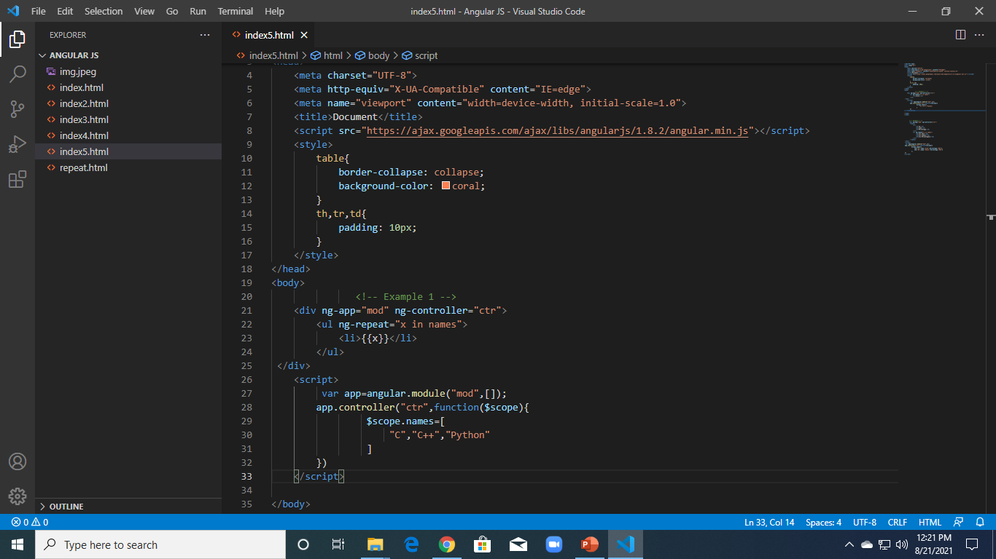

Slide 11
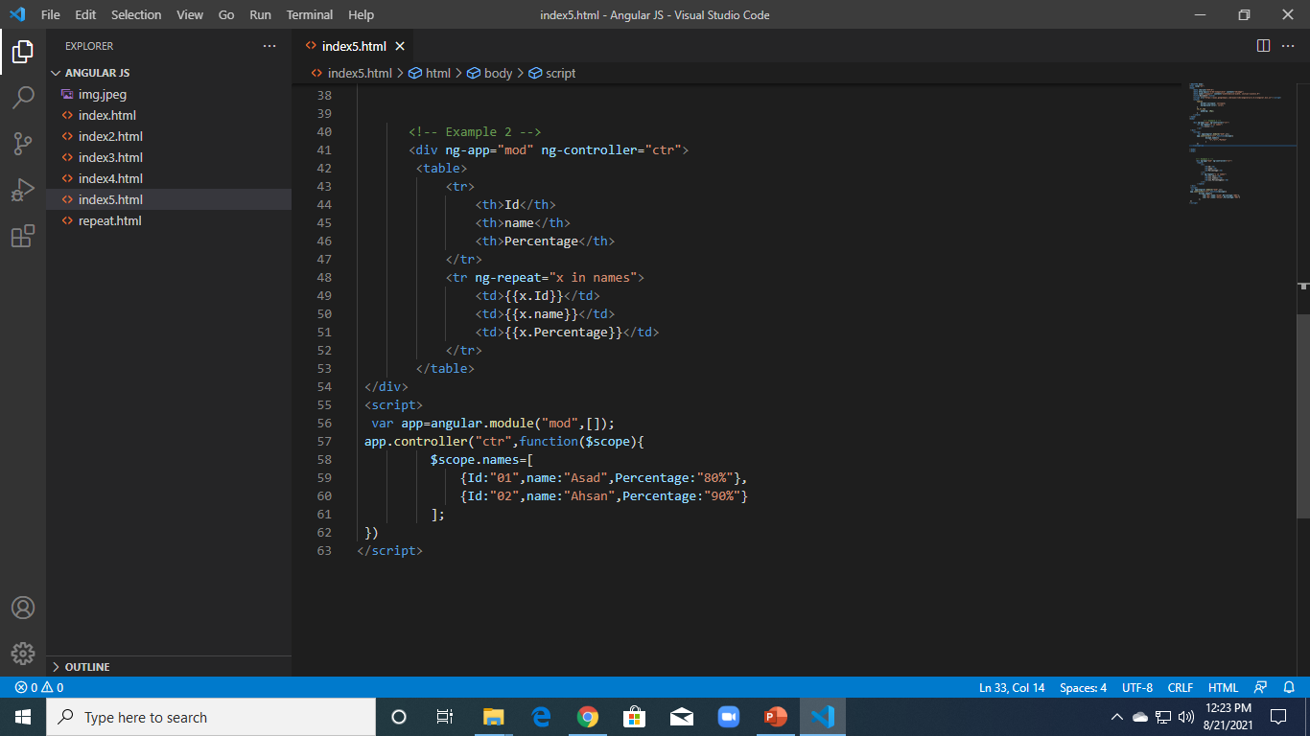

Slide 12
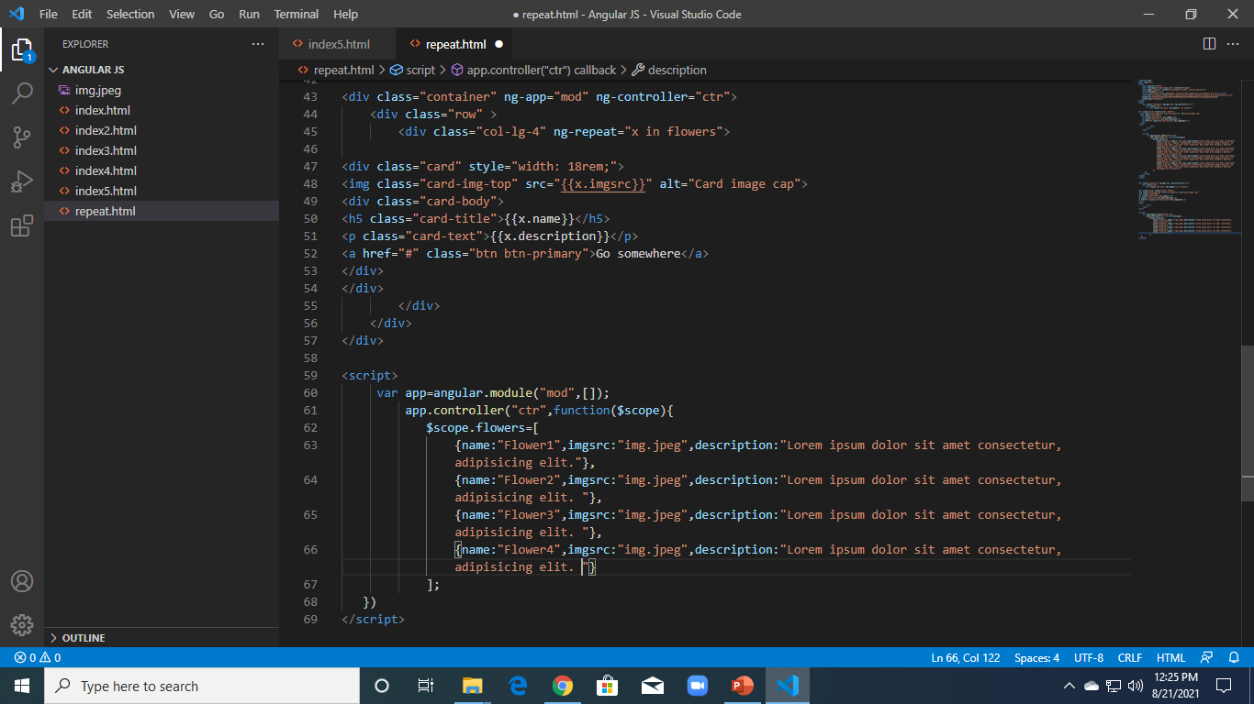

Slide 13
NG-include
The ng-include directive includes HTML from an external file.
The included content will be included as child nodes of the specified element.
The value of the ng-include attribute can also be an expression, returning a filename
By default, the included file must be located on the same domain as the document.

Slide 14
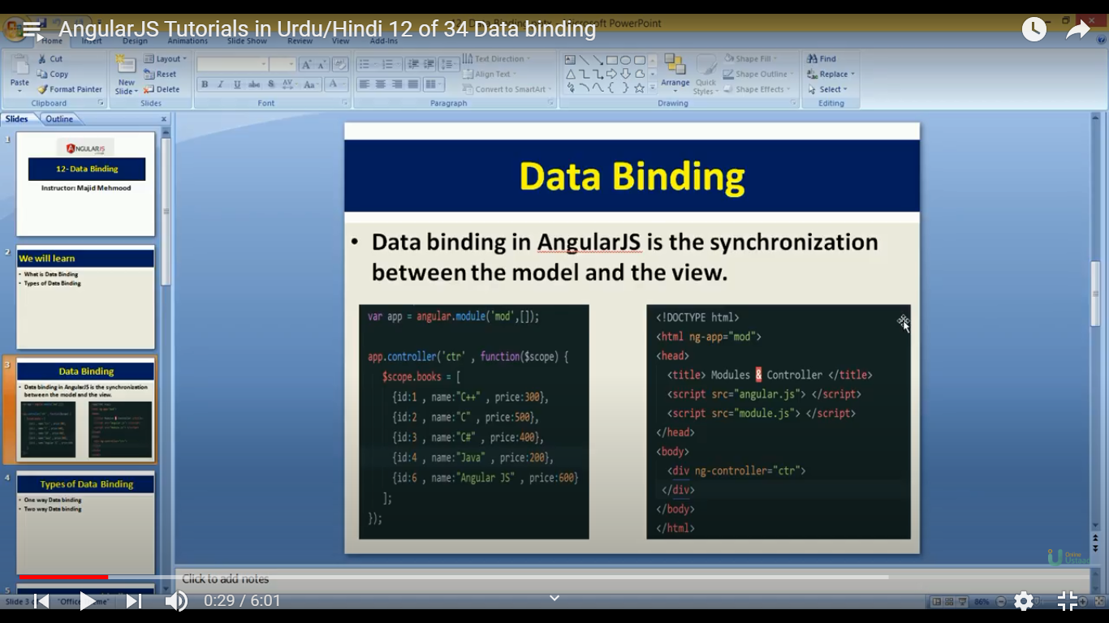
Data-binding
Data-binding in AngularJS is the synchronization(link) between view and model

Slide 15
Types of Data-binding
One way data-binding
Two way data-binding

Slide 16
One way Data-binding
Performed using ng-bind
View
Model

Slide 17
two way Data-binding
Performed using ng-model
Used with inputs, textbox, checkbox and radio buttons
View
Model

Slide 18
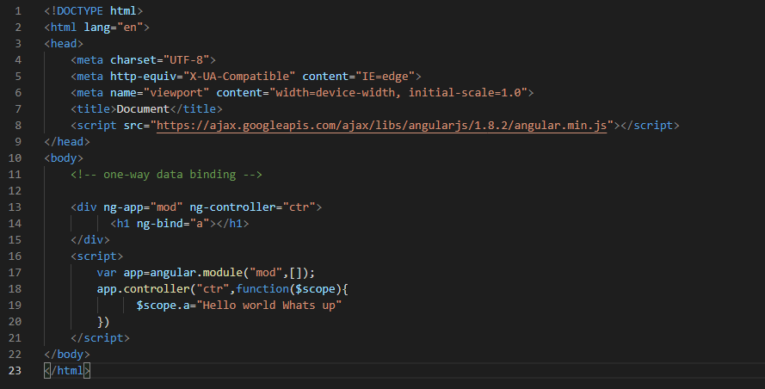

Slide 19
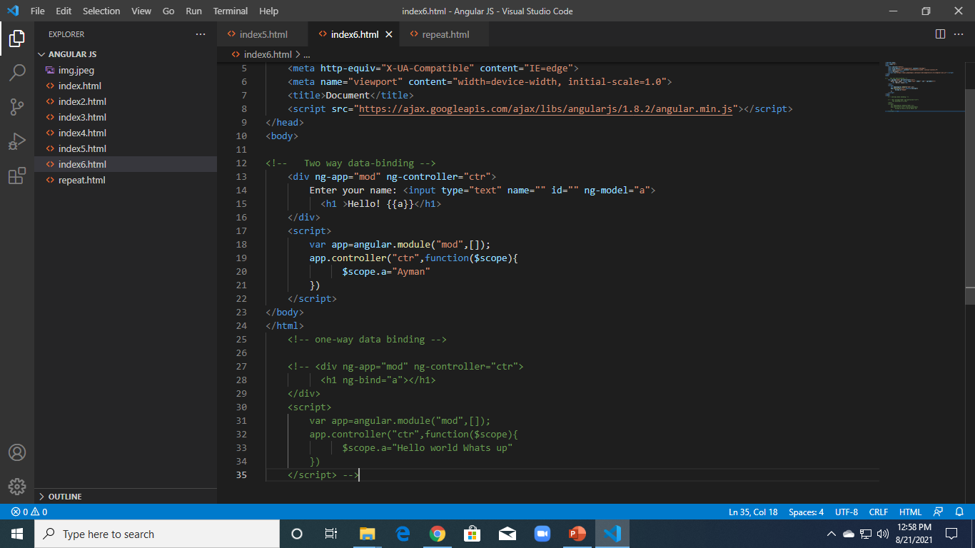

Slide 20
Event handling in angular js
The AngularJS has a set of Event Directives that can be used to set custom behavior when several types of events are triggered.
The table below has a list of all such event directives

Slide 21
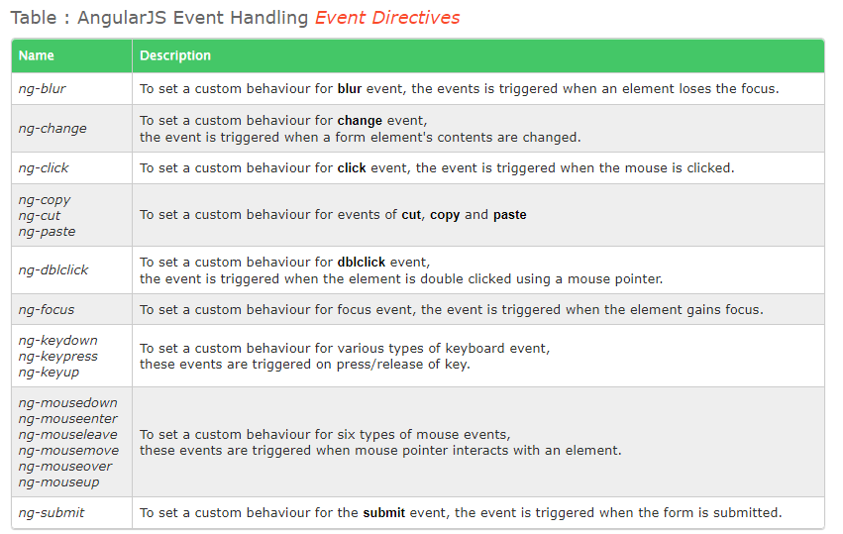

Slide 22
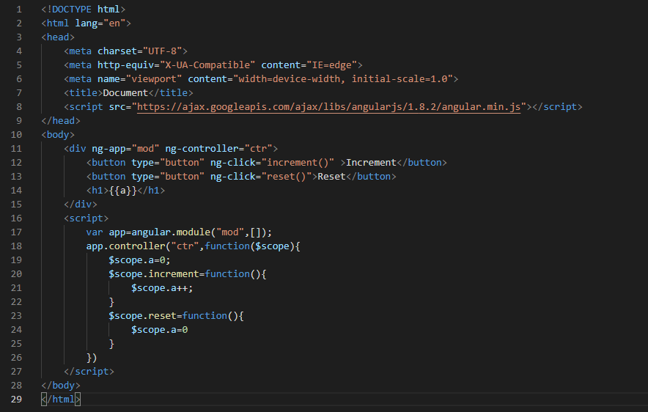

Slide 23
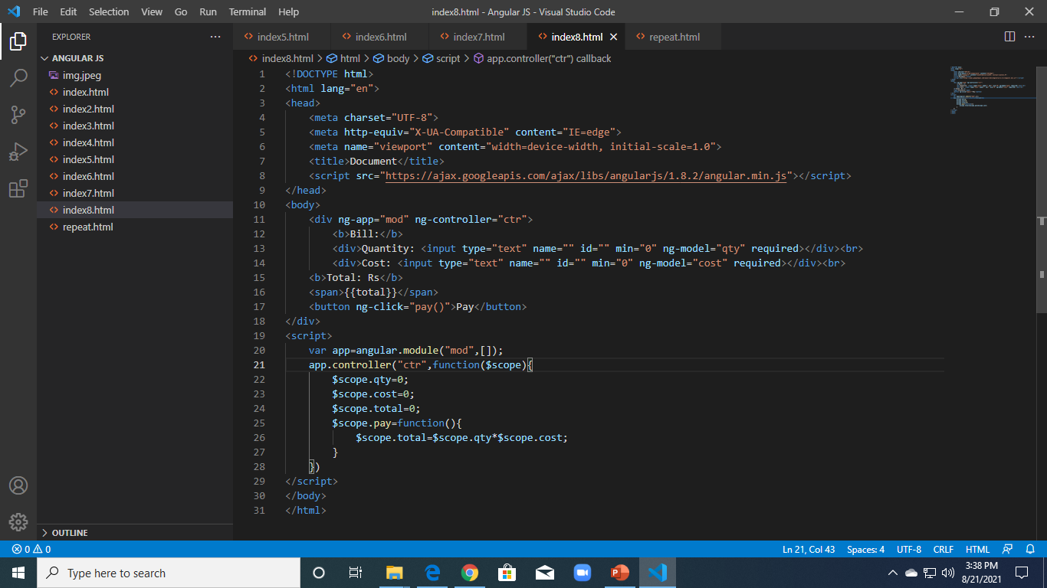

Slide 24
filters
Filters are use to extract data from unformatted data of server side
In short, filters format the value of an expression for displaying to the end user
Filters are added to expressions by using the pipe character |, followed by a filter
For example, {{ expression | filter}}
Note: filter do not change the underlying data in the database. They only do the formatting for display

Slide 25
Built-in filters
Currency
Date
Lowercase
Uppercase
Search
LimitTo
orderBy

Slide 26
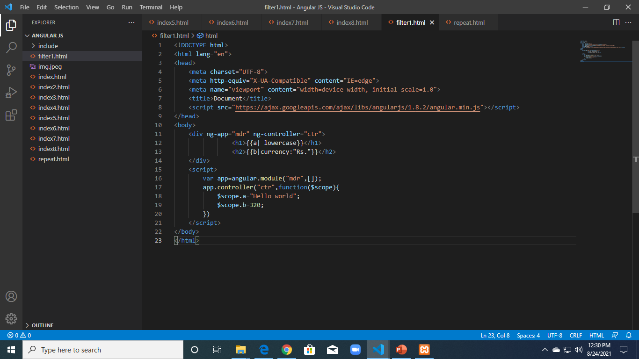

Slide 27
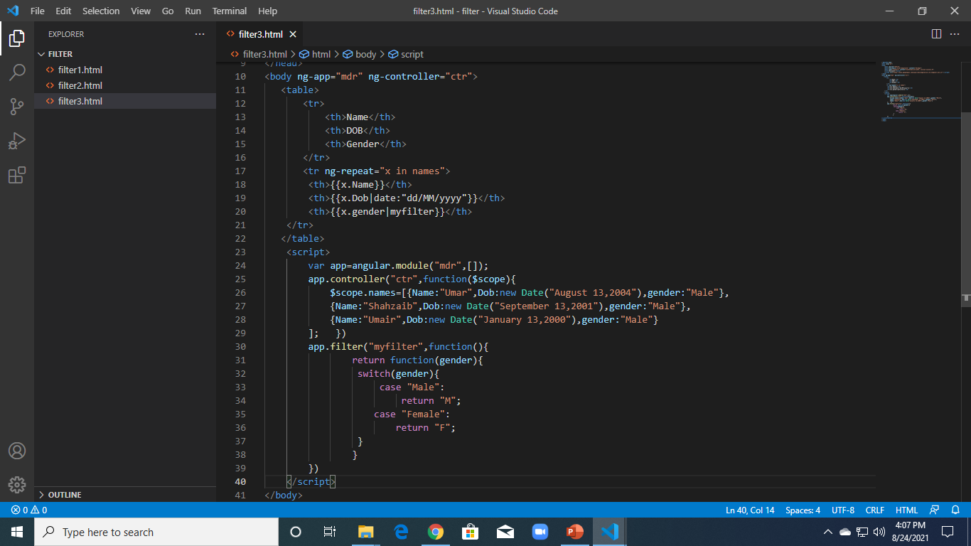
Custom Filter + Date filter Example

Slide 28
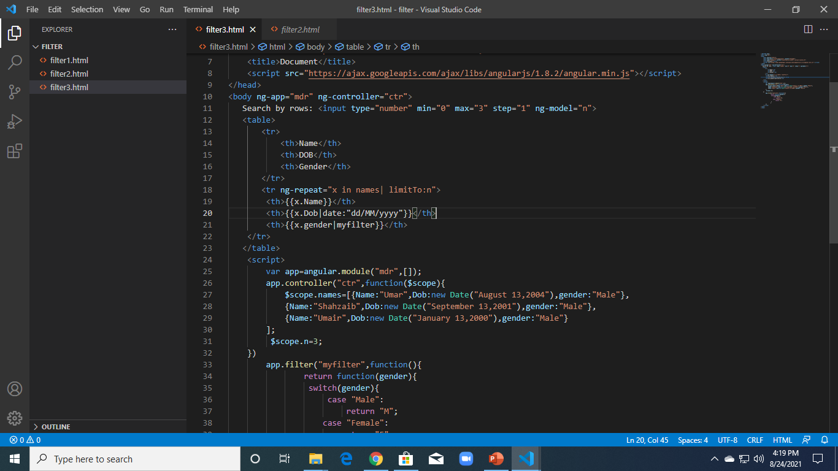
LimitTo Filter

