Slide 1

JAVASCRIPT
Prepare By : Muniba Javaid

Slide 2
WHAT IS SCRIPTING
Scripting refers to a series of command that are interpreted and executed sequentially and immediately on occurrence of an event.
This event is an action generated by a use while interacting with a web page.
Examples of events include button click, selecting a product from a menu, and so on.
A scripting language refers to set of instruction that provide some functionality when the user interact with a web page.
Scripting language are often embedded in the HTML pages to change the behavior of the web pages.

Slide 3
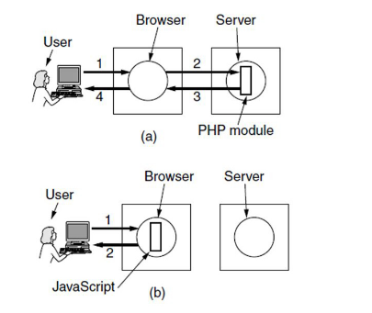
Cont.….
There are two types of scripting language. They are as follow
Client Side Scripting
Server Side Scripting
Client Side Scripting
Refers to a script being executed on the client machine by the browser.
Server Side Scripting
Refer to a script being executed on a web server to generate dynamic HTML pages.

Slide 4
SO WHAT IS JAVASCRIPT
JavaScript is arguably one of the most important languages today.
It is the de facto language of the internet

Slide 5
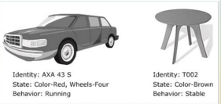
Cont.….
Java script is a scripting language that allows building dynamic web pages by ensuring maximum user interactive.
Java script language is an object based language, which mean that it provides objects for specifying functionalities.
In real world, an object is a visible entity such as car or a table having some characteristics and capable of performing certain actions.
Similarly, in a scripting language an object has a unique identity, state and behavior.
Following figure displays some real world objects

Slide 6
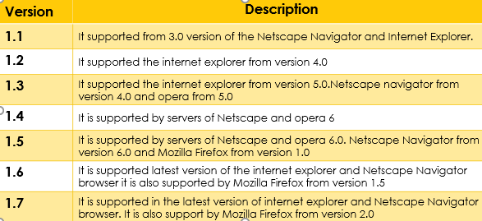
VERSION OF JAVASCRIPT
The first version of java script was developed by Brendan Eich at Netscape in 1995 and was named java script 1.0.
Following table list the various version of java script language.

Slide 7
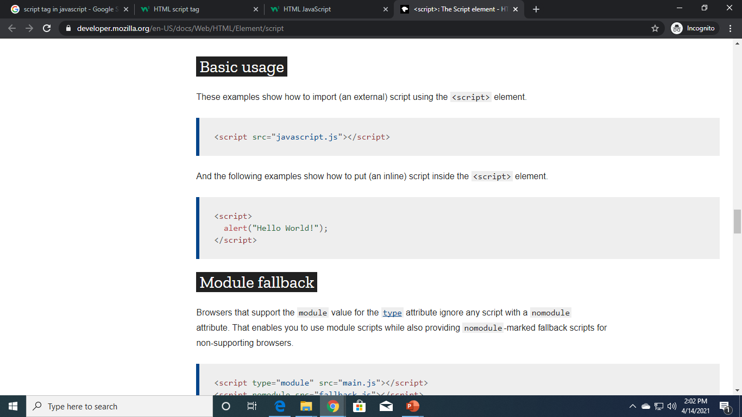
Script tag
The HTML <script> tag is used to define a client-side script (JavaScript).
The <script> element either contains script statements, or it points to an external script file through the src attribute.
Common uses for JavaScript are image manipulation, form validation, and dynamic changes of content.

Slide 8
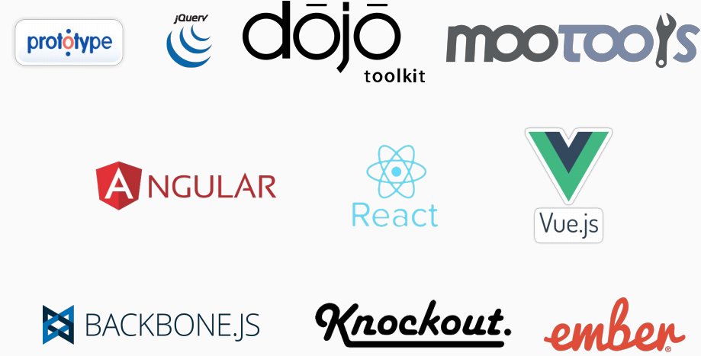
JS LIBRARIES AND FRAMEWORK

Slide 9
AJAX
In 2004, Google implemented a standardized version of AJAX technology on their Gmail and Google Maps products.
After Ajax JavaScript scene exploded, with new powerful libraries like jQuery which abstracted away browser inconsistencies and made it easier to apply design patterns.
At that time there were lots of effort done by libraries like:
Prototype
jQuery
Dojo
Mootools
And many others
jQuery outshine here and was the most popular JavaScript library for web interfaces

Slide 10
JQUERY
jQuery is cross-platform JavaScript library designed to simplify the client-side scripting. It is free, open-source software.
jQuery is a lightweight, "write less, do more", JavaScript library.
jQuery takes a lot of common tasks that require many lines of JavaScript code to accomplish, and wraps them into methods that you can call with a single line of code.
jQuery made is easier to write JavaScript code once and it will run well on all browsers and version.
jQuery handle that internally
jQuery became fantastically popular due to its ease of use
Ease of use does not necessarily result ease of maintenance.

Slide 11
LET START JAVASCRIPT IMPLEMENTATION

Slide 12
Cont.…..
To work with JavaScript you don’t need any software
You just need to have Browser installed on your machine and you can use any text editor to write code.
To manage projects and organize files we use IDE 4. We will use Microsoft’s Visual Studio Code

Slide 13
INSTALLATION
Download and install Visual Studio code
https://code.visualstudio.com/

Slide 14
HOW TO CREATE JAVASCRIPT FILE ON VISUAL CODE
Open Visual Studio code and create two files
index.html
index.js

Slide 15
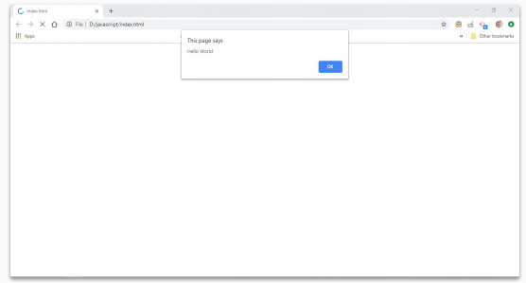
Initial Code and Setup
Open file in browser and you will see alert in browser window

Slide 16
There are 3 Common Methods in JavaScript through which we can display Output.

Slide 17
ALERTS
An alert is a box that pops up to give the user a message.
Here's code for an alert that displays the message "Thanks for your input!"
alert is a keyword
The quoted text "Thanks for your input!" is called a text string or simply a string.
alert("Hello World");

Slide 18
Cont.…
‘window. Alert’ and ‘alert’ are the same
window is object in browser which contains many other objects and properties, and alert is one of them.
alert is a function that take any input and display it in popup to user
Alerts are not available when you are working with server side JavaScript

Slide 19
CONSOL.LOG
Console.log is function that write message on console/terminal
Objective of console.log is to create logs for debugging
Instead of displaying text to user it shows output in browser’s developer tool
Also when working with server side JavaScript, we can use console.log for logging and output will be in terminal.
console.log("Hello World");
console.log(2+8);

Slide 20
DOCUMENT.WRITE
For testing purpose you can use document.write to display message or text in browser window
This will be displayed in browser window
document.write("Hello Word");
document.write(2+8);

Slide 21
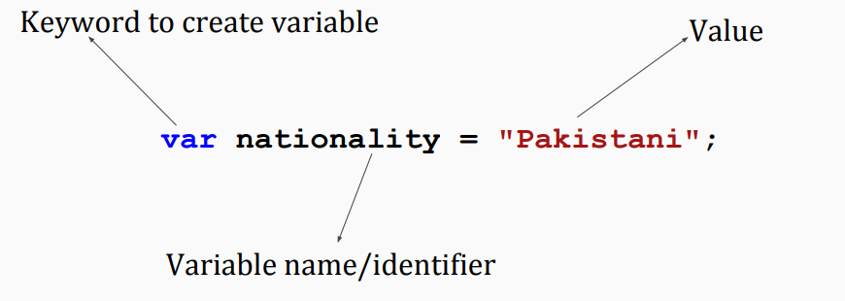
VARIABLES
Variables are containers for storing data values.
Variables are used to store information to be referenced and manipulated in a computer program
Variable is a term that refers to a particular value
A variable changes over time or based on user input.
A variable is assigned a value in one place and then used repetitively

Slide 22
Cont.…
var nationality = "Pakistani";
var age = 25;
var isFeePaid = true;
var weight = 60.55;

Slide 23
DECLERATION AND INTIALIZATION
You can declare and initialize in single line or you can do that in two line
Only declaration will leave variable undefined
var age = 25; OR
var age; -- Declaration
age = 25; -- Initialization

Slide 24
Data Types

Slide 25
Data Types
Variables contains data
Each data has type, that’s why we call it data type
Variables can hold numbers like 100 and text values like "John Doe"
In programming, text values are called text strings.

Slide 26
Data Types
Six types are considered to be primitives.
Number -- integers, ﬂoats etc
String -- an array of characters
Boolean -- true or false
Null -- No Value
Undeﬁned -- a declared variable but hasn’t been given a value
Symbol -- a unique value that's not equal to any other value

Slide 27
Data Types
Complex Types
Objects
Functions
Function is callable object that executes a block of code, it lies under the object type

Slide 28
Variable for String
1. To store text in variable we use string
var name = "Muniba";
name = "Samra";

Slide 29
String - Single quotes and double quotes
Text strings are always enclosed in quotes
You can use single or double quotes
var name = "Muniba";
var nationality = 'US';
var message = "What is your father's number";

Slide 30
Variable for Numbers
1. To store whole numbers or decimal values we use number data type
var age = 25;
var weight = 150.5;
var newWeight = weight + 20; var originalNumber = 12 + 5;

Slide 31
Variable for Boolean
1. To store true/false boolean data type
var isFeePaid = true; var examPassed = false;

Slide 32
Undeﬁned
The undeﬁned data type can only have one value-the special value undeﬁned
If a variable has been declared, but has not been assigned a value, has the value undeﬁned
var name; var age;

Slide 33
Null
This is another special data type that can have only one value-the null value.
A null value means that there is no value.
It is not equivalent to an empty string ("") or 0, it is simply nothing
var name = null;
var nationality = "Pakistani"; nationality = null;

Slide 34
Difference between null and undeﬁned
undeﬁned means a variable has been declared but has not yet been assigned a value.
null is an assignment value. It can be assigned to a variable as a representation of no value
undeﬁned and null are two distinct types: undeﬁned is a type itself (undeﬁned) while null is an object.
Unassigned variables are initialized by JavaScript with a default value of undeﬁned. JavaScript never sets a value to null. That must be done programmatically.

Slide 35
typeof Operator
You can use the JavaScript typeof operator to ﬁnd the type of a JavaScript variable.
The typeof operator returns the type of a variable or an expression
typeof "Hello" // Returns "string" var a = 45;
typeof | a; | // | Returns | "number"
typeof | true; | // | Returns | "boolean"

Slide 36
Statement and Expression

Slide 37
Statements
A computer program is a list of "instructions" to be "executed" by a computer.
In a programming language, these programming instructions are called statements.
A JavaScript program is a list of programming statements.
A statement can set a variable equal to a value.
A statement can also be a function call, i.e. document.write().

Slide 38
Statements
1. Each line below is a statement
var | a | = | 4; | // | Statement | 1
var | b | = | 2; | // | Statement | 2
var | c | = | 0; | // | Statement | 3
c = | a | + | b; | // | Statement | 4
alert(a); |  |  |  | // | Statement | 4
console.log(c); |  |  |  | // | Statement | 4

Slide 39
End of Statement with semicolon ;
To end statement add semicolon at the end of each executable statement
Semicolons separate JavaScript statements.
var a = 4;
When separated by semicolons, multiple statements on one line are allowed
i = 3; j = 5; k = i + j; alert(i);console.log(k);

Slide 40
Expressions
An expression is a combination of values, variables, function calls and operators, which computes to a value.
The computation is called an evaluation.
a 4 | + / | b; 2; | // // |  | expression expression
var |  | a | = | 5;
a * 4;
"John" + " " + "Doe";
// expression
// expression

Slide 41
Comments

Slide 42
Comments
Comments are for the human, not the machine.
They help you and others understand your code when it comes time to revise, they make code more readable.
You can also use commenting to comment out portions of your code for testing and debugging.
They will prevent execution of code
There are two ways mark text as a comment, single line comments and multi-line comments

Slide 43
Single line comments
Single line comments start with //.
Any text between / and the end of the line will be ignored (will not be executed).
// Declare and initialize variable var a = 6; //This is comment
//This below code will not execute
//var b = 8;

Slide 44
Multi-line comments
Multi-line comments start with /* and end with */.
Any text between /* and */ will be ignored.
/*
This code declared and initialize variable a and show on screen
*/
var a = 6; alert(a);

Slide 45
Variable Names

Slide 46
Variable Names Legal and Illegal
A variable name can't contain any spaces
A variable name can contain only letters, numbers, dollar signs, and underscores.
The ﬁrst character must be a letter, or an underscore (_), or a dollar sign ($).
Subsequent characters may be letters, digits, underscores, or dollar signs.
Numbers are not allowed as the ﬁrst character of variable.

Slide 47
Variable Names Legal and Illegal
1. Legal names:
var | hello = | 56;
var | _xyz = | 44;
var | $work = | 90;
var | user2 = | 56;
var | i_info | = 99;
var | my$work | = 77;

Slide 48
Variable Names Legal and Illegal
1. Illegal names:
var 2user = 12; // Can't start with number var my user = 23; // Can't contains space var hello#world = 34;
var my-info = 44; var my?info = 45; var my*info = 45;

Slide 49
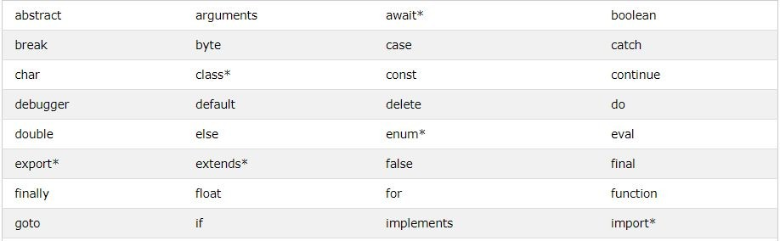
Reserved Keywords
Reserved Keywords cannot be used as variable name
Here are few reserved keywords

Slide 50
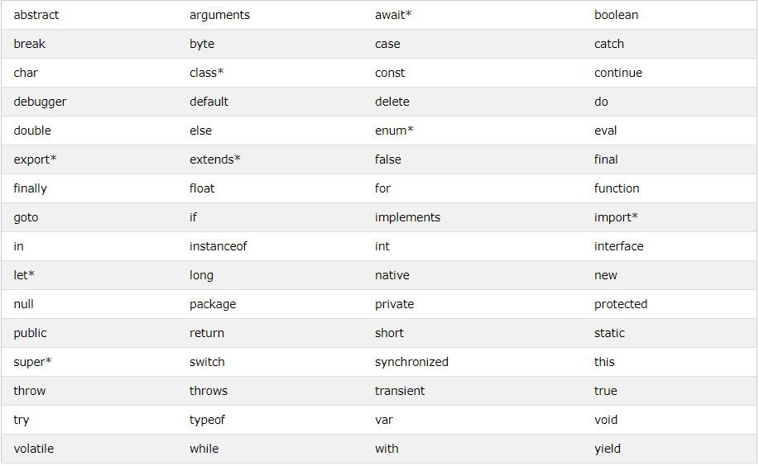

Slide 51
Case Sensitive
Variable names are case sensitive.
So rose and Rose are two different variables
var | rose | = | "Hello";
var | Rose | = | "Hello";
alert(rose); alert(Rose); alert(ROSE); // Error

Slide 52
Camel Case
If there's more than one word in the variable name, then it is recommended to use camel case
A camelCase name begins in lower case. If there's more than one word in the name, each subsequent word gets an initial cap, creating a hump.

Slide 53
Camel Case
var userResponse
var userResponseTime
var userResponseTimeLimit var response
This Style of naming a variable is called camel case

Slide 54
Operators

Slide 55
Arithmetic Operators
var | a | = | 5;
var | b | = | 3;
var | c | = | a | + | b; | // | Addition, | result | 8
var d = a - b; var e = a * b; var f = a / b; var g = a % b; var h = a ** b;
// Subtraction, result 2
// Multiplication, result 15
// Division, result 1.66
// Modulus, result 2
// Exponentiation, result 125

Slide 56
Assignment Operators
Assignment operator assign value to variables
When you need to apply arithmetic operation and assign value to same variable then you can also use them
var a = | a a | = + | 5; 2; | // // | equals Assign | = 7 | is in | assignment operator variable a
OR
var | a | = | 5;
a+=2; |  | // |  |  | Assign | 7 | in | variable | a

Slide 57
Assignment Operators
Example
Same as
a | += | 5; | a | = | a | + | 5;
a | -= | 5; | a | = | a | - | 5;
a | *= | 5; | a | = | a | * | 5;
a | /= | 5; | a | = | a | / | 5;
a | %= | 5; | a | = | a | % | 5;
a | **= | 5; | a | = | a | ** | 5;

Slide 58
Eliminating ambiguity -- BODMAS
Complex arithmetic expressions can pose a problem when there are multiple operators in single expression
var a = 5 + 2 * 3 - 2 / 2; // result 10
The evaluation of above expression is depends on BODMAS rule
3.

Slide 59
Eliminating ambiguity -- BODMAS
B
O DM AS
Brackets ﬁrst
Orders (i.e. Powers and Square Roots, etc.) Division and Multiplication (left-to-right) Addition and Subtraction (left-to-right)

Slide 60
Eliminating ambiguity -- BODMAS
var a = 5 + 2 * (3 - 2) / 2; // result 6
3 - 2 with brackets will be evaluated ﬁrst, result 1
2 * result of (3 - 2) so 2 * 1, result 2
Result of 2 * (3 -2) divide by 2 so 2 / 2, result 1 4. 5 + result of 2 * (3 - 2 ) / 2, so 5 + 1, result 6

Slide 61
Eliminating ambiguity -- BODMAS
var | a | = | 3 | + | 5 | * 2; |  |  |  |  | // | result | 13
var | b | = | 8 | / | 2 | - 1; |  |  |  |  | // | result | 3
var | c | = | 3 | % | 2 | + 4 | - 1; |  |  |  | // | result | 4
var | d | = | a | + | 5 | * c | - b | / | (3 | + | b);// | result | 32.5

Slide 62
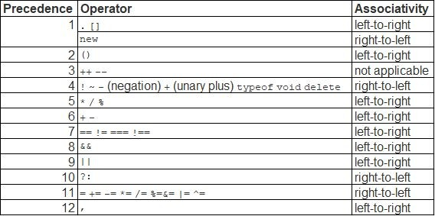
Operator Precedence -- Few of them

Slide 63
Increment and Decrement Operator
While working on application you will frequently required to increase variable by 1 or decrease variable by 1
For this situation you can use increment and decrement operator
3. ++ increment operator
-- decrement operator
These operators can be used as preﬁx and postﬁx

Slide 64
Increment and Decrement Operator
1. We can increase or decrease value using existing addition and subtraction operators
var | a | = | 12;
a = | a | + | 1; | // | 13
a = | a | - | 1; | // | 12
var | b | = | 12;
b += |  | 1; |  | // | 13
b -= |  | 1; |  | // | 13

Slide 65
Increment and Decrement Operator
Preﬁx Increment and Decrement
var age = 12;
++age; alert(age); | //Result | 13
--age;
alert(age); | //Result | 12

Slide 66
Increment and Decrement Operator
Postﬁx Increment and Decrement
var age = 12;
age++; alert(age); | //Result | 13, | same | as | prefix
age--;
alert(age); | //Result | 12, | same | as | postfix

Slide 67
Increment and Decrement Operator
What is the difference between Preﬁx and Postﬁx
You will NOT ﬁnd any difference if you will not assign result of preﬁx and postﬁx to any other variable
Preﬁx operator ﬁrst increase/decrease the value in variable and then assign result to other variable
Postﬁx operator ﬁrst assign the value in other value then increase/decrease value in actual variable

Slide 68
Increment and Decrement Operator
Preﬁx Increment
var age = 12;
var newAge = ++age;
alert(age); | //Result | 13
alert(newAge); | //Result | 13

Slide 69
Increment and Decrement Operator
Postﬁx Increment
var age = 12;
var newAge = age++;
alert(age); alert(newAge);
//Result 13
//Result 12 , see the difference

Slide 70
Increment and Decrement Operator
Preﬁx Decrement
var age = 12;
var newAge = --age;
alert(age); | //Result | 11
alert(newAge); | //Result | 11

Slide 71
Increment and Decrement Operator
Postﬁx Decrement
var age = 12;
var newAge = age--;
alert(age); alert(newAge);
//Result 11
//Result 12 , see the difference

Slide 72
Increment and Decrement Operator
Example 1
var var | a b | = = | 4; 2;
var | c | = | a++ - b; | // first value | of a placed | here
which is 4 then increase 1 in a so will become 5
alert(a); | // | 5
alert(b); | // | 2
alert(c); | // | 2

Slide 73
Increment and Decrement Operator
Example 2
var var | a b | = = | 4; 2;
var | c | = | ++a | + b; | // first value | of a increased | so
will become 5 then value of a will be placed here, 5
alert(a); | // | 5
alert(b); | // | 2
alert(c); | // | 7

Slide 74
Increment and Decrement Operator
Example 2
var var | a b | = = | 4; 2;
var | c | = | ++a | + b; | // first value | of a increased | so
will become 5 then value of a will be placed here, 5
alert(a); | // | 5
alert(b); | // | 2
alert(c); | // | 7

Slide 75
Increment and Decrement Operator
Example 4
var | a | = | 4;
var | b | = | 3;
var | c | = | ++a | + | b++ | - a | + | --b;
alert(a); |  |  |  | // |  | 5
alert(b); |  |  |  | // |  | 3
alert(c); |  |  |  | // |  | 6

Slide 76
String Concatenation

Slide 77
Concatenating Text strings
The + operator can also be used for concatenating strings
E.g:
var firstName = "Abraham"; var lastName = "aLincoln";
//concatenate firstName, space character and lastName var fullName = firstName + " " + lastName; alert(fullName);

Slide 78
Concatenating strings and numbers
1. Adding two numbers, will return the sum, but adding a number and a string will return a string:
var | a | = | "6" | + 2; | // |  | "62"
var | b | = | 3 + | "6"; | // |  | "36"
var | c | = | "Hello " + |  | 2; | // | "Hello 2"
var | d | = | 2 + "Hello |  | "; | // | "2 Hello"
var e = "Hello "+ 3 + 4; var f = 3 + 4 + "Hello "; var g = "Hello "+ (3 + 4);
// "Hello 34"
// "7Hello"
// "Hello 7"

Slide 79
Prompt and Parsing String

Slide 80
prompt or window.prompt()
The prompt()/window.prompt() method displays a dialog box that prompts the visitor for input.
In a prompt, you can specify a second string. This is the default response that appears in the ﬁeld when the prompt displays.
The prompt() method returns the input value if the user clicks "OK". If the user clicks "cancel" the method returns null.

Slide 81
prompt or window.prompt()
var question = "What is your name?"; var defaultAnswer = "John";
var name = prompt(question, defaultAnswer); console.log("Name = "+ name);

Slide 82
prompt or window.prompt()
1. If you ask for number in prompt and try apply addition operator on it then it will concatenate the value because prompt returns string
var question = "What is your age?";
var age = prompt(question);// Assuming input 12 var newAge = age + 5; // It will concatenate console.log("New Age = "+ newAge); //result 125

Slide 83
Convert string to integer
1. Addition operator in string concatenate values, even if value in string is number
var | value1 | = | "3";
var | value2 | = | "5";
var | value3 | = | value1+value2;
console.log(value3);// result, 35

Slide 84
Convert string to integer
1. prompt function also returns string even if you provide number in input box
//Assuming we will provide value 5 in input
var | age | = | prompt("What | is | your | age");
var | num | = | 4;
var | sum | = | age + num;
console.log(sum); // result, 54

Slide 85
Convert string to integer
If you are sure that string has number, then you have to convert it into number to perform addition
We need to use parseInt function for conversion
var | age | = | prompt("What | is | your | age");//input | 5
var | num | = | 4;
var | sum | = | parseInt(age) | + | num;
console.log(sum); // result, 9

Slide 86
Convert string to integer
1. If value is not number then it will return NaN
var | age | = | prompt("What | is | your | age");//input | abc
var | num | = | 4;
var | sum | = | parseInt(age) | + | num;
console.log(sum); // result, NaN

Slide 87
Convert string to decimal
1. If your string is number with decimal places then you can use parseFloat for conversion
var | age | = | prompt("What | is | your |  | age");//input | 5.5
var | num | = | 4;
var | sum | = | parseFloat(age) |  | + | num;
console.log(sum); // result, 9.5

Slide 88
Comparison Operators

Slide 89
Comparison operators
1. Comparison operators are used in logical statements to determine equality or difference between variables or values. They will result in true or false only
Operator | Description
== | equal to
=== | equal value and equal type
!= | not equal
!== | not equal value or not equal type
Operator | Description
> | greater than
< | less than
>= | greater than and equal to
<= | less than and equal to

Slide 90
Comparison operators
var a = 3;
console.log(a | == 6); | //return | false
console.log(a | === 6); | //return | false
console.log(a | != 6); | //return | true
console.log(a | !== 6); | //return | true
console.log(a | > 6); | //return | false
console.log(a | < 6); | //return | true
console.log(a | >= 6); | //return | false
console.log(a | <= 6); | //return | true

Slide 91
Comparison operators
1. == and === are used for equality check
2. == does not consider data type of values being compared and
3. == tries to convert one of the value and compare based on that
4. === also check datatype of the values and datatype of value on both side should be same otherwise it will return false

Slide 92
Comparison operators
var a = 3; console.log(a | == | 3); | //return | true
console.log(a | == | "3"); | //return | true
console.log(a | == | 6); | //return | false
console.log(a | === | 3); | //return | true
console.log(a | === | "3"); | //return | false
console.log(a | === | 6); | //return | false

Slide 93
Comparison operators
Be careful JavaScript is dynamic language and many decision taken at start are still causing confusion
Comparing different type of values will result in answer which is not easily understandable
E.g: When comparing a string with a number, JavaScript will convert the string to a number while doing the comparison. An empty string converts to 0. A non-numeric string converts to NaN which is always false.

Slide 94
Logical Operators

Slide 95
Short-circuit Logical Operators
Logical operators are used to determine the logic between variables or values.
Logical operators required boolean operands on both side of operator
However, the && and || operators actually return the value of one of the speciﬁed operands, so if these operators are used with non-Boolean values, they will return a
non-Boolean value.

Slide 96
Logical Operators
There are three logical operators in JavaScript:
|| (OR)
&& (AND)
! (NOT)

Slide 97
&& Logical Operator
1. This logical operator is used with two or more values (operands), and only evaluates to true if all the operands are true. It will return the false value if at least one value is false.
alert( | true | && | true ); | // | true
alert( | false | && | true ); | // | false
alert( | true | && | false ); | // | false
alert( | false | && | false ); | // | false

Slide 98
&& Logical Operator
var a = 60;
var b = a > 50 && a < 70; alert(b); // return true
var c = 80;
var d = c > 50 && c < 70; alert(d); // return false

Slide 99
|| Logical Operator
1. The logical operator || (OR) also is used with two or more values, but it evaluates to true if any of the operands (values) are true, so only evaluates to false if both operands are false.
alert( | true | || | true ); | // | true
alert( | false | || | true ); | // | true
alert( | true | || | false ); | // | true
alert( | false | || | false ); | // | false

Slide 100
|| Logical Operator
var a = 60;
var b = a < 50 || a > 70; alert(b); // return false
var c = 80;
var d = c < 50 || c > 70; alert(d); // return true

Slide 101
! Logical NOT
1. Using the ! operator in front of a boolean will convert it to opposite value. It means that a true value will return false, and a false will return true. This method is known as negation:
alert( !true ); // false alert( !false ); // true

Slide 102
! Logical NOT
var var | a b | = = | 60; !(a | < | 50);
alert(b); |  |  |  | // |  | return | true
var var | c d | = = | 80; !(c | > 50);
alert(d); |  |  |  | // |  | return | false

Slide 103
Why they are called short-circuit
&& and || operator stops evaluation of expression once they ﬁnd desired value
&& stops evaluation as soon as it ﬁnds false and returns false
&& returns true if all values are true
|| stops evaluation as soon as it ﬁnds true and returns true
|| returns false if all values are false

Slide 104
Conditions

Slide 105
Conditions
Up until now, all the code in our programs has been executed chronologically
Very often when you write code, you want to perform different actions for different decisions.
You can use conditional statements in your code to do this.

Slide 106
Conditions
In JavaScript we have the following conditional statements:
Use if to specify a block of code to be executed, if a speciﬁed condition is true
Use else to specify a block of code to be executed, if the same condition is false
Use else if to specify a new condition to test, if the ﬁrst condition is false
Use switch to specify many alternative blocks of code to be executed (Discussed later)

Slide 107
Conditions: if
1. The if statement is the fundamental control statement that allows JavaScript to make decisions and execute statements conditionally.
if (condition) {
// block of code to be executed if the condition is true
}

Slide 108
Conditions: if
var age = 12;
if( age > 9 ) { console.log("Age = "+age);
}

Slide 109
Conditions: else
1. Use the else statement to specify a block of code to be executed if the condition is false.
if (condition) {
//block of code to be executed if the condition is true
} else {
//block of code to be executed if the condition is false
}

Slide 110
Conditions: else
var age = 15;
if( age > 18 ) {
console.log("Qualifies for driving");
} else {
console.log("Does not qualify for driving");
}

Slide 111
Conditions: else if
1. Use the else if statement to specify a new condition if the ﬁrst condition is false.

Slide 112
Conditions: else if
if (condition1) {
//block of code to be executed if condition1 is true
} else if (condition2) {
//block of code to be executed if the condition1 is false and condition2 is true
} else {
//block of code to be executed if the condition1 is false and condition2 is false
}

Slide 113
Conditions: else if
var score = 80; if( score > 80 ) {
console.log("Grade A");
} else if( score > 70 ) { console.log("Grade B");
} else if( score > 60 ) { console.log("Grade C");
} else {
console.log("Failed");
}

Slide 114
Conditions: nested if
1. nested if statements means an if statement inside an if statement.
if (condition1) {
//Code to be executed if the condition1 is true
if (condition1) {
//Code to be executed if the condition2 is true
}
}

Slide 115
Conditions: else if
var score = 80; if( score > 80 ) {
console.log("Grade A");
} else if( score > 70 ) { console.log("Grade B");
} else if( score > 60 ) { console.log("Grade C");
} else {
console.log("Failed");
}

