Slide 1

Array
Made by: Ayman Naeem

Slide 2
Arrays
Consider a scenario where you want to store the names of 100 employees within an IT department.
This can be done by creating 100 variables and storing the names.
However, keeping track of 100 variables is a tedious task and it results in inefficient memory utilization.
The solution to this problem is to create an array variable to store the names of 100 employees.
An array is a collection of values stored in adjacent memory locations.
These array values are referenced using a common array name.
These array values are referenced using a common array name.
These values that are also referred to as elements and can be accessed by using subscript or index numbers.
The subscript number determines the position of an element in an array list.

Slide 3
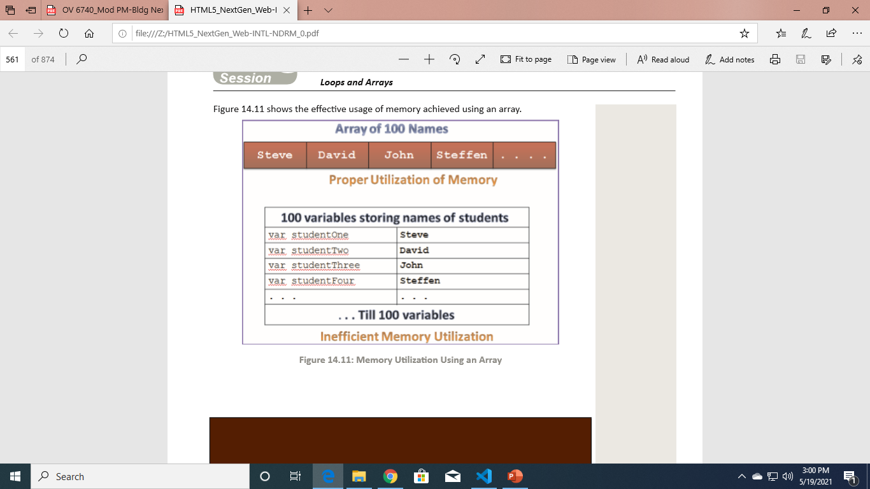
Cont…

Slide 4
Cont…
JavaScript supports two types of arrays that are as follows:
Single-dimensional array
Multi-dimensional array

Slide 5
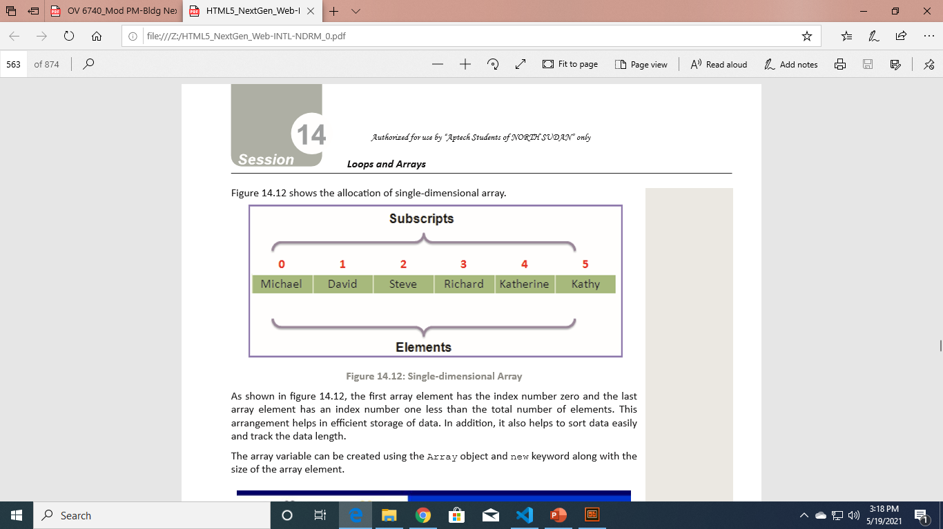
Single-dimensional Array
In a single-dimensional array, the elements are stored in a single row in the allocated memory.
The first array element has the index number zero and the last array element has an index number one less than the total number of elements.
This arrangement helps in efficient storage of data. In addition, it also helps to sort data easily and track the data length.
The array variable can be created using the Array object and new keyword along with the size of the array element.

Slide 6
Syntax
var variable_name = new Array(size); //Declaration
variable_name[index] = ‘value’;
where,
variable_name: Is the name of the variable.
size: Is the number of elements to be declared in the array.
index: Is the index position.

Slide 7
Code
//Declaration using Array Object and then Initialization
var arr=new Array(2);
arr[0]="Ayman";
arr[1]="Sara";
arr[2]="Arfa";
//Declaration and Initialization
var arr=new Array("Ayman" ,"Sara" ,"Arfa");
//Declaration and Initialization Without Array
var arr=["Ayman" ,"Sara" ,"Arfa"];

Slide 8
Accessing Single-dimensional Arrays
Array elements can be accessed by using the array name followed by the index number specified in square brackets.
Access Array Elements Without Loops
var arr=["Ayman","Sara","Arfa"];
alert(arr[0]+arr[1]);

Slide 9
Access Array Elements With Loops
JavaScript allows you to access array elements by using different loops.
Thus, you can access each array element by putting a counter variable of the loop as the index of an element.
However, this requires the count of the elements in an array. So, the length property can be used to determine the number of elements in an array.

Slide 10
Code
var arr=["Ayman","Sara","Arfa"];
for(var i=0;i<arr.length;i++)
{
alert(arr[i]);
}

Slide 11
Multi-dimensional Array
Consider a scenario to store the employee IDs of 100 employees and their salary structure.
The salary structure will include the basic salary, allowances, HRA, and the total gross salary. Now, if a single-dimensional array is used, then two separate arrays need to be created for storing employee IDs and salaries.
However, using a multi-dimensional array, both IDs and salaries are stored in just one array.
However, using a multi-dimensional array, both IDs and salaries are stored in just one array.
These dimensions are represented as rows and columns similar to those of a Microsoft Excel sheet.
These dimensions are represented as rows and columns similar to those of a Microsoft Excel sheet.

Slide 12
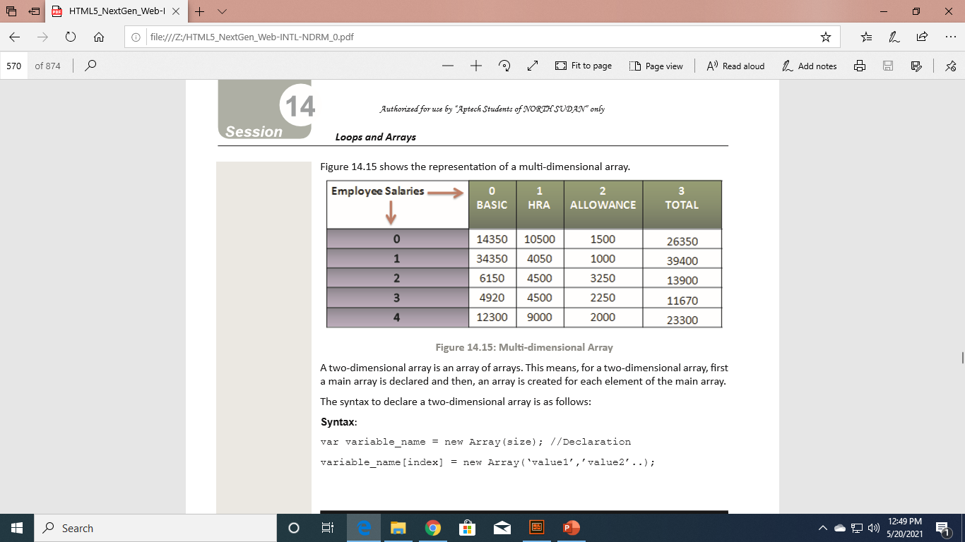
Cont…
A two-dimensional array is an array of arrays. This means, for a two-dimensional array, first a main array is declared and then, an array is created for each element of the main array.

Slide 13
Syntax
var variable_name = new Array(size); //Declaration
variable_name[index] = new Array(‘value1’,’value2’..);
where,
variable_name: Is the name of the array
index: Is the index position.
value1: Is the value at the first column.
value2: Is the value at the second column.

Slide 14
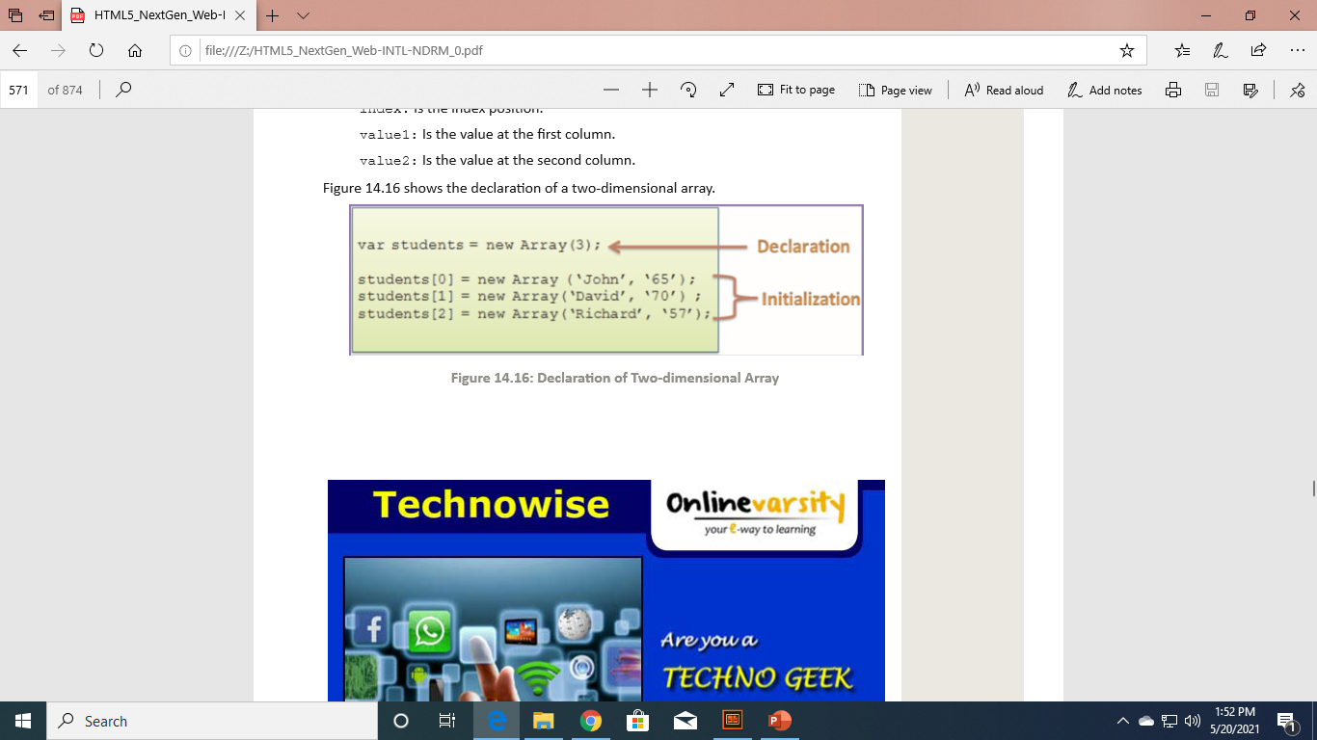

Slide 15
Accessing Two-dimensional Arrays
Multi-dimensional arrays can be accessed by using the index of main array variable along with index of sub-array.
Access Array Elements Without Loops
var arr=new Array(3);
arr[0]=new Array('John', 25, 'China');
arr[1]=new Array('Jack', 28, 'Sydney');
console.log(arr[0][0]+'\n'+ arr[0][1]);

Slide 16
Access Array Elements With Loops
var arr=new Array(2);
arr[0]=new Array('John', 25, 'China');
arr[1]=new Array('Jack', 28, 'Sydney');
for(var i=0;i<arr.length;i++)
{
for(var j=0;j<arr[i].length ;j++){
console.log(arr[i][j]);
}
}

Slide 17
Array Methods
An array is a set of values grouped together and identified by a single name. An array is a set of values grouped together and identified by a single name.
It provides the length property that allows you to determine the number of elements in an array.
The various methods of the Array object allow to access and manipulate the array elements.

Slide 18
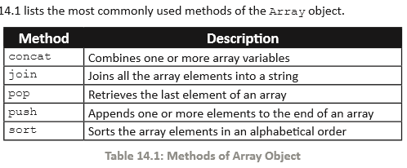
Cont…

Slide 19
Code
var arr=new Array(2);
arr[0]=new Array('John', 'hello', 'China');
arr[1]=new Array('Jack', 28, 'Sydney');
console.log(arr[0].join(""));
console.log(arr[0].pop());
console.log(arr[0].sort());
console.log(arr[0].push("Pakistan"))
console.log(arr[0]);
console.log(arr[0].concat(arr[1]));

Slide 20
For…in loop
The for...in loop is an extension of the for loop. It enables to perform specific actions on the arrays of objects.
The loop reads every element in the specified array and executes a block of code only once for each element in the array.
The syntax of the for...in loop is as follows:
Syntax:
for (variable_name in array_name)
{
//statements;
}
where,
variable_name: Is the name of the variable.
array_name: Is the array name.

Slide 21
Code
var arr=["Ayman","Pakistan",10]
for(var i in arr)
{
console.log(arr[i]);
}

Slide 22
Thank you

