Slide 1
LOOPS
Made by: Ayman naeem

Slide 2
Introduction
Consider a scenario where you want to accept and display ten numbers to the user.
Instead of writing the same lines of code again and again for 10 times, you can use loops.
Loops allow you to execute a single statement or a block of statements multiple times.
They are widely used when you want to display a series of numbers and accept repetitive input.
A loop construct consists of a condition that instructs the compiler the number of times a specific block of code will be executed.
JavaScript supports three types of loops that are as follows:
For loop, while loop and do-while loop
If the condition is not specified within the construct, the loop continues infinitely. Such, loop constructs are referred to as infinite loops.

Slide 3
while Loop
The while loop executes a block of code as long as the given condition remains true.
The while loop begins with the while keyword, which is followed by parentheses containing a Boolean condition.
If this condition returns true, the block of statements within the while loop are executed.
After every iteration, the program control is transferred back to the while statement, where the condition is again checked for another round of execution. This process is continued till the specified condition becomes false
Once the condition becomes false, the while statement stops the execution of loop and transfers the control to next statement appearing after the block.

Slide 4
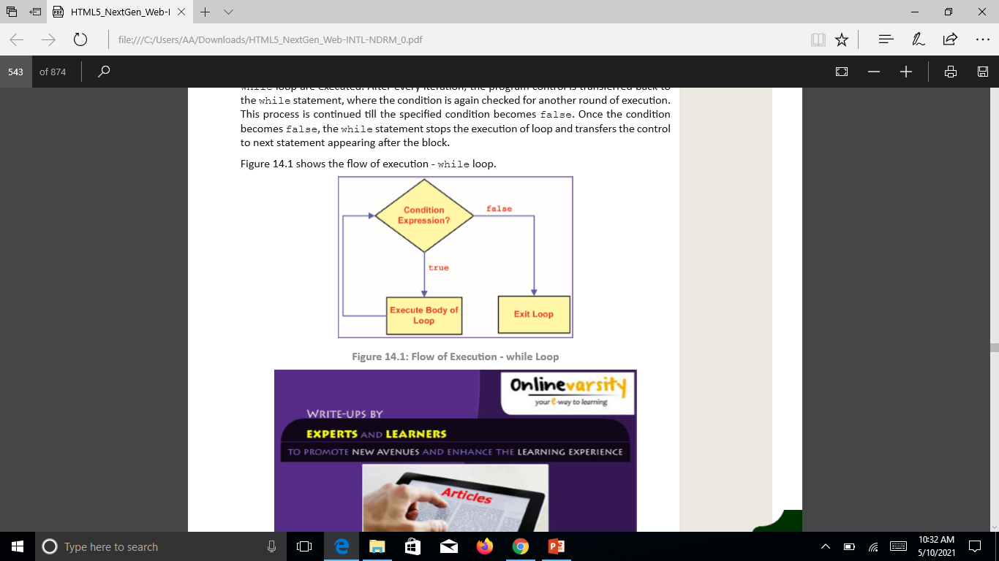
Flow diagram

Slide 5
Syntax
while (condition)
{
// statements;
}
where, condition: Is a Boolean expression.

Slide 6
Code
var i=0;
while(i<10){
console.log(i);
i++;
}

Slide 7
for Loop
The for loop is similar to the while loop in functionality.
It executes the statements within the loop as long as the given condition is true.
Unlike the while loop, the for loop specifies the loop control statements at the top instead in the body of the loop.
The for loop begins with the for keyword, which is followed by parentheses containing three expressions, each of which are separated by a semicolon.
The three expressions are referred to as initialization expression, condition expression, and increment/ decrement expression respectively.
These three expressions are optional.

Slide 8
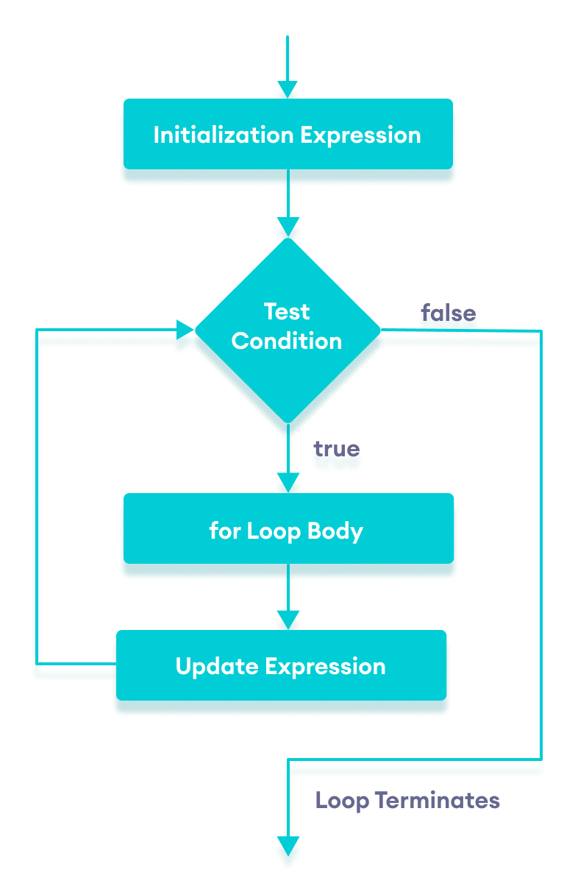
Flow diagram

Slide 9
Syntax
for (initialization; condition; increment/decrement)
{
// statements;
}
where,
initialization: Initializes the variable(s) that will be used in the condition.
condition: Comprises the condition that is checked, before the statements in the loop are executed.

Slide 10
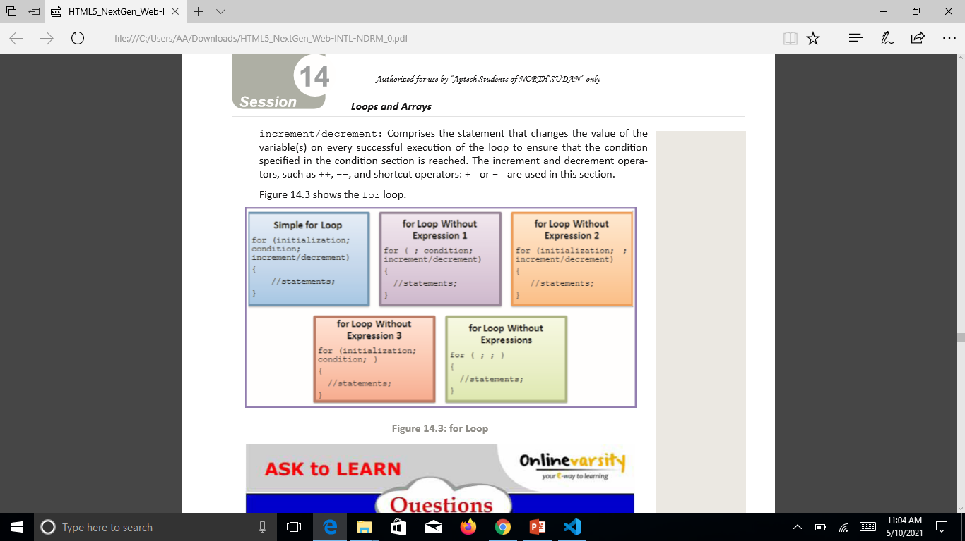
Cont..
increment/decrement: Comprises the statement that changes the value of the variable(s) on every successful execution of the loop to ensure that the condition specified in the condition section is reached. The increment and decrement operators, such as ++, --, and shortcut operators: += or -= are used in this section.

Slide 11
Code
var i;
for(i=0;i<=10;i++){
console.log(i);
}

Slide 12
do-while Loop
The do-while loop is similar to the while loop.
This is because both the do-while and while loops execute until the condition becomes false.
However, the do-while loop differs by executing the body of the loop at least once before evaluating the condition.
Thus, even if the condition is false, the do-while loop executes at least once.
The do-while loop starts with the do keyword and is followed by a block of statements.

Slide 13
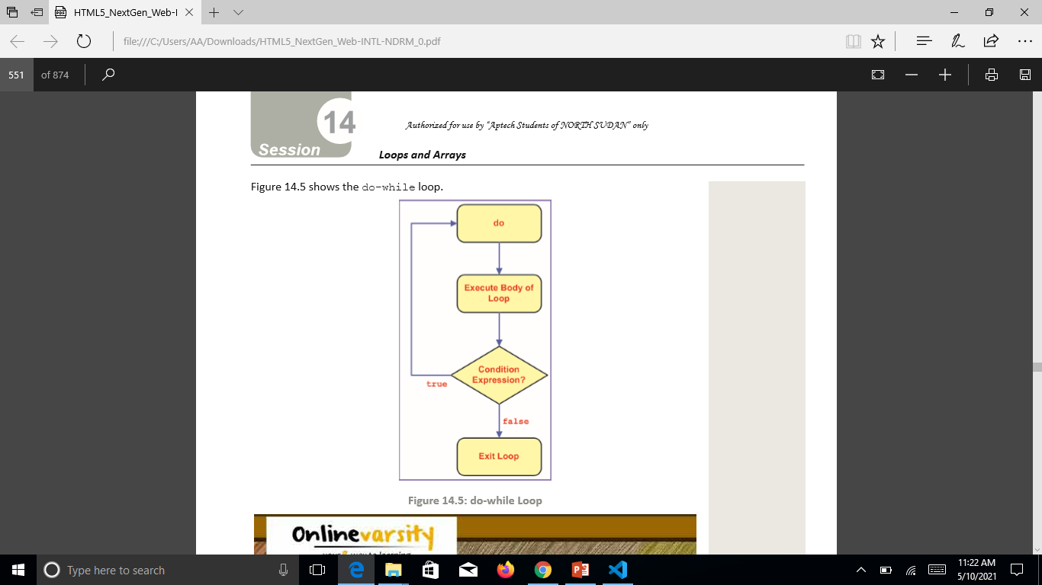
Flow diagram

Slide 14
syntax
do
{
…
Statements;
…
}
while(condition);
where,
condition: Is a Boolean expression.

Slide 15
Code
var i;
i=prompt("Enter a number");
do{
i++;
console.log("My country name is Pakistan")
}
while(i<5);

Slide 16
Break statement
The break statement can be used with decision-making statements, such as
switch-case and loop constructs, such as for and while loops.
The break statement is denoted by using the break keyword.
It is used to exit the loop without evaluating the specified condition.
The control is then passed to the next statement immediately after the loop.

Slide 17
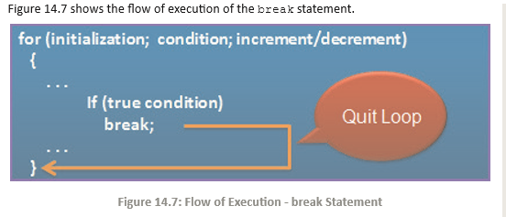
Flow execution

Slide 18
code
for (i = 1; i <= 5; i++) {
// break condition
if (i == 3) {
break;
}
console.log(i);
}

Slide 19
continue Statement
The continue statement is mostly used in the loop constructs.
The continue statement is denoted by the continue keyword.
It is used to terminate the current execution of the loop and continue with the next repetition by returning the control to the beginning of the loop.
This means, the continue statement will not terminate the loop entirely, but terminates the current execution.

Slide 20
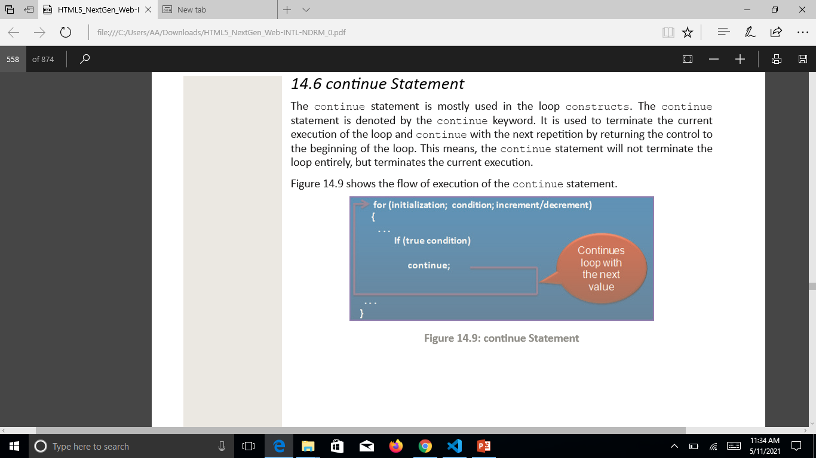
Flow diagram

Slide 21
Code
var result = "";
for (var i = 0; i <= 15; i++)
{
if((i%2) != 0)
{
continue;
}
result = result + i + "\n";
}

