Slide 1
JavaScript
Instructor: Tehreem Hussain
Class: BS(SE) 2017

Slide 2
Why use client-side programming?
PHP already allows us to create dynamic web pages. Why also use client-side scripting?
client-side scripting (JavaScript) benefits:
usability: can modify a page without having to post back to the server (faster UI)
efficiency: can make small, quick changes to page without waiting for server
event-driven: can respond to user actions like clicks and key presses

Slide 3
Why use client-side programming?
server-side programming (PHP) benefits:
security: has access to server's private data; client can't see source code
compatibility: not subject to browser compatibility issues
power: can write files, open connections to servers, connect to databases, ...

Slide 4
What is JavaScript?
a lightweight programming language ("scripting language")
used to make web pages interactive
insert dynamic text into HTML (ex: user name)
react to events (ex: page load user click)
get information about a user's computer (ex: browser type)
perform calculations on user's computer (ex: form validation)

Slide 5
What is JavaScript?
a web standard (but not supported identically by all browsers)
NOT related to Java other than by name and some syntactic similarities

Slide 6
JavaScript vs. PHP
similarities:
both are interpreted, not compiled
both are relaxed about syntax, rules, and types
both are case-sensitive
both have built-in regular expressions for powerful text processing

Slide 7
JavaScript vs. PHP
differences:
JS is more object-oriented: noun.verb(), less procedural: verb(noun)
JS focuses on user interfaces and interacting with a document; PHP is geared toward HTML output and file/form processing
JS code runs on the client's browser; PHP code runs on the web server

Slide 8
Why Study JavaScript?
JavaScript is one of the 3 languages all web developers must learn:
1. HTML to define the content of web pages
2. CSS to specify the layout of web pages
3. JavaScript to program the behavior of web pages

Slide 9
What JavaScript can do.
JavaScript Can Change HTML Content
JavaScript Can Change HTML Attribute Values
JavaScript Can Change HTML Styles (CSS)
JavaScript Can Hide HTML Elements
JavaScript Can Show HTML Elements

Slide 10
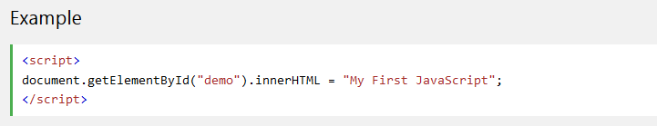
JavaScript Where To
The <script> Tag
In HTML, JavaScript code must be inserted between <script> and </script> tags.

Slide 11
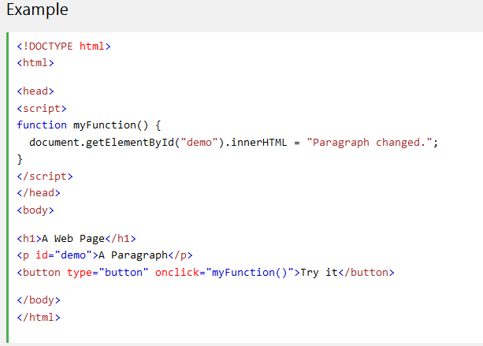
JavaScript in <head> or <body>
Notes:
You can place any number of scripts in an HTML document.
Scripts can be placed in the <body>, or in the <head> section of an HTML page, or in both.

Slide 12
JavaScript Output
JavaScript can "display" data in different ways:
Writing into an HTML element, using innerHTML.
Writing into the HTML output using document.write().
Writing into an alert box, using window.alert().
Writing into the browser console, using console.log().

Slide 13
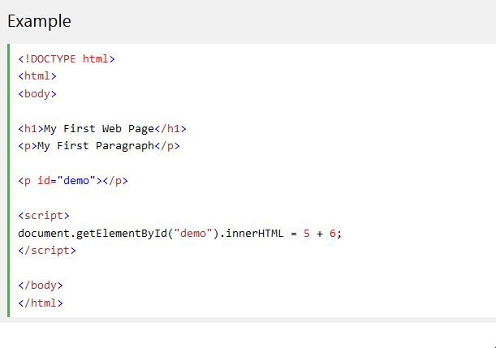
Using innerHTML
To access an HTML element, JavaScript can use the document.getElementById(id) method.
The id attribute defines the HTML element. The innerHTML property defines the HTML content:
Notes:
To access an HTML element, JavaScript can use the document.getElementById(id) method.
The id attribute defines the HTML element. The innerHTML property defines the HTML content:

Slide 14
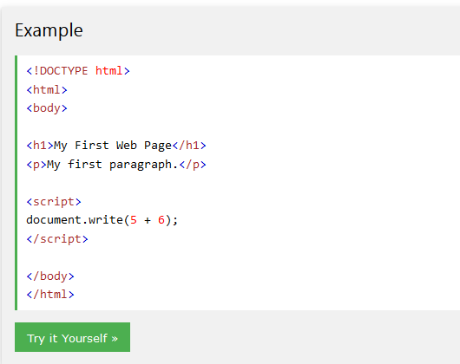
Using document.write()
For testing purposes, it is convenient to use document.write():
Using document.write() after an HTML document is loaded, will delete all existing HTML:
The document.write() method should only be used for testing.
Notes:
For testing purposes, it is convenient to use document.write():
Using document.write() after an HTML document is loaded, will delete all existing HTML:
The document.write() method should only be used for testing.

Slide 15
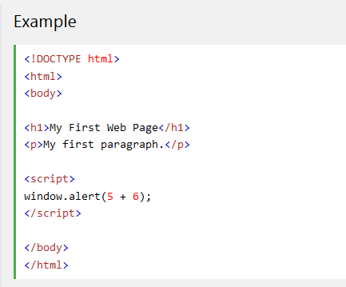
Using window.alert()
You can use an alert box to display data:

Slide 16
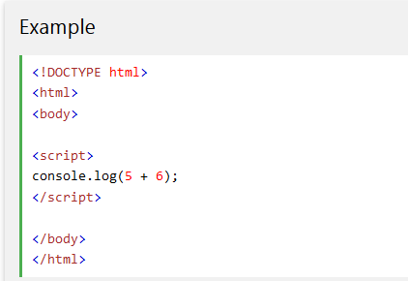
Using console.log()s
For debugging purposes, you can use the console.log() method to display data.
Notes:
For debugging purposes, you can use the console.log() method to display data.

