Slide 1
JSON
Prepared By : Muniba Javaid Khan

Slide 2
WHAT IS JSON
JSON stands for JavaScript Object Notation
JSON is a lightweight data-interchange format
JSON is plain text written in JavaScript object notation
JSON is used to send data between computers
JSON is language independent.

Slide 3
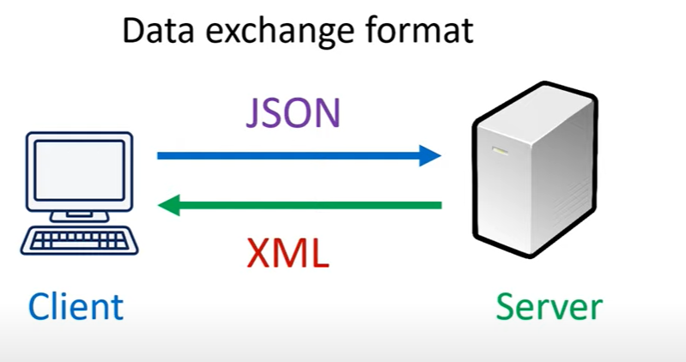
WHEN TO USE JSON

Slide 4
Data Format Of JSON And XML
JSON FORMAT
XML FORMAT
{
"Student": [
{"name":"John","age":30,"city":"NewYork"},
{"name":"David","age":45,"city":"London"}
]}
<employees> <employee> <firstName>John</firstName> <lastName>Doe</lastName> </employee> <employee> <firstName>Anna</firstName> <lastName>Smith</lastName> </employee> <employee> <firstName>Peter</firstName> <lastName>Jones</lastName> </employee> </employees>

Slide 5
Difference B/W JSON And XML
JSON | XML
JavaScript Object Notation | Extensible Markup Language.
Text Based Format | Markup Language
Light Weight | Heavier
Does not support comment and namespace | Support Comment and Name Spaces

Slide 6
JavaScript Object Literals Vs JSON
JAVASCRIPT OBJECT
var person = { name: "David“ age:24 }
JSON FORMAT
var person = { "name": "David“ "age":24 }

Slide 7
Data Type Allow In JSON
In JSON, values must be one of the following data types:
a string
a number
an object (JSON object)
an array
a boolean
null
JSON values cannot be one of the following data types:
a function
a date
undefined

Slide 8
Advantages Of JSON
Human Readable Format
Language Independent
Support all popular programming languages.
Easy to organize and access.
It is light weight.
Can not use it for transfer audio, video, images or any other binary information.

Slide 9
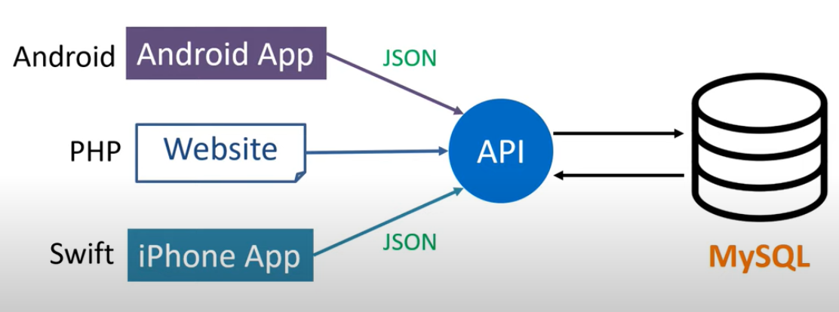
Use of API
JSON used in API
So WHAT IS API:

