Slide 1
Play Ball in VR
Game Development
WS-20/21
TU-Ilmenau
Presentation on-
Group-9:
Munim Ahmed
Sadia Ferdous Snigdha
S M Arfi
Nabeel Asim
Supervisor.
Date:28.10.20

Slide 2
MOTIVATION
To develop a VR game
Experiencing the virtual world
Experiencing the properties of physics in VR
Hands on experience with grabbing and throwing objects in VR

Slide 3
PROJECT DESCRIPTION
An interesting VR game
The scene contains a virtual 3D room including some moving objects as well as fixed objects
Game objects are few balls which will be placed somewhere in the room
The main goal is pick up one ball and throw it to the target object
If it collides with any walls or any fixed object the game will restart, hence no scores obtained
Score will be earned by clearing the moving targets of the entire room
Notification texts will be generated after clearing each target and also when the ball collide with the walls/fixed objects

Slide 4
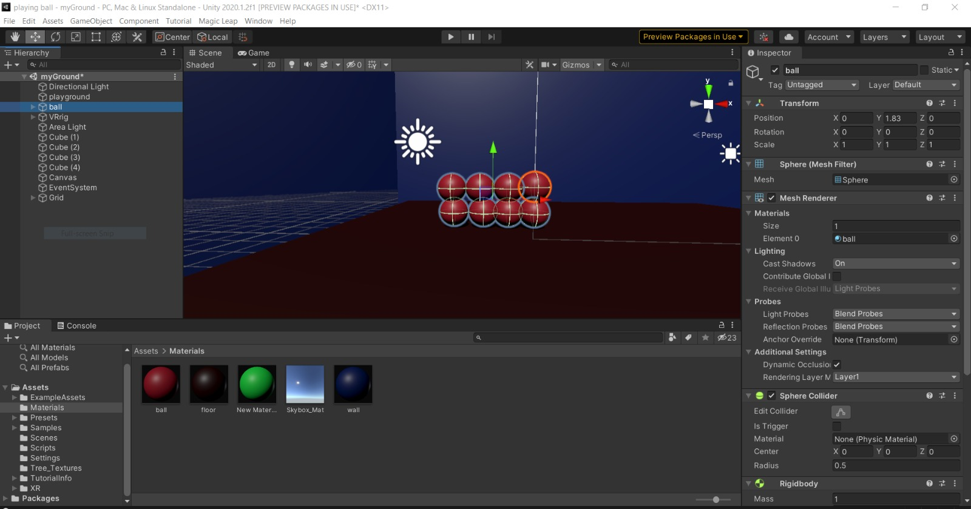
USE CASE DIAGRAM

Slide 5
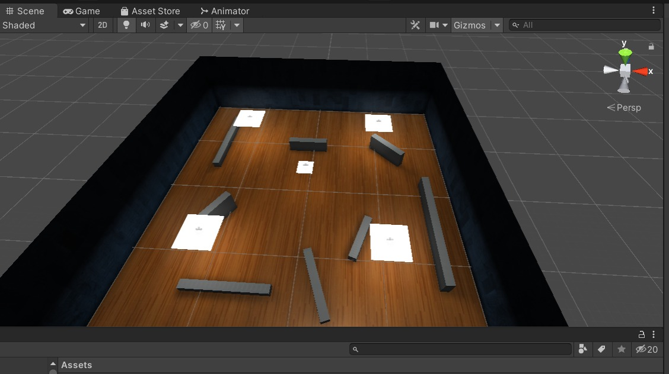
USE CASE DIAGRAM

Slide 6
What's New!
Added a story line
Hit only the specific charecters
Avoid hitting the restricted charectars
Get rid of insects
Specified the charecters
Ants, cockroaches, rats and human
Non-Vr mode
Play just using the mouse

Slide 7
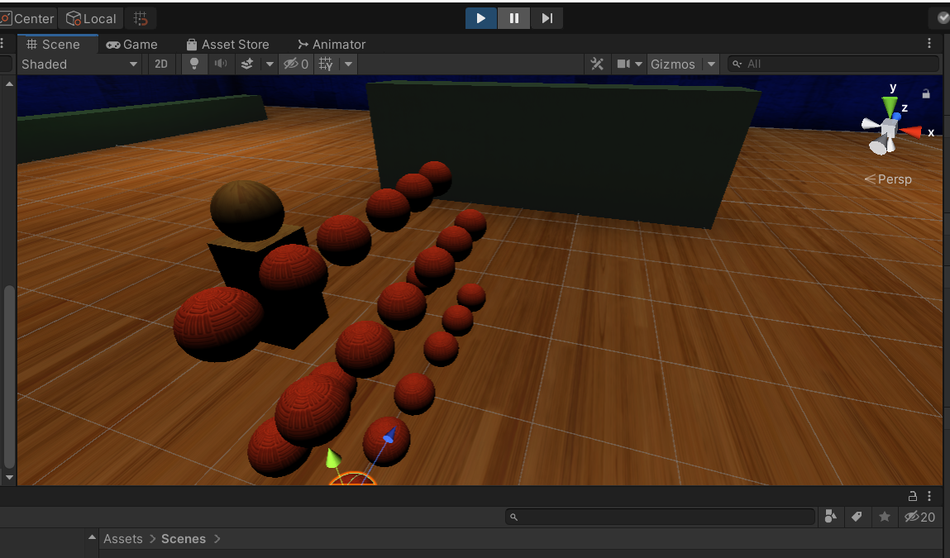
What's new!

Slide 8
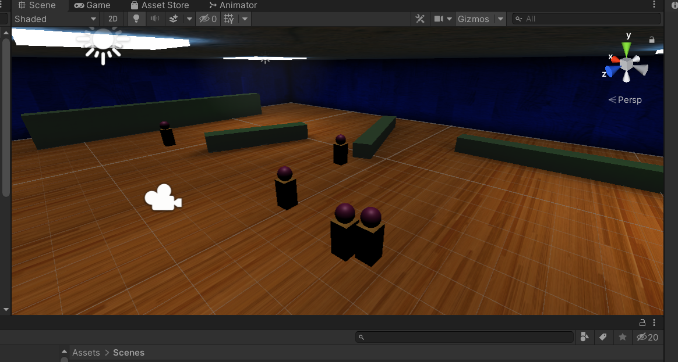
What's new!

Slide 9
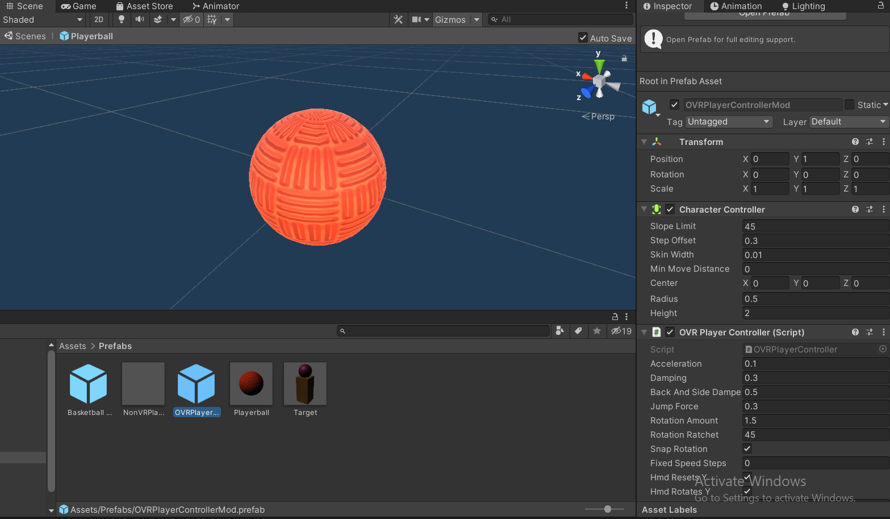
What's new!

Slide 10
Technologies
Interections:
Grabbing with hands
Detecting the movements of hands
Tracking the movements of head
Detecting force/ mass
Detecting player's movement
Controllers & Software:
Unity Editor
Oculus Rift Touch controllers
Oculus Rift HMD
Oculus Sensors
C# Programming language

