Slide 1
CIS 3252W
Business Intelligence
Project 4 Final Report
Using Business
Intelligence to
Address Employee
Retention
Workforce Stability
& Predictive Analytics
Using the IBM HR Analytics Employee Attrition Dataset
to identify at-risk employees and build retention strategies.
1,470
35
16.1%
Employees
Variables
Attrition Rate
Munim Awal | April 26, 2026

Slide 2
CONTEXT
Turnover is expensive — and mostly preventable.
Most organizations react after someone leaves. This project uses data to act earlier.
50–200%
16.1%
54%
of salary to replace
one mid-level employee
of employees left during
the observation period
of departing employees
regularly worked overtime
Munim Awal | CIS 3252W | April 26, 2026
Slide 2 of 7

Slide 3
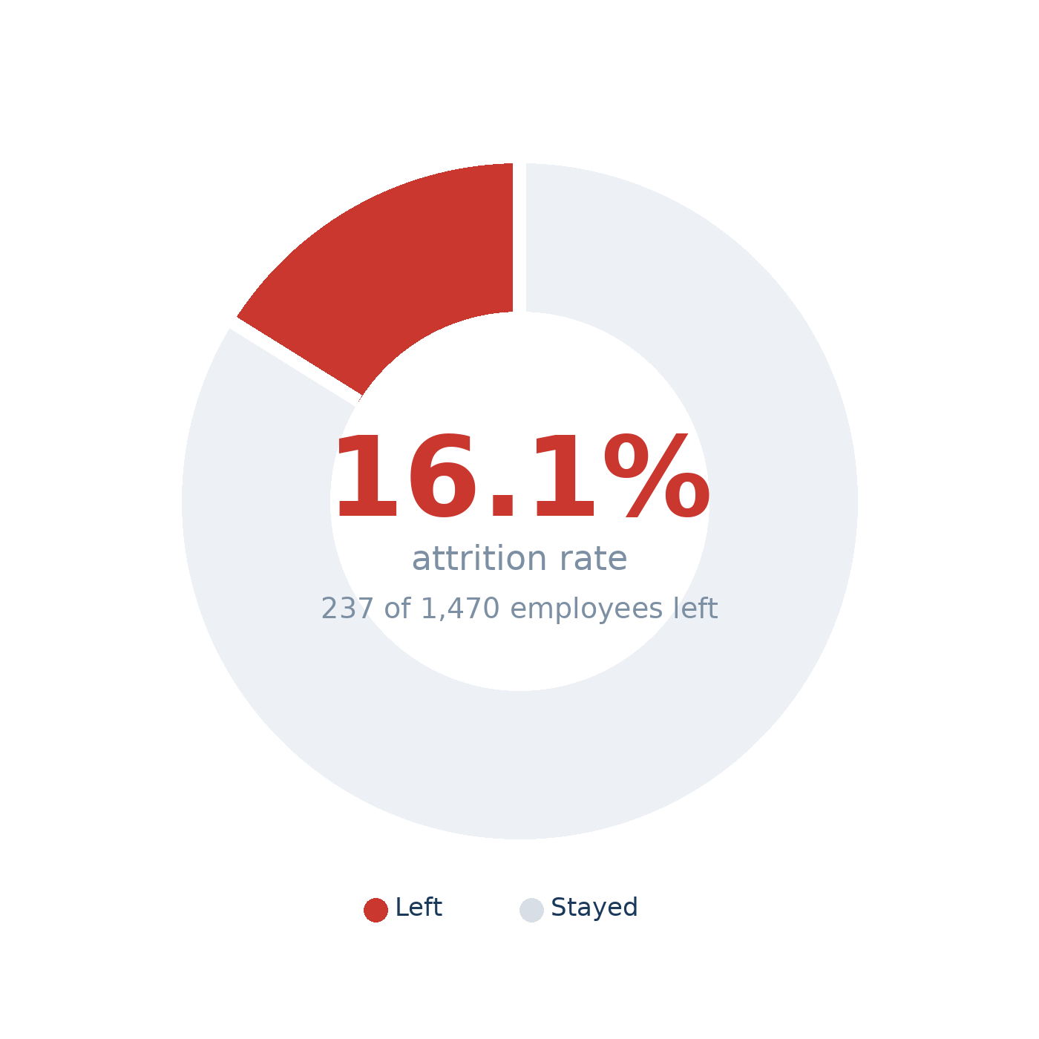
DATA SOURCE
IBM HR Analytics Employee Attrition Dataset
Source
Kaggle — pavansubhasht/ibm-hr-analytics-attrition-dataset
Records
1,470 employees, 35 variables, 0 missing values
Outcome
Attrition — Left (1) or Stayed (0)
Predictors
OverTime, JobSatisfaction, YearsAtCompany,
WorkLifeBalance, Age, Department, JobRole
Munim Awal | CIS 3252W | April 26, 2026
Slide 3 of 7

Slide 4
METHODOLOGY
CRISP-DM framework with logistic regression modeling.
01
02
03
04
05
Business
Understanding
Data
Understanding
Data
Preparation
Logistic
Regression
Deployment
& Action
Define the problem:
which employees are
most at risk?
Explore 1,470 records,
check distributions
and group differences.
Recode variables,
create dummy codes,
verify data types.
Binary outcome model.
Odds ratios show
effect size per predictor.
Translate coefficients
into specific, ranked
retention strategies.
Munim Awal | CIS 3252W | April 26, 2026
Slide 4 of 7

Slide 5
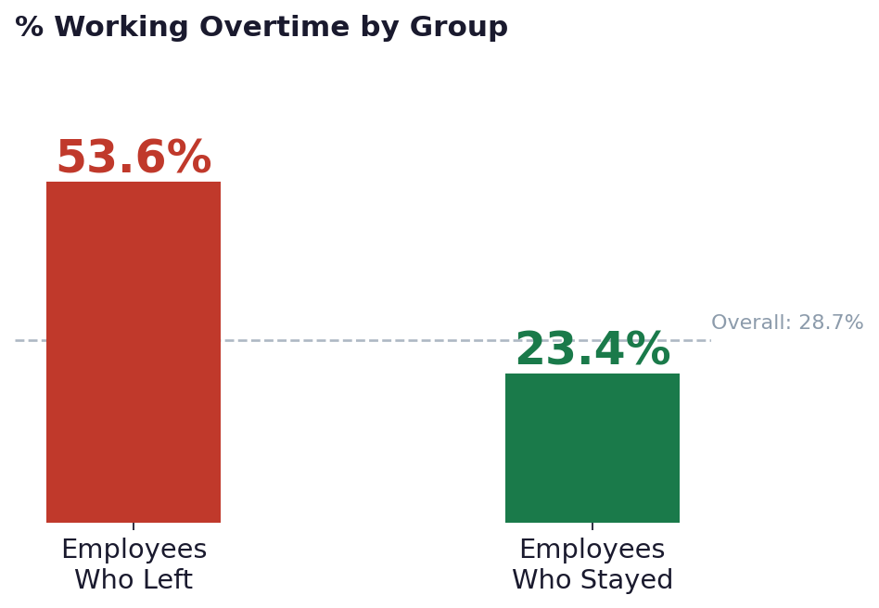
KEY FINDINGS
Overtime was the strongest predictor of attrition.
4.195x
more likely to leave if working overtime
Odds Ratio = 4.195 | p < .001
OverTime is the single largest attrition risk factor in the entire model and it is directly within organizational control.
Munim Awal | CIS 3252W | April 26, 2026
Slide 5 of 7

Slide 6
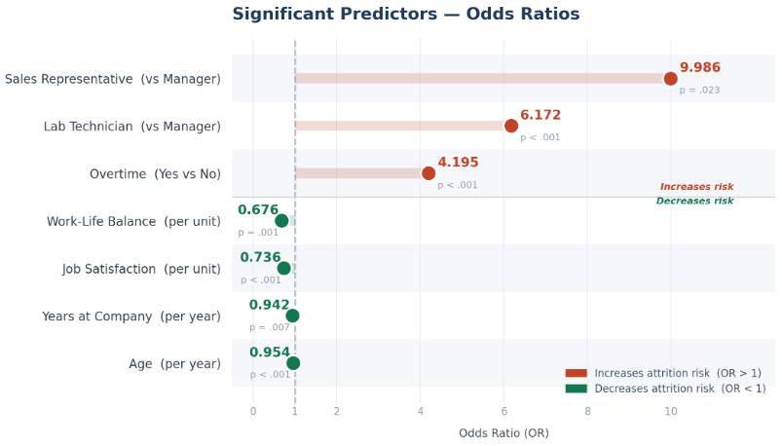
MODEL RESULTS
86.1% accuracy — AUC 0.730 on held-out test data.
86.1%
0.730
80.0%
17.0%
Accuracy
AUC
Precision
Recall *
* Low recall is expected with 16.1% attrition base rate. Best used as a risk-ranking tool, not a binary classifier.
Munim Awal | CIS 3252W | April 26, 2026
Slide 6 of 7

Slide 7
BUSINESS RECOMMENDATIONS
Four actions — each tied to a significant model finding.
01
Reduce Overtime
03
Early-Tenure Mentorship
OverTime OR = 4.195 p < .001
YearsAtCompany OR = 0.942 p = .007
Monitor weekly hours. Redistribute workload before burnout becomes chronic. Flag employees over standard hours for 3+ consecutive weeks.
Structured 90-day onboarding. Peer mentors for new hires in Sales and Lab roles. Check-ins at 30, 90, and 180 days.
02
Quarterly Satisfaction Surveys
04
Flexible Scheduling
JobSatisfaction OR = 0.736 p < .001
WorkLifeBalance OR = 0.676 p = .001
Short 3-question pulse surveys each quarter. Manager follow-up within 30 days for anyone scoring 2.0 or below on the 4-point scale.
Hybrid options, protected personal time, and clear after-hours norms. Each 1-point improvement in balance reduces attrition odds by 32%.
The dominant attrition predictors are organizational decisions — not fixed employee traits. These findings are actionable.

