Slide 1
AWS Energy Power Plant System

Slide 2
Submitted by:
Name | ID
1. Munim Ahmed | 20-43303-1
2. Arafat Al Khair Fuad | 20-43607-1
3. Mirza Asif Mahmud | 20-43314-1
4. Nabila Chowdhury Joya | 20-42268-1
5. Mosa. Umme Ruman Rifat | 20-42936-1

Slide 3
INDEX
Introductions
Objective
Object Functions
Scenarios
Components
Significance
Conclusions

Slide 4
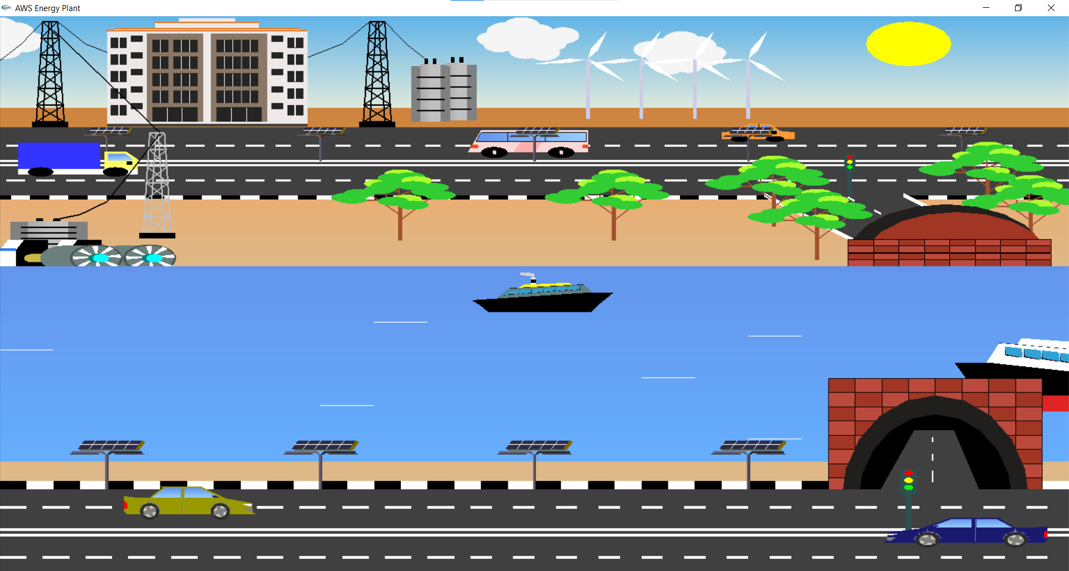
Introduction
Our project is about an Energy powerplant System. The project serves as a visual demonstration of how resources such as wind, water, solar power, etc. can be utilized and used as a power reserve for underdeveloped countries. Here Open Graphics Library is used to create different 2D objects of the real-life scenario and Code blocks that fulfilled the purpose of an IDE.

Slide 5
Objective
The main objective of this project is to demonstrate how to use the natural resources in the underdeveloped areas of Bangladesh to meet the power deficit through a demo model of computer graphics and to suggest potential solutions as well as apply animations for moving objects, include different modes for scenario and finally implement keyboard controlling and sound effect.

Slide 6
Object Functions
Cloud();
Rain_cloud();
Storm_cloud();
Lamppost_Panelroad();
Tunnel_upperside();
Tunnel();
Turbine();
Windmill();
Tower();
Tree();
Bluecar();
Building();
Bus();
trafficLight();
Car();
Ship();
Star();
Thunder();
Sun_moon();

Slide 7
Scenarios
We have implemented three displays; they are "Day", "Night", and "Rain". The scenarios change by pressing the buttons D, N, and R. The components of the scenes are changed according to the phenomenon of the scenes. We have used different functions to change the scenarios.

Slide 8
Display Functions
displayDay() -- int val=1
displayNight() -- int val=9
displayRain() -- int val=5

Slide 9
Day View For “Day” display, the base background is kept sky blue. Then, sky (), cloud () and sun () functions are called to create the environment of a sunny day in OpenGL. We have used logic if(val==1) in different object functions to change the color combinations

Slide 10
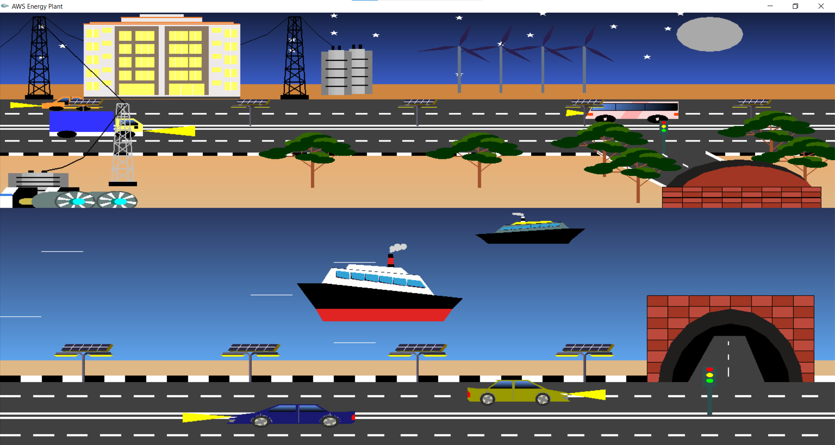
Night View
For “Night” display, the base background is kept blue. Then, sky (), star() and sun_moon() functions are called to create the environment of a night view in OpenGL. We have added light on different object and used
If(val==9) logic in different functions to change the colors.

Slide 11
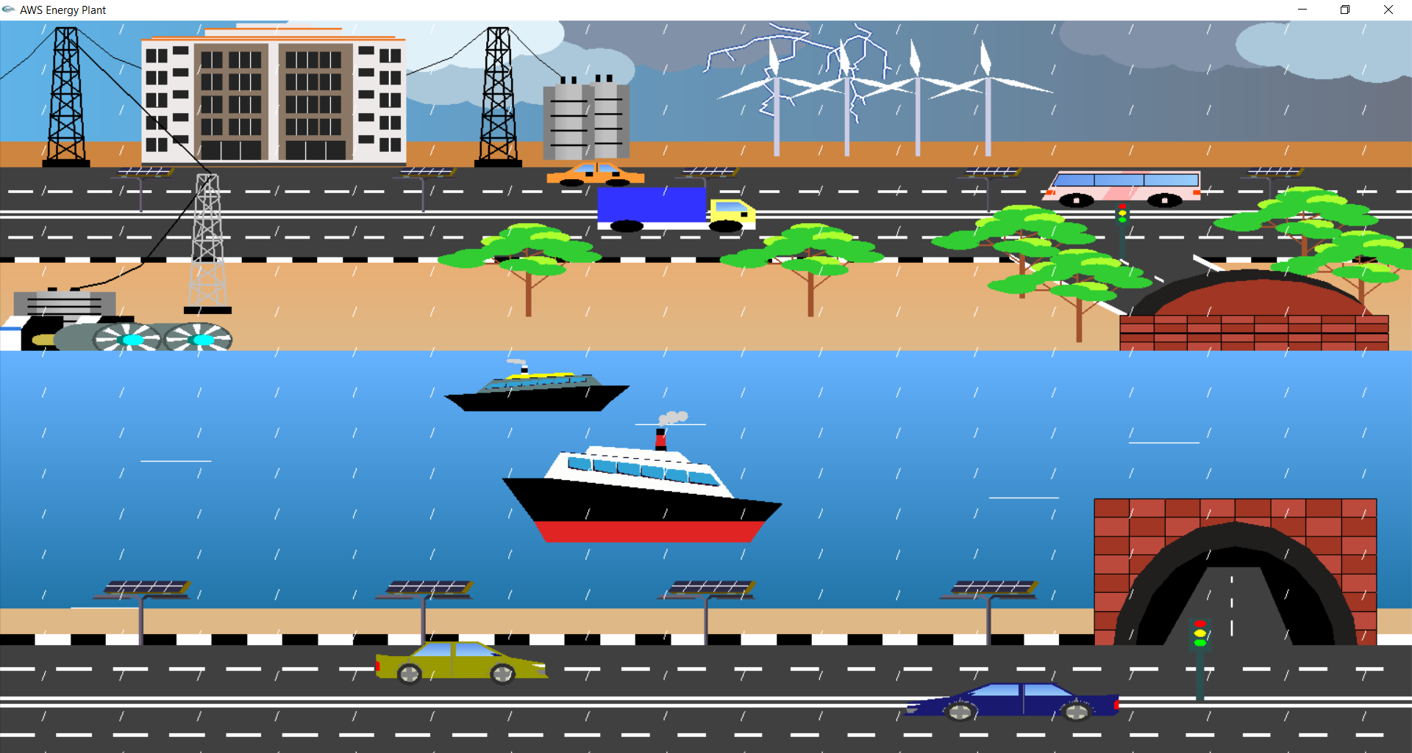
Rainy View
For “Rainy” display, the base background is kept Ash. Then, sky(), cloud() and thunder() functions are called to create the environment of a rainy day in OpenGL. We have used rain animation for rainfall. We used two loop functions to translate a rain drop both vertically and horizontally.

Slide 12
Drawing Functions
GL_TRIANGLES -- is used to form a triangle with 3 vertices in 2D shape.
GL_LINES -- used to create a line to end.
GL_POLYGON -- used for creating a polygon. A polygon is formed by specifying a series of vertices.
GK_TRIANGLE_FAN – used to draw a circle.
GL_QUADS -- used for creating a 4-vertex quadrilateral primitive.
glColor3f() and glColor3ub() -- function which takes 3 parameter is used to color particular shape

Slide 13
Important Functions used
Gltranslate() – for translate the object
Glscaling() – For resizing
Glrotate () – for rotate any object (tire of car, windmill,turbine)
glPushMatrix() -- glPushMatrix copies the top matrix and pushes it onto the stack
glPopMatrix() – glPopMatrix pops the top matrix off the stack.

Slide 14
Animation Functions
animation_car1() – (animation Function for bus)
animation_ship1() – (animation Function for ship1)
animation_ship2() – (animation Function for ship2)
animation_waves() – (animation Function for wave)

Slide 15
Animation Functions
blade_translation() – for Turbine’s blade rotating
doFrame() – for Windmill transition
Cloud_animation() – for cloud animation
RainAnimation() – for rain fall animation
updateCar() – for upper road car animation
updateTruck() – for truck animation

Slide 16
Sound Functions
soundDay()
-- sound of ship, car
soundNull()
soundRain()
-- sound of rain

Slide 17
Mouse and keyboard functions
handleKeypress()– For changing the day, night and rain view
handleMouse()– For switching the sound

Slide 18
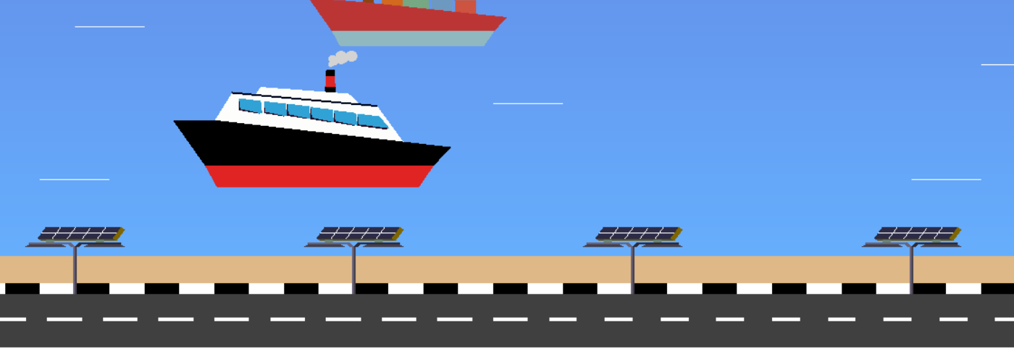
Solar Lamppost

Slide 19
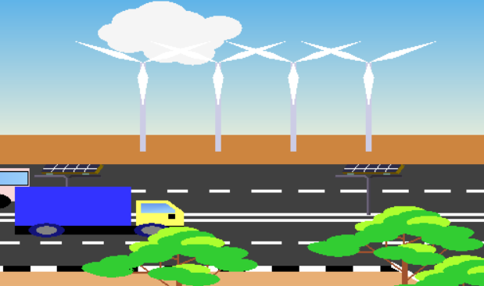
Windmill

Slide 20
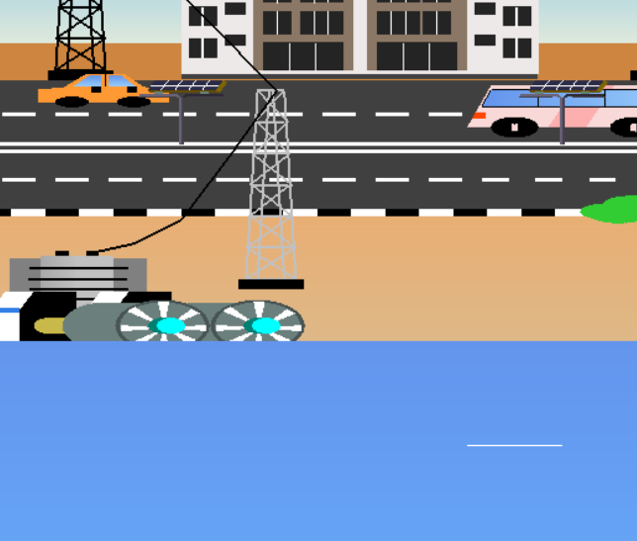
Turbine

Slide 21
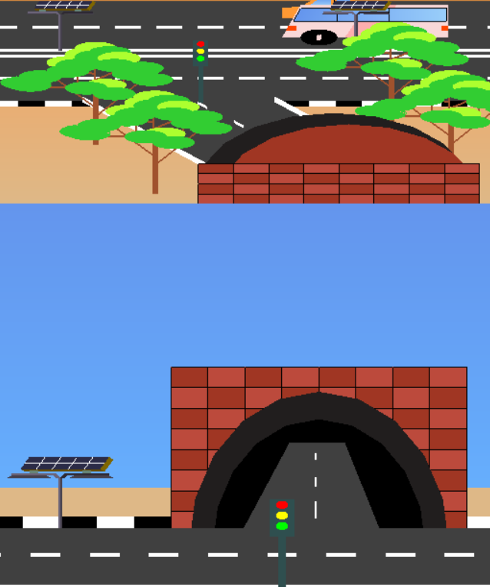
Tunnel

Slide 22
Significance of the project
The project is about proposing a potential solution to cope up with lack of electricity in underdeveloped areas of Bangladesh. The country is yet to improve in this sector and meet up the sufficient demand of electricity. Till then, implementing the proposed mechanisms in unprivileged areas can redeem the necessity of electricity to a great extent:
Setting up of windmill and turbine
Installation of solar panels
Installation of solar powered lights by roadside and bridge

Slide 23
Conclusion and Future Work
To recapitulate, the “AWS Energy Plant” is created with OpenGL in Code Blocks that is an open-source Integrated Development Environment. This is a beginner level project with 2D objects only. There are lots of ways to make the scenario more accurate and realistic. For future implementations, the scenario of thunder storming can use better animation effects. The cars and hills can be made more realistic by using 3D effect, shading or projection method. Overall, considering a beginner level project, it serves its purpose to propose a technical solution to cope up with the electricity problem in underdeveloped areas in Bangladesh and solve the issue regarding frequent accidents in bridge during night.

Slide 24


