Slide 1
Munirah Al-shahrani
Cardiovascular Disease dataset

Slide 2
INDEX
-INTRODUCTION
- AIMS AND OBJECTIVES
- QUESTIONS
- WORKFLOW
- RESULTS
- CONCLUSION

Slide 3
introduction
Heart and blood vessel disease (also called heart disease) includes numerous problems, many of which are related to a process called atherosclerosis.
These data were selected to calculate the number of heart patients in order to dispense medications.

Slide 4
questions
what Number of people with heart disease smoking and non-smokers?
what Number of people with heart disease?
what Number of cholesterol?
What Number of women and men?

Slide 5
The cardiovascular disease dataset is an open-source dataset found on Kaggle.
The dataset Contains 70000 Rows and 11 Columns
How did you appeal to the real age of data? Age divided by number of days of the year
I figured out how many males and females suffer from Cardio disease.
And how many smokers and non-smokers have heart disease

Slide 6
answers
1- Smoke
0 | 32050
1 | 2929
3-
1 52385
2 9549
3 8066
Name: cholesterol, dtype: int64
_____________________________________________________
-4
cardio
gender
1 22616
2 12363
______________________________________________
2-
0 35021
1 34979
Name: cardio, dtype: int64

Slide 7
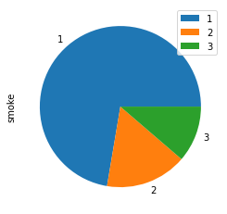
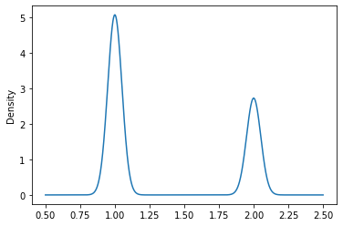
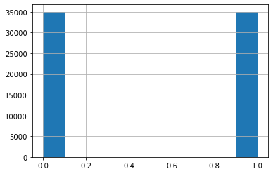
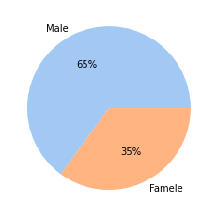
Algorithms
#gender
Comparison between cholesterol patients and smokers
Number of cardio patientsNumber of cardio patients
Number of male and female smokers
gender

Slide 8
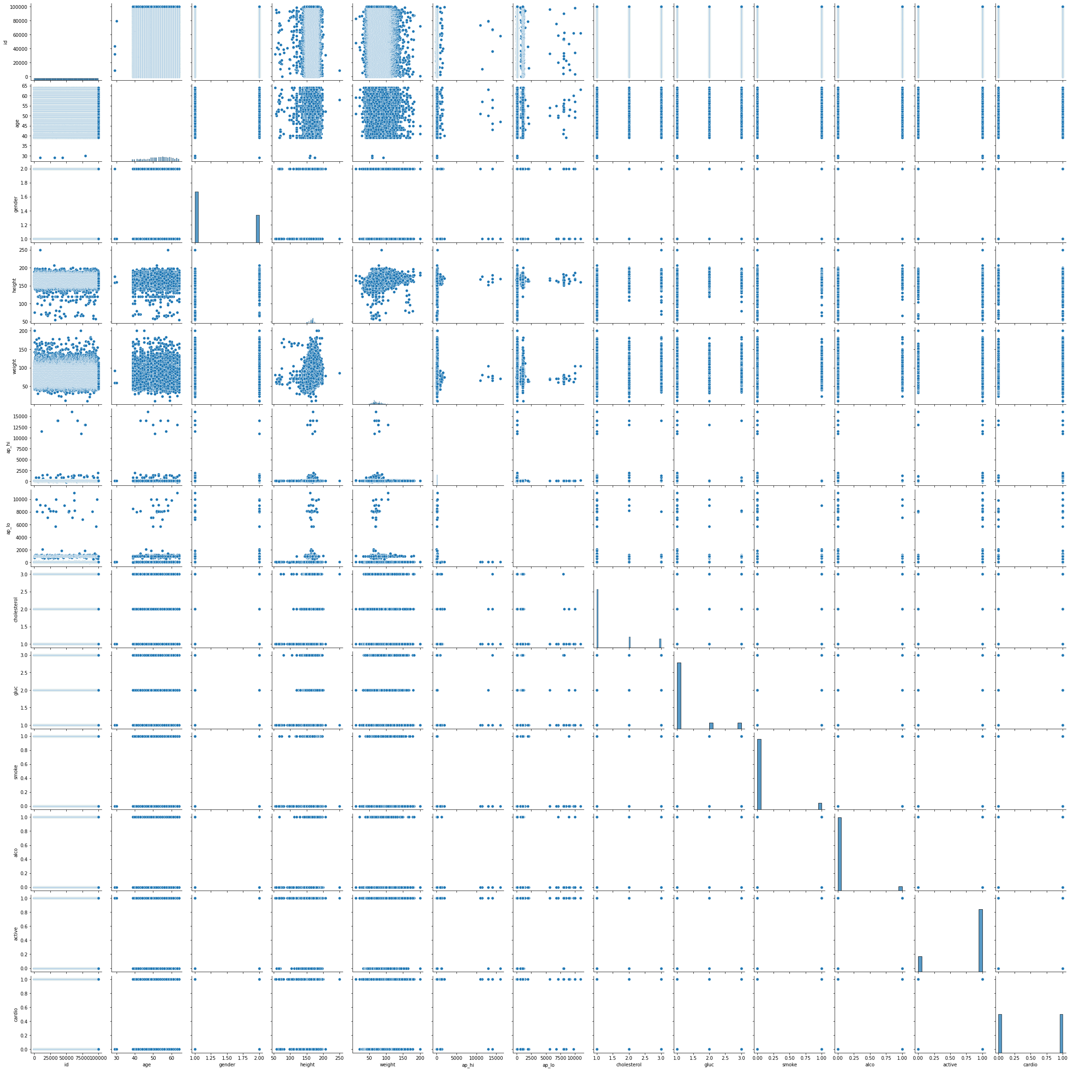
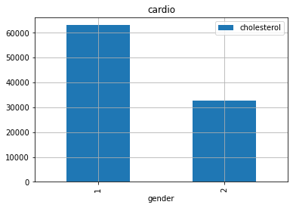
The ratio of calcitriol to males and females

Slide 9
Conclusion: To find out how many people are infected with the discharge of medications

Slide 10
Tools:
• There are tools that will be used to achieve the goal of this project, such as Jupyter notebook,Numpy,Matplotlib,pandas.

