Slide 1

Cardiovascular Disease dataset
Munirah Mohammed Alshahrani

Slide 2
Presentation Outline:
5
1
3
INTRODUCTION
WORKFLOW
TOOLS
2
4
6
QUESTIONS
RESULTS
CONCLUSION

Slide 3
INTRODUCTION
Heart and blood vessel disease (also called heart disease) includes numerous problems, many of which are related to a process called atherosclerosis.
These data were selected to calculate the number of heart patients in order to dispense medications.

Slide 4
QUESTIONS
what Number of people with heart disease smoking and non-smokers?
what Number of people with cardio disease?
what Number of cholesterol? & What Number of women and men?

Slide 5
The cardiovascular disease dataset is an open-source dataset found on Kaggle.
The dataset Contains 70000 Rows and 12 Columns
How did I convert date to age? Age divided by number of days of the year
I figured out how many males and females suffer from Cardio disease.
And how many smokers and non-smokers have heart disease

Slide 6
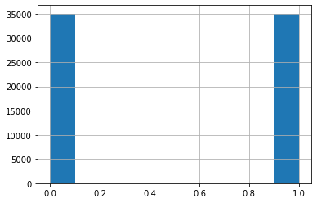
Algorithms to answer the questions
Number of cardio patients

Slide 7

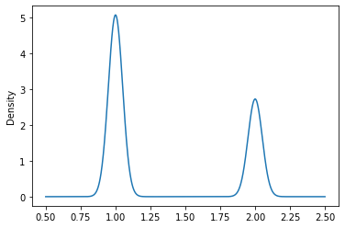
Number of female and male by gender having heart issues?

Slide 8
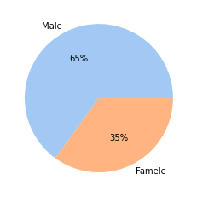
Number of male and female smokers

Slide 9
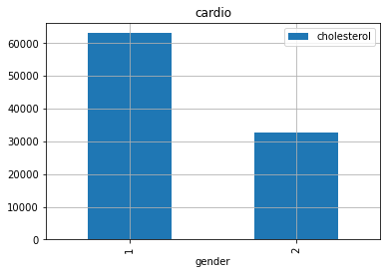
The ratio of calcitriol to males and females

Slide 10



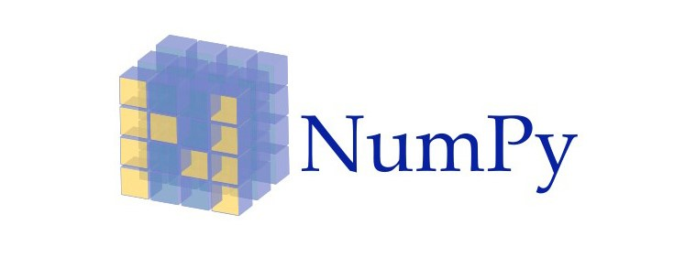
Tools
1
2
3
4

Slide 11

CONCLUSION
This data exploration and predictive analysis of heart disease has identified which health factors statistically affect a patient’s disease risk, in addition to the extent to which those factors contribute to the risk. Both a graphical analysis as well as a prediction explanation demonstrated that even a limited amount of health data from a patient provides a template to understand their risk for disease.

Slide 12

THANKS!
Do you have any questions?
Munirah3m@gmail.com

