Slide 1
Statistical Inference
Estimation and B. Test of Hypothesis
Properties of a good estimator:
1. Unbiasedness
2. Consistency
3. Sufficiency and
4. Efficiency
1. Point Estimation
2. Interval Estimation
1. Parametric Test
2. Non-Parametric Test

Slide 2
What is Hypothesis?
A hypothesis is an assumption or statement about the unknown characteristic(s) of the population of investigation.
A hypothesis expresses an expected relationship between two variables in a study and is developed before conducting any research.
Hypotheses are not opinions but rather are expected relationships based on facts and observations.
They help support scientific research and expand existing knowledge.

Slide 3
Statistical Hypothesis : Statement or assumption about population parameter(s) or about the probability distribution characterizing a population under study on the basis of sample observations is known as a statistical hypothesis. A statistical hypothesis is that hypothesis which is testable on the basis of the sample information.
Null hypothesis : In testing hypothesis the decision maker should maintain neutral or noncommittal attitude before sample observations are taken. Such neutrality is the keynote of the null hypothesis for appropriate decision making. A statistical hypothesis stated to make an appropriate decision is called a null hypothesis and usually denoted by H₀. Any other hypothesis opposite of the null hypothesis is called alternative hypothesis, denoted by H₁ or H_{a}.
For example, Let (x₁, x₂,…..,x_{n­}) be a random sample from population having a parameter θ. We wish to test the hypothesis.
H₀ : θ = θ₀

Slide 4
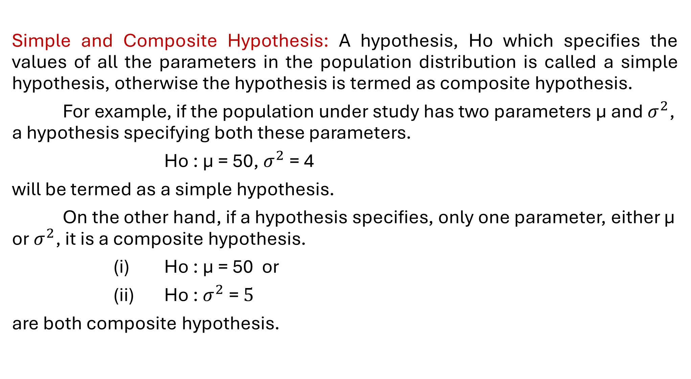
Simple and Composite Hypothesis: A hypothesis, Ho which specifies the values of all the parameters in the population distribution is called a simple hypothesis, otherwise the hypothesis is termed as composite hypothesis.
For example, if the population under study has two parameters µ and $σ^{2}$, a hypothesis specifying both these parameters.
Ho : µ = 50, $σ^{2}$ = 4
will be termed as a simple hypothesis.
On the other hand, if a hypothesis specifies, only one parameter, either µ or $σ^{2}$, it is a composite hypothesis.
(i) Ho : µ = 50 or
(ii) Ho : $σ^{2}$ = $5$
are both composite hypothesis.

Slide 5
Errors in Test of Hypothesis
 |  | Decision
 |  | Accept | Reject
Null Hypothesis | True | No Error | Type –I Error (Rejection Error) Producer Risk
 | False | Type –II Error (Acceptance Error) Consumer Risk | No Error

Slide 6
Level of Significance (α): Probability of committing type I error is called level of significance. That is probability of rejecting a true null hypothesis is called level of significance. It is denoted by α.
Commonly used Parametric Tests:
A. Normal Test or, Z-test
B. t-test
C. F-test and
D. Chi-square test.
Aim of test of hypothesis is to reject the null hypothesis.

Slide 7
Non-parametric or, Distribution Free Tests
Sign Tests: i. One sample & ii. Two samples
Fisher-Irwin test
McNemer Test
Wilcoxon Matched-pair Test Or, Signed Rank Test
Rank sum test (U-test: Wilcoxon-Mann-Whitney Test & H-test: Kruskal-Wallis test)
Spearman’s Rank correlation coefficient test
Kendall’s coefficient of concordance test
One sample Runs test
Chi-Square test

Slide 8
How to Develop Research Hypothesis?
Define or state the problem to solve in general area.
Narrow down the area into more specific area.
Make sure that the hypothesis clearly defines the topic and the focus of the experiment.
Try to write the hypothesis properly by mentioning the research objective.
Define the variables.
Examine the hypothesis.

Slide 9
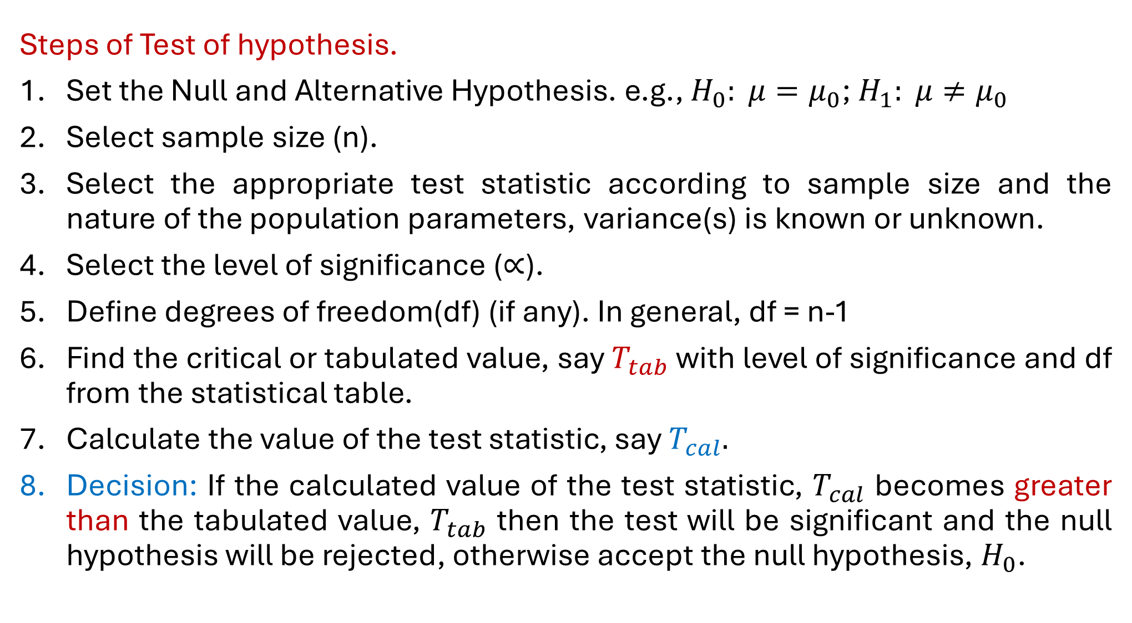
Steps of Test of hypothesis.
Set the Null and Alternative Hypothesis. e.g., $H_{0}: μ=μ_{0}$; $H_{1}: μ≠μ_{0}$
Select sample size (n).
Select the appropriate test statistic according to sample size and the nature of the population parameters, variance(s) is known or unknown.
Select the level of significance ($∝$).
Define degrees of freedom(df) (if any). In general, df = n-1
Find the critical or tabulated value, say $T_{tab}$ with level of significance and df from the statistical table.
Calculate the value of the test statistic, say $T_{cal}.$
Decision: If the calculated value of the test statistic, $T_{cal}$ becomes greater than the tabulated value, $T_{tab}$ then the test will be significant and the null hypothesis will be rejected, otherwise accept the null hypothesis, $H_{0}$.

Slide 10
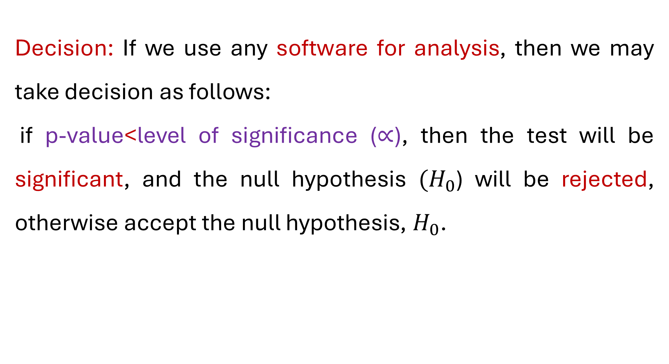
Decision: If we use any software for analysis, then we may take decision as follows:
if p-value<level of significance ($∝$), then the test will be significant, and the null hypothesis $(H_{0}$) will be rejected, otherwise accept the null hypothesis, $H_{0}$.

Slide 11
What is Confidence Interval?
In statistics, a confidence interval (CI) is a range of values used to estimate an unknown statistical parameter, such as a population mean. Rather than reporting a single point estimate (e.g., "the average reading time is 6 hours per day"), a confidence interval provides a range, such as 4 to 6 hours, along with a specified confidence level, typically 95%. This indicates that if the same sampling procedure were repeated 100 times, approximately 95 of the resulting intervals would be expected to contain the true population mean.
Generally, we use 95%, 99% and 90% confidence level.

Slide 12
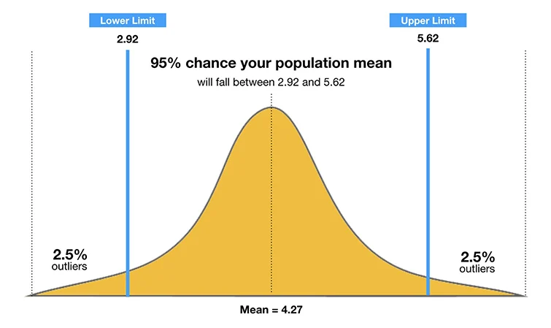

Slide 13


Construction of 95% CI.
Where,
$\overline{x}=$ Sample mean
Z = Confidence level value
S = Sample standard deviation
n = Sample size

Slide 14
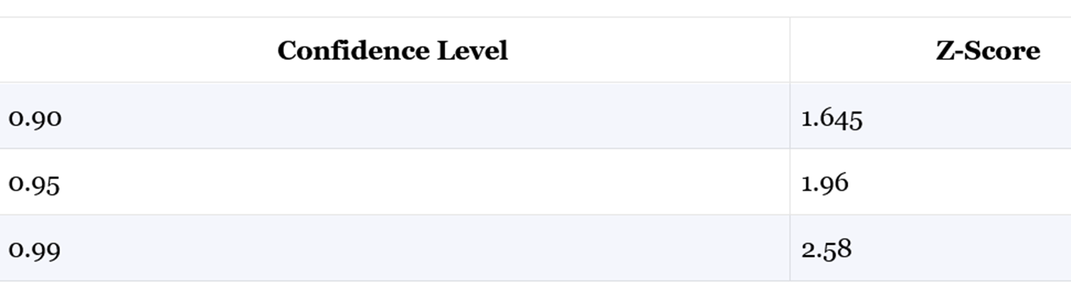

Construct a 95% CI for population mean for the following information:
Sample mean ($\overline{x}$) = 86 kg
Sample standard deviation (S) = 6.2 kg
Sample size (n) = 46

Slide 15
Problem: Suppose, the obtained marks of 10 randomly selected students of CSE department of statistics of 59 batch are
63, 63, 66, 70, 70, 67, 71, 68, 69 and 71 respectively.
On the basis of the above data could we consider that the average marks of the batch is 66 with sample standard deviation 3.011?
Solution: Here, H₀ : µ = 66 and H₁ : µ ≠ 66

Slide 16
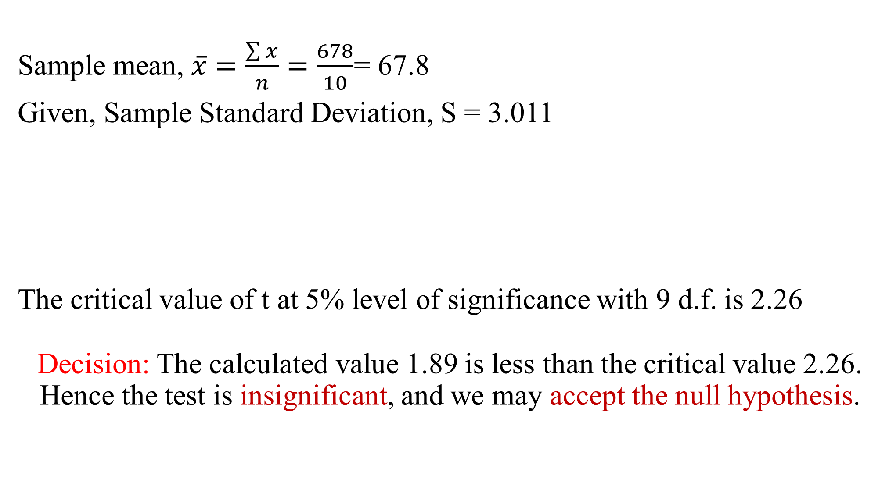
Sample mean, $\overline{x}=\frac{\sum{x}}{n}=\frac{678}{10}$= 67.8
Given, Sample Standard Deviation, S = 3.011
The critical value of t at 5% level of significance with 9 d.f. is 2.26
Decision: The calculated value 1.89 is less than the critical value 2.26. Hence the test is insignificant, and we may accept the null hypothesis.
x
−
μ
67
−
.
0
8
66
The test statistic
=
=
= 1.89 (app); with (10
-
t
1=9) df
s
/
n
3
.
011
/
10

Slide 17
Conditions for Chi-square test?
There are Certain Conditions for the Validity of the Test :
Sample observations should be independent.
Number of observations should be large (N > 50).
The expected frequency in each cell should be at least 5. If the expected frequency of any class is less than 5, the group is combined with its preceding or following group (whose expected frequency is at least 5) and for this the degrees of freedom of the χ² statistic will be reduced.

Slide 18
The test statistic is
with 1 d.f.
Example: The following are the results of an investigation to examine the effectiveness of a new antivirus program in laptop:
H₀ : The antivirus is not effective.
Comment on the hypothesis at 5% level of significance.
Tabulated values is 6.635
Antivirus Status | Have used Antivirus
 | Yes | No
Working | 45 | 15
Not Working | 10 | 50

Slide 19
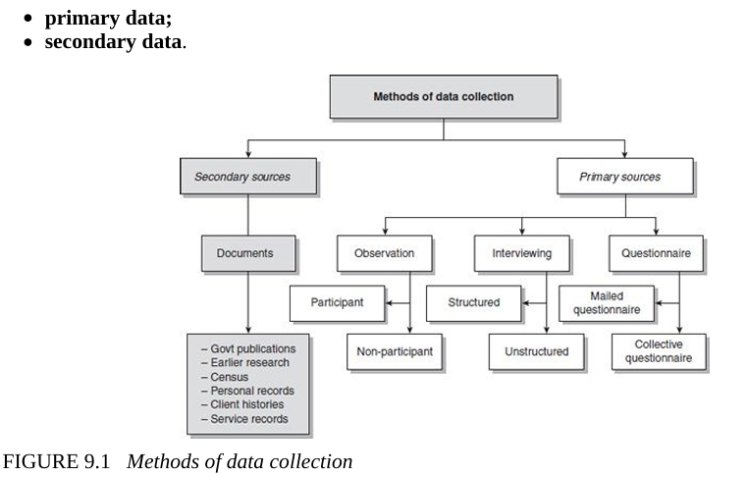
Methods of Data Collection

Slide 20
The questionnaire:
A questionnaire is a written list of questions, the answers to which are recorded by respondents. In a questionnaire respondents read the questions, interpret what is expected and then write down the answers. The only difference between an interview schedule and a questionnaire is that in the former it is the interviewer who asks the questions (and if necessary, explains them) and records the respondent’s replies on an interview schedule, and in the latter replies are recorded by the respondents themselves.

Slide 21
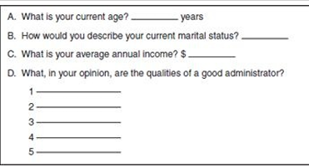
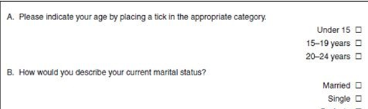
In an open-ended question the possible responses are not given. In the case of a questionnaire, the respondent writes down the answers in his/her words.
In a closed question the possible answers are set out in the questionnaire or schedule and the respondent or the investigator ticks the category that best describes the respondent’s answer.

Slide 22
Focus Group Interview: The only difference between a focus group interview and an in-depth interview is that the former is undertaken with a group and the latter with an individual. In a focus group interview, you explore the perceptions, experiences and understandings of a group of people who have some experience in common with regard to a situation or event. For example, you may explore with relevant groups such issues as domestic violence, physical disability or refugees. In focus group interviews, broad discussion topics are developed beforehand, either by the researcher or by the group. These provide a broad frame for discussions which follow. The specific discussion points emerge as a part of the discussion. Members of a focus group express their opinions while discussing these issues.

Slide 23
Characteristics of a good questionnaire:
A good questionnaire should be valid, reliable, clear, concise, sequential and interesting. It is important to design the questionnaire based on a conceptual framework, scrutinise each question for relevance and clarity, and think of the analysis you are going to perform at the end of the day. A final touch-up will make a difference in the response rate and always pilot-test the questionnaire to perfect the questionnaire.

Slide 24
Data : Data is plural word means collection of information. In singular word, a piece of information is called datum. Data means observations or evidences. The scientific educational researches require the data by means of some standardized research tools or self-designed instrument. Data are both qualitative and quantitative in nature. Data are things with which we think of.
Data and facts are used in educational research, therefore, it is essential to understand them clearly.

Slide 25
Needs of Data: The data are needed in a research work to serve the following purposes:
Collection of data is very essential in any educational research to provide a solid foundation for it.
It is something like the raw material that is used in the production of data. Quality of data determines the quality of research.
It provides a definite direction and definite answer to a research inquiry. Whatever inquiry has to give a definite answer to an investigation. Data are very essential for a scientific research.
The data are needed to substantiate the various arguments in research findings.

Slide 26
The main purpose of data collection is to verify the hypotheses.
Statistical data are used in two basic problems of any investigation: a) Estimation of population parameters, and b) The hypotheses testing.
The qualitative data are used to find out the facts and quantitative data are employed to formulate new theory or principles.
Data are also employed to ascertain the effectiveness of new device for its practical utility.
Data are necessary to provide the solution of the problem.

Slide 27
Types of Data in research point:
The data can be classified into two broad categories:
1. Qualitative data or Attributes and
2. Quantitative data.
1. Qualitative data or Attributes : The characteristics or traits for which numerical value can not be assigned, are called attributes, e.g. motivation, confidence, honesty integrity etc.
2. Quantitative Data or Variables: The characteristics or traits for which numerical value can be assigned, are called quantitative data. e.g. Height, Weight, Price, etc.
Each of these are two types:
1. Primary Data &
2. Secondary Data

Slide 28
The primary data are those which are collected afresh and for the first time, and thus happen to be original in character.
The secondary data, on the other hand, are those which have already been collected by someone else and which have already been passed through the statistical process. The researcher would have to decide which sort of data he would be using (thus collecting) for his study and accordingly he will have to select one or the other method of data collection. The methods of collecting primary and secondary data differ since primary data are to be originally collected, while in case of secondary data the nature of data collection work is merely that of compilation.

Slide 29
The Interview & Questionnaire
Interviewing is a commonly used method of collecting information from people. In many walks of life we collect information through different forms of interaction with others.
Simply, any person-to-person interaction, either face to face or otherwise, between two or more individuals with a specific purpose in mind is called an interview.

Slide 30
Types of interview:
When interviewing a respondent, you, as a researcher, have the freedom to decide the format and content of questions to be asked of your respondents, select the wording of your questions, decide the way you want to ask them and choose the order in which they are to be asked. This process of asking questions can be either very flexible, where you as the interviewer have the freedom to think about and formulate questions as they come to your mind around the issue being investigated, or inflexible, where you have to keep strictly to the questions decided beforehand – including their wording, sequence and the manner in which they are asked.

Slide 31
Interviewing
Unstructured Interviews
Structured Interviews
Interviews at different levels of flexibility & specificity
-Flexible interview structure and manner
-Flexible interview contents
-Flexible in interview questions
-Rigid in interview structure and manner
-Rigid in interview contents
- Rigid in interview questions and wording

Slide 32
Unstructured Interviews
The strength of unstructured interviews is the almost complete freedom they provide in terms of content and structure. You are free to order these in whatever sequence you wish. You also have complete freedom in terms of the wording you use and the way you explain questions to your respondents. You may formulate questions and raise issues on the spur of the moment, depending upon what occurs to you in the context of the discussion.
As unstructured interviews are dominantly used in qualitative research.

Slide 33
Structured Interviews
In a structured interview the researcher asks a predetermined set of questions, using the same wording and order of questions as specified in the interview schedule.
An interview schedule is a written list of questions, open ended or closed, prepared for use by an interviewer in a person-to-person interaction (this may be face to face, by telephone or by other electronic media). Note that an interview schedule is a research tool/instrument for collecting data, whereas interviewing is a method of data collection.
One of the main advantages of the structured interview is that it provides uniform information, which assures the comparability of data. Structured interviewing requires fewer interviewing skills than does unstructured interviewing.

Slide 34
The Questionnaire
A questionnaire is a written list of questions, the answers to which are recorded by respondents. In a questionnaire respondents read the questions, interpret what is expected and then write down the answers.
The only difference between an interview schedule and a questionnaire is that in interview schedule it is the interviewer who asks the questions (and if necessary, explains them) and records the respondent’s replies on an interview schedule, and in the questionnaire replies are recorded by the respondents themselves.

Slide 35
In the case of a questionnaire, as there is no one to explain the meaning of questions to respondents, it is important that the questions are-
Clear and easy to understand.
Also, the layout of a questionnaire should be such that it is easy to read and pleasant to the eye, and the sequence of questions should be easy to follow.
A questionnaire should be developed in an interactive style. This means respondents should feel as if someone is talking to them.
In a questionnaire, a sensitive question or a question that respondents may feel hesitant about answering should be prefaced by an interactive statement explaining the relevance of the question. It is a good idea to use a different font for these statements to distinguish them from the actual questions.

Slide 36
Editing: Editing of data is a process of examining the collected raw data (specially in surveys) to detect errors and omissions and to correct these when possible. As a matter of fact, editing involves a careful scrutiny of the completed questionnaires and/or schedules. Editing is done to assure that the data are accurate, consistent with other facts gathered, uniformly entered, as completed as possible and have been well arranged to facilitate coding and tabulation.

Slide 37
Field Editing consists in the review of the reporting forms by the investigator for completing (translating or rewriting). While doing field editing, the investigator must restrain himself and must not correct errors of omission by simply guessing what the informant would have said if the question had been asked.
Central Editing has written in abbreviated and/or in illegible form at the time of recording the respondents’ responses. This type of editing is necessary in view of the fact that individual writing styles often can be difficult for others to read. This sort of editing should be done as soon as possible after the interview, preferably on the very day or on the next day.

Slide 38
What is Field Work:
Fieldwork, field research or field studies, is the collection of raw data outside a laboratory, library, or workplace setting. The approaches and methods used in field research vary across disciplines. For example, biologists who conduct field research may simply observe animals interacting with their environments, whereas social scientists conducting field research may interview or observe people in their natural environments to learn their languages, folklore, and social structures.
Field research involves a range of well-defined, although variable, methods: informal interviews, direct observation, participation in the life of the group, collective discussions, analyses of personal documents produced within the group, self-analysis, results from activities undertaken off- or on-line, and life-histories. Although the method generally is characterized as qualitative research, it may (and often does) include quantitative dimensions.

Slide 39
The objective of training is to ensure that the data collection instrument is administered uniformly by all fieldworkers.
The goal of training session is to ensure that each respondent is provided with common information.
If the data are collected in a uniform manner from all respondents, the training session will have been a success.
Points for training program for interviewers:
How to make initial contact with the respondent and secure the interview
How to ask survey question
How to probe
How to record responses
How to terminate the interview

Slide 40
The basics of Good Interviewing:
Have integrity and be honest.
Have patience, tact and courtesy.
Pay attention to accuracy and detail.
Exhibit a real interest in the inquiry at hand, but keep you’re your opinions to yourself.
Be a good listener.
Keep the inquiry and respondent’s responses confidential.
Respect others’ rights.

Slide 41
Editing: The process of making data for coding and transfer to data storage. Its purpose is to ensure the completeness, consistency and reliability of data. It is the process of checking and adjusting the data for omission, legibility and consistency.
Field Editing: Preliminary editing by a field supervisor on the same day as the interview. Its purpose is to catch technical omissions, check legibility of handwriting, and clarify responses that are logically or conceptually inconsistent.
In-house Editing: A rigorous editing job performed by centralized office staff,

Slide 42
Data Processing is the collection and manipulation of digital data to produce meaningful information. Data processing is a form of information processing, which is the modification (processing) of information in any manner detectable by an observer. It involves the careful selection, organization, and transformation of raw data into insightful, useful information.
The term data processing has mostly been subsumed by the more general term information technology (IT).
Types of Data Processing:
Manual data processing
Automatic data processing
Computerized data processing

Slide 43
Data Processing Steps/Points:
Data processing involves transforming raw data into useful information.
Stages of data processing include collection, filtering, sorting, and analysis.
Data processing relies on various tools and techniques to ensure accurate, valuable output.

Slide 44
Data Tabulation: Tabulation refers to the orderly arrangement of data in a table or other summary format.
Simple, or Marginal Tabulation: Counting the number of different responses to a question or query and putting them in a frequency distribution is called simple, or original, tabulation. It tells the researcher how frequently each responses occurs.
Frequency Table
Do you have smart phone of SAMSUNG?
Response | Frequency
Yes | 330
No | 70
Total | 400

Slide 45
Cross Tabulation: Organising data by groups, categories, or classes to facilitate comparisons; a joint frequency distribution of observations two or more sets of variables is called cross tabulation.
Table: Cross-Tabulation of subjects and grade in final exam of students.
Subject | Grade
 | A | B | C
Mathematics | 50 | 60 | 25
Statistics | 55 | 50 | 15
Basic Computer | 45 | 30 | 10
Total | 150 | 140 | 50

Slide 46
Contingency Table: The presentation of cross tabulation for two qualitative variables (attributes).
Table: 2X2 Contingency table of the question “Did you take makeup exam?”
Students Type | Did you take makeup exam?
 | Yes | No | Total
Male | 15 | 5 | 20
Female | 18 | 2 | 20
Total | 33 | 7 | 40

Slide 47
Different measures of central tendency are :
1. Mean or, Average
i. Arithmetic Mean (AM) (For all values)
ii. Geometric Mean (GM) (Only for positive values)
iii. Harmonic Mean (HM) (Not for Zero)
2. Mode
3. Median Quantiles
(Quartiles, Deciles & Percentiles)
Relationship among AM, GM and HM
1. For non-zero positive observations: AM ≥ GM ≥ HM
2. For two non-zero positive observations: AH = G²
where, A = Arithmetic mean, G = Geometric mean and
H = Harmonic mean.

Slide 48
Measurement | For ungrouped data | For grouped data | Uses for
Arithmetic Mean (AM) |  |  | Ratio scale measurement
Geometric Mean (GM) |  |  | Rates, Ratio, Percentages data
Harmonic Mean (HM) |  |  | Km/hr, speed/hr, Tk/kg etc.

Slide 49
Measures of Dispersion (বিস্তার পরিমাপ)
Measures of Dispersion may be divided in two broad types :
a) Absolute Measures (Have same unit as variable) and
b) Relative Measures (Unitless).
Absolute Measures :
1. Range (R) = Highest Value – Lowest Value
2. Quartile Deviation (QD) =
3. Mean Deviation (MD) = and
4. Standard Deviation (SD)
Absolute measures will retain the same unit of measurement of the variable.

Slide 50
Relative Measures :
1. Co-efficient of Range
2. Co-efficient of Quartile Deviation (CQD)
3. Co-efficient of Mean Deviation (CMD) and
4. Co-efficient of Variation (CV) =
Relative measures of dispersion have no unit because these are the ratio of absolute measures and the corresponding values.
Relative measures are more appropriate if,
1. Two or more distributions have different measurement units, e.g., kg, inch, lb, etc.
2. Measurement units are same but mean (average) differences big.

Slide 51
Meaning of Communication:
In research, communication is the process by which one person or group or source send a message or a findings to an audience or receiver and then receives feedback about the message or findings.
Elements for Successful Communication:
The communicator (Who), the source or sender of the message, that means the writer of the report.
The message (says what) (the findings of the research), the set of meanings being sent to or received by the audience.
The medium (in What Way) (the oral, poster or written format), means by which the message is carried or delivered to the audience.
The audience (To Whom), the receiver or destination of the message, the beneficiaries, the manager or decision maker of the research and the findings.
Feedback (With What Effect), is the follow-up process to collect messages from audience.

Slide 52
Meaning of Research Report:
Research Report is a presentation of research findings directed to a specific audience to accomplish, to carry a specific purpose.
A research report may be an oral presentation and/or a written statement that has the purpose of communicating research findings, recommendations for courses of action, other findings to management or other specific audience or receivers.

Slide 53
Research Format:
The general plan of organization for the parts of a written or oral presentation of a research report. It includes the following points/steps:
Title page
Letter of transmittal
Letter of authorization
Table of contents (and list of figures and tables)
Summary
5.1 Objectives
5.2 Results
5.3 Conclusions
5.4 Recommendations

Slide 54
6. Body
6.1 Introduction
6.11 Background
6.12 Objectives
6.13 Significance of the study
6.2 Methodology
6.3 Results
6.4 Limitations
6.5 Conclusions and Recommendations
7. Appendix
7.1 Data collection forms
7.2 Detailed calculations
7.3 General Tables
7.4 Bibliography/References
7.5 Other Support Materials/Tools/Instruments/Directions.

Slide 55
Guidelines or Steps of Writing Research Report
Research reports are the product of slow, painstaking, accurate inductive work. The usual steps involved in writing report are:
logical analysis of the subject-matter;
preparation of the final outline;
preparation of the rough draft;
rewriting and polishing;
preparation of the final bibliography; and
writing the final draft.

Slide 56
Referencing: The report should follow an academic style of referencing. According to Butcher (1981: 226), there are four referencing systems from which to choose:
The short-title system; used in most general books,
The author–date system; mainly in science and social science books;
The reference by number system;
The author–number system.
You need to adopt the one that is acceptable to your university and academic discipline.

Slide 57
Writing a Bibliography:
There are several well-established systems/style for writing a bibliography. Some of the most commonly used ones are:
The Harvard system;
The American Psychological Association (APA) system;
The American Medical Association (AMA) system;
The McGraw-Hill system;
The Modern Languages Association (MLA) system;
The footnote system.

Slide 58
Differences between References and Bibliography:
A reference list includes only the sources you've directly cited in your work, providing evidence for specific claims, while a bibliography includes all sources consulted during your research, whether cited in the text or not, offering background or further reading for the audience. References focus on direct engagement with sources and are typical in styles like APA, whereas bibliographies offer a broader view of the research and are common with footnote/endnote styles like Chicago.
Cited vs. Consulted: A reference list contains only cited works, while a bibliography contains all consulted works.
Purpose: References support specific points in the text; bibliographies offer background and further reading.
Scope: References are selective and focused; bibliographies are comprehensive and broad.

