Slide 1

Data Science :
Malicious Server Hack
Prepared By : Munira Alzhrani

Slide 2
01
Introduction
02
Data Analysis
03
References

Slide 3
1. Introduction
Data Science Process
Get The Data
Data Analysis
1
3
5
2
4
Define The Goal
Clean
The Data
visualization

Slide 4
1.1 Problem Description :
All the countries across the globe have adapted to means of digital payments and with the increased volume of digital payments, hacking has become a pretty common event wherein the hacker can try to hack your details just with your phone number linked to your bank account. However, there is data with some anonymized variables based on which one can predict that the hack is going to happen.

Slide 5
Are you Ready To Discover Our Data ??
DS
Fly With Me To Discover Our Datasets

Slide 6
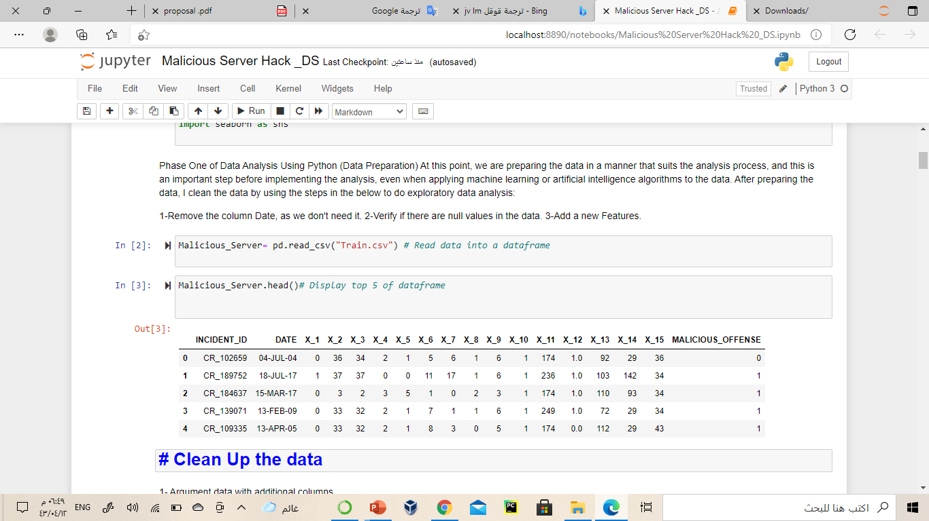
DataSet [1]
This is a subset of the full data loaded as pandas which contains
18 features and 23856 observations

Slide 7
1- How many times has the anonymous recording?
Questions
2- How many hacks are there ?
DS
3- Which month has the most penetration?
4- How long has there been no penetration of server?

Slide 8
1-Remove the column Date, as we don't need it.
2-Verify if there are null values in the data.
3-Add a new Features.
Data Cleaning
DS

Slide 9
Exploratory Data Analysis
DS

Slide 10
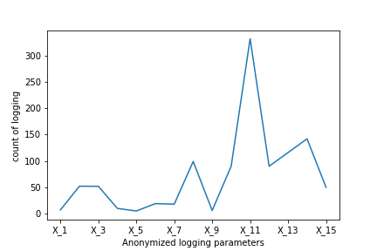
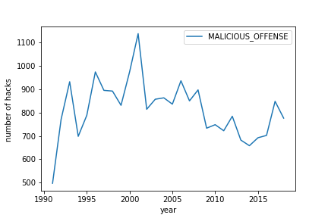
Ans: How many times has the anonymous recording?
Ans: How many hacks are there ?
By using Function Value_counts ()
I concluded happened 22788 hacks cases.

Slide 11
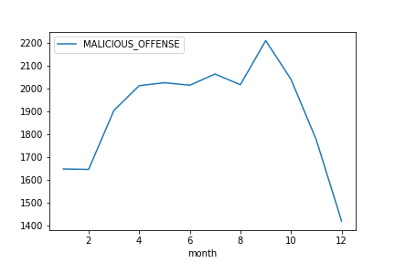
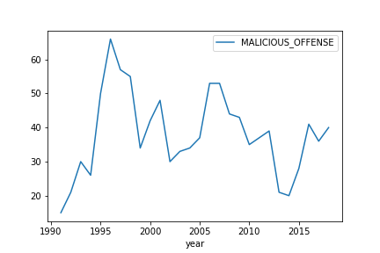
Ans: Which month has the most penetration?
Ans: How long has there been no penetration of server?

Slide 12
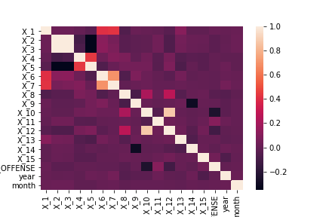
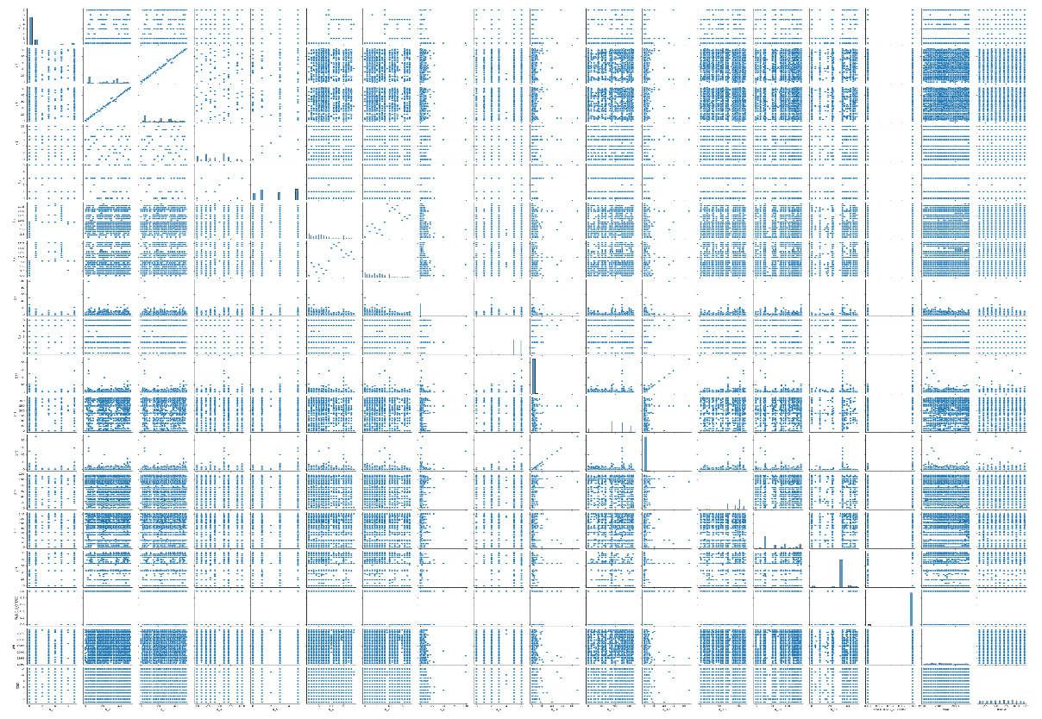
Relationships In The Data

Slide 13
Tools
Data Processing
Pandas
Matplotlib , Seaborn
Visualization
Jupyter notebook for its execution.

Slide 14

References
[1] https://www.kaggle.com/lplenka/malicious-server-hack

