Slide 1



Signatures verification System
Deep learning project T5-bootcamp
20 Jan 22

Slide 2
The Agenda
01
03
05
Introduction
Models
Tools
06
02
04
Conclusion
Data
Overveiw
Deployment

Slide 3
01
Introduction

Slide 4
Introduction
Using handwritten signatures to verify identity can be challenging when there are skilled forgeries, where a person's signature is compromised and a forger intentionally tries to imitate it, We are created signature verification systems by using deep learning model that can identify fraud cases in individual signatures, to prevent document fraud in financial, legal, and commercial settings.

Slide 5


Why Signatures?

Slide 6
02
Data Overview

Slide 7
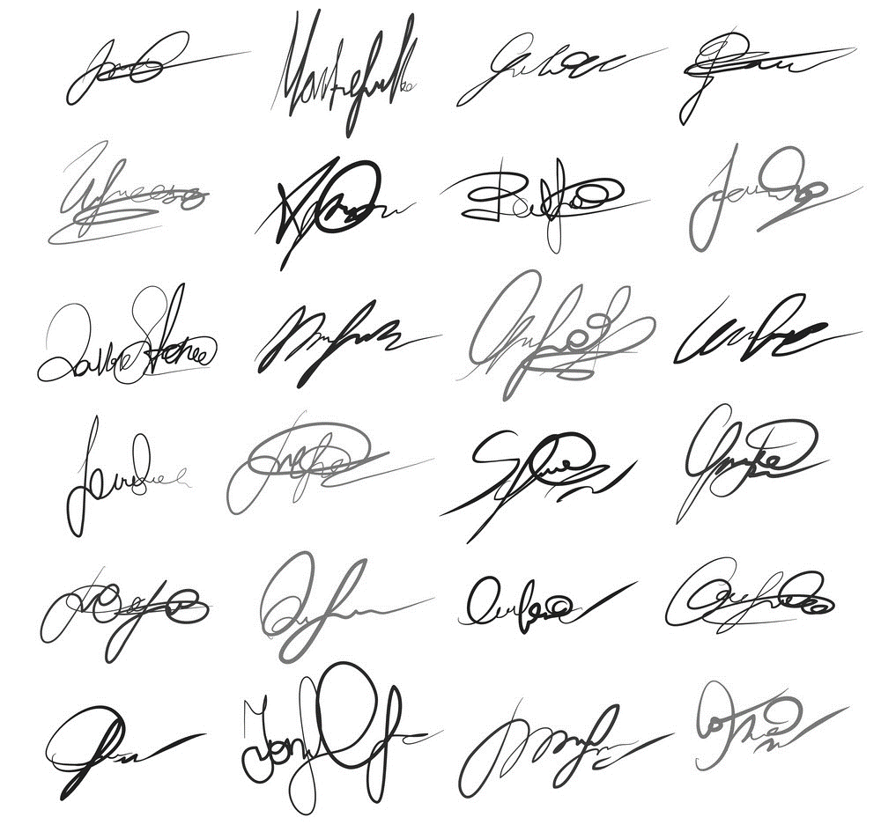
Data Overview
We have 1021 files containing Real and forge signature for 69 person.
Data source:
Kaggle

Slide 8
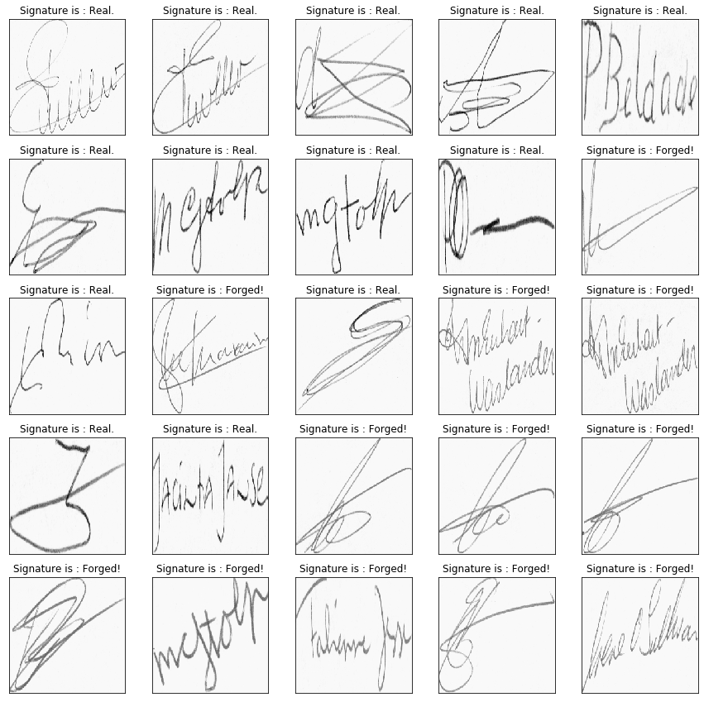
Data Exploring

Slide 9
03
Models

Slide 10
Models intro: Preprocess
Image resize
Reshape
Convert color
Normalize

Slide 11
Models Intro
Model | Vgg 16 | Inception-v3 | Xception | ResNet-50
Optimizers | SGD ,ADAM ,RMSprop , Adgrad
Epochs/Batch size | Epoch 20 and BS 64

Slide 12
Models Details
Phase 1
Phase 2
With freezing
Without freezing

Slide 13
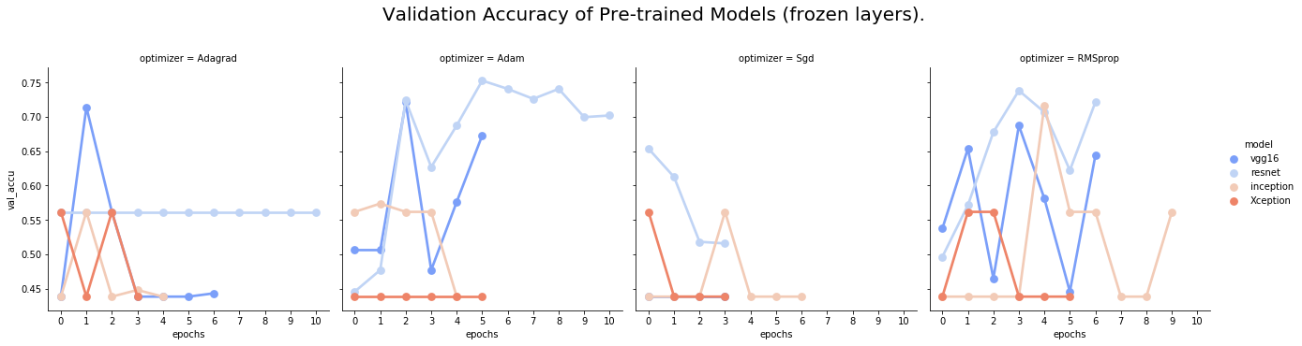
Phase 1: Frozen layers

Slide 14
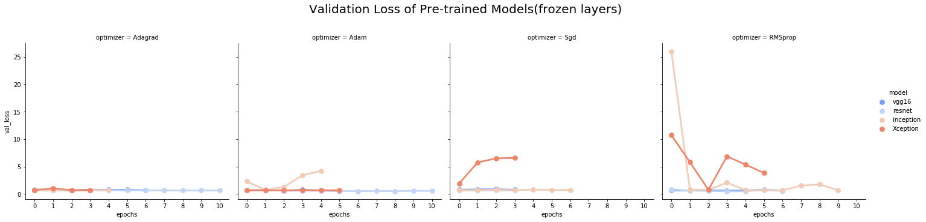
Phase 1: Frozen layers

Slide 15
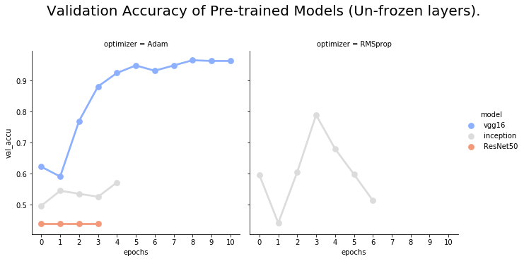
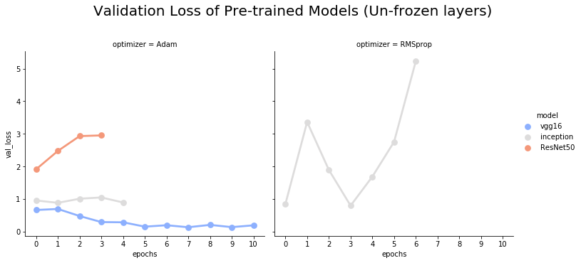
Phase 2: Unfrozen layers

Slide 16


What did we choosed?
VGG 16

Slide 17
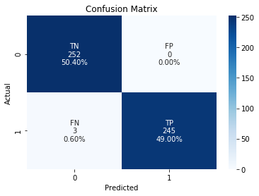
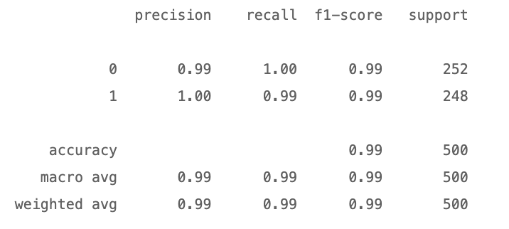
Chosen Model
Vgg 16

Slide 18
04
Deployment

Slide 19
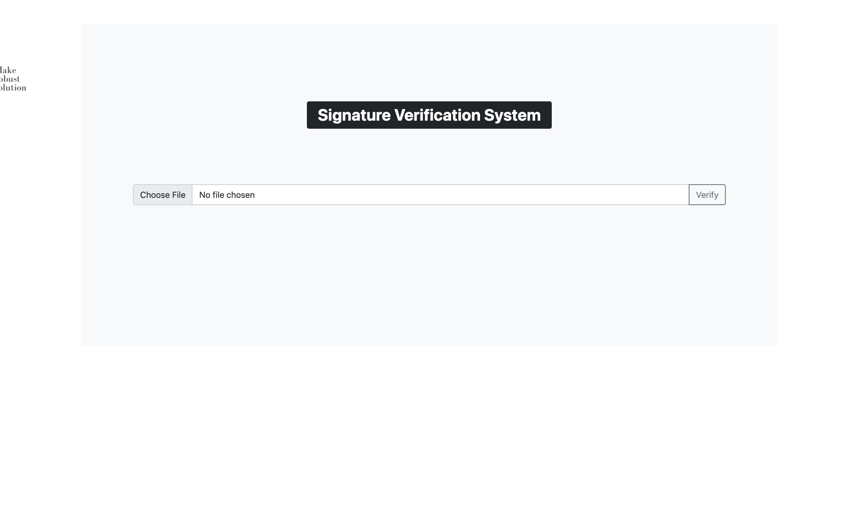
Deployment
RUN

Slide 20
05
Tools

Slide 21



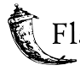


Tools
VsCode
Tensorflow
Keras
Flask
Colab
Opencv

Slide 22
06
Conclusion

Slide 23
Future work
Handle pdf file with pictures
On-time Signatures Verfication
Expand the system to contain Government stamp

Slide 24

Conclusion
This product will help to save time and effort on employees in companies, institutions banks, to authenticate papers and verify signatures and Increase the accuracy rate, as the device has a low probability of error.

Slide 25
Last words from team MRS
Munirah ALzahrani
Shatha Alghamdi
Munirah ALshahrani
Rahaf Almayouf
Email
LinkedIn
Email
LinkedIn
Email
LinkedIn
Email
LinkedIn

Slide 26
Thank you !
Feedbacks?

Slide 27


