Slide 1

SpeakApp
Networking THE nation

Slide 2

Several projects and policies that the government of Ghana wants implement, with deep research and analysis…

Slide 3
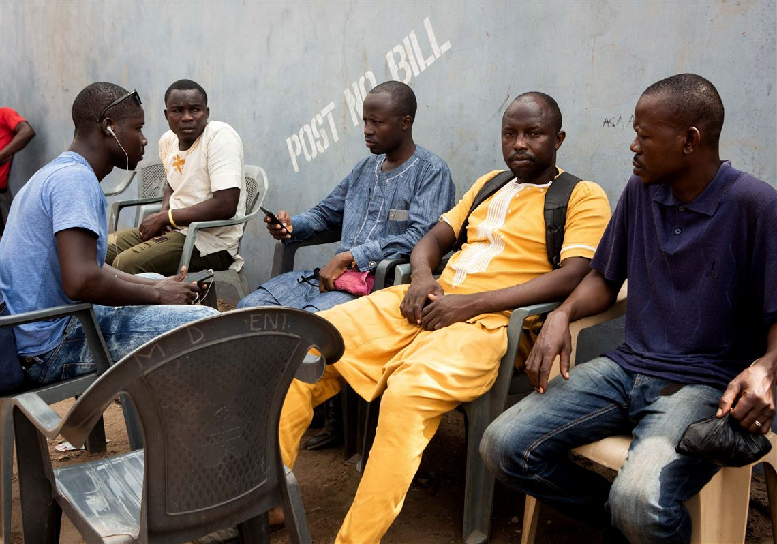
These are issues that people want’s to talk about… and let the authorities know how the average Ghanaian is really being affected by policies and projects…

Slide 4
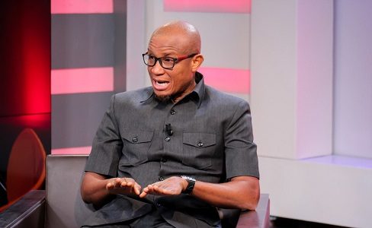
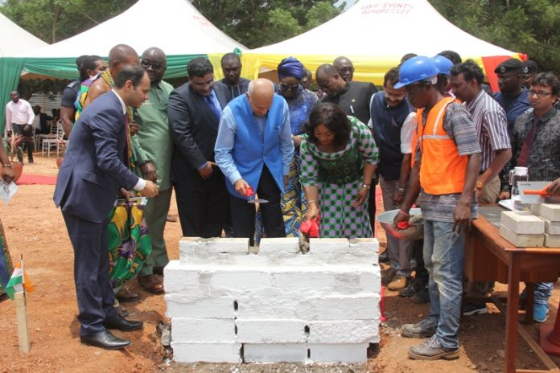

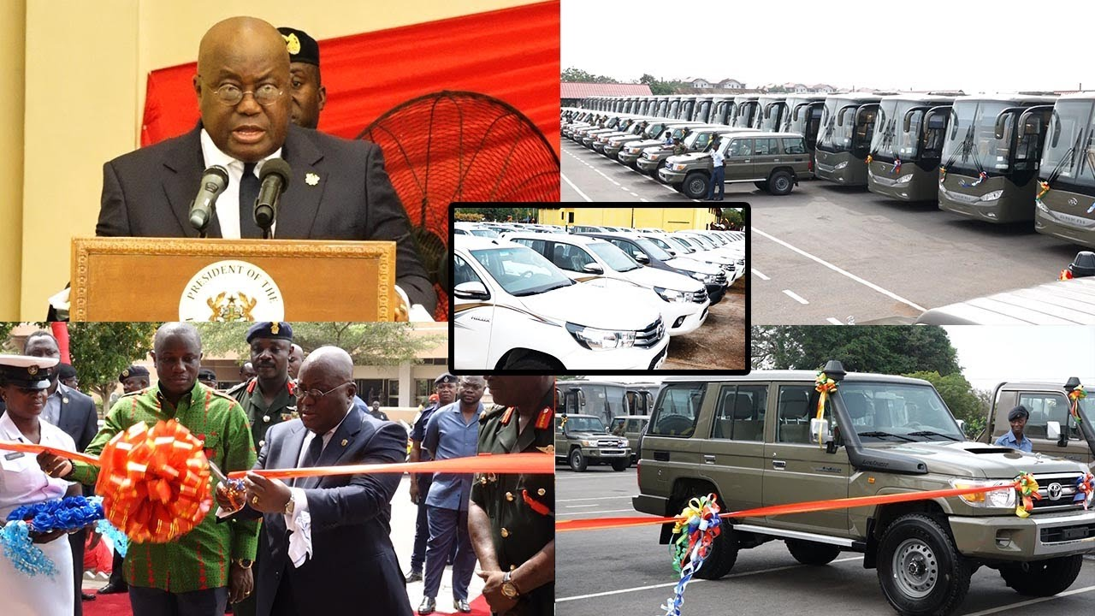
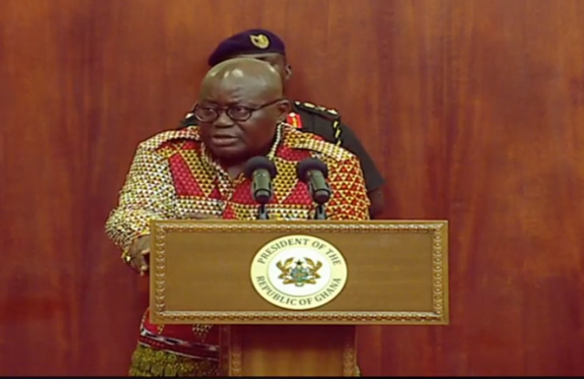

Slide 5
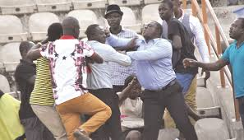
The media is always running and searching for what and who to report to… is the information that they get credible enough, what is being done about the issues that they report about

Slide 6

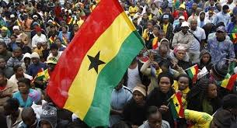

How do we connect these incredibly busy groups of people for sustainable nation building…

Slide 7
SpeakApp
Networking the nation

Slide 8



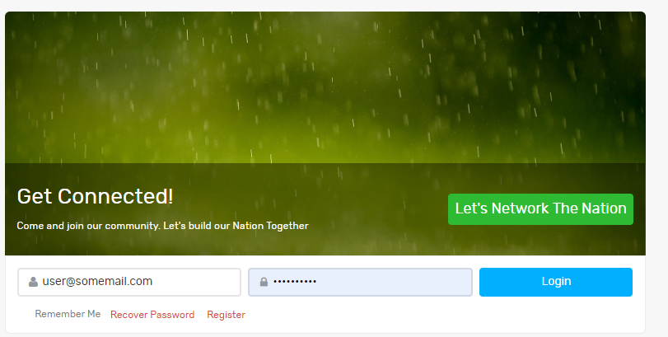

Basically what happens is this:

Slide 9
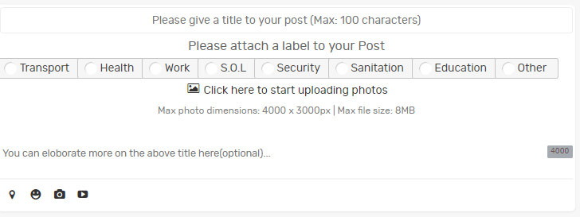
After login page:

Slide 10
Title bar and the title of your post:
The title bar gives a title and heading to you post to enable people know exactly what the post is all about

Slide 11
The label set:
The purpose of the label set it’s to give a particular label to the posted incident…

Slide 12

Browsing your files for the post:

Slide 13
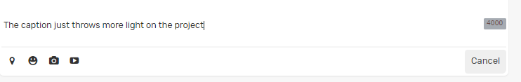
Adding an optional caption to your post:

Slide 14
After posting you can be you will see the post that you did:

