Slide 1
From signals to knowledge
An ISA-88 knowledge graph in Neo4j, fed from the automation layer by Litmus Edge
Munish Patwa · Working Student in Engineering (m/f/d)
Prepared for Givaudan Deutschland GmbH, Dortmund site · November 2026
Notes:
Thank you for the invitation. In the next 17 minutes I'll show you a concept for a plant knowledge graph: ISA-88 as the structure, Neo4j as the store, Litmus Edge as the data orchestrator. I did not stop at slides: I built a small working prototype with simulated data, and I'm happy to show it live at the end. Everything that is an assumption about your site is marked with an orange badge.

Slide 2
Today, "what happened in batch X?" needs six systems
PLC / SCADA
Historian
Batch system
MES / ERP
LIMS
CMMS
live values, alarms
time series
recipes, phases
orders, material lots
lab results, specs
work orders, devices
Each system knows its own part. Nobody knows how the parts connect.
A typical QA question after a temperature deviation
hours
→ seconds
Which raw material lots went into the batch, and where did its product go?
Was the sensor itself at fault? has it misbehaved before?
Is the same device model installed elsewhere?
manual cross-referencing of exports, paper batch records and maintenance notes vs. one graph query
⚠ Assumption
Notes:
The starting point in most batch plants: data exists, but in silos. The PLC knows the temperature, the batch system knows the phase, the MES knows the lots, the LIMS knows the lab results, the CMMS knows which transmitter is installed. When QA asks the questions on the left after a deviation, someone cross-references exports by hand. My assumption is that this takes hours; I'd love to hear how long it takes at Dortmund today. The value of a knowledge graph is not more data – it is the connections between data we already have.

Slide 3
Target vision: one connected model of plant, process and history
Production & QA
Maintenance
Engineering
Digitalization
Genealogy + process context in one query
Deviation context: phase, equipment, alarms
Faster batch-record review
History per position and per device
Failure patterns across the same model
From reactive to condition based
Single structured plant model (ISA-88)
Impact analysis before changes
Onboarding: the plant is explorable
Reusable foundation for analytics
Context for AI assistants (GraphRAG)
Same model for every new Process Cell
< 1 min
1 model
0
cross-system batch question (today: hours)
ISA-88 structure for engineering, maintenance and QA
write paths back into the control layer
⚠ Assumption
Notes:
The target picture is one connected model that every role can query. For production and QA: genealogy plus process context – not only which lots went in, which the ERP may already answer, but also the phase, equipment and sensor history behind them, in one query.For maintenance: history per position and per physical device. For engineering: the plant structure in one place, following ISA-88. And for digitalization: a foundation – the same graph later gives an AI assistant the context it needs. The 'less than a minute' is an assumption; the prototype answers it in milliseconds, but real data quality decides this.

Slide 4
ISA-88 gives the structure: where (physical) and how (procedural)
Physical Model explains where
Procedural Model explains how
⚠ Example plant
Enterprise
Givaudan
Procedure
Master Recipe "Citrus Base" v3
Site
Dortmund
Unit Procedure
Reaction
Area
Production
Operation
React
Process Cell
PC-01 Compounding
Phase
Heat to 85 °C
Unit
Reactor R-101
The link is what makes it a graph
Equipment Module
R-101 Temp. Control
Unit Procedure runs on a Unit
Phase runs on an Equipment Module
Recipe = what should happen · Batch = what did happen
Control Module
TT-101 (temperature)
Notes:
Quick recap of ISA-88. The physical model describes where things happen – down to the Control Module, a single transmitter or valve. The procedural model describes how – a recipe broken down into unit procedures, operations and phases. Two points matter for the graph: first, the two models are linked – a phase runs on an equipment module. Second, ISA-88 separates the recipe, what should happen, from the batch, what actually happened. A tree alone would fit in a relational table. These cross-links are why a graph database pays off. The example plant – PC-01 with a reactor, a mixer and a tank – is my assumption.

Slide 5
Data model: ISA-88 as a property graph in Neo4j
Physical Model
Execution: what happened
Procedural Model: what should happen
:Equipment:Enterprise
CONTAINS {validFrom}
:Equipment:Site
:MaterialLot
:Equipment:Area
CONSUMED / PRODUCED
:MasterRecipe
FOLLOWS
:Equipment:ProcessCell
:Batch
:UnitProcedure
:Equipment:Unit
HAS_PHASE_RUN
:Operation
:Equipment:EquipmentModule
EXECUTED_ON
:PhaseRun
INSTANCE_OF
:Phase {sp_*}
:Equipment:ControlModule
DURING
RAISED_BY
Two labels per node
:Alarm
(:Equipment:Unit) → "everything below Area X" at any depth
:Tag
:PhysicalDevice
Position ≠ device
ON
TT-101 is a Control Module; the transmitter is a PhysicalDevice
↑ HAS_TAG
↓ INSTALLED_AT {from,to}
:WorkOrder
No raw time series
PhaseRun-[:MEASURED {min,max,avg}]→Tag; values stay in TimescaleDB
Notes:
Here is the model. Three groups. Left, the physical model: every equipment node carries a generic Equipment label plus its ISA-88 level, connected with CONTAINS. Right, the procedural model: Master Recipe down to Phase, with the setpoints as properties. In the middle, the execution: a Batch FOLLOWS a recipe, has Phase Runs, each an INSTANCE_OF a recipe phase and EXECUTED_ON an equipment module. Material lots hang off the batch, alarms are RAISED_BY a control module and linked to the Phase Run that was active. Three decisions I want to highlight: two labels per node lets me query any depth even if the hierarchy changes. A position is not a device – that's what makes the maintenance use case work. And raw time series stay out of Neo4j: the graph stores aggregates and a reference.

Slide 6
Architecture: Litmus Edge orchestrates, data flows upwards only
Level 0–2 · Field & control
Level 3 · Site operations
Level 3.5 · Industrial DMZ
Level 4 · Enterprise IT
Sensors / actuators
Litmus Edge
MQTT broker
CMMS / ERP export
4–20 mA, IO-Link, Profibus
DeviceHub drivers: OPC UA, Modbus, S7
Normalise + map to UNS topic
Buffer (store & forward)
Outbound only to LEM
TLS 8883 · ACL per client
work orders, devices
Sync job
PLCs
Ingest service
watermark + Cypher MERGE
S7, Modbus TCP, OPC UA server
idempotent writes, topic check
Neo4j knowledge graph
SCADA / batch system
TimescaleDB
Bolt over TLS · RBAC
phase & batch events, alarms (OPC UA A&C)
staging + raw time series
(prod: existing historian)
MES (lots, orders)
ISA-95 level 3 via REST/SQL
Apps
Streamlit · Browser · BI / AI
⚠ Site systems
Unified Namespace topic = ISA-88 path
Raw values → TimescaleDB; only context → Neo4j
New equipment appears via its topic, but is only accepted if it exists in the Engineering Master List
Prototype: every box is a container; Litmus Edge simulated with its real payload format
givaudan/dortmund/production/pc01/r101/r101-temp/tt101/pv
{"deviceName":"PLC-PC01","tagName":"TT101.PV",
"value":85.2,"timestamp":1792345200000,"success":true}
Notes:
The architecture follows the Purdue model from left to right. Litmus Edge sits at level 3: it connects to the PLCs and the batch system with its DeviceHub drivers – OPC UA, Modbus, S7 – normalises the tags and publishes them on topics that follow the ISA-88 path. That's the Unified Namespace. In the DMZ, an MQTT broker receives everything over TLS; an ingest service writes raw values and events into TimescaleDB, which serves as staging and time-series store – in production that could be the existing historian. On the IT side, a sync job pulls new events every few seconds using a watermark and writes them into Neo4j with MERGE, so it can always be re-run safely. Master data – the equipment list, recipes, CMMS – comes in as a second input. Litmus also has a native PostgreSQL connector, so the MQTT hop could be removed; I kept MQTT because it decouples consumers.

Slide 7
Security: zones and conduits, no write-back, least privilege
OT/IT separation (IEC 62443 zones)
Litmus Edge in L3, broker + time series in the DMZ, graph in IT. Firewalls on both sides of the DMZ; no direct IT→OT path.
The recipe is the crown jewel
Setpoints (sp_*) live only on Phase nodes
Property level privileges hide them from non-production roles
Maintenance sees equipment + history, not formulas
All queries audited (query log)
One-way data flow
Connections are only opened from the lower zone outwards. The graph never writes back to the control layer and insights reach the plant through people and the CMMS.
Encryption & identity
TLS on MQTT, SQL and Bolt; certificate per edge device; broker ACLs (edge may only publish, ingest only subscribe); secrets in a vault.
Access to the knowledge graph
DENY READ {sp_temperature_c, sp_amount_kg}
ON GRAPH plant NODES Phase TO maintenance_reader;
Neo4j Enterprise RBAC: sync = only writer; engineering / maintenance / QA = read roles; SSO via AD / Entra ID.
Demo runs Neo4j Community (no RBAC); roles shown as concept.
Notes:
Security is non-negotiable in OT, so the design starts from zones and conduits as in IEC 62443. Data moves only upwards and outwards; nothing in IT can open a connection into the plant network, and the graph has no write-back. If the graph is wrong or compromised, production is unaffected. That's a conscious trade-off: we give up closed-loop automation for now. For the graph itself: TLS everywhere, the sync service is the only writer, and people get read roles via SSO. And because this is a flavours and fragrances company, the recipe is intellectual property – Neo4j Enterprise can hide the setpoint properties from roles that don't need them.

Slide 8
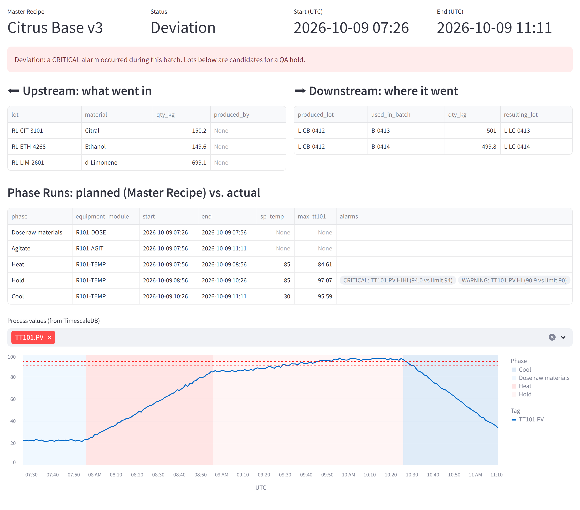
Use case 1 – traceability: B-0412 ran too hot. What is affected?
1
HIHI alarm on TT-101 during Hold
Alarm -[:DURING]→ PhaseRun links it to the batch
2
Upstream
which raw material lots went in
3
Downstream
L-CB-0412 → B-0413, B-0414 → product lots on QA hold
MATCH (b:Batch {id:'B-0412'})-[:PRODUCED]->(l0)
MATCH path = (l0)
((:MaterialLot)<-[:CONSUMED]-(:Batch)
-[:PRODUCED]->(:MaterialLot)){0,5}
RETURN [n IN nodes(path) | n.id]
One query, any number of genealogy levels in SQL this is a recursive join across MES, batch and historian data.
Live demo available · simulated data
Notes:
Let me make this concrete with one story that runs through all use cases. Batch B-0412, Citrus Base, raises a high-high alarm on TT-101 during the Hold phase. Because the alarm is linked to the Phase Run, and the Phase Run to the batch, the graph immediately gives QA the full picture: which raw material lots went in, which intermediate lot came out, and that this lot was used in two Lemon Compound batches whose product lots should go on hold. The Cypher on the left is the whole genealogy – one quantified path pattern, any depth. The screenshot is from my prototype; the temperature curve below comes from TimescaleDB, located through the graph.

Slide 9
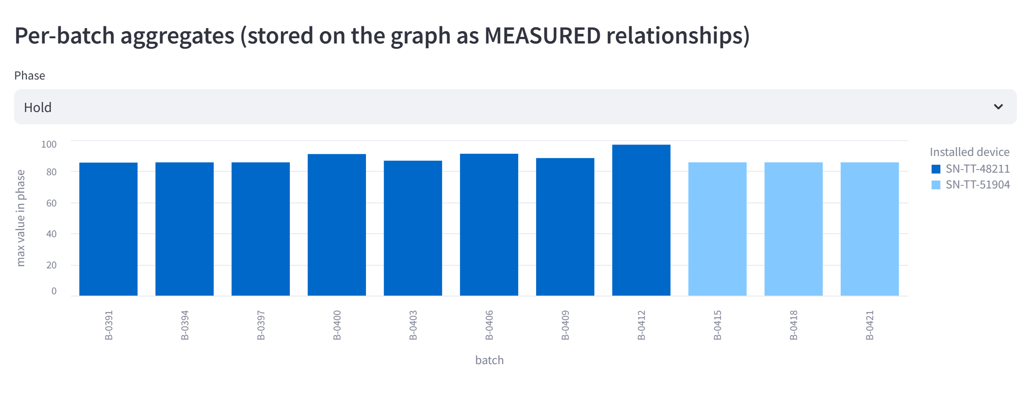
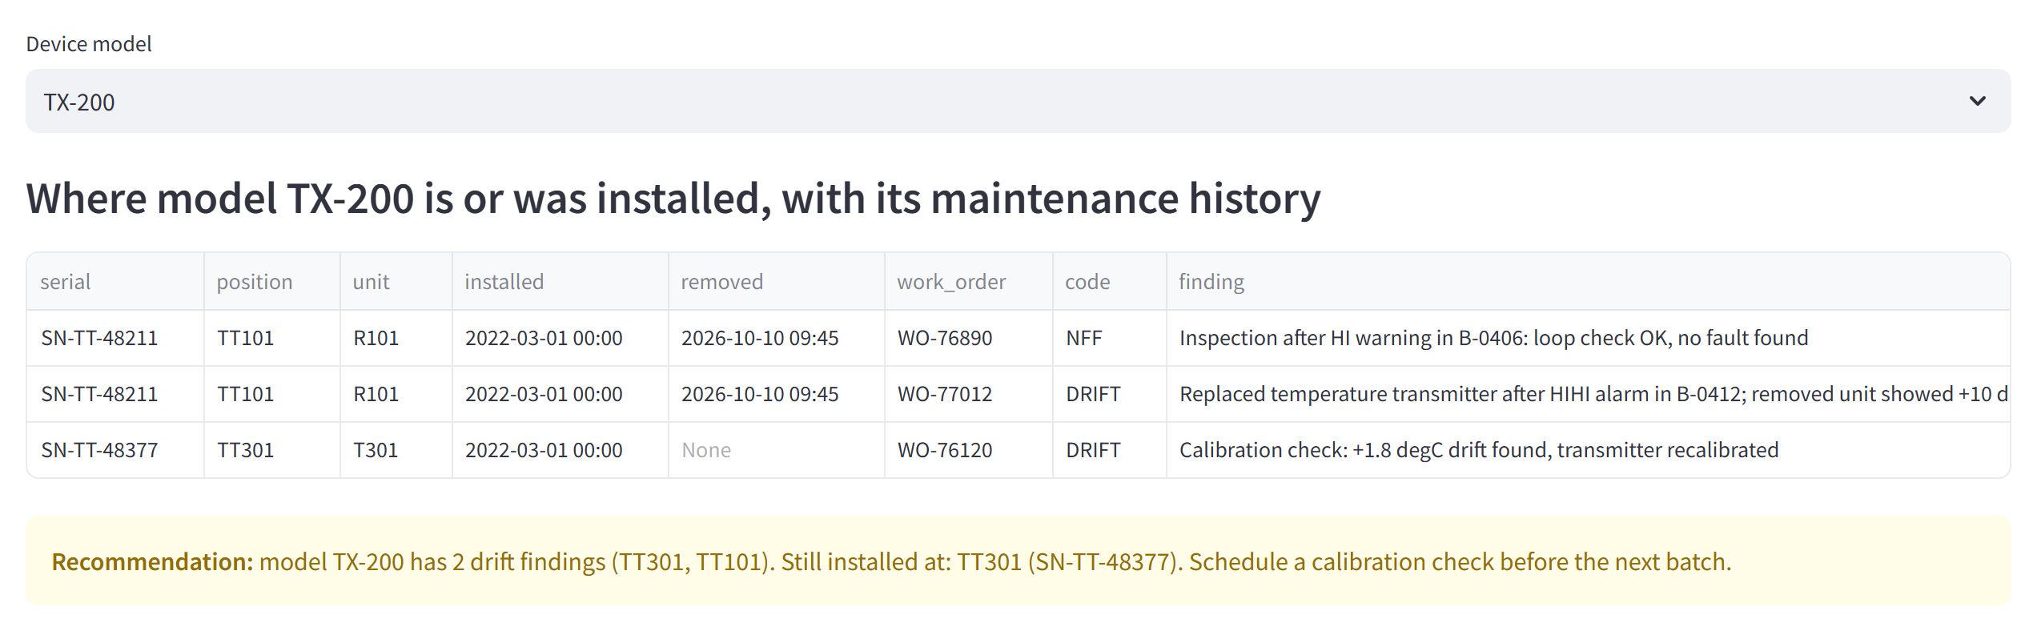
Use cases 2 + 3 – find the cause, prevent the next failure
Fault analysis
Maintenance knowledge
Was it the process or the sensor? TT-101 already warned in B-0400 and B-0406 the work order then said "no fault found".
The removed transmitter was model TX-200. The same model still runs at TT-301 which drifted once before.
(alarm:Alarm)-[:RAISED_BY]->(cm)<-[i:INSTALLED_AT]-(d:PhysicalDevice)
WHERE i.from <= alarm.time AND (i.to IS NULL OR alarm.time < i.to)
→ Recommendation: calibrate TT-301 before its next batch
Notes:
The same graph answers the next two questions without any new integration. Fault analysis: was it the process or the sensor? The alarm history shows TT-101 warned twice before, and the maintenance check then found nothing. Because aggregates per phase are stored on the graph, I can plot the peak temperature per batch and colour it by the physical device that was installed – the drift is obvious, and it disappears after the replacement. Maintenance knowledge: the removed transmitter was model TX-200. The graph knows the same model is installed at TT-301, which had a drift finding before. So instead of waiting for the next alarm, maintenance can calibrate it proactively. That's the step from reactive to preventive.

Slide 10
Scalability & maintainability: grow by adding, not by migrating
More Process Cells in Dortmund
New data types
A new Process Cell = new rows in the Engineering Master List + its tags mapped in Litmus Edge. The UNS path and the graph model stay the same.
A new source = new labels + relationships + one loader. Existing queries keep working, no need for schema migration (e.g. quality results, energy, CIP cycles).
Changes to the hierarchy
Data volume & performance
CONTAINS carries validFrom / validTo: a Unit moved to another Process Cell keeps its history. The Engineering Master List stays the single owner.
Raw time series never enter Neo4j; per-phase aggregates do. Indexes on ids and times. Sync scales out from polling to CDC (Debezium → Kafka → Neo4j connector).
MATCH (pc:ProcessCell)-[r:CONTAINS]->(:Unit {id:'M201'})
WHERE r.validFrom <= date($asOf) AND (r.validTo IS NULL OR date($asOf) < r.validTo)
Notes:
How does it grow? Within Dortmund, a new Process Cell is just new rows in the engineering master list and its tags mapped in Litmus Edge; because the topic path and the graph both follow ISA-88, it is the same model again. New data types are just new labels and relationships – no migration, existing queries keep working. Hierarchy changes are handled by validity periods on CONTAINS, so history stays correct – the query at the bottom answers 'where was M-201 at that date'. And performance: the expensive data – raw time series – never enters the graph. If polling gets too slow, the sync moves to change data capture with Kafka.

Slide 11
Challenges & open questions – and how I'd address them
Challenge
Risk / open question
Mitigation
Master-data quality
Tag names and hierarchy are inconsistent in legacy systems
Start with one Process Cell; Engineering Master List as owner; unknown topics flagged, not auto-created
PLC connectivity
Mixed PLCs / DCS, incomplete tag docs; direct access may need PLC changes
Read via the existing SCADA/DCS OPC UA server, no PLC changes; small tag set, slow polling
OT change management
New edge connections touch validated control systems
Read only drivers, no write back, change requests with automation team, test on a non production line
Ownership & adoption
Who maintains the model? Will people use it?
Clear data owners per source; build use cases with QA and maintenance, not for them
Licences & skills
Litmus, Neo4j Enterprise, Cypher know-how
Pilot on Community / trials, measure value, then decide; short Cypher training
Notes:
Where could this fail? Honestly, mostly not in the technology. The biggest risk is master data: in brownfield plants tag names and hierarchies are inconsistent, so I'd start small and make the engineering master list the owner. Second, connectivity: plants mix PLC and DCS types, tag documentation is often incomplete, and direct PLC access can mean changing the PLC itself. So I'd read through the existing SCADA or DCS OPC UA server first, with a small tag set and slow polling. Third, any new connection to control systems needs proper OT change management. And finally ownership and adoption – the graph is only as good as the people maintaining it. These are also my open questions to you: how are tags and hierarchies maintained in Dortmund today?

Slide 12
Start small, prove value, then extend
Pilot on one Process Cell with one use case, the model and pipeline repeat for every cell in Dortmund
0–3 months
3–9 months
9+ months
Pilot
Extend
Deepen
PC-01 · batch traceability · read-only · measure query time vs. today
all Process Cells · CMMS integration · fault & maintenance use cases
more Dortmund sources (quality, energy, CIP) · AI assistant on the graph (GraphRAG)
Thank you!
Any Questions?
Notes:
To close: I'd start with a pilot on one process cell and one use case – traceability – read-only, and measure the time saved against today. If that holds, extend to all Process Cells in Dortmund and bring in the CMMS for the maintenance use cases; then add further Dortmund sources such as quality and energy data. The long-term payoff is that the graph becomes the context layer for AI assistants. Thank you – I'm happy to take questions, or to show you the prototype running live.

Slide 13
Backup: assumptions used in this concept
⚠ Plant
Process Cell PC-01 "Compounding" with Reactor R-101, Mixer M-201, Storage Tank T-301; 25 equipment nodes
⚠ Automation
Batch control system with OPC UA access to tags, phase/batch events and alarms (e.g. SIMATIC Batch or similar)
⚠ Time series
An existing site historian could replace TimescaleDB; the graph only stores a reference
⚠ IT systems
MES at ISA-95 level 3 provides material lots; SAP PM (or similar) exports work orders and installed devices
⚠ Recipes
"Citrus Base" (intermediate) feeds "Lemon Compound"; setpoints and recipes are invented
⚠ Numbers
"Hours → seconds" and the pilot timeline are estimates to be validated with the site
⚠ Prototype
Litmus Edge simulated with its documented payload format; real Litmus Edge Developer Edition tested separately
Notes:
Backup slide – all assumptions in one place.

Slide 14
Backup: node types, relationships and key properties
Label | Properties | Relationships
Equipment (+ level label) | id, name, level | CONTAINS {validFrom, validTo}
Tag | id, topic, engUnit, limits, timeSeriesStore | (ControlModule)-[:HAS_TAG]->(Tag)
PhysicalDevice | serial, model, manufacturer | INSTALLED_AT {from, to} → ControlModule
MasterRecipe / UnitProcedure / Operation / Phase | id, name, version, sp_* setpoints | HAS_UNIT_PROCEDURE / HAS_OPERATION / HAS_PHASE, RUNS_ON
Batch | id, start, end, status | FOLLOWS, HAS_PHASE_RUN, CONSUMED / PRODUCED {qtyKg}
PhaseRun | id, start, end, actual_* | INSTANCE_OF, EXECUTED_ON, MEASURED {min, max, avg}
MaterialLot / Material | id, name | OF_MATERIAL
Alarm | id, time, level, severity, value, limit | RAISED_BY, DURING
WorkOrder | id, created, completed, failureCode | ON, TRIGGERED_BY, REMOVED / INSTALLED
Notes:
Backup slide – reference for questions on the data model.

