Slide 1

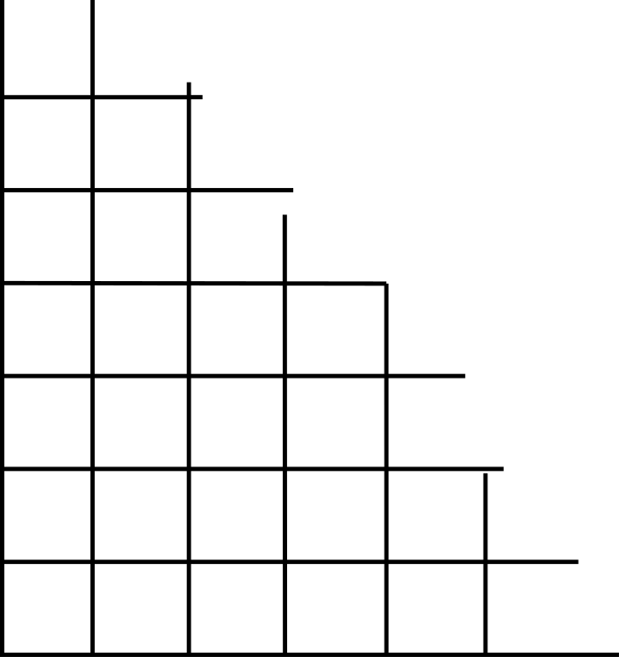
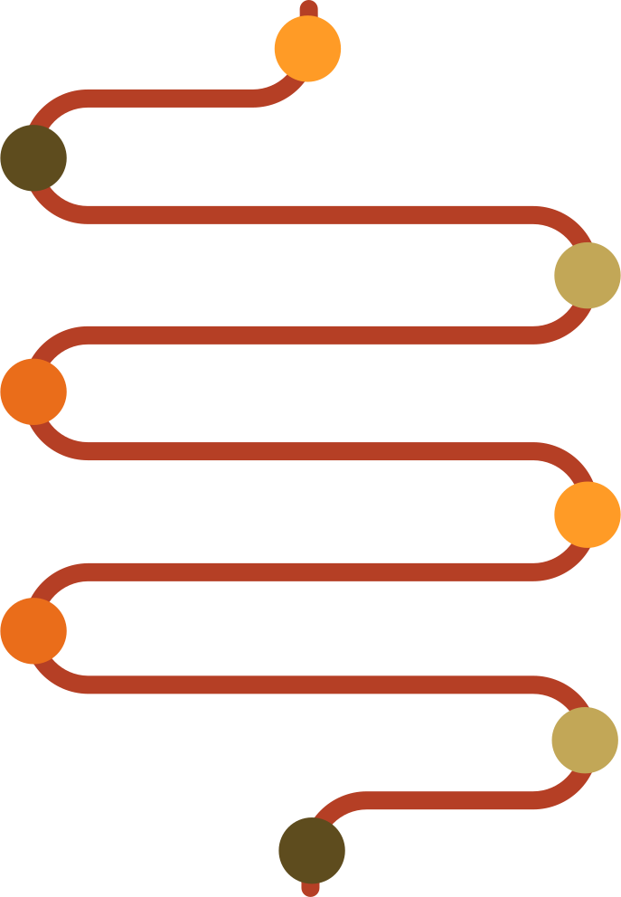

Inference of protein secondary structure motifs
Predicting α-helix secondary structure
Group 10 · Alsu Alimzanova, Nazrin Azizova, Munish Patwa, Rohit Stanly

Slide 2

What are we trying to predict?
A protein consists of a sequence of amino acids from the 20 standard types (A, L, G, E, K, …).
Each amino acid represents either an alpha-helix or other structures. The goal is to calculate the probability of a helix, P(helix), for each position of the amino acids. This process does not involve predicting the amino acid letters; instead, the letters serve as the input.
Input: amino-acid sequence
A L G E K M V
Output: probability of helix at each position
0.05 0.14 0.72 0.83 0.20 ...
Given the protein letters, we estimate which parts are likely to be α-helices.

Slide 3

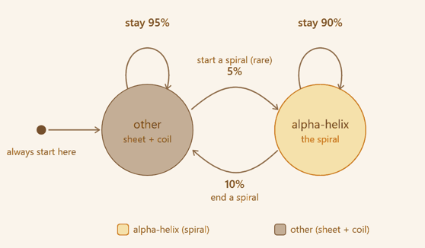
The two-state HMM: how hidden structure changes
Setup:
Two hidden states: alpha-helix and other.
Every simulated chain starts in other.
Helices appear as continuous segments, not isolated random points.

Slide 4
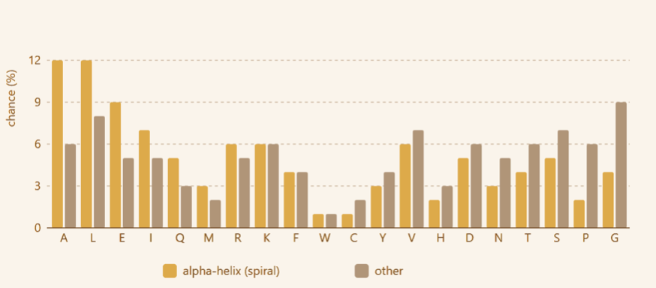
How hidden states produce amino acids?
Yellow bars: P(amino acid | alpha-helix). Grey bars: P(amino acid | other).
A and L are more common in helix while G and P are more common in other.
A can still appear in other, and G can still appear in helix.
Forward–Backward uses these probabilities together with the transition rules.

Slide 5
Where Simulation-Based Inference appears?
1. Simulator makes fake protein chains with known hidden states.
2. Forward–Backward computes exact HMM posterior probabilities: P(helix | sequence).
3. BayesFlow studies many pairs: sequence window → posterior probability.
4. After training, test performed on human insulin
5. Evaluation compares BayesFlow, Forward–Backward, and known ground truth.
SBI idea: when real labeled data are limited or inference is costly, use a simulator to generate training examples

Slide 6
Forward-Backward
How it works?
we provide input: one amino-acid sequence from the simulator.
and expect output: one probability per position: P(helix at position i | whole sequence).
These probabilities are called gamma/posteriors in the HMM.
They are exact for the fixed HMM, BayesFlow is trained to reproduce them.
Important: exact for the HMM does not mean perfect biological truth.
Example
Sequence: A L G E K
FB output: 0.03 0.28 0.65 0.82 0.20
Forward-Backward is a teacher
BayesFlow is a student
On simulated data, FB reached AUC ≈ 0.798 vs true hidden states — this is the HMM ceiling because emissions overlap.
On simulated data, exact FB achieves AUC ~ 0.798 vs true hidden states. This is the HMM ceiling because helix/other emission tables overlap

Slide 7



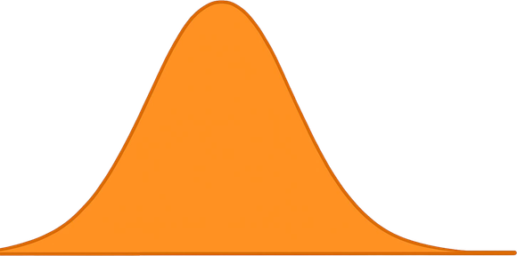


BayesFlow learns from local sliding windows
P(helix) for center residue
A K L A E E L A L G S T
sliding window: 31 residues (±15)
center on the residue
posterior mean ± uncertainty
CouplingFlow outputs a posterior distribution, summarized by mean ± uncertainty.
Sliding the window along the chain gives one prediction per residue.
one-hot encoding
CouplingFlow
31 positions x 21 channels
(20 amino acids + 1 padding)
amortized posterior

Slide 8
How we fitted BayesFlow
Training target | Forward-Backward P(helix), as logit
Input | 31 x 21 one-hot sliding window
Network | BayesFlow CouplingFlow
Training data | around 300,000 windows from 15,000 chains
Regime | offline, Adam, 30 epochs, batch 512
Validation | held-out tail block - no leakage (asserted)
Interpretation: BayesFlow is not trained directly on real labels. It is trained to imitate the exact HMM posterior produced by Forward-Backward

Slide 9

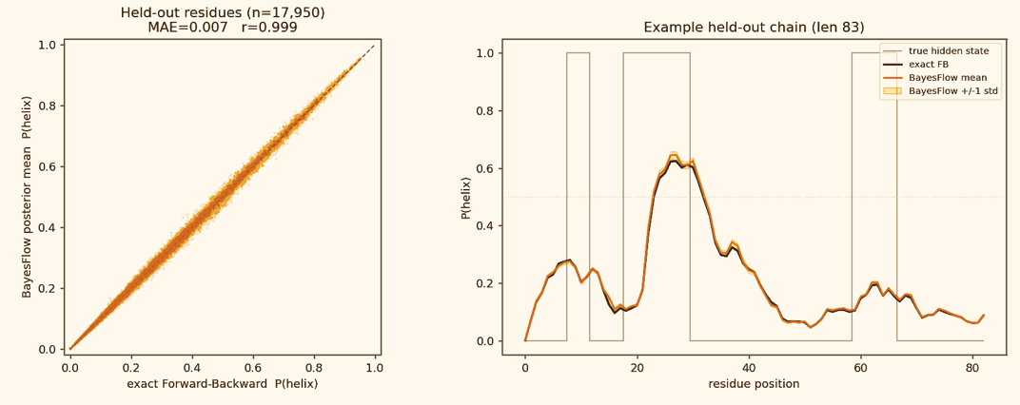
Held-out simulated validation
BayesFlow near-perfectly reproduced exact Forward-Backward on unseen simulation.
Results:
correlation r = 0.999 and MAE = 0.007
BayesFlow is interchangeable with FB for this HMM.

Slide 10
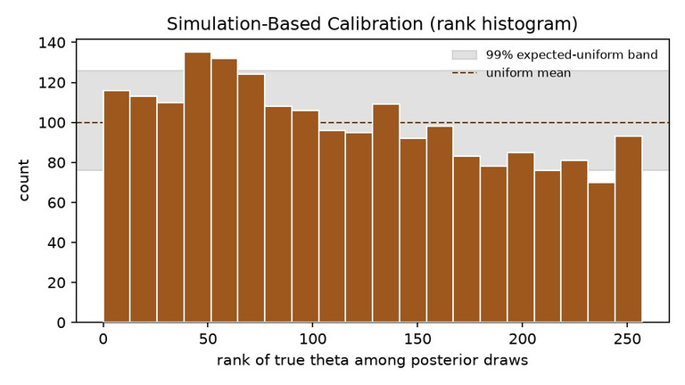
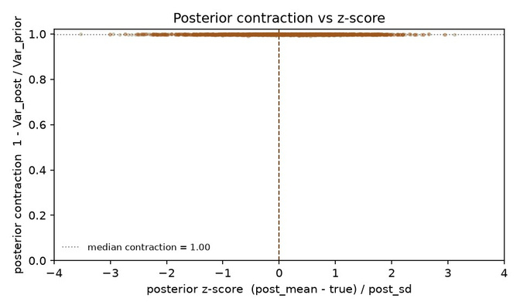
Is the posterior trustworthy?
2 checks: calibration (SBC) and posterior contraction
SBC rank histogram - calibration
Posterior contraction vs z-score
Posterior contraction ~ 1.0 - the window removes almost all prior uncertainty
Calibration is close, but SBC is not flat - a small location bias, not an over-narrow posterior
This is not a bug: it is a tunable accuracy-calibration trade-off (next slide)

Slide 11
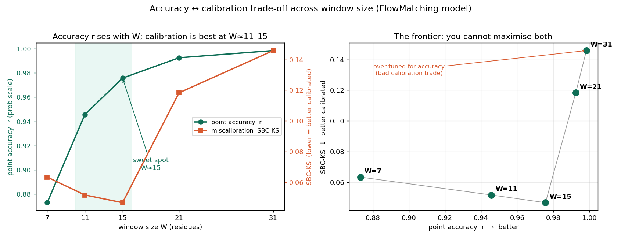
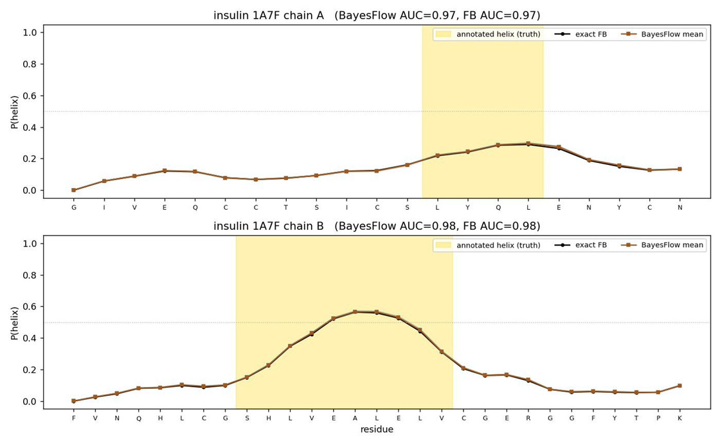
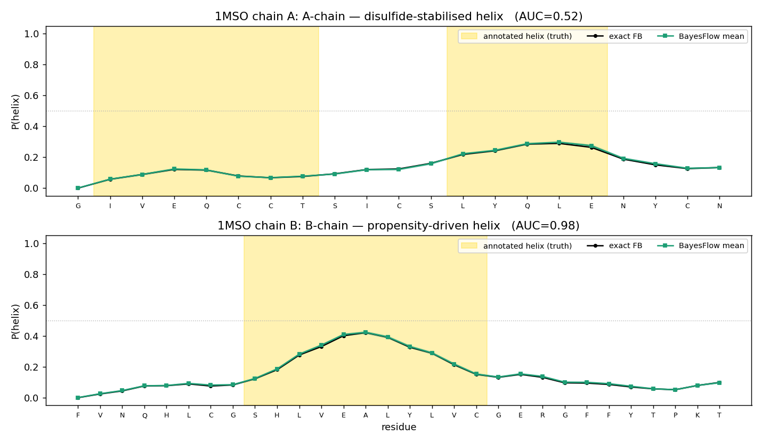
The accuracy-calibration trade-off
We swept the window size W in {7,11,15,21,31} and measured point accuracy (r) and calibration (SBC-KS)
Accuracy rises with W (r 0.87 -> 0.998); calibration is U-shaped, best at W=11-15 then degrades 2-3x
W=15 is the knee: near-top accuracy (r 0.976) AND best calibration - a knob to tune, not a defect

Slide 12
First real protein: human insulin
trained only on simulation
Wild-type insulin (1MSO): P(helix) rises inside the annotated B-chain helix
B-chain AUC 0.98, but A-chain 0.52 (chance) - BayesFlow and exact FB agree
A-chain helix is likely disulfide-stabilised (consistent with the data); a sequence-only HMM cannot see 3-D bonds
P(helix): BayesFlow vs exact FB; gold band = annotated helix (truth)

Slide 13
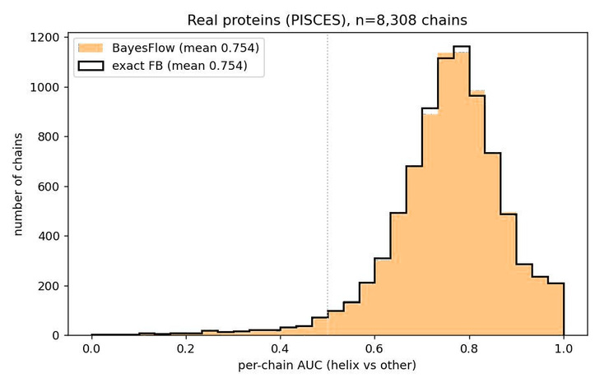
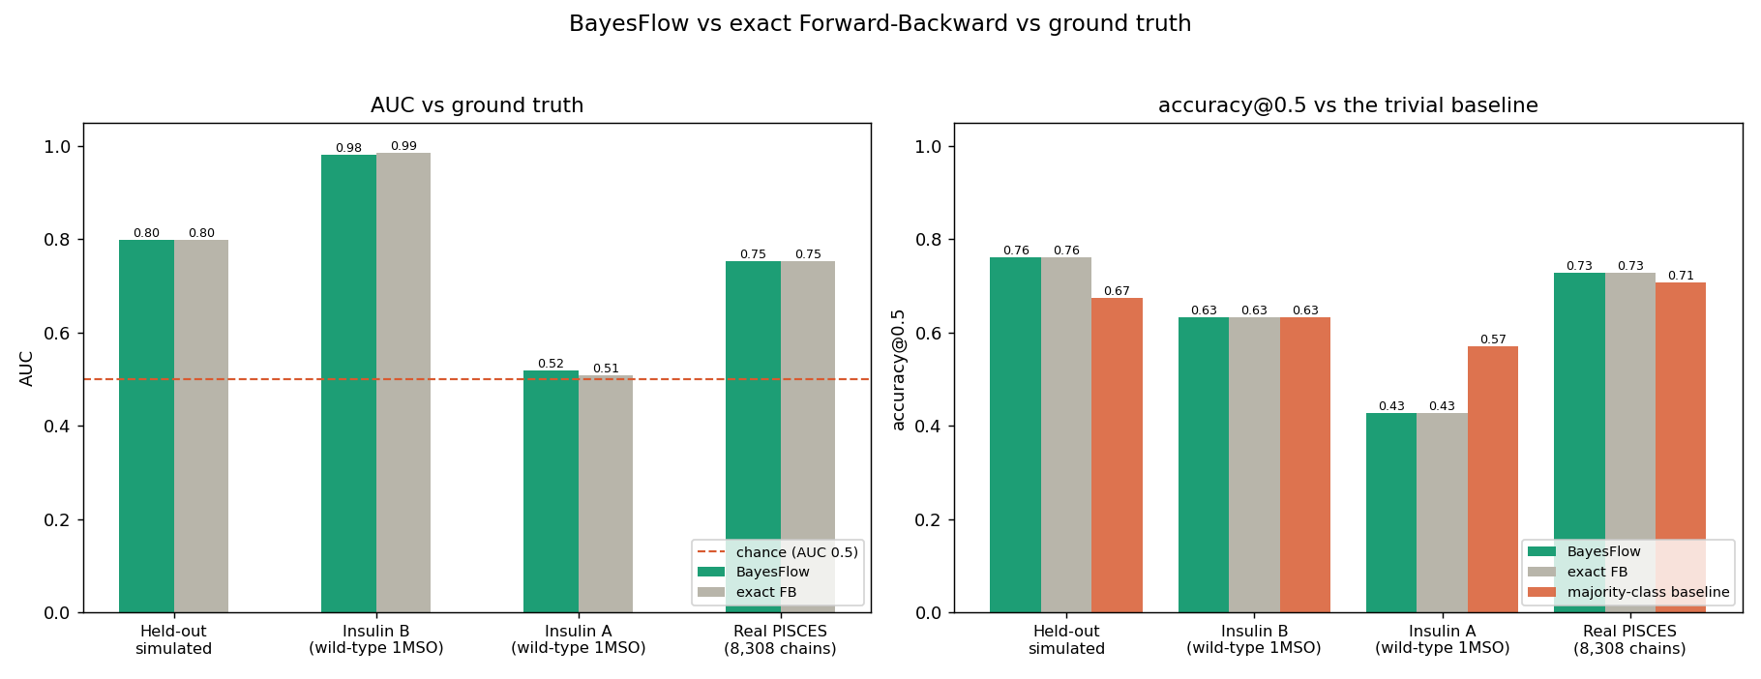
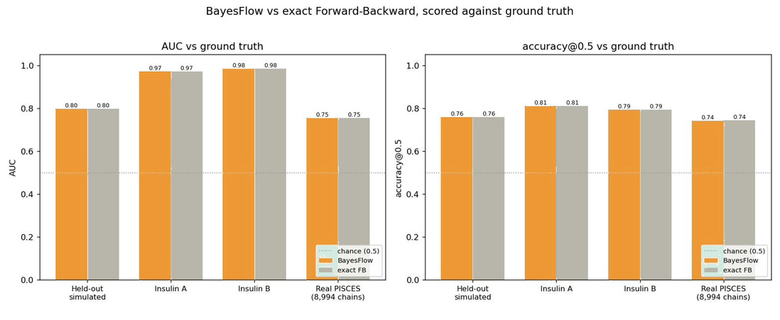
Does it hold across the real proteome?
All 8,994 real PISCES chains - BayesFlow vs exact Forward-Backward.
Per-chain AUC over real chains - BayesFlow = exact FB
AUC & accuracy across all four settings - BayesFlow vs FB
Scored all 8,994 real chains; per-chain AUC 0.75 over the 8,308 with both classes
BayesFlow = exact FB everywhere ( held-out, insulin, PISCES)
Held-out sim: correlation 0.999 with FB - interchangeable

Slide 14

Summary
BayesFlow reproduces the exact HMM posterior.
BayesFlow learns the HMM world only, not the real biology.
Real-data AUC around 0.75 shows useful signal
What BayesFlow
Can do
Cannot do
Fast amortized approximation of Forward-Backward posteriors
Recover biological structure that is absent from the simulator
munish.patwa@tu-dortmund.de · rohit.stanly@tu-dortmund.de
nazrin.azizova@tu-dortmund.de · alsu.alimzanova@tu-dortmund.de

