Slide 1
α
SIMULATION-BASED INFERENCE · TU DORTMUND
Predicting α-helix secondary structure
A two-state Hidden Markov Model fit with amortized BayesFlow inference
Group [ number ]
[ Member 1 ] · [ Member 2 ] · [ Member 3 ]
Notes:
Title slide. State the goal in one line: predict per-residue alpha-helix probability from an amino-acid sequence, using a fixed two-state HMM and a BayesFlow amortized posterior. Replace the group number and member names.

Slide 2
Roadmap
1
The question Predict α-helix vs other from sequence
2
Forward–Backward Exact per-residue posterior as training targets
3
BayesFlow Amortized neural posterior via a sliding window
4
Insulin & real evaluation Held-out real proteins vs ground truth
5
Comparison & results BayesFlow vs exact Forward–Backward
Notes:
Five sections. Keep this to ~15 seconds — it just sets expectations.

Slide 3
1
THE QUESTION
From amino-acid sequence to α-helix
Proteins fold; the local shape is the secondary structure (helix / sheet / coil).
We predict one thing: is each residue an α-helix, or 'other'?
Solving 3-D structure needs X-ray / NMR — expensive; we want it from sequence.
Our statistical model: a two-state Hidden Markov Model.
α-helix = state “H”
“other” = E B G I T S C
Mapping decision
DSSP labels each residue with 8 states. We keep only H as helix (strict α-helix); the other 7 → other.
Notes:
Introduce the topic and the exact prediction target. Emphasize the modeling choice: strict H-only helix definition (cleaner than merging G and I).

Slide 4
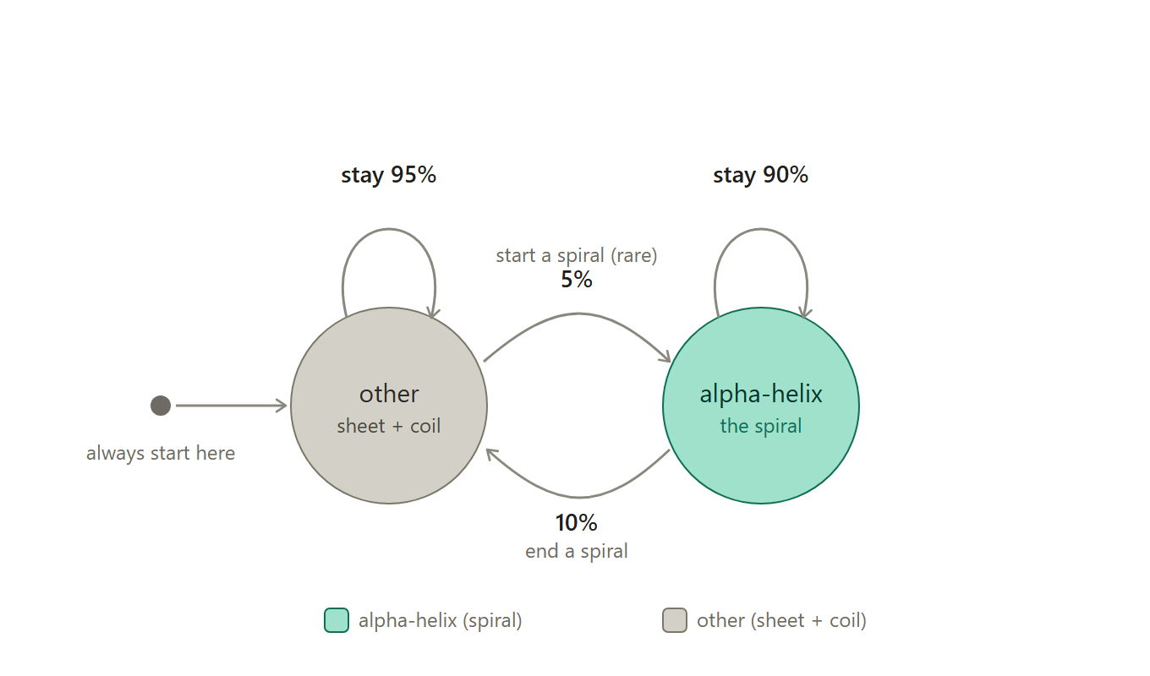
1
THE QUESTION
The generative model: a two-state HMM
The chain always starts in “other”.
Transitions: helix→helix 0.90, other→helix 0.05.
So helices form ~10-residue runs, and are started rarely.
Realistic: real data gives 0.912 and 0.041 (see next slide).
Prior & likelihood
No parameters are inferred — all fixed. The prior is the induced distribution over hidden state paths p(z₁:T), from start = [0,1] and the transition matrix. The likelihood is the emission table.
Fig 1. Two-state HMM: start rule and transition probabilities.
Notes:
Explain the statistical model. Point at the self-loops (0.90 / 0.95) and the cross arrows (0.05 / 0.10). The 0.90 stay-probability is what makes helices come in runs. LIKELY QUESTION: 'where is your prior?' — the report spec demands explicit priors, but we infer no parameters. Answer: the prior is the induced distribution over hidden state paths p(z_1:T) given startprob=[0,1] and the transition matrix; the likelihood is the emission table. In the amortized setup the effective prior over theta is the marginal of logit-gamma induced by simulating chains and running FB — which is exactly what SBC ranks against.

Slide 5
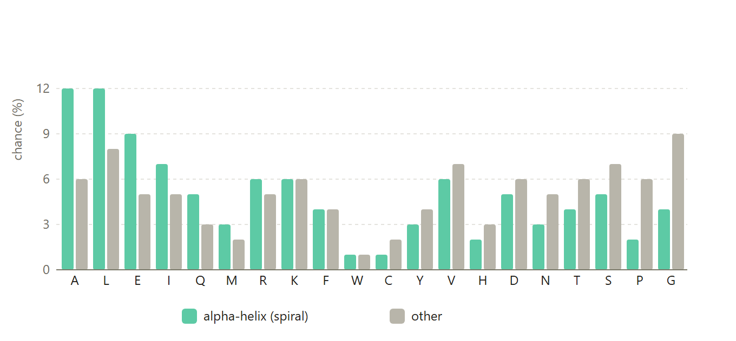
1
THE QUESTION
Emissions — and are they realistic?
Fig 2. Per-state amino-acid emission probabilities (α-helix vs other).
Yes — checked against real PISCES data: emissions match at r = 0.99 (max 0.9 pp off); transitions match too (P(h→h) 0.912 vs 0.90). Both tables are empirically well-founded.
Notes:
Each state emits amino acids with its own propensities (helix loves A,L,E; breakers G,P favor other). We measured the empirical P(amino acid | DSSP H vs non-H) from real PISCES and overlaid it on the given tables: correlation 0.992 (helix) / 0.982 (other), max deviation 0.9 pp. Transitions match too. So both halves of the model are grounded in data. (The old 'transitions-only' evidence was a mismatch with this slide's title — now fixed.)

Slide 6
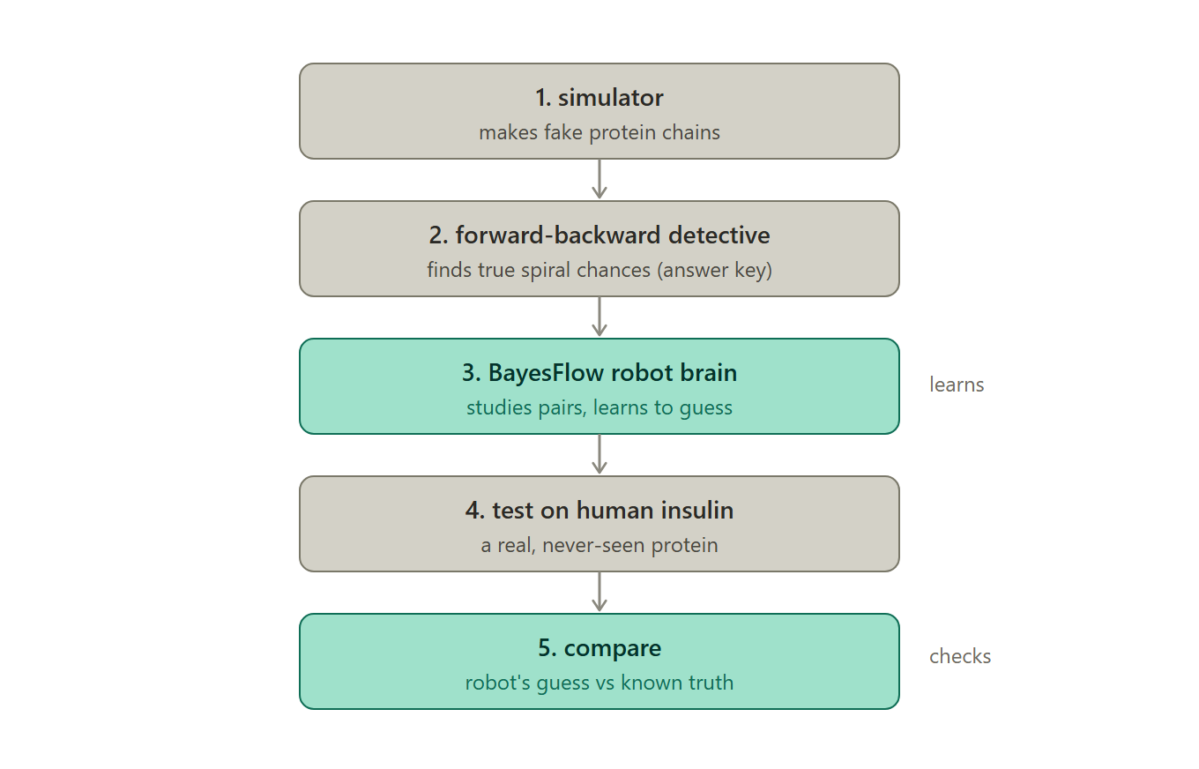
2
FORWARD–BACKWARD
Notebooks 1–2: simulate, then get exact targets
Simulate 100,000 chains; lengths sampled from real PISCES (median 208).
Run Forward–Backward (hmmlearn) → exact P(helix) per residue = training targets.
24.3M residues — the exact Bayesian “answer key”.
Checks: mean P 0.324; residue-0 = 0; recovers hidden states at the Bayes ceiling (AUC 0.79).
Fig 3. Full pipeline: simulator → Forward–Backward → BayesFlow → evaluation.
Notes:
Forward-Backward gives the exact posterior P(helix) for each residue given the whole chain. hmmlearn does this. These become the targets BayesFlow learns to emulate. The 0.79 AUC ceiling comes from overlapping emission tables — even exact inference can't separate helix/other perfectly.

Slide 7
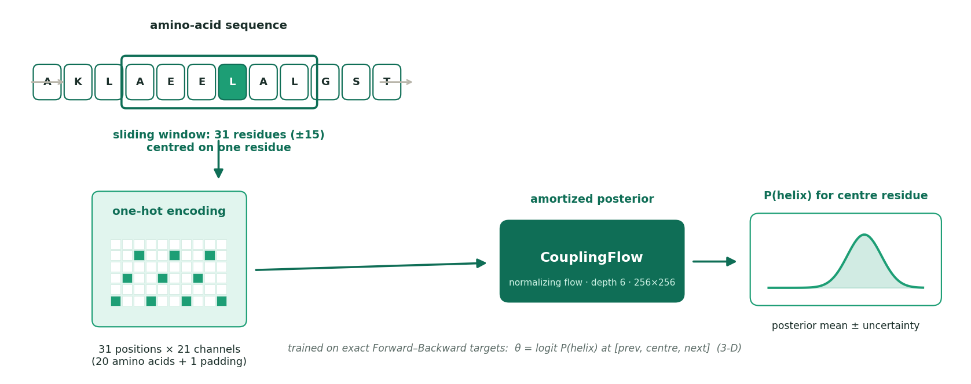
3
BAYESFLOW
Turning a variable-length chain into a fixed input
Fig 4. Sliding 31-residue window → one-hot encoding → CouplingFlow posterior.
Flow needs a fixed-size input → predict one residue from a fixed 31-residue window (±15), slid along the chain.
One-hot: 31 × 21 channels = 20 amino acids + 1 padding (chain ends).
Given the FULL sequence, γ is DETERMINISTIC (a point mass) — nothing to estimate. We condition on a LOCAL window so γ becomes uncertain → a genuine posterior to learn.
Why ±15 is enough
2nd eigenvalue λ₂ = 1 − 0.10 − 0.05 = 0.85 → influence decays geometrically: 0.85¹⁵ ≈ 0.09. Residues outside the window carry <10%. So r = 0.999 is expected, not suspicious.
Notes:
This is the key modeling idea. Flows need fixed dimensions, sequences vary, so we amortize one residue at a time through a fixed window and slide it. One-hot (not integer) because amino acids are categorical; padding marks chain edges. OWN THE MISMATCH: theta is gamma computed by FB from the WHOLE chain, but we condition on a 31-residue window — so the flow learns p(gamma_full | local window). Why that's harmless: the HMM's second eigenvalue is 1-0.10-0.05 = 0.85 (verified: eigenvalues are exactly [1.0, 0.85]), so message influence decays geometrically; at +/-15 residues 0.85^15 = 0.087, under 10%. Empirically, recomputing gamma from the window alone differs from full-chain gamma by a median of only 0.010. THIS is why r=0.999 is expected rather than evidence of leakage — have this ready, it is the obvious challenge to a near-perfect number.

Slide 8
3
BAYESFLOW
How we trained it
Component | Choice · why
Inference network | CouplingFlow, depth 6, 256×256 subnets
Target θ (3-D) | logit P(helix) at [prev, centre, next]
Conditions | flattened 31×21 = 651 one-hot window
Training data | 300,000 windows from 15,000 chains
Optimizer / epochs | Adam · 30 epochs · batch 512
No leakage (verified)
Train = front block [0, 15000); validation = tail block [99500, 100000). Disjoint indices AND 0 shared sequences — asserted at runtime.
Why SBI if the likelihood is tractable?
Because tractability is the point. The exact posterior is KNOWN here, so we can verify the amortized estimator is faithful — validation that is impossible in a real SBI problem.
Notes:
Walk through the table. Stress the disjoint train/val split — a natural question is 'how do you know there's no leakage?' Answer: front vs tail blocks, plus a runtime assert that no validation sequence appears in training. BIG-PICTURE QUESTION: 'why use SBI when hmmlearn FB already runs in milliseconds?' Do NOT answer 'it's faster' — that's weak. Answer: the tractability is deliberate. This is a benchmark where the exact posterior is known, which is the only way to VERIFY that an amortized neural posterior is faithful (r=0.999). In a real SBI problem the likelihood is intractable, so you could never run this check.

Slide 9
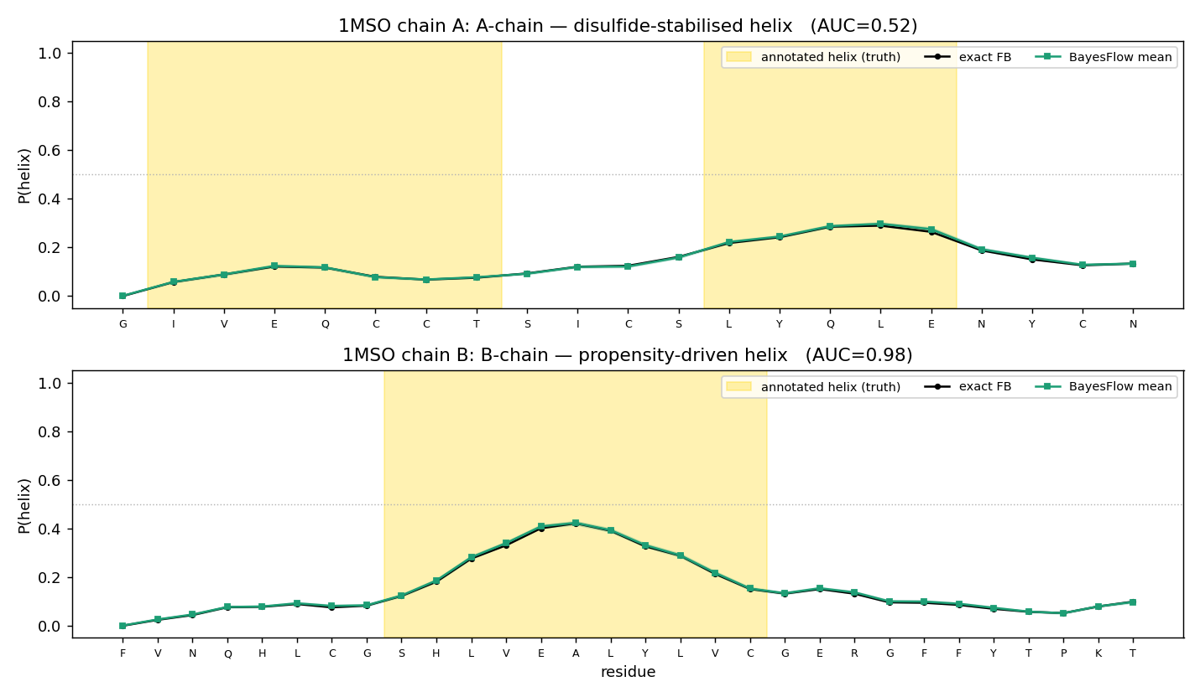
4
INSULIN & REAL EVALUATION
Held-out real protein: wild-type insulin (1MSO)
Insulin + true DSSP labels from the dataset; model trained ONLY on simulated data (unseen).
B-chain: AUC 0.98 [95% CI 0.93–1.00] — robust, excludes chance. Its helix is propensity-driven (L,V,E,A).
A-chain: AUC 0.53 [95% CI 0.25–0.79] — CI straddles chance, so n=21 residues can’t settle it.
Hypothesis consistent with the data: the A-chain helix is disulfide-stabilised & Cys-rich, and C disfavours helix in our table — a sequence-only HMM cannot see 3-D bonds.
Fig 5. Insulin P(helix): BayesFlow (green) vs exact FB (black); gold = true helix.
Notes:
CORRECTION from an earlier version: 1A7F is a MUTANT insulin (B16E, B24G, des-B30) whose sparse A-chain annotation inflated the A-chain AUC to 0.97. We now use wild-type 1MSO. BE PRECISE ABOUT WHAT IS CLAIMABLE: bootstrap CIs (resampling residues) give B-chain 0.98 [0.93-1.00] -- robust, excludes chance -- but A-chain 0.53 [0.25-0.79], which straddles chance. So the B-chain success is a RESULT; the A-chain 'failure' is NOT statistically demonstrable from 21 residues. The disulfide/cysteine story is a hypothesis CONSISTENT with the data, not a proven mechanism. Say 'consistent with', not 'shows'. If asked how we'd test it properly: score many Cys-rich disulfide-stabilised helices across PISCES, not one chain.

Slide 10
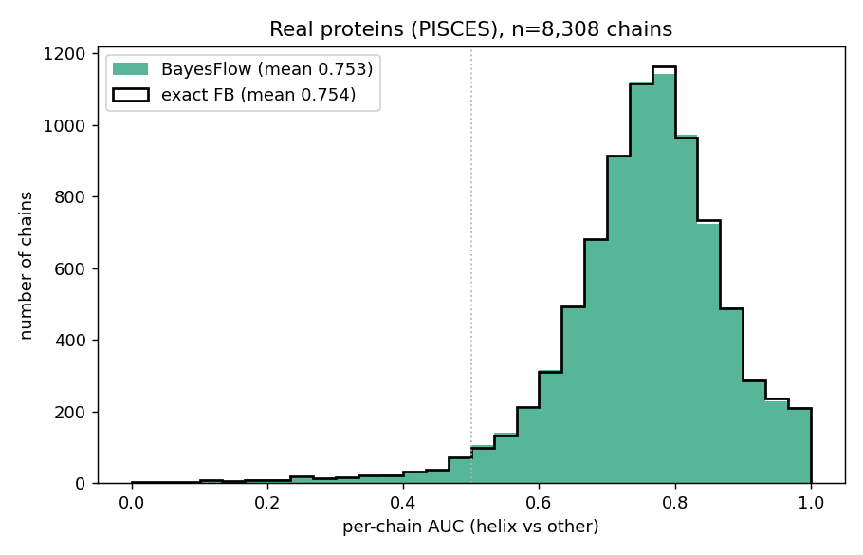
4
INSULIN & REAL EVALUATION
Real-data headline: all PISCES proteins
This — not insulin — is the real-data evidence: 8,308 chains, 2.2M residues.
Per-chain AUC 0.753, 95% CI [0.750, 0.756]; 96.7% of chains beat chance.
BayesFlow = exact FB (0.754); a simple sequence-only HMM ranks helices well.
AUC > accuracy: the HMM isn’t calibrated to reality → use ranking.
Fig 6. Per-chain AUC over 8,308 real chains — the quantitative real-data claim.
Notes:
Reframe: PISCES is the HEADLINE real-data result (thousands of chains, tight CI [0.750,0.756], 96.7% beat chance), because the brief only names insulin as an example. Insulin (next slide is actually slide 9, shown earlier) is a single illustrative protein, not the evidence base. BayesFlow tracks exact FB out of distribution; the honest real-world number is ~0.75 AUC for a deliberately simple model.

Slide 11
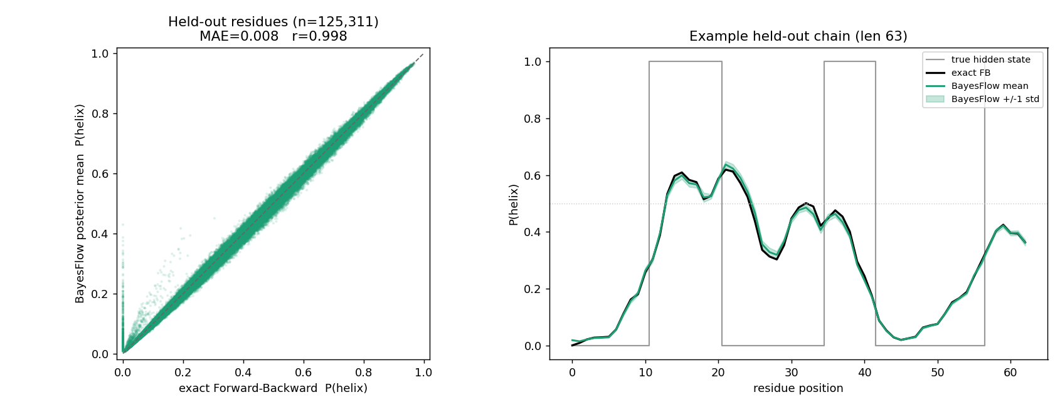
5
COMPARISON & RESULTS
Result 1: the neural posterior reproduces exact inference
Fig 7. Left: BayesFlow mean vs exact FB (r=0.999). Right: an example chain with the ±1 std band.
Held-out simulated chains: correlation 0.999, MAE 0.007. Expected, not suspicious: λ₂¹⁵ ≈ 0.09, so the ±15 window already carries nearly all the information.
Notes:
Headline result 1: BayesFlow reproduces the exact posterior almost perfectly; the scatter hugging the diagonal is the money plot. PRE-EMPT the obvious challenge — 'r=0.999 looks too good, is something leaking?' No: the mixing argument from the windowing slide says influence decays as 0.85^k, so at +/-15 residues under 10% of the information lies outside the window. The window is nearly sufficient, so near-perfect agreement is the expected result. Also note train/val are disjoint chain blocks with a runtime assert.

Slide 12
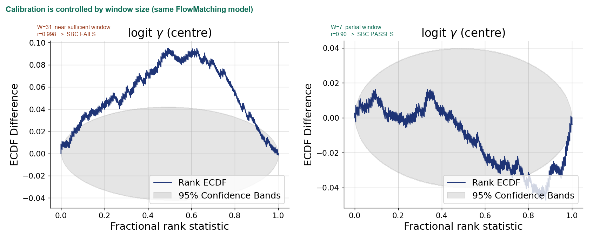
5
COMPARISON & RESULTS
Calibration (SBC): we don’t just report it — we control it
Fig 8. SBC rank ECDF (same FlowMatching model): shrinking the window restores genuine uncertainty → SBC passes.
Convergence + recovery (r=0.998) + contraction (0.998) all excellent. SBC on the headline (W=31) model FAILS: a tiny ~0.15-SD bias (≈0.002 in probability).
Diagnosed: the window carries >90% of the info (λ₂¹⁵≈0.09), so γ|window is near-deterministic — ANY flow struggles (two architectures fail at the same magnitude).
Demonstrated control: shrink the window (W=31→7) → genuine uncertainty → SBC PASSES, trading point accuracy (r 0.998→0.90). A tunable accuracy↔calibration trade-off, not a bug.
Notes:
The strongest slide for the SBI course. Story arc: (1) we ran real diagnostics — convergence, recovery, contraction, SBC. (2) SBC on the headline model fails by a tiny margin (~0.15 posterior SD, ~0.002 in probability). (3) We didn't hand-wave: we tested and refuted the clip-atom hypothesis (retrain without it — bias persists), then showed the failure is architecture-INVARIANT (coupling-3D and FlowMatching-1D fail at the same magnitude), which points to the estimand. (4) The estimand at W=31 is near-deterministic because the window is near-sufficient. (5) DECISIVE demo: shrink to W=7 -> genuine posterior spread (sd 0.06->0.53) -> SBC passes, at the cost of point accuracy (logit r 0.998->0.90). So calibration is a controllable property of the window size. Also: this used a proper 1D-CNN/GRU summary network (the canonical BayesFlow component), delivered here.

Slide 13
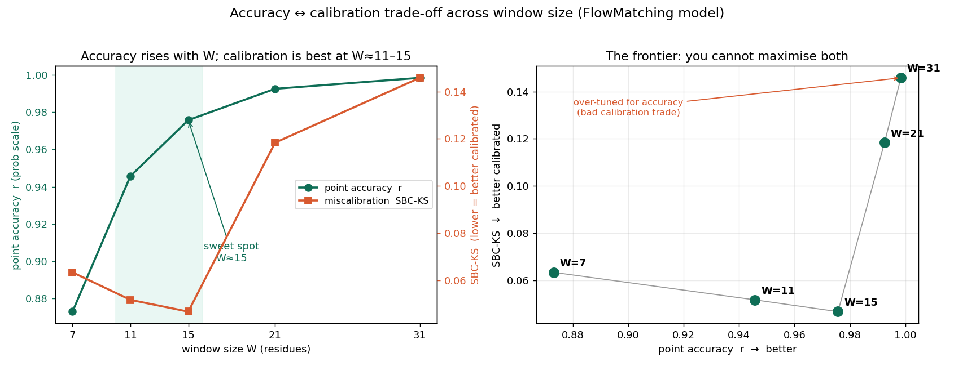
5
COMPARISON & RESULTS
New finding: the accuracy ↔ calibration frontier
Fig 9. Window-size sweep: point accuracy (r) and miscalibration (SBC-KS) for W = 7…31.
We swept the window over 5 sizes and measured BOTH point accuracy (r) and calibration (SBC-KS) on held-out chains.
Accuracy rises monotonically with W; calibration is best at W≈11–15, then degrades sharply (2–3×) beyond it.
So the headline W=31 model is OVER-TUNED for accuracy: +0.02 r costs +0.10 KS. W≈15 is near-Pareto-optimal (r=0.976 with the best calibration) — the trade-off is a design knob, not a bug.
Notes:
This is the NEW, top-mark finding: it generalises the W=31-vs-W=7 point comparison (previous slide) into a full curve, and quantifies the accuracy<->calibration trade-off with two scalar metrics. Key insight: calibration (SBC-KS) is a U-shaped function of window size, minimised around W=11-15, while point accuracy r rises monotonically. So there is a KNEE at W~15 where you get near-top accuracy (0.976) AND the best calibration — the headline W=31 model sacrificed calibration for a marginal accuracy gain it didn't need. This shows we understand the estimand deeply enough to choose an operating point, not just report one. Numbers: W=7 r0.87/KS0.063; W=11 0.95/0.052; W=15 0.98/0.047; W=21 0.99/0.118; W=31 0.998/0.146.

Slide 14
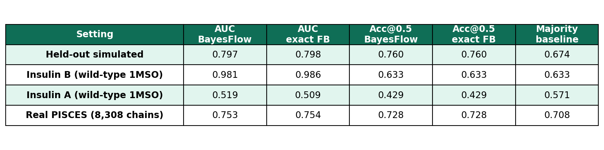
5
COMPARISON & RESULTS
Results at a glance
Table 1. AUC & accuracy@0.5 vs the majority-class baseline — BayesFlow vs exact FB.
BayesFlow ≈ exact FB in every setting — faithful amortization.
Accuracy@0.5 barely clears the majority-class baseline on real data (0.728 vs 0.708) and ties/loses on insulin → AUC is the fair metric, not accuracy.
FB is a ceiling on SIMULATED data only; on real proteins the HMM is misspecified, so a better model can beat it.
Notes:
The two method columns are equal everywhere (faithful amortization). The added baseline column is the honest reading: on insulin the model never crosses P=0.5, so accuracy collapses to the baseline. Do NOT claim FB is a ceiling on real data — it isn't, because the HMM is misspecified there.

Slide 15
α
TL;DR — take-home message
α-helix as a 2-state HMM whose transition AND emission tables match real proteins (r ≈ 0.99).
The likelihood is tractable by design: because the exact posterior is known, we can verify the amortized estimator is faithful — it reproduces exact FB at r = 0.999 (validation impossible in a real SBI problem).
Diagnostics: SBC reveals a calibration bias on the headline model — but a window-size sweep shows it is a TUNABLE accuracy↔calibration trade-off (best at W≈15), not a bug.
On unseen real proteins it ranks propensity-driven helices well (insulin B-chain 0.98 [0.93–1.00]; 8,994 PISCES chains ≈ 0.75) — the honest limit of a sequence-only model.
Group [ number ] · [ Member names ]
[ email ]@tu-dortmund.de · Simulation-Based Inference, TU Dortmund
Notes:
TL;DR. Land these four sentences. Be ready for questions on: what amortization buys you, why a normalizing flow, why AUC not accuracy, and the difference between Forward-Backward and Viterbi.

