Slide 1

DATA & AI IN ECONOMICS, TU DORTMUND
THE IMPACT OF
PIT STOP STRATEGY
DOES THE UNDERCUT PAY OFF
Does the undercut pay off? The causal effect of pit timing in Formula 1, 2022 to 2025.
Under the guidance of: Dr. -Ing. Alexander Elias Krause
Presented by: Munish Patwa, Simran Arora, Nimesh Jitendra Bhavsar

Slide 2
01
DOES THE UNDERCUT PAY OFF
INTRODUCTION

Slide 3
RESEARCH QUESTION
How does pit stop strategy shape race performance?
Causal core:
Does pitting early, before about 40% of the race, actually improve a driver's net positions gained versus the grid, once car quality, grid slot and track conditions are held fixed?
DOES THE UNDERCUT PAY OFF
The catch:
Faster cars tend to pit at different times and also finish higher up the order.
A simple comparison would therefore mix the effect of pit strategy with the effect of car performance.
The goal is to separate the impact of the strategy from the impact of the car.
1

Slide 4
DATA DESCRIPTION
Dataset:
96,336 laps from the 2022 to 2025 seasons, enriched with OpenF1 weather and stint data.
Scale:
25 circuits, 31 drivers, about 660 driver races for the causal work and 3,436 stints for the clustering.
DOES THE UNDERCUT PAY OFF
Unit:
One lap, re-aggregated to driver and race, or to stint, depending on the question.
Three methodologies:
Causal block (DoWhy, fixed effects, Double Machine Learning)
Supervised block (regression and classification against a grid only baseline)
Unsupervised block (K-Means, PCA and a Gaussian mixture).
2

Slide 5
02
DOES THE UNDERCUT PAY OFF
EXPLORATORY DATA ANALYSIS

Slide 6
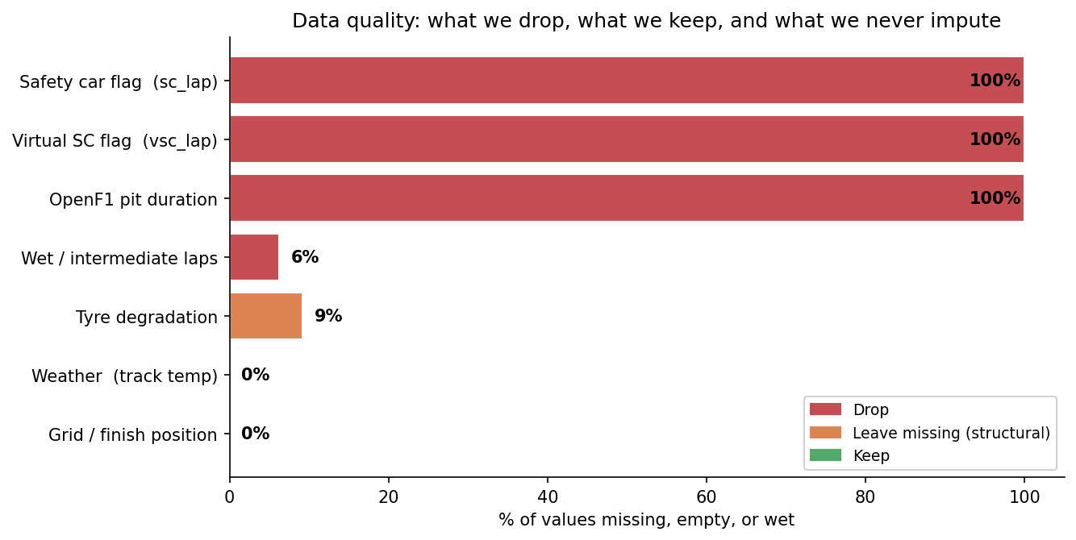
EXPLORATORY DATA ANALYSIS
DATA CLEANING
DOES THE UNDERCUT PAY OFF
Variables with no usable information (Safety Car, VSC and OpenF1 pit duration) are dropped.
Wet-weather laps are removed, while complete weather and grid variables are retained.
Missing values in tyre degradation are imputed using the median to preserve observations without being overly influenced by outliers.
3

Slide 7
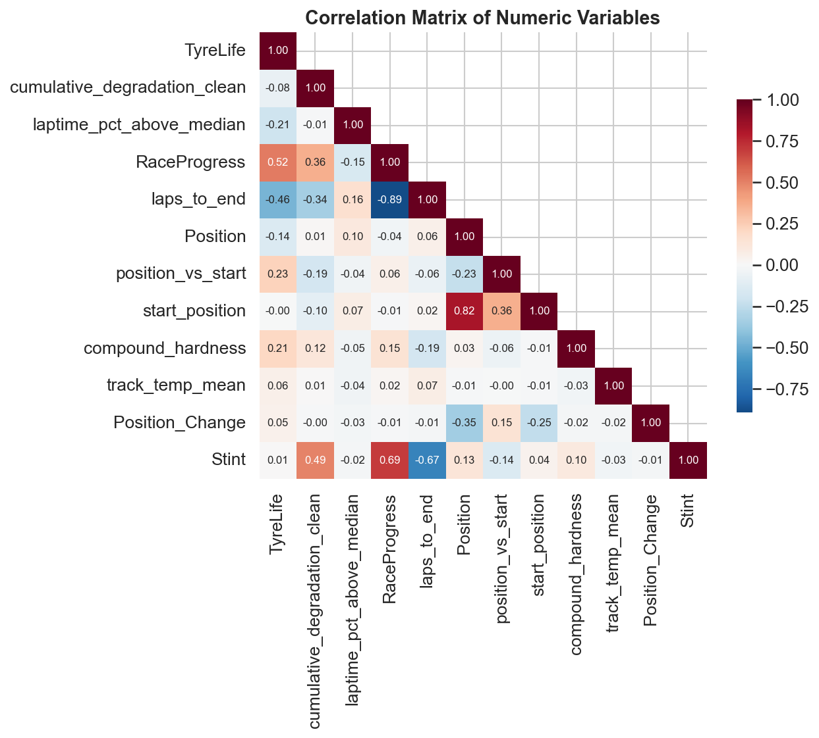
EXPLORATORY DATA ANALYSIS
FEATURE CORRELATION
The selected predictors exhibit limited multicollinearity, supporting their joint use in the models.
DOES THE UNDERCUT PAY OFF
3

Slide 8
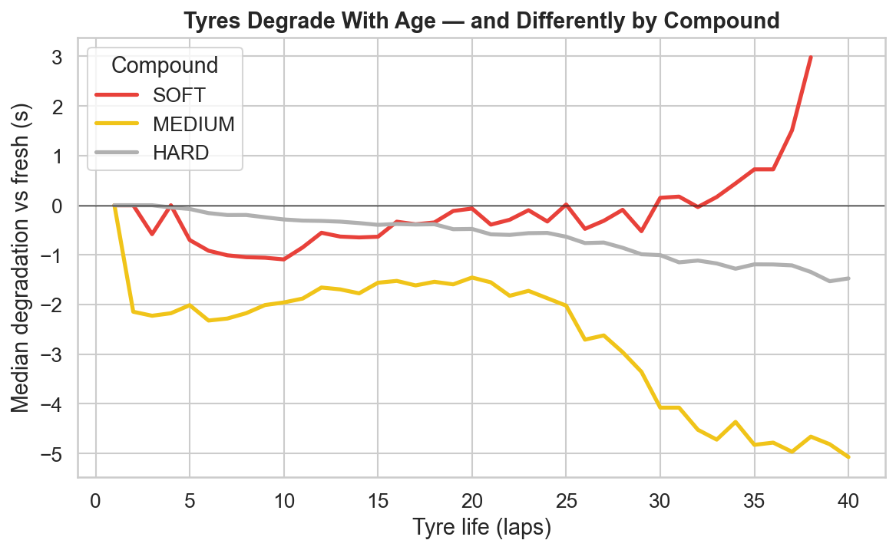
EXPLORATORY DATA ANALYSIS
TYRES DEGRADE WITH AGE, BY COMPOUND
DOES THE UNDERCUT PAY OFF
Tyre degradation increases as tyres age, with softer compounds generally deteriorating faster than harder compounds.
The first lap of each stint is excluded when estimating degradation to avoid the out-lap bias.
5

Slide 9
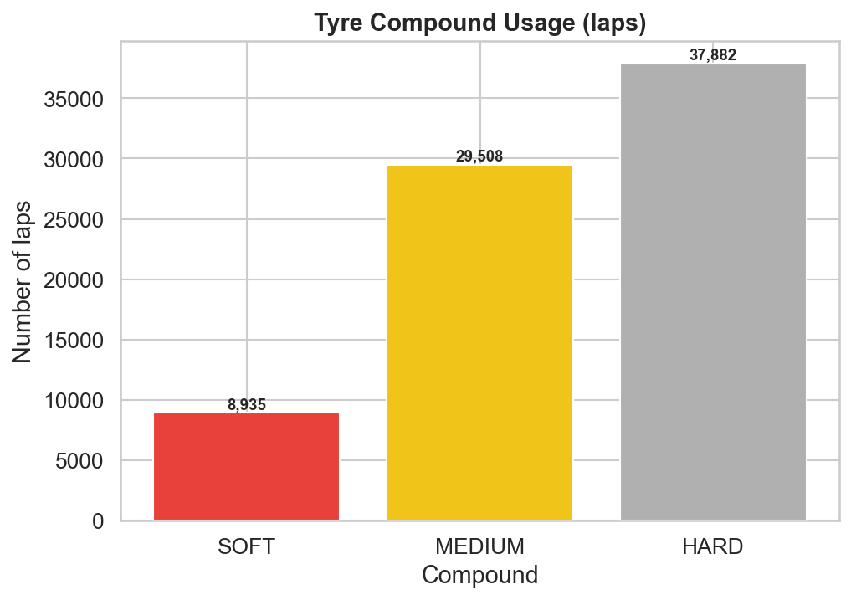
EXPLORATORY DATA ANALYSIS
TYRE COMPOUND USAGE
Hard and medium compounds account for most laps, while soft tyres are used less frequently due to their higher degradation.
DOES THE UNDERCUT PAY OFF
4

Slide 10
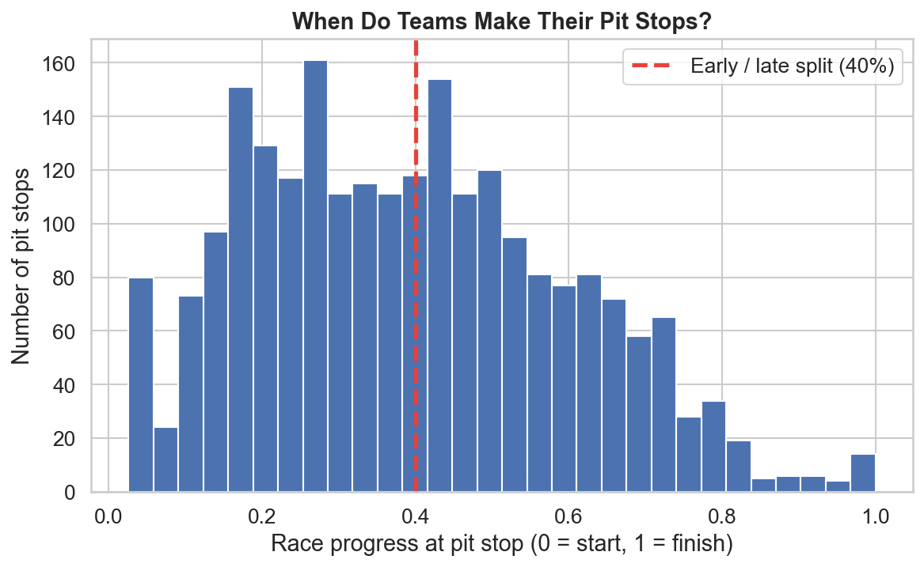
EXPLORATORY DATA ANALYSIS
WHEN TEAMS MAKE THE FIRST STOP
DOES THE UNDERCUT PAY OFF
First pit stops occur across a wide range of the race, indicating substantial variation in pit timing. The 40% race-progress threshold defines the treatment variable, classifying stops as early or late for the causal analysis.
6

Slide 11
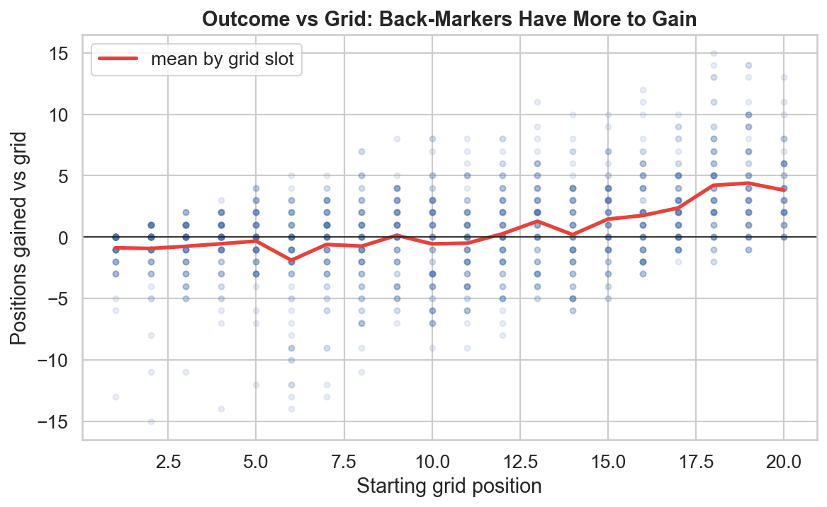
EXPLORATORY DATA ANALYSIS
THE GRID CEILING
Net positions gained depend strongly on starting grid position, with drivers further back having greater opportunity to gain places
DOES THE UNDERCUT PAY OFF
7

Slide 12
03
DOES THE UNDERCUT PAY OFF
CAUSAL INFERENCE

Slide 13
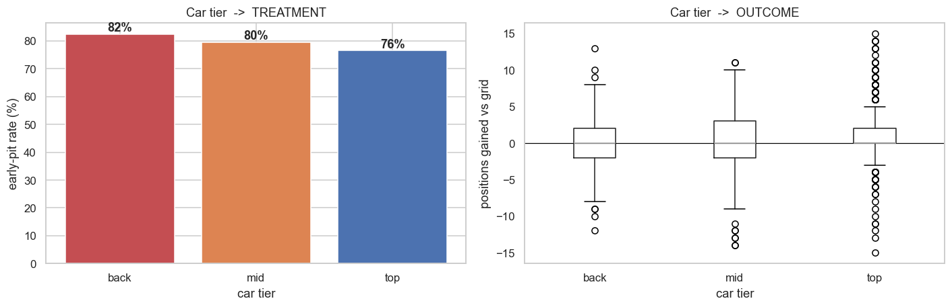
OBJECTIVE
WHY THIS NEEDS CAUSAL INFERENCE
Car quality is a confounder. It changes both when a team pits and how the race ends.
DOES THE UNDERCUT PAY OFF
The early stop rate rises for weaker cars.
Weaker cars tend to pit early and finish worse, so just comparing early and late stoppers really compares cars, not strategies.
We measure the effect of the pit decision itself, with car quality held equal.
9

Slide 14
SETUP
TARGET, FEATURES AND ESTIMATION
Treatment: Early pit, the first stop before 40% of the race (a binary flag).
Outcome (target): position_vs_start, the net positions gained versus the grid, per driver-race.
DOES THE UNDERCUT PAY OFF
Features: Car tier, grid slot, track temperature and rainfall, plus race and constructor fixed effects.
Scope: The 2023 and 2024 seasons, about 660 driver races.
Estimation: Fit each estimator, cluster errors by race, sweep the cut off, cross fit Double ML over 10 seeds.
10

Slide 15
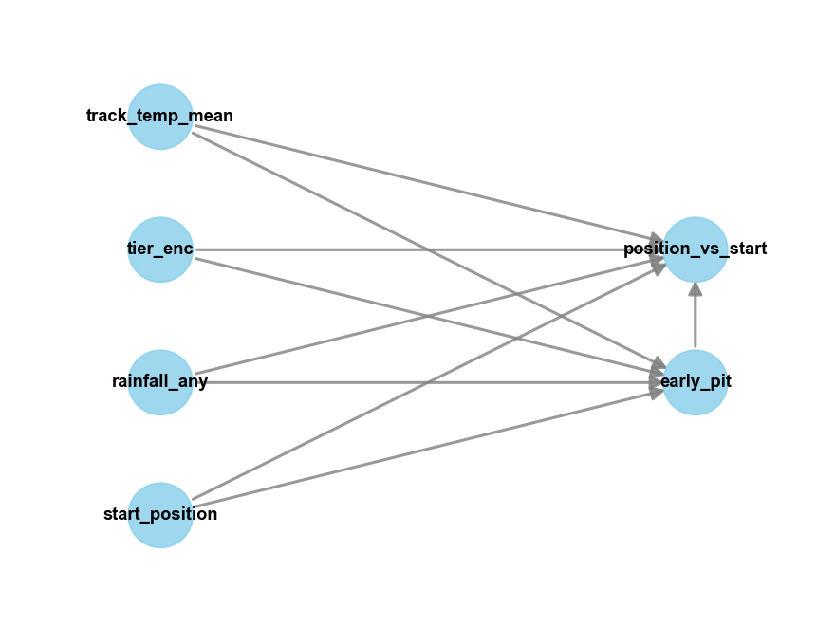
METHODOLOGY
FROM A DIAGRAM TO A FAIR COMPARISON
Backdoor set:
Car tier, grid slot, track temperature and rainfall, all observed.
Standard to strict:
We build up from a backdoor adjustment in DoWhy, to two way fixed effects, to Double Machine Learning.
Why fixed effects:
A race fixed effect only compares early and late stoppers inside the same race. That cancels weather, safety cars and anything else specific to the race, even things we never measured. About 70% of races have both kinds of stop, so the comparison is feasible.
DOES THE UNDERCUT PAY OFF
11

Slide 16
RESULTS
EARLY STOPS COST POSITIONS
Pitting early costs roughly 0.7 to 1.0 finishing positions.
A negative number means early stoppers gain fewer places than late stoppers under the same conditions.
DOES THE UNDERCUT PAY OFF
−0.97
−0.74
≈ −0.5
Two way fixed effects
race + constructor, p = 0.039
Double Machine Learning
median of 10 seeds, p ≈ 0.035
Backdoor adjustment
DoWhy, refutation passes
12

Slide 17
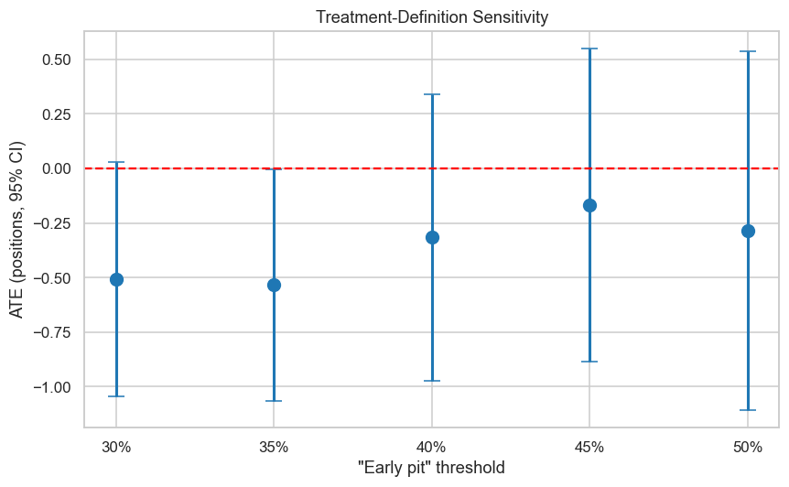
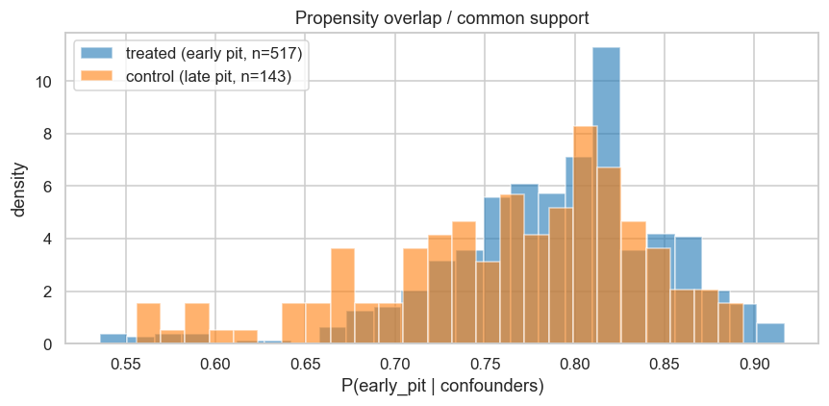
EVALUATION
SENSITIVITY ANALYSIS
DOES THE UNDERCUT PAY OFF
Threshold: The estimated effect remains negative across 30 50% cutoffs, showing robustness to the treatment definition.
Refutation: Placebo, random-cause and subset tests support the estimated effect.
Overlap: Treated and control groups have good common support, with only 7 of 660 observations outside it.
Inference: Standard errors are clustered by race to account for within-race dependence.
13

Slide 18
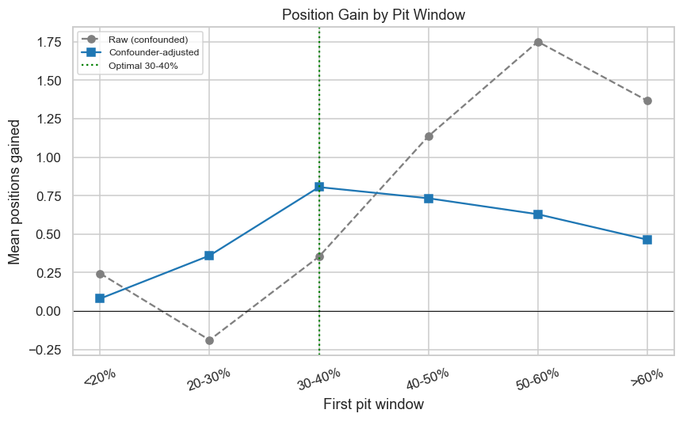
RESULTS
WHEN DOES AN EARLY STOP HELP?
After adjusting for confounders, the value of the first stop is an inverted U.
Before 30%: too early, value is thrown away.
30 to 50%: the sweet spot, about plus 0.8 positions.
After 50%: the gain fades away again.
Fresh tyres only repay the pit lane time once the old set has worn enough.
DOES THE UNDERCUT PAY OFF
14

Slide 19
04
DOES THE UNDERCUT PAY OFF
SUPERVISED LEARNING

Slide 20
OBJECTIVE & SETUP
WHAT WE PREDICT
Objective: Measure how predictable the outcome is, and whether strategy beats a grid only baseline.
Target: position_vs_start, reframed to points (top 10) and to podium, points or none.
DOES THE UNDERCUT PAY OFF
Mechanism target: The pit decision (does the car stop next lap), to confirm the wear to pit link.
Features: Grid slot, car tier, first pit timing, stops, compounds, track temperature, rainfall.
Unit: One driver-race, and lap level for the pit decision.
15

Slide 21
METHODOLOGY & METRICS
MODEL DESCRIPTION
Models: Ridge, Random Forest, Gradient Boosting and SVR, plus gradient boosted classifiers.
Baseline: A grid only model, the bar that everything must beat.
DOES THE UNDERCUT PAY OFF
Train and test: Train on 2022 to 2024, test on 2025, with 5 fold time series cross validation.
Additional Analysis: Crossed mixed-effects models to quantify variance components, and feature ablation to assess the contribution of individual features.
Metrics: RMSE and R squared for regression, ROC AUC for classification.
16

Slide 22
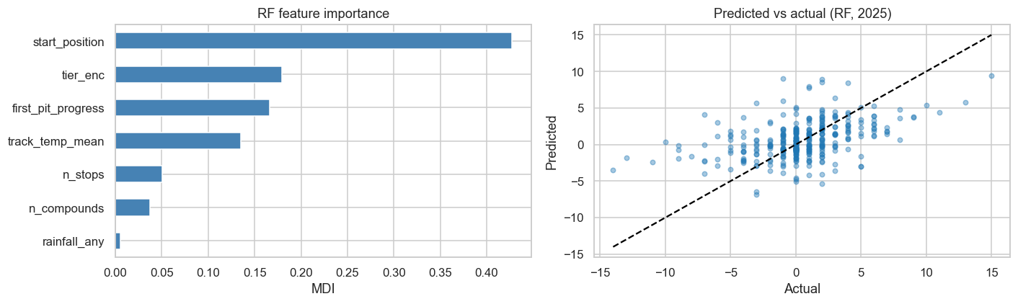
RESULTS
HOW PREDICTABLE IS THE OUTCOME?
DOES THE UNDERCUT PAY OFF
Random Forest Feature Importance
Predicted vs Actual (RF, 2025)
Grid position dominates prediction:
Starting position is the strongest predictor, followed by car tier and first pit timing.
Strategy adds modest predictive value:
The full model improves RMSE from 3.35 (grid-only baseline) to 3.05, but R² remains around 0.10, indicating that only a small fraction of the variation is predictable.
17

Slide 23
RESULTS
WHY IS PREDICTION DIFFICULT?
Most variation is noise
Mixed-effects modelling attributes roughly 80% of the variance to residual variation not explained by the available predictors.
We are close to the prediction ceiling
Feature ablation shows that adding more engineered features provides only small improvements, with RMSE stabilising around 3.0.
Some decisions are much easier to predict
While race outcome is noisy, the pit-stop decision is highly predictable, achieving an AUC of 0.96.
DOES THE UNDERCUT PAY OFF
17

Slide 24
RESULTS
PREDICTING RACE ACHIEVEMENTS
Race achievements are highly predictable.
The classifiers achieve AUC ≈ 0.87 for points finishes and three-class outcomes, and AUC ≈ 0.95 for podium finishes.
The strongest signal is the starting grid.
A grid-only classifier performs nearly as well as the full model, showing that grid position and car quality dominate prediction, while pit strategy contributes comparatively little.
DOES THE UNDERCUT PAY OFF
18

Slide 25
05
DOES THE UNDERCUT PAY OFF
UNSUPERVISED LEARNING

Slide 26
OBJECTIVE & SETUP
WHY UNSUPERVISED LEARNING
The causal block asks whether an early pit stop works.
This block asks: what strategy patterns actually exist?
3,324 dry-compound stints across 2022–2025
No labels -drivers and teams make choices, we discover structure
Goal: interpretable archetypes that connect back to the causal treatment definition
Key question: Does the `early_pit binary` (< 40%) correspond to a real, distinct cluster?
DOES THE UNDERCUT PAY OFF
19

Slide 27
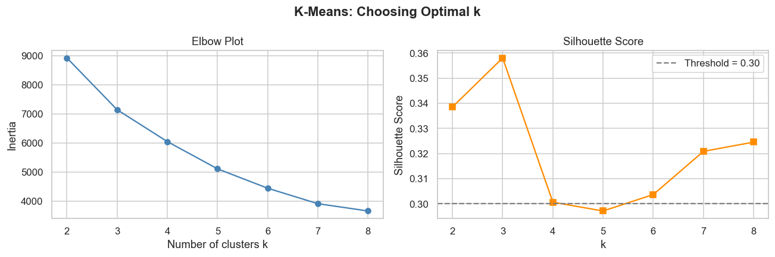
METHODOLOGY & METRICS
Choosing Clusters
DOES THE UNDERCUT PAY OFF
Elbow: inertia curve bends sharply at k = 3 and flattens beyond it
Silhouette: peaks at k = 3 (score ≈ 0.358 > 0.30 threshold), drops for k > 4
Decision: k = 3 agreed by both criteria; interpretable (3 natural strategy types)
20

Slide 28
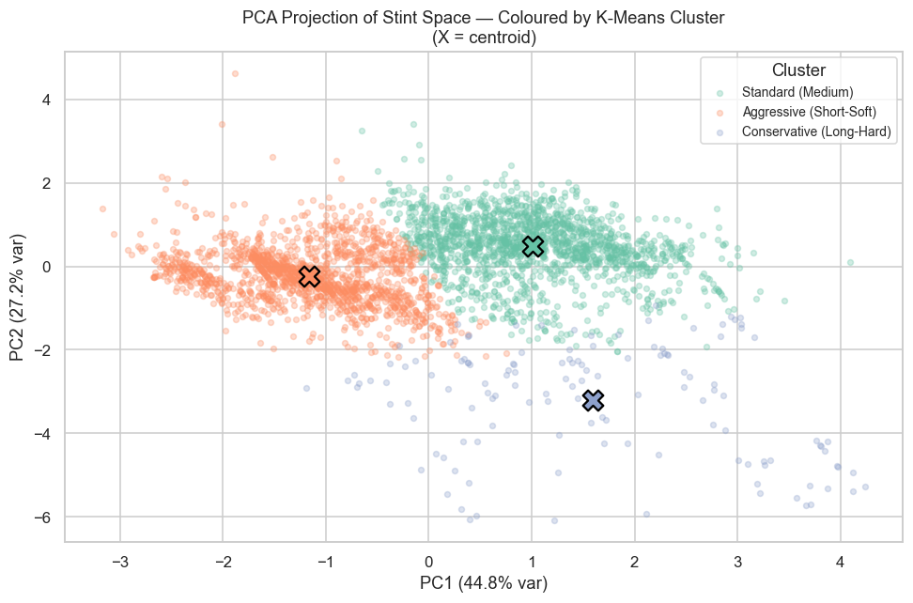
RESULTS
PCA Projection
PC1 + PC2 together explain 72% of the stint-space variance (44.8% + 27.2%), so this 2D view captures most of the structure
Aggressive (orange) separates leftward on PC1 - shorter stints, earlier pit timing pull it toward negative PC1
Conservative (purple) separates downward on PC2 - distinct compound hardness / degradation profile, not just stint length
Standard (green) is the largest cluster and occupies the central-right region, overlapping slightly with both others at the boundaries - expected for a "baseline" strategy type
Centroids (×) are well-spaced with no two sitting on top of each other - confirms k = 3 is not over-splitting
The overlap zone between Aggressive and Standard around PC1 ≈ 0 corresponds to stints near the 40% race-progress boundary, which is exactly where the causal treatment definition sits
DOES THE UNDERCUT PAY OFF
21
Three real strategy types — the clustering finds geometric structure, not arbitrary label boundaries.

Slide 29
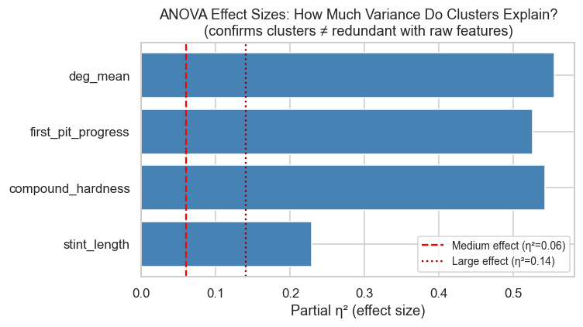
RESULTS
ANOVA
One-way ANOVA tests whether the three clusters differ significantly on each raw feature, all four pass with p < 0.001
Partial η² measures how much of each feature's variance the cluster label explains, the benchmark lines: medium = 0.06, large = 0.14
deg_mean, compound_hardness, first_pit_progress all reach η² ≈ 0.50-0.55, the clusters account for roughly half the variance in each, a very large effect
Even the weakest feature, stint_length, sits at η² ≈ 0.22 still well above the "large" threshold
Every bar clears the dotted large-effect line by a wide margin, the separation is not a statistical artefact of sample size
DOES THE UNDERCUT PAY OFF
Clusters explain 22–55% of feature variance the three archetypes capture real, large behavioural differences, not noise
21

Slide 30
06
DOES THE UNDERCUT PAY OFF
CONCLUSION

Slide 31
TL;DR
1
Strategy matters, but only a little. Grid slot and car quality dominate.
2
Pitting early does not pay. It costs about 0.7 to 1.0 positions, and three methods agree.
DOES THE UNDERCUT PAY OFF
3
The best first stop is mid race, around 30 to 50%. Going earlier than 30% wastes value.
4
Strategies form a smooth spectrum, not a handful of types.
5
Who scores is easier to predict; how many places you gain is mostly noise.
23

Slide 32
KEY TAKEAWAY
Pit on tyre life, not on instinct.
DOES THE UNDERCUT PAY OFF
The undercut is mostly a myth.
Early stops cost places, the payoff sits in the middle of the race, and once you account for the car, strategy is a small lever on a noisy result.
What makes the finding credible is that three separate methods all point the same way.
24

Slide 33
07
DOES THE UNDERCUT PAY OFF
FUTURE WORK

Slide 34
FUTURE WORK
Safety car as an instrument. Recover safety car and VSC timing from FastF1; because a safety car makes a stop cheap, it can serve as an instrument and move the design from adjustment to IV.
Separate forced early stops. Flag first lap incidents such as damage and punctures, so a stop that was forced is not mistaken for a strategic choice.
DOES THE UNDERCUT PAY OFF
Dynamic car quality. Replace the static yearly tier with rolling, race by race form, so mid season upgrades and slumps enter the controls.
Heterogeneous effects. Use causal forests to learn which drivers and tracks actually gain, turning the average effect into a conditional policy.
Broader conditions. Bring wet races back in, and add tyre compound and circuit interactions that the dry race core leaves out.
25

Slide 35
08
DOES THE UNDERCUT PAY OFF
LIMITATIONS

Slide 36
WHAT TO KEEP IN MIND
Interference: Positions are roughly zero sum, so one driver's stop changes everyone else's race. We report the individual effect and cluster errors by race.
Selection within a race: Fixed effects cannot remove a first lap incident that forces an early stop.
DOES THE UNDERCUT PAY OFF
No safety car data: Those columns were corrupt, so we adjust for confounders rather than use them as an instrument.
Missing 2022 weather: The causal block runs on 2023 and 2024 only.
Noise floor: The low R squared is real outcome noise from crashes and retirements, reported plainly rather than hidden.
26

