Slide 1
Healthcare dashboard
Devi Sowmya Reddy Munagala
Munish Mummadi
Sai Raj Ullenga
Shivakumar Udutha
Shreya Nandhivargam

Slide 2
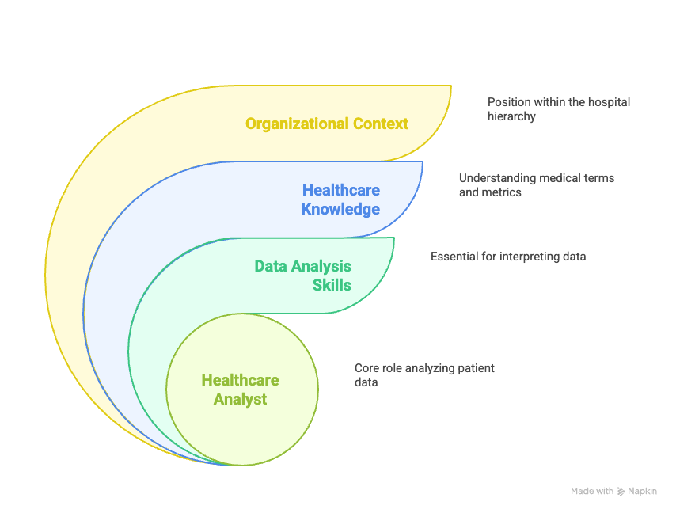
Intended user
User profile and context
Profile
Organizational Hierarchy
Thought Process
Assumed Knowledge

Slide 3
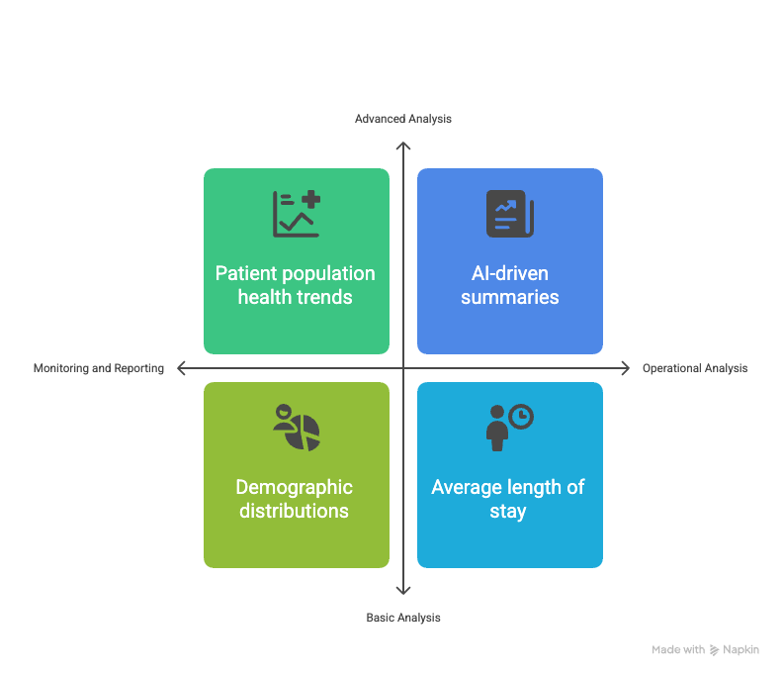
User decision making needs
Key areas of responsibility
Does application meet the needs?
Arrival at Decision Needs

Slide 4
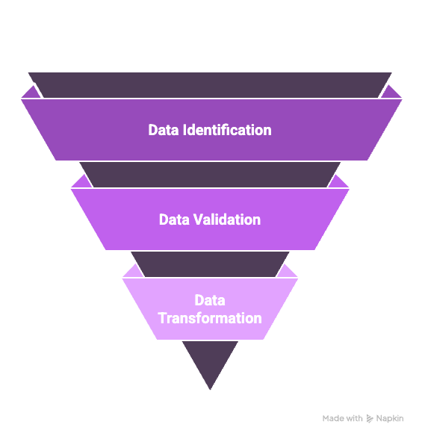
Data validation and preparation
Data identification
Data validation
Data Transformation/computation

Slide 5
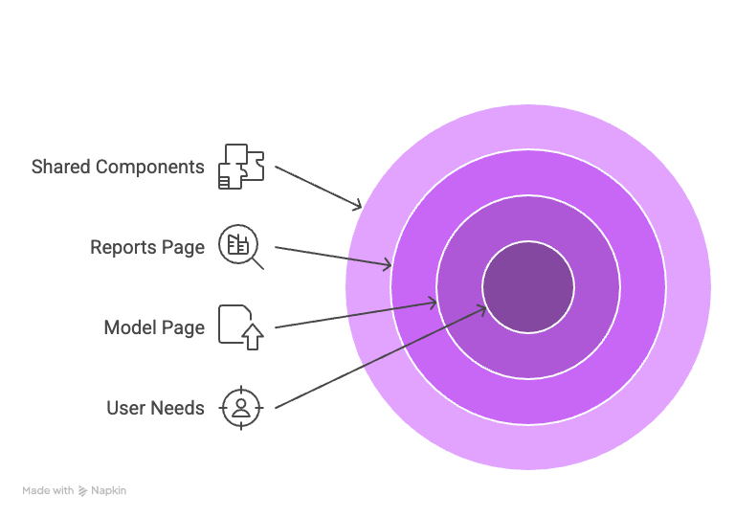
User interface design
/model page
/reports page
interactions

Slide 6
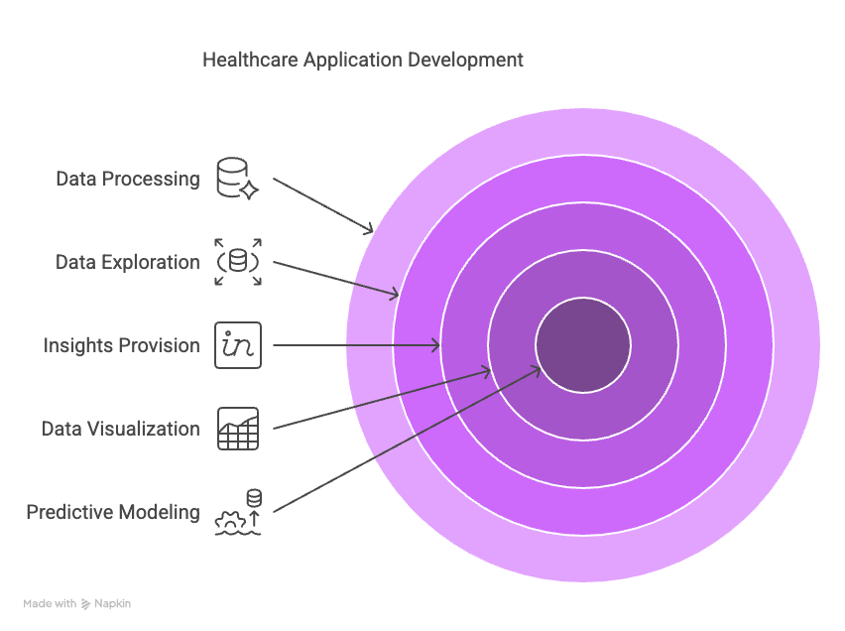
Validation and Verification
Rationale for satisfying needs.
Verification using Traceability matrix
Overall Verification

