Slide 1
Healthcare dashboard
Devi Sowmya Reddy Munagala
Munish Mummadi
Sai Raj Ullenga
Shivakumar Udutha
Shreya Nandhivargam

Slide 2
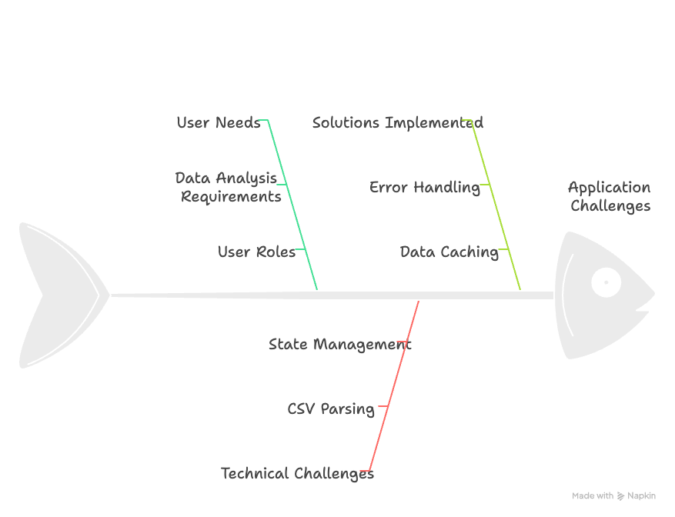
Intended user
Application Features
Technical challenges addressed
Solutions implemented in code

Slide 3
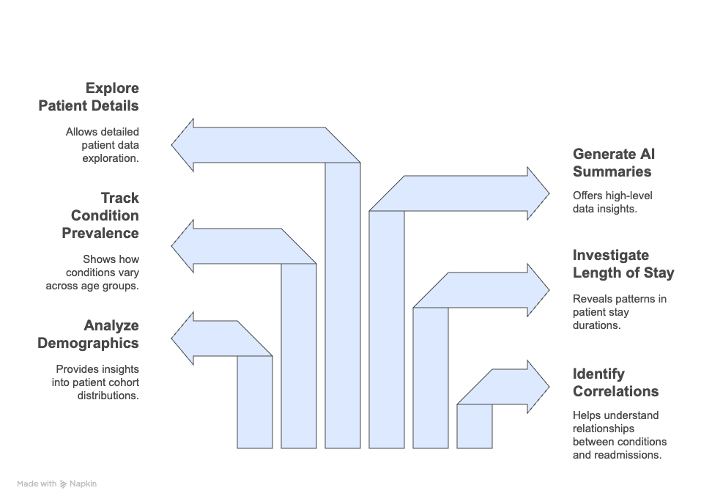
User decision making needs
Decision support
Need implementation in application
Technical Challenges addressed in code
Solutions implemented
Relevant Coursework

Slide 4
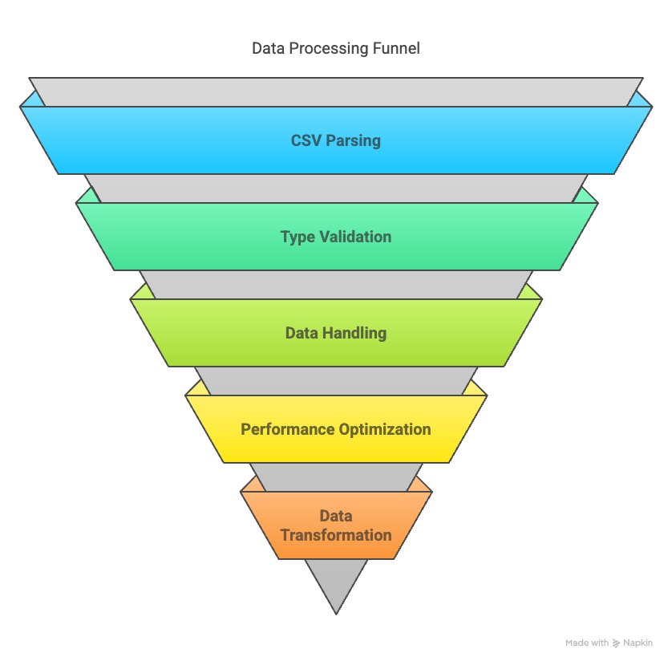
Data validation and preparation
Process implemented in code
Technical Challenges addressed in code
Solutions implemented in code
Relevant coursework

Slide 5
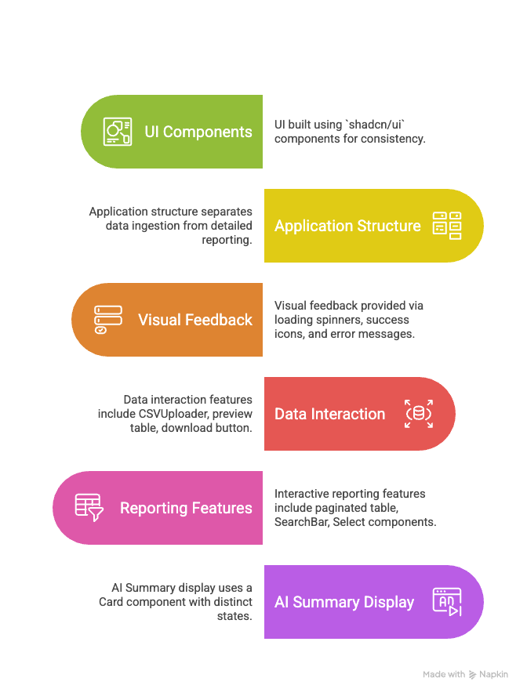
User interface design
Design implementation highlights
Technical challenges addressed in code
Solutions implemented in code
Relevant Coursework

Slide 6
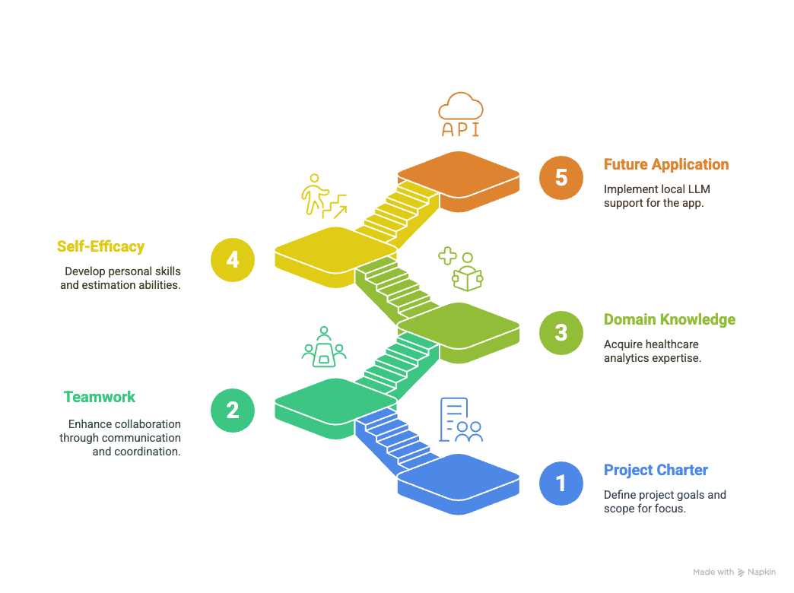
Final reflection
Project Charter
Teamwork
Domain Knowledge
Self-Efficacy
Future plans

