Slide 1
Job Dashboard - ML

Slide 2
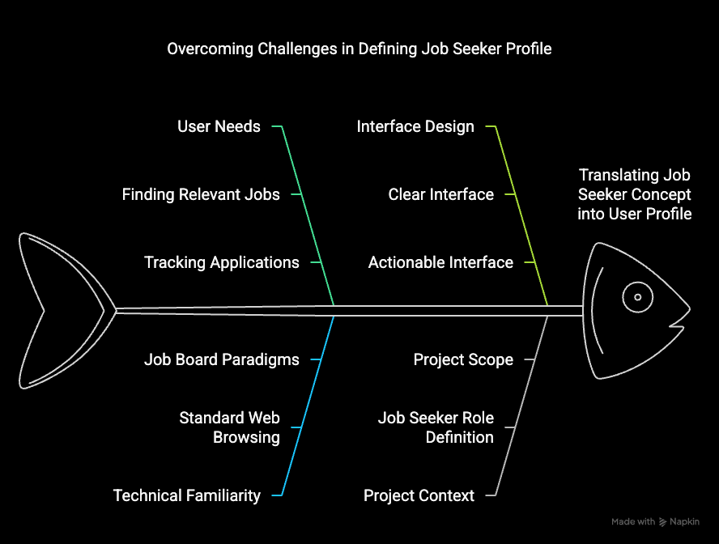
Defining the User
Key challenges
Overcoming Challenges

Slide 3
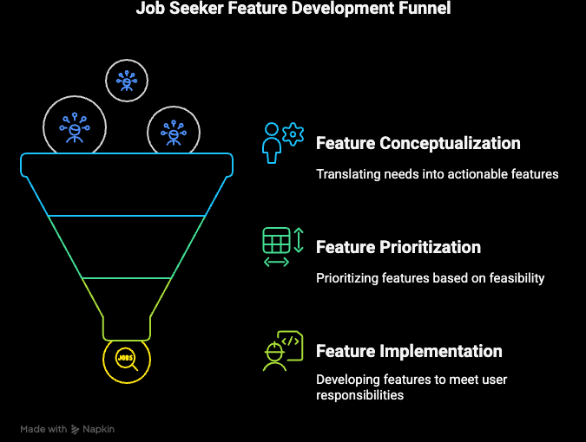
Determining Needs
Process
Key Challenges
Solution
Curriculam help

Slide 4
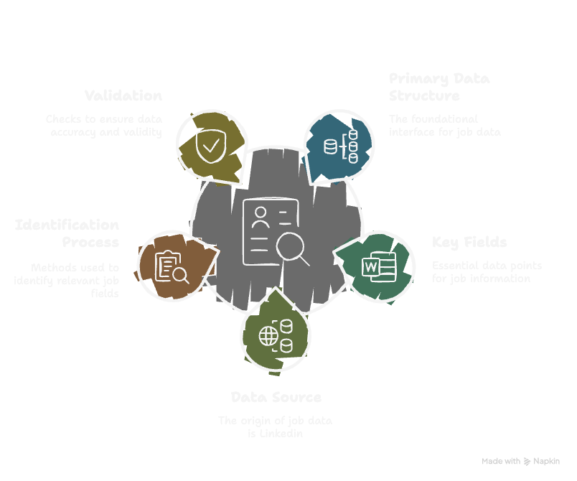
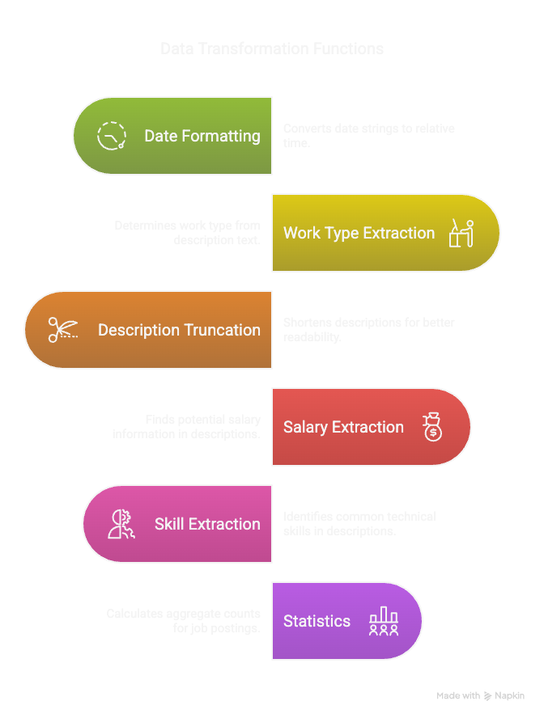
Data Validation & Preparation

Slide 5
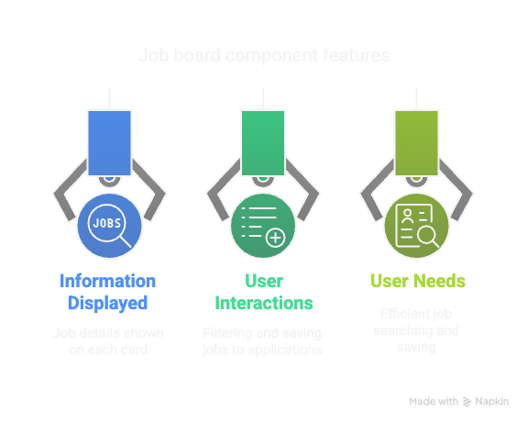
User Interface Design
Our job board is built based on problems we faced + requirements gathered.
We handled User interactions, Information and needs to better serve the user.

Slide 6
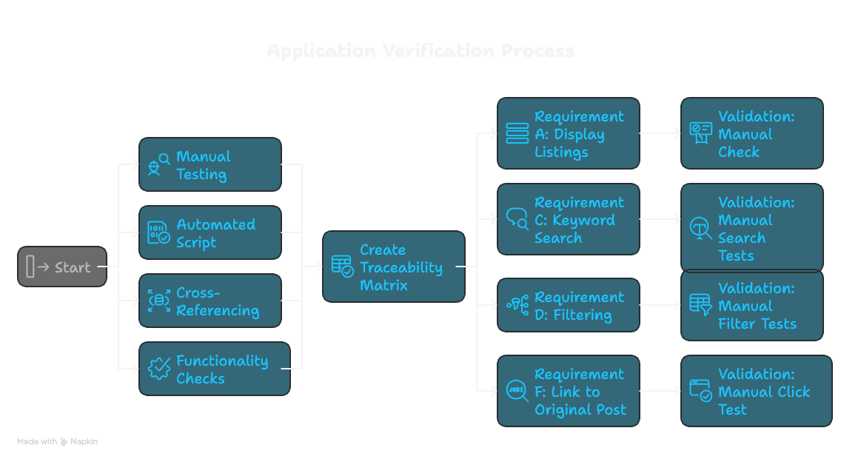
Final Reflection
Project charter and output evaluation.
Team design, communication methods and coordination.
Role assignment, individual contribution explanation.

Slide 7
Thank you

