Slide 1
Job Dashboard - ML

Slide 2
Intended User
User Profile: Job Seeker (individual looking for employment opportunities).
Assumed Role: End-user interactng directly with the web application.
Thought Process: As our designated job type is Machine learning. We made necessary adjustments to properly display them.
Context: It is assumed that User is familiar with general web browsing, job searching concepts(title, locations, companies). Helps them with an efficient way to find relevant jobs and manage their process.

Slide 3
User’s Decision-Making Needs
Goals: Find relevant job openings wrt criteria like location, company, skills etc. Exploration of job postings, tracking applications
Role: Contains filters(`JobList`) and company/job exploration(`Explore`).
Identifying Needs: Since most of us are job seekers. We discussed among ourselves to create/solve this one.

Slide 4
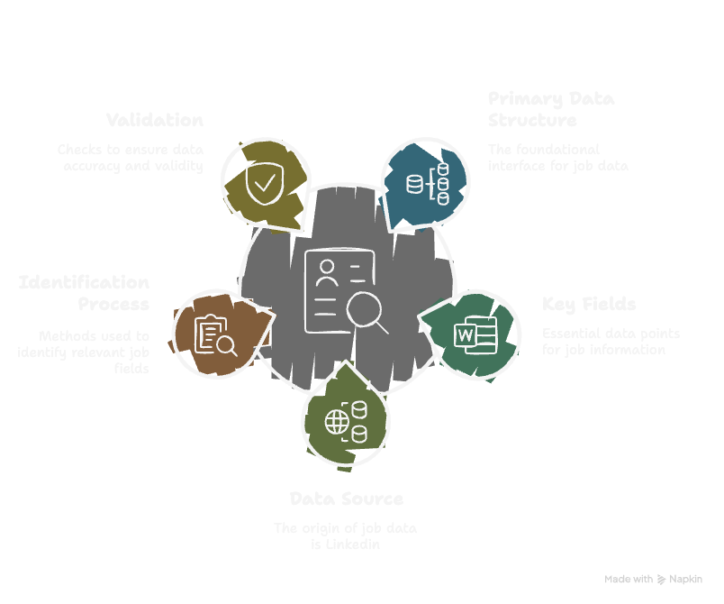
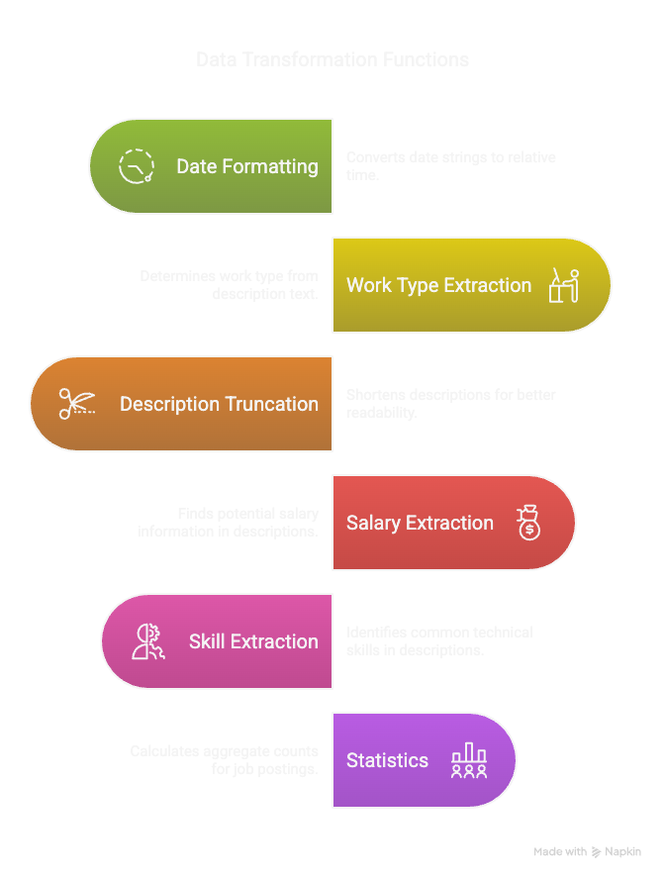
Data Validation & Preparation

Slide 5
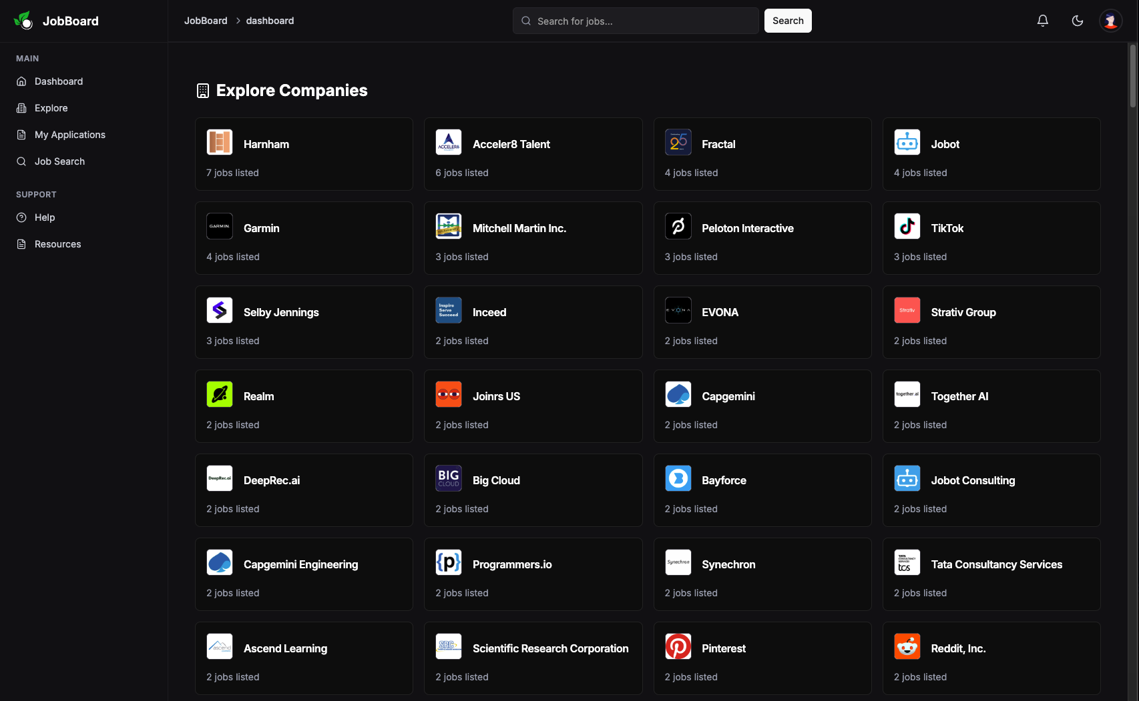
User Interface Design
Our main page is `Explore` which provides insights of all the job listings.

Slide 6
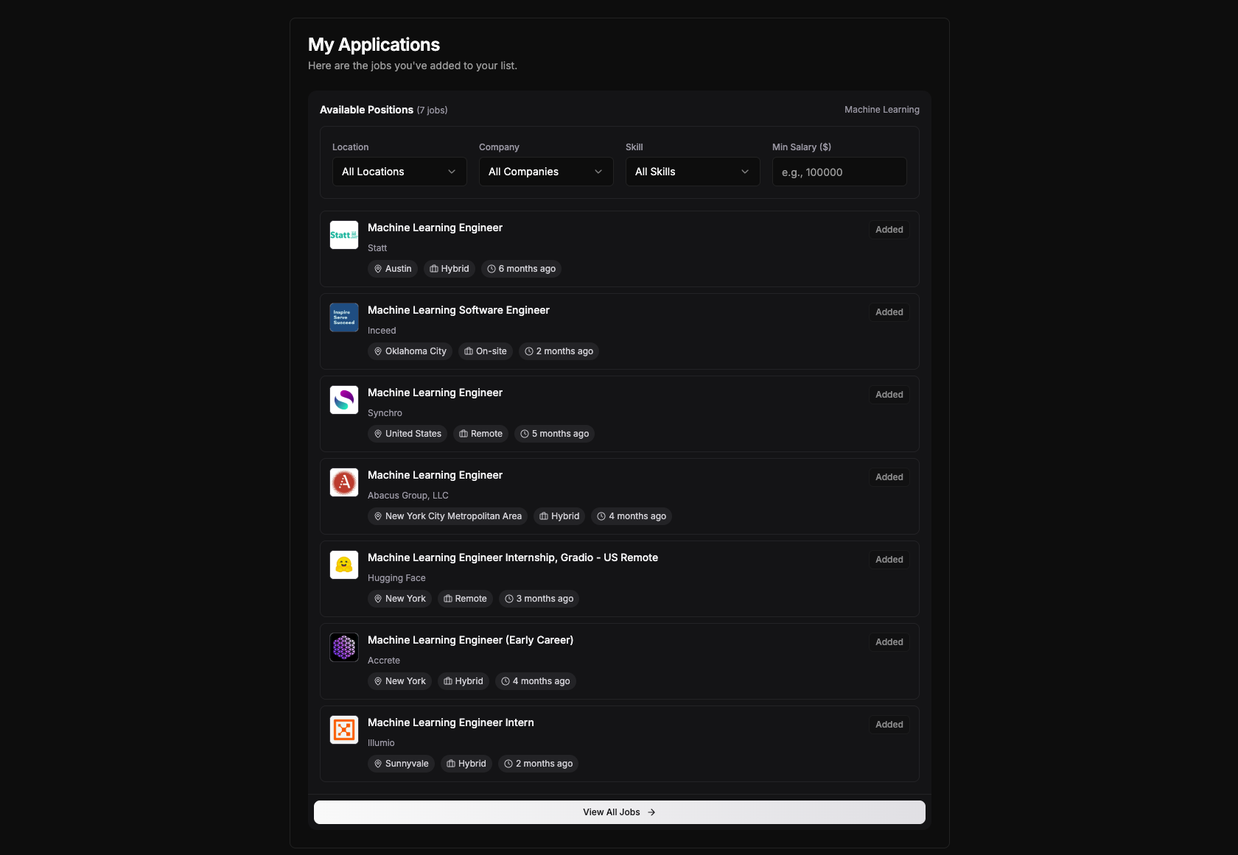
User Interface Design
My Applications Page
Use `Add` button on Explore page to add them to localstorage
`View all jobs` button to redirect to main page.

Slide 7
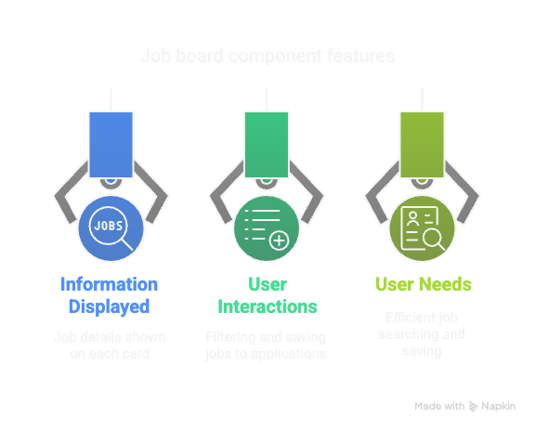
User Interface Design
Our job board is built based on problems we faced + requirements gathered.
We handled User interactions, Information and needs to better serve the user.

Slide 8
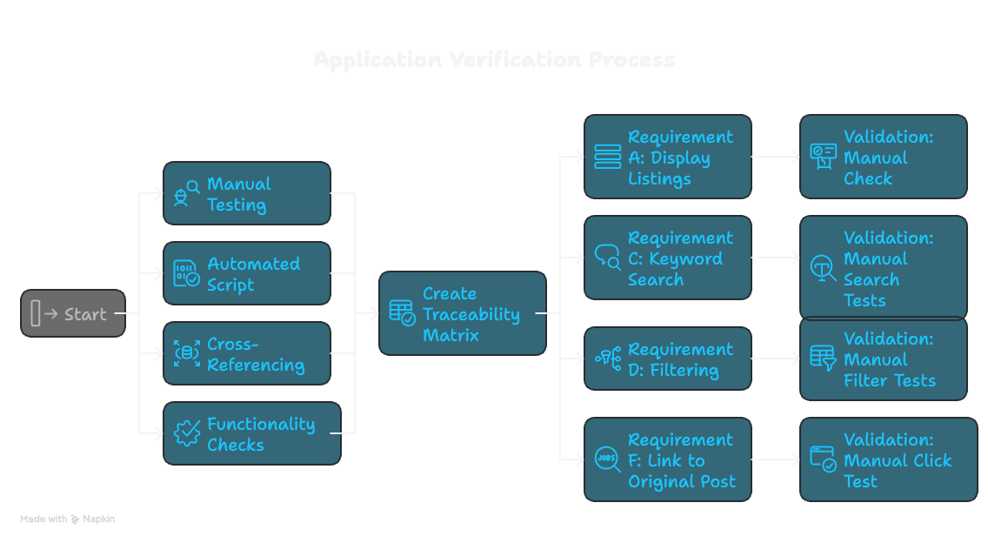
Validation & Verification
Utilized traceability matrix along the process of building our application to finetune our website to best represent our user’s needs.

Slide 9
Thank you

