Slide 1


Forecasting Daily Average Temperature
By Amrutha Sri Varshini Yaddanapudi

Slide 2
Contents
Overview of the data
Preprocessing and EDA
Prediction Models and Conclusion

Slide 3
Overview of the data
Daily climate data covering Indonesia from 2010 to 2020
Owned by Greeg Titan and edited by Elmajo Adriel, data is sourced from Badan Meteorologi, Klimatologi, dan Geofisika Indonesia (BMKG).
Forecasts based on temperature and precipitation are important to agriculture, to traders within commodity markets and are used by utility companies to estimate demand over coming days.
On an everyday basis, many people use weather forecasts to determine what to wear on a given day.
Features Included
Tn: Min temperature (°C)
Tx: Max temperature (°C)
Tavg: Avg temperature (°C)
RH_avg: Avg humidity (%)
RR: Rainfall (mm)
ss: Sunshine duration (hour)
ff_x: Max wind speed (m/s)
ddd_x: Wind direction at maximum speed (°)
ff_avg: Avg wind speed (m/s)
ddd_car: Most wind direction (°)

Slide 4
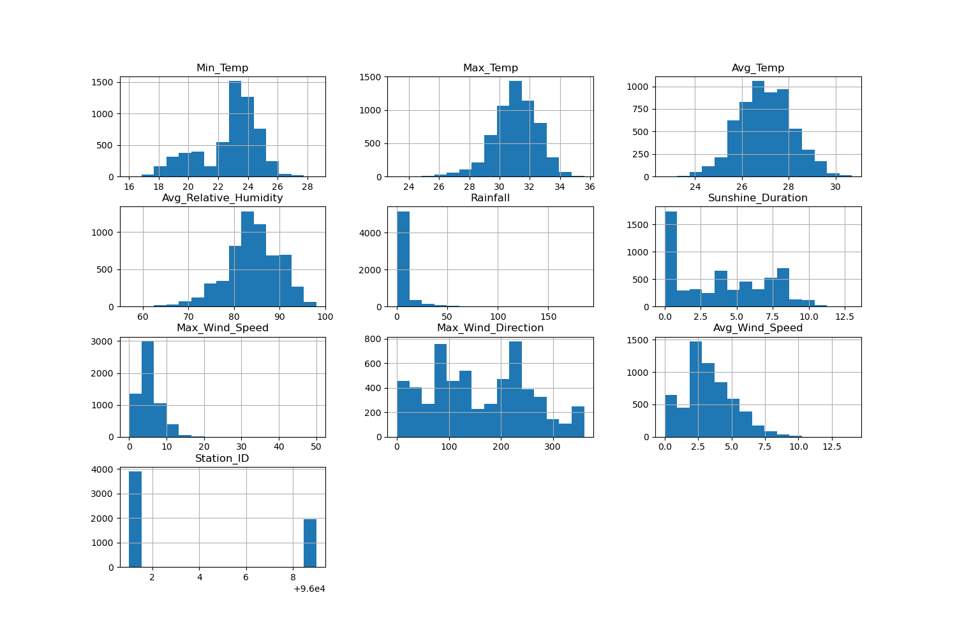
Exploratory Data Analysis
Histogram of Numerical Features

Slide 5
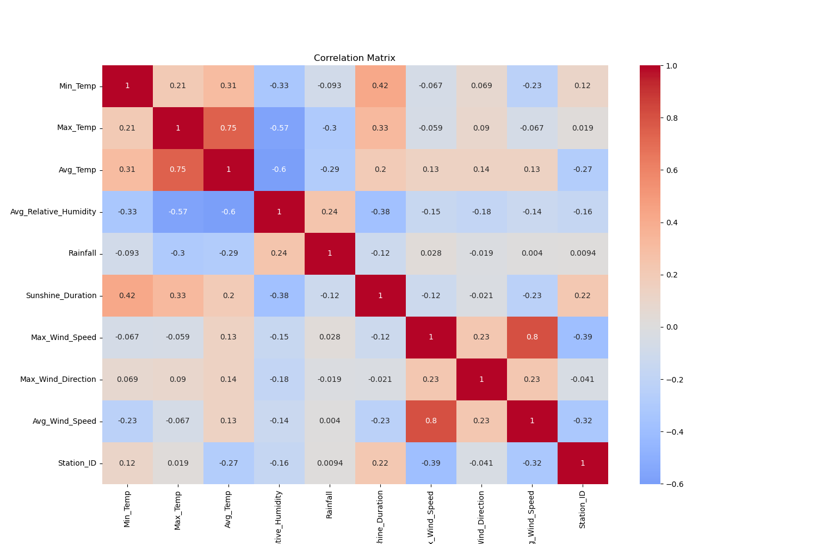
Correlation Matrix

Slide 6
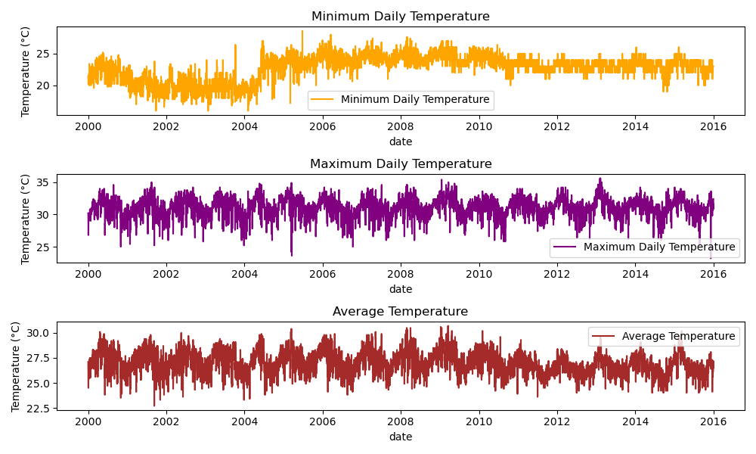
Plotting Minimum, Maximum and Average Temperatures over Time

Slide 7
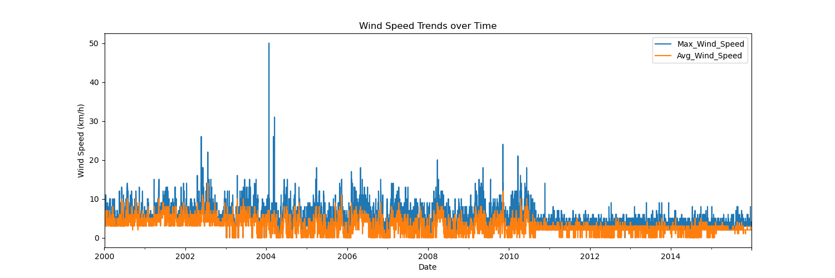
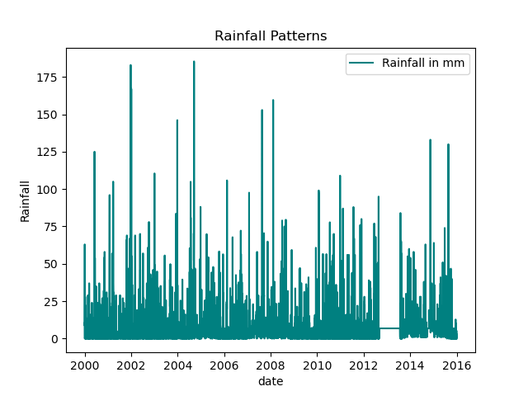
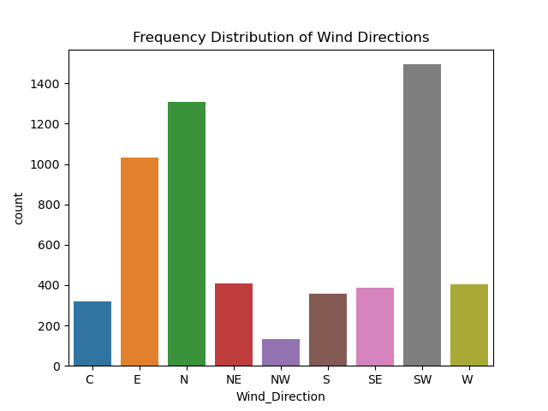

Slide 8
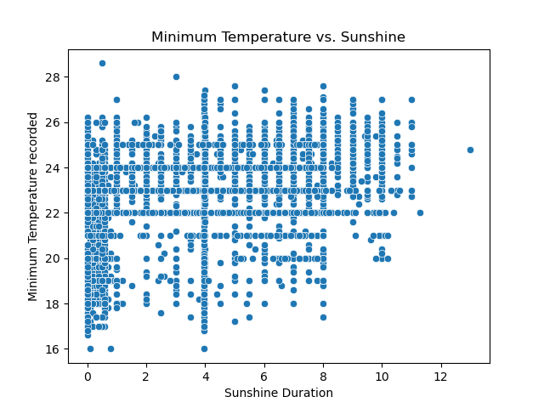
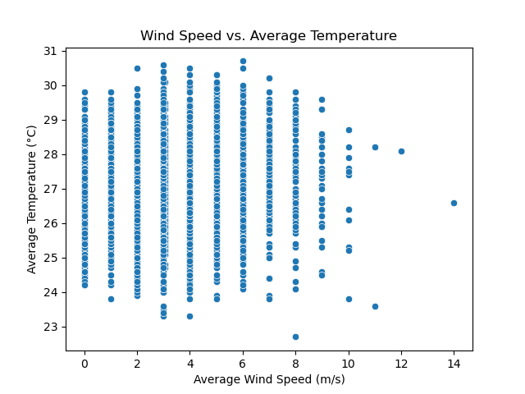
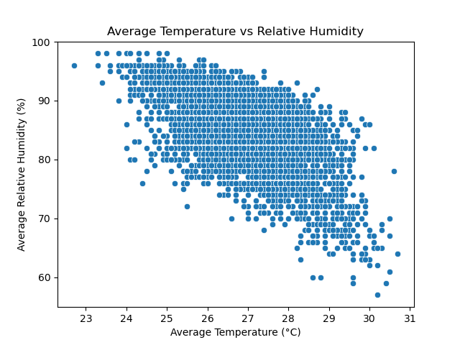

Slide 9
Stationarity and Decomposition
ADF and KPSS tests
STL decomposition results
Seasonality and trend analysis

Slide 10
Stationarity
ADF and KPSS tests:
Augmented Dickey-Fuller (ADF) and Kwiatkowski-Phillips-Schmidt-Shin (KPSS) tests are employed to assess stationarity
ADF checks for the presence of a unit root, indicating non-stationarity, while KPSS tests for stationarity around a deterministic trend.
Interpretation: ADF: If the p-value is below a significance level, we reject the null hypothesis of a unit root, suggesting stationarity.
KPSS: If the p-value is above a threshold, the series is considered stationary; otherwise, it may exhibit a unit root.
Initially, for the raw data the ADF results indicated the data was stationary where as KPSS test indicated the data is non-stationary.

Slide 11
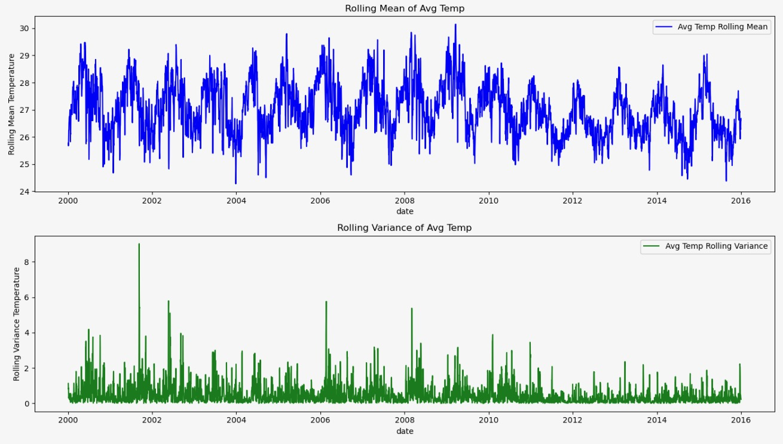
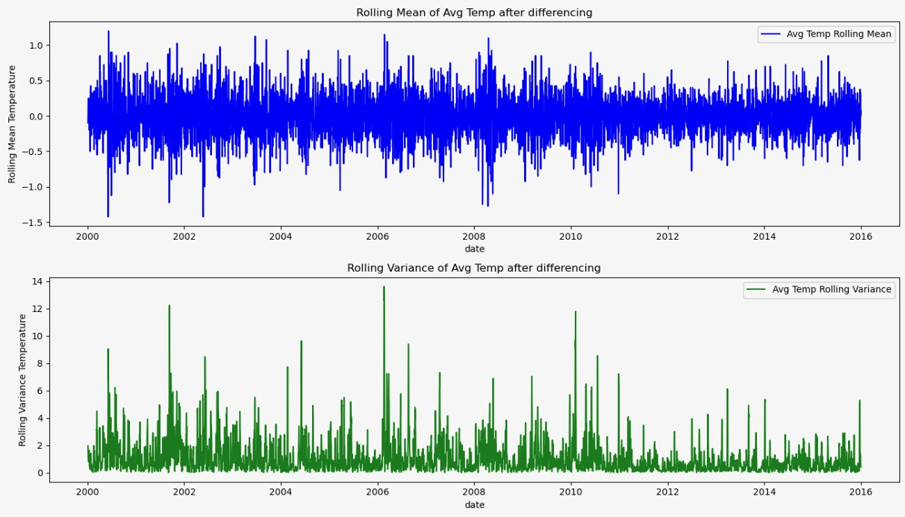

Slide 12
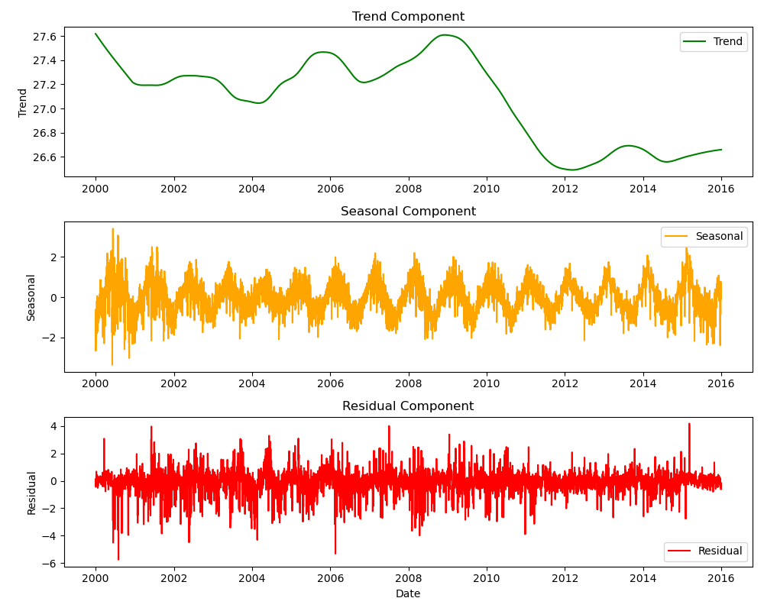
STL Decomposition on raw data

Slide 13
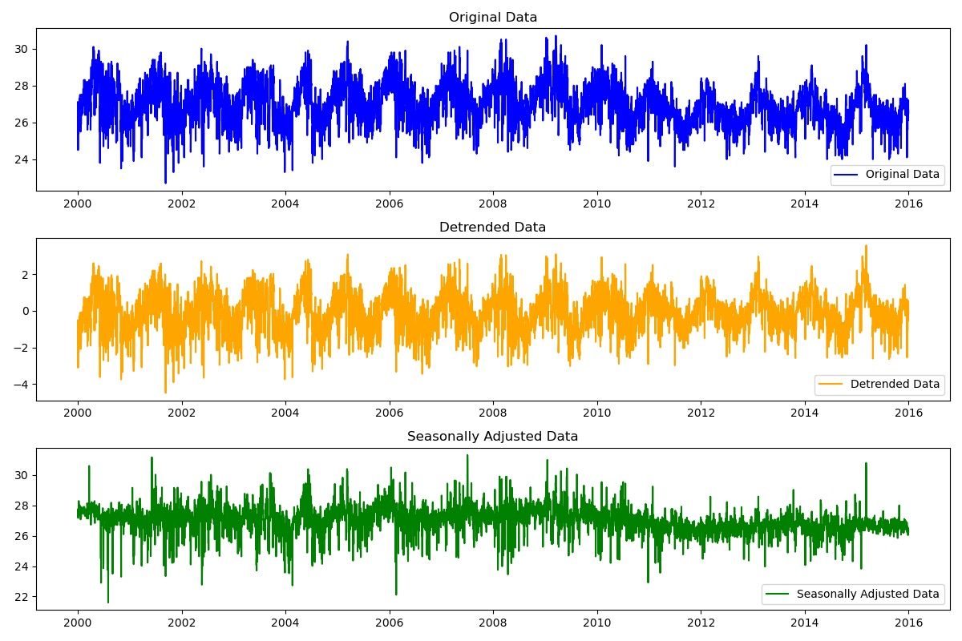
STL Decomposition

Slide 14
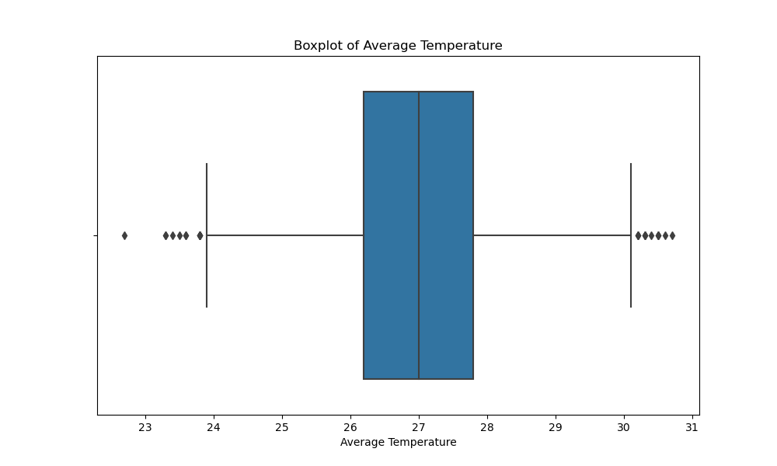
Dealing with Outliers
Boxplot of Average Temperature

Slide 15
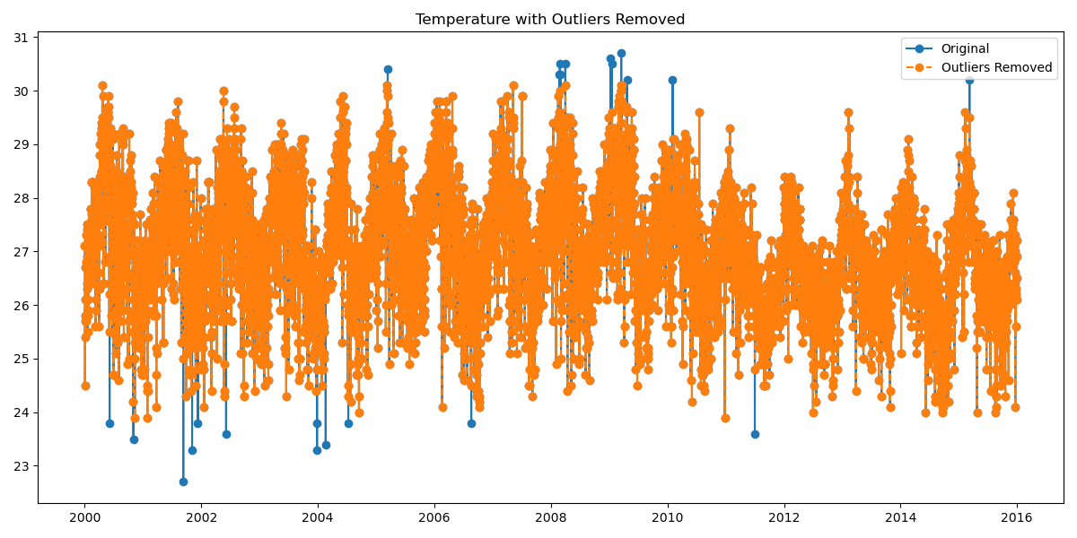

Slide 16
Forecasting Models
ARMA, ARIMA and SARIMA model
Holt-Winters Method
Linear Regression Model
Key findings from each model

Slide 17
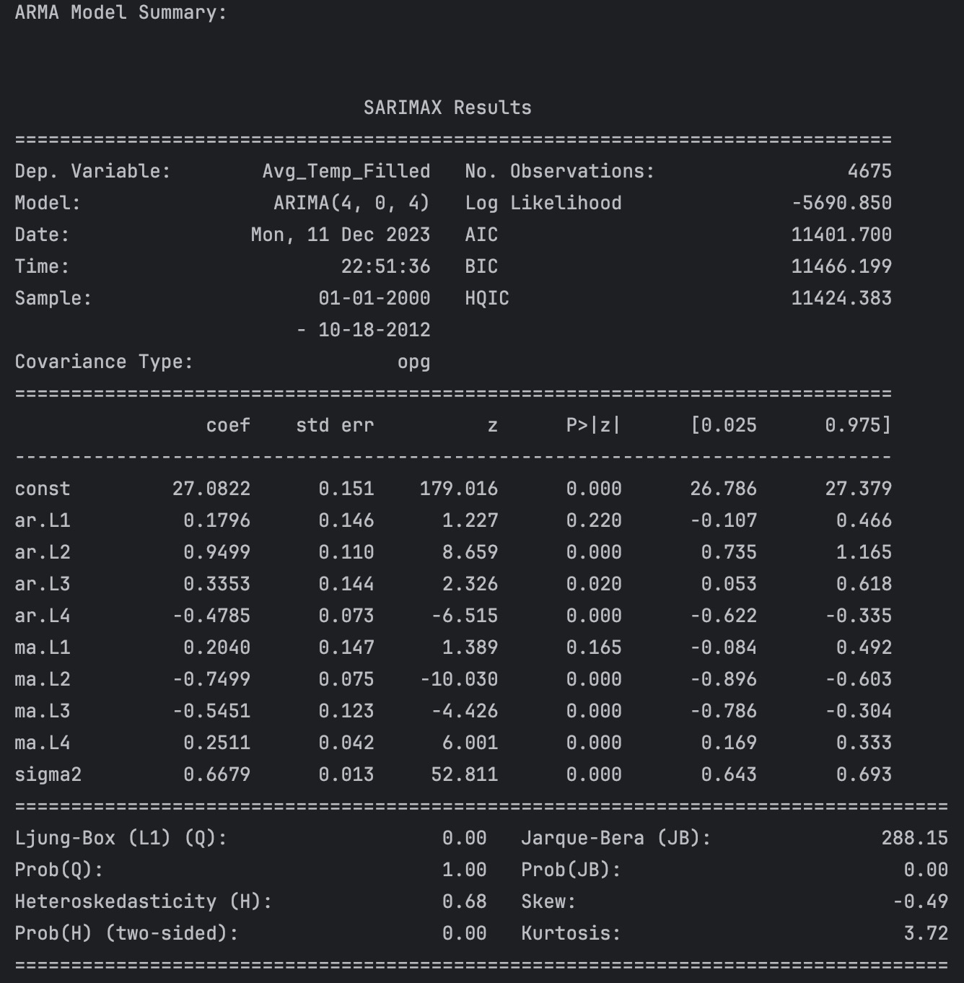
Forecasting Models - ARMA

Slide 18
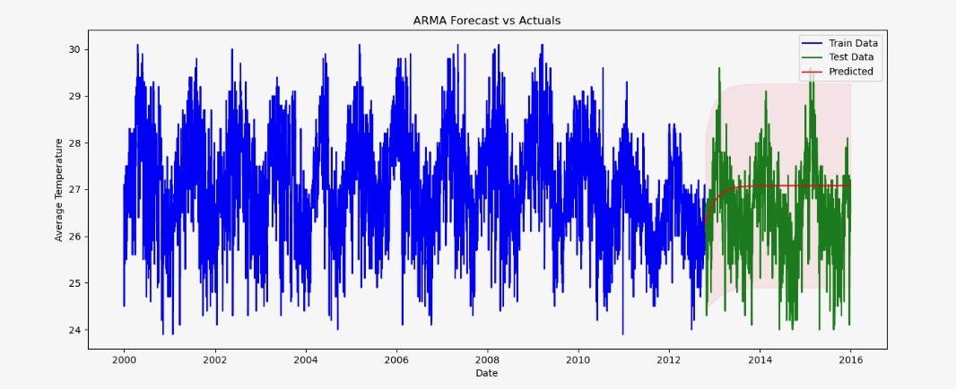
Forecasting Models - ARMA

Slide 19
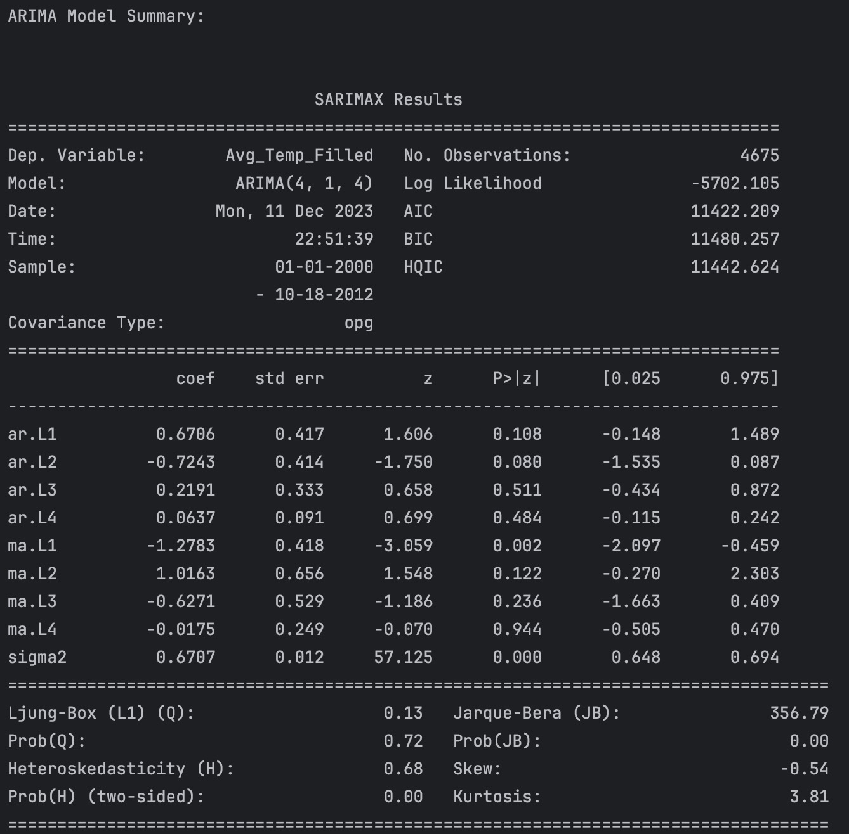
ARIMA Forecast vs Actuals

Slide 20
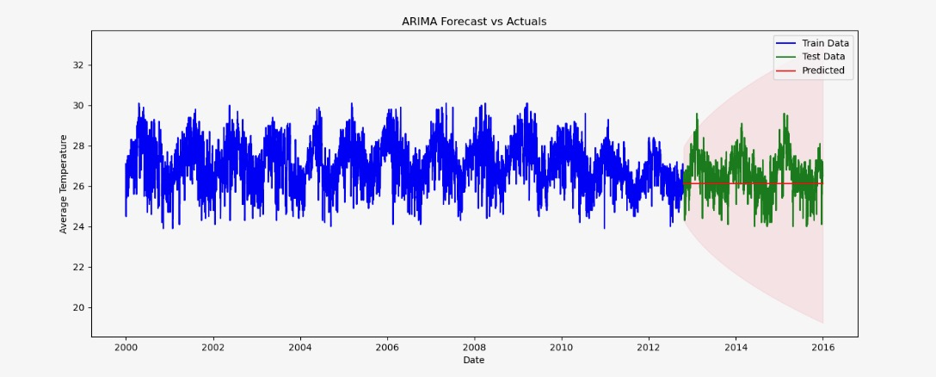
ARIMA Forecast vs Actuals

Slide 21
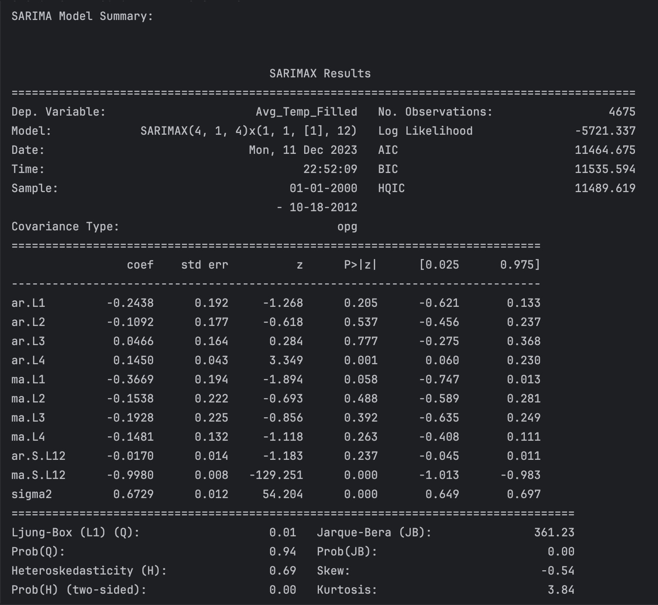
SARIMA

Slide 22
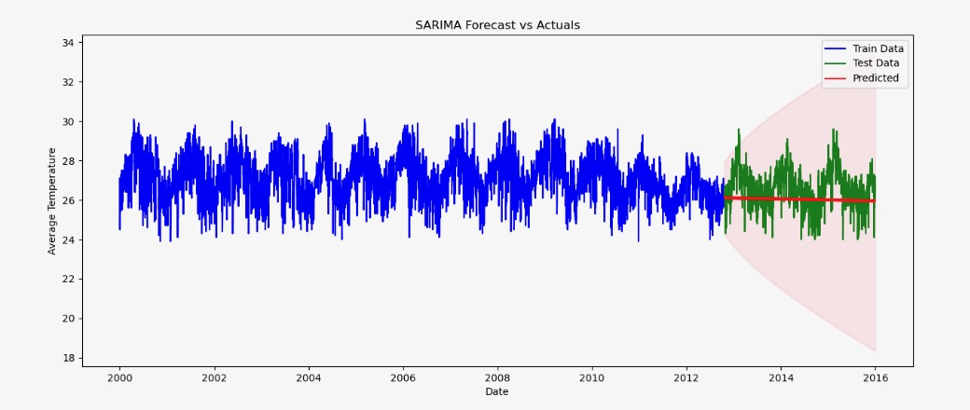
SARIMA Forecast vs Actuals
The SARIMA model appears to have a good fit to the data, with low autocorrelation in the residuals, relatively normal residuals, and no significant signs of heteroskedasticity or extreme skewness.
The model's performance should be further evaluated by comparing it to alternative models and conducting out-of-sample testing to ensure its effectiveness in forecasting.

Slide 23
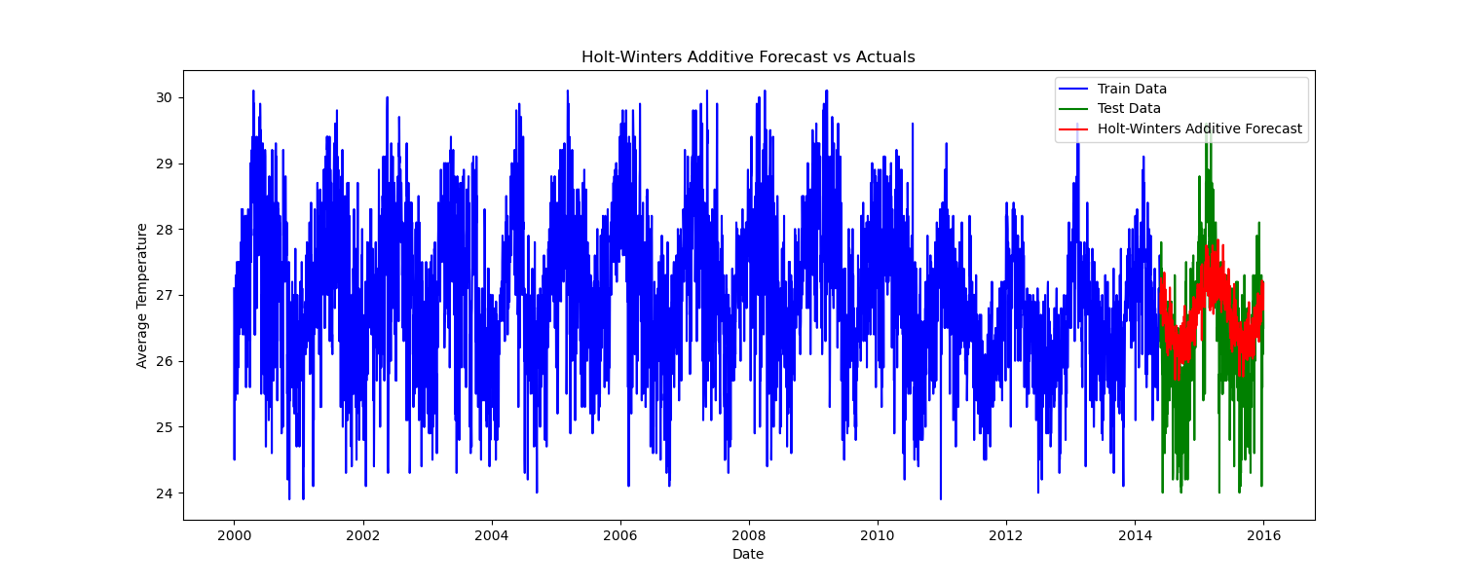
Holt-Winters Additive Forecast vs Actuals

Slide 24
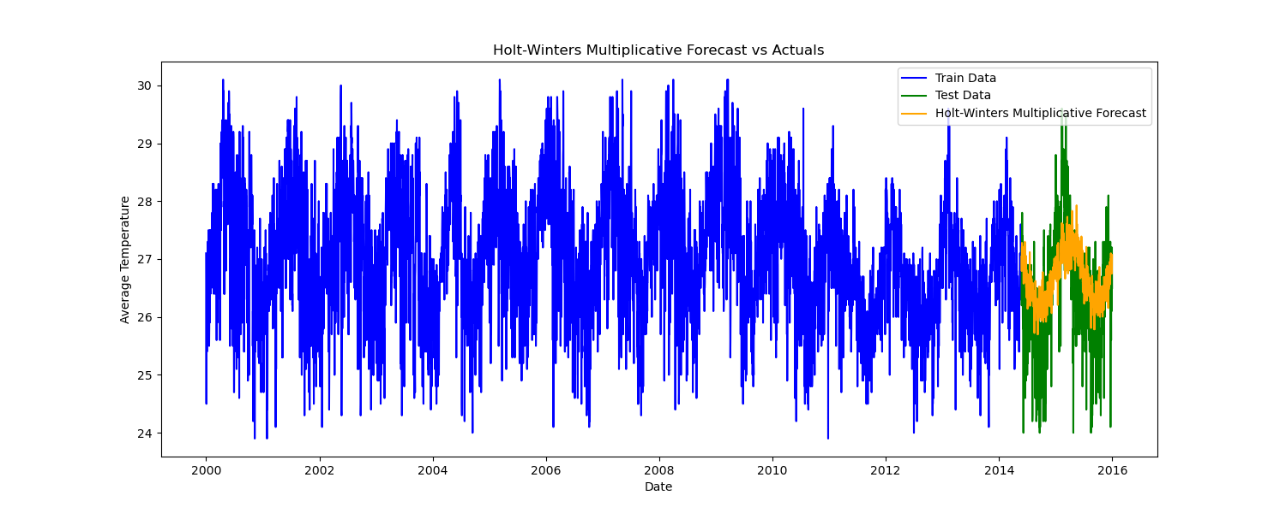
Holt-Winters Multiplicative Forecast vs Actuals

Slide 25
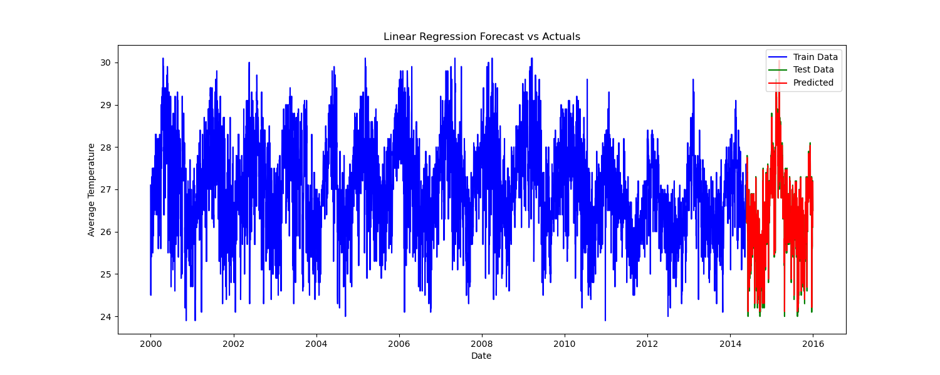
Linear Regression Forecast vs Actuals

Slide 26
Comparison of Models
Among the time series models (ARMA, ARIMA, SARIMA), the SARIMA model has the highest AIC and BIC values, suggesting that it may not be the best fit for the data. Additionally, it has a relatively higher Ljung-Box statistic (Q) indicating some potential issues with residuals and normality.
The ARIMA model performs slightly better in terms of AIC and BIC compared to SARIMA, but it still has some issues with the Ljung-Box statistic
The multiple linear regression model stands out with a significantly lower MSE, RMSE, and a high R-squared value of 0.8595, indicating a strong fit to the data. The adjusted R-squared value of 0.8952 suggests that the predictors in the regression model explain a substantial amount of variance.
Considering the performance metrics, the multiple linear regression model appears to be the better model for the data. It outperforms the time series models (ARMA, ARIMA, SARIMA) in terms of predictive accuracy and goodness of fit. Therefore, the multiple linear regression model is the final model selected for this dataset.

Slide 27
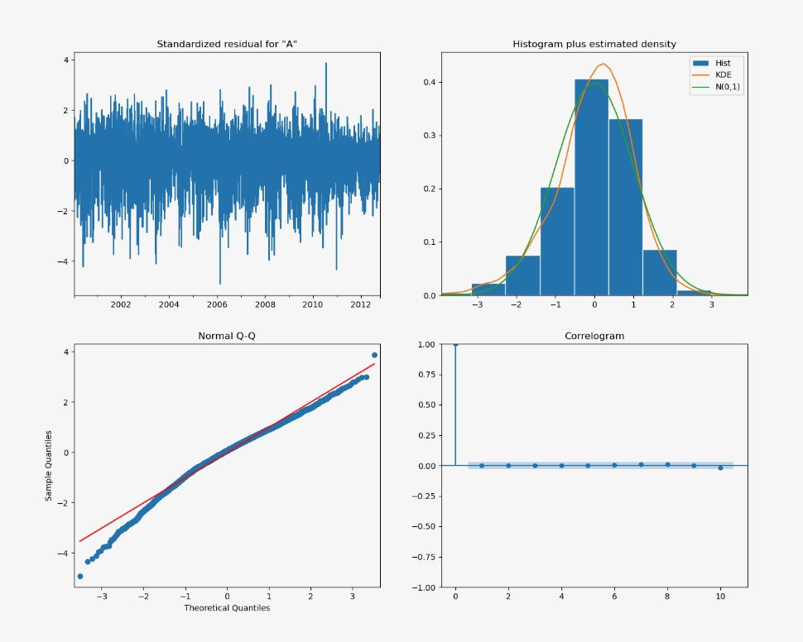
Residual Analysis

Slide 28
Conclusion and Future Directions
In conclusion, our predictive modelling of average temperatures provides a foundation for informed decision-making in various sectors.
Suggestions for Future Research:
Fine-Tuning Models
Incorporating Additional Variables
Regional Analysis
Long-Term Climate Impact
Data Continuity

