Slide 1

GHARPAR
BY MUNNAZZAH ASLAM(SE-007)

Slide 2
OBJECTIVE:
GHARPAR is designed to establish a solution, connecting customers ad service providers.
Our aim is to simplify the process of getting a job done.
The ultimate in comfortable, convenient, and professional beauty services at home.
GHARPAR is a desktop based app solution for providing you with high quality, hygienic, and timely at-home cooking, beauty, home services.

Slide 3
INTRODUCTION:
Project title “GHARPAR” not only keeps the record of various people like customers, employees, services etc. but as well as it reduce the extensive tension and stress in the present system. It wills maker the system more versatile and user friendly. It also calculates the proper billing slip of customers. This project is based on description about the structure of Online Services At-Home. The project contains:
Keeping the record of all persons like customers, employees, services etc.
Maintains proper list of all persons.
Generating proper bill slip.

Slide 4
HOW IT WORKS:
Tell us what you need to get done whether online or you can talk to us over the phone.
We will shortlist the best employee options for you, depending upon the criteria you specify.
We will shortlist the best employee options for you, depending upon the criteria you specify.

Slide 5
PROCESS MODEL:
1) The process model used in GHARPAR is “ITERATIVE MODEL.”
2) It is a constant loop of communication, planning, construction and development.
3) Changes can be made.
4) User’s feedback is taken.
5) Construction is based on user requirements.

Slide 6
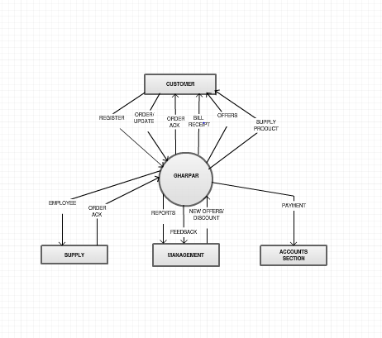
ER DIAGRAM:

Slide 7
USER REQUIREMENTS:
Users new to the application should be able to register by themselves. Users will be differentiated by unique user identifiers.
Transactions should be secure. That is, user’s personal details should not be leaked at any cost.
Users should be able to view a complete list of specified services available in the application.
Users should be able to search for items by related attributes.
Users should be able to select items of interest and add them to their carts for future purchase.
All selected services should be provided to the user following on time.
Users should be able to view the status of services they have ordered.
Large numbers of users should be able to use the application simultaneously.
The performance of the application should not degrade with an increase in the number of goods or services offered.

Slide 8
ADMINISTRATOR REQUIREMENTS:
Administrators should be able to manage applications.
Data managers should be able to delete users.
Site administrators should be able to change the status of goods purchased by users after items have been shipped.
Administrators should be able to view all user transactions.
Site managers should be able to view all orders for the day.

Slide 9
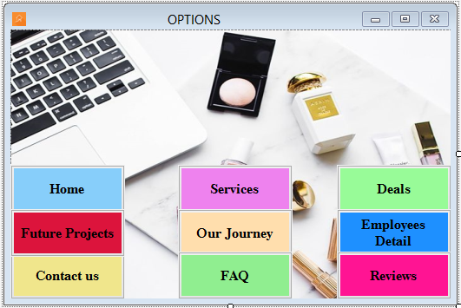
FEATURES: Functional Requirements: This section provides requirement overview of the system. Various functional modules that can be implemented by the system will be:

Slide 10
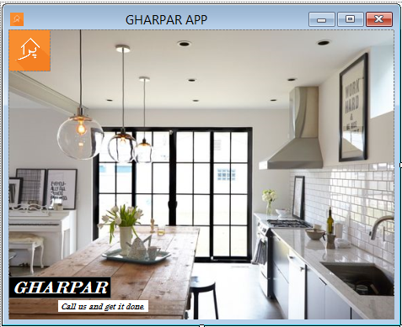
APPLICATION HOME PAGE:

Slide 11
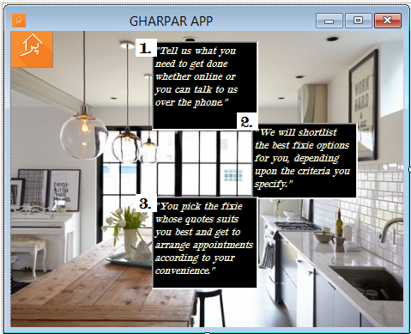

Slide 12
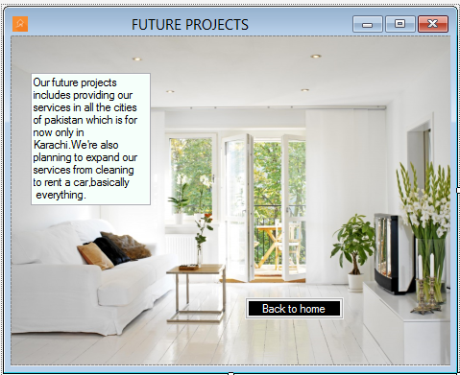

Slide 13
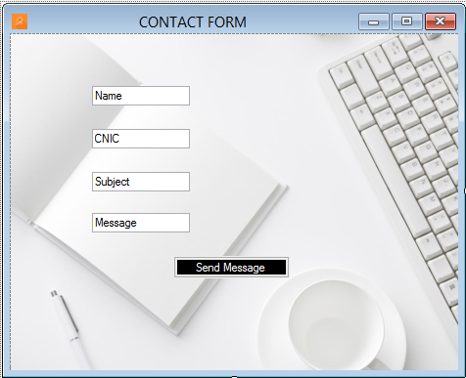

Slide 14
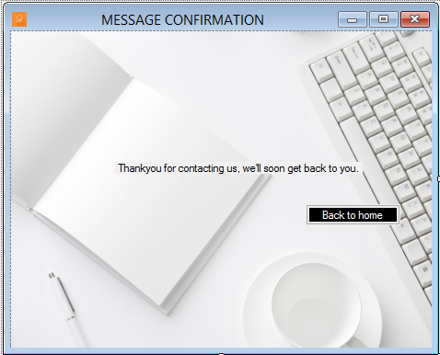

Slide 15
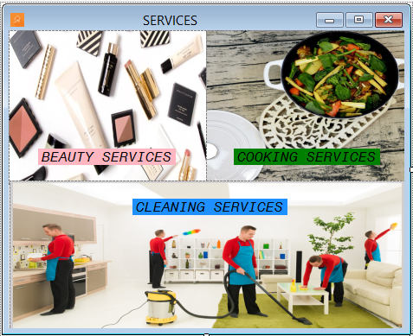

Slide 16
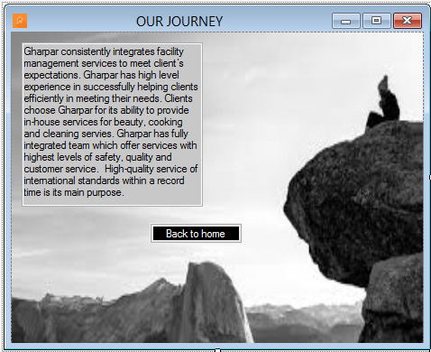

Slide 17
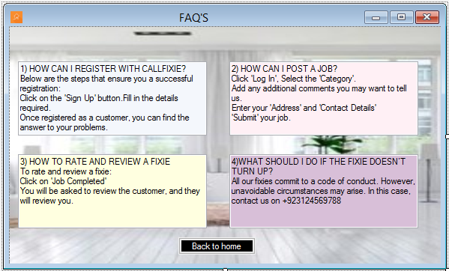

Slide 18
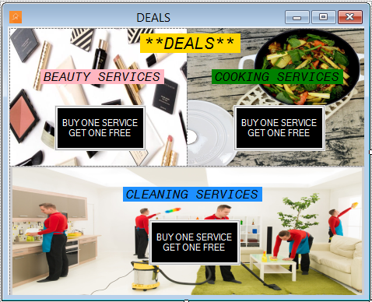

Slide 19
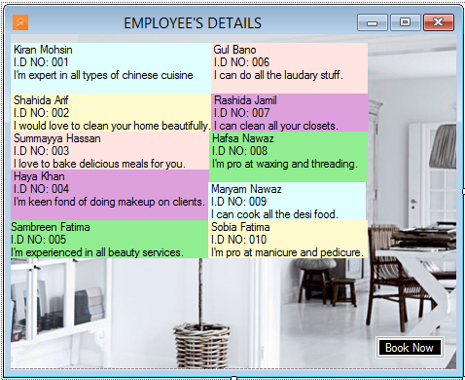

Slide 20
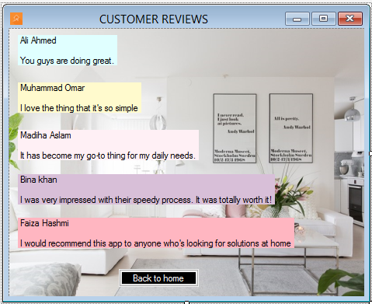

Slide 21
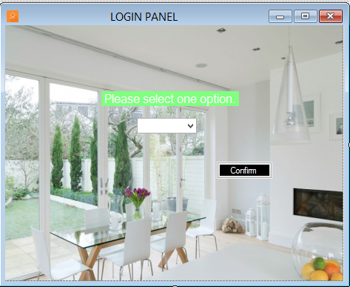

Slide 22
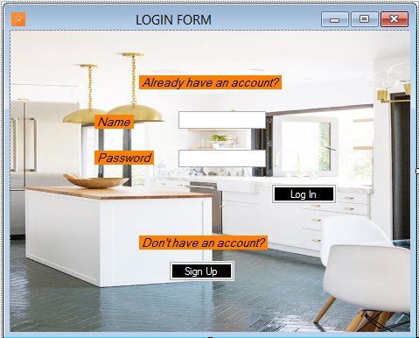

Slide 23
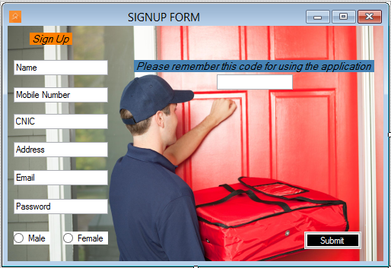

Slide 24
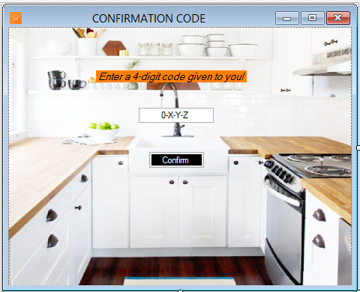

Slide 25
NON-FUNCTIONAL REQUIREMENTS:
1) Security:
system must automatically log out all customers after a period of inactivity.
The system should not leave any cookies on the customer’s computer containing the user’s password.
Sensitive data will be encrypted before being sent over insecure connections like the internet.
2) Reliability:
The system provides storage of all databases.
The reliability of the overall program depends on the reliability of the separate components. The main pillar of reliability of the system is the backup of the database which is continuously maintained and updated to reflect the most recent changes.
Thus the overall stability of the system depends on the stability of container and its underlying operating system.
3) Availability:
The system should be available at all times .That is , it should be available 24 X 7.
4) Maintainability:
A commercial database is used for maintaining the database and the application server takes care of the application.
5) Portability:
The system shall run on PC, Laptops, and PDA etc.

Slide 26
BUSINESS REQUIREMENTS: 1)Data should be consistent. 2)A screen should be there for entering customer contacts. 3) When customers cancel their order we need to ask them why (optional survey). 4) A screen to view reviews of the customer should be there. 5)We need to generate a monthly report that indicates why lost customers uninstall our application.

Slide 27
CONCLUSION: This application is basically designed for people who find it hard to their work by themselves or people who do not have the time to do the work such as: cleaning home, cooking, doing makeup or other beauty services. GHARPAR provides them all the services at their home to ease their problems.

