Slide 1

Team Matplotlib dot pyplot
Team Members:
Lucas Munson
Katie Blood
Gloria Evans

Slide 2
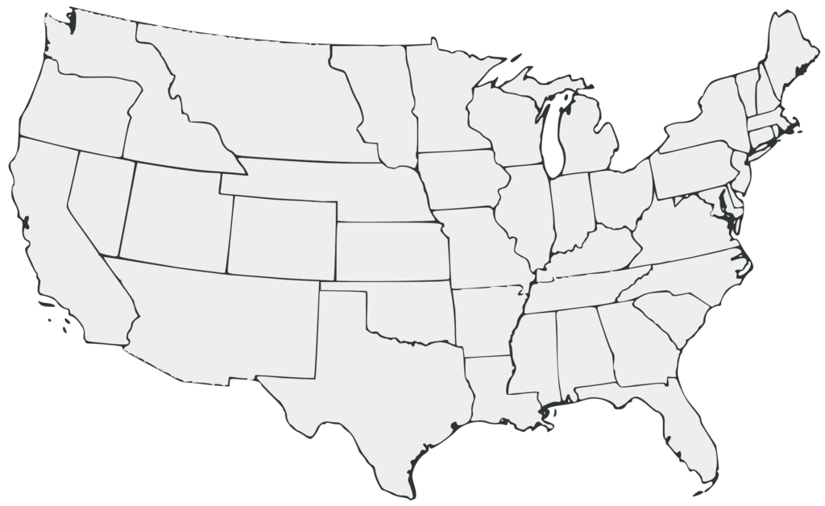
Mobility Changes in the U.S during the covid-19 Pandemic 2020-2021
Source: www.google.com/covid19/mobility/
This Photo by Unknown Author is licensed under CC BY-SA

Slide 3
Hypotheses:
An increase in Coronavirus cases will result in a decrease in the number of visitors at parks and a decline in the usage of the transit system.
Grocery stores and pharmacies were still essential outings during the pandemic and therefore did not experience as great of a decrease in movement.
The more mobility people had in an area directly influenced the number of COVID-19 cases.

Slide 4
Limitations
The data used only goes back to the beginning of the pandemic, roughly March 2020.
The baseline used is five weeks from the beginning of the year 2020. There is no way to determine if the baseline is a representative week.
We do not have enough movement data from before the pandemic to establish a good baseline.
Parks also are a place that fluctuates based on the time of year. Visitation will be higher during the warmer months.

Slide 5
Methods
Merge – Combined years 2020 and 2021 data
Drop columns – Drop data not relevant to hypothesis
Datetime - To convert date column data into actual dates
Matplotlib.dates – to plot dates as x-axis tick marks
Plotly was used for the heatmap.

Slide 6
ANOVA
statistic=462.39777712696065, pvalue=0.0)
With a p-value so small that it is not within the precision scope of a floating point number, we feel confident in rejecting the null hypothesis, and saying that the relationship between cases and people’s movement is statistically significant.
ANOVA Numbers: F- statistic: 462.39777712696065
P-Value: 0.0

Slide 7
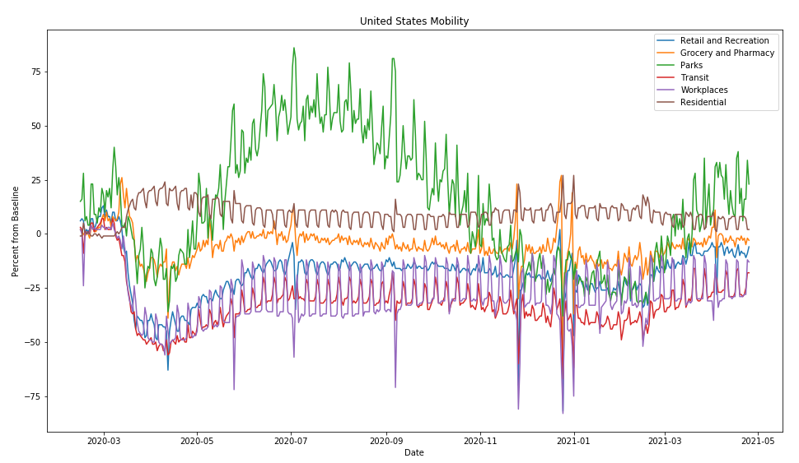
National mobility during covid-19

Slide 8
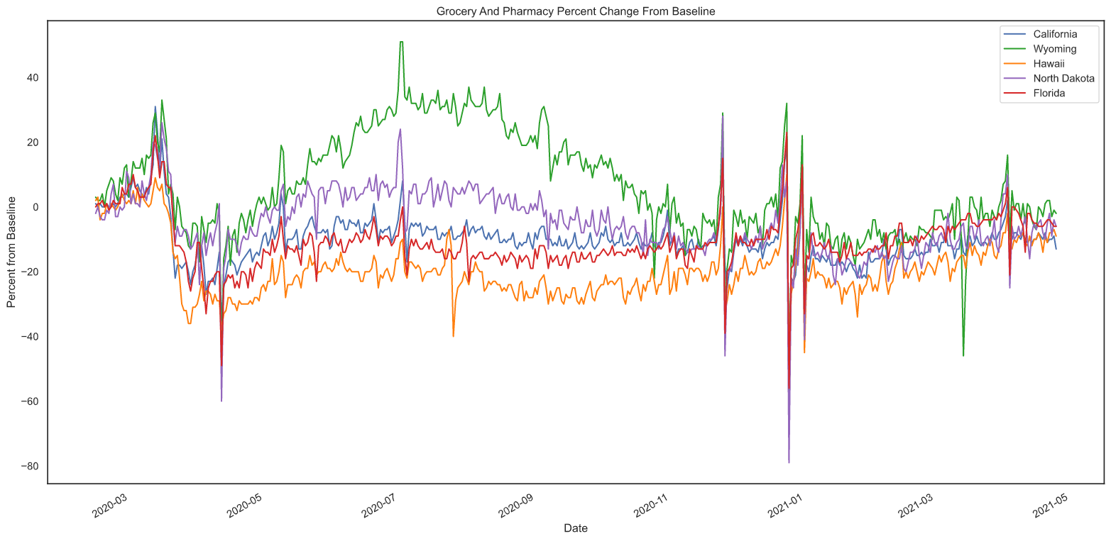
State Grocery and pharmacy mobility

Slide 9
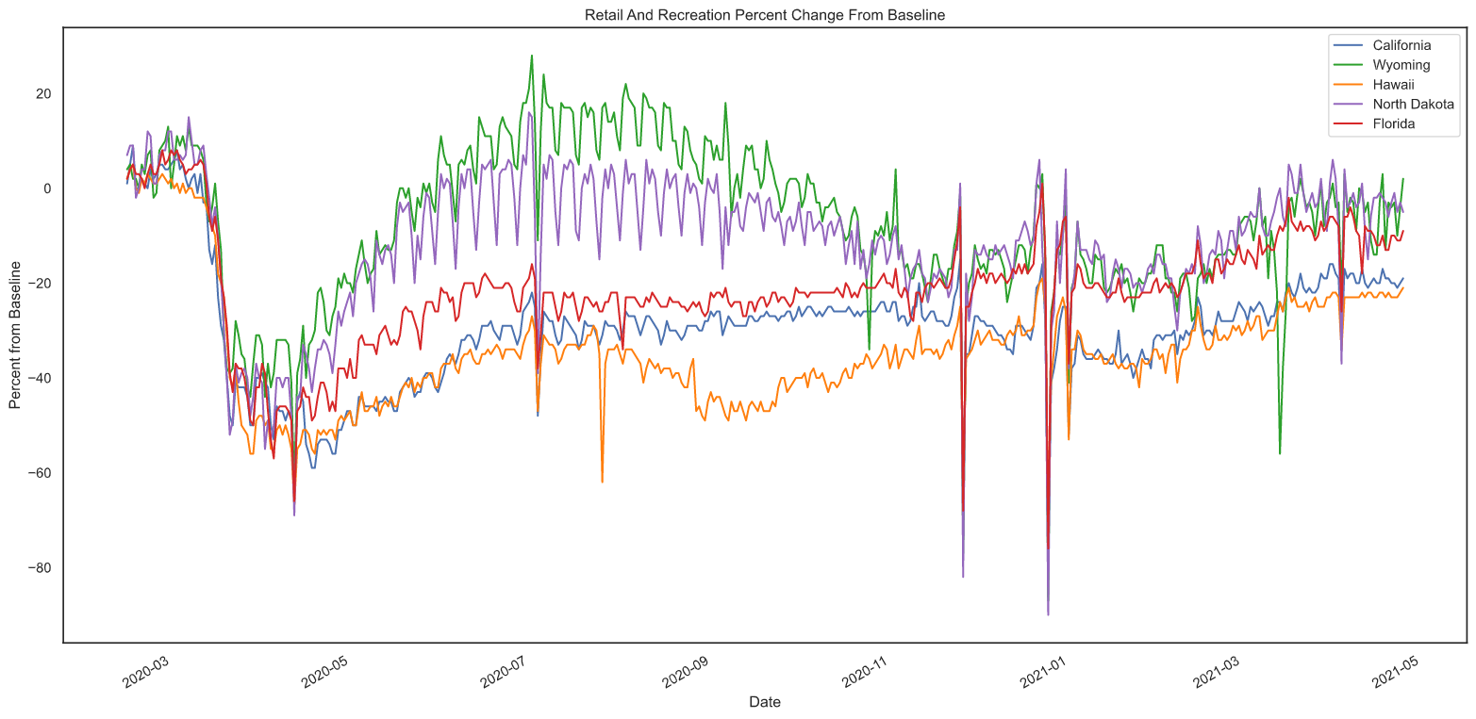
State Retail and recreation mobility

Slide 10
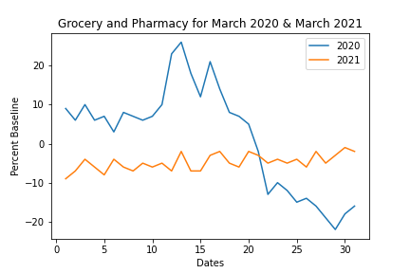
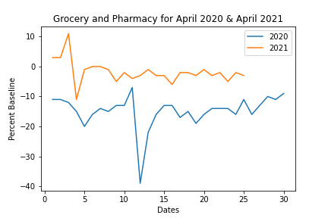
Grocery and pharmacy comparison

Slide 11
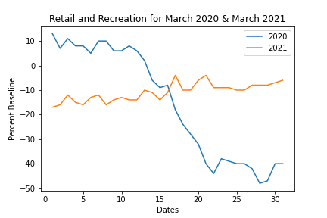
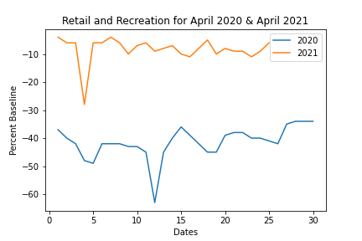
Retail and recreation comparison

Slide 12
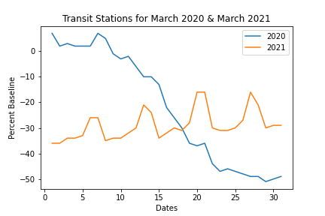
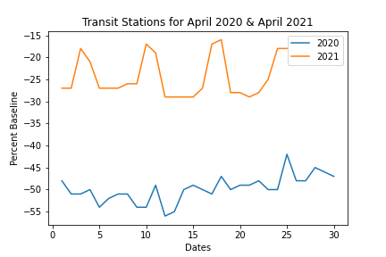
Transit station comparison

Slide 13
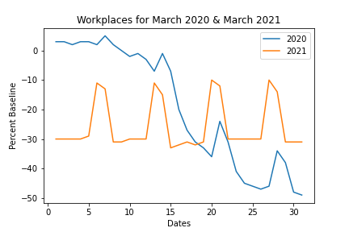
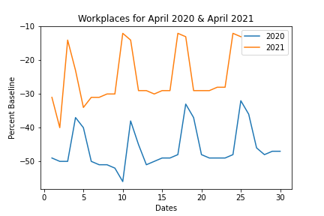
Workplace comparison

Slide 14
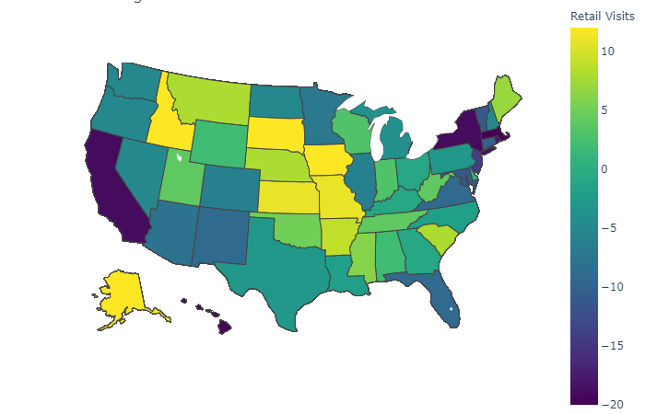
Heatmap of retail visits during pandemic

Slide 15
summary

Slide 16
Any Questions?

