Slide 1

Team Matplotlib dot pyplot
Team Members:
Lucas Munson
Katie Blood
Gloria Evans

Slide 2
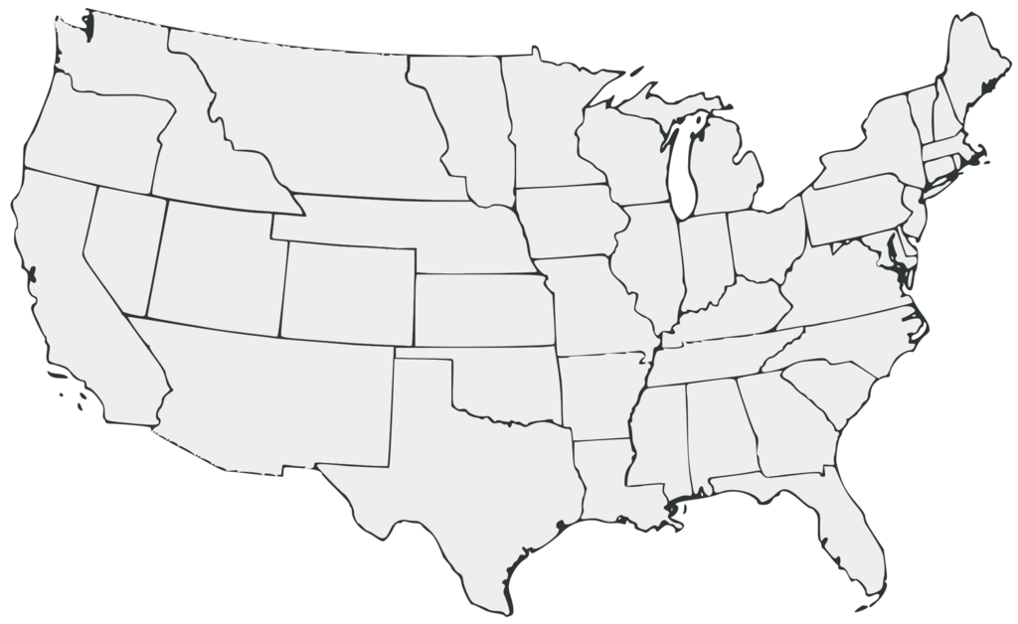
Mobility Changes in the U.S during the covid-19 Pandemic 2020-2021
Source: support.google.com/covid10-mobility
This Photo by Unknown Author is licensed under CC BY-SA

Slide 3
Hypotheses:
An increase in Coronavirus cases will result in a decrease in the number of visitors at parks and a decline in the usage of the transit system.
Grocery stores and pharmacies were still essential outings during the pandemic and therefore did not experience as great of a decrease in movement.
The more mobility people had in an area directly influenced the number of COVID-19 cases.

Slide 4
Limitations
The data used only goes back to the beginning of the pandemic, roughly March 2020. The baseline used is five weeks from the beginning of the year 2020.

Slide 5
Methods
Merge – Combined years 2020 and 2021 data
Drop columns – Drop data not relevant to hypothesis
Datetime - To convert date column data into actual dates
Matplotlib.dates – to plot dates as x-axis tick marks

Slide 6
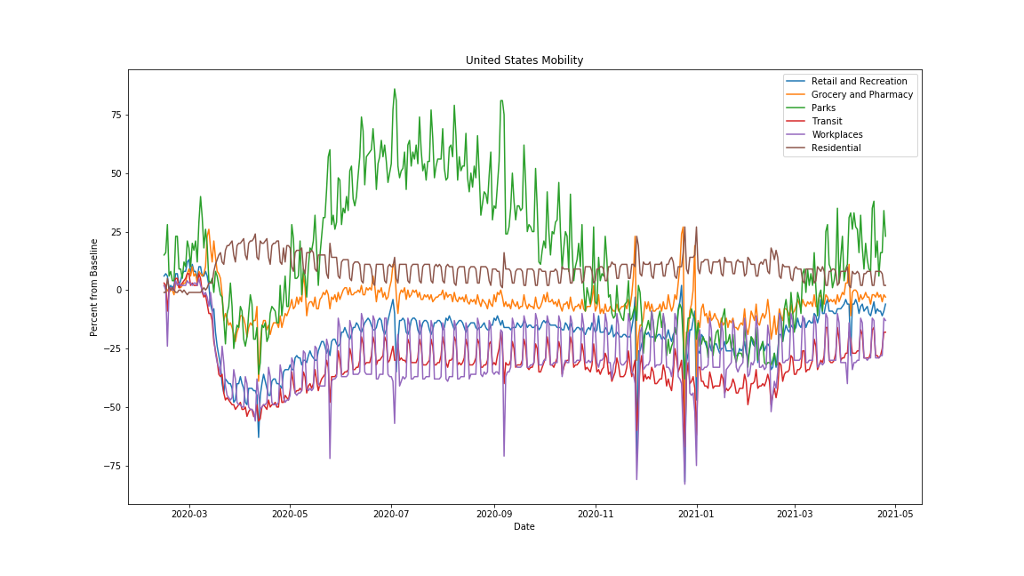
Graph of all the data nationwide

Slide 7
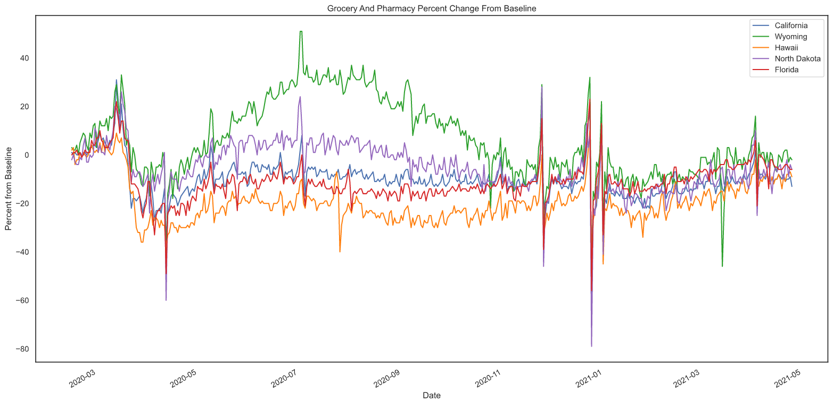
Grocery and pharmacy state graph

Slide 8
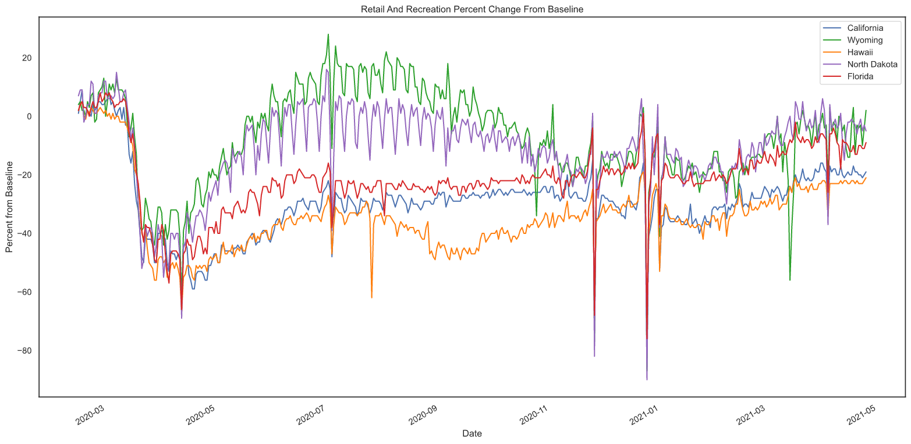
Retail state graph

Slide 9
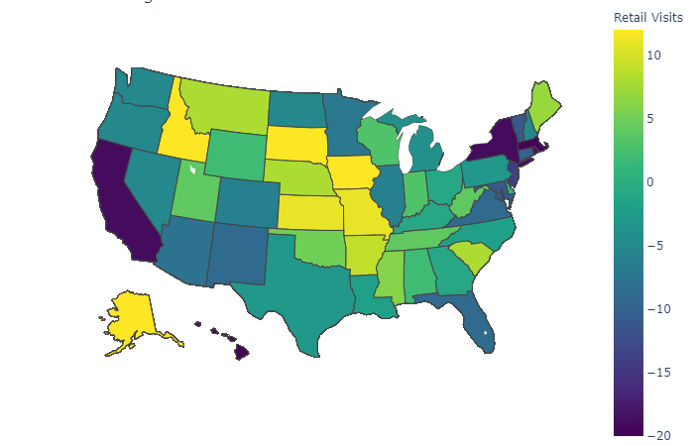
Heatmap of variables (if I can get it working)

Slide 10
ANOVA/ ordinary least squares (again, if we can get it working right)

Slide 11
Summary of findings, re-visit hypothesies and say what happened with them and if they are good and all that kind of stuff

Slide 12
QUESTIONS????? (or maybe some other kinda thing I dunno I feel like the last slide is always questions)

