Slide 1
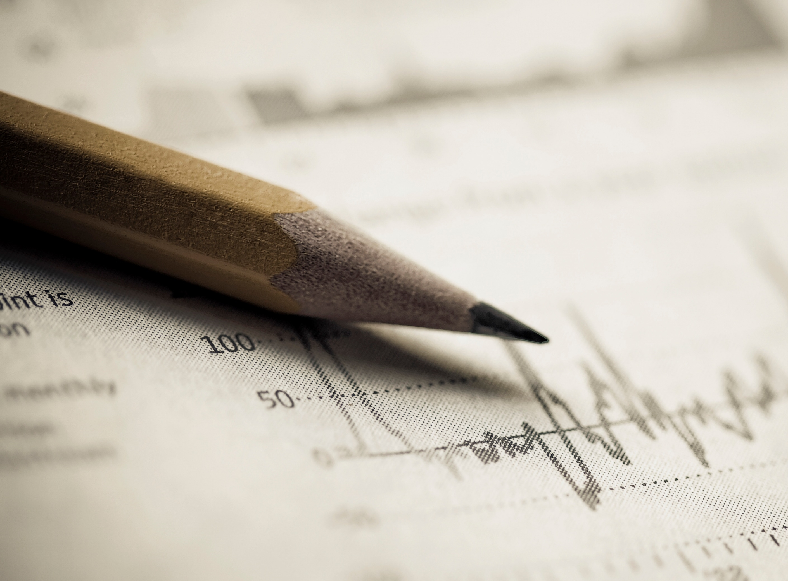
Team Matplotlib dot pyplot
Team Members:
Lucas Munson
Katie Blood
Gloria Evans

Slide 2
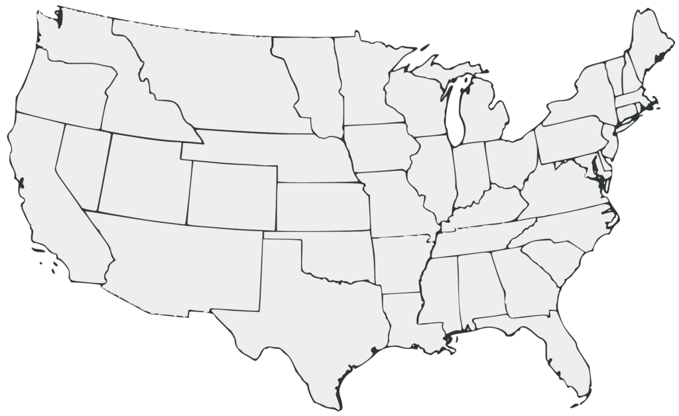
Mobility Changes in the U.S during the covid-19 Pandemic 2020-2021
Source: support.google.com/covid10-mobility
This Photo by Unknown Author is licensed under CC BY-SA

Slide 3
Hypotheses:
An increase in Coronavirus cases will result in a decrease in the number of visitors at parks and a decline in the usage of the transit system.
Grocery stores and pharmacies were still essential outings during the pandemic and therefore did not experience as great of a decrease in movement.
The more mobility people had in an area directly influenced the number of COVID-19 cases.

Slide 4
Limitations
The data used only goes back to the beginning of the pandemic, roughly March 2020.
The baseline used is five weeks from the beginning of the year 2020. There is no way to determine if the baseline is a representative week.
We do not have enough movement data from before the pandemic to establish a good baseline.

Slide 5
Methods
Merge – Combined years 2020 and 2021 data
Drop columns – Drop data not relevant to hypothesis
Datetime - To convert date column data into actual dates
Matplotlib.dates – to plot dates as x-axis tick marks
Plotly was used for the heatmap.

Slide 6
ANOVA
statistic=462.39777712696065, pvalue=0.0)
With a p-value so small that it is not within the precision scope of a floating point number, we feel confident in rejecting the null hypothesis, and saying that the relationship between cases and people’s movement is statistically significant.
ANOVA NUM NUMS: F- statistic: 462.39777712696065
P-Value: 0.0

Slide 7
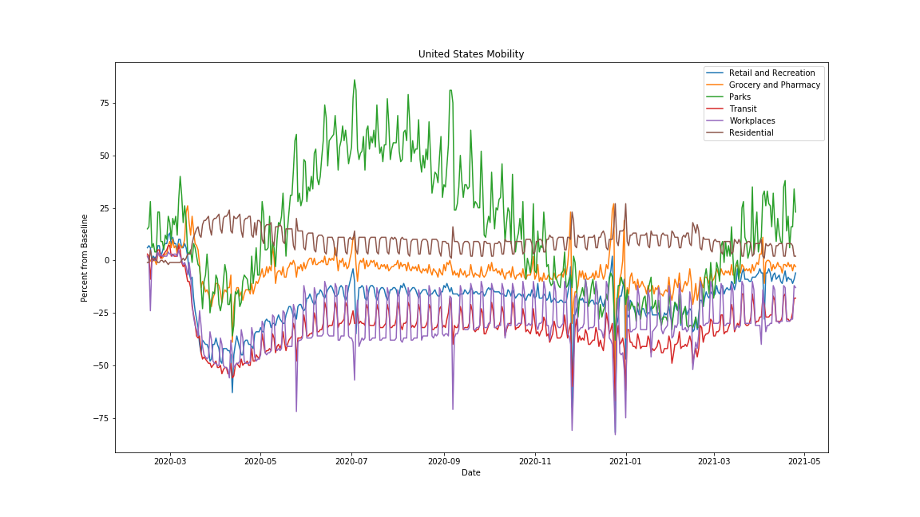
Graph of all the data nationwide

Slide 8
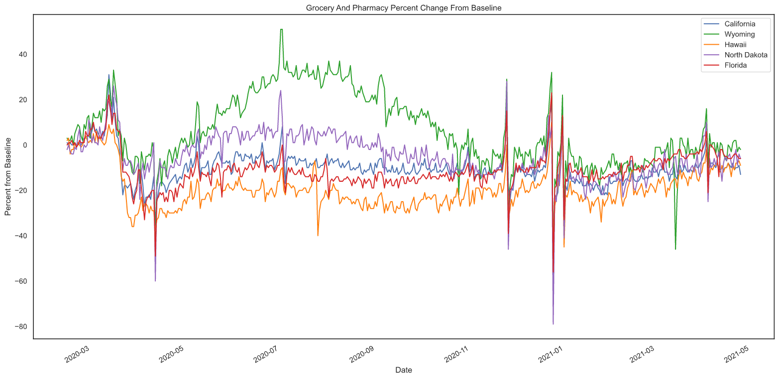
Grocery and pharmacy state graph

Slide 9
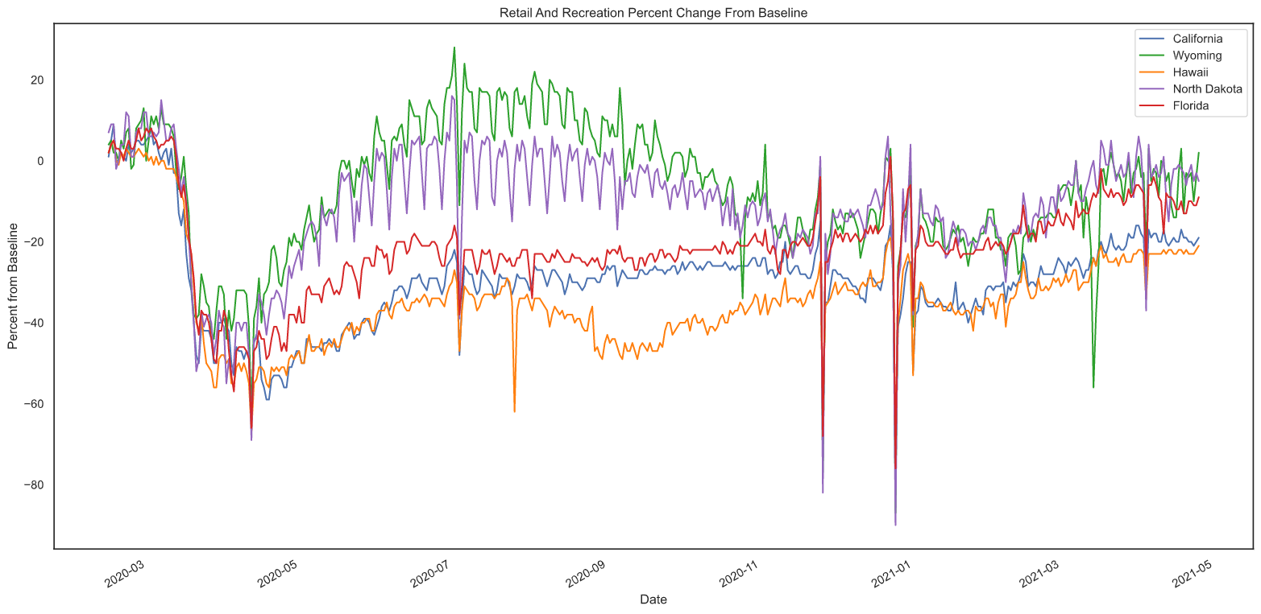
Retail state graph

Slide 10
Lets put the YOY line stuff here

Slide 11
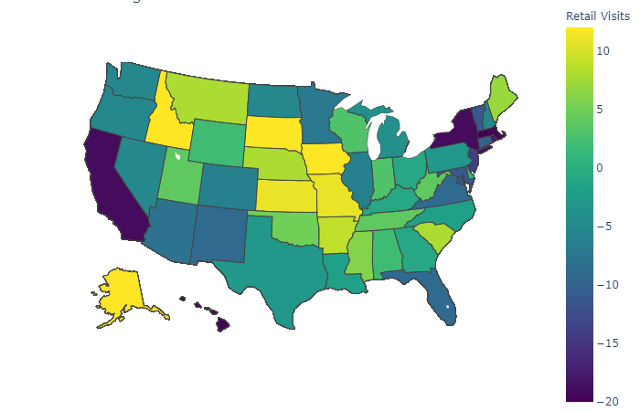
Heatmap of variables (if I can get it working)

Slide 12
Summary of findings, re-visit hypothesies and say what happened with them and if they are good and all that kind of stuff

Slide 13
QUESTIONS????? (or maybe some other kinda thing I dunno I feel like the last slide is always questions)

