Slide 1








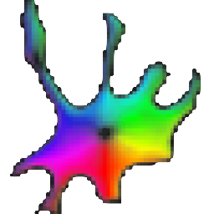




Code architecture
Image storage
Access via pysmb module
temp copy to local memory
FISH images
Network-attached storage
NAS (NFS, SMB)
Local computer
Image processing
Write back to NAS
Metadata
Cellpose
additional automation codes
Data frame
Cell segmentation,
spot quantification and classification
Folder with results

