Slide 1



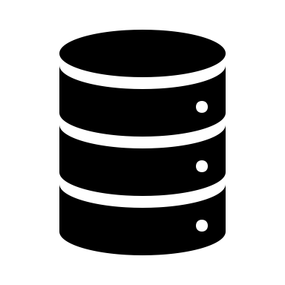

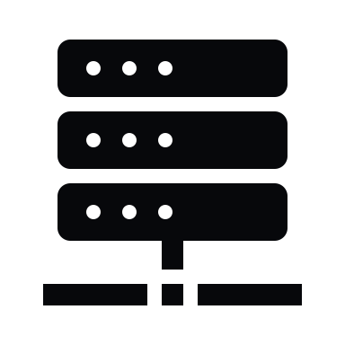











Code architecture
Experiments FISH images
IN
Image storage
OUT
Server Message Block (SMB) protocol
read/copy to local
Data interpretation
Network-attached storage
NAS (NFS, SMB)
Secure Shell (SSH) protocol
remote server
Write back to NAS
Metadata
PDF
Data frame
Segmentation
Spot detection
Data management
Folder with results
Image processing

