Slide 1
Python module
to process FISH (Fluorescence In Situ Hybridization) images
Luis Aguilera
Joshua Cook

Slide 2
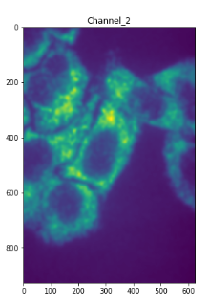


Motivation
Extracting quantitative data from FISH images.
Multi-step process. (Segmentation, spot detection, quantification).
Requires a skilled user.
Labor intensive.
Multiple steps require user input (to select thresholds).
User-to-user variability.
Large and complex datasets that are:
Difficult to transfer data between computers (local/remote).
Difficult to interpret.
Difficult to apply (new/retrospective) changes.

Slide 3


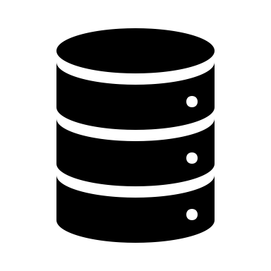






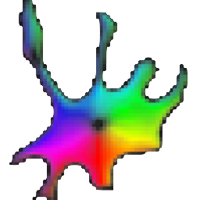



Code architecture
Image storage
Access via pysmb module
temp copy to local memory
FISH images
Network-attached storage
NAS (NFS, SMB)
Local computer
Image processing
Write back to NAS
Metadata
Cellpose
Cell segmentation,
3D-spot quantification and classification
Data frame
Folder with results

Slide 4
Easy to use
Experimental parameters
# Path to folder with images
data_dir # path to a folder with images.
# Cell Segmentation
channels_with_cytosol = [1,2] # list or int indicating the channels where the cytosol is detectable
channels_with_nucleus = 0 # list or int indicating the channels where the nucleus is detectable
channels_with_FISH = [1,2] # list or int with the channels with FISH spots.
diamter_nucleus = 200 # approximate nucleus size in pixels
diameter_cytosol = 250 # approximate cytosol size in pixels
# Parameters for spot detection
voxel_size_z = 500 # Microscope conversion px to nanometers in the z axis.
voxel_size_yx = 103 # Microscope conversion px to nanometers in the xy axis.
psf_z = 600 # PSF emitted by a [rna] spot in the z plan, in nanometers.
psf_yx = 150 # PSF emitted by a [rna] spot in the yx plan, in nanometers.
# Cluster Detection
minimum_spots_cluster = 7 # The number of intensities for a point to be considered as a cluster.
Running the pipeline
dataframe_FISH = PipelineFISH(data_dir, channels_with_cytosol, channels_with_nucleus, channels_with_FISH, diamter_nucleus, diameter_cytosol, voxel_size_z, voxel_size_yx, psf_z, psf_yx, minimum_spots_cluster).run()

Slide 5
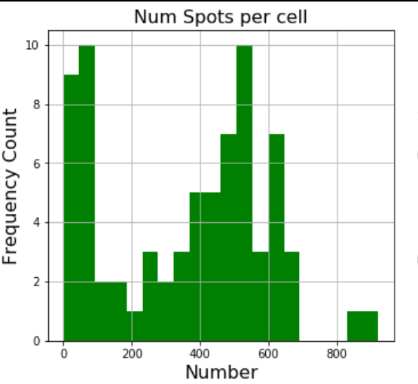
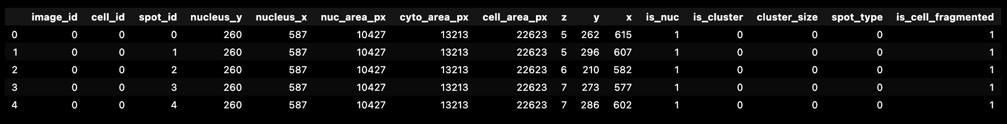
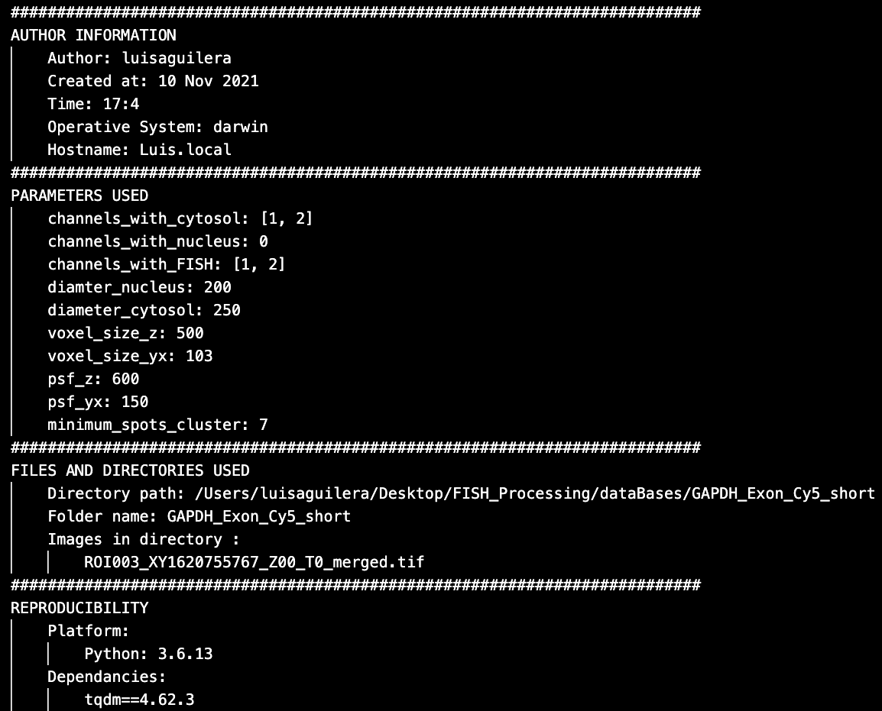
Easy to interpret
Data-frame with all information (Pandas)
Metadata for reproducibility (text file)

Slide 6

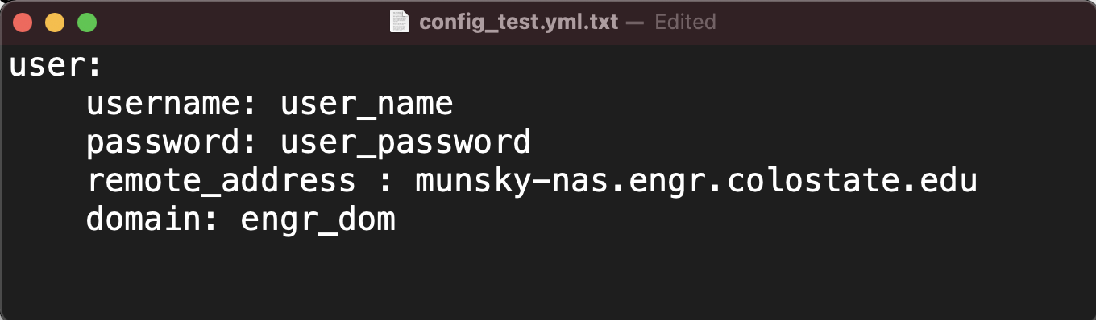
Connection to NAS
NAS (NFS, SMB)
Local computer
Configuration file (.yaml)
NASConnection(config_file, share).copy_files(remote_folder, local_folder, timeout=60)
Options to interact with NAS.
Download images to local computer.
Write .tex and .csv files to NAS.

Slide 7
Try it in Google Colab!
https://colab.research.google.com/drive/1CQx4e5MQ0ZsZSQgqtLzVVh53dAg4uaQj?usp=sharing

