Slide 1

rSNAPed : RNA Sequence to NAscent Protein Experiment Designer
Luis Aguilera, William Raymond, Brooke Silagy, Tatsuya Morisaki, Tim Stasevich, Brian Munsky.
Notes:
Today I am going to talk to you about the work Luis and I have been doing lately. We have been working on simulating cell data of single-cell mRNA translation.

Slide 2








Automation
Non-automated pipeline
selected parameter(s)
Target (#spots)
tuning
parameters
Image(s)
large process(es)
Segmentation/tracking
Process parameters
Data

Slide 3



Automation
Automated Image processing pipeline
100s cells
1000s spots
rsnaped-pipeline-CLI
automated data management
Segmentation
1
Tracking
2
Quantification
¹ Automatic parameter tuning
² Automatic decision taking if an analysis fails
CLI : Command Line Interface

Slide 4



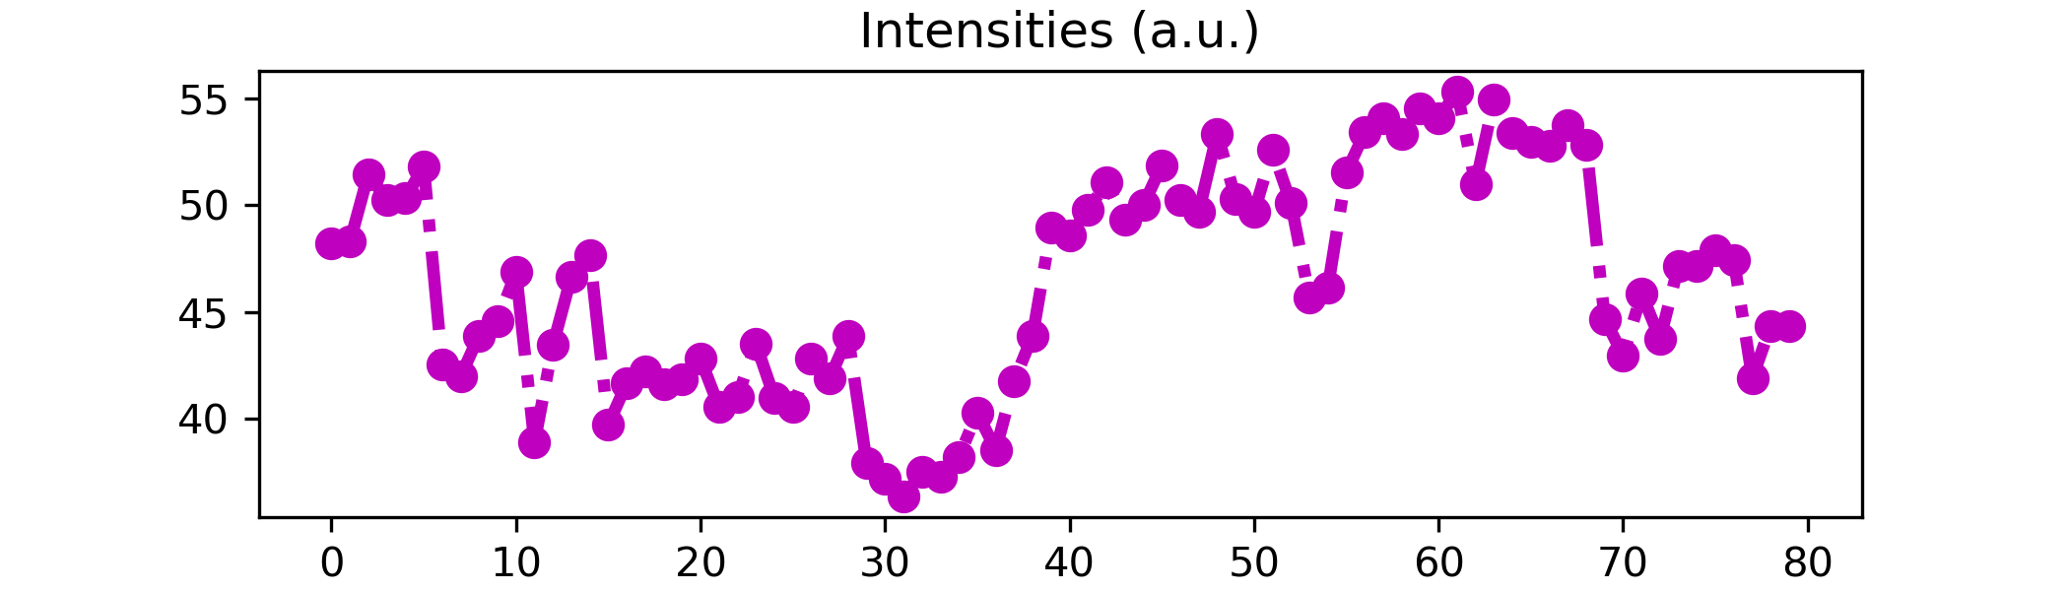

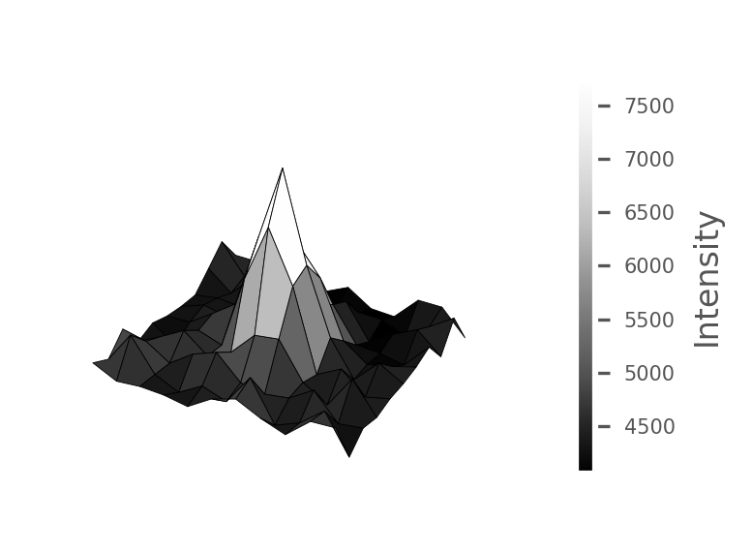
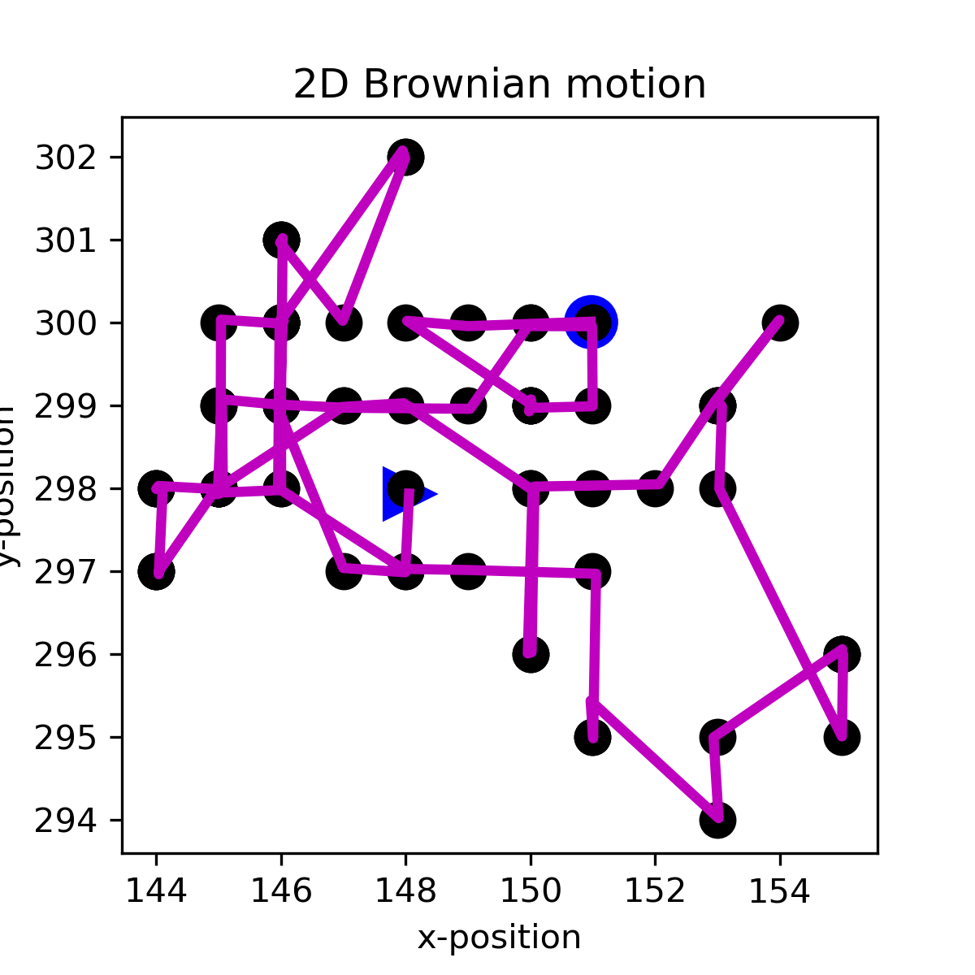
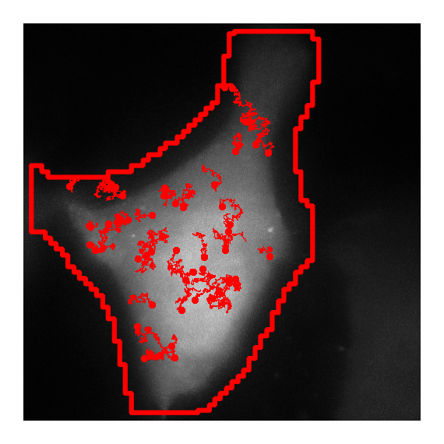
Steps to simulate a cell
Simulating cell background
Each pixel in the simulated image is generated by random sampling from a gaussian distribution built with parameters obtained from an original video.
Real Image
Simulated Image
Simulating translation spots (Point Spread Function, PSF)
Spots are simulated using SSA models (rSNAPsim). SSA intensities are converted into 2D gaussian kernels, with amplitude proportional to the SSA intensity.
Simulating spot movement
Spot movement is simulated by a 2D random walk process.
Notes:
With simulated data sets, we are implementing multiple experimental designs to test the limits of current single-molecule gene expression technology. We are looking for specific challenges from differing parameters that can bias the measurements. Some of these parameters we are adjusting include the diffusion coefficient, number of spots, number of cells, and simulated time in seconds. We can also adjust the mask selection method and intensity calculation method.
By gaining information from these large data sets, we can improve the simulated pipeline to generate more accurate data as well as test new hypothesis with the simulation before performing it in the lab.
This is really beneficial, because we can run a whole experiment pipeline, generate a lot of simulated data and test if a hypothesis makes sense. If it does make sense, you can go on to the lab and do the experiment. This ability to test new hypotheses in silico saves a lot of time and resources before setting up an experiment in the lab.

Slide 5
Luis Aguilera, William Raymond, Brooke Silagy, Tatsuya Morisaki, Tim Stasevich, Brian Munsky.

