Slide 1
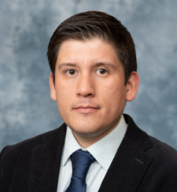



1st Annual Undergraduate Quantitative Biology Summer School
Module 1b: Single-particle tracking in Python
Instructor: Luis Aguilera
e-mail: luis.aguilera@colostate.edu

Slide 2
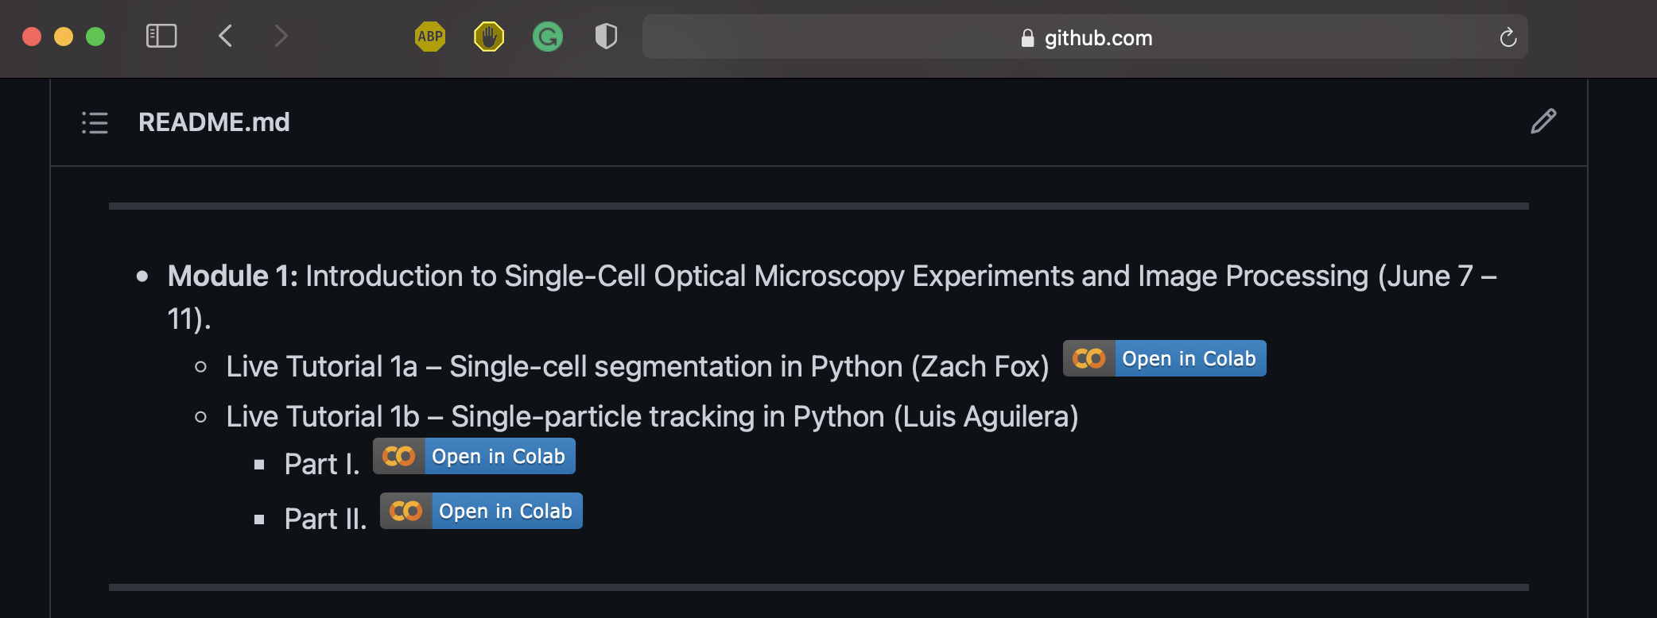
Program
Outline
Program
Introduction
Simulator
Tracking
Diffusion
Complex Scenarios
Libraries
https://github.com/MunskyGroup/uqbio2021

Slide 3



Introduction
Outline
Program
Introduction
Simulator
Tracking
Diffusion
Complex Scenarios
Libraries
From microscope image(s) to quantitative data…
Cell _ID | Spot_ID | x | y | intensity
0 | 0 | 10 | 200 | 111.2
0 | 1 | 20 | 34 | 21.3
1 | 0 | 15 | 11 | 46.5
1 | 1 | 25 | 320 | 15.1
… | … | … | … | …
Segmentation
Tracking
Microscope image(s)
Quantitative data
Image source: MacKintosh, F.C., 2012. Active diffusion: the erratic dance of chromosomal loci. Proceedings of the National Academy of Sciences, 109(19), pp.7138-7139.

Slide 4
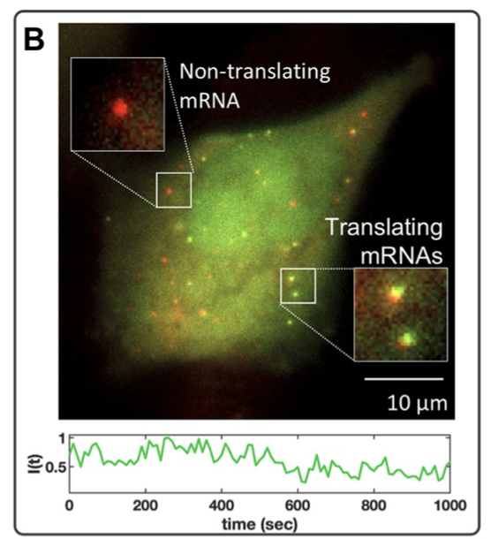
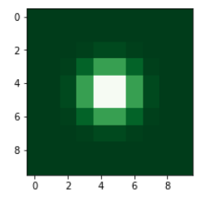
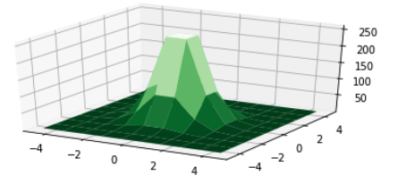
Introduction
Outline
Program
Introduction
Simulator
Tracking
Diffusion
Complex Scenarios
Libraries
Detecting particles in images
Zoom in
(Single Particle)
Examples of particles in cells:
Single proteins
Single mRNAs
Receptors in membrane
Complex RNA-Protein
Image source: Aguilera, L.U., Raymond, W., Fox, Z.R., May, M., Djokic, E., Morisaki, T., Stasevich, T.J. and Munsky, B., 2019. Computational design and interpretation of single-RNA translation experiments. PLoS computational biology, 15(10), p.e1007425.

Slide 5


Simulator
Outline
Program
Introduction
Simulator
Tracking
Diffusion
Complex Scenarios
Libraries
2D Random walk (Brownian-movement) simulator
Create an empty NumPy array with dimensions [T,Y,X,C]
To represent particles define a 2D-Gaussian Kernel matrix
Define initial particles position (random [Y,X] coordinates).
x_pos [0,sp] = rand value in x_lim
y_pos [0,sp] = rand value in y_lim
4. Simulate Brownian movement
for t in range (1, num_timePoints):
for sp in range (0, num_spots):
x_pos[t,sp] = x_pos [t,sp] +
y_pos[t,sp] = y_pos [t,sp] +
$$𝒩\left(0,1\right) \sqrt{2∗D∗t }$$
$$𝒩\left(0,1\right) \sqrt{2∗D∗t }$$

Slide 6
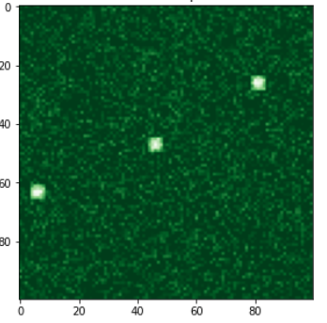
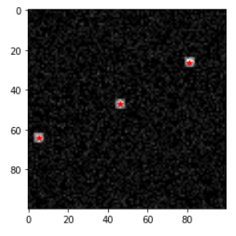
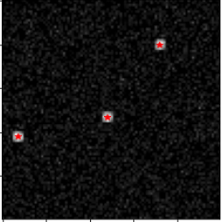
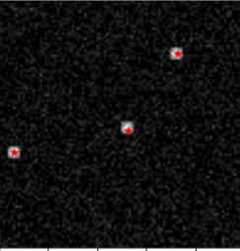
Tracking
Outline
Program
Introduction
Simulator
Tracking
Diffusion
Complex Scenarios
Libraries
Particle tracking (2 step process)
Particle detection
Particle linking
Time (frames)

Slide 7
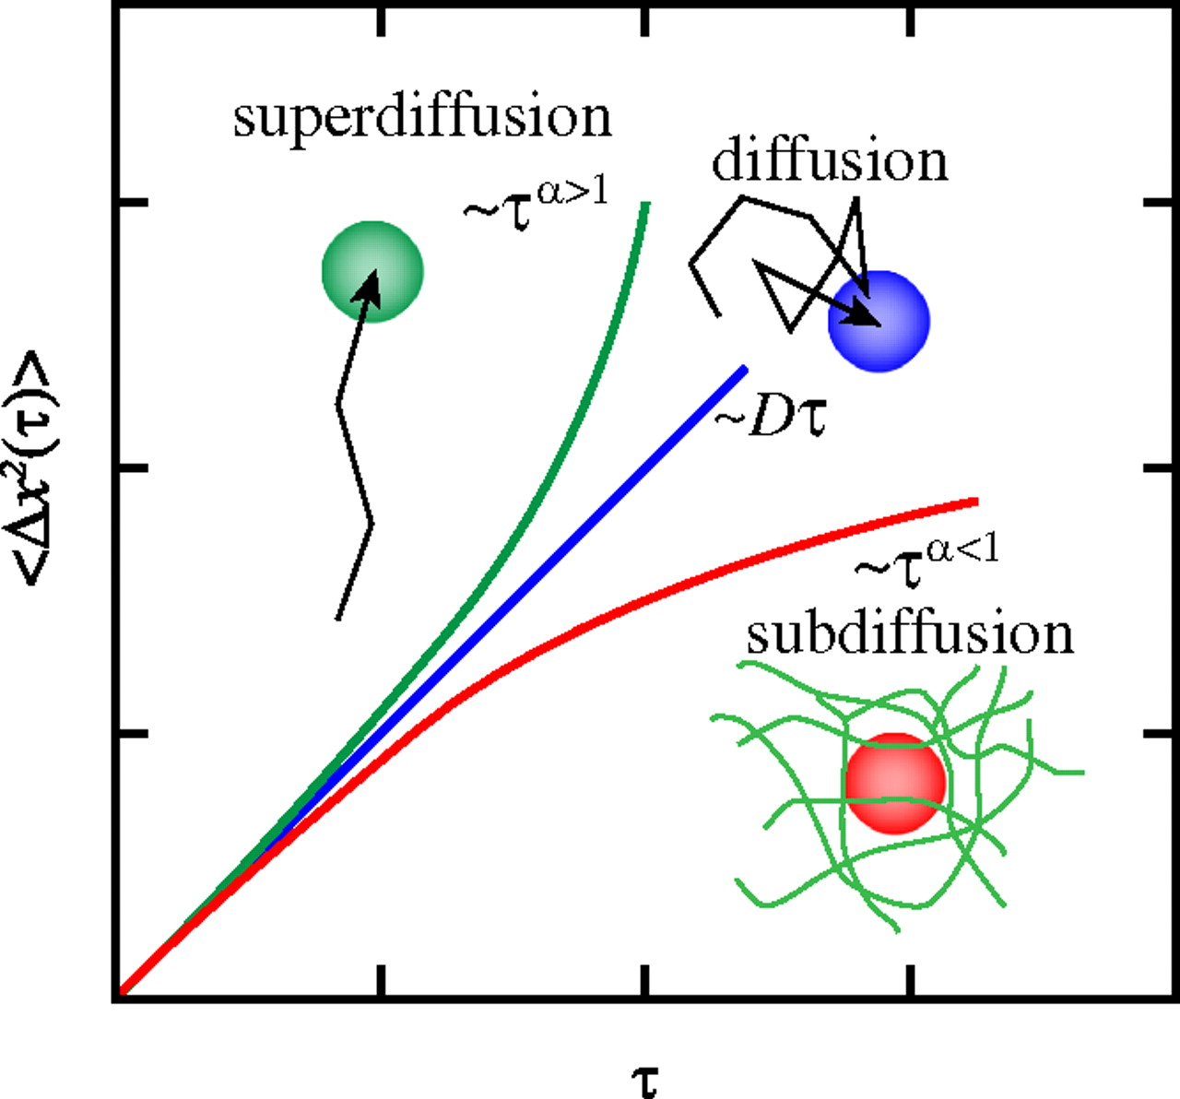
Diffusion
Outline
Program
Introduction
Simulator
Tracking
Diffusion
Complex Scenarios
Libraries
Types of movement
Image source: MacKintosh, F.C., 2012. Active diffusion: the erratic dance of chromosomal loci. Proceedings of the National Academy of Sciences, 109(19), pp.7138-7139.

Slide 8
Complex scenarios
Outline
Program
Introduction
Simulator
Tracking
Diffusion
Complex Scenarios
Libraries
Particle tracking is challenging in different scenarios
Particle blinking (Bursting gene expression)
New particles enter the system (nascent mRNAs, proteins)
Particles interact (complex formation)
Noisy background

Slide 9
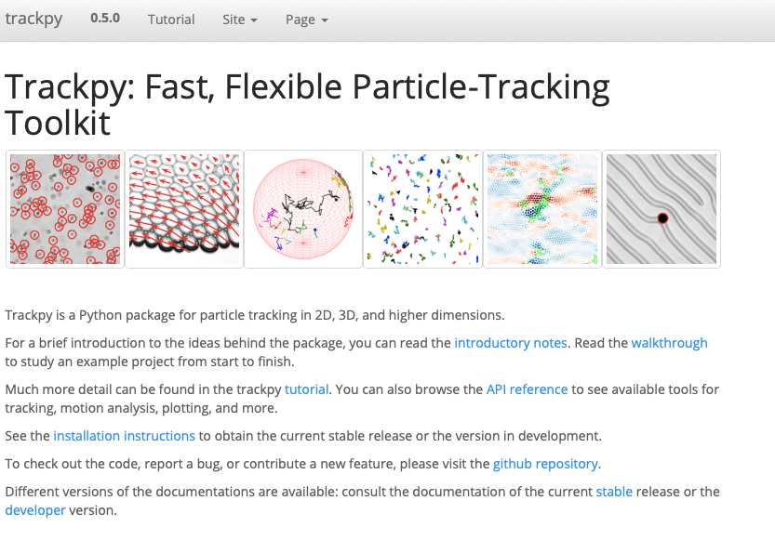
Libraries
Outline
Program
Introduction
Simulator
Tracking
Diffusion
Complex Scenarios
Libraries
Trackpy
Allan, Daniel B., Caswell, Thomas, Keim, Nathan C., van der Wel, Casper M., & Verweij, Ruben W. (2021, April 13). soft-matter/trackpy: Trackpy v0.5.0 (Version v0.5.0).

Slide 10
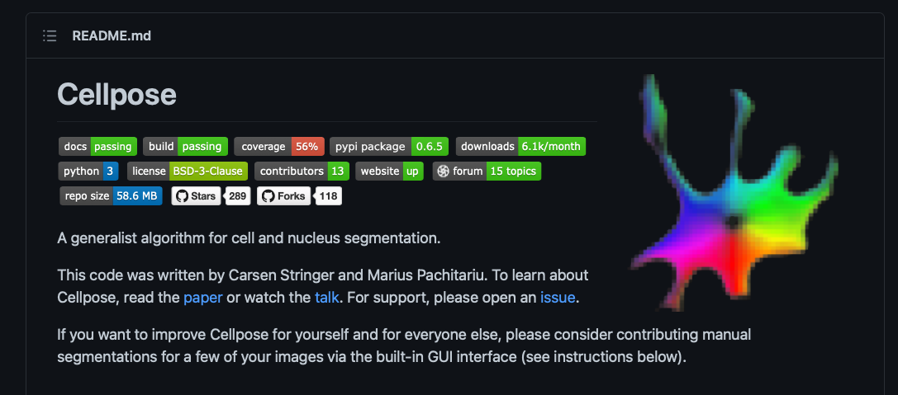
Libraries
Outline
Program
Introduction
Simulator
Tracking
Diffusion
Complex Scenarios
Libraries
Cellpose
Stringer, C., Wang, T., Michaelos, M. and Pachitariu, M., 2021.Cellpose: a generalist algorithm for cellular segmentation. Nature Methods, 18(1), pp.100-106.

Slide 11
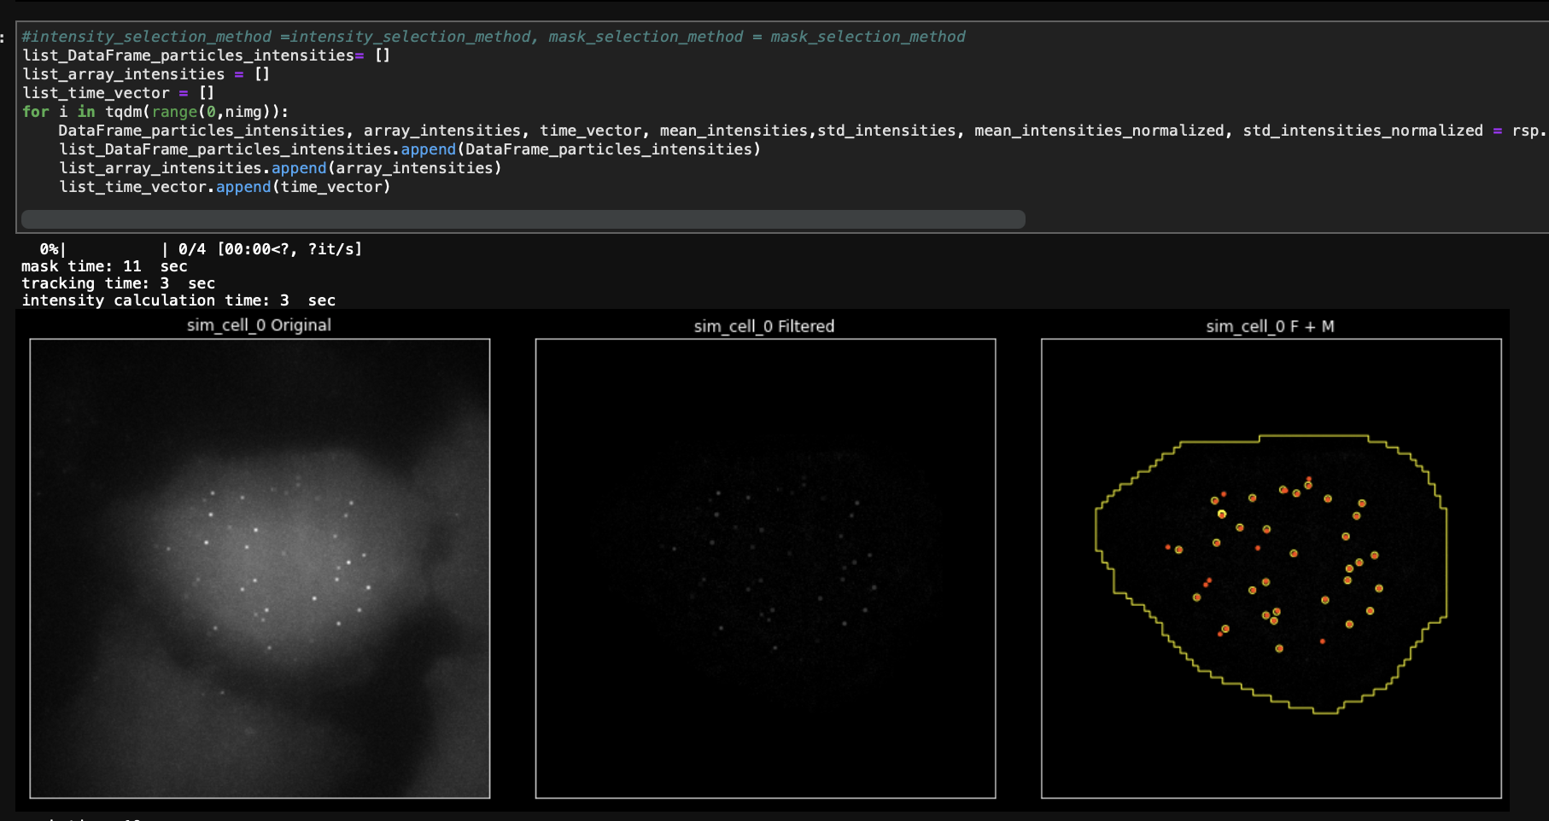

Libraries
Outline
Program
Introduction
Simulator
Tracking
Diffusion
Complex Scenarios
Libraries
Robust pipeline for particle tracking
Segmentation
Tracking
Data generation

