Slide 1
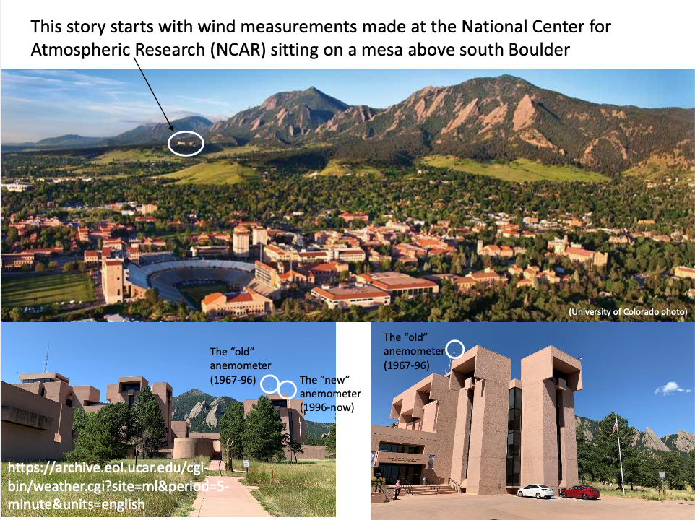
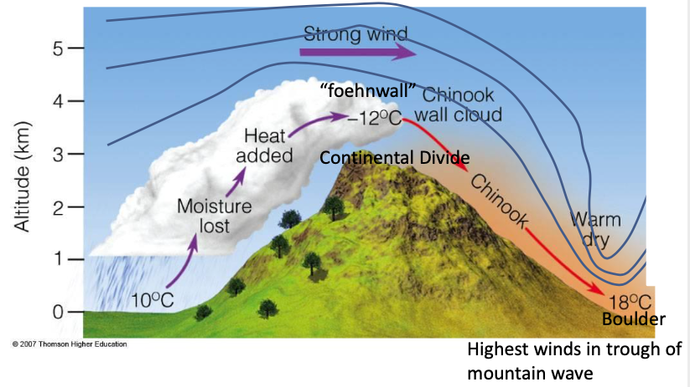
Have we experienced a change in severe Chinook wind events in Boulder?
148 mph wind gust recorded Thursday on Monarch Pass By Kieran Nicholson | knicholson@denverpost.com | The Denver Post
PUBLISHED: February 19, 2016 at 10:30 am

Slide 2
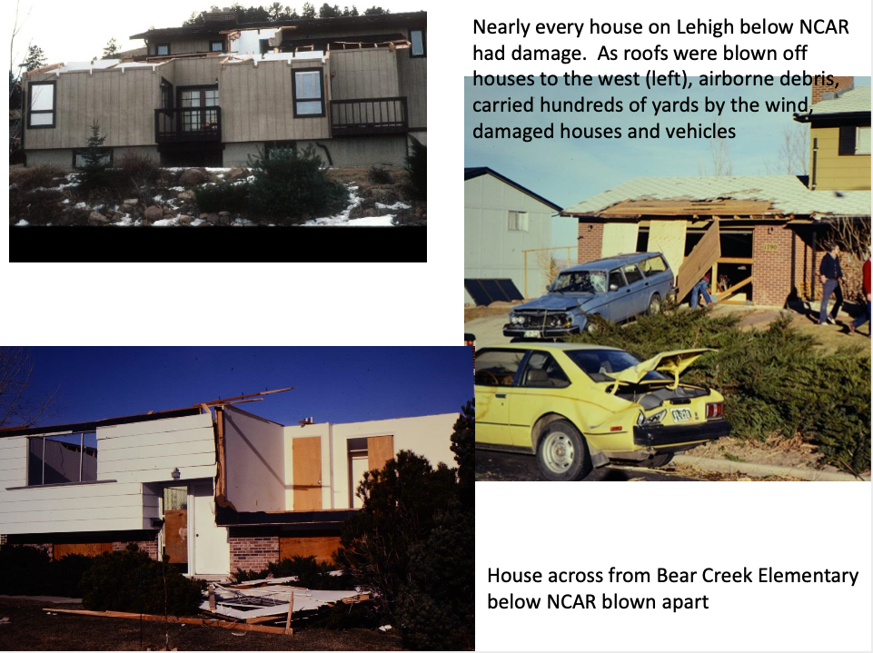
Boulder citizens awoke on the morning of January 17, 1982 (if they slept at all) to extensive damage across the city

Slide 3
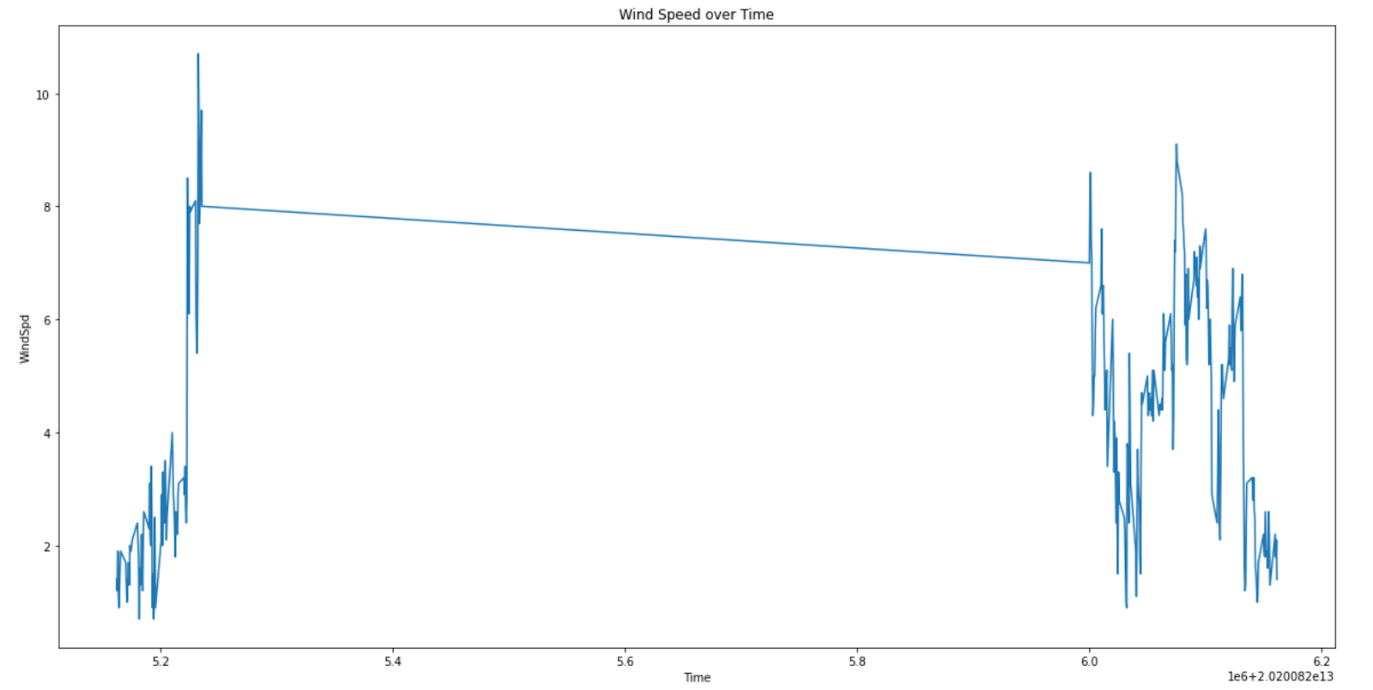
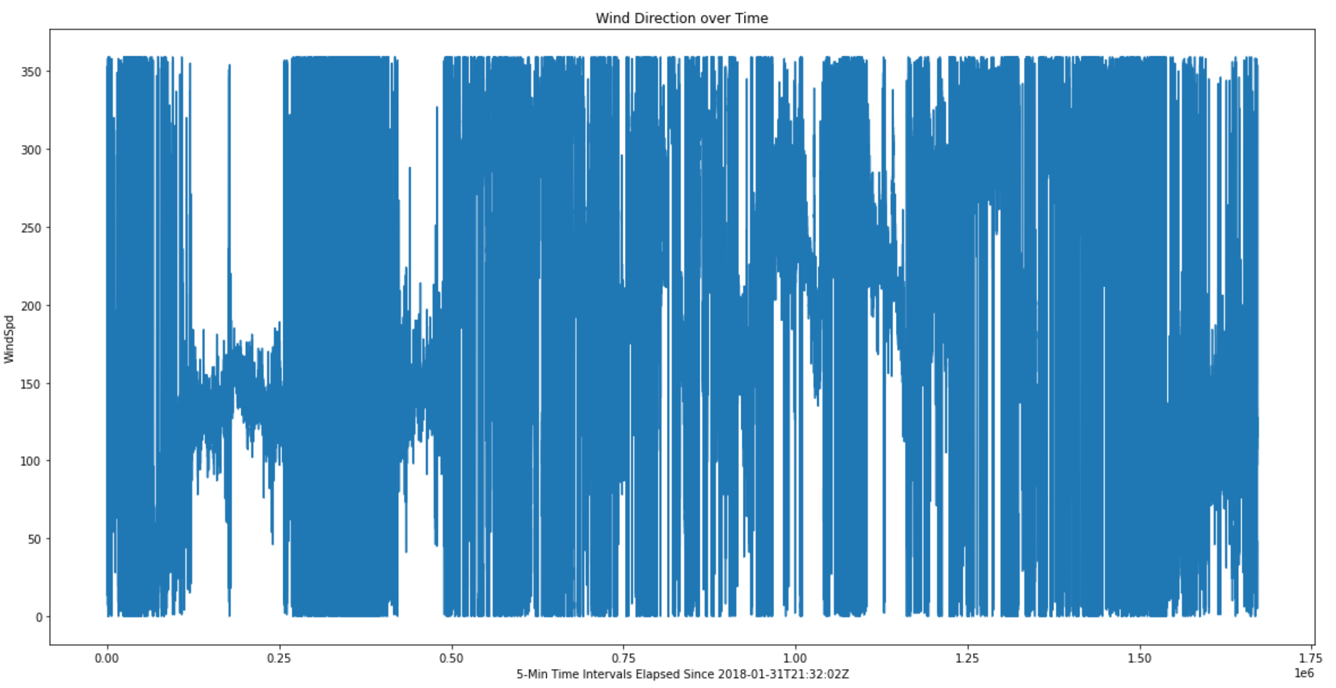
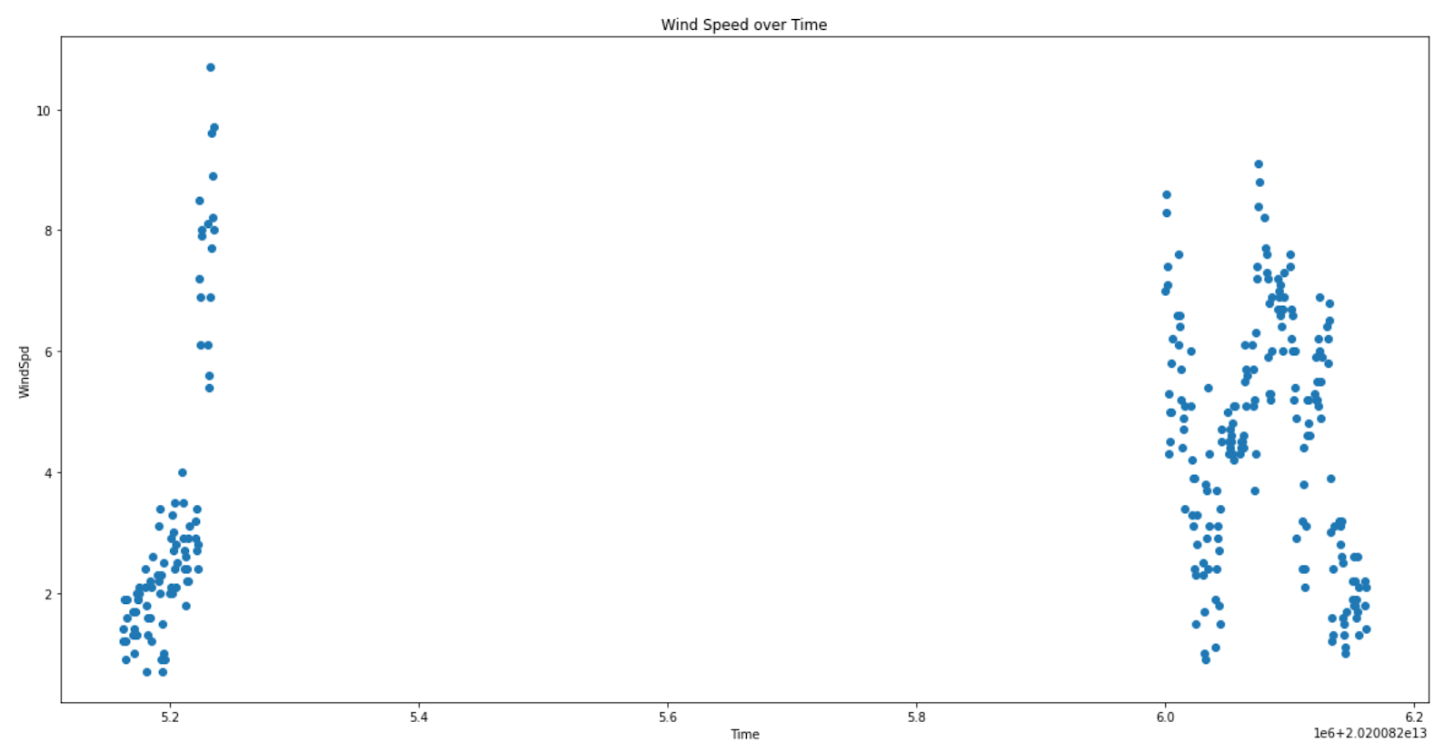
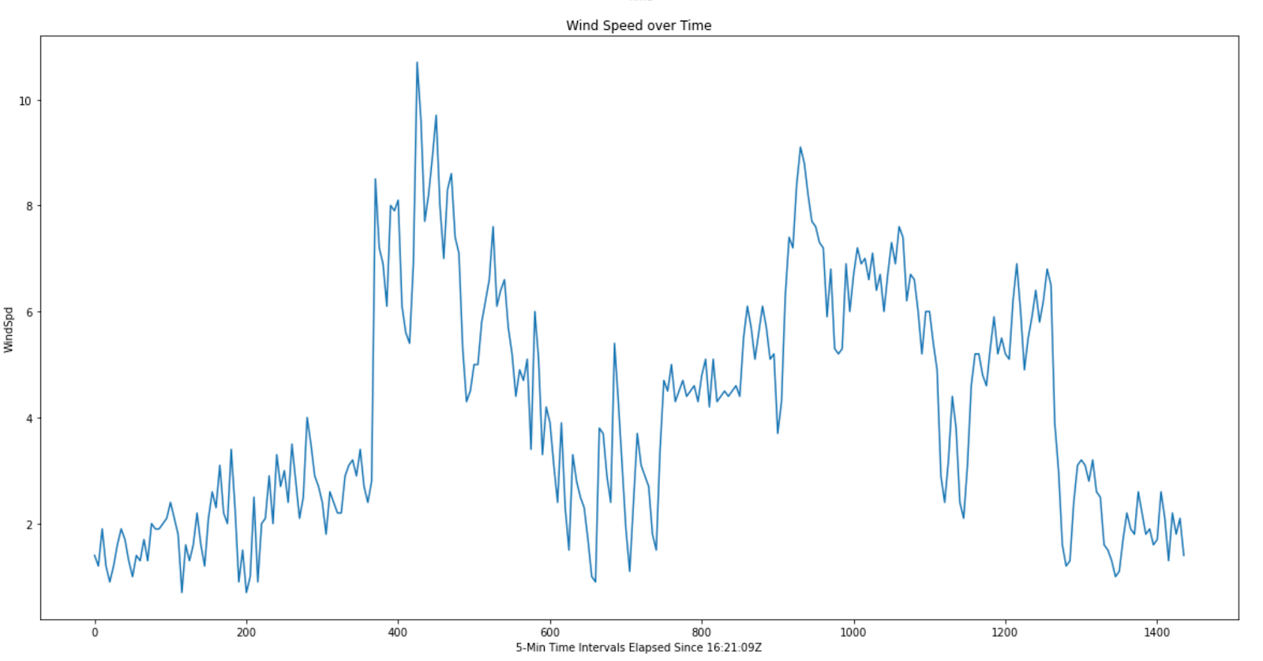
First few weeks I needed to plot sample Wind Speed data from anemometer, try different plot styles and see which one works the best! (I had to do a lot of converting of types when I plotted this data and needed to read in the files and store them into proper lists, figure out what they got stored as and convert on a needed basis.
Time was difficult to figure out, and it screwed up my X-Axis a few times, but I finally was able to convert timestamps into 5-Minute intervals spread out across time as is shown by the third graph, we no longer have that sudden break in between days.
Now that I had the plotting figured out, it was time to move onto the real datasets!
Things I needed to figure out were what the missing values were encoded as in Python, and now once I know what they are, my new goal is to find out how to replace them.
At first, I was thinking I’d delete them out of the table overall but if I do that on a dataset that has a bunch of missing values altogether that could take a huge chunk out of the graph which we don’t want, so I need to assign them to some arbitrary value, get the list conversions done, and then make them some kind of Null Value in Python so they don’t show up on the graph at all.

