Slide 1

Anemometer Project
Update: 10/23/2020
Muntaha Pasha

Slide 2

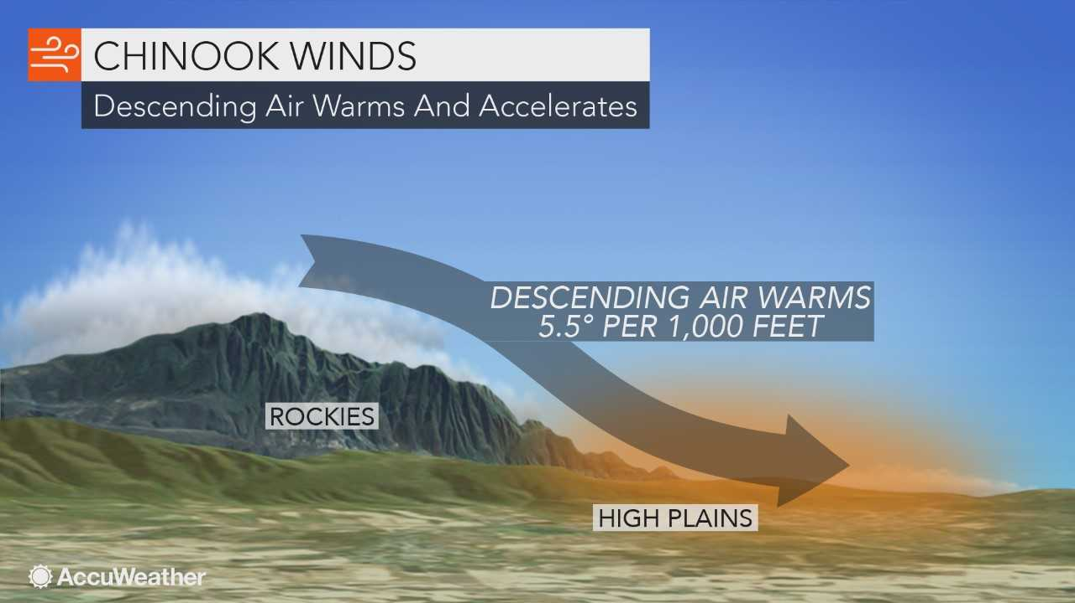
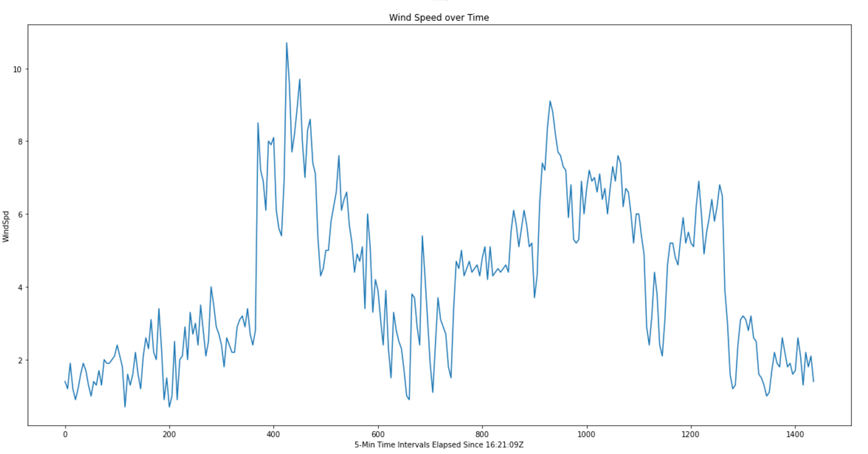
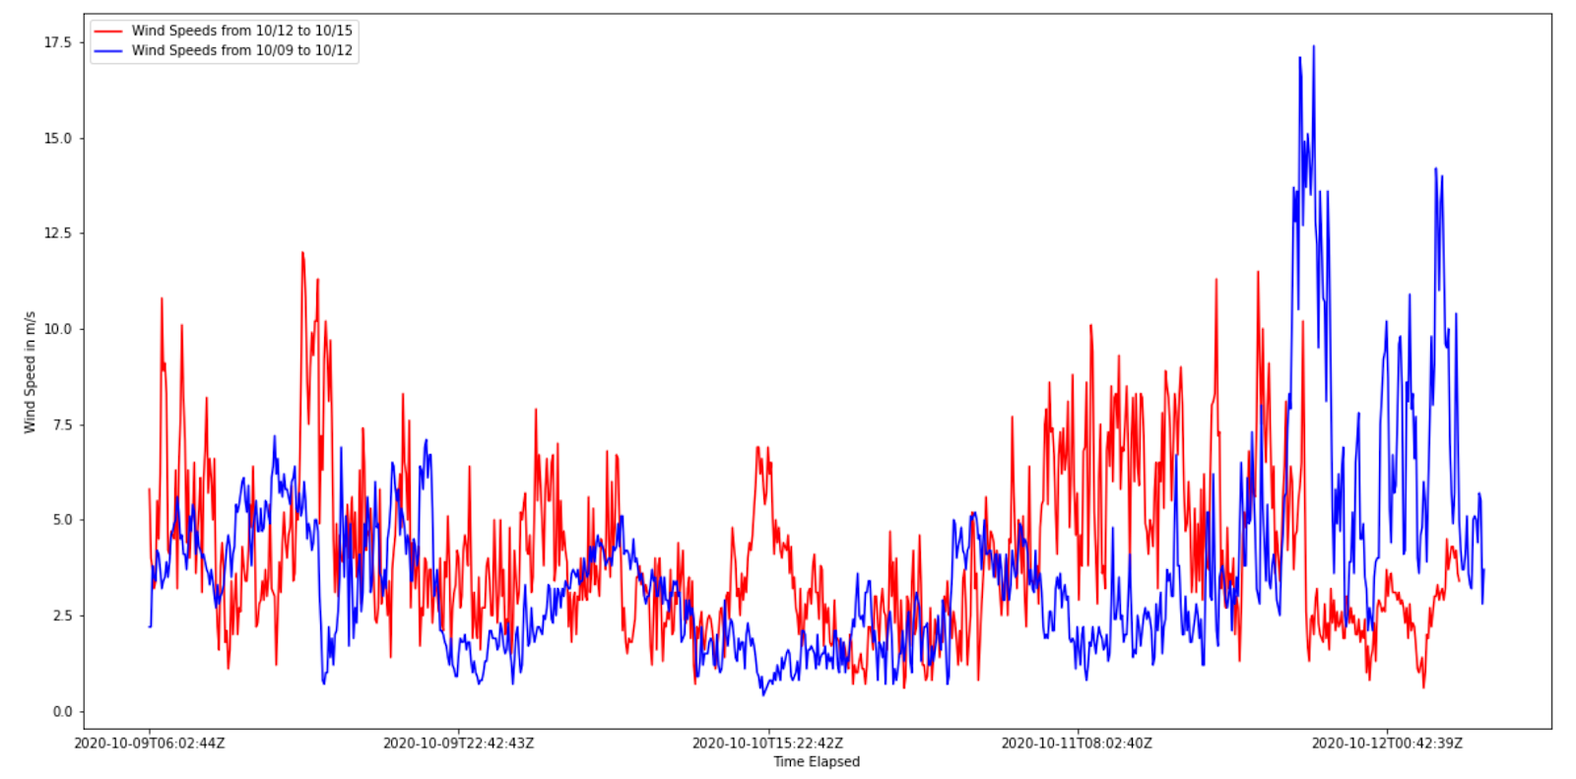
Recap
Studying Chinook Wind Events in Boulder, CO and trying to understand why wind speeds in these events have weakened over the years. Is this perhaps due to some changes in climate, or is this due to newer/updated wind instruments?
Spent first few weeks making charts with sample wind speed data, trying to read in csv files in Python, and did some exercises with cleaning and prepping analysis data in order to make an accurate graph.
Started using Pandas to read in the data more efficiently. Created plots showcasing the higher Wind Speeds we observed over October 12th – October 15th, and compared that to what normal wind speeds look like.

Slide 3
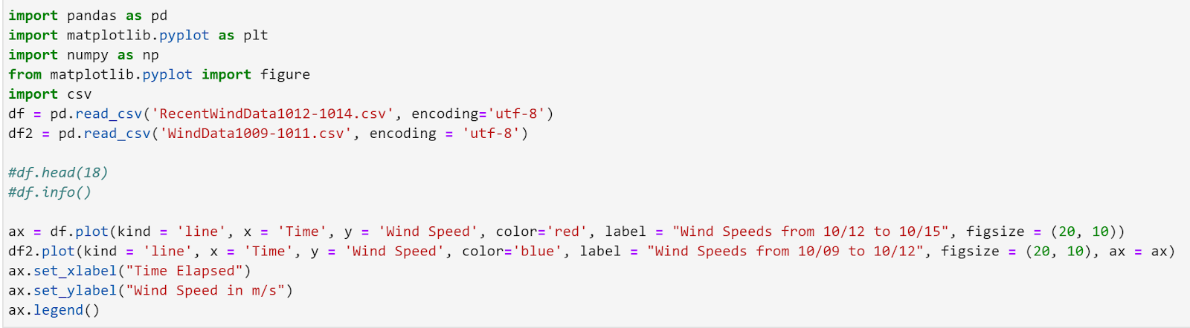
Major Changes/Updates
By using Pandas, I no longer needed messy Type-Conversions with Date/Time, or important wind variables like WindDir/WindSpd. Most of these got converted in the DataFrame.
Graphing became a LOT easier.

Slide 4
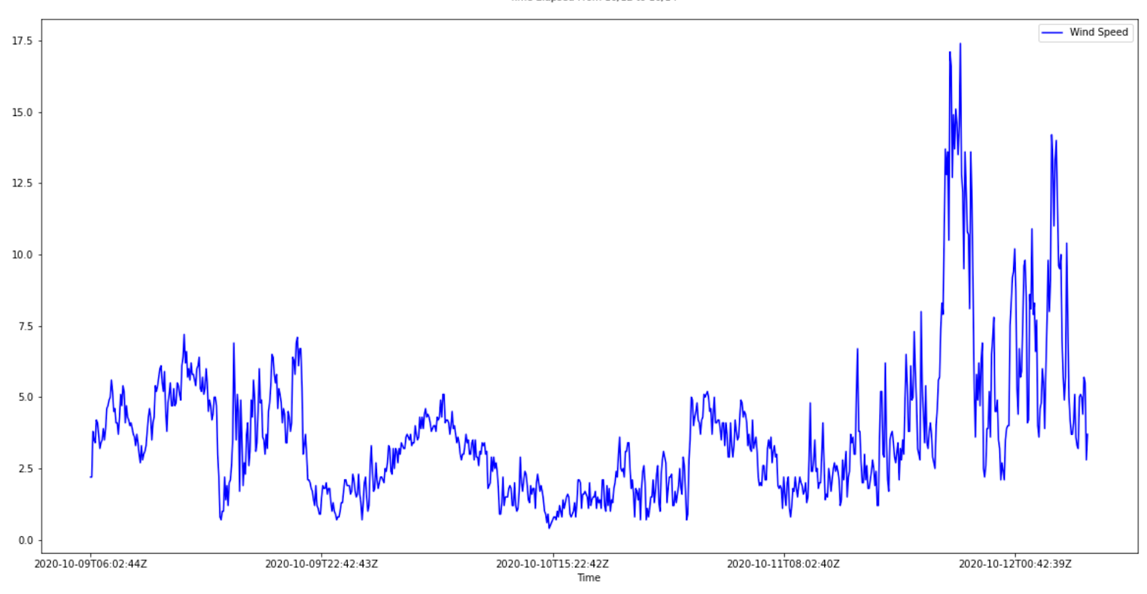
Graphing Recent Wind Observations (WXT Anemometer)
These Data Observations are taken at 5-minute intervals from the old NCAR Anemometer (WXT) from October 9th through October 12th. You can see that October 12th was a particularly windy day here in the Foothills area. (Wind speeds recorded in m/s)

Slide 5
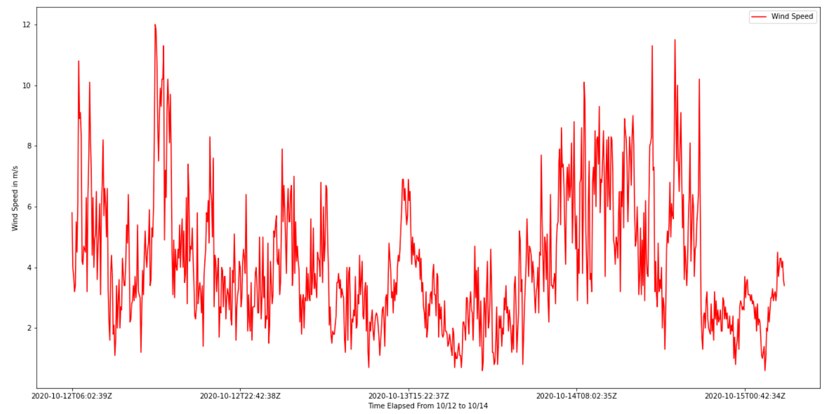
Graphing Recent Wind Observations (WXT) Cont.
Using the same anemometer’s data, I then looked at our windy week here in Colorado from October 12th to around October 15th. Compared to the previous time stamp, this one was way more chaotic! (Wind speeds recorded in m/s)

Slide 6
Graphing Recent Wind Observations (WXT) Cont.
I decided to overlay the data together to see a clearer relation between October 9th - October 12th, and then that windy time period from October 12th – October 15th.

Slide 7
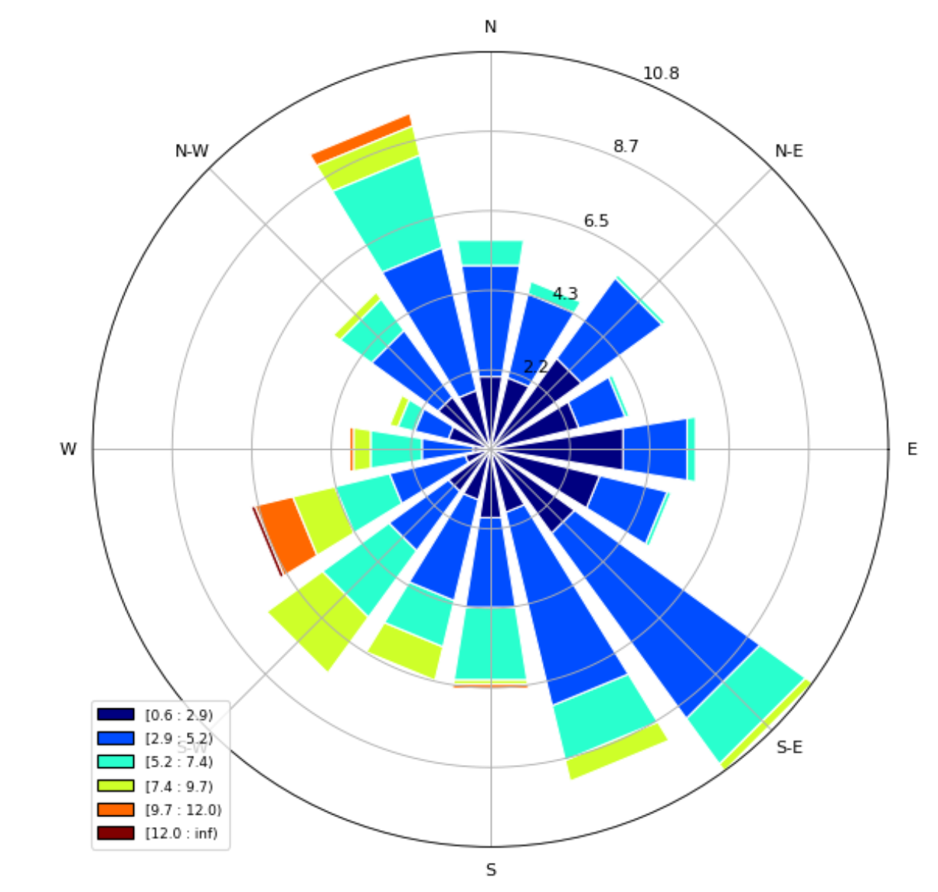
Wind Roses
I was able to create some wind roses for the data as well, as another way of visualizing the wind data. Here is an example one from October 12th – October 15th.

Slide 8
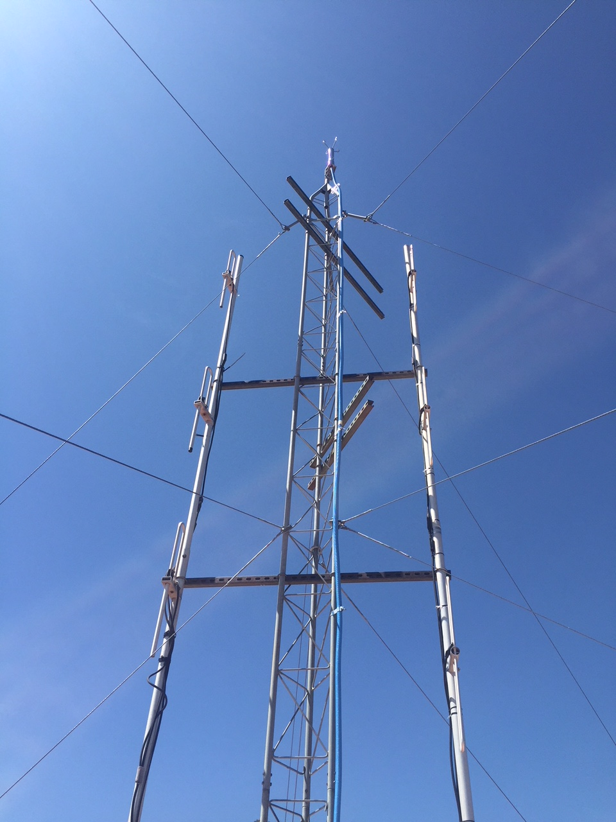
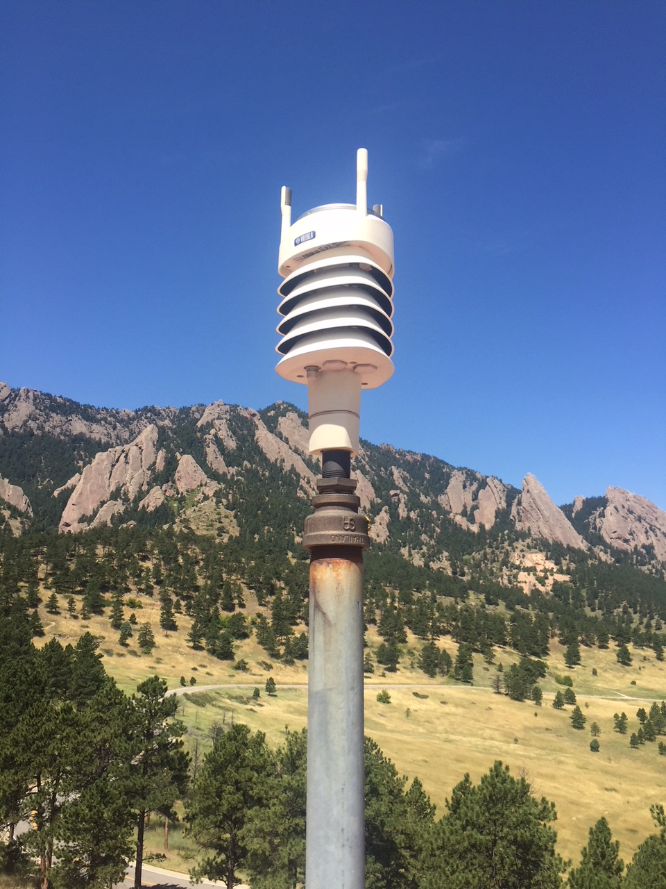
Next Steps…
The data from the new Anemometer (Sonic) needs to be analyzed and unpacked on a Supercomputer. I’ll be doing this via Cheyenne, which is NCAR’s main SC since the data for this anemometer is taken by the second as opposed to the minute timestamp used by the WXT. (They are huge files!)

