Slide 1
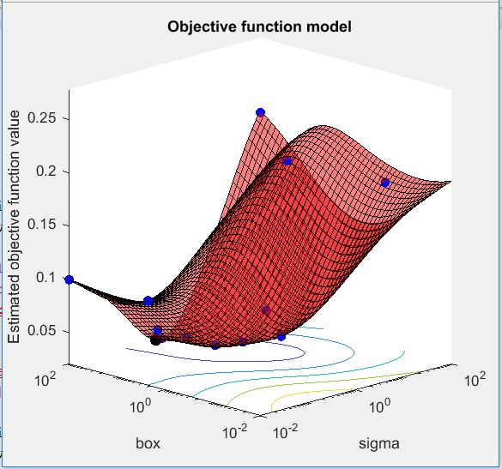
SEIS 763 - Machine Learning Group Project Summer Semester, 2017
Sohana Badhon
Greg Houston
Bruce Jackson
Muntaser Khan
Alghamdi Samia

Slide 2
Overview
Data Set
Analysis Plan
Data Pre-Processing
Method Detail
Comparison & Summary

Slide 3
Data Set
Description: Human Resources Analytics
Title: Why are our best and most experienced employees leaving prematurely?
Source: https://www.kaggle.com/ludobenistant/hr-analytics
Records: 14,999
Attributes: 10

Slide 4
Data Set
Attributes

Slide 5
Data Set

Slide 6
Analysis Plan
Management Problem
Employees are expensive to recruit and train.
The HR department would like to intervene before employees leave.
Management would like to predict which employees are at risk of leaving.
Analysis Task
Build a predictive model using machine learning techniques.
Target Variable: Whether the employee left
This is a classification task where we want to distinguish between two groups (those who left v. those who didn’t)

Slide 7
Analysis Plan
Methods
Logistic Regression
Support Vector Machine
Autoencoder + Logistic Regression & Lasso
Neural Network

Slide 8
Data Pre-Processing
Converted Sales and Salary to dummy variables
10 dummy variables represent Sales and 3 dummy variables represent Salary
Standardized numeric columns
Set up a split sample for training/validation data, test data
Validation done with cross-validation of training set
For neural net, let software split the data set
Oriented data (transposed) according to analysis method

Slide 9
Logistic Regression

Slide 10
Logistic Regression
Essentially the probability that a given observation is in a particular category
Predicts classes by linking thetaT(x) to probabilities/likelihood [0…1] via a logistic function
Uses a Generalized Linear Model with target function that is a Log-Likelihood or Maximum Log-Likelihood

Slide 11
Logistic Regression Discussion
Pros
Works on categorical data
If data is well-separated, don’t need to do SVM
Cons
Extra steps to pre-process data
Pitfalls
If confusion matrix is unbalanced, prediction is unreliable
Comments

Slide 12
Logistic Regression ROC Curves
Class 0 (Stayed) ; AUC = 0.82
Class 1 (Left); AUC =0.82

Slide 13
Final Model Information—Logistic Regression
Confusion Matrices
Accuracy: 0.8014
Emloyee Left (Class 0)
Precision : 0.6094
Recall : 0.3556
F-Statistic : 0.4492
Emloyee Stayed(Class 1)
Precision :0.8218
Recall : 0.9288
F-Statistic : 0.8720
 | 0 | 1
True 0 | 315 | 28
True 1 | 77 | 30
 | 0 | 1
True 0 | 10,614 | 814
True 1 | 2,301 | 1,270

Slide 14
Logistic Regression Lasso

Slide 15
LR Lasso Regularization
Performed Lasso Regularization
Kept 14 of 18 predictors

Slide 16
LR Lasso ROC Curves
Class 0 (Stayed) ; AUC = .78
Class 1 (Left); AUC = 0.78

Slide 17
Final Model Information—Logistic Regression With Lasso
Confusion Matrix
Accuracy: 0.7915
Emloyee Left (Class 0)
Precision : 0.6077
Recall : 0.3537
F-Statistic : 0.4472
Emloyee Stayed(Class 1)
Precision :0.8211
Recall : 0.9285
F-Statistic : 0.8715
 | 0 | 1
True 0 | 10,290 | 792
True 1 | 2,231 | 1,236

Slide 18
Support Vector Machine

Slide 19
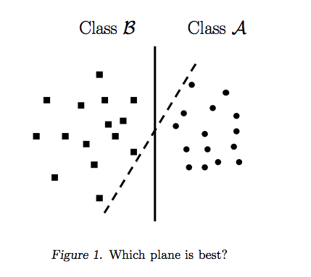
How SVM Algorithm work
A supervised machine learning algorithm mostly used in classification problems
Data items are plotted in n-dimensional space where n is the # of features (here it’s 10)
Only focus on the points that are most difficult to tell apart, where other classifiers pay attention to all of the points
It finds the best separating line after searching for support vectors and then drawing a line connecting them.

Slide 20
Pros and Cons of SVM
Pros
It works really well with clear margin of separation
It is effective in high dimensional spaces.
It is effective in cases where number of dimensions is greater than the number of samples (~15k samples in this problem).
It uses a subset of training points in the decision function (called support vectors), so it is also memory efficient.
Cons:
It doesn’t perform well, when we have large data set because the required training time is higher. Fortunately we are only working with 14,999 records in this data set.
It also doesn’t perform very well, when the data set has more noise (target classes are overlapping)
SVM doesn’t directly provide probability estimates, these are calculated using an expensive k-fold cross-validation( we have done 5, 10 and 15 fold cross validation here)

Slide 21
Performance
Optimal box constraint and kernel function:
General Information:
Optimization completed.
MaxObjectiveEvaluations of 30 reached.
Total function evaluations: 30
Total elapsed time: 2025.7902 seconds.
Total objective function evaluation time: 1888.3694

Slide 22
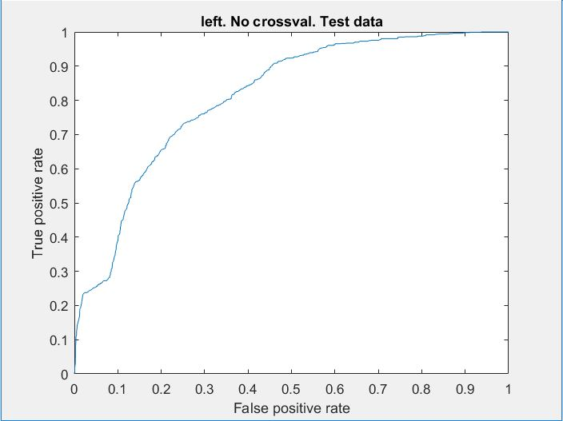
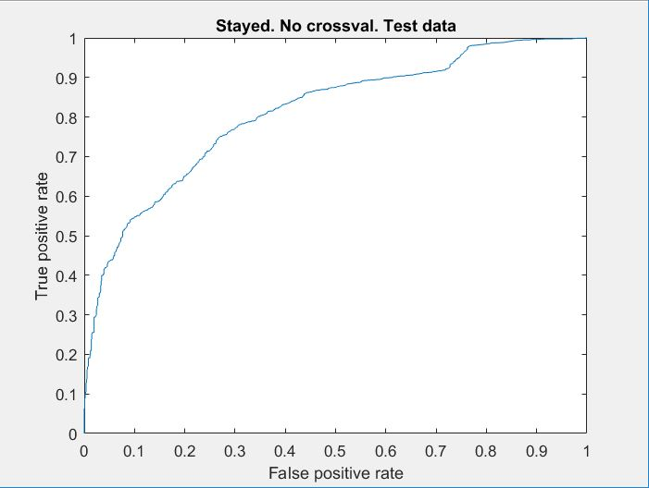
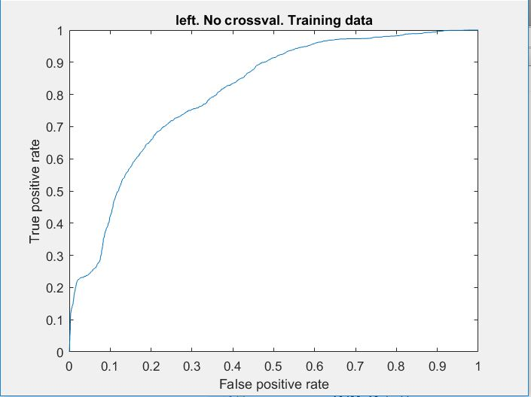
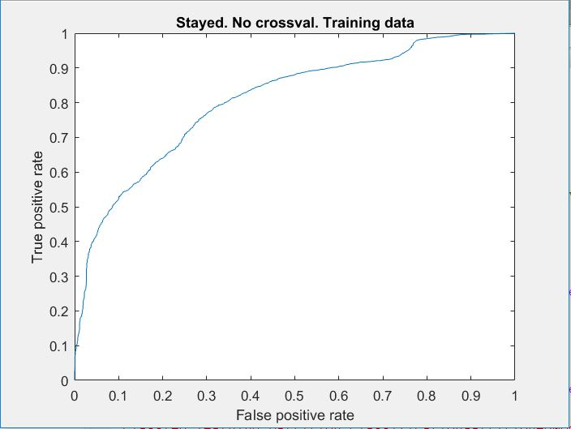
SVM Model / No Crossval
Positive Class
Negative Class
Accuracy: .7793 Precision: .8034
F1: .8666 Recall: .9405
Accuracy: .7788 Precision: .8016
F1: .8667 Recall: .9433

Slide 23
Prediction likelihood
Average likelihood of 1 prediction: .6975
Average likelihood of 0 prediction: .8184
Overall error rate: 22.07%

Slide 24
SVM Model w/ Crossval
5 Fold
10 Fold
15 Fold
AVG F1 Score
POS: .8665
kfoldLoss: .2213
AVG F1 Score
POS: .8665
kfoldLoss: .2215
AVG F1 Score
POS: .8667
kfoldLoss: .2209
Kfold 15: Held most consistent F1 score and least classification error. There was loss in negative class identification.
F1: Model without crossval()
POS: .8666

Slide 25
Box Constraint
Added Box Constraint:
SVMModel=fitcsvm(x,y,'Standardize',true,'Crossval','on','kfold',15,'BoxConstraint',.045);
Slight Overall Improvement:
Classification error ran slightly better (kfoldLoss)
POS: F1 = .8666
NEG: F1 = .1033

Slide 26
Data is not linearly separable
Implement Kernel:
SVMModel = fitcsvm(x,y,'Standardize',true,'Crossval','on','kfold',15,'KernelFunction','rbf’,…
‘BoxConstraint’, 1);
Kfoldloss: .0263
POS: F1 = .9808
CFM =
3390 38
95 977

Slide 27
Implementation of Box Constraint and Kernel Function.
Search for Optimal Settings
sigma = optimizableVariable('sigma',[1e-2,1e2],'Transform','log');
box = optimizableVariable('box',[1e-2,1e2],'Transform','log');
c = cvpartition(10499,'kfold',15);
minfn = @(z)kfoldLoss(fitcsvm(x,y,'CVPartition',c,...
'KernelFunction','rbf','BoxConstraint',z.box,...
'KernelScale',z.sigma));
results = bayesopt(minfn,[sigma,box],'IsObjectiveDeterministic',true,...
'AcquisitionFunctionName','expected-improvement-plus')

Slide 28
Best Estimated Sigma and Box Constraint
|====================================================================|
| Iter | Eval | Objective | Objective | BestSoFar | BestSoFar | sigma | box |
| | result | | runtime | (observed) | (estim.) | | |
|====================================================================|
| 1 | Best | 0.031908 | 114.8 | 0.031908 | 0.031908 | 4.7004 | 73.863 |
| 2 | Accept | 0.21516 | 68.834 | 0.031908 | 0.031908 | 0.30493 | 0.032178 |
| 3 | Accept | 0.23802 | 39.336 | 0.031908 | 0.031908 | 61.081 | 0.021171 |
| 4 | Accept | 0.098771 | 130.4 | 0.031908 | 0.031908 | 0.020565 | 1.4632 |
| 5 | Accept | 0.098771 | 133.25 | 0.031908 | 0.031908 | 0.010114 | 99.893 |
| 6 | Accept | 0.23764 | 40.532 | 0.031908 | 0.031908 | 99.344 | 22.713 |
| 7 | Accept | 0.042575 | 16.597 | 0.031908 | 0.031908 | 2.9035 | 0.25642 |
| 8 | Accept | 0.09458 | 34.269 | 0.031908 | 0.031908 | 7.374 | 0.070058 |
| 9 | Best | 0.028003 | 170.19 | 0.028003 | 0.028003 | 3.5775 | 98.143 |
| 10 | Accept | 0.060196 | 27.754 | 0.028003 | 0.028003 | 4.0047 | 0.033727 |
Best estimated feasible point (according to models):
sigma box
______ ______
1.0395 10.368
General Information:
Optimization completed.
MaxObjectiveEvaluations of 30 reached.
Total function evaluations: 30
Total elapsed time: 2025.7902 seconds.
Total objective function evaluation time: 1888.3694

Slide 29
Best possible sigma and box constraint while minimizing loss

Slide 30
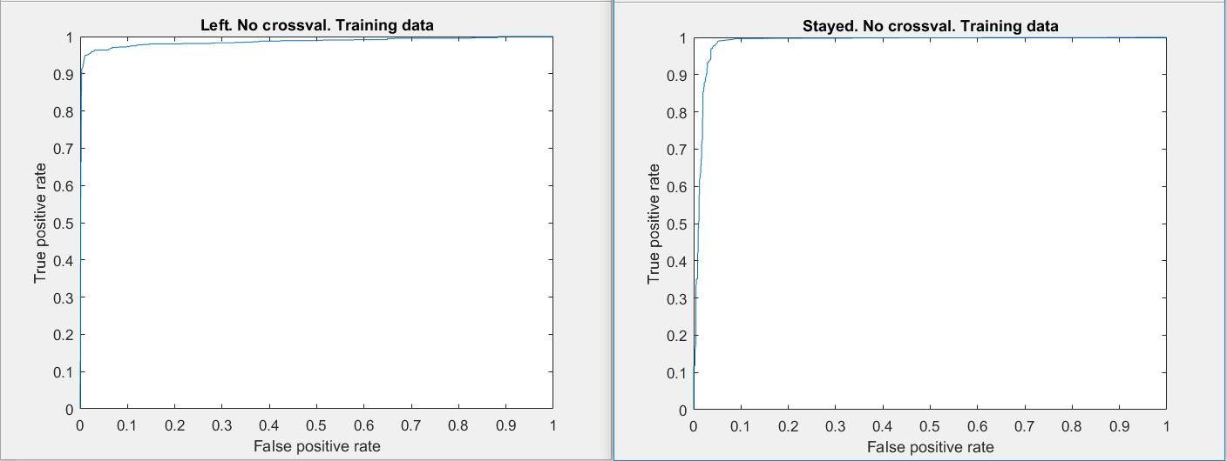
ROC: Box = 10.368 Sigma = 1.039

Slide 31
Final Model Information
Positive Class
Accuracy = .9764
Precision = .9845
Recall = .9845
F1 = .9845
Misclassification Rate = .0236 or 2.36%
Average likelihood of 1 prediction: .9987
Average likelihood of 0 prediction: .9949
Negative Class
Accuracy = .9765
Precision = .9506
Recall = .9506
F1 = .9506
Misclassification Rate = .0236 or 2.36%

Slide 32
Autoencoder

Slide 33
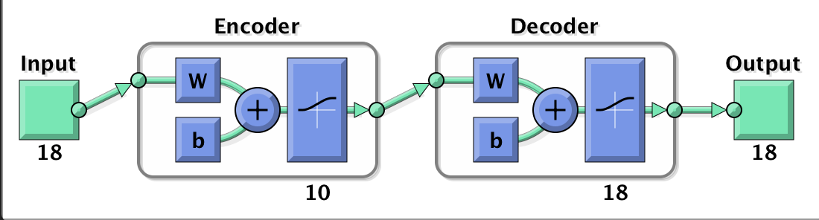
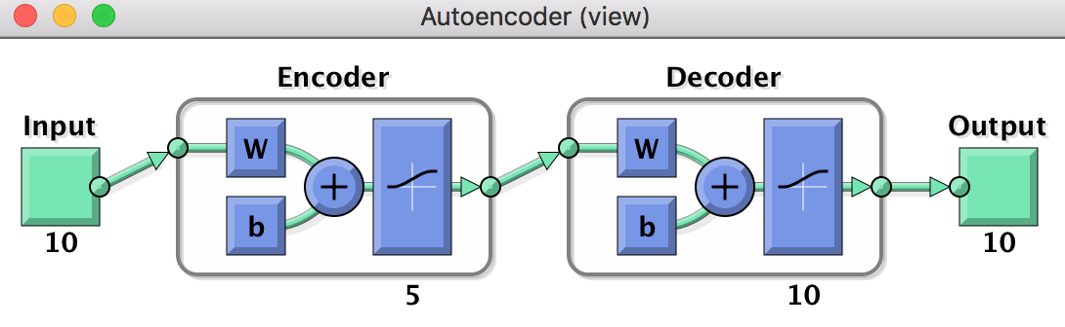
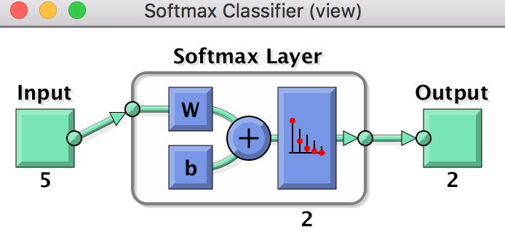
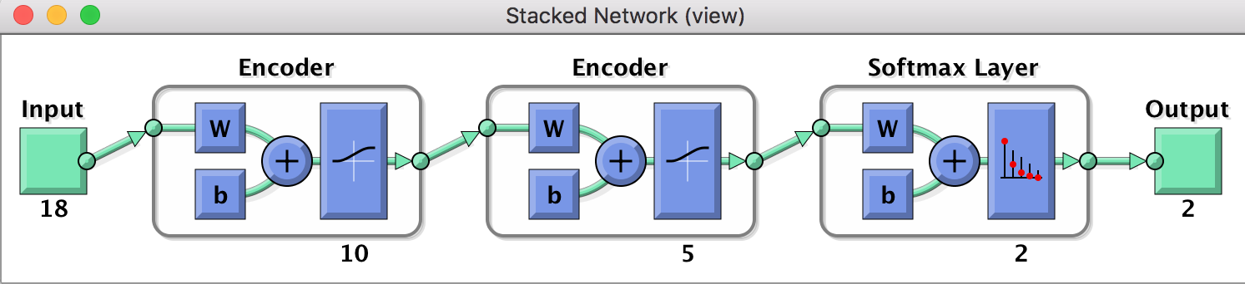
Auto-encoder
Using two layers autoencoder
First layer has 10 neurons;
the second layer has 5 neurons

Slide 34
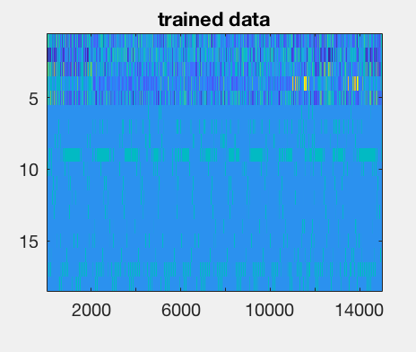
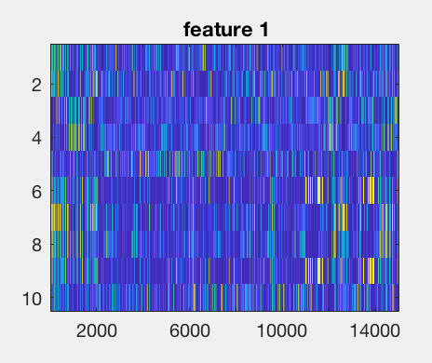
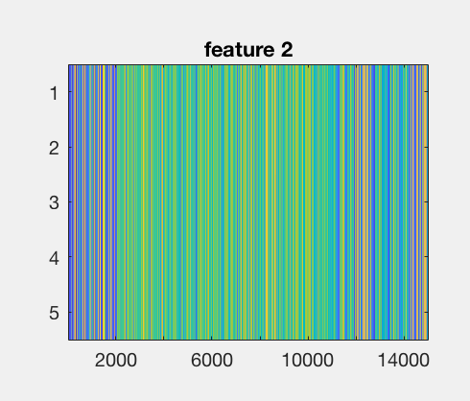
Auto-encoder with two layers
18 features compressed to 10 features, and 5 features

Slide 35
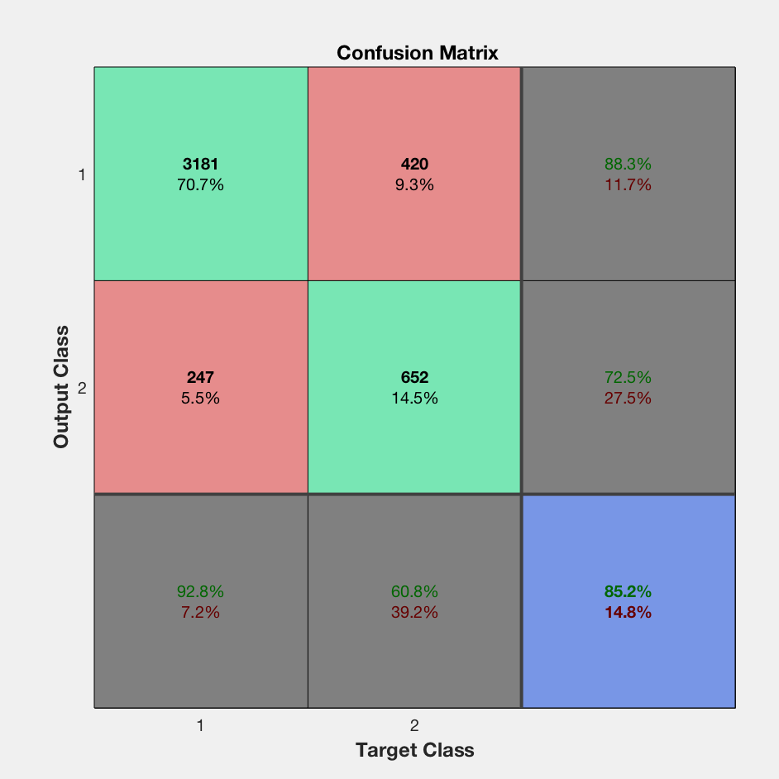
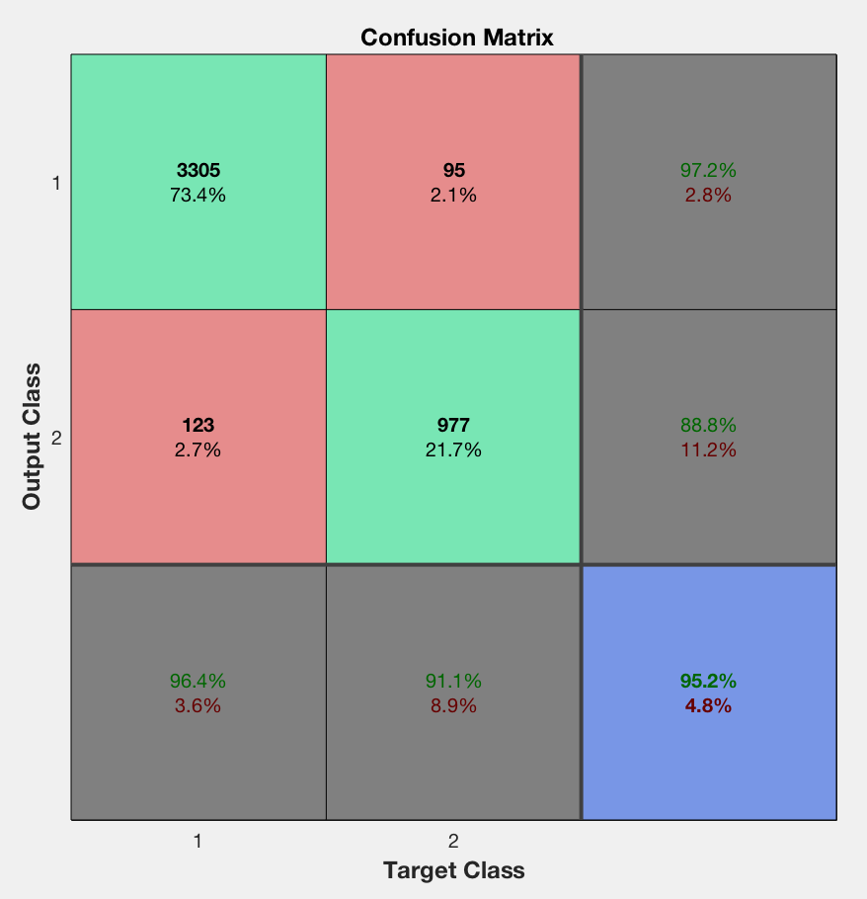
Confusion matrix
Before fine -tuning
After fine-tuning

Slide 36
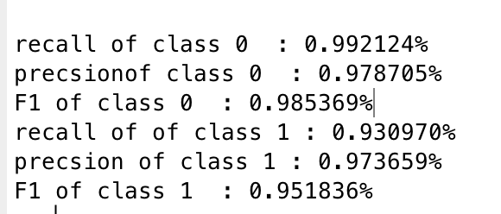
Measures Based on Confusion Matrix
Class 0
Class 1

Slide 37
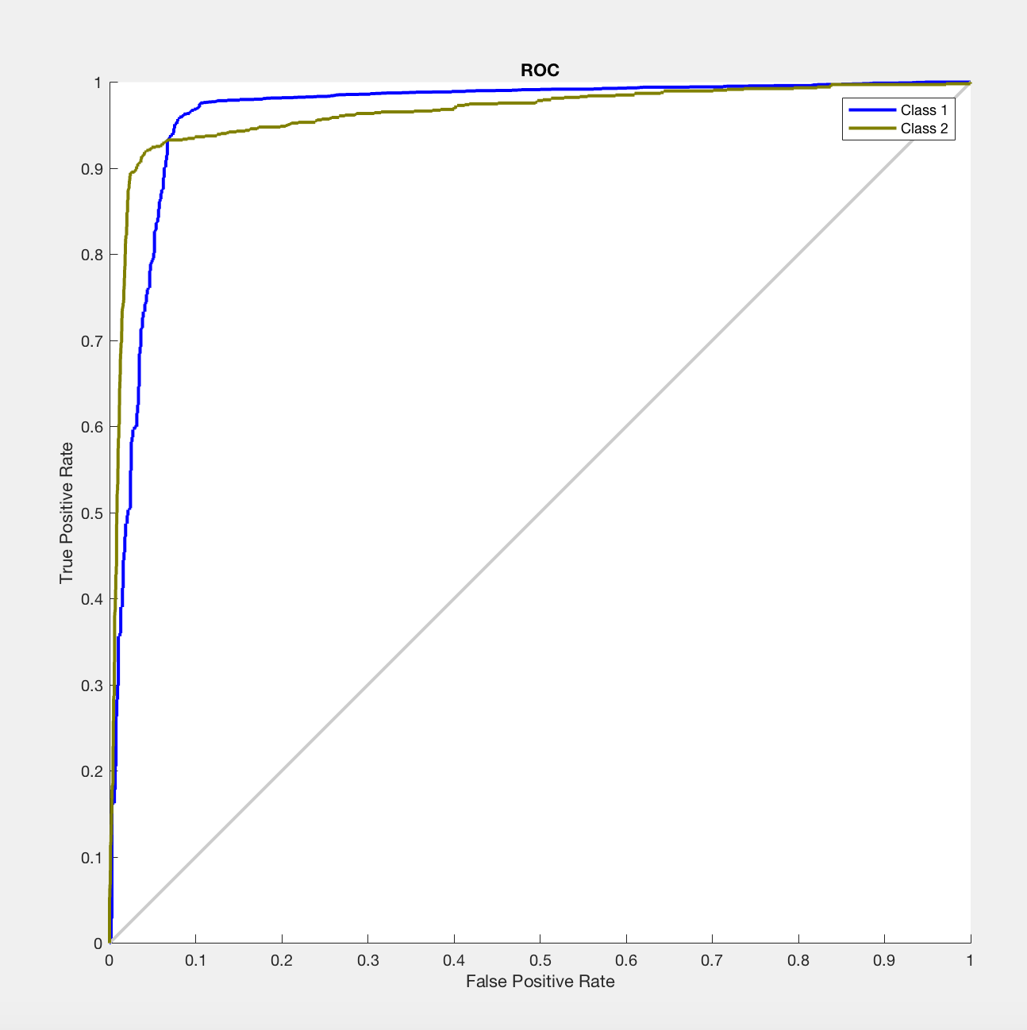
ROC for both class
AUC for both classes =96%

Slide 38
Autoencoder Plus Logistic & Lasso

Slide 39
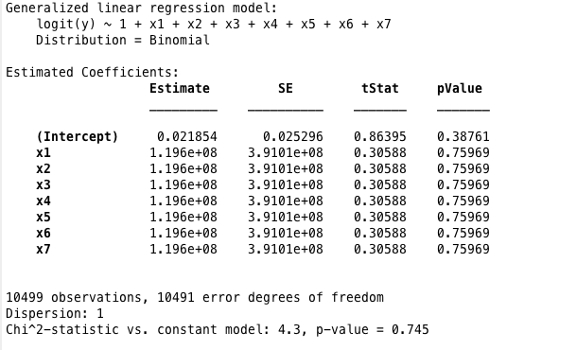
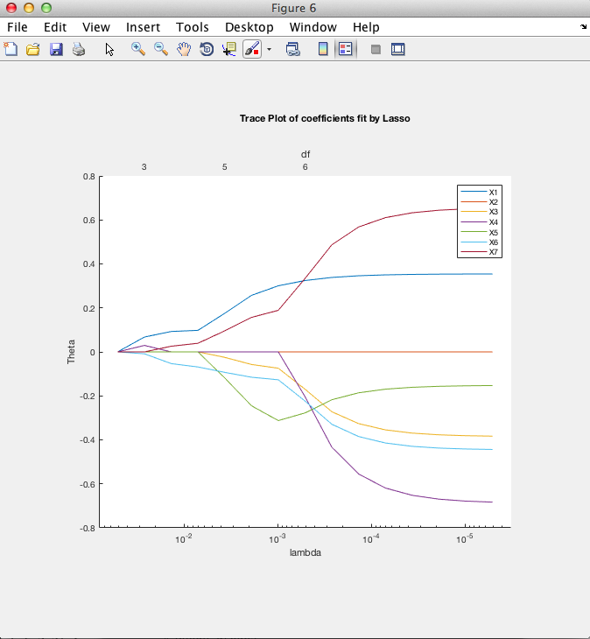
Logistic + Lasso
1.Extract newX from layer3 and Re-standardization
2. mdl = fitglm(znewX', Y, 'distr', 'binomial', 'link', 'logit') Get the Logistic model.
3.Remove the Outliers and Re-standardization
4.Apply Lasso regularization.

Slide 40
Auto-encoder
Logistic Regression + Lass0 Regularization
SVM
CFM =
2390 2859
2391 2859
Accuracy = 0.5000
Class_1:Employee Left
Precision_C1 = 0.4999
Recall_C1 = 0.4553
F1_C1 = 0.4766
Class_0: Employee Stayed
Precision_C0 = 0.5000
Recall_C0 = 0.5446
F1_C0 = 0.5213
CFM =
4666 583
4694 556
Accuracy = 0.4974
Class_1:Employee Left
Precision_C1 = 0.4985
Recall_C1 = 0.8889
F_C1 = 0.6388
Class_0: Employee Stayed
Precision_C0 = 0.4881
Recall_C0 = 0.1059
F1_C0 = 0.1740

Slide 41
Neural Network

Slide 42
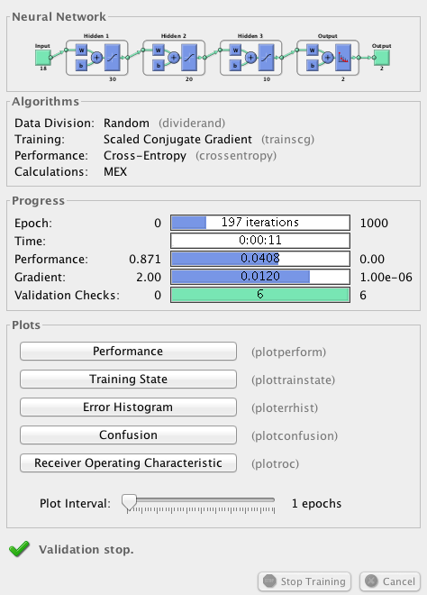
Neural Network Training
% transpose data
Y(Y~=0) = 1;
Y = Y';
Y = [~Y; Y];
X =X';
% Create a Pattern Recognition Network
hiddenLayerSize = [30,20,10];
net = patternnet(hiddenLayerSize, trainFcn);

Slide 43
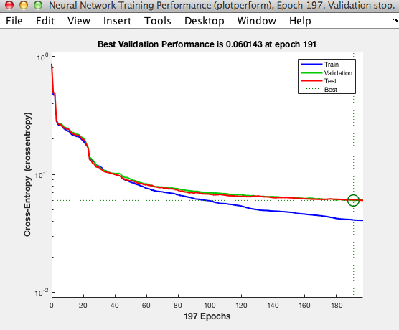
Neural Network Training
% Setup Division of Data for Training, Validation, Testing
net.divideParam.trainRatio = 70/100;
net.divideParam.valRatio = 15/100;
net.divideParam.testRatio = 15/100;
% Train the Network
[net,tr] = train(net,x,t);
No Over fit
Test data is better than Training data
% Test the Network
y = net(x);
e = gsubtract(t,y);
performance = perform(net,t,y);
tind = vec2ind(t);
yind = vec2ind(y);
percentErrors = sum(tind ~= yind)/numel(tind);

Slide 44
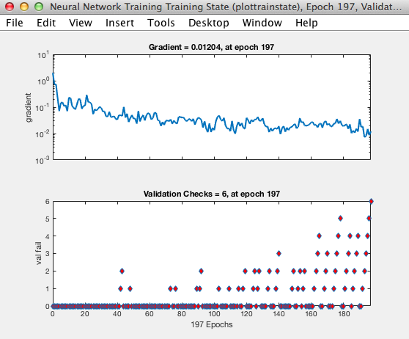
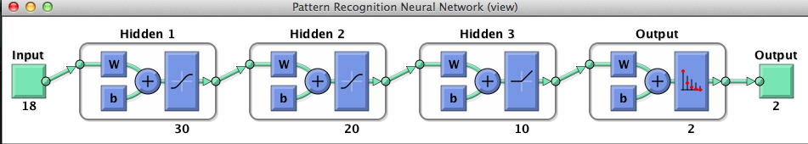
Neural Network Training
% Change the activation layer to ReLU
net.layers{3}.transferFcn='poslin’

Slide 45
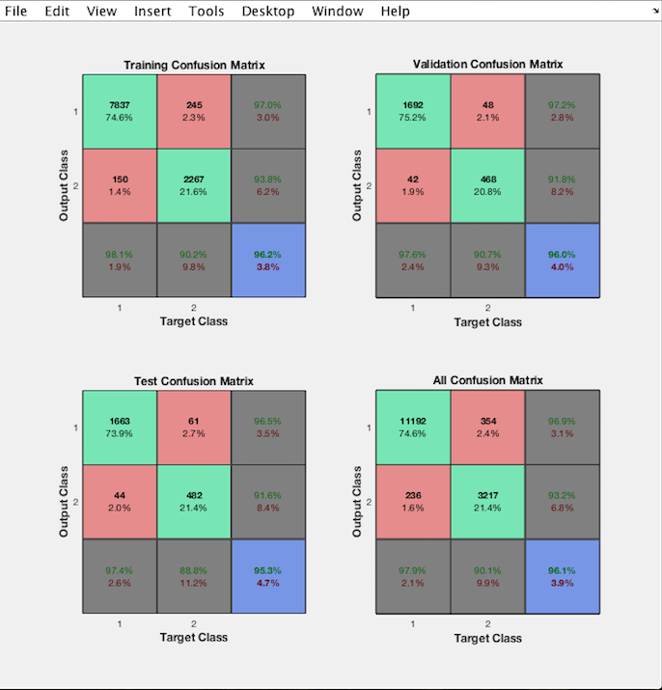
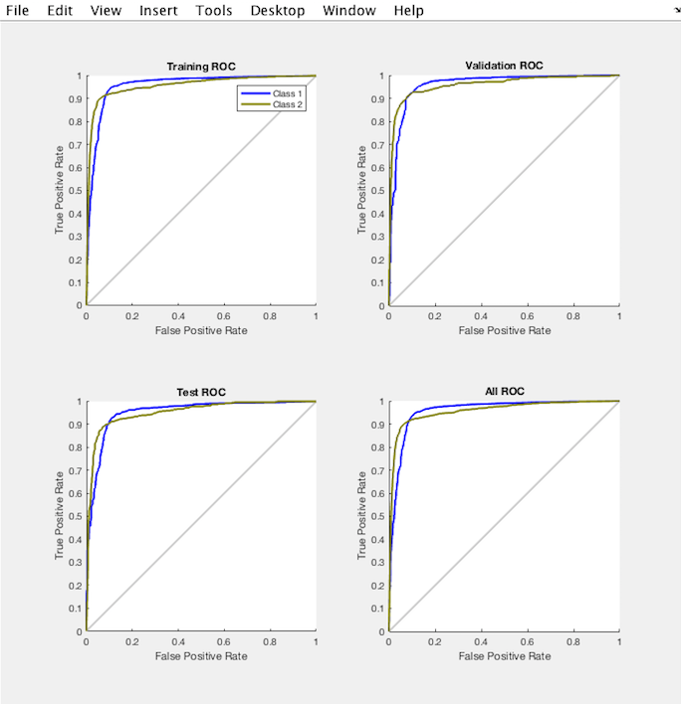
Neural Network Training

Slide 46
Model Comparison
Logistic
SVM
Auto-encoder
Neural Network
Accuracy: 0.8014
Emloyee Left (Class 0)
Precision : 0.6094
Recall : 0.3556
F-Statistic : 0.4492
Emloyee Stayed(Class 1)
Precision :0.8218
Recall : 0.9288
F-Statistic : 0.8720
Accuracy: 0.9764
Emloyee Left (Class 0)
Precision : 0.9506
Recall : 0.9506
F-Statistic : 0.9506
Emloyee Stayed(Class 1)
Precision : 0.9845
Recall : 0.9845
F-Statistic : 0.9845
Accuracy: 0.9520
Emloyee Left (Class 0)
Precision : 0.9921
Recall : 0.9787
F-Statistic : 0.9853
Emloyee Stayed(Class 1)
Precision : 0.9309
Recall : 0.9736
F-Statistic : 0.9518
Accuracy: 0.9610
Emloyee Left (Class 0)
Precision : 0.9010
Recall : 0.9320
F-Statistic : 0.9162
Emloyee Stayed(Class 1)
Precision : 0.9790
Recall : 0.9690
F-Statistic : 0.9740

Slide 47
Summary
Support Vector Machine was best model on all attributes, including precision & recall
Imbalanced confusion matrix meant Logistic Regression not an option
Scaling data is important

Slide 48
Appendix

Slide 49
References
The Element of Statistical Learning, by T. Hastie, R. Tibshirani, J. Friedman, Springer,
2013.
Deep Learning, by Ian Goodfellow, Yoshua Bengio, Aaron Courville,MIT Press, 2016
Learning From Data, by Y. S. Abu-Mostafa, M. Magdon-Ismail, H. T. Lin, AMLBook,
2012.
Matlab, Statistics and Machine Learning Toolbox, http://www.mathworks.com/help/stats/

Slide 50
LR Lasso Cook’s Distance
Set cutoff at >5x the mean

