Slide 1
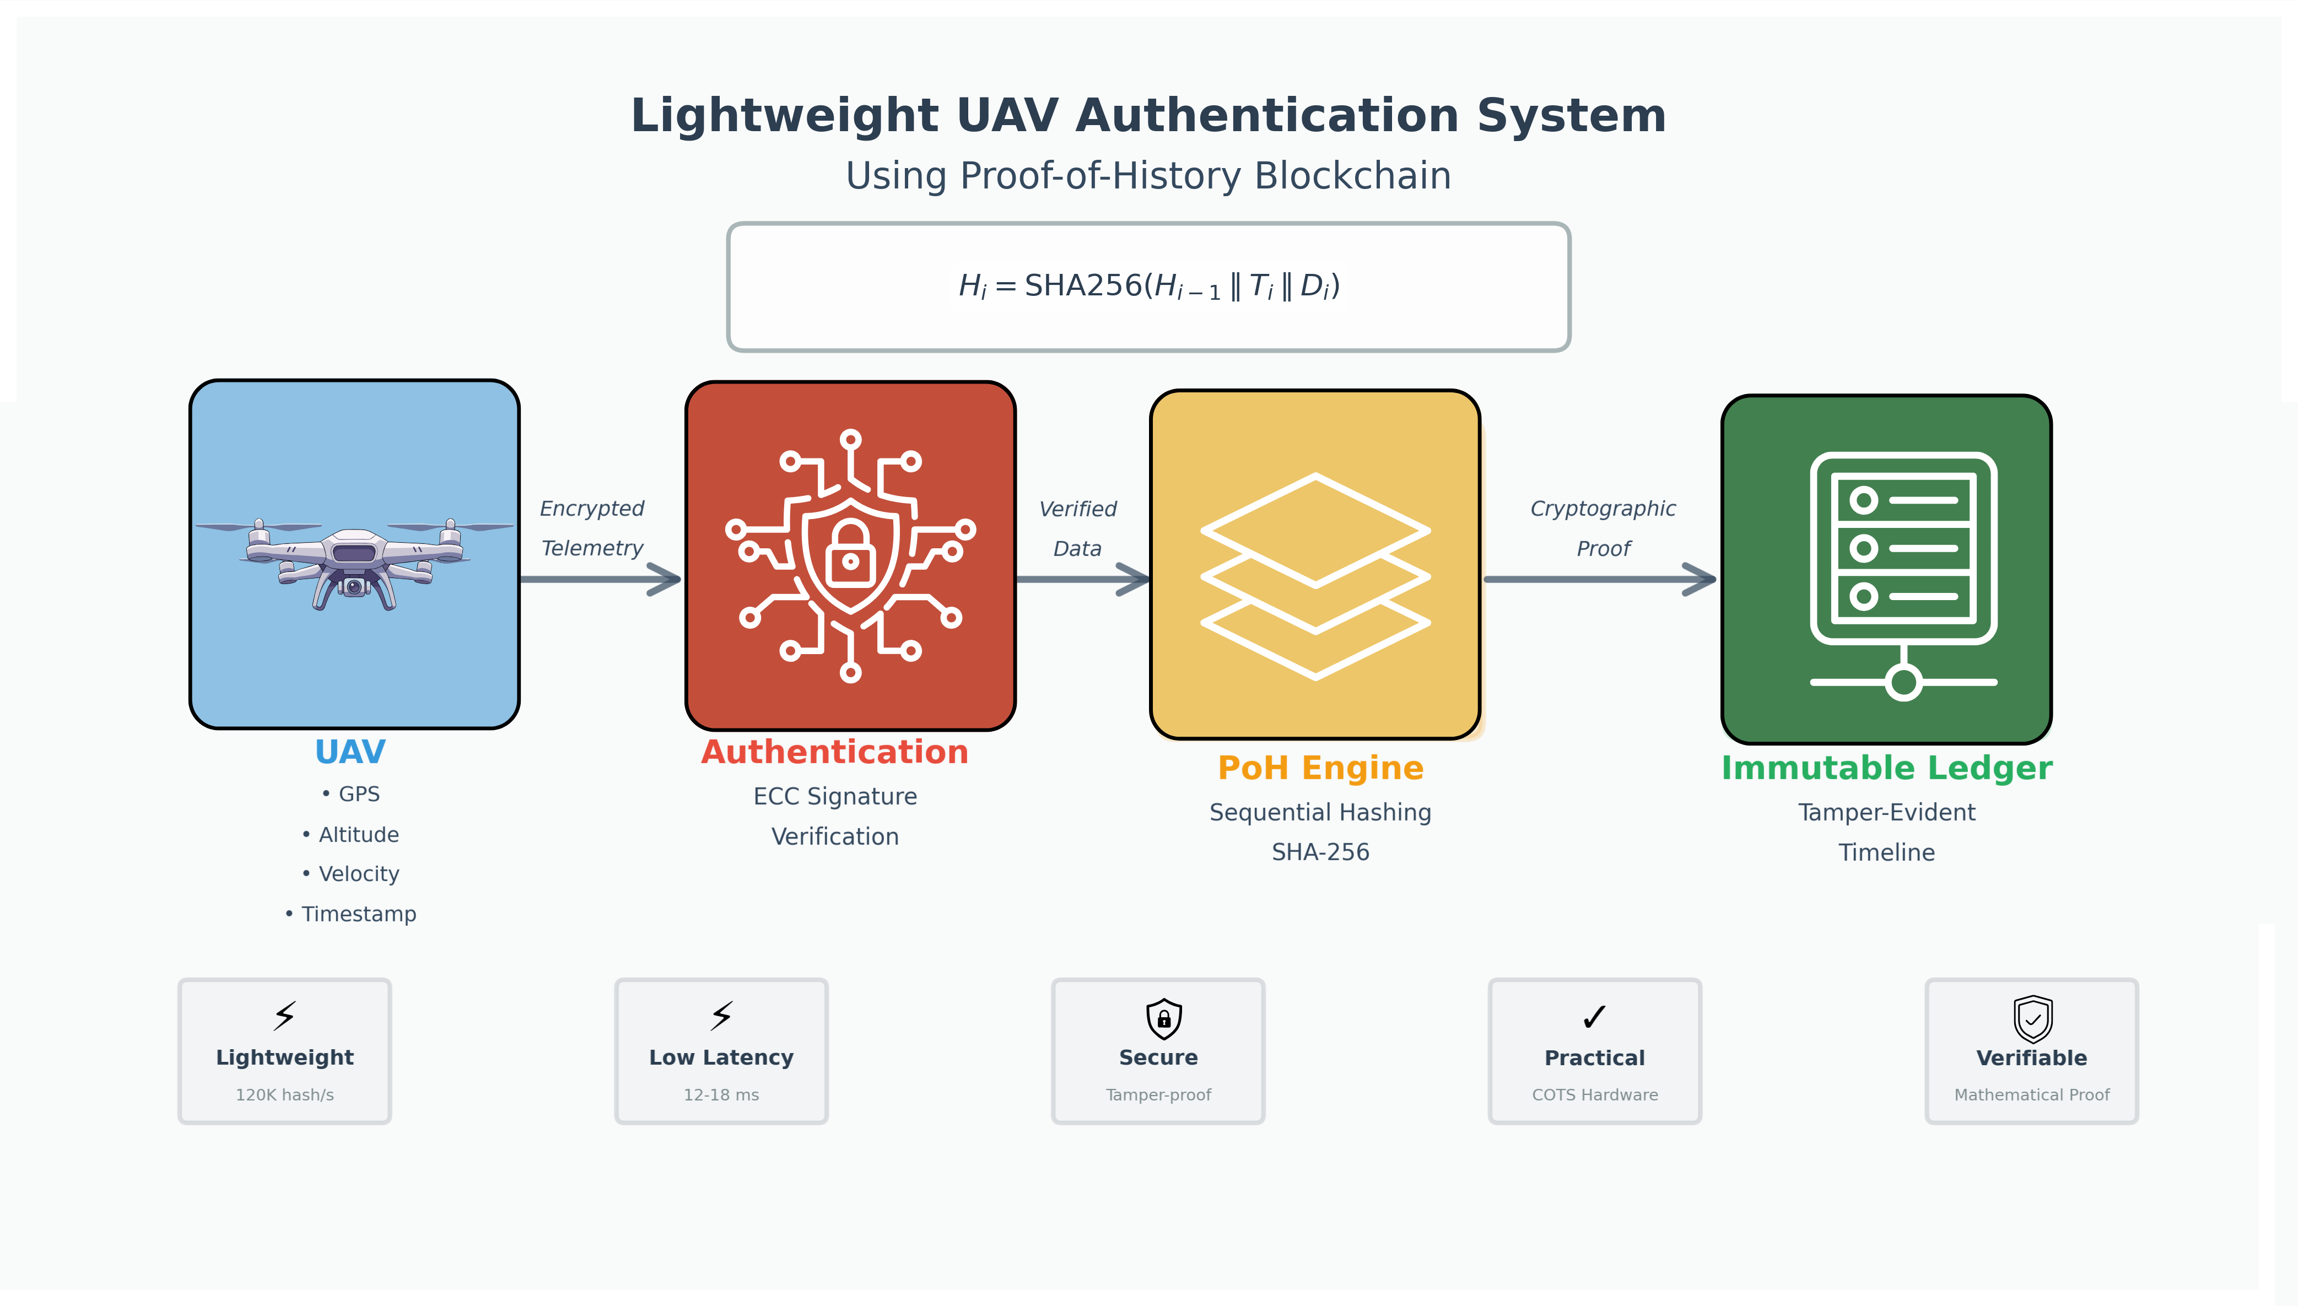
Nanjing University of Posts and Telecommunications (NJUPT)
Design and Implementation of UAV Authentication System based on Proof-of-History Blockchain Technology
Student: MUNTASIR AL MAMUN
Student No.: F22040119
Major: Computer Science and Technology
Institution: NJUPT — School of Computer Science
Year: 2026
UAV Authentication using PoH Blockchain | MUNTASIR AL MAMUN | NJUPT 2026
1 / 16

Slide 2
Presentation Outline
1
Introduction & Motivation
2
Research Objectives & Contributions
3
Related Work & Research Gap
4
System Architecture
5
PoH Engine Design
6
Authentication Protocol (ECC)
7
Implementation Details
8
Evaluation – Performance
9
Evaluation – Security Tests
10
Conclusion & Future Work
UAV Authentication using PoH Blockchain | MUNTASIR AL MAMUN | NJUPT 2026
2 / 16

Slide 3
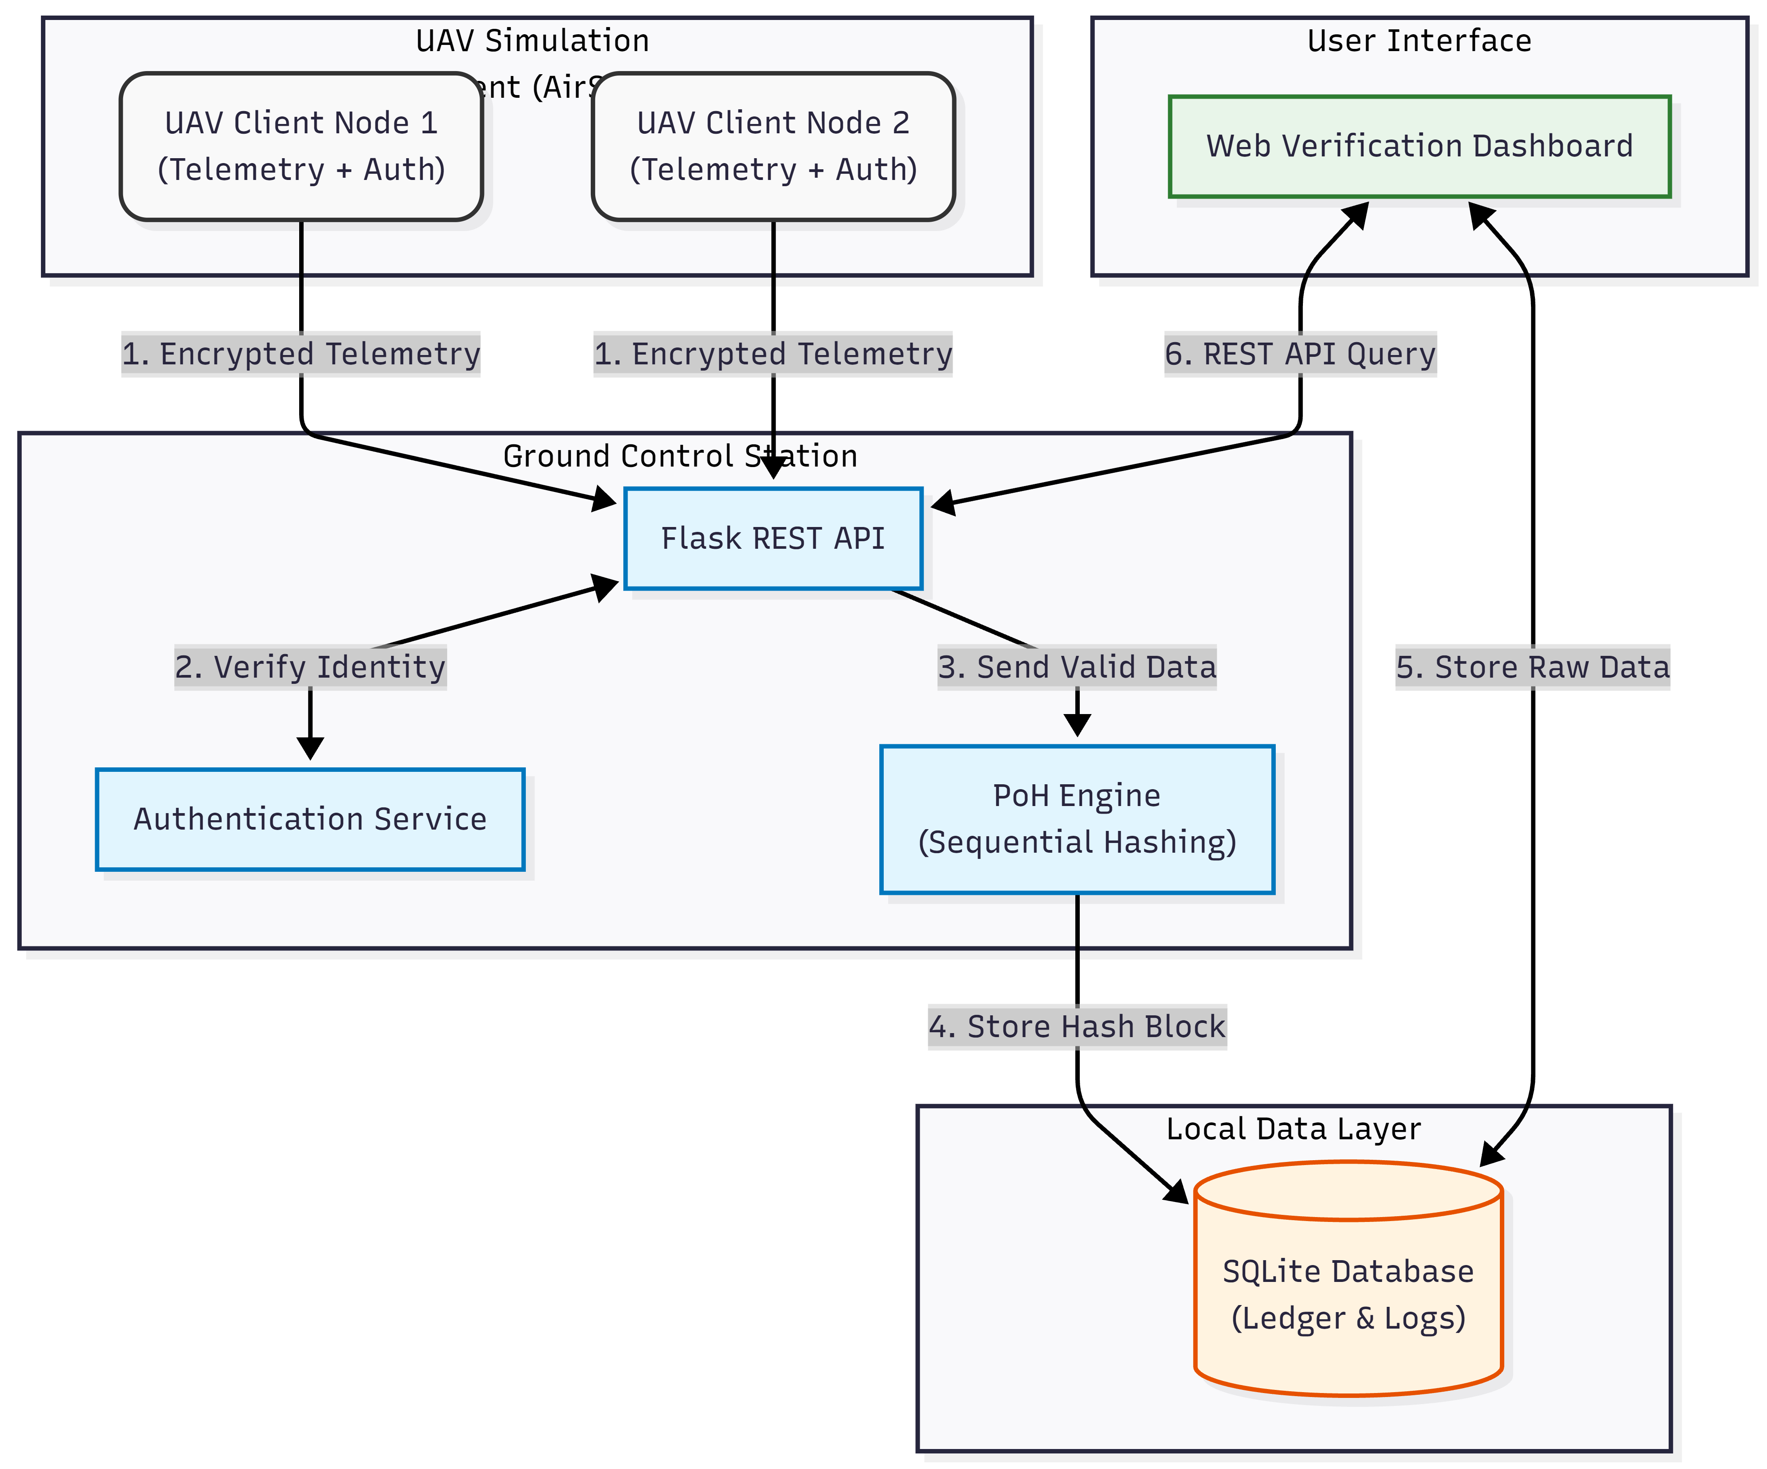
Introduction & Motivation
Why do UAVs need a new security paradigm?
UAVs are transforming logistics, agriculture, surveillance & emergency response
Critical Security Threats:
• Spoofing & command hijacking over wireless links
• Unauthorized telemetry manipulation & replay attacks
• Centralized architectures = single point of failure
• Forged timestamps → undetectable event reordering
Why existing solutions fall short:
• Traditional PKI: no tamper-evident logging
• PoW / PoS blockchains: too heavy for UAV hardware
• Symmetric keys: scale poorly in multi-UAV fleets
Fig. 1 – UAV Data Integrity Challenges & PoH Motivation
UAV Authentication using PoH Blockchain | MUNTASIR AL MAMUN | NJUPT 2026
3 / 16

Slide 4
Research Objectives & Contributions
Objectives
Key Contributions
1.
Develop a PoH-based sequential hashing engine for UAV telemetry
✔ First PoH-based UAV verification framework bridging blockchain principles with real-time flight data
2.
Integrate lightweight ECC mutual authentication
✔ Full end-to-end prototype: authentication + sequential logging + verification dashboard
3.
Implement in AirSim + PX4 SITL simulation environment
4.
Design real-time web verification dashboard
✔ Empirical performance & security evaluation under multi-UAV AirSim/PX4 conditions
5.
Evaluate performance & security against common attack vectors
✔ Open-source modular architecture as a foundation for distributed UAV blockchain research
UAV Authentication using PoH Blockchain | MUNTASIR AL MAMUN | NJUPT 2026
4 / 16

Slide 5
Related Work & Research Gap
UAV Authentication
ECC-based mutual auth, 5G-AKA, RF fingerprinting — lack tamper-evident logging
Blockchain for UAVs
PoW/PoS/DPoS: too heavy. Permissioned chains lack inherent temporal ordering
PoH & VDF Research
Strong sequential-time proofs but no integrated lightweight UAV solution
Hybrid Logging
High-res local logs + periodic anchors — but no unified auth-integrity linkage
Research Gap: No existing system unifies PoH temporal ordering with lightweight ECC authentication for real-time, resource-constrained UAV environments.
UAV Authentication using PoH Blockchain | MUNTASIR AL MAMUN | NJUPT 2026
5 / 16

Slide 6
System Architecture
Modular service-oriented framework
UAV Client Nodes
AirSim-simulated drones; autonomous flight + telemetry broadcasting via MAVLink
Ground Control Station
Authentication hub + PoH ledger node; Flask REST API; ECC key registry
PoH Blockchain Engine
Python SHA-256 sequential hashing; tamper-evident event timeline
Web Dashboard
Real-time telemetry viz; block verification; forensic log export
Fig. 3.1 – Overall System Architecture
UAV Authentication using PoH Blockchain | MUNTASIR AL MAMUN | NJUPT 2026
6 / 16

Slide 7
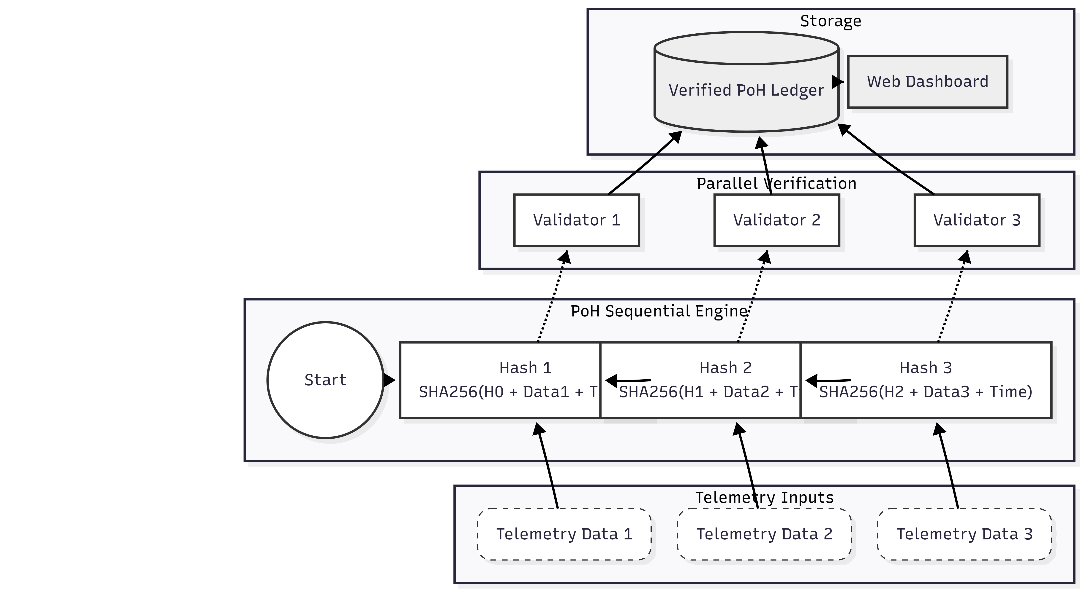
Proof-of-History Engine
Cryptographic backbone — tamper-evident sequential timeline
Core Formula:
Hᵢ = SHA256( Hᵢ₋₁ ∥ Eventᵢ ∥ Timestampᵢ )
Key Properties:
• Inherently sequential — cannot be parallelised
• Any block alteration invalidates all later hashes
• Verification is embarrassingly parallel (fast audit)
• No distributed consensus needed
Performance:
• > 120,000 hashes/sec on i5-11400H
• Block creation < 1 ms per event
• Full-chain verification: 180–260 ms
Fig. 3.2 – PoH Hash Sequence & Verification
UAV Authentication using PoH Blockchain | MUNTASIR AL MAMUN | NJUPT 2026
7 / 16

Slide 8
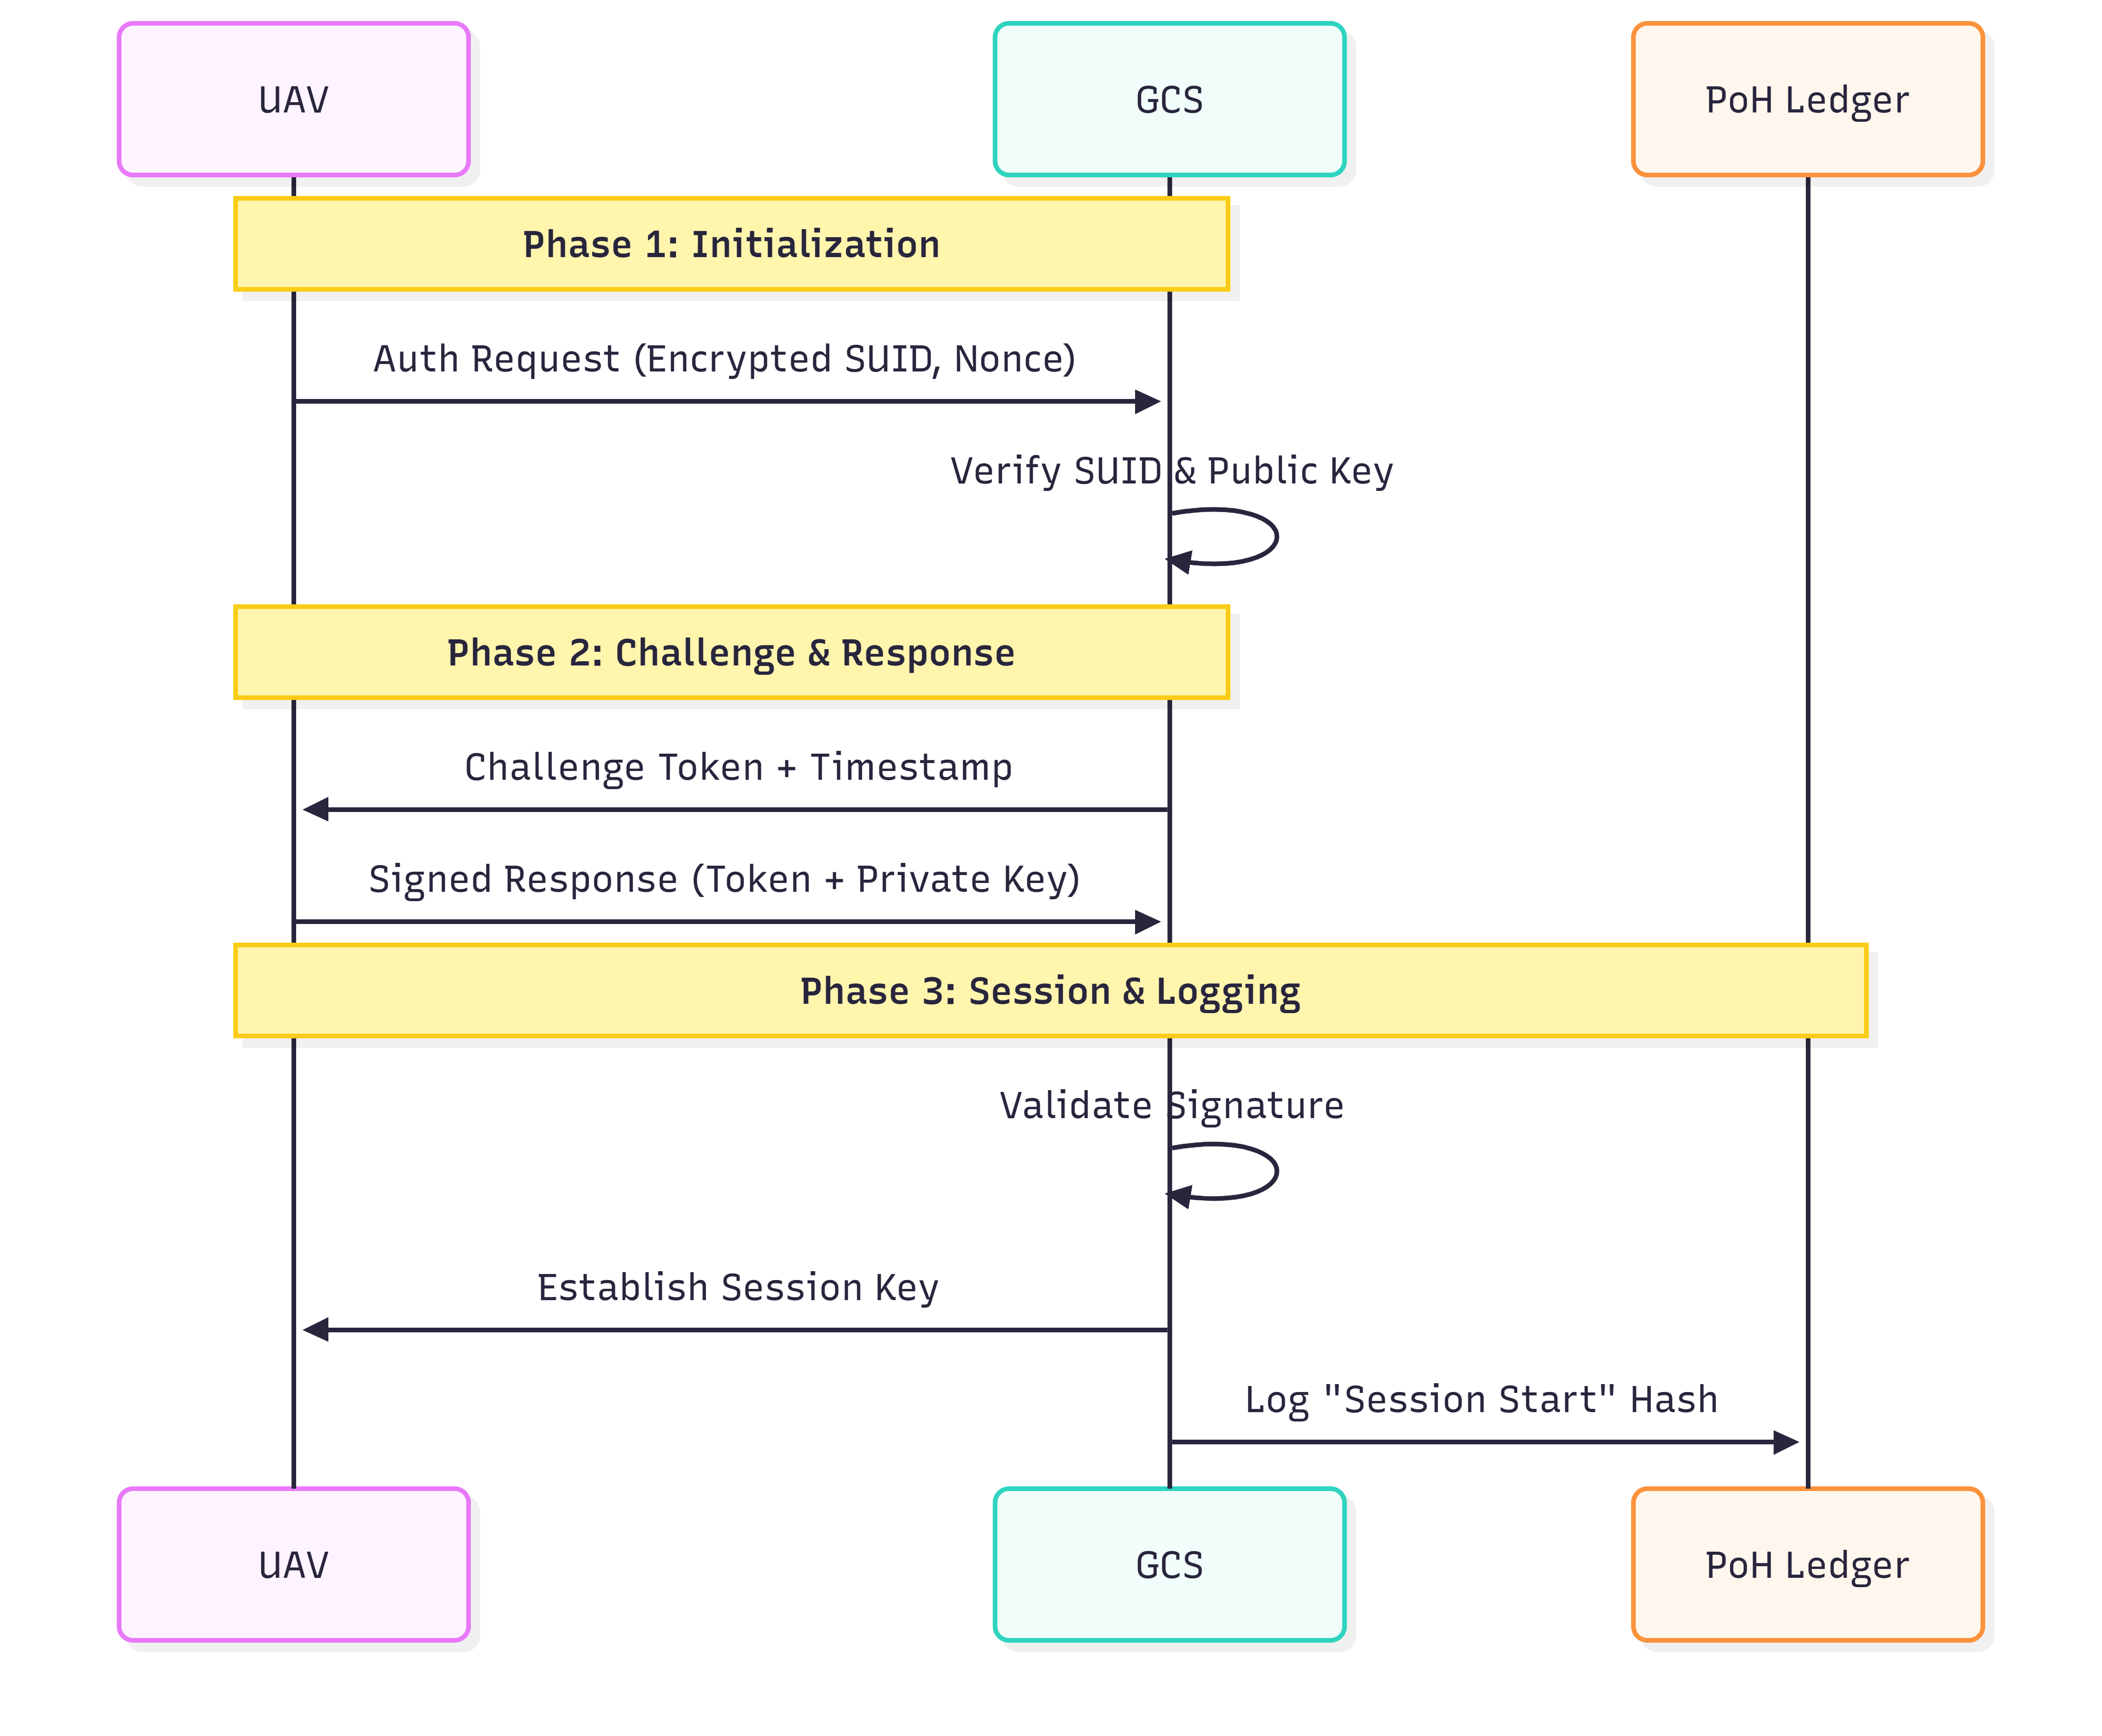
Authentication Protocol
ECC-based lightweight mutual authentication
Why ECC?
Equivalent security to RSA with smaller key sizes →
ideal for resource-constrained UAV hardware
3-Phase Handshake:
Phase 1 – Initialization:
UAV sends encrypted temp ID + signed nonce
Phase 2 – Challenge:
GCS verifies signature, issues random challenge token
Phase 3 – Verification:
UAV signs challenge; GCS verifies → session key K_Session
Session Security:
• K_Session derived via one-way KDF
• Each packet carries MAC(message, K_Session)
• Session initiation event embedded in PoH chain
• Prevents spoofing, replay & command injection
Fig. 3.3 – UAV–GCS Three-Phase Authentication Flow
UAV Authentication using PoH Blockchain | MUNTASIR AL MAMUN | NJUPT 2026
8 / 16

Slide 9
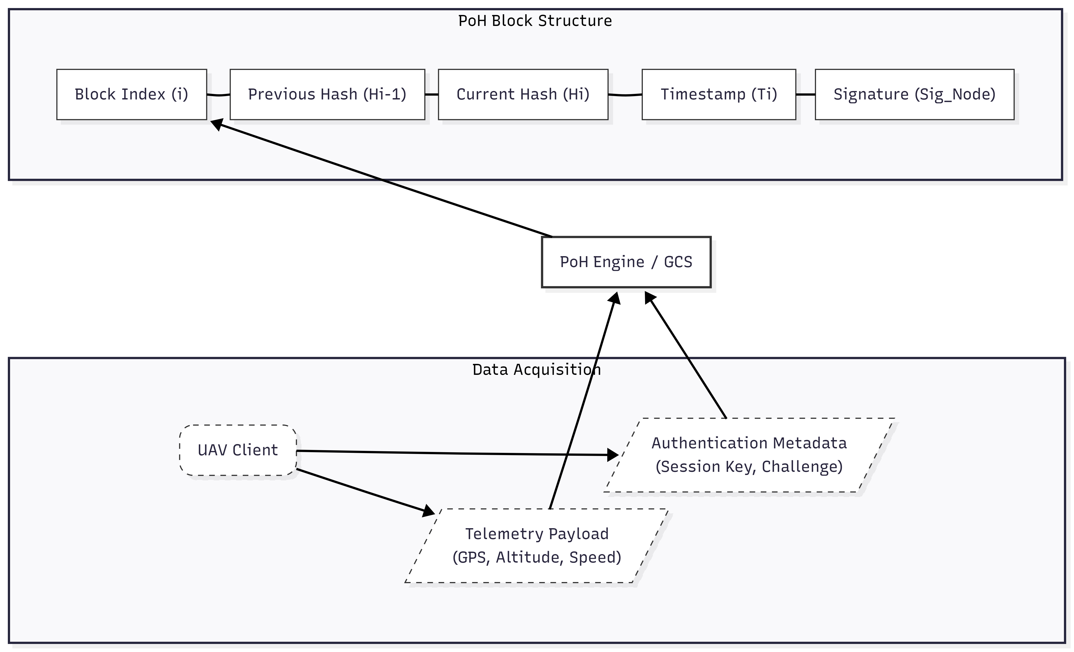
Data Model & Block Format
Three-layer verifiable ledger structure
Layer 1 – Transaction Data
UAV_ID, Timestamp, GPS, Altitude, Velocity, System Status, Challenge tokens & Session Keys (KTx)
Layer 2 – PoH Metadata
Block Index (i), Previous Hash (Hᵢ₋₁), Current Hash (Hᵢ), Timestamp (Tᵢ), GCS Node Signature (Sig_Node)
Layer 3 – Verification Record
Links session keys to PoH index → retrospective session verification without re-running authentication protocol
Fig. 3.4 – PoH Ledger Block Structure
UAV Authentication using PoH Blockchain | MUNTASIR AL MAMUN | NJUPT 2026
9 / 16

Slide 10
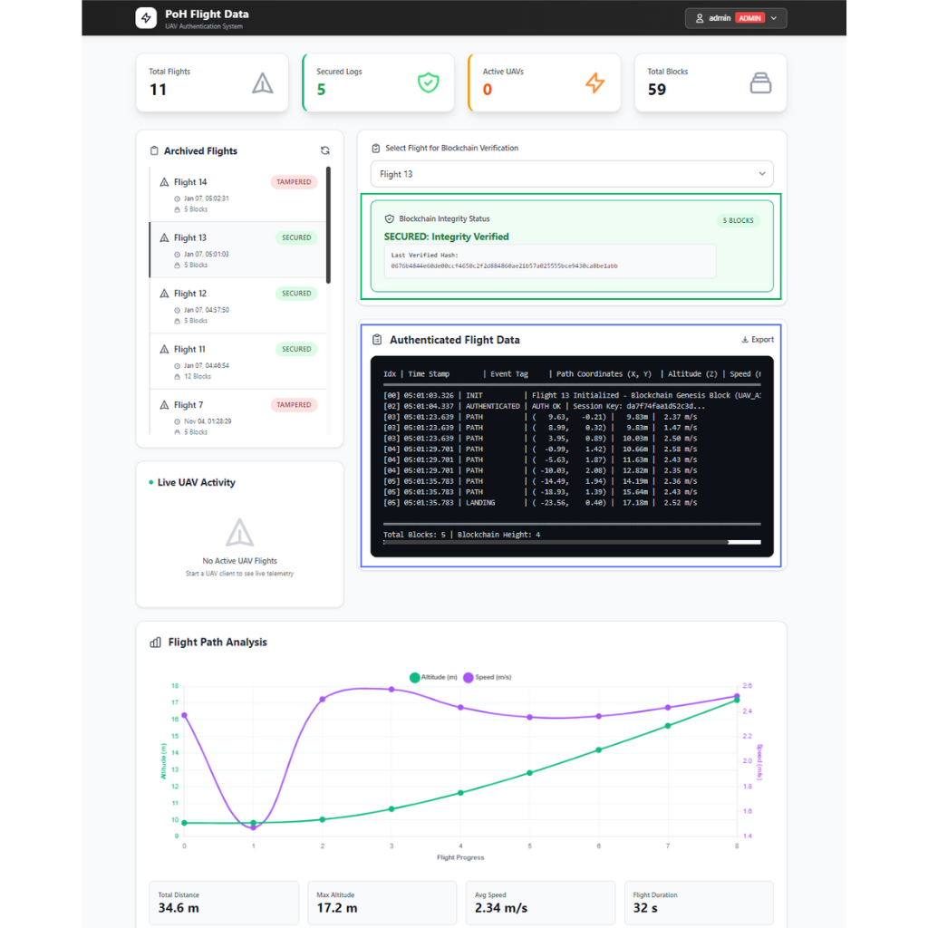
Implementation Details
Technology stack & simulation environment
Hardware Platform:
Intel i5-11400H @ 2.7 GHz | 16 GB DDR4 | NVIDIA GTX 1660 Ti | Windows 11 / WSL Ubuntu 22.04
Software Stack:
Python 3.11 + Flask 3.0 · PyCryptodome (ECC/SHA-256)
SQLite 3.41 + SQLAlchemy ORM · Jinja2 + AJAX dashboard
Microsoft AirSim + PX4 SITL · MAVLink protocol
API Endpoints:
/api/telemetry — receives signed UAV packets → PoH chain
/api/verify — recomputes hashes, returns integrity token
/api/logs — authenticated historical blockchain access
Dashboard Panels:
Telemetry Viz · Blockchain Ledger · Authentication Log · Export (JSON/CSV)
Fig. 4.2 – Real-time Web Verification Dashboard
UAV Authentication using PoH Blockchain | MUNTASIR AL MAMUN | NJUPT 2026
10 / 16

Slide 11
Evaluation – Performance Results
AirSim + PX4 SITL multi-UAV simulation
Approach
Auth Latency
Telemetry Log
Ordering
UAV Suitability
This Work (PoH)
~ms (12-18 ms)
< 1 ms/block
Deterministic
★★★★★
PKI-based Auth
Low-Medium
Not supported
None
★★★☆☆
PoW Blockchain
High
Sec–Min
Probabilistic
★☆☆☆☆
PoS Blockchain
Med–High
Seconds
Probabilistic
★★☆☆☆
DAG Ledger
Medium
Sub-second
Partial
★★★☆☆
Key Metrics: Auth cycle 12–18 ms · Telemetry ingestion 6–10 ms · Hash throughput 110–125 K/s · Block latency < 3 ms · Full-chain verify 180–260 ms
UAV Authentication using PoH Blockchain | MUNTASIR AL MAMUN | NJUPT 2026
11 / 16

Slide 12
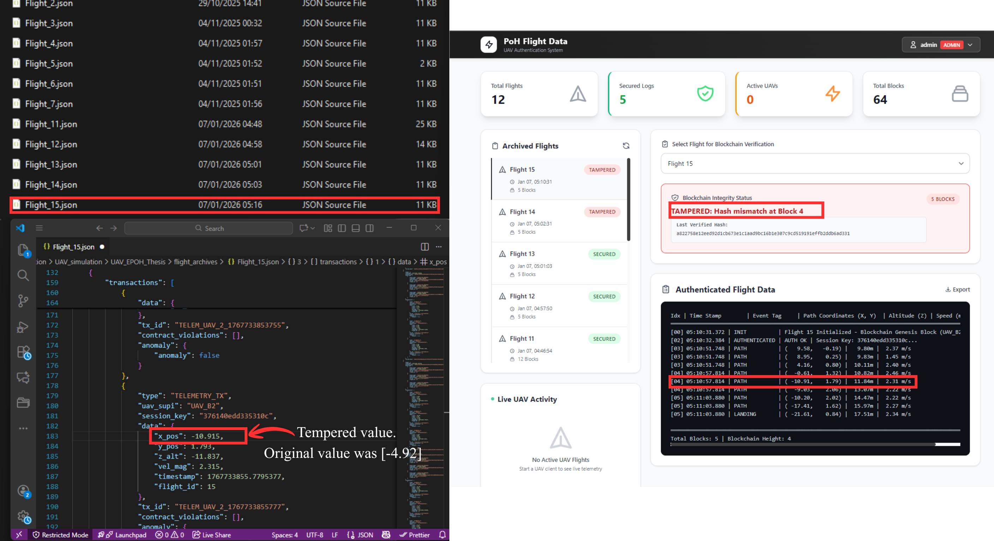
Evaluation – Security Tests
Four adversarial scenarios verified
✗ Impersonation Attack
Spoofed SUPI / invalid SUCI → authentication rejected immediately; no PoH entry created
✗ Replay Attack
Captured packets have stale timestamps misaligned with advancing PoH sequence → classified stale & rejected
✗ Data Tampering
Modified block → hash mismatch detected; entire downstream chain flagged invalid (see dashboard alert)
✗ Malicious Chain Fork
Attacker cannot regenerate valid sequential hashes at comparable speed → forked chain rejected by GCS
Fig. 5.1 – Data Tampering Attack & PoH Detection Response
✔ All four attack categories successfully mitigated by the PoH + ECC framework
UAV Authentication using PoH Blockchain | MUNTASIR AL MAMUN | NJUPT 2026
12 / 16

Slide 13
Conclusion & Future Work
Summary
Future Work
✔ Novel PoH-based UAV authentication framework — verifiable tamper-evident event timeline without heavy consensus
Multi-node Distributed PoH
Replicate ledger across GCS nodes for fault-tolerance & scalability
✔ ECC mutual authentication binds verified UAV identities directly to the PoH ledger
UAV Swarm & Inter-UAV Auth
Handover procedures, cross-UAV verification in BVLOS missions
✔ Real-time web dashboard enables live monitoring and forensic audit
Physical Hardware Deployment
✔ Strong resilience against impersonation, replay, tampering & chain-fork attacks
Real-world energy, latency & communication constraints on embedded controllers
Cloud Integration
✔ Practical performance: ms-level latency, 110–125K hashes/sec throughput
Periodic checkpoint anchoring to cloud ledger for regulatory compliance
UAV Authentication using PoH Blockchain | MUNTASIR AL MAMUN | NJUPT 2026
13 / 16

Slide 14
Thank You
Questions & Discussion
Design and Implementation of UAV Authentication System based on Proof-of-History Blockchain Technology
MUNTASIR AL MAMUN
Student No.: F22040119 | Computer Science & Technology
Nanjing University of Posts and Telecommunications | 2026
UAV Authentication using PoH Blockchain | MUNTASIR AL MAMUN | NJUPT 2026
14 / 16

