Slide 1

Angular

Slide 2
Contents
Project Setup
Components
How angular app starts
Databinding
Directives
Angular App Life Cycle
Binding to Custom Property
Binding to Custom Events
View Encapsulation
Local Reference in Template
@ViewChild()
Ng-content
@ContentChild()
Custom Directive

Slide 3
Angular
Angular is a development platform, built on TypeScript.
It is used to develop single phage applications

Slide 4
Benefits
Scalability
Well integrated libraries
Powerful developer tools that helps

Slide 5
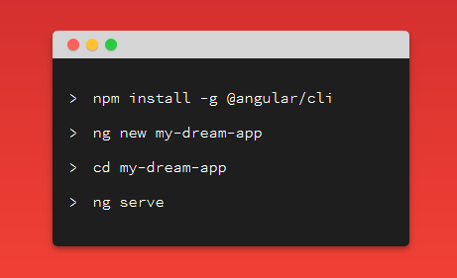
Project Setup
Install the Angular CLI
Create new application
Run the application

Slide 6
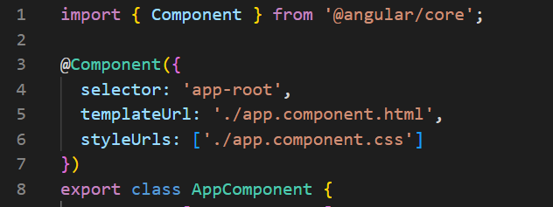
Component
Main building block for Angular applications
An HTML template
A TypeScript class
A CSS selector
CSS styles (optional)

Slide 7
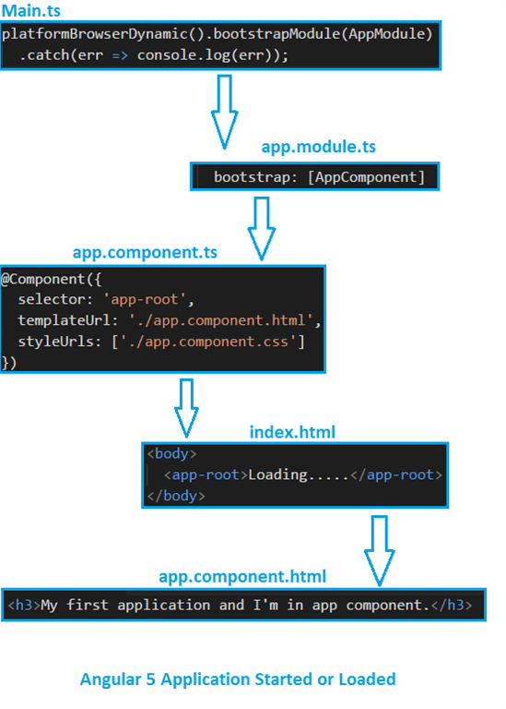
How angular app starts

Slide 8
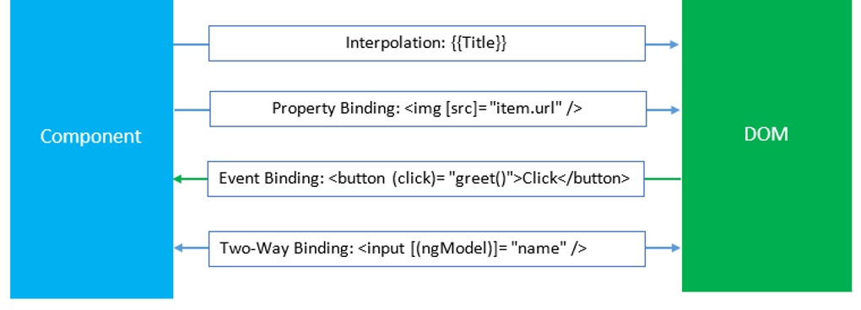
Databinding

Slide 9
Directives
Structural
Attribute
Component

Slide 10
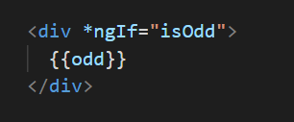
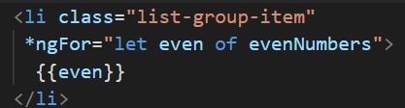
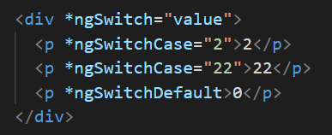
Structural Directive
*ngIf
*ngFor
*ngSwitch

Slide 11

Attribute Directive
Attribute Directive
ngClass
ngStyle

Slide 12
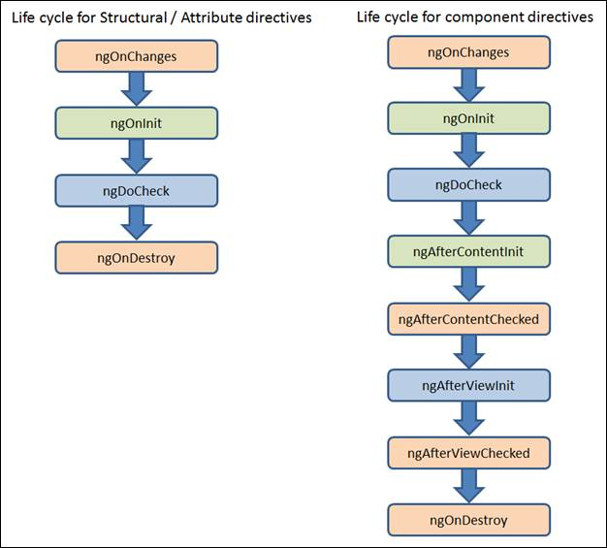
Life Cycle

Slide 13
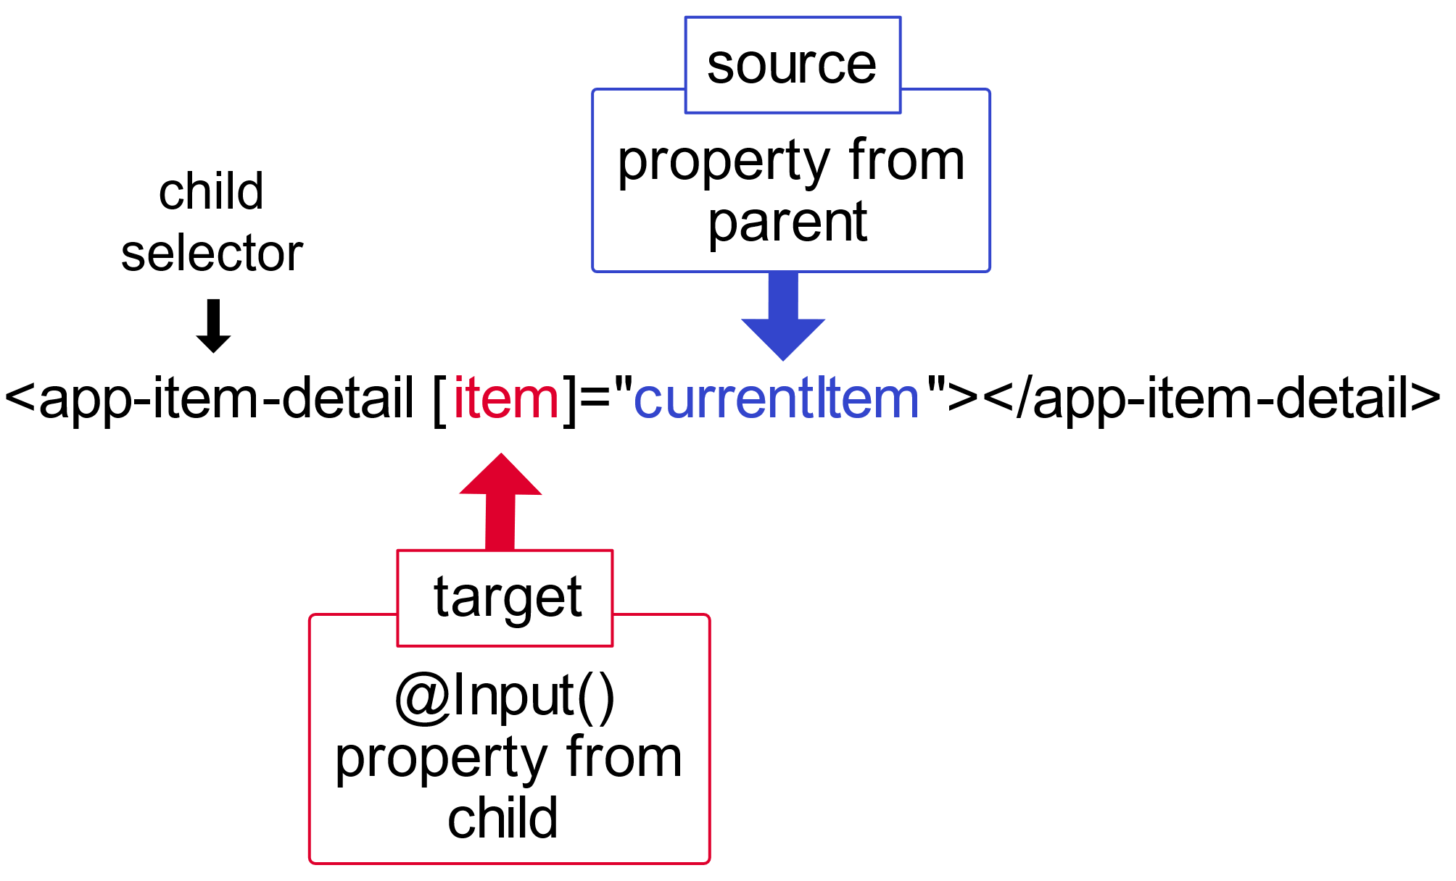
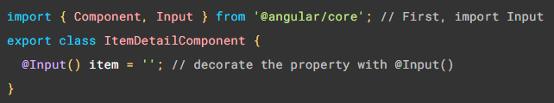
Binding to Custom Property
@Input()
Decorator that marks a class field as an input property and supplies configuration metadata.
Sending data to a child component

Slide 14
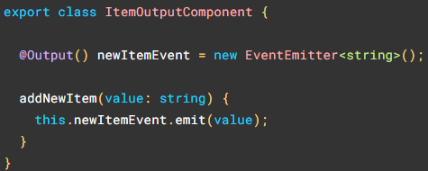
Binding to Custom Events
@Output() decorator in a child component or directive lets data flow from the child to the parent.
To raise an event, an @Output() must have the type of EventEmitter

Slide 15
View Encapsulation
In Angular, a component's styles can be encapsulated within the component's host element so that they don't affect the rest of the application.
ViewEncapsulation.ShadowDom
ViewEncapsulation.Emulated
ViewEncapsulation.None

Slide 16
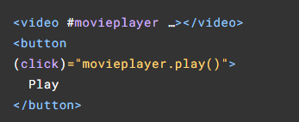
Local Reference in Template
‘#variablename’ is used to make local variable in template

Slide 17
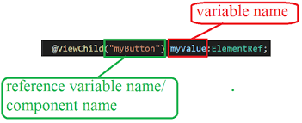
@ViewChild()
Property decorator that configures a view query. The change detector looks for the first element or the directive matching the selector in the view DOM.
View queries are set before the ngAfterViewInit callback is called.

Slide 18
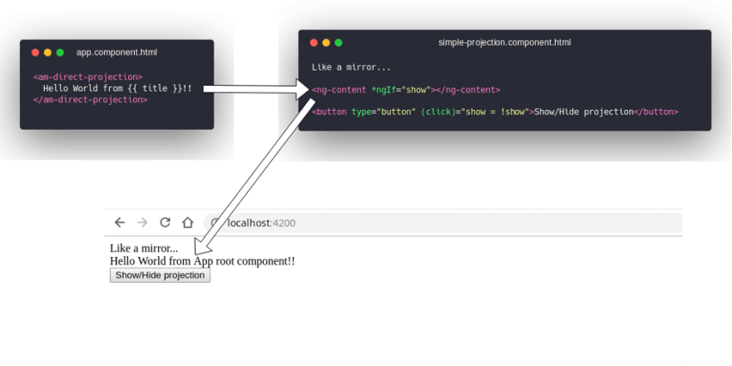
ng-content Element
The <ng-content> element specifies where to project content inside a component template.

Slide 19
@ContentChild()
Property decorator that configures a content query.
Content queries are set before the ngAfterContentInit callback is called.

Slide 20
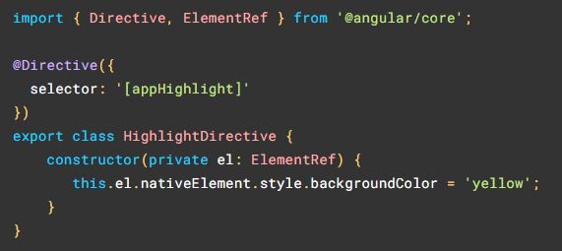
Custom Directives
Generate directive:
ng generate directive highlight

Slide 21
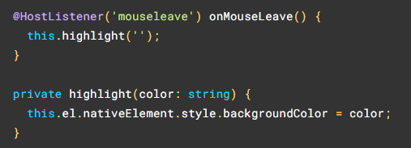
Handling user events
@HostListener() decorator listens events in DOM.

Slide 22
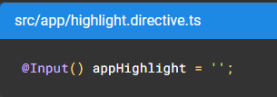
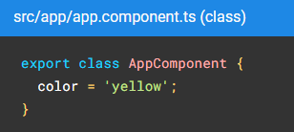
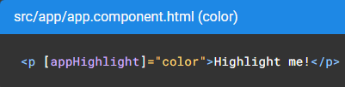
Passing values into an attribute directive
Add a field in directive and decorate it with @Input()
Name field same as directive selector or use alias.

Slide 23
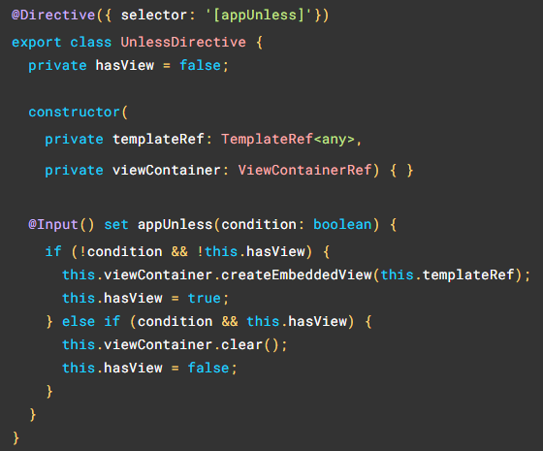
Creating a structural directive

Slide 24

Thank you

