Slide 1
Angular

Slide 2
Angular
Angular is a development platform, built on TypeScript.
It is used to develop single phage applications

Slide 3
Benefits
Scalability
Well integrated libraries
Powerful developer tools that helps
develop
build
test
update

Slide 4
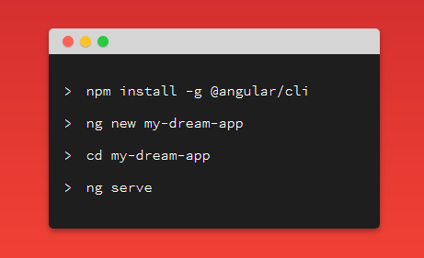
Project Setup
Install the Angular CLI
Create new application
Run the application

Slide 5
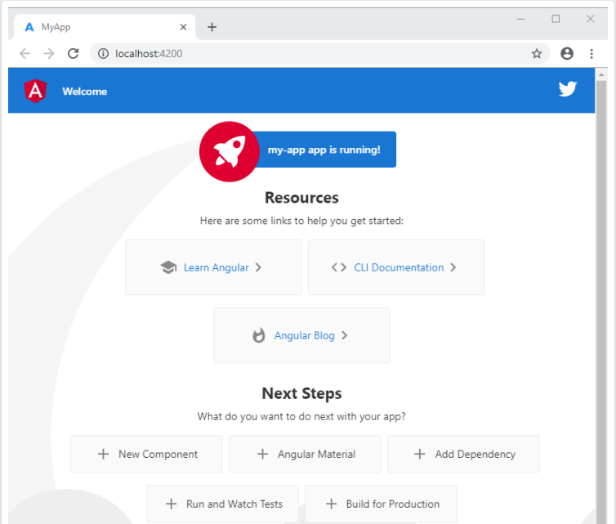

Slide 6
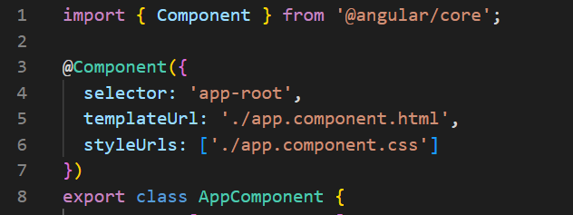
Component
Main building block for Angular applications
An HTML template
A TypeScript class
A CSS selector
CSS styles (optional)

Slide 7
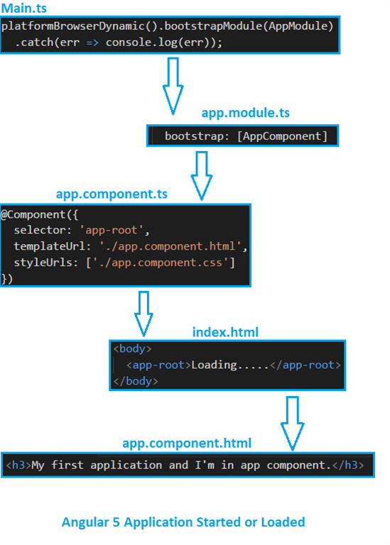
How angular app starts

Slide 8
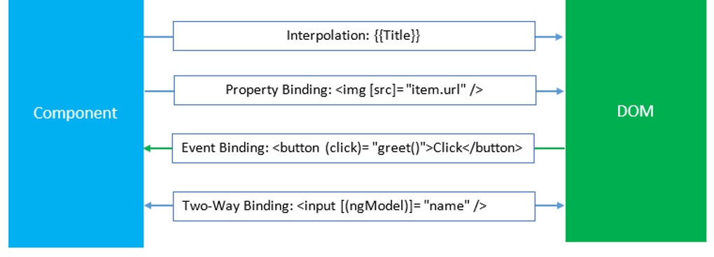
Databinding

Slide 9
Directives
Structural
Attribute
Component

Slide 10
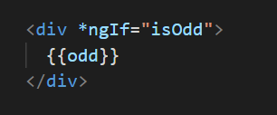
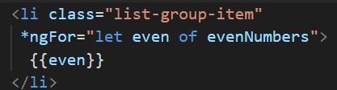
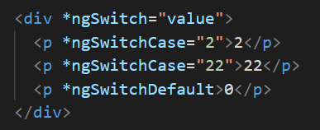
Structural Directive
*ngIf
*ngFor
*ngSwitch

Slide 11

Attribute Directive
Attribute Directive
ngClass
ngStyle

Slide 12
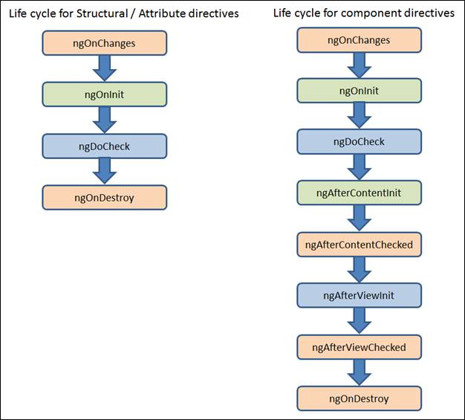
Life Cycle

Slide 13
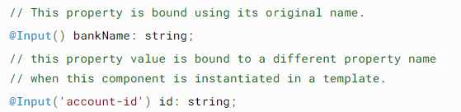
Binding to Custom Property
@Input()
Decorator that marks a class field as an input property and supplies configuration metadata.
It exposes property

Slide 14
Binding to Custom Events

