Slide 1


&
A Presentation
on
Crop Pest Detection & Classification Using Deep Learning
8th International Conference on Intelligent Sustainable Systems - ICISS 2026 4^{th &} 5th March 2026
PAPER ID: ICISS-0435
Authored by
Dr.D.Ganesh
Dr.M. Sunil Kumar
M.L.Tejaswi
P.Vanaja
R.Bharath Kumar
S.Ajith Kumar

Slide 2
Table of Contents
Abstract
Introduction
Literature Survey
Problem Statement
Objectives
Proposed System Design
Algorithm
Dataset Description
Result
Conclusion
References

Slide 3
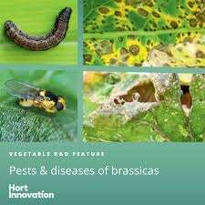
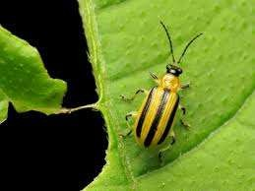
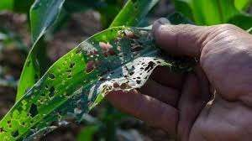
Introduction
Agricultural productivity plays a crucial role in ensuring global food security, butcrop pests significantly threaten yields, leading to substantial economic losses and food shortages. Traditional pest detection methods, such as manual scouting and chemical treatments, are time-consuming, labor-intensive, and often inaccurate. As a result, modern technologies such as deep learning and computer vision have emerged as effective solutions for automated pest detection and classification.

Slide 4
Abstract
The challenge of agricultural productivity caused by crop pests is a significant problem since the use of pesticides is associated with significant losses of yield and the promotion of the use of excessive amounts that harm the environmental sustainability and human health. Pest species identification in rural settings continues to be a problem as there are only a few computational resources, as well as the complexity of the conditions in the field and the similarity of visually similar pests. To deal with these issues, this paper presents an effective deep learning-based system, which is called DeepestNet integrated with EfficientNet-B4, to perform automated crop pest identification and classification. The proposed model uses EfficientNet-B4 which is a small but strong feature extractor and DeepestNet classifier which is trained to identify pests of multiple classes. Normalization and data augmentation are used to pre-process field and annotated pest images in order to improve their resistance to different environmental conditions. The transfer learning is used to train the model and the performance of the model is measured using standard performance indices such as accuracy, precision, recall and F1-score. The results of the experiment indicate that the suggested approach can reach superior classification performance in contrast to standard CNN, Faster R-CNN, and YOLO-based networks and reach the superior accuracy of 95.4. The proposed framework is highly suitable in the real-time implementation on edge and mobile hardware because of its low computational complexity and high accuracy. This helps to detect pests in time, help reduce the unneeded use of pesticides, enhance crop productivity, and help promote precision agriculture practices that are sustainable.

Slide 5
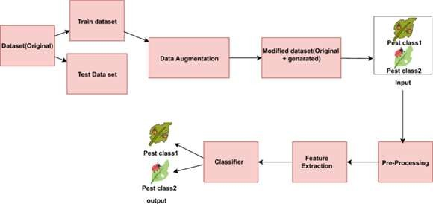
Introduction
This project focuses on developing an advanced deep learning-based model,
DeepestNet, for crop pest recognition and classification using EfficientNet-B4 as the backbone network. The proposed system aims to provide an efficient, accurate, and scalable approach to identifying various crop pests from images, enabling early pest detection and improved pest management strategies.

Slide 6
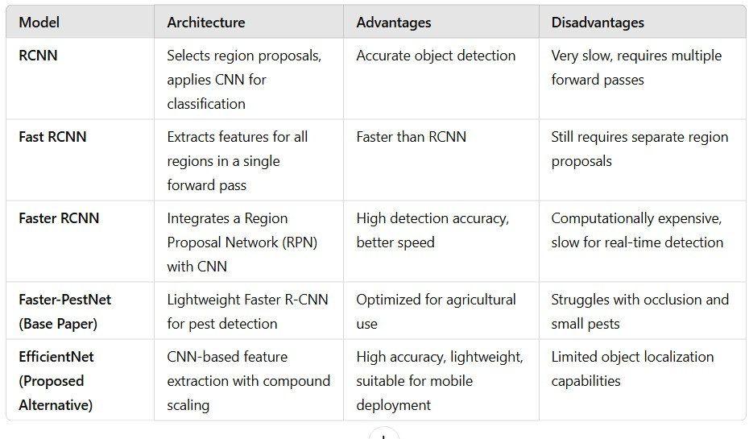
Literature Survey

Slide 7
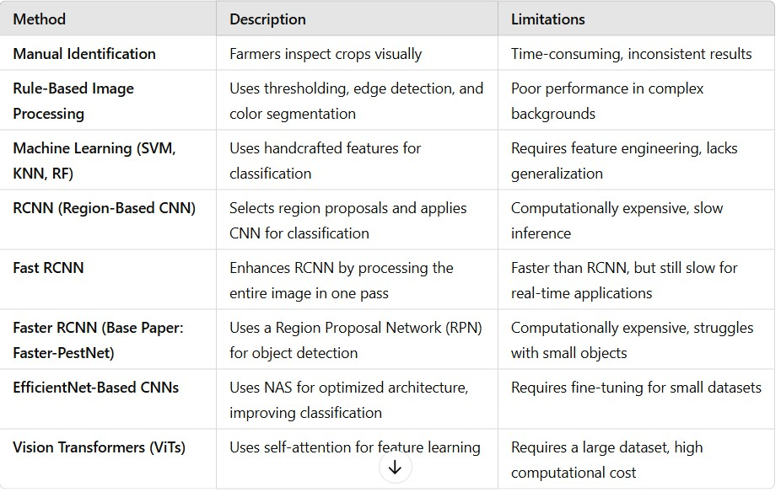
Literature Survey

Slide 8
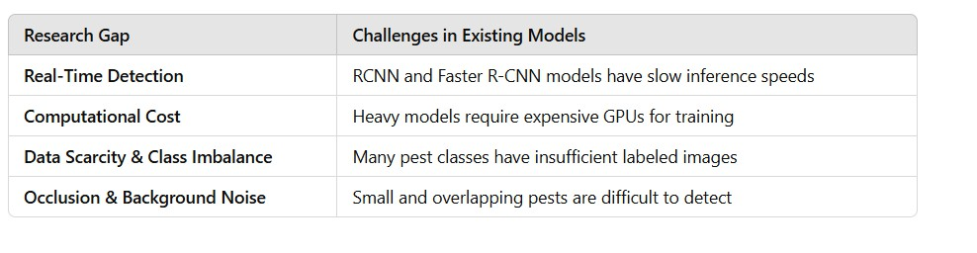
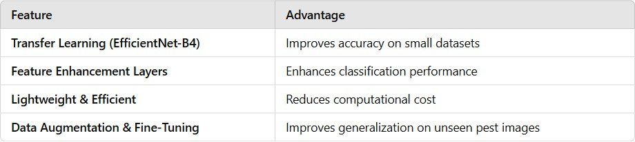
Literature Survey

Slide 9
Problem Statement
To develop a DeepPestNet-based deep learning model for accurate recognition and classification of crop pests, we integrate advanced image processing, feature extraction, and deep neural networks. This enhances real-time pest identification and supports precision agriculture. Farmers and agronomists can make timely pest control decisions, reducing crop loss and optimizing yield.

Slide 10
Objectives
Objective 1
To identify the most accurate and computationally efficient deep learning model
for real-time crop pest detection.
Research Gap:
To bridge these gaps, this research proposes a DeepestNet integrated with EfficientNet-B4, designed to achieve high accuracy with low computational complexity, enabling real-time, edge-deployable, and reliable crop pest detection under practical agricultural conditions.
Expected Outcome:
Identification of a high-performing yet computationally efficient baseline model
suitable for real-time pest detection in field conditions.

Slide 11
Objectives
Objective 2
To develop a physics-enhanced spatio-temporal deep learning model for accurate
and time-consistent crop pest detection and assessment in precision agriculture.
Research Gap:
Existing pest detection models lack temporal modeling, biological consistency, multi-task prediction, real-time deployability, and robustness to field conditions, limiting their effectiveness in precision agriculture.
Expected Outcome:
Improved detection accuracy, temporal consistency, and robustness compared to single-frame and purely data-driven models.

Slide 12
Objectives
Objective 3
To formulate a biologically consistent, multi-task pest analysis framework integrating temporal attention and physics-guided constraints for species classification, life-stage prediction, and infestation severity estimation.
Research Gap:
Current pest detection systems do not integrate temporal attention with biology- driven constraints for simultaneous species, life-stage, and severity analysis, limiting early-warning and decision-support capabilities.
Expected Outcome:
A reliable decision-support system capable of early warning, severity assessment, and biologically meaningful predictions for precision agriculture.

Slide 13
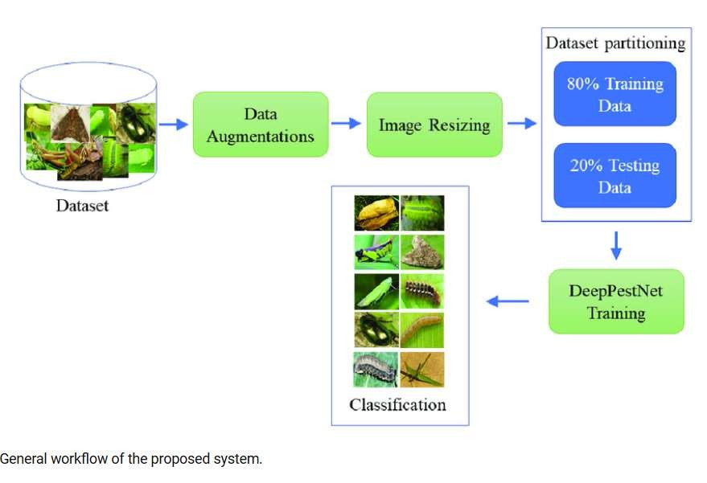
Proposed System Design
The proposed system is an AI-driven crop pest detection and classification model based on DeepestNet with EfficientNet-B4.
The goal is to provide farmers with an efficient, accurate, and real-time pest recognition system, reducing crop losses and optimizing pest control measures.

Slide 14
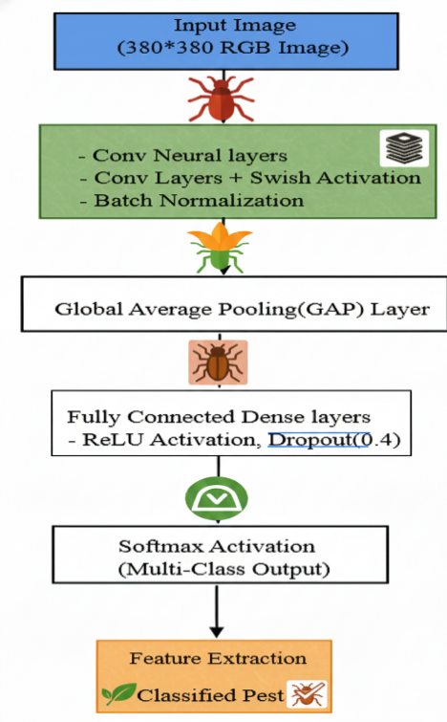
Algorithm
Input Image
The algorithm begins with the snap of the image of the crop pest using a camera or smartphone.
Preprocessing
Preprocessing will take care of converting the image into the proper format, increase feature extraction, and provide the model with resistance to alteration with changes in the conditions around.
Feature Extraction
These characteristics are then used in classification. EfficientNet-B4 is chosen as it can
give high accuracy and is computationally affordable.
DeepestNet Classifier
The DeepestNet network that has fully connected layers provides a decision on the appropriate pest category of the extracted features.
Output
The final result of the model is the categorized form of pest, and a confidence score of the accuracy of prediction.

Slide 15
Dataset Description
The dataset consists of annotated field-based crop pest images collected under diverse agricultural conditions. Images are resized to 380 × 380 (RGB), normalized, and augmented to improve robustness. An 80:20 train–test split is used to support accurate and real-time pest classification in precision agriculture.
Attributes Included:
Image: RGB image of the crop pest
Pest Label: Class of the identified pest
Image Size: 380 × 380 × 3
Augmentation: Rotation, flipping, contrast enhancement

Slide 16
Result
Model | Accuracy (%) | Precision (%) | Recall (%) | F1-Score (%)
Faster R-CNN | 88.5 | 85.2 | 86.8 | 86.0
YOLOv5 | 91.2 | 89.5 | 90.3 | 89.9
Traditional CNN | 85.7 | 83.1 | 82.5 | 82.8
DeepestNet + EfficientNet-B4 (Proposed) | 95.4 | 94.1 | 94.8 | 94.4

Slide 17
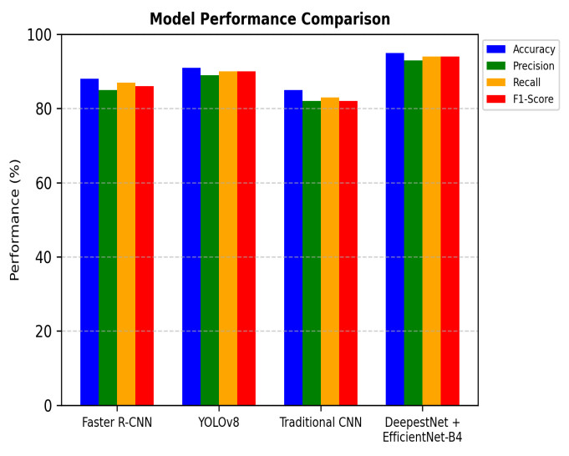
Result

Slide 18
Conclusion
The proposed DeepestNet with EfficientNet-B4 model provides accurate and efficient crop pest detection, achieving 95.4% accuracy. It supports real-time field deployment, reduces pesticide overuse, and improves crop productivity. Future work focuses on larger datasets, IoT/drone integration, and enhanced model interpretability for smart precision agriculture.

Slide 19
References
Ali, F., Qayyum, H., & Iqbal, M. J. (2023). Faster-PestNet: A lightweight deep learning framework for crop pest detection and classification IEEE Access, 11, 101234-101245 https://doi.org/10.1109/ACCESS.2023.3317506
Ullah, N., Khan, J. A., Alharbi, L. A., Raza, A., Khan, W., & Ahmad, I. (2022). An efficient approach for crops pests recognition and classification based on novel DeepPestNet deep learning model.IEEE Access, 10, 75922–75934. https://doi.org/10.1109/ACCESS.2022.3189676
Akbar, J. U. M., Kamarulzaman, S. F., Muzahid, A. J. M., Rahman, M. A., & Uddin, M. (2024). A comprehensive review on deep learning assisted computer vision techniques for smart greenhouse agriculture. IEEEAccess, 12, 1944–1968.https://doi.org/10.1109/ACCESS.2024.3349418
Nguyen-Tan, T., & Le-Trung, Q. (2024). A novel 5G PMN-driven approach for AI-powered irrigation and
crop health monitoring. IEEEAccess, 12, 89231–89244. https://doi.org/10.1109/ACCESS.2024.3452719
Li, X., Hou, B., Tang, H., Talpur, B. A., Zeeshan, Z., Bhatti, U. A., Liao, J., Liu, J., Alabdullah, B., & Al Naimi, I. S. (2024). Abnormal crops image data acquisition strategy by exploiting edge intelligence and dynamic-static synergy in smart agriculture. IEEE Journal of Selected Topics in Applied Earth Observations and Remote Sensing, 17, 6543–6557. https://doi.org/10.1109/JSTARS.2024.3414306

Slide 20
References
Yang, H., Xu, P., Zhang, S., Kim, H., & Shin, I. (2025). Construction of an intelligent analysis system for crop health status based on drone remote sensing data and CNN. IEEE Access, 13, 16721–16733. https://doi.org/10.1109/ACCESS.2025.3540279
Liu, W., & Wu, G. (2020). DFF-ResNet: An insect pest recognition model based on residual
networks. Big
Data Mining and Analytics, 3(4), 300–310.
https://doi.org/10.26599/BDMA.2020.9020021
Li, L., Zhang, S., & Wang, B. (2021). Plant disease detection and classification by deep
learning—A review.
IEEE Access, 9, 56683–56698.
https://doi.org/10.1109/ACCESS.2021.3069646
Vilar-Andreu, M., García, L., García-Sánchez, A.-J., Asorey-Cacheda, R., & Garcia-Haro, J.
(2024). Enhancing precision agriculture pest control: A generalized deep learning approach
with YOLOv8-based
insect detection. IEEE Access, 12, 67521–
67534.https://doi.org/10.1109/ACCESS.2024.3413979
Akbar, J. U. M., Kamarulzaman, S. F., Muzahid, A. J. M., Rahman, M. A., & Uddin, M. (2024). A comprehensive review on deep learning assisted computer vision techniques for
smart greenhouse agriculture. IEEE Access, 12, 1944–
1968.https://doi.org/10.1109/ACCESS.2024.3349418

Slide 21
Any Queries?

Slide 22


