Slide 1

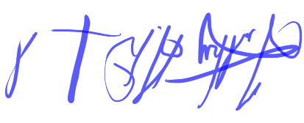

CERTIFICATE
Of Perfect Attendance
THIS CERTIFICATE IS PRESENTED TO…
Paul Moss
Your perfect attendance record is a remarkable achievement, reflecting your unwavering commitment and reliability. By never missing a single day of work, you have set an outstanding example for your colleagues. Your consistent presence and dedication have significantly contributed to the success of our team. Your positive attitude and continuous collaboration make you an invaluable asset to our organization. We deeply appreciate your outstanding contributions and exceptional dedication.
29th of May 2024
Timothy A Drummond
(ELT Manager)
Munye H Sufi
(ELT Senior Instructor)

Slide 2
CERTIFICATE
Of Perfect Attendance
THIS CERTIFICATE IS PRESENTED TO…
Dahir Adani
Your perfect attendance record is a remarkable achievement, reflecting your unwavering commitment and reliability. By never missing a single day of work, you have set an outstanding example for your colleagues. Your consistent presence and dedication have significantly contributed to the success of our team. Your positive attitude and continuous collaboration make you an invaluable asset to our organization. We deeply appreciate your outstanding contributions and exceptional dedication.
29th of May 2024
Timothy A Drummond
(ELT Manager)
Munye H Sufi
(ELT Senior Instructor)

Slide 3
CERTIFICATE
Of Perfect Attendance
THIS CERTIFICATE IS PRESENTED TO…
Shah Nawaz
Your perfect attendance record is a remarkable achievement, reflecting your unwavering commitment and reliability. By never missing a single day of work, you have set an outstanding example for your colleagues. Your consistent presence and dedication have significantly contributed to the success of our team. Your positive attitude and continuous collaboration make you an invaluable asset to our organization. We deeply appreciate your outstanding contributions and exceptional dedication.
29th of May 2024
Timothy A Drummond
(ELT Manager)
Munye H Sufi
(ELT Senior Instructor)

