Slide 1

CSE208 · DIGITAL LOGIC DESIGN LABORATORY · CLASS 06
Encoders &
Priority Encoders
Munzer Mahmood
Lecturer, Department of Computer Science and Engineering
Presidency University

Slide 2
Where We Are
Recap · Class 05
Last class you learned
So far
Circuits that route a value
A multiplexer selects one of 2ⁿ inputs with n select lines
2-to-1 MUX: Y = S̅ I₀ + S I₁
Any Boolean function fits in one multiplexer
A demultiplexer sends one input to one of 2ⁿ outputs
A decoder is a demux with its data input held at 1
Today
Circuits that name a line — they turn it into a binary code
Today the input is one active line. The output is its number.
Notes:
Bridge from routing data (MUX/DEMUX) to coding data. An encoder answers: which line is active?

Slide 3
Today's Learning Objectives
By the end of today's laboratory, you should be able to:
1
Explain what an encoder does and why 2ⁿ inputs need only n outputs.
2
Derive the output expressions of 4-to-2, 8-to-3 and 10-to-4 encoders.
3
Explain why an ordinary encoder fails when two inputs are active.
4
Write the truth table of a 4-to-2 priority encoder and simplify it with K-maps.
5
Build and verify an encoder and a priority encoder from basic gates.
6
Verify priority encoding with the 74148 IC or a simulator.

Slide 4
Why Do We Need Encoders?
Motivation
A keypad has many keys, but the processor only needs to know which one — as a number.
101
3-bit code for key 5
0
1
2
3
4
5
6
7
8 key lines — key 5 is pressed
Many → few
2ⁿ input lines shrink to an n-bit code.
Fewer wires
8 keys need 3 wires; 64 keys need only 6.
Everywhere
Keyboards, interrupt controllers, position sensors.
An encoder answers one question: which line is active?
Notes:
Ask the class: how many wires would a 104-key keyboard need without encoding? With encoding, 7 bits are enough.

Slide 5
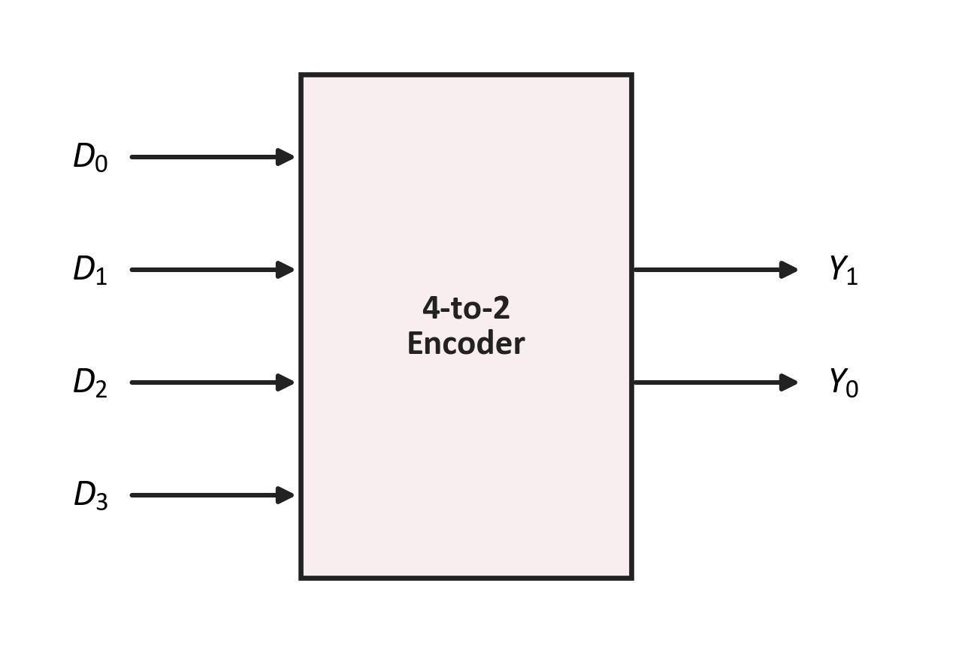
The Encoder
Topic 1 · Encoder
Definition
An encoder is a combinational circuit with 2ⁿ input lines and n output lines. The outputs give the binary code of the one input that is active.
Inputs: D₀ … D₃ — exactly one of them is 1
Outputs: Y₁Y₀ — the index of that input
Example: D₂ = 1 → Y₁Y₀ = 10
The reverse of a decoder
A decoder turns a code into one line; an encoder turns one line into a code.
Notes:
Stress the assumption: exactly one input is 1. We will break this assumption later and see why priority encoders exist.

Slide 6
Counting Inputs and Outputs
Topic 1 · Encoder
Every extra output bit doubles the number of lines an encoder can name:
Inputs | Outputs | Encoder | Also called
4 | 2 | 4-to-2 | —
8 | 3 | 8-to-3 | Octal-to-binary
10 | 4 | 10-to-4 | Decimal-to-BCD
16 | 4 | 16-to-4 | Hex-to-binary
The rule
The output is the index of the active input, written in binary.
Example — 8-to-3
D₀ → 000 D₅ → 101 D₇ → 111
2ⁿ inputs ⇒ n output bits
The 10-input encoder is the odd one: 4 bits could name 16 lines, it uses only 10.
Notes:
Same counting rule as the MUX select lines, read in the other direction.

Slide 7
4-to-2 Encoder — Truth Table
Topic 1 · Encoder
D₃ | D₂ | D₁ | D₀ | Y₁ | Y₀
0 | 0 | 0 | 1 | 0 | 0
0 | 0 | 1 | 0 | 0 | 1
0 | 1 | 0 | 0 | 1 | 0
1 | 0 | 0 | 0 | 1 | 1
Reading the outputs
Y₁ is 1 for D₂ and D₃.
Y₀ is 1 for D₁ and D₃.
Boolean expressions
Y₁ = D₂ + D₃
Y₀ = D₁ + D₃
Only the four valid rows — exactly one input is 1
An encoder is just OR gates — one per output bit.
D₀ appears in no equation: its code is 00.
Notes:
No AND gates, no inverters: each output simply ORs the inputs whose index has a 1 in that bit.

Slide 8
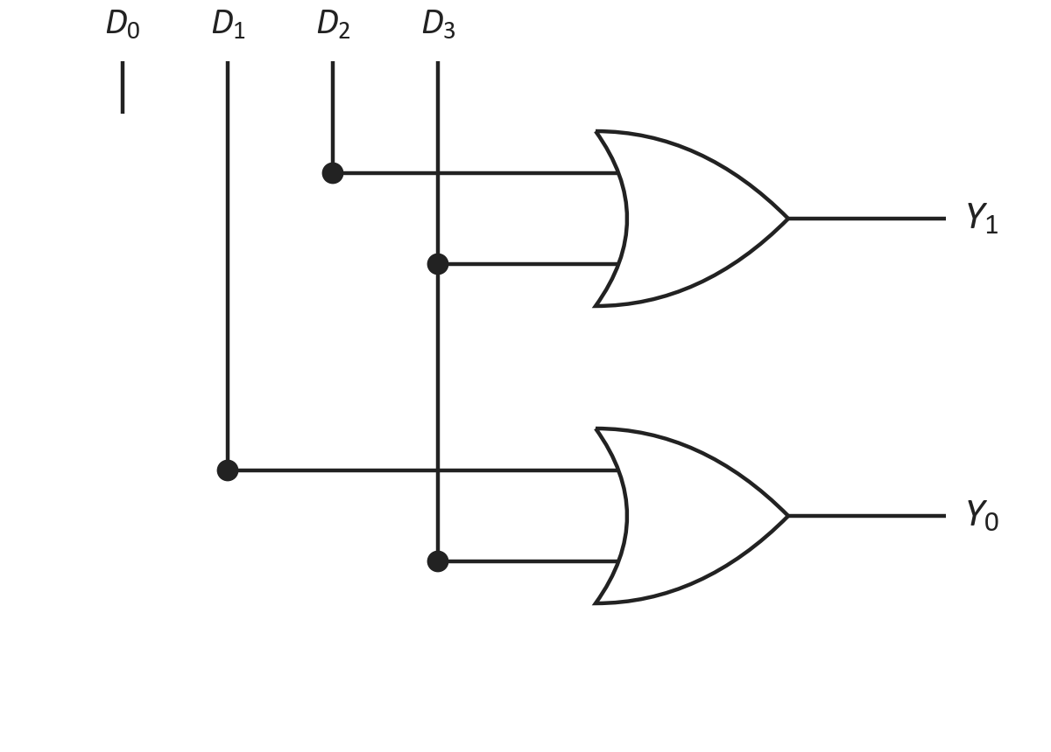
4-to-2 Encoder — Logic Circuit
Topic 1 · Encoder
Boolean expressions
Y₁ = D₂ + D₃ Y₀ = D₁ + D₃
Where is D₀?
Not connected. When only D₀ is 1, both outputs stay 0 — the code 00.
In the laboratory
One 7432 — two of its four OR gates.

Slide 9
8-to-3 Encoder (Octal-to-Binary)
Topic 1 · Encoder
Eight inputs, three outputs — one row per active input:
Active input | Y₂ | Y₁ | Y₀
D₀ | 0 | 0 | 0
D₁ | 0 | 0 | 1
D₂ | 0 | 1 | 0
D₃ | 0 | 1 | 1
D₄ | 1 | 0 | 0
D₅ | 1 | 0 | 1
D₆ | 1 | 1 | 0
D₇ | 1 | 1 | 1
One OR gate per output bit
Y₂ = D₄ + D₅ + D₆ + D₇
Y₁ = D₂ + D₃ + D₆ + D₇
Y₀ = D₁ + D₃ + D₅ + D₇
Spot the pattern
Y₀ collects the odd inputs; Y₂ collects the upper half.
Each output ORs the inputs whose index has a 1 in that bit position.
Notes:
Read each Y column top to bottom: the 1s mark which inputs go into that OR gate.

Slide 10
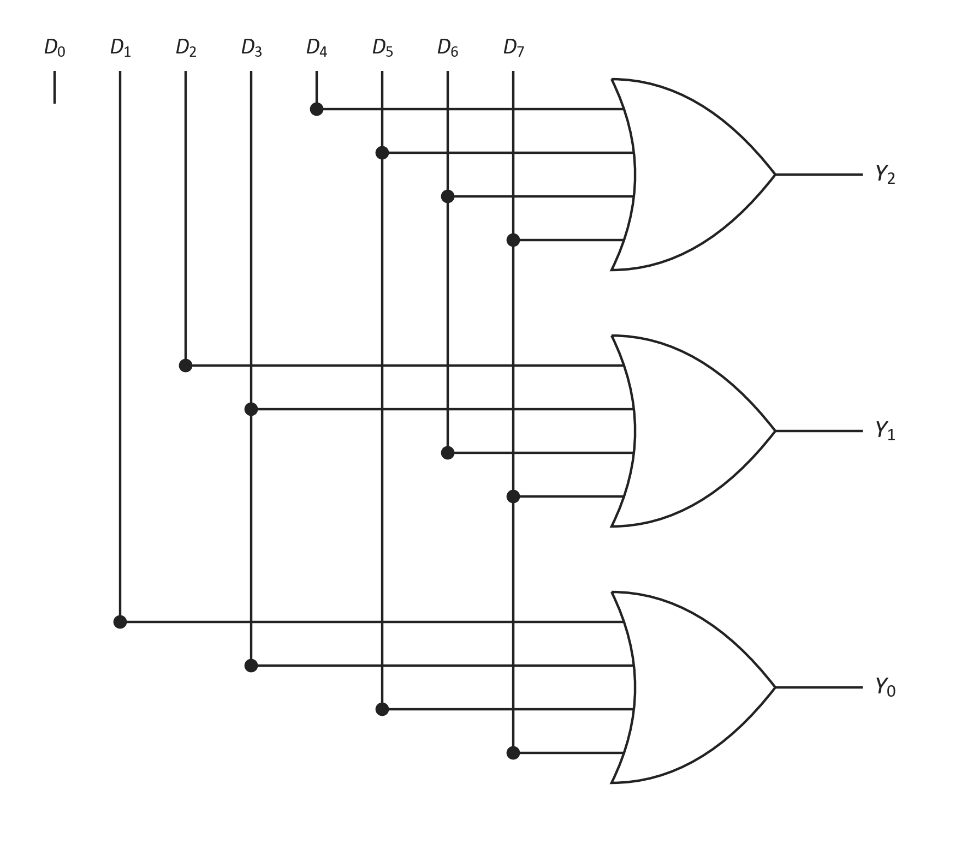
8-to-3 Encoder — Logic Circuit
Topic 1 · Encoder
Three 4-input OR gates
Each gate takes the four inputs with a 1 in its bit.
In the laboratory
A 4-input OR is three 2-input ORs. Nine gates in all — three 7432 ICs.
Check the pattern
D₇ feeds all three gates: 7 = 111.

Slide 11
Let's Trace It: 8-to-3 Encoder
Worked example
Suppose only D₅ = 1 — every other input is 0:
1
Y₂ = D₄ + D₅ + D₆ + D₇ = 0 + 1 + 0 + 0 = 1
101
= 5 in binary
2
Y₁ = D₂ + D₃ + D₆ + D₇ = 0 + 0 + 0 + 0 = 0
3
Y₀ = D₁ + D₃ + D₅ + D₇ = 0 + 0 + 1 + 0 = 1
4
Output Y₂Y₁Y₀ = 101
The encoder reports exactly which input was active: D₅ → 101.

Slide 12
10-to-4 Encoder (Decimal-to-BCD)
Topic 1 · Encoder
Active input | Y₃ | Y₂ | Y₁ | Y₀
D₀ | 0 | 0 | 0 | 0
D₁ | 0 | 0 | 0 | 1
D₂ | 0 | 0 | 1 | 0
D₃ | 0 | 0 | 1 | 1
D₄ | 0 | 1 | 0 | 0
D₅ | 0 | 1 | 0 | 1
D₆ | 0 | 1 | 1 | 0
D₇ | 0 | 1 | 1 | 1
D₈ | 1 | 0 | 0 | 0
D₉ | 1 | 0 | 0 | 1
One OR gate per BCD bit
Y₃ = D₈ + D₉
Y₂ = D₄ + D₅ + D₆ + D₇
Y₁ = D₂ + D₃ + D₆ + D₇
Y₀ = D₁ + D₃ + D₅ + D₇ + D₉
Why four outputs?
Three bits name only 8 lines, so the tenth line needs a fourth bit. The bit weights are 8-4-2-1.
Ten keys on a numeric keypad → one BCD digit for a display or processor.
Notes:
Same recipe as the 8-to-3 encoder: read each Y column top to bottom, and OR the inputs that have a 1 there. Y0 again collects the odd digits.

Slide 13
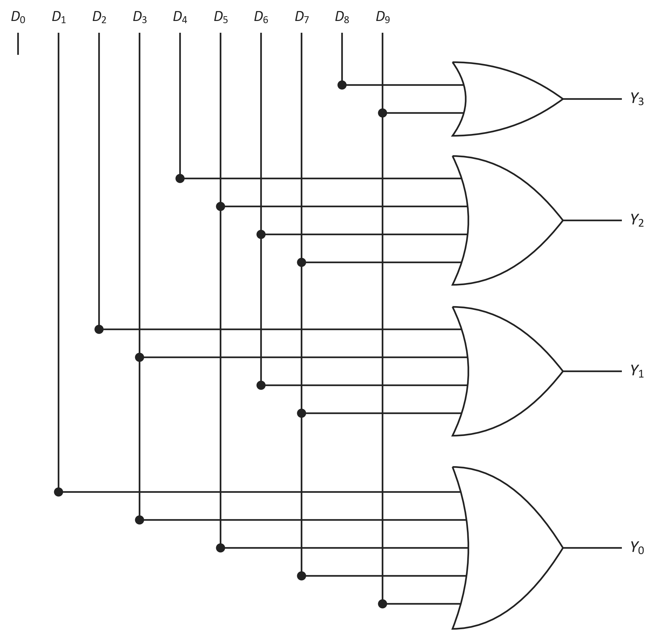
10-to-4 Encoder — Logic Circuit
Topic 1 · Encoder
Four OR gates
With 2, 4, 4 and 5 inputs — one gate per BCD bit.
Still no D₀
Digit 0 is 0000, so D₀ feeds no gate.
As an IC
The 74147 does this job, with priority and active-LOW pins.

Slide 14
What Happens to 1010 – 1111?
Topic 1 · Encoder
Four bits can name 16 codes, but BCD uses only ten of them:
0000
digit 0
0001
digit 1
0010
digit 2
0011
digit 3
0100
digit 4
0101
digit 5
0110
digit 6
0111
digit 7
1000
digit 8
1001
digit 9
1010
unused
1011
unused
1100
unused
1101
unused
1110
unused
1111
unused
In the encoder
Never produced: there is no input line D₁₀ … D₁₅, so they get no row.
Unless two keys are pressed
D₈ + D₂ → 1010 — not a decimal digit at all.
In the decoder
Next class they come back as don't-cares: input codes that never occur.
4 bits name 16 codes — BCD uses 10 and leaves 6 unused.
Notes:
An encoder's truth table is indexed by the active input line, so codes without an input line simply have no row. They only appear by accident when two inputs are active, which is exactly the problem the priority encoder fixes. The 74147 is a priority encoder, so it never outputs them.

Slide 15
When the Encoder Gets Confused
Topic 1 · Limitations
The ordinary encoder assumes exactly one input is 1. Break that rule and it fails:
Problem 1 — two inputs active
D₂ = 1 and D₄ = 1 together:
Y₂ = 1, Y₁ = 1, Y₀ = 0 → 110 = 6
A key nobody pressed!
Problem 2 — no input active
All inputs are 0:
Y₂Y₁Y₀ = 000
The same code as D₀. Was key 0 pressed or not?
Fix both: give the inputs a priority, and add a valid output V.
Real keyboards do see two keys at once — so the fix is not optional.
Notes:
Let students compute the D2+D4 case themselves before revealing 110. The OR gates mix the two codes together.

Slide 16
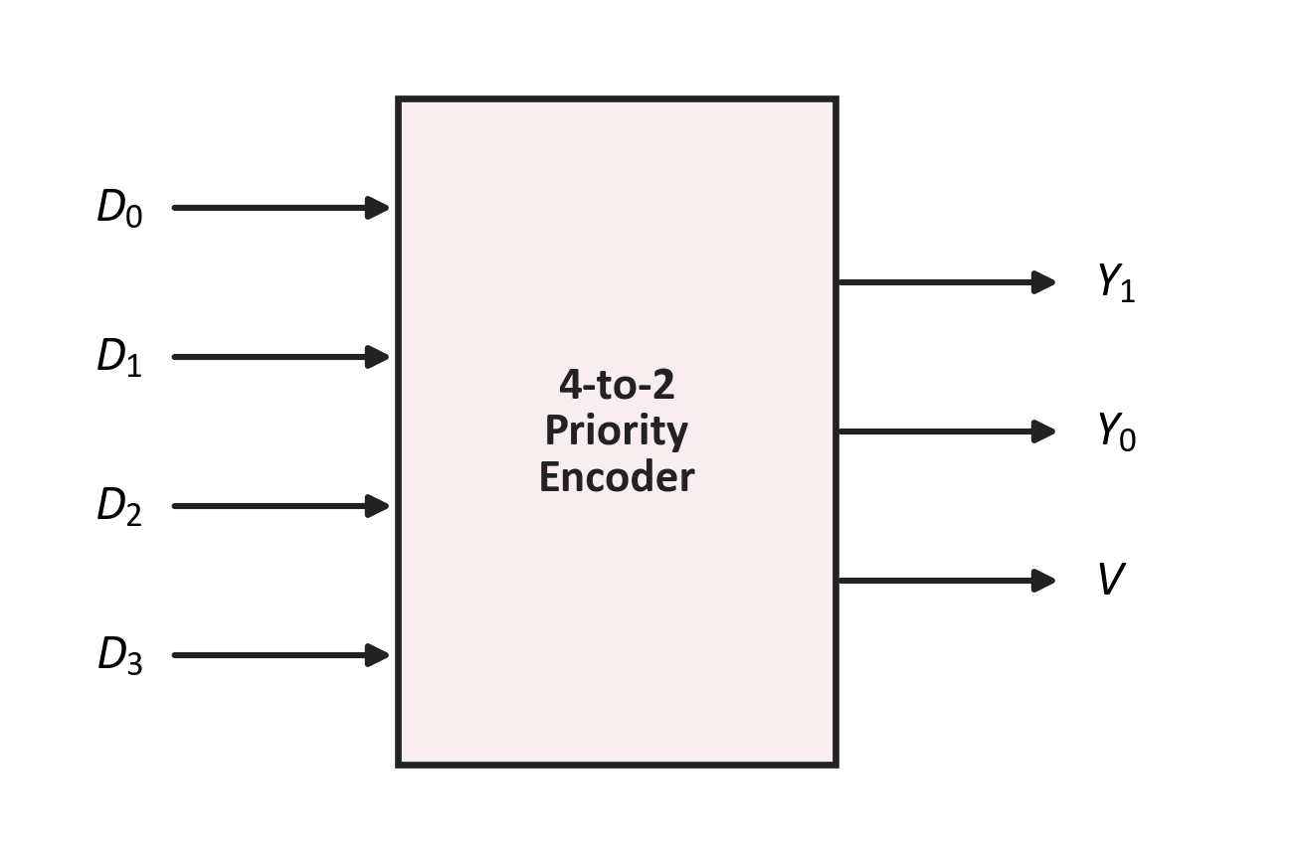
The Priority Encoder
Topic 2 · Priority Encoder
Definition
A priority encoder allows several inputs to be active at once. It outputs the code of the highest-priority active input, plus a valid bit V.
Priority: D₃ highest, D₀ lowest
Lower inputs are ignored when a higher one is 1
V = 1 when at least one input is active
V solves problem 2
V = 0 means “nothing active” — the Y outputs are then meaningless.

Slide 17
4-to-2 Priority Encoder — Truth Table
Topic 2 · Priority Encoder
D₃ | D₂ | D₁ | D₀ | Y₁ | Y₀ | V
0 | 0 | 0 | 0 | X | X | 0
0 | 0 | 0 | 1 | 0 | 0 | 1
0 | 0 | 1 | X | 0 | 1 | 1
0 | 1 | X | X | 1 | 0 | 1
1 | X | X | X | 1 | 1 | 1
Reading the X's
X means “0 or 1 — it does not matter”. Once D₃ = 1, nothing below it counts.
The first row
No input is active, so V = 0 and Y₁Y₀ are don't-cares.
Five rows stand for all 16 input combinations
Read each row from the left: the first 1 you meet is the winner.
Notes:
Expand row 3 (001X) into its two real rows to show what X stands for.

Slide 18
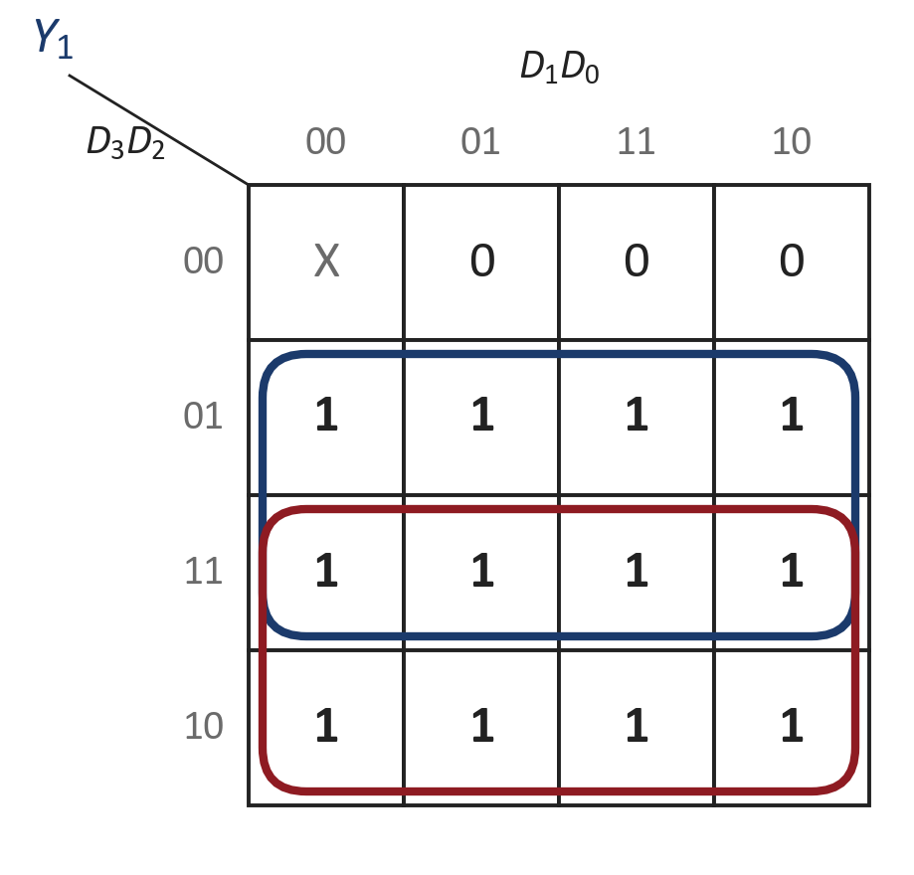
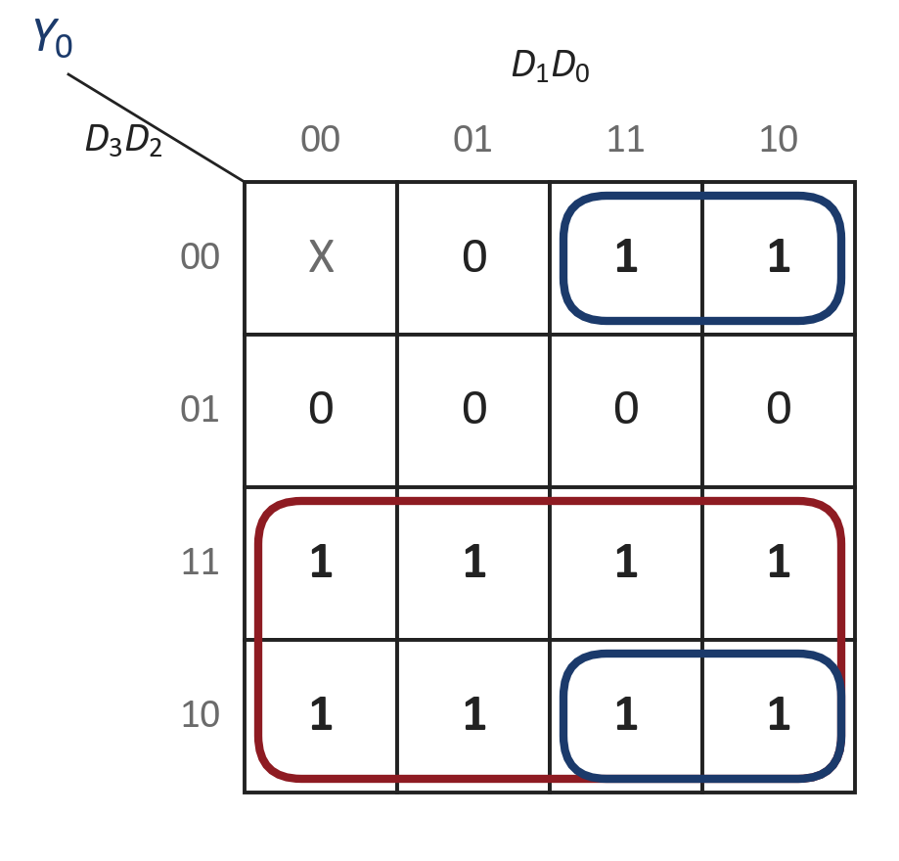
Simplifying with K-maps
Topic 2 · Priority Encoder
Results
Y₁ = D₂ + D₃
Y₀ = D₃ + D₁D̅₂
V = D₀ + D₁ + D₂ + D₃
Navy: D₂ Maroon: D₃
Maroon: D₃ Navy: D₁D̅₂ (wraps top ↔ bottom)
V needs no K-map: it is 1 whenever any input is 1.
The X in cell 0000 is not needed here — use a don't-care only when it helps.
Notes:
This ties back to the K-map method from the adder lab. The D1·D2' group wraps from the top row to the bottom row.

Slide 19
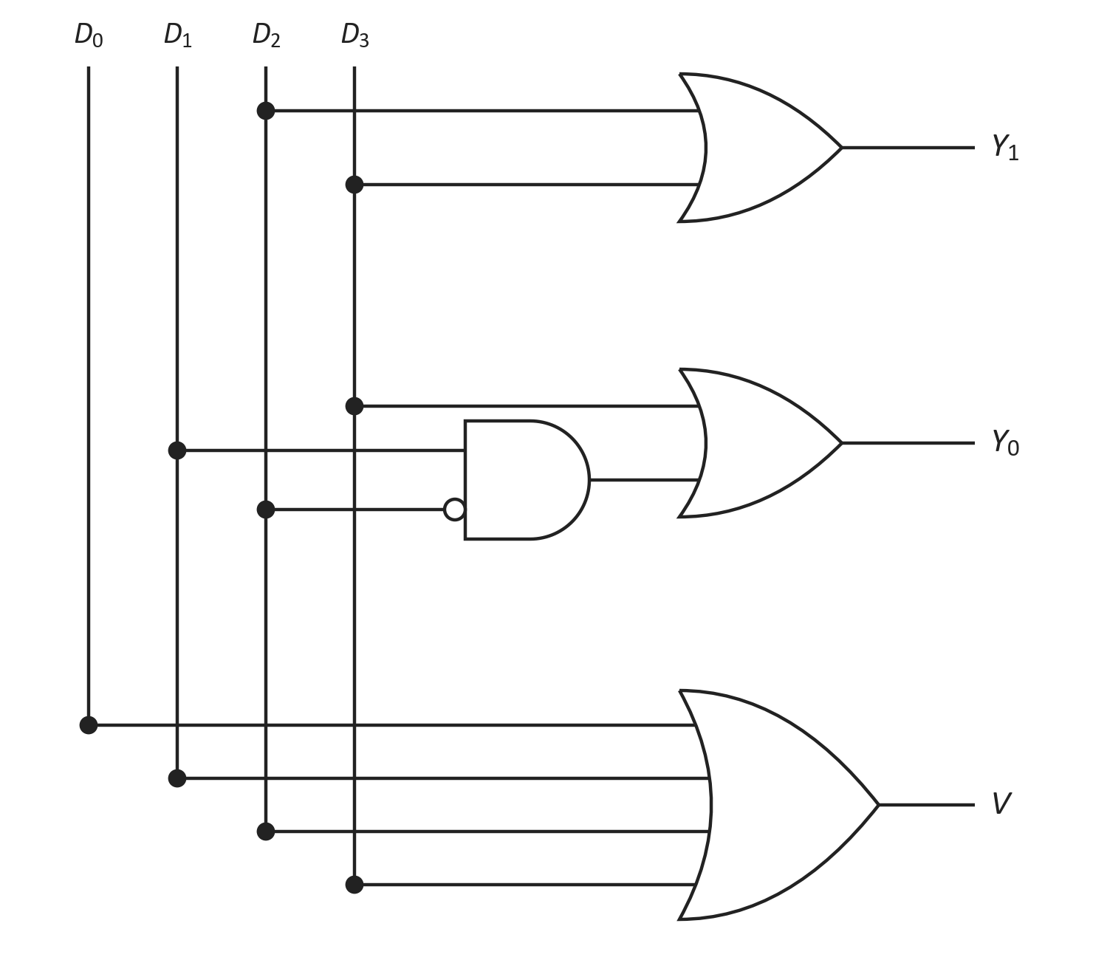
Priority Encoder — Logic Circuit
Topic 2 · Priority Encoder
Boolean expressions
Y₁ = D₂ + D₃
Y₀ = D₃ + D₁D̅₂
V = D₀ + D₁ + D₂ + D₃
About the bubble
It is an inverter: D₁ only counts when D₂ = 0.
In the laboratory
7404, 7408 and 7432. Write V = Y₁ + D₁ + D₀ and every OR fits in one 7432.

Slide 20
Let's Trace It: Priority Encoder
Worked example
Suppose D₃ = 0 and D₂ = D₁ = D₀ = 1 — three inputs active at once:
1
Y₁ = D₂ + D₃ = 1 + 0 = 1
10
D₂ wins · V = 1
2
AND: D₁ · D̅₂ = 1 · 0 = 0 — D₂ blocks D₁
3
Y₀ = D₃ + 0 = 0 + 0 = 0
4
V = D₀ + D₁ + D₂ + D₃ = 1
Three inputs active, one answer: the highest one, D₂.

Slide 21
Encoder vs Priority Encoder
Summary
Feature | Encoder | Priority encoder
Active inputs allowed | Exactly one | Any number
Two inputs active | Wrong code | Highest one wins
No input active | Looks like D₀ | V = 0
Outputs | n | n + V
Gates | OR only | OR, AND, NOT
Typical IC | Built from 7432 | 74148, 74147
Same code outputs — plus a priority rule and one extra output.

Slide 22
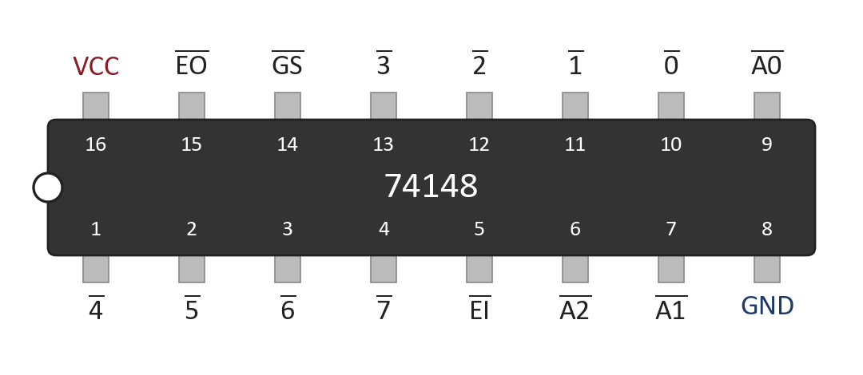
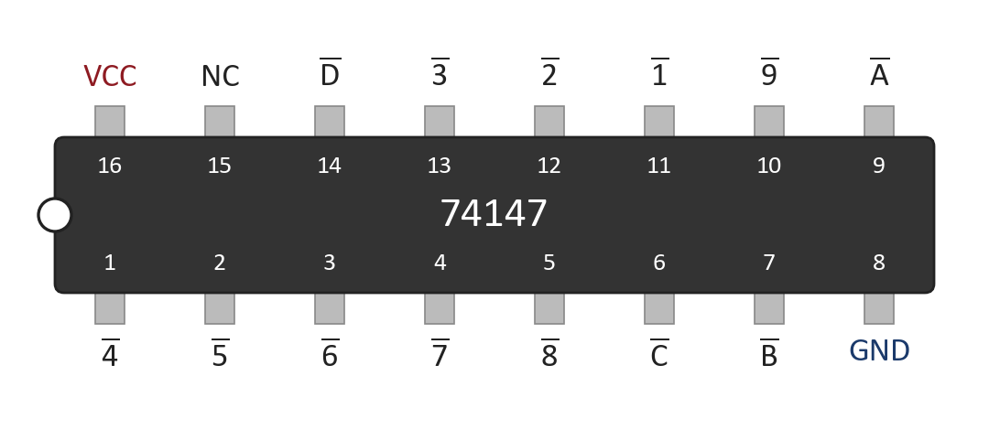
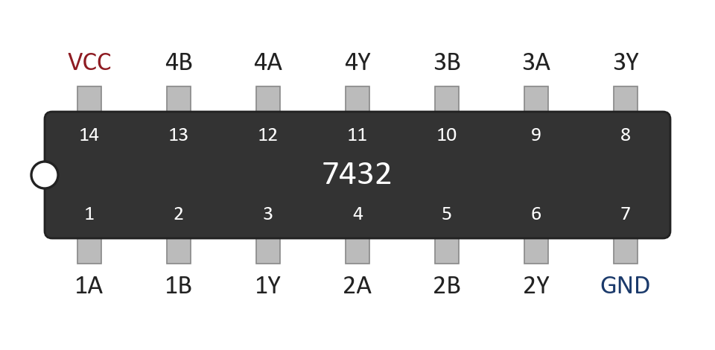
Laboratory ICs
In the lab
74148
8-to-3 priority encoder
74147
Decimal-to-BCD priority encoder
7432
Quad 2-input OR gate
Active-LOW pins
Every 74148/74147 input and output is active-LOW: an active input is 0, and the code comes out inverted.
16-pin vs 14-pin
74148/74147: VCC is pin 16, GND is pin 8. The 7432: VCC pin 14, GND pin 7.
Tie E̅I̅ (pin 5) of the 74148 to GND to switch it on.

Slide 23
Where Priority Encoders Work
Application
Keyboard (D₀)
Priority
Encoder
1
Devices ask for the CPU at the same time.
Timer (D₁)
CPU
11, V = 1
2
The encoder passes only the most urgent.
Network (D₂)
3
V tells the CPU a request is waiting.
Disk (D₃)
Disk (D₃) and keyboard (D₀) both ask — the disk is served first.
Interrupt controllers in every PC are built around this idea.
Notes:
The CPU reads the 2-bit code to know which device to serve. Lower-priority requests wait until the higher one is cleared.

Slide 24
Circuit Simulation
Logisim Evolution
Build the gate-level circuits first, then compare with the built-in block.
1
Create a circuit Encoder4to2: inputs D0–D3, outputs Y1, Y0.
2
Wire the two OR gates and test the four one-hot inputs.
3
Set D1 = D2 = 1 together — record the wrong code.
4
Create PriorityEncoder4to2 with outputs Y1, Y0 and V.
5
Use Project ▸ Analyze Circuit to list all 16 rows.
Compare with the built-in block
Logisim's Plexers library has a ready-made Priority Encoder.
6
Drop Logisim's own Priority Encoder beside yours.
7
Confirm both give the same code and valid bit.

Slide 25
Quick Check #1
Quiz
How many outputs does an encoder with 16 inputs need?
Hint: 2ⁿ inputs need n outputs.

Slide 26
Quick Check #1
Quiz
How many outputs does an encoder with 16 inputs need?
Hint: 2ⁿ inputs need n outputs.
4

Slide 27
Quick Check #2
Quiz
An 8-to-3 encoder has only D₆ = 1. What is Y₂Y₁Y₀?
Hint: write 6 in binary.

Slide 28
Quick Check #2
Quiz
An 8-to-3 encoder has only D₆ = 1. What is Y₂Y₁Y₀?
Hint: write 6 in binary.
110

Slide 29
Quick Check #3
Quiz
A 4-to-2 priority encoder has D₀ = 1 and D₂ = 1. What are Y₁Y₀ and V?
Y₁Y₀ = 00, V = 1
Y₁Y₀ = 10, V = 1
1
2
Y₁Y₀ = 10, V = 0
Y₁Y₀ = 11, V = 1
3
4

Slide 30
Quick Check #3
Quiz
A 4-to-2 priority encoder has D₀ = 1 and D₂ = 1. What are Y₁Y₀ and V?
Y₁Y₀ = 00, V = 1
Y₁Y₀ = 10, V = 1
1
2
Y₁Y₀ = 10, V = 0
Y₁Y₀ = 11, V = 1
3
4

Slide 31
Quick Check #4
Quiz
Why does a priority encoder need the valid output V?
To mark the highest input
To tell “no input” apart from “D₀ active”
1
2
To drive the OR gates
To double the number of outputs
3
4

Slide 32
Quick Check #4
Quiz
Why does a priority encoder need the valid output V?
To mark the highest input
To tell “no input” apart from “D₀ active”
1
2
To drive the OR gates
To double the number of outputs
3
4

Slide 33
What Comes Next?
Class 07
Next class
Decoders — from a binary code back to a single active line.
You have already met them twice:
Decoder
n inputs, 2ⁿ outputs — exactly one output is active.
Encoder, reversed
Today: line → code.
Next: code → line.
74138
The 3-to-8 decoder from the demultiplexer lab.
A demultiplexer with its data input held at 1 is exactly a decoder.

Slide 34
Today's Takeaways
Summary
1
An encoder turns one active line out of 2ⁿ into an n-bit code.
2
Each output bit ORs the inputs with a 1 in that bit position.
3
4-to-2: Y₁ = D₂ + D₃, Y₀ = D₁ + D₃.
4
An ordinary encoder gives a wrong code when two inputs are active.
5
A priority encoder lets the highest active input win.
6
The valid bit V separates “nothing active” from “D₀ active”.
7
The 74148 is an 8-to-3 priority encoder with active-LOW pins.

Slide 35
Before You Leave
Self-check
You should be able to answer:
Which 4-bit codes does a decimal-to-BCD encoder never produce?
Write Y₀ of an 8-to-3 encoder.
1
2
What goes wrong when two inputs of an encoder are 1?
Why is D₀ not connected in a 4-to-2 encoder?
3
4
Derive Y₀ of a 4-to-2 priority encoder with a K-map.
On a 74148, inputs 3̅ and 5̅ are both LOW. Which wins?
5
6

Slide 36
Lab Task — Experiment 06
Assessment
Implementation of an Encoder and a Priority Encoder
Construct the following circuits and verify every input combination.
Part A — 4-to-2 Encoder
Part B — 4-to-2 Priority Encoder
Two OR gates for Y₁ and Y₀
IC: 7432
Test one-hot inputs, then D₁ = D₂ = 1
Outputs Y₁, Y₀ and V
ICs: 7404, 7408, 7432
Verify all 16 input combinations
Part C (bonus): verify the 74148 for inputs 0–7 (active-LOW) and record the outputs.
Submit:
1
Circuit diagrams
2
Truth tables
3
Boolean expressions
4
Experimental observations
5
Short conclusion

Slide 37
Many Lines, One Code
1
Encoder — one active line in, its binary index out
NEXT CLASS
Decoders
From a code back to a single line.
2
OR gates only — one gate per output bit
3
Priority encoder — the highest active input wins
4
Valid bit V — tells “nothing” apart from D₀
Questions?

