Slide 1

CSE208 · DIGITAL LOGIC DESIGN LABORATORY · CLASS 04
Subtractors: Half & Full
Borrowing with logic gates — the same XOR, a different second output
Munzer Mahmood
Lecturer, Department of Computer Science and Engineering
Presidency University

Slide 2
Recap · Class 03
Where We Are
Last class you learned
Last class
Binary addition: 1 + 1 = 10₂ → Sum 0, Carry 1
Gates → binary addition
Half adder: S = A ⊕ B, C = AB
Full adder: S = A ⊕ B ⊕ C_{in}
C_{out} = AB + C_{in}(A ⊕ B)
Full adder = 2 half adders + 1 OR gate
Today
Gates → binary subtraction
Almost the same circuit — watch carefully what changes.
CSE208 · Digital Logic Design Laboratory · Class 04
2
Notes:
Recap the adder. Stress that the Difference output will turn out to be the same XOR as the Sum.

Slide 3
Today's Learning Objectives
By the end of today's laboratory, you should be able to:
1
Apply the rules of binary subtraction, including the borrow.
2
Define a half subtractor and derive its truth table.
3
Use minterms and the SOP method to derive its Difference and Borrow.
4
Explain why a half subtractor is not enough for multi-bit subtraction.
5
Define a full subtractor and derive its Difference and Borrow-out expressions.
6
Build a full subtractor using two half subtractors and an OR gate.
7
Verify subtractors using a simulator or the 7486, 7408, 7432 and 7404 ICs.
CSE208 · Digital Logic Design Laboratory · Class 04
3

Slide 4
Motivation
Why Do We Need Subtractors?
Subtraction is the second arithmetic operation every processor must perform — and it is where the idea of a borrow comes from:
Comparison
Counting down
Address arithmetic
A − B shows which value is larger
Timers, loop counters, countdowns
Offsets and differences of addresses
Subtractor
ALU
CPU
Computer
Build a circuit that subtracts two single bits — then copy it for every bit.
Real processors often subtract by adding the 2's complement — but the borrow is what we learn here.
CSE208 · Digital Logic Design Laboratory · Class 04
4
Notes:
Mention 2's complement: real ALUs often subtract by adding. The dedicated subtractor is how we learn the borrow.

Slide 5
The four cases
Binary Subtraction Rules
Subtracting two 1-bit numbers has only four cases:
0 − 0 = 0
10₂ − 1 = 1
1 − 0 = 1
1 − 1 = 0
(0 − 1, after borrowing)
Borrow = 0
Borrow = 1
Borrow = 0
Borrow = 0
Difference = 0
Difference = 1
Difference = 1
Difference = 0
Two outputs
Why borrow?
Every column produces a Difference (D) and a Borrow (B_{out}) taken from the next column.
0 − 1 is impossible in one column, so we borrow 2 from the left: 10₂ − 1 = 1.
Two inputs, two outputs — that is exactly a half subtractor.
CSE208 · Digital Logic Design Laboratory · Class 04
5
Notes:
Stress the second case: 0 minus 1 cannot be done in one column, so we borrow from the next column to the left.

Slide 6
Why one circuit is not enough
Subtracting Multi-bit Numbers
Borrow
1
1
Rightmost column: A₀ − B₀ — only 2 bits, nothing is borrowed yet.
A
1
0
1
1
(11)
− B
0
1
1
0
(6)
2
Every other column: A_{i} − B_{i} − borrow-in — 3 bits.
Diff
0
1
0
1
(5)
3
A column that cannot subtract borrows from the column to its left.
3 bits in
2 bits in
2 inputs ⇒ Half Subtractor 3 inputs ⇒ Full Subtractor
Here only bit 2 borrows — but any column might.
CSE208 · Digital Logic Design Laboratory · Class 04
6
Notes:
Work the example column by column. Only bit 2 generates a borrow, and bit 3 has to subtract it.

Slide 7
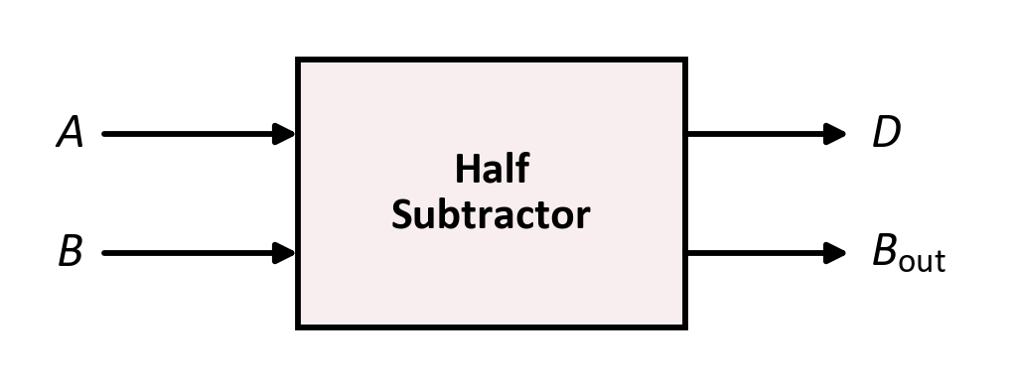
Topic 1 · Half subtractor
The Half Subtractor
Definition
A half subtractor is a combinational circuit that subtracts two 1-bit inputs, B from A, and produces two outputs: a Difference (D) and a Borrow (B_{out}).
Inputs: A (minuend), B (subtrahend)
Outputs: D, B_{out}
B_{out} = 1 means we had to borrow from the next column
Why “half”?
It subtracts only two bits — there is no input for a borrow from a previous column.
Order matters: A − B is not the same as B − A.
CSE208 · Digital Logic Design Laboratory · Class 04
7

Slide 8

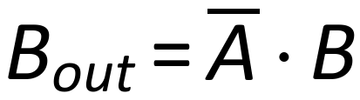
Topic 1 · Half subtractor
Half Subtractor — Truth Table
A
B
B_{out}
D
Look at column D
0
0
0
0
D = 1 when the inputs are different → XOR
0
1
1
1
1
0
0
1
1
1
0
0
Look at column B_{out}
B_{out} = 1 only when A = 0 and B = 1 → NOT + AND
Only row 01 needs a borrow
Half subtractor = one XOR + one AND + one NOT
The Difference is the same XOR as the adder's Sum.
CSE208 · Digital Logic Design Laboratory · Class 04
8
Notes:
Compare with the half adder: the D column is identical to S, only the second output differs.

Slide 9
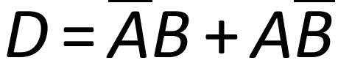
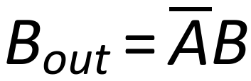
Technique · SOP
Deriving the Expressions
Use the Sum of Products (SOP) method:
D = 1 in rows 01 and 10
1
Write the minterm of every row where the output is 1.
2
OR those minterms together.
3
Simplify and recognise the gate.
B_{out} = 1 only in row 01
Compare with the half adder: C = AB, but B_{out} = A̅B — the minuend is inverted.
One inverter is the whole difference between adding and subtracting.
CSE208 · Digital Logic Design Laboratory · Class 04
9
Notes:
Same SOP method as the adder. The only new thing is the complemented literal in the borrow term.

Slide 10
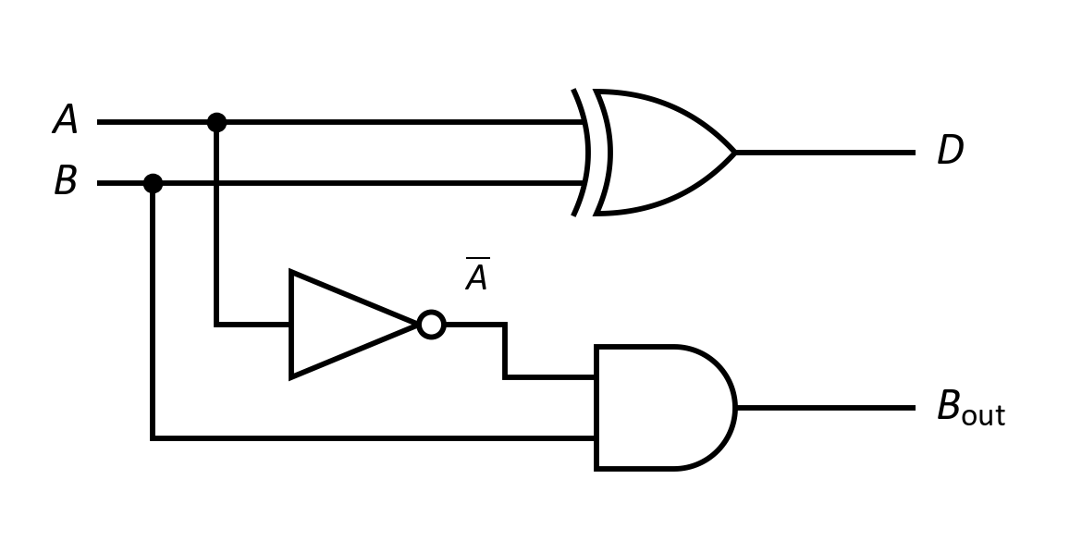
Topic 1 · Half subtractor
Half Subtractor — Logic Circuit
Boolean expressions
In the laboratory
One gate of the 7486 (XOR), one of the 7408 (AND) and one of the 7404 (NOT) on input A.
Gates used: 1 XOR + 1 AND + 1 NOT.
CSE208 · Digital Logic Design Laboratory · Class 04
10

Slide 11

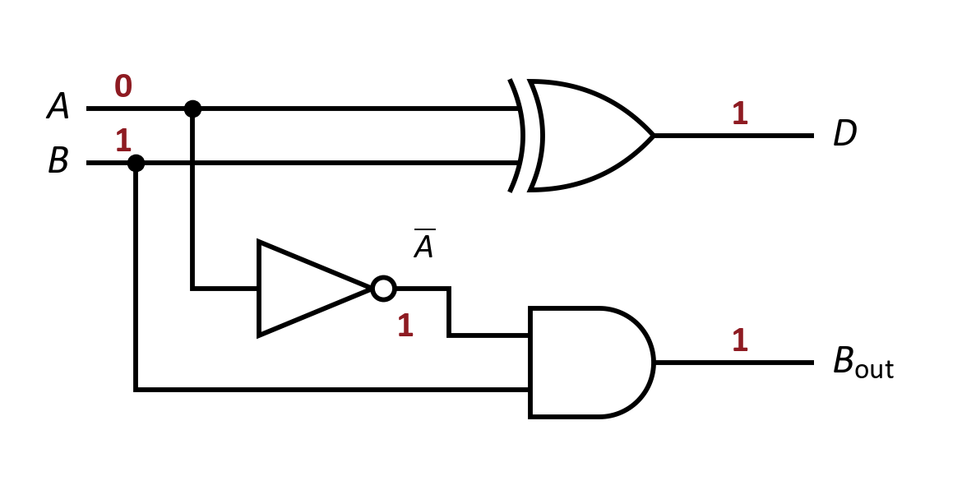


Worked example
Let's Trace It: Half Subtractor
Given the half subtractor circuit, suppose:
1
XOR:
2
NOT + AND:
3
Check:
Try it yourself
Repeat the trace for A = 1, B = 1. What are D and B_{out}?
CSE208 · Digital Logic Design Laboratory · Class 04
11

Slide 12
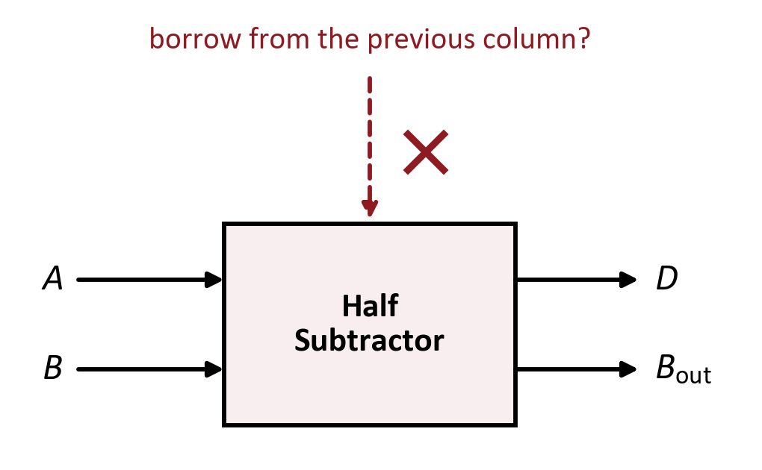
Topic 1 · Half subtractor
Limitation of the Half Subtractor
A half subtractor has only 2 inputs.
From the 2nd column on we must handle 3 bits: A_{i}, B_{i} and the borrow-in.
So, it works only for the least significant bit.
Add a third input for the incoming borrow → the Full Subtractor
One missing wire is the whole difference.
CSE208 · Digital Logic Design Laboratory · Class 04
12
Notes:
Same argument as the half adder: from the second column on, three bits arrive.

Slide 13
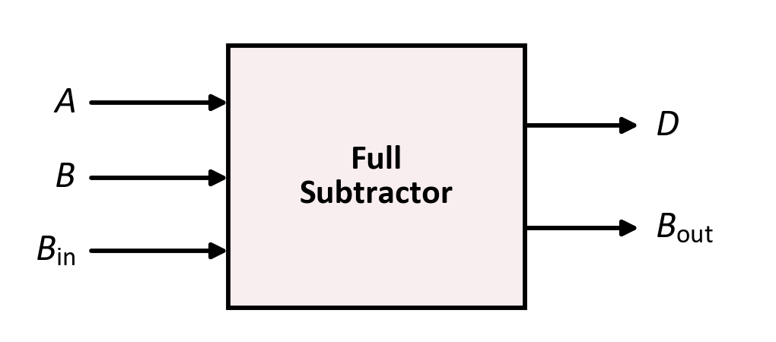
Topic 2 · Full subtractor
The Full Subtractor
Definition
A full subtractor subtracts three 1-bit inputs — it computes A − B − B_{in} and produces a Difference (D) and a borrow-out (B_{out}).
Inputs: A, B, B_{in} (3 bits)
Outputs: D, B_{out}
Smallest result: 0 − 1 − 1 = −2, so one borrow is always enough
The chain
The B_{out} of one column becomes the B_{in} of the next column.
Three bits in, two bits out — enough for every column.
CSE208 · Digital Logic Design Laboratory · Class 04
13

Slide 14
Topic 2 · Full subtractor
Full Subtractor — Truth Table
A
B
B_{in}
Result
B_{out}
D
Look at column D
0
0
0
0
0
0
D = 1 when an odd number of inputs are 1 — exactly like the adder's Sum.
0
0
1
−1
1
1
0
1
0
−1
1
1
0
1
1
−2
1
0
Look at column B_{out}
1
0
0
1
0
1
B_{out} = 1 whenever A − B − B_{in} goes below zero.
1
0
1
0
0
0
1
1
0
0
0
0
D = Σm(1, 2, 4, 7)
B_{out} = Σm(1, 2, 3, 7)
1
1
1
−1
1
1
Result = A − B − B_{in}; a negative result needs a borrow
Eight rows — verify every one of them in the lab.
CSE208 · Digital Logic Design Laboratory · Class 04
14
Notes:
Read the Result column: a negative value means a borrow, and D is that value plus 2.

Slide 15
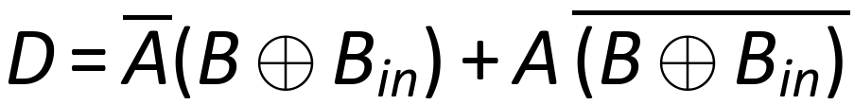

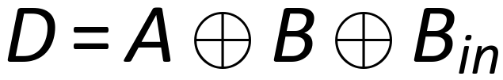
Topic 2 · Full subtractor
Full Subtractor — Deriving the Difference
minterms 1, 2, 4, 7
group by A
XOR and XNOR
the XOR pattern again
Exactly the same expression as the full adder's Sum.
Adding and subtracting differ only in the second output.
CSE208 · Digital Logic Design Laboratory · Class 04
15
Notes:
Identical algebra to the full adder's Sum, because the minterms are the same.

Slide 16
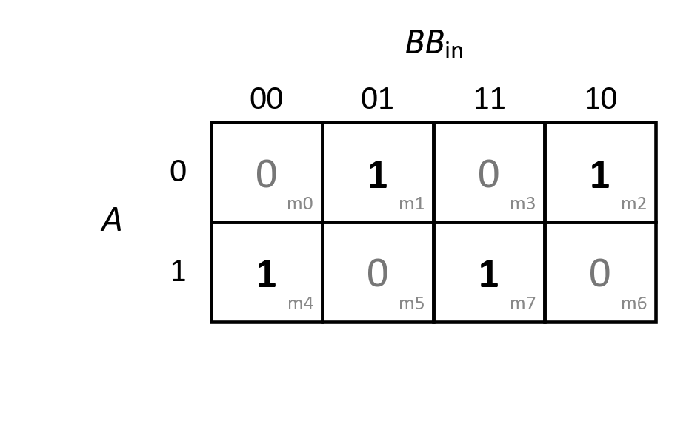
Topic 2 · K-map
Can We Simplify D?
The 1s form a checkerboard — no two 1s are adjacent.
No group of 2 or 4 is possible, so the SOP cannot be simplified.
Use XOR gates instead of four 3-literal AND terms.
A checkerboard K-map is the signature of an XOR function.
The same map we drew for the adder's Sum.
CSE208 · Digital Logic Design Laboratory · Class 04
16

Slide 17
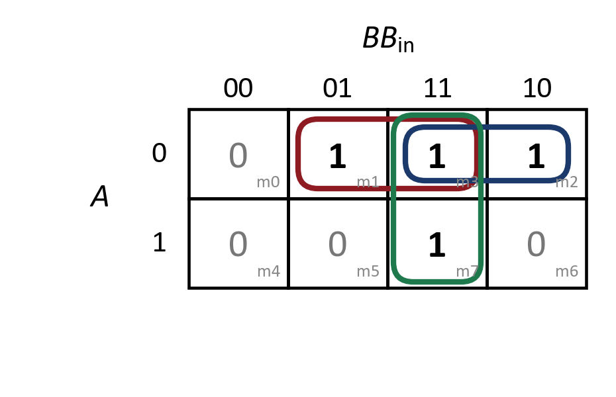
Topic 2 · K-map
Deriving B_{out} with a K-map
m1, m3
→
A̅B_{in}
m2, m3
→
A̅B
m3, m7
→
BB_{in}
B_{out} = A̅B + A̅B_{in} + BB_{in}
Compare with the adder
C_{out} = AB + AC_{in} + BC_{in}. The subtractor is the same shape with A inverted.
CSE208 · Digital Logic Design Laboratory · Class 04
17
Notes:
m3 is shared by all three groups. Note every group sits in the A = 0 row except the one with m7.

Slide 18
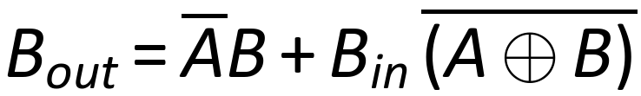
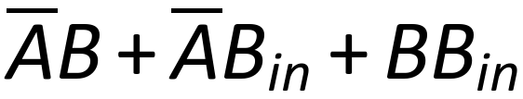
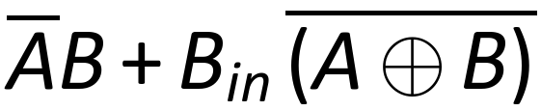
Topic 2 · Full subtractor
Another Form of B_{out}
minterms 1, 2, 3, 7
group the terms
complement law
Form 1 (from the K-map)
Form 2 (reuse the XOR)
1 NOT + 3 AND + 1 three-input OR
2 NOT + 2 AND + 1 OR
A ⊕ B is already built for the Difference — so reuse its complement.
CSE208 · Digital Logic Design Laboratory · Class 04
18
Notes:
This second form reuses A XOR B from the Difference, which leads to the two-half-subtractor design.

Slide 19
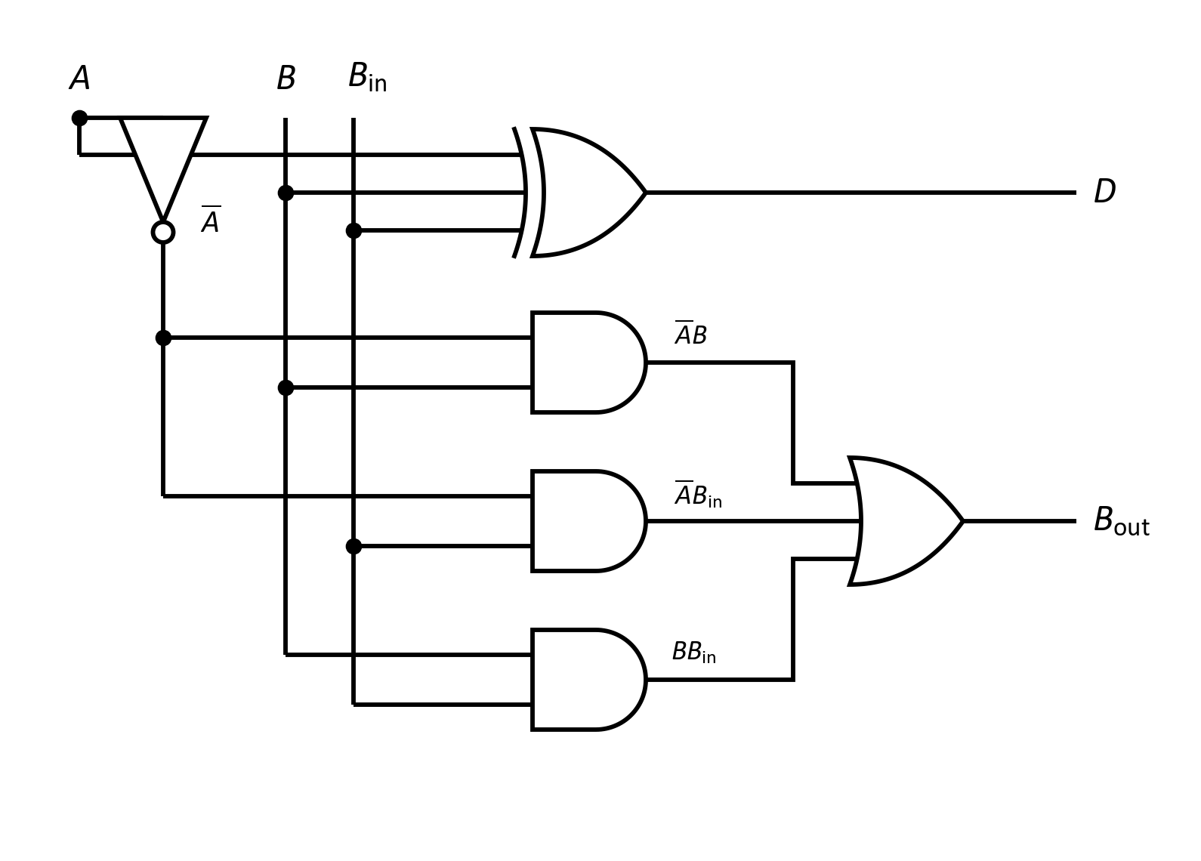


Topic 2 · Full subtractor
Full Subtractor — Logic Circuit (SOP Form)
Boolean expressions
In the laboratory
One inverter makes A̅, which feeds two of the AND gates.
Gates used: 2 XOR + 1 NOT + 3 AND + 1 three-input OR.
CSE208 · Digital Logic Design Laboratory · Class 04
19

Slide 20
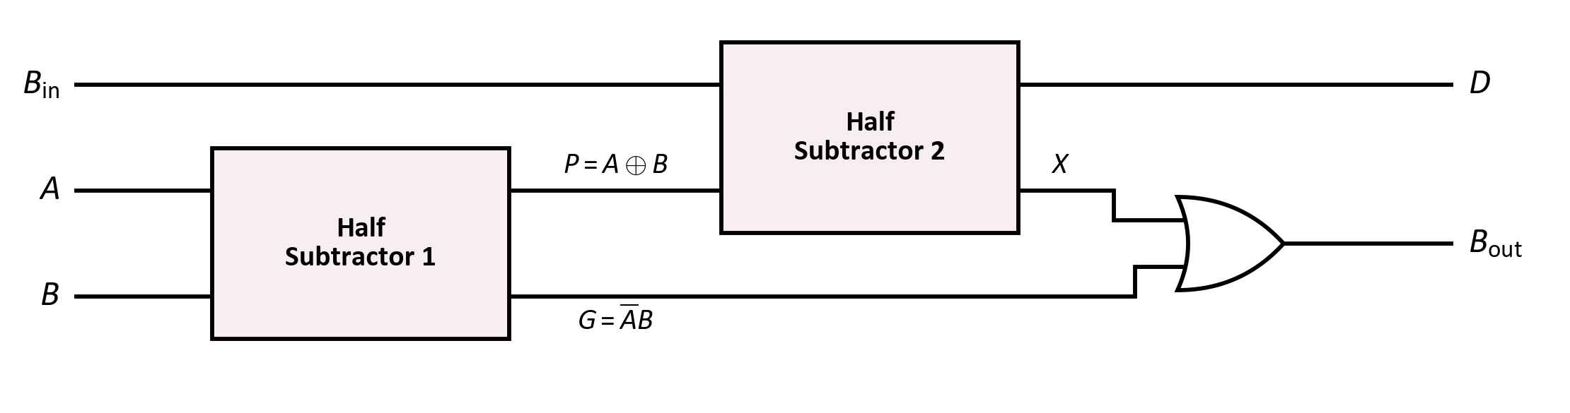
Topic 2 · Full subtractor
Full Subtractor from Two Half Subtractors
1
Half Subtractor 1 handles A − B → P = A ⊕ B, G = A̅B
2
Half Subtractor 2 handles P − B_{in} → D = P ⊕ B_{in}, X = P̅·B_{in}
3
OR gate combines the two borrows → B_{out} = G + X
Full Subtractor = 2 Half Subtractors + 1 OR gate
CSE208 · Digital Logic Design Laboratory · Class 04
20
Notes:
G and X can never both be 1, so a plain OR is enough to combine the two borrows.

Slide 21
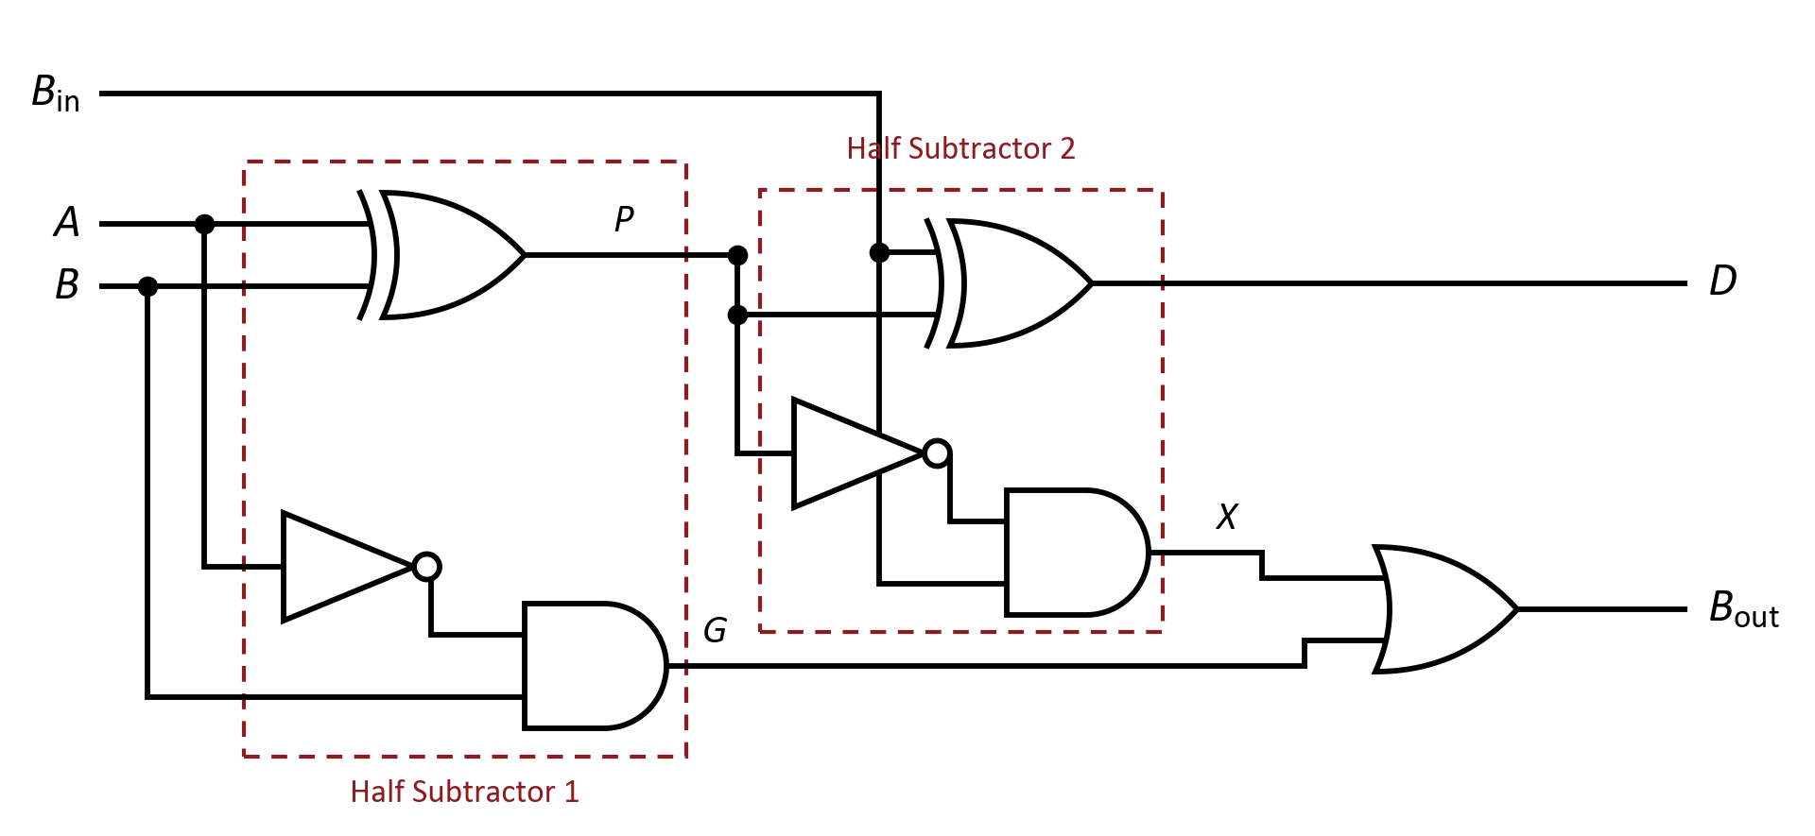
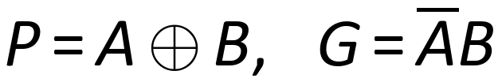

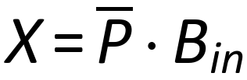

Topic 2 · Full subtractor
Full Subtractor — Gate-Level Circuit
Gates used: 2 XOR + 2 NOT + 2 AND + 1 OR
Think
Can G and X both be 1 at the same time? (No — so the OR never has to add two borrows.)
CSE208 · Digital Logic Design Laboratory · Class 04
21

Slide 22

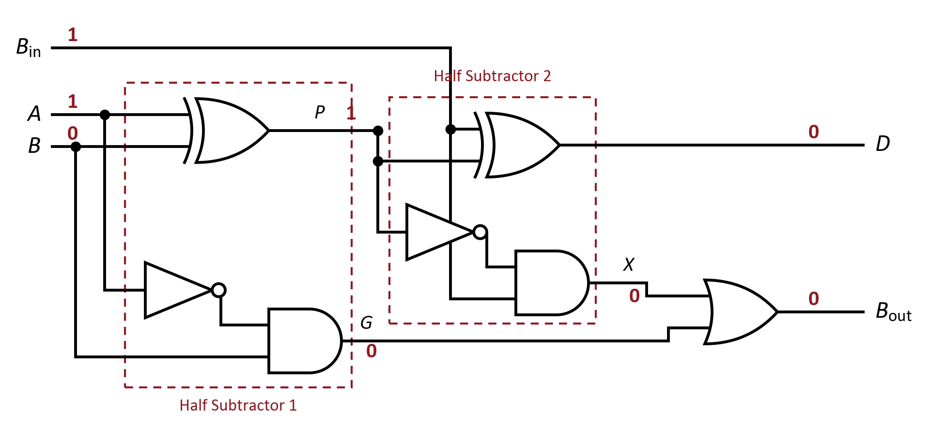




Worked example
Let's Trace It: Full Subtractor
Suppose:
1
HS 1:
2
HS 2:
3
OR:
4
Check:
Try it yourself
Trace A = 0, B = 1, B_{in} = 1. What are D and B_{out}?
CSE208 · Digital Logic Design Laboratory · Class 04
22

Slide 23
Summary
Half Subtractor vs Full Subtractor
Feature
Half Subtractor
Full Subtractor
Inputs
2 (A, B)
3 (A, B, B_{in})
Outputs
D, B_{out}
D, B_{out}
Difference
A ⊕ B
A ⊕ B ⊕ B_{in}
Borrow
A̅B
A̅B + B_{in}(A ⊕ B)′
Basic gates
1 XOR + 1 AND + 1 NOT
2 XOR + 2 AND + 2 NOT + 1 OR
Used for
The LSB only
Every bit position
A full subtractor with B_{in} = 0 behaves exactly like a half subtractor.
CSE208 · Digital Logic Design Laboratory · Class 04
23

Slide 24
Summary
Adder vs Subtractor — Side by Side
Adder
Subtractor
Operation
A + B (+ C_{in})
A − B (− B_{in})
First output
S = A ⊕ B ⊕ C_{in}
D = A ⊕ B ⊕ B_{in}
Second output (half)
C = AB
B_{out} = A̅B
Second output (full)
AB + C_{in}(A ⊕ B)
A̅B + B_{in}(A ⊕ B)′
Extra gate needed
—
NOT on A, and on P
Built from
2 half adders + OR
2 half subtractors + OR
Same XOR, same structure — only the inverters are new.
CSE208 · Digital Logic Design Laboratory · Class 04
24
Notes:
The punchline of the class: invert the minuend and an adder becomes a subtractor.

Slide 25
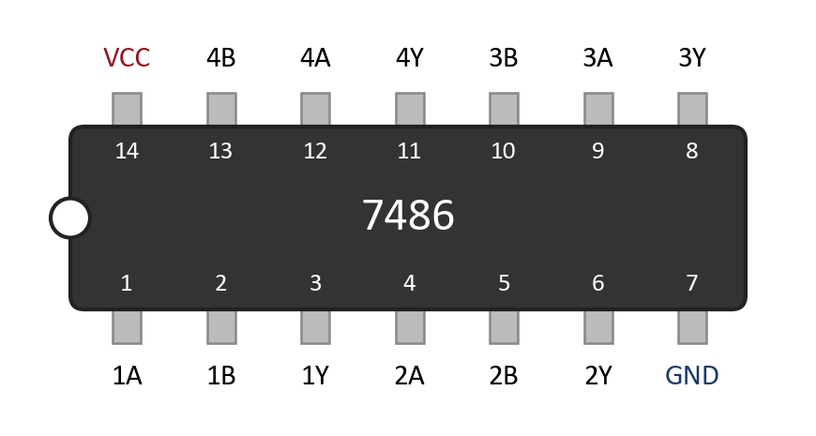


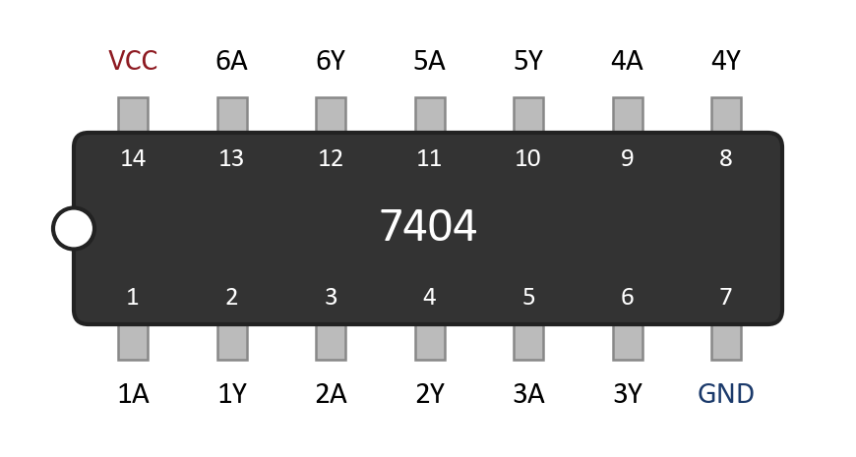
In the lab
Laboratory ICs
7486
7408
7432
7404
Quad 2-input XOR
Quad 2-input AND
Quad 2-input OR
Hex inverter (NOT)
Important
The 7404 is different: it has six 1-input gates, so the pins run input–output–input–output. VCC is still pin 14 and GND still pin 7.
New chip today: the 7404 inverter is what turns an adder into a subtractor.
CSE208 · Digital Logic Design Laboratory · Class 04
25

Slide 26
Logisim Evolution
Circuit Simulation
Build the half subtractor once, then reuse it twice.
1
Create a circuit named HalfSubtractor.
2
Place inputs A, B and outputs D, B_{out}.
3
Wire one XOR, one NOT and one AND; test all 4 rows.
4
Create a second circuit, FullSubtractor.
One block, used twice
5
Place two HalfSubtractor sub-circuits and one OR.
6
Test all 8 input combinations.
7
Compare with the truth table.
Keep the adder file open — the two circuits differ by one inverter.
CSE208 · Digital Logic Design Laboratory · Class 04
26

Slide 27
Quiz
Quick Check #1
How many inputs and outputs does a half subtractor have?
Hint: which bits does it subtract, and what does it produce?
CSE208 · Digital Logic Design Laboratory · Class 04
27

Slide 28
Quiz
Quick Check #1
How many inputs and outputs does a half subtractor have?
Hint: which bits does it subtract, and what does it produce?
2 in, 2 out
CSE208 · Digital Logic Design Laboratory · Class 04
27

Slide 29
Quiz
Quick Check #2
A full subtractor has A = 0, B = 1, B_{in} = 1. What are D and B_{out}?
Hint: 0 − 1 − 1 = −2, so borrow and add 2.
CSE208 · Digital Logic Design Laboratory · Class 04
28

Slide 30
Quiz
Quick Check #2
A full subtractor has A = 0, B = 1, B_{in} = 1. What are D and B_{out}?
Hint: 0 − 1 − 1 = −2, so borrow and add 2.
D = 0, B_{out} = 1
CSE208 · Digital Logic Design Laboratory · Class 04
28

Slide 31
Quiz
Quick Check #3
Which gate turns a half adder into a half subtractor?
AND
OR
1
2
NOT
NAND
3
4
CSE208 · Digital Logic Design Laboratory · Class 04
29

Slide 32
Quiz
Quick Check #3
Which gate turns a half adder into a half subtractor?
AND
OR
1
2
NOT
NAND
3
4
NOT
CSE208 · Digital Logic Design Laboratory · Class 04
29

Slide 33
Quiz
Quick Check #4
How many half subtractors (plus one OR gate) make a full subtractor?
Hint: one for A − B, then one for the borrow-in …
CSE208 · Digital Logic Design Laboratory · Class 04
30

Slide 34
Quiz
Quick Check #4
How many half subtractors (plus one OR gate) make a full subtractor?
Hint: one for A − B, then one for the borrow-in …
2
CSE208 · Digital Logic Design Laboratory · Class 04
30

Slide 35
Class 05
What Comes Next?
Next class
Karnaugh Map Based Combinational Design — a picture instead of algebra.
We used a K-map twice already, for C_{out} and for B_{out}. Next class we make it the main tool:
Group the 1s
Read it off
Build it
Adjacent cells merge and drop a variable
Each group becomes one product term
Fewer gates for the same function
Same circuits, fewer gates — simplification is a design skill.
CSE208 · Digital Logic Design Laboratory · Class 04
31

Slide 36
Summary
Today's Takeaways
1
Binary subtraction: 0 − 1 needs a borrow from the next column.
2
Half subtractor: D = A ⊕ B, B_{out} = A̅B.
3
The Difference is the same XOR as the adder's Sum.
4
A half subtractor has no borrow-in, so it fits only the LSB.
5
Full subtractor: D = A ⊕ B ⊕ B_{in}.
6
B_{out} = A̅B + A̅B_{in} + BB_{in} = A̅B + B_{in}(A ⊕ B)′.
7
Full subtractor = 2 half subtractors + 1 OR gate.
CSE208 · Digital Logic Design Laboratory · Class 04
32

Slide 37
Self-check
Before You Leave
You should be able to answer:
What is the difference between a half and a full subtractor?
Why is the Difference the same as the adder's Sum?
1
2
Write the complete truth table of a full subtractor.
Derive B_{out} using a K-map.
3
4
How do you build a full subtractor from two half subtractors?
Which ICs do you need to build a full subtractor in the lab?
5
6
CSE208 · Digital Logic Design Laboratory · Class 04
33

Slide 38
Assessment
Lab Task — Experiment 04
Implementation of Half Subtractor and Full Subtractor
Construct the following circuits and verify every row of the truth table.
Part A — Half Subtractor
Part B — Full Subtractor
One XOR + one NOT + one AND
Two half subtractors + one OR gate
ICs: 7486, 7404, 7408
ICs: 7486, 7404, 7408, 7432
Verify all 4 rows
Verify all 8 rows
Submit:
1
Circuit diagrams
2
Truth tables
3
Boolean expressions & K-maps
4
Experimental observations
5
Short conclusion
CSE208 · Digital Logic Design Laboratory · Class 04
34

Slide 39
One Inverter Makes the Difference
1
Half subtractor — 2 bits in, Difference and Borrow out
NEXT CLASS
Karnaugh Maps
2
Full subtractor — 3 bits in, handles the borrow from the last column
Group the 1s and read off the simplest expression.
3
Two half subtractors + OR — the standard full subtractor
4
The Difference is the adder's Sum — only the borrow is new
Questions?

