Slide 1

CSE208 · DIGITAL LOGIC DESIGN LABORATORY · CLASS 05
Multiplexers &
Demultiplexers
Choosing one line out of many — and sending one line back out to many
Munzer Mahmood
Lecturer, Department of Computer Science and Engineering
Presidency University

Slide 2
Recap · Class 04
Where We Are
Last class you learned
So far
Binary subtraction and the borrow
Circuits that compute a value
Half subtractor: D = A ⊕ B, B_{out} = A̅B
Full subtractor: D = A ⊕ B ⊕ B_{in}
Full subtractor = 2 half subtractors + 1 OR
The inverter (7404) is what adders lack
Today
Circuits that route a value
No arithmetic today — just getting the right bit to the right place.
CSE208 · Digital Logic Design Laboratory · Class 05
2
Notes:
Pivot point of the course: we stop doing arithmetic and start routing data.

Slide 3
Today's Learning Objectives
By the end of today's laboratory, you should be able to:
1
Explain what a multiplexer does and why n select lines give 2ⁿ inputs.
2
Derive the output expression of a 2-to-1 and a 4-to-1 multiplexer.
3
Build and verify a 4-to-1 multiplexer from basic gates.
4
Use a multiplexer to implement any Boolean function.
5
Explain what a demultiplexer does and derive its output expressions.
6
Build and verify a 1-to-4 demultiplexer from basic gates.
7
Verify both circuits using a simulator or the 74151 and 74138 ICs.
CSE208 · Digital Logic Design Laboratory · Class 05
3

Slide 4
Motivation
Why Do We Need Data Selectors?
Inside a computer, many signals compete for very few wires. Two circuits solve this:
Many → one
One → many
Together
A multiplexer picks one of several inputs
A demultiplexer sends one input to a chosen output
Many signals share a single wire, in turn
Choosing between the ALU result and memory inside a CPU
Reading many sensors through one input pin
Routing one data stream to several destinations
Wires are expensive — sharing them is a design skill.
The same two blocks appear in every CPU, memory and network chip.
CSE208 · Digital Logic Design Laboratory · Class 05
4
Notes:
Core idea: wires are expensive. One shared line carrying many signals in turn is the whole motivation.

Slide 5
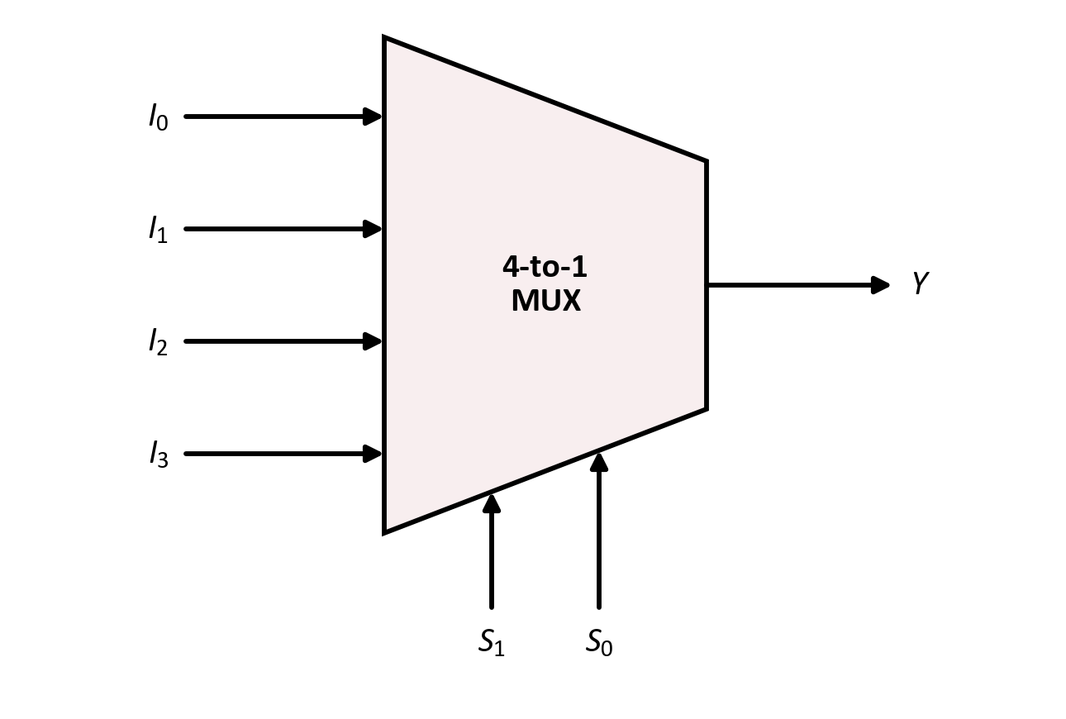
Topic 1 · Multiplexer
The Multiplexer
Definition
A multiplexer (MUX) is a combinational circuit that selects one of several data inputs and passes it to a single output. The select lines decide which one.
Data inputs: I₀ … I₃
Select lines: S₁, S₀
Output: Y — a copy of the selected input
Also called
A data selector — it is a digital rotary switch with no moving parts.
The trapezoid symbol is standard: wide on the input side, narrow on the output side.
CSE208 · Digital Logic Design Laboratory · Class 05
5

Slide 6
Topic 1 · Multiplexer
The Select Lines
Each select line doubles the number of inputs a multiplexer can choose from:
Select lines (n)
Data inputs (2ⁿ)
Multiplexer
The rule
1
2
2-to-1
Read S₁S₀ as a binary number — that is the index of the chosen input.
2
4
4-to-1
3
8
8-to-1
S₁S₀ = 00
→
Y = I₀
4
16
16-to-1
S₁S₀ = 01
→
Y = I₁
n
2ⁿ
2ⁿ-to-1
S₁S₀ = 10
→
Y = I₂
S₁S₀ = 11
→
Y = I₃
n select lines ⇒ 2ⁿ data inputs
CSE208 · Digital Logic Design Laboratory · Class 05
6
Notes:
The select value read as a binary number IS the index of the chosen input. That is the whole trick.

Slide 7
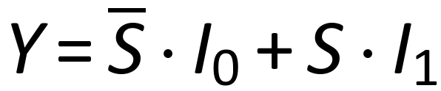
Topic 1 · Multiplexer
2-to-1 Multiplexer
One select line, two data inputs:
S
Y
Reading it as a sum of products
0
I₀
Take each row where Y follows an input, and AND that input with the select condition.
1
I₁
A compressed truth table — we list the
select value, not all 8 rows
S̅ enables I₀; S enables I₁. Exactly one AND gate is “open” at a time.
Every larger multiplexer is this same pattern, repeated.
CSE208 · Digital Logic Design Laboratory · Class 05
7
Notes:
Start with the smallest MUX. The compressed truth table is the key idea: we tabulate against the select, not against the data.

Slide 8
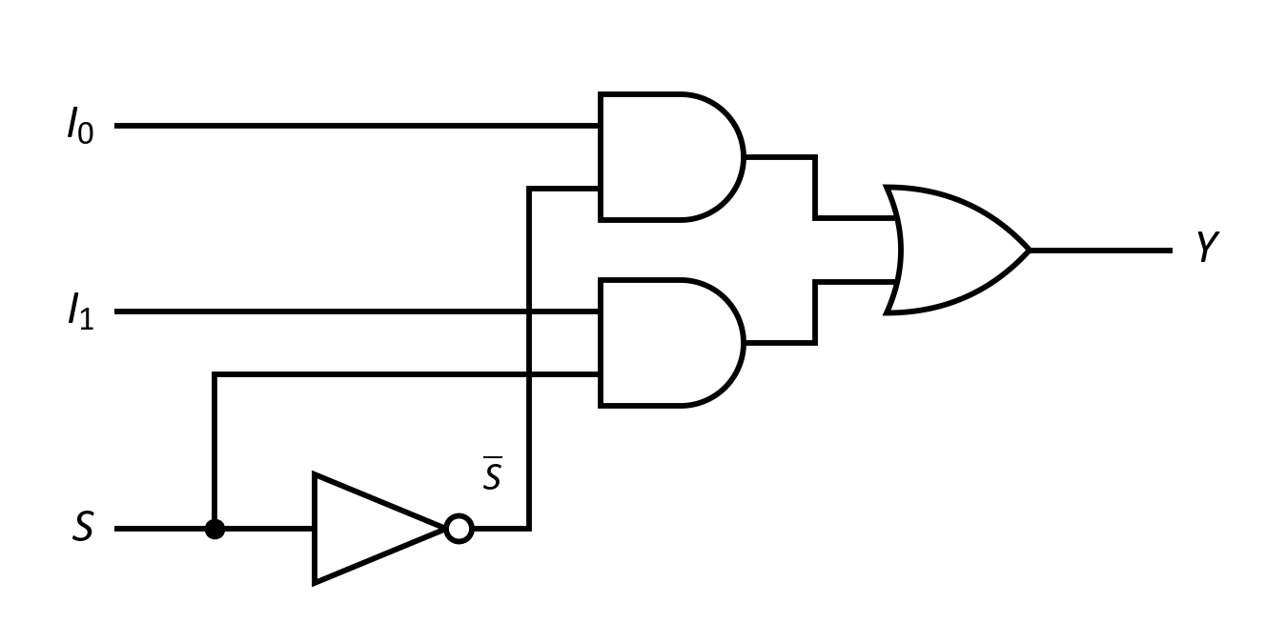
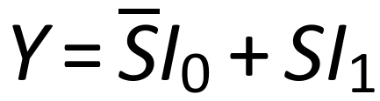
Topic 1 · Multiplexer
2-to-1 Multiplexer — Logic Circuit
Boolean expression
In the laboratory
One 7404 inverter, two 7408 AND gates and one 7432 OR gate.
Gates used: 1 NOT + 2 AND + 1 OR.
CSE208 · Digital Logic Design Laboratory · Class 05
8

Slide 9
Topic 1 · Multiplexer
4-to-1 Multiplexer
Two select lines, four data inputs:
S₁
S₀
Y
One product term per input
0
0
I₀
AND the data input with the select combination that chooses it.
0
1
I₁
1
0
I₂
1
1
I₃
4 AND gates + 1 four-input OR + 2 inverters
Only one input reaches Y at a time
Notice each term contains every select literal — just like a minterm.
CSE208 · Digital Logic Design Laboratory · Class 05
9
Notes:
Each product term carries all the select literals plus one data input. That is the pattern to memorise.

Slide 10
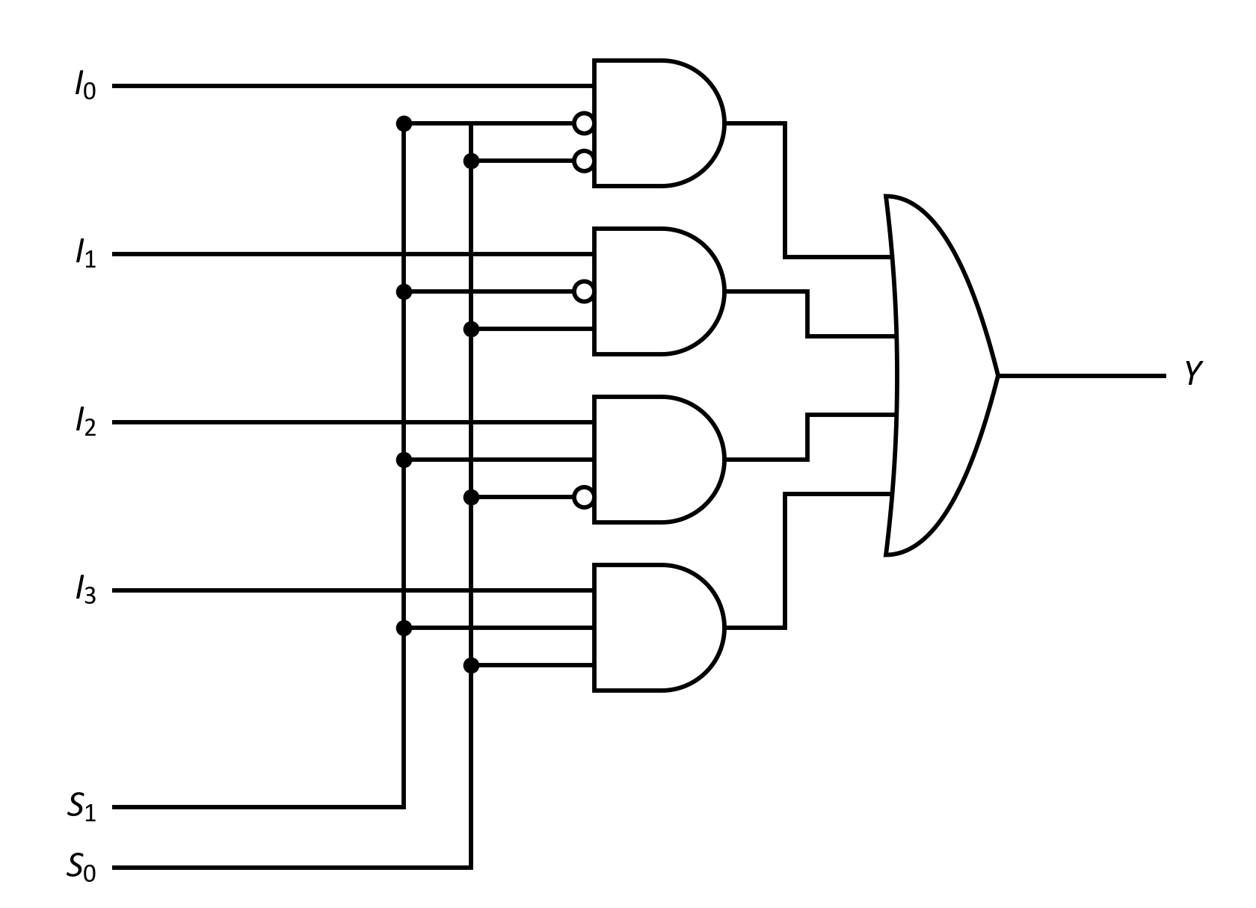
Topic 1 · Multiplexer
4-to-1 Multiplexer — Logic Circuit
Boolean expression
About the bubbles
A bubble on an AND input is an inverter — in the lab that is a 7404 gate.
Check the pattern
Each AND gate opens for exactly one value of S₁S₀.
CSE208 · Digital Logic Design Laboratory · Class 05
10
Notes:
Explain the bubbles: each one is an inverter from the 7404. Drawing them as bubbles keeps the wiring readable.

Slide 11
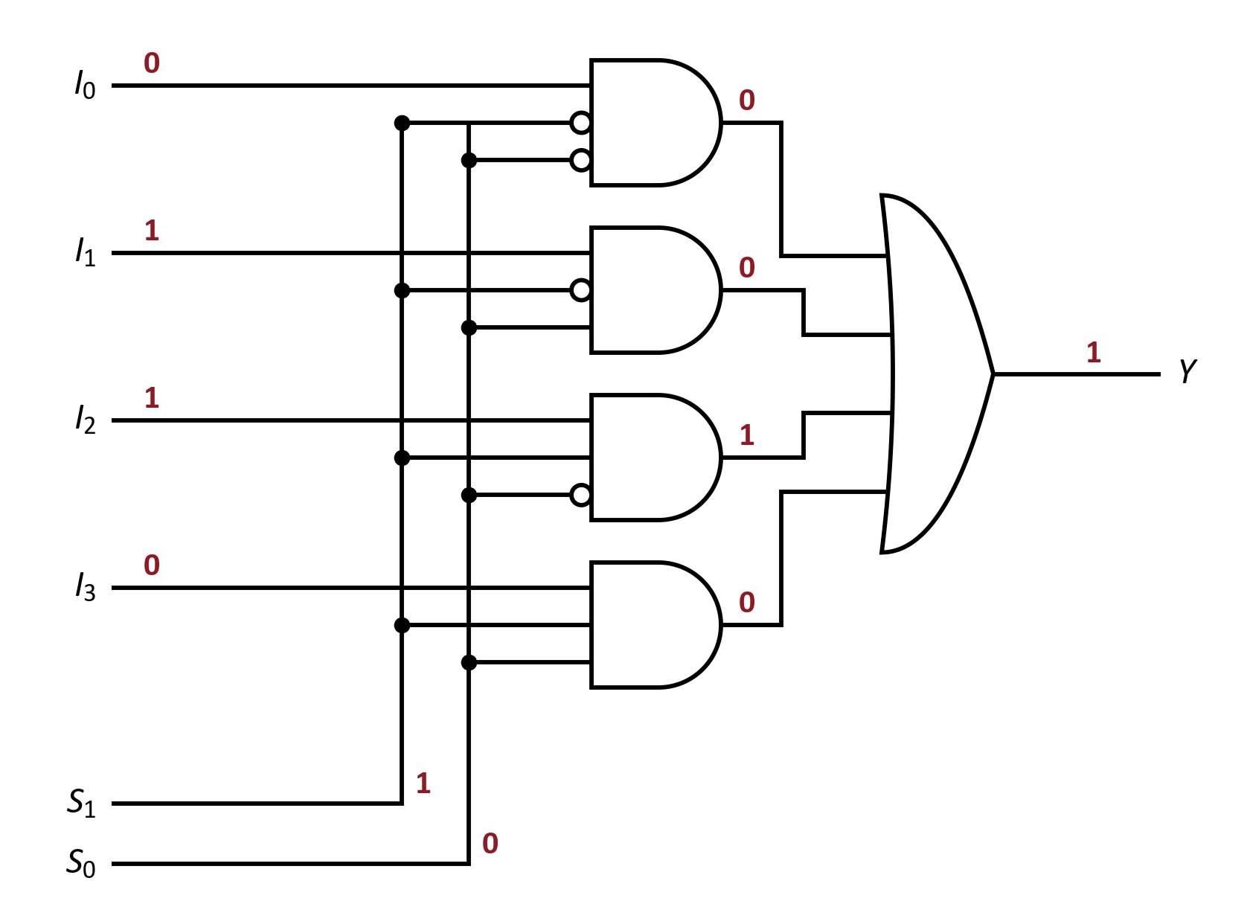





Worked example
Let's Trace It: 4-to-1 Multiplexer
Suppose the inputs and select lines are:
1
AND₀:
2
AND₁:
3
AND₂:
4
AND₃:
5
OR:
S₁S₀ = 10 is binary 2, so the multiplexer passes I₂.
CSE208 · Digital Logic Design Laboratory · Class 05
11

Slide 12
Topic 1 · Multiplexer
The Enable Input
Most multiplexer ICs add an enable (or strobe) input that switches the whole chip on or off:
Enable active (E = 1)
Enable inactive (E = 0)
The multiplexer works normally — Y follows the selected input.
Y is forced to 0, whatever the select lines say.
It lets you cascade small multiplexers into larger ones.
On the 74151 the enable is active-LOW — tie it to GND to switch the chip on.
Leaving an enable pin floating is the most common MUX wiring mistake.
CSE208 · Digital Logic Design Laboratory · Class 05
12
Notes:
Needed for cascading. Warn them the 74151 enable is active LOW.

Slide 13
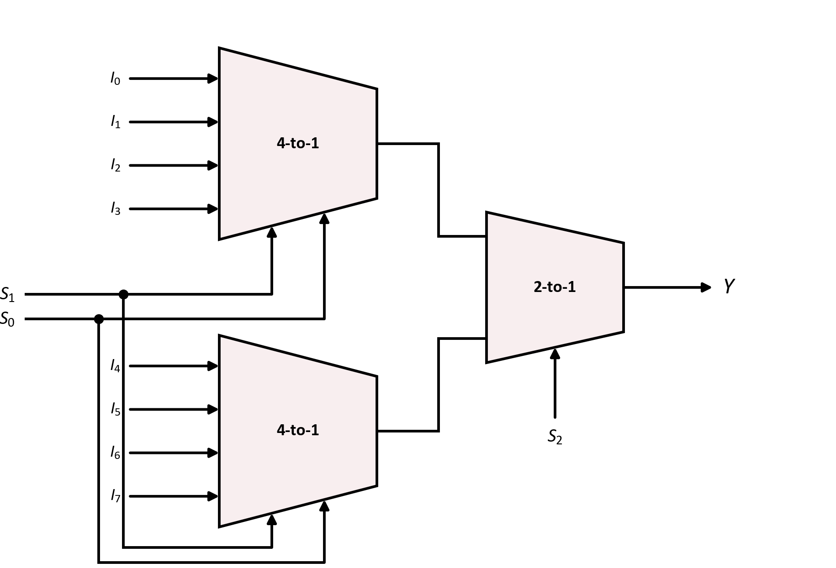
Topic 1 · Multiplexer
Building Larger Multiplexers
1
Two 4-to-1 multiplexers each pick one input from their own half.
2
S₁S₀ drive both halves in parallel.
3
A final 2-to-1 uses S₂ to choose which half reaches Y.
Two 4-to-1 + one 2-to-1 = one 8-to-1 multiplexer
The same idea builds a 16-to-1 from four 4-to-1 and one 4-to-1.
CSE208 · Digital Logic Design Laboratory · Class 05
13
Notes:
Only needed if the lab does not have a 74151. Good exercise in hierarchy.

Slide 14
Topic 1 · Application
A Multiplexer Can Build Any Boolean Function
The idea
A 2ⁿ-to-1 multiplexer with the n variables on its select lines produces every minterm. Tie each data input to the value the function needs for that row.
1
Connect the n input variables to the n select lines.
2
Write out the truth table of the function.
3
Set I_{k} = 1 where the function is 1, and I_{k} = 0 where it is 0.
One IC replaces a whole page of AND–OR gates.
No simplification needed — the truth table is the wiring diagram.
CSE208 · Digital Logic Design Laboratory · Class 05
14
Notes:
This is the most useful idea of the class. Compare the gate count with an SOP circuit.

Slide 15
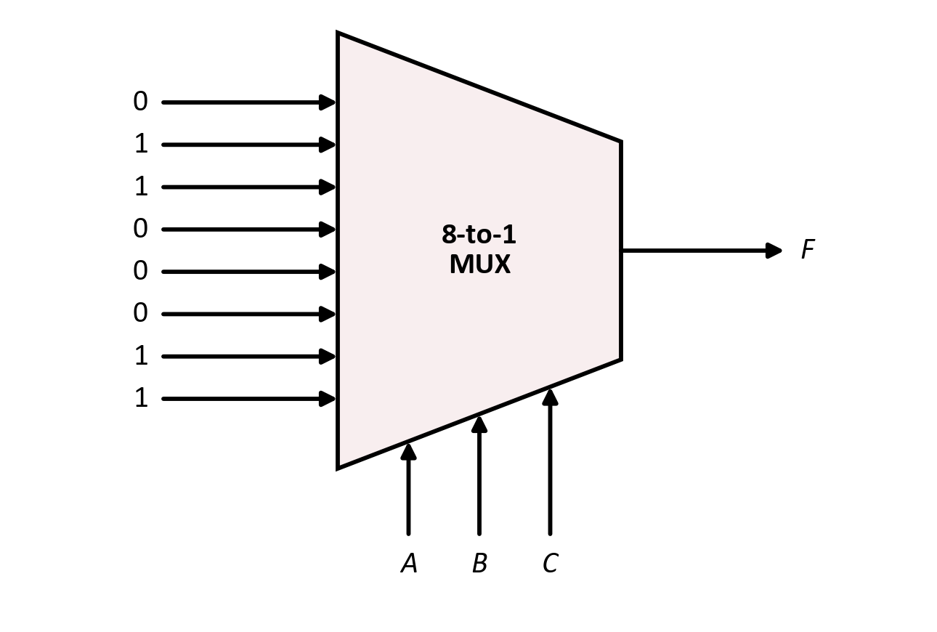
Worked example
Example: F = Σm(1, 2, 6, 7) with an 8-to-1 MUX
A
B
C
F
I_{k}
0
0
0
0
I₀ = 0
Wiring
0
0
1
1
I₁ = 1
A, B, C → the select pins. Each data pin goes to +5 V or GND.
0
1
0
1
I₂ = 1
0
1
1
0
I₃ = 0
1
0
0
0
I₄ = 0
1
0
1
0
I₅ = 0
Result
1
1
0
1
I₆ = 1
One 74151 and a few wires — no gate ICs at all.
1
1
1
1
I₇ = 1
The I_{k} column is just the F column, read straight off the truth table.
CSE208 · Digital Logic Design Laboratory · Class 05
15

Slide 16
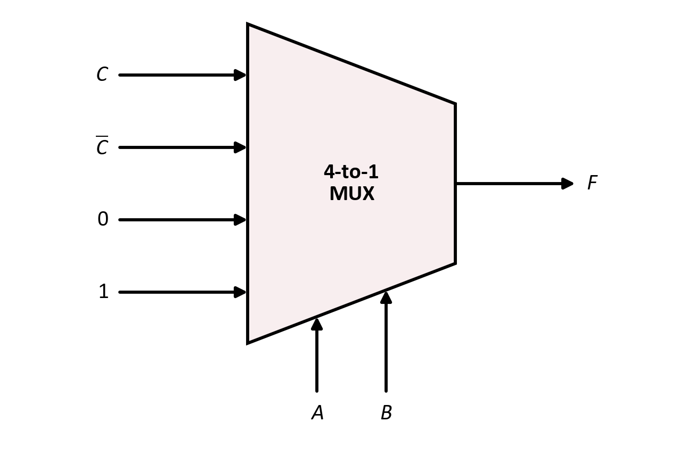
Worked example
The Same F with a 4-to-1 MUX
Put A and B on the select lines and let C appear on the data inputs. Group the truth table in pairs:
A B
C = 0
C = 1
So I_{k} =
0 0
F = 0
F = 1
I₀ = C
Four cases
0 1
F = 1
F = 0
I₁ = C̅
Each pair of rows is 0, 1, C or C̅.
1 0
F = 0
F = 0
I₂ = 0
1 1
F = 1
F = 1
I₃ = 1
n variables need only a 2ⁿ⁻¹-to-1 multiplexer if one variable rides on the data inputs.
One 7404 for C̅ is the only extra gate.
CSE208 · Digital Logic Design Laboratory · Class 05
16
Notes:
Half the multiplexer size: put two variables on the selects and express each pair of rows in terms of the third.

Slide 17
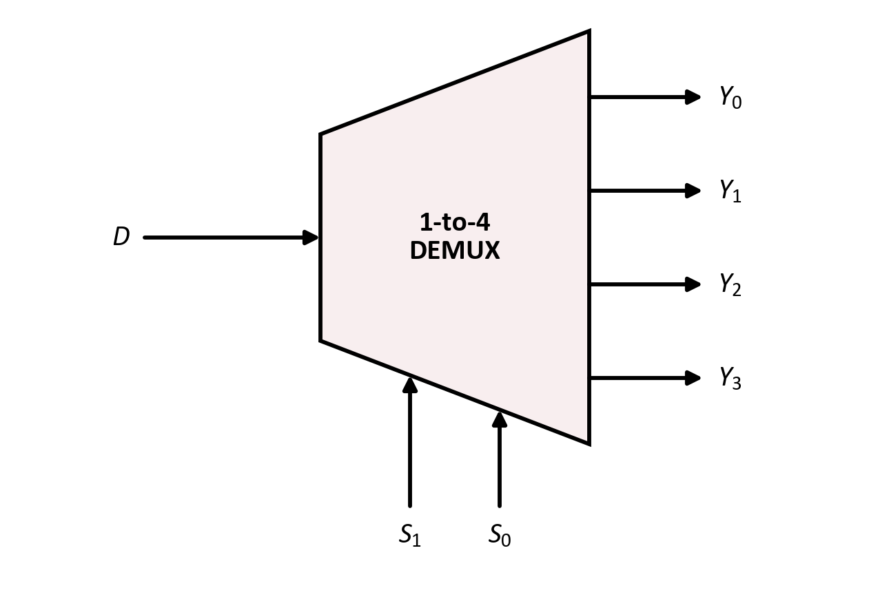
Topic 2 · Demultiplexer
The Demultiplexer
Definition
A demultiplexer (DEMUX) takes a single data input and routes it to one of several outputs. The select lines decide which output receives the data.
Data input: D
Select lines: S₁, S₀
Outputs: Y₀ … Y₃ — only one carries D, the rest are 0
The mirror image
A multiplexer is many-to-one; a demultiplexer is one-to-many.
Same select lines, same trapezoid — drawn the other way round.
CSE208 · Digital Logic Design Laboratory · Class 05
17

Slide 18
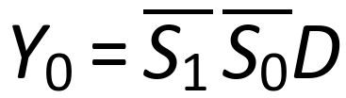
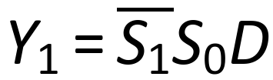
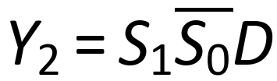

Topic 2 · Demultiplexer
1-to-4 Demultiplexer — Truth Table
S₁
S₀
Y₀
Y₁
Y₂
Y₃
Output expressions
0
0
D
0
0
0
0
1
0
D
0
0
1
0
0
0
D
0
1
1
0
0
0
D
Exactly one output follows D; the others are held at 0
Same product terms as the MUX — but no OR gate.
The multiplexer collects the terms; the demultiplexer keeps them apart.
CSE208 · Digital Logic Design Laboratory · Class 05
18
Notes:
Stress: the unselected outputs are 0, not undefined. Each output is an AND of D with one select combination.

Slide 19
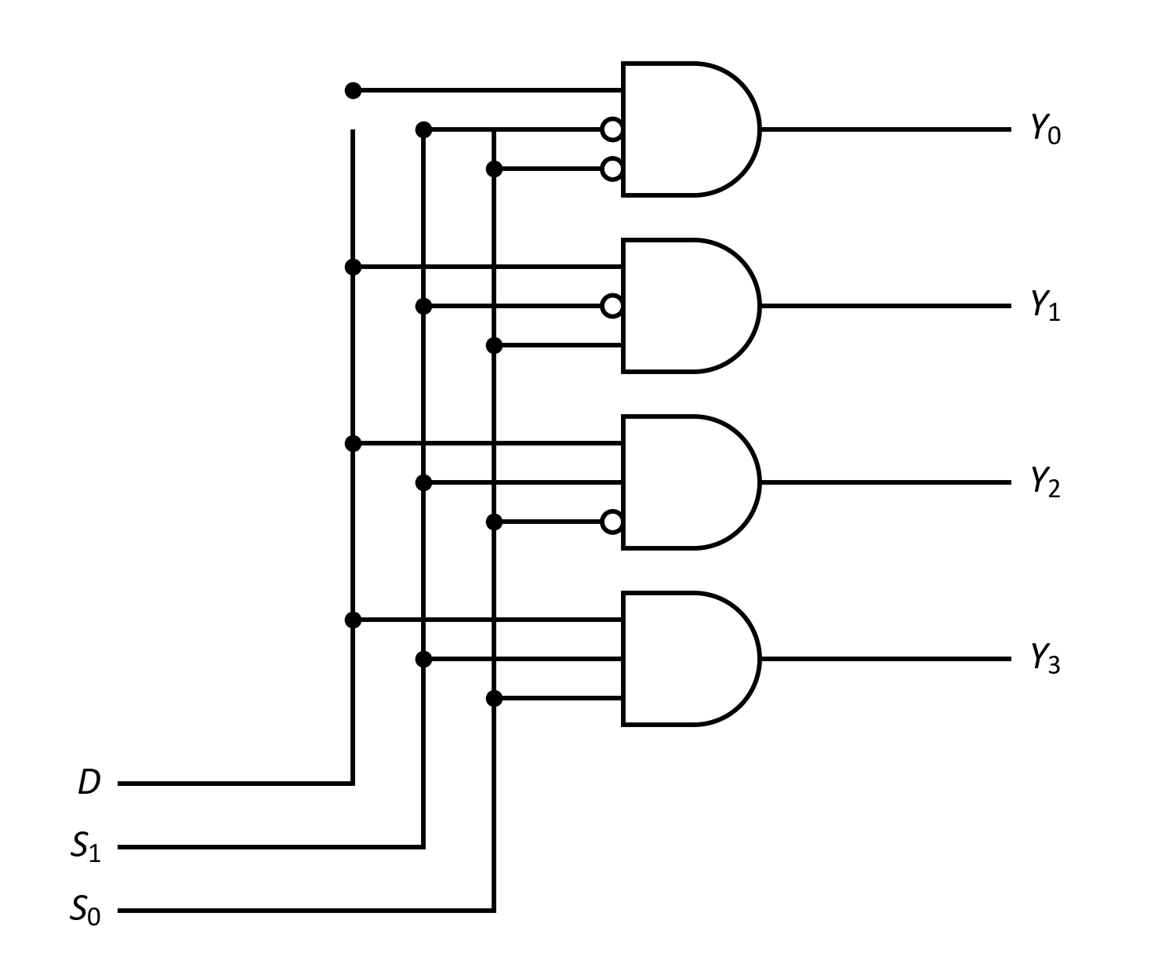
Topic 2 · Demultiplexer
1-to-4 Demultiplexer — Logic Circuit
Compare with the multiplexer
The same four AND gates and the same select bubbles — the data input simply fans out to all four instead of being collected by an OR.
In the laboratory
Two 7404 inverters and four 3-input AND gates (7411), or four 7408 gates in pairs.
Gates used: 2 NOT + 4 three-input AND
No OR gate anywhere — that is the whole difference.
CSE208 · Digital Logic Design Laboratory · Class 05
19

Slide 20
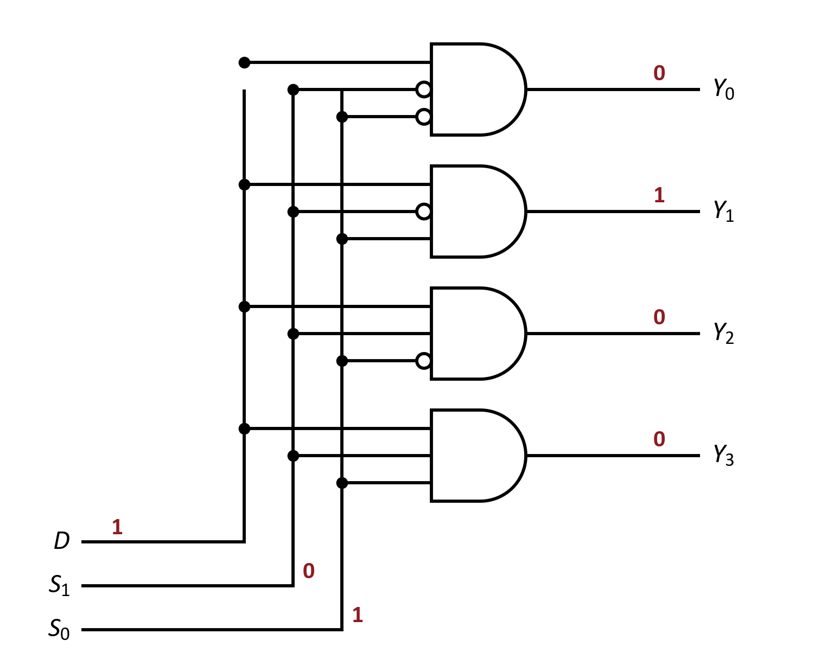





Worked example
Let's Trace It: 1-to-4 Demultiplexer
Suppose:
1
Y₀:
2
Y₁:
3
Y₂:
4
Y₃:
Try it yourself
Trace D = 1 with S₁S₀ = 11. Which output goes high?
CSE208 · Digital Logic Design Laboratory · Class 05
20

Slide 21
Topic 2 · Demultiplexer
Demultiplexer vs Decoder
These two circuits are so close that one IC usually serves as both:
Decoder
Demultiplexer
n inputs, 2ⁿ outputs. The input is a code, and exactly one output goes active for each code. No separate data input.
The same 2ⁿ outputs, plus a data input. The select code picks the output; the data decides what it carries.
Feed the data into a decoder's enable pin and it becomes a demultiplexer.
The 74138 is sold as a “3-to-8 decoder / demultiplexer”.
Its outputs are active-LOW: the selected one goes to 0, not to 1.
CSE208 · Digital Logic Design Laboratory · Class 05
21
Notes:
They are the same silicon. A decoder with an enable pin IS a demultiplexer - feed the data into the enable.

Slide 22
Summary
Multiplexer vs Demultiplexer
Feature
Multiplexer
Demultiplexer
Direction
Many → one
One → many
Data lines
2ⁿ inputs
1 input
Outputs
1 output
2ⁿ outputs
Select lines
n
n
Also called
Data selector
Data distributor
Gates
2ⁿ AND + 1 OR + n NOT
2ⁿ AND + n NOT
Typical IC
74151, 74153
74138, 74139
Same select logic, same AND array — only the OR gate differs.
CSE208 · Digital Logic Design Laboratory · Class 05
22

Slide 23
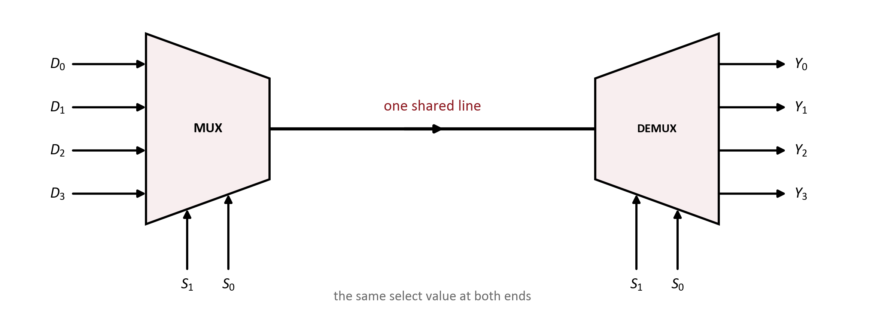
Application
Working Together: One Line, Many Signals
1
The multiplexer picks one of four sources and puts it on the shared line.
2
The demultiplexer sends it to the matching destination.
3
Both ends must use the same select value at the same moment.
Four signals, one wire — this is time-division multiplexing.
CSE208 · Digital Logic Design Laboratory · Class 05
23
Notes:
This is how a single bus wire, a telephone line or a serial link carries many channels.

Slide 24
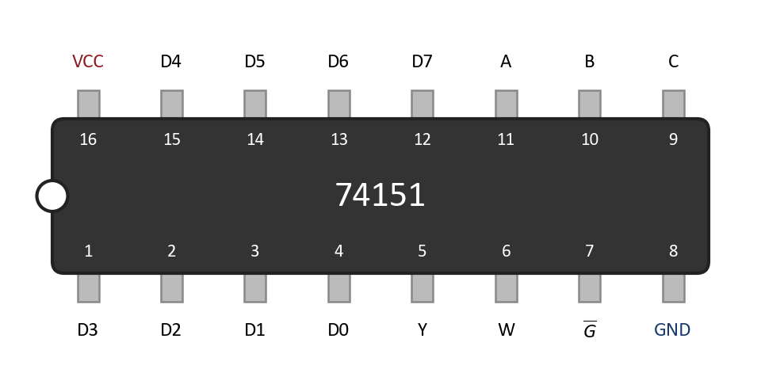
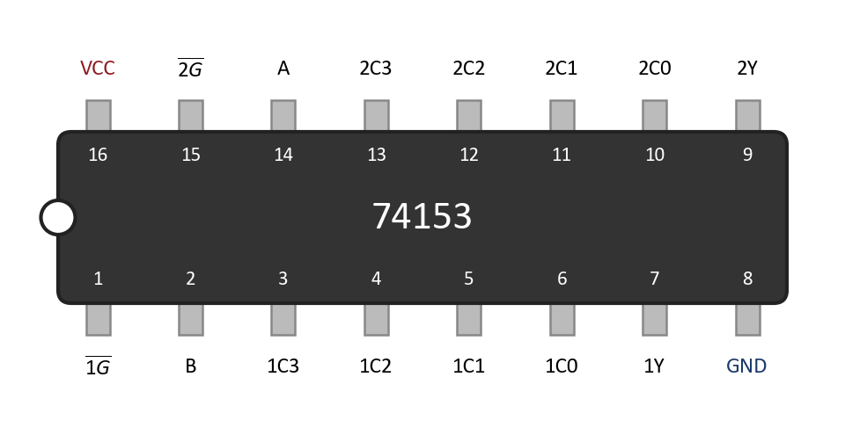
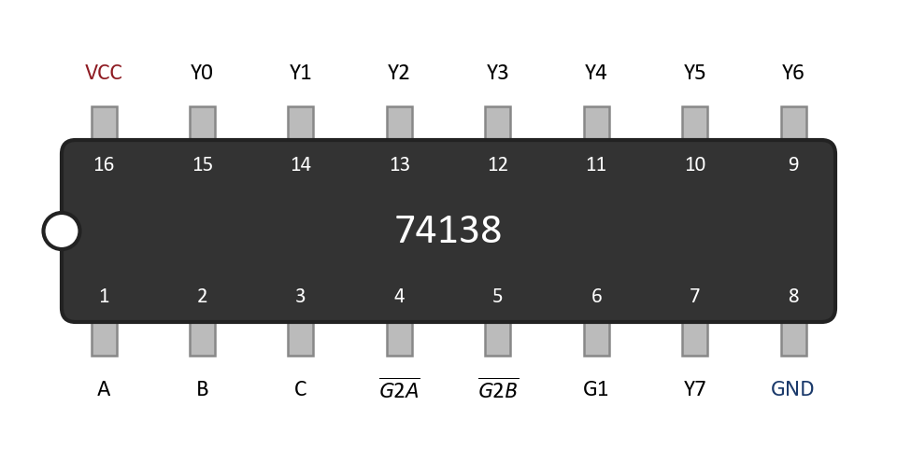
In the lab
Laboratory ICs
74151
74153
74138
8-to-1 multiplexer
Dual 4-to-1 multiplexer
3-to-8 decoder / demux
Active-LOW pins
16-pin packages
The 74151 enable (G̅) and all 74138 outputs are active-LOW. Tie G̅ to GND.
These are 16-pin ICs: VCC is pin 16 and GND is pin 8 — not 14 and 7.
The 74151 also gives W, the complement of Y, on pin 6.
CSE208 · Digital Logic Design Laboratory · Class 05
24

Slide 25
Logisim Evolution
Circuit Simulation
Build the gate-level circuits first, then compare with the built-in blocks.
1
Create a circuit named Mux4to1.
2
Place inputs I₀–I₃, S₁, S₀ and output Y.
3
Wire four AND gates, two NOT gates and one OR gate.
4
Test all four select values with different data.
5
Create a second circuit, Demux1to4.
Compare yours with the
built-in block
6
Drop Logisim's own Multiplexer block beside yours.
7
Confirm both behave identically.
Logisim's Plexers library has both blocks ready-made.
CSE208 · Digital Logic Design Laboratory · Class 05
25

Slide 26
Quiz
Quick Check #1
How many select lines does a 16-to-1 multiplexer need?
Hint: n select lines choose between 2ⁿ inputs.
CSE208 · Digital Logic Design Laboratory · Class 05
26

Slide 27
Quiz
Quick Check #1
How many select lines does a 16-to-1 multiplexer need?
Hint: n select lines choose between 2ⁿ inputs.
4
CSE208 · Digital Logic Design Laboratory · Class 05
26

Slide 28
Quiz
Quick Check #2
A 4-to-1 MUX has I₀I₁I₂I₃ = 1010 and S₁S₀ = 11. What is Y?
Hint: read S₁S₀ as a binary number.
CSE208 · Digital Logic Design Laboratory · Class 05
27

Slide 29
Quiz
Quick Check #2
A 4-to-1 MUX has I₀I₁I₂I₃ = 1010 and S₁S₀ = 11. What is Y?
Hint: read S₁S₀ as a binary number.
Y = 0
CSE208 · Digital Logic Design Laboratory · Class 05
27

Slide 30
Quiz
Quick Check #3
Which gate does a demultiplexer NOT need?
AND
NOT
1
2
OR
All three are needed
3
4
CSE208 · Digital Logic Design Laboratory · Class 05
28

Slide 31
Quiz
Quick Check #3
Which gate does a demultiplexer NOT need?
AND
NOT
1
2
OR
All three are needed
3
4
OR
CSE208 · Digital Logic Design Laboratory · Class 05
28

Slide 32
Quiz
Quick Check #4
A 1-to-4 DEMUX has D = 1 and S₁S₀ = 10. Which output is 1?
Hint: 10 in binary is …
CSE208 · Digital Logic Design Laboratory · Class 05
29

Slide 33
Quiz
Quick Check #4
A 1-to-4 DEMUX has D = 1 and S₁S₀ = 10. Which output is 1?
Hint: 10 in binary is …
Y₂
CSE208 · Digital Logic Design Laboratory · Class 05
29

Slide 34
Class 06
What Comes Next?
Next class
Encoders and Decoders — turning codes into lines, and lines back into codes.
You have already met half of it today:
Decoder
Encoder
Priority encoder
One line active per input code
The reverse: a code from an active line
What to do when two lines are active
A demultiplexer with its data input tied high is exactly a decoder.
CSE208 · Digital Logic Design Laboratory · Class 05
30

Slide 35
Summary
Today's Takeaways
1
A multiplexer selects one of 2ⁿ inputs using n select lines.
2
Read the select lines as a binary number — that is the input index.
3
2-to-1: Y = S̅I₀ + SI₁. 4-to-1 adds two more product terms.
4
A 2ⁿ-to-1 MUX can implement any n-variable Boolean function.
5
A demultiplexer sends one input to one of 2ⁿ outputs.
6
Same AND array as the MUX, but no OR gate.
7
A decoder is a demultiplexer whose data input is held at 1.
CSE208 · Digital Logic Design Laboratory · Class 05
31

Slide 36
Self-check
Before You Leave
You should be able to answer:
How many select lines does a 32-to-1 multiplexer need?
Write the output expression of a 4-to-1 multiplexer.
1
2
How do you implement F = Σm(0, 3, 5) with an 8-to-1 MUX?
What is the difference between a MUX and a DEMUX?
3
4
Why does a demultiplexer need no OR gate?
Why is the 74151 enable pin tied to GND in the lab?
5
6
CSE208 · Digital Logic Design Laboratory · Class 05
32

Slide 37
Assessment
Lab Task — Experiment 05
Implementation of a Multiplexer and a Demultiplexer
Construct the following circuits and verify every select combination.
Part A — 4-to-1 Multiplexer
Part B — 1-to-4 Demultiplexer
Four AND + two NOT + one OR
Four AND + two NOT (no OR)
ICs: 7408, 7404, 7432
ICs: 7411 or 7408, 7404
Verify all four select values
Verify all four select values
Part C (bonus): implement F = Σm(1, 2, 6, 7) with a 74151.
Submit:
1
Circuit diagrams
2
Truth tables
3
Boolean expressions
4
Experimental observations
5
Short conclusion
CSE208 · Digital Logic Design Laboratory · Class 05
33

Slide 38
One Wire, Many Signals
1
Multiplexer — many inputs in, the selected one out
NEXT CLASS
Encoders &
Decoders
2
Demultiplexer — one input in, out to the selected line
Codes into lines, and lines back into codes.
3
n select lines choose between 2ⁿ lines, read as a binary index
4
Any Boolean function fits in a single multiplexer
Questions?

