Slide 1

CSE208: Digital Logic Design Laboratory
Class 02: Universal Gates — NAND & NOR
Munzer Mahmood
Lecturer
Department of Computer Science and Engineering
Presidency University

Slide 2
Recap: Class 01
What We Learned
Seven basic gates: NOT, AND, OR, NAND, NOR, XOR and XNOR — each described by a truth table.
The basic trio
The inverted pair
NOT → inverts the input
NAND = NOT(AND)
AND → all inputs are 1
NOR = NOT(OR)
OR → at least one input is 1
Both have a bubble ( ○ ) at the output
Question for Today
Can we build every other gate using only ONE type of gate?
CSE208 — Digital Logic Design Laboratory
2 / 40

Slide 3
Today’s Learning Objectives
By the end of today’s laboratory, you should be able to:
1
Define a universal gate.
2
Explain why NAND and NOR are called universal gates.
3
Build NOT, AND and OR using only NAND gates.
4
Build NOT, OR and AND using only NOR gates.
5
Use De Morgan’s theorem to convert between gate forms.
6
Implement a simple Boolean expression using only NAND gates.
7
Verify universal-gate circuits using a simulator or the 7400 / 7402 ICs.
CSE208 — Digital Logic Design Laboratory
3 / 40

Slide 4
What is a Universal Gate?
Definition
A universal gate is a gate that can implement ANY Boolean function, without using any other type of gate.
Every Boolean function can be written using only:
AND OR NOT
So, if one gate can make NOT, AND and OR, it can make everything:
NAND or NOR
NOT, AND, OR
Any Digital Circuit
Key Idea
NAND and NOR are the two universal gates.
CSE208 — Digital Logic Design Laboratory
4 / 40

Slide 5
Why Use Universal Gates?
Advantages
Where you see them
Only one type of IC is needed
Logic ICs: 7400 (NAND), 7402 (NOR)
Cheaper in mass production
Processors and memory chips
Small and fast in CMOS
FPGA / ASIC design
Did You Know?
The Apollo Guidance Computer, which flew to the Moon, was built almost entirely from NOR gates.
CSE208 — Digital Logic Design Laboratory
5 / 40

Slide 6
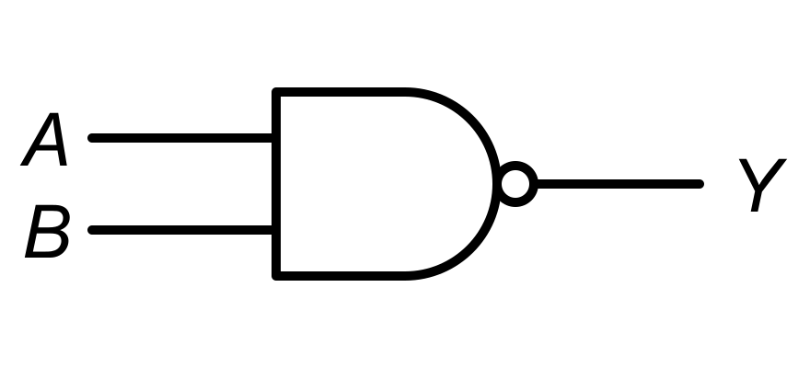



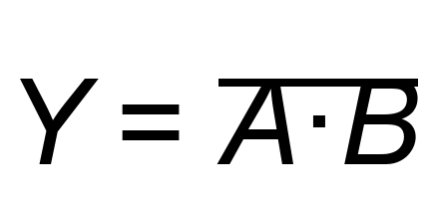
NAND Gate — Quick Review
0
0
1
0
1
1
1
0
1
1
1
0
NAND = 0 only when all inputs are 1
CSE208 — Digital Logic Design Laboratory
6 / 40

Slide 7
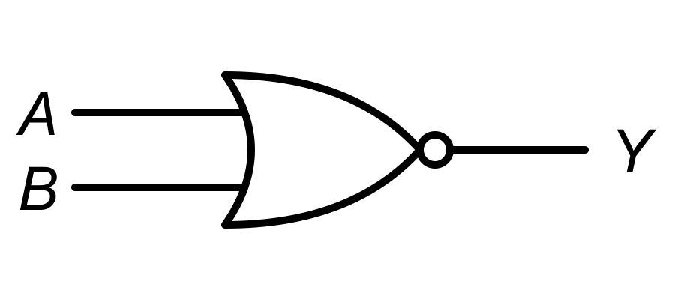
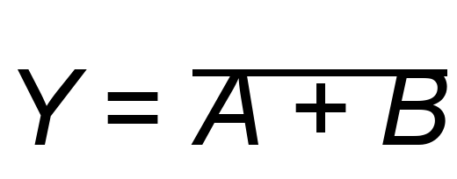
NOR Gate — Quick Review
0
0
1
0
1
0
1
0
0
1
1
0
NOR = 1 only when all inputs are 0
CSE208 — Digital Logic Design Laboratory
7 / 40

Slide 8
Building Gates with NAND Only: The Plan
We build the three basic gates in order — each one uses the previous result:
Step 1
NOT
Step 2
AND
Step 3
OR
The Recipe
NOT — connect both inputs of a NAND together.
AND — a NAND followed by a NOT (NAND inverter).
OR — invert each input first, then NAND them.
Remember
Two NOTs cancel each other: NOT(NOT A) = A
CSE208 — Digital Logic Design Laboratory
8 / 40

Slide 9
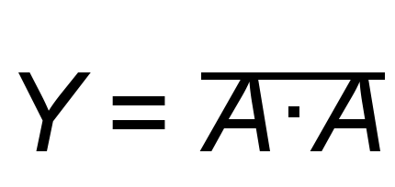
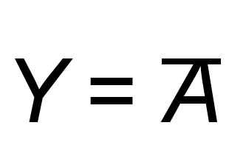
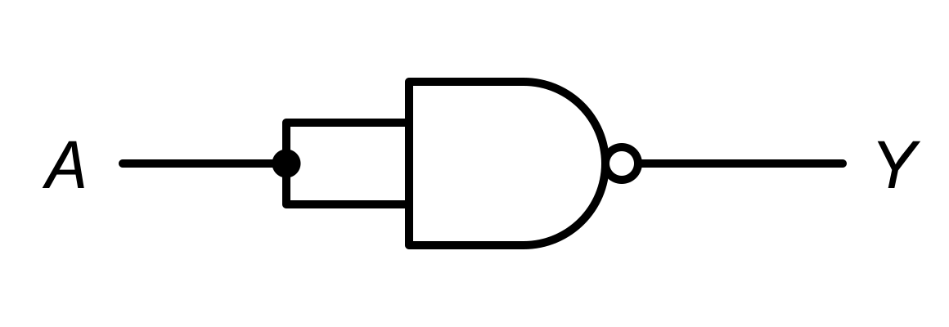

NOT Gate using NAND
0
0
1
1
1
0
Trick
Tie both inputs together: A·A = A, so the NAND simply inverts A. Gates used: 1 NAND
CSE208 — Digital Logic Design Laboratory
9 / 40

Slide 10
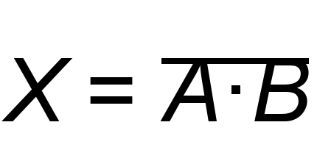
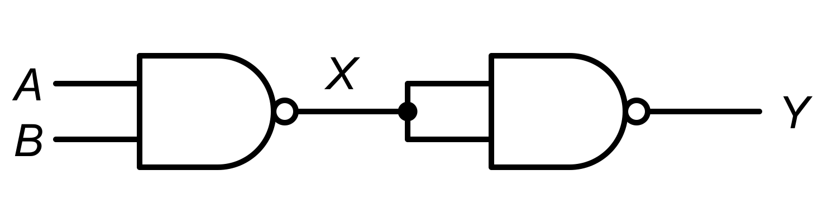
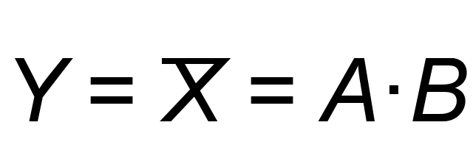

AND Gate using NAND
0
0
1
0
0
1
1
0
1
0
1
0
1
1
0
1
Idea
NAND = NOT(AND). Invert it once more and we get AND back. Gates used: 2 NAND
CSE208 — Digital Logic Design Laboratory
10 / 40

Slide 11
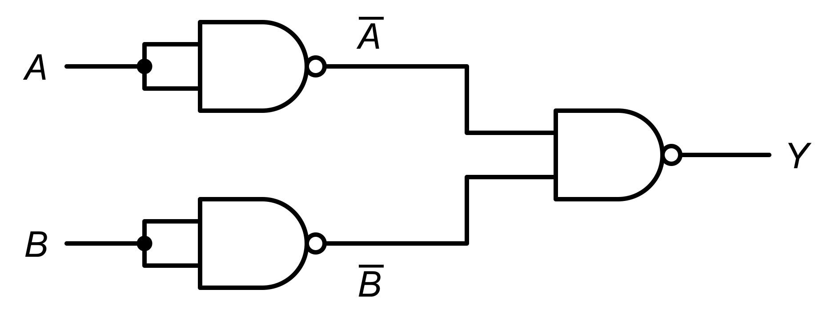
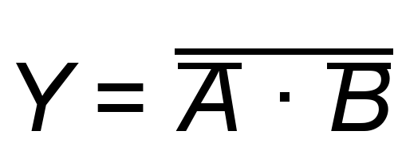
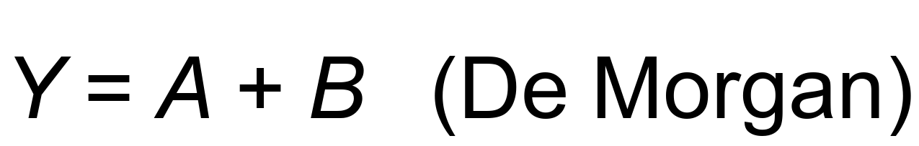

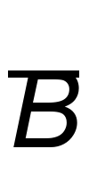
OR Gate using NAND
0
0
1
1
0
0
1
1
0
1
1
0
0
1
1
1
1
0
0
1
Idea
Invert the INPUTS (not the output), then NAND them. Gates used: 3 NAND
CSE208 — Digital Logic Design Laboratory
11 / 40

Slide 12
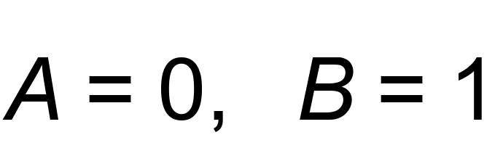
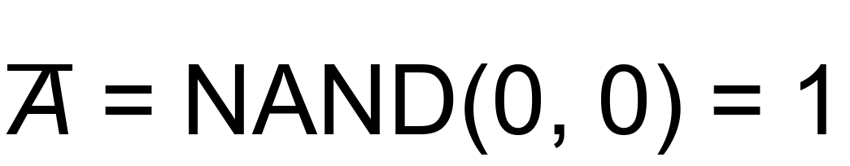
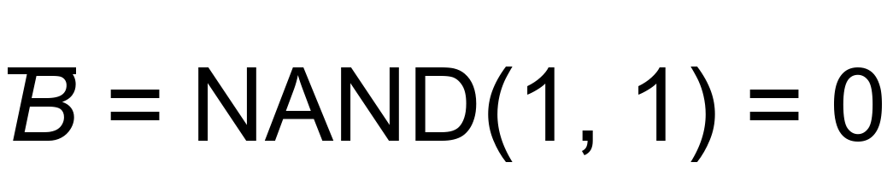
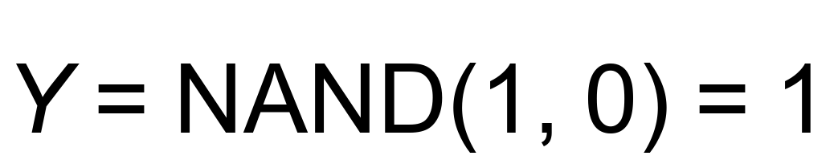
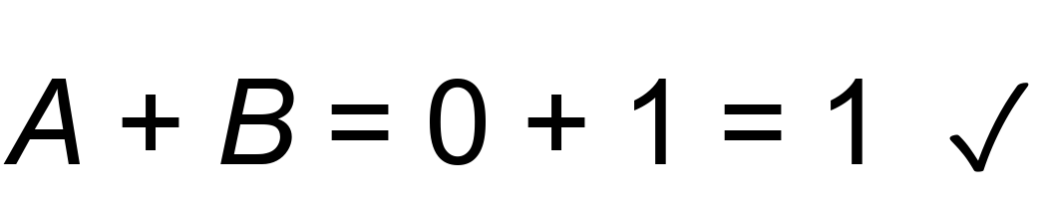
Let’s Analyze: OR using NAND
Given the OR-from-NAND circuit, suppose:
1
Gate 1:
2
Gate 2:
3
Gate 3:
4
Check:
Laboratory Skill
Trace the circuit gate by gate, then compare with the expected truth table.
CSE208 — Digital Logic Design Laboratory
12 / 40

Slide 13
NAND as a Universal Gate — Summary
Target gate | How to build it with NAND | NAND gates
NOT | Tie both inputs together | 1
AND | NAND → NOT | 2
OR | NOT each input → NAND | 3
NOR | OR (3 NAND) → NOT | 4
XOR | Special 4-gate circuit (see Challenge) | 4
Key Idea
NOT + AND + OR from NAND alone ⇒ NAND is universal.
CSE208 — Digital Logic Design Laboratory
13 / 40

Slide 14
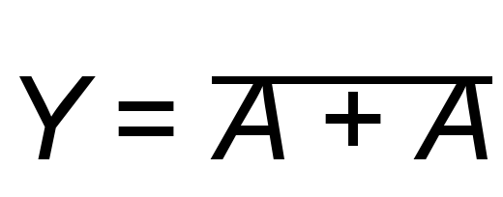
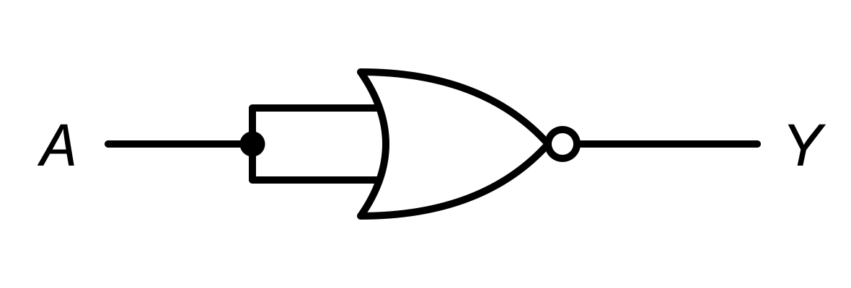
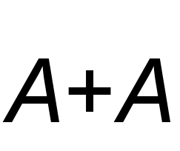
NOT Gate using NOR
0
0
1
1
1
0
Trick
Same trick as NAND: tie both inputs together, since A + A = A. Gates used: 1 NOR
CSE208 — Digital Logic Design Laboratory
14 / 40

Slide 15
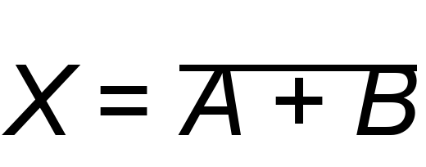
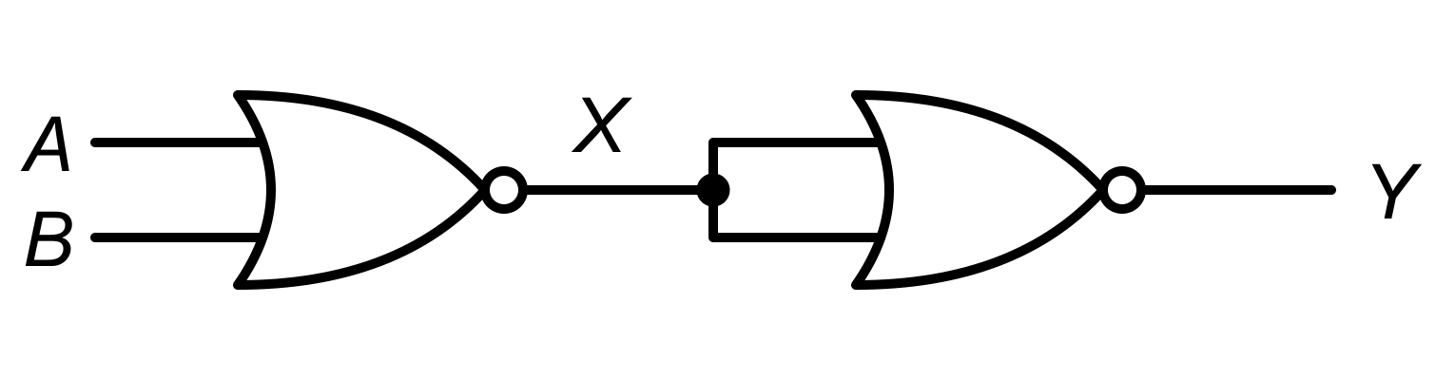
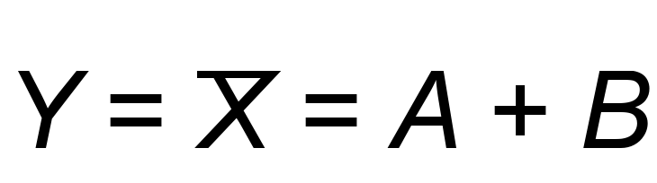
OR Gate using NOR
0
0
1
0
0
1
0
1
1
0
0
1
1
1
0
1
Idea
NOR = NOT(OR). Invert it once more and we get OR back. Gates used: 2 NOR
CSE208 — Digital Logic Design Laboratory
15 / 40

Slide 16

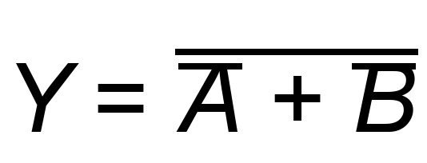
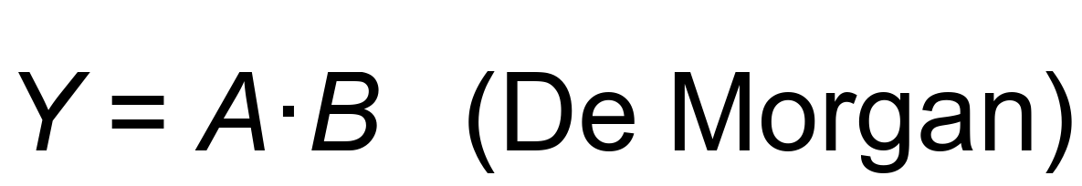
AND Gate using NOR
0
0
1
1
0
0
1
1
0
0
1
0
0
1
0
1
1
0
0
1
Idea
Invert the INPUTS, then NOR them. Gates used: 3 NOR
CSE208 — Digital Logic Design Laboratory
16 / 40

Slide 17
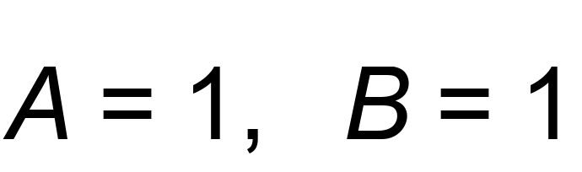
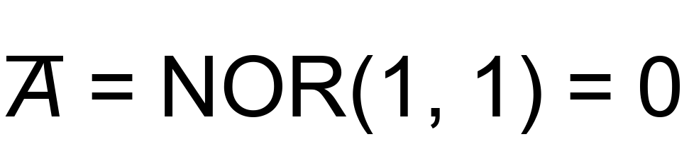
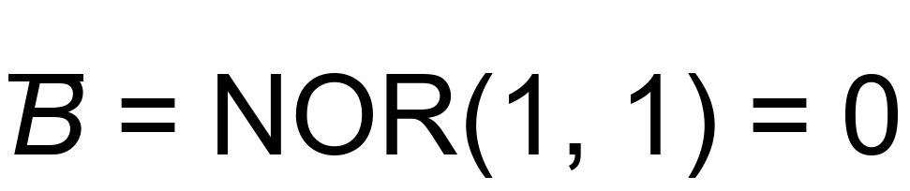
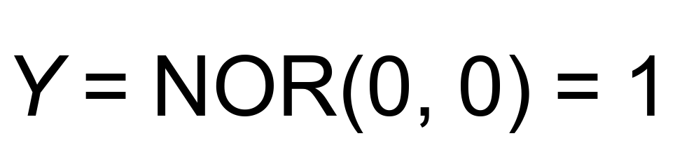
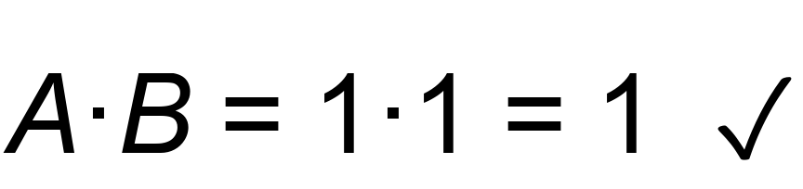
Let’s Analyze: AND using NOR
Given the AND-from-NOR circuit, suppose:
1
Gate 1:
2
Gate 2:
3
Gate 3:
4
Check:
Try It Yourself
Repeat the trace for A = 1, B = 0. What is Y?
CSE208 — Digital Logic Design Laboratory
17 / 40

Slide 18
NAND vs NOR
Target gate | Using NAND | Using NOR
NOT | 1 gate (tie inputs) | 1 gate (tie inputs)
AND | 2 gates (NAND → NOT) | 3 gates (NOT inputs → NOR)
OR | 3 gates (NOT inputs → NAND) | 2 gates (NOR → NOT)
Pattern
NAND and NOR are mirror images (duals): swap AND ↔ OR and the recipes swap too.
Memory Trick
The gate you get in 2 steps is the one inside the name: NAND → AND, NOR → OR.
CSE208 — Digital Logic Design Laboratory
18 / 40

Slide 19
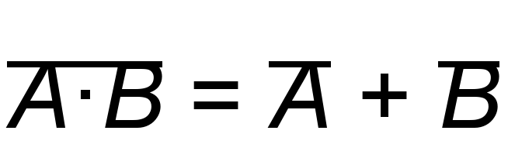
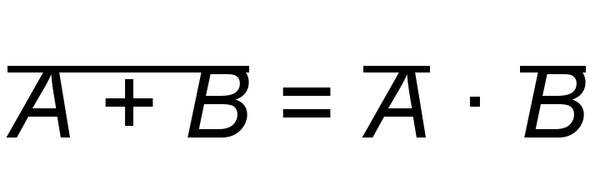
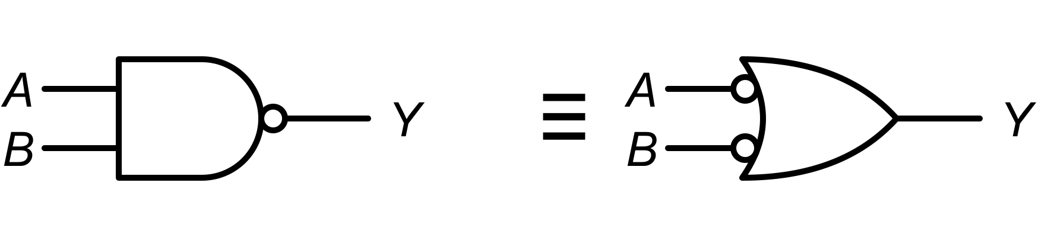
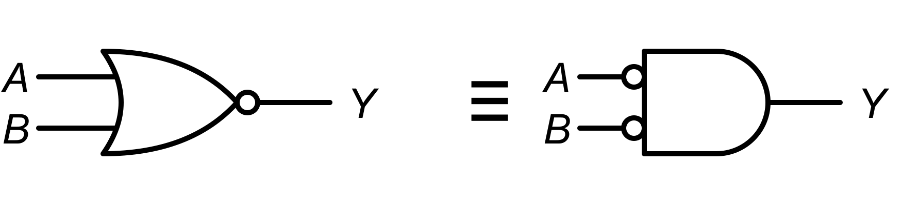
De Morgan’s Theorem — The Key Tool
Theorem 1
Theorem 2
NAND = OR with inverted inputs
NOR = AND with inverted inputs
Rule of Thumb
Break the bar, change the sign: AND ↔ OR.
CSE208 — Digital Logic Design Laboratory
19 / 40

Slide 20
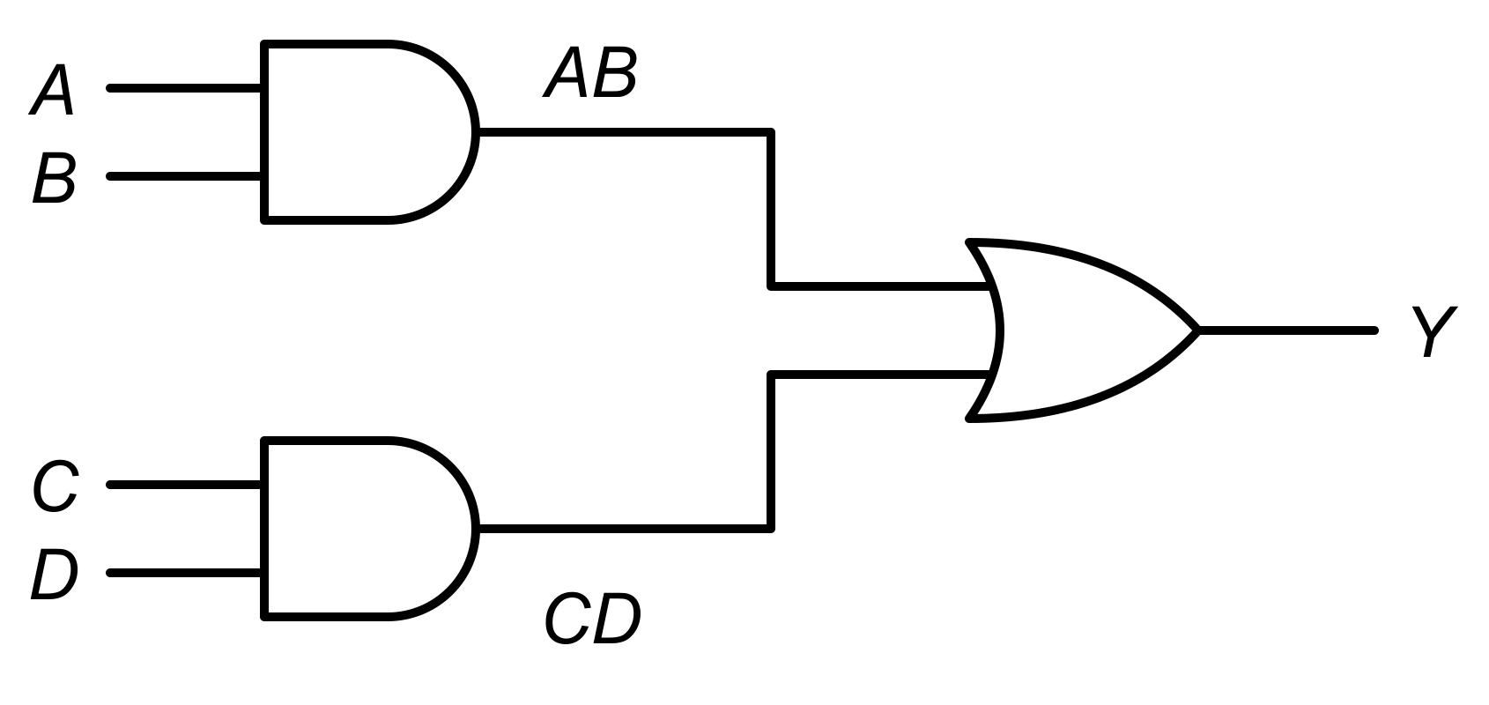
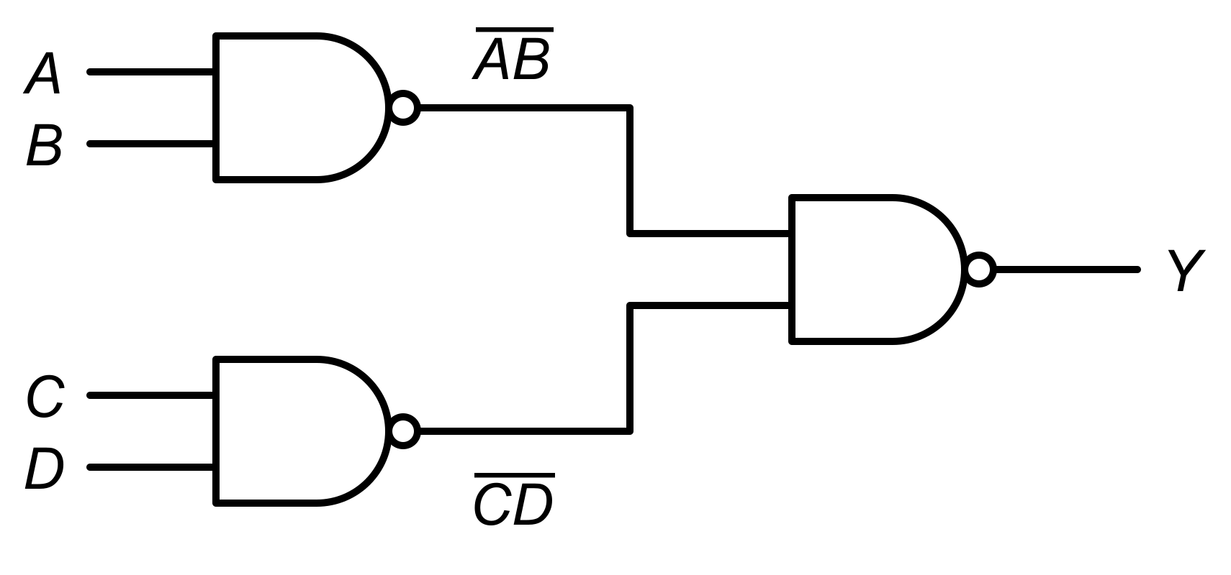
Any Boolean Function using only NAND
Every Boolean function can be written as a Sum of Products (SOP), so every function can be built from NAND:
1
Write it in SOP form — expand if needed, e.g. A(B + C) = AB + AC
2
Draw the AND–OR circuit — one AND per product term, one OR at the output.
3
Replace every gate with NAND — the AND–OR becomes NAND–NAND.
4
Complemented input? — make NOT A with a NAND whose inputs are tied.
5
Single-literal term? — a lone variable (like C) must enter the output NAND inverted.
AND–OR
NAND–NAND (same function!)
≡
CSE208 — Digital Logic Design Laboratory
20 / 40

Slide 21
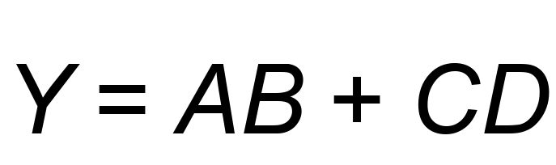
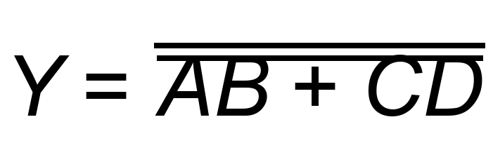
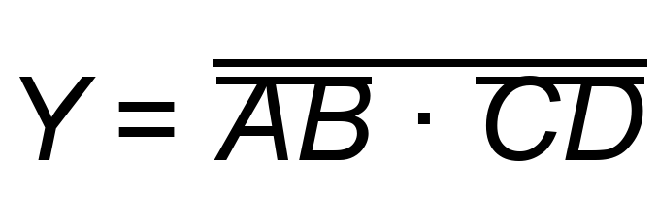
Example 1: Y = AB + CD using only NAND
Apply a double inversion, then De Morgan:
Each bar-term is a NAND gate → 3 NAND gates in total.
Key Idea
AND–OR (sum of products) circuit ⇒ replace every gate with NAND ⇒ NAND–NAND circuit.
CSE208 — Digital Logic Design Laboratory
21 / 40

Slide 22
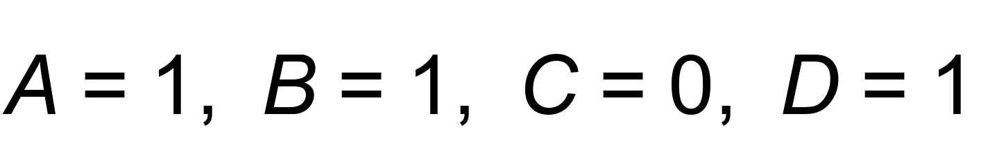
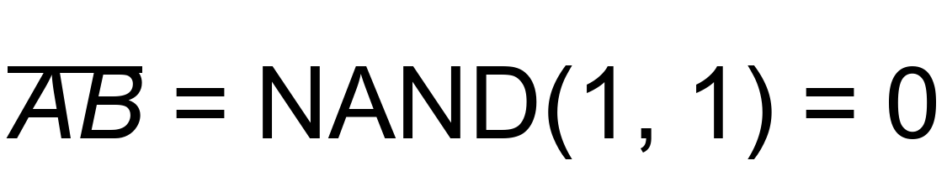
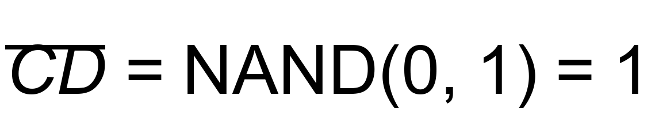
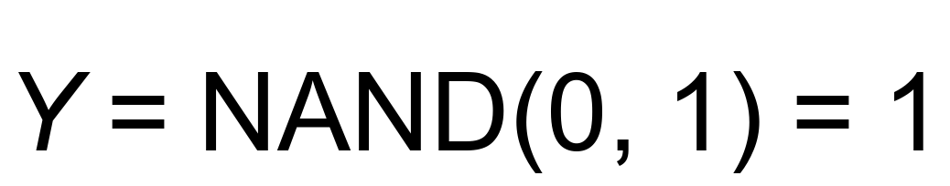

Let’s Verify Example 1
Suppose:
1
First NAND:
2
Second NAND:
3
Output NAND:
4
Direct:
Laboratory Skill
A 4-input circuit has 2⁴ = 16 rows — verify all of them in the lab.
CSE208 — Digital Logic Design Laboratory
22 / 40

Slide 23
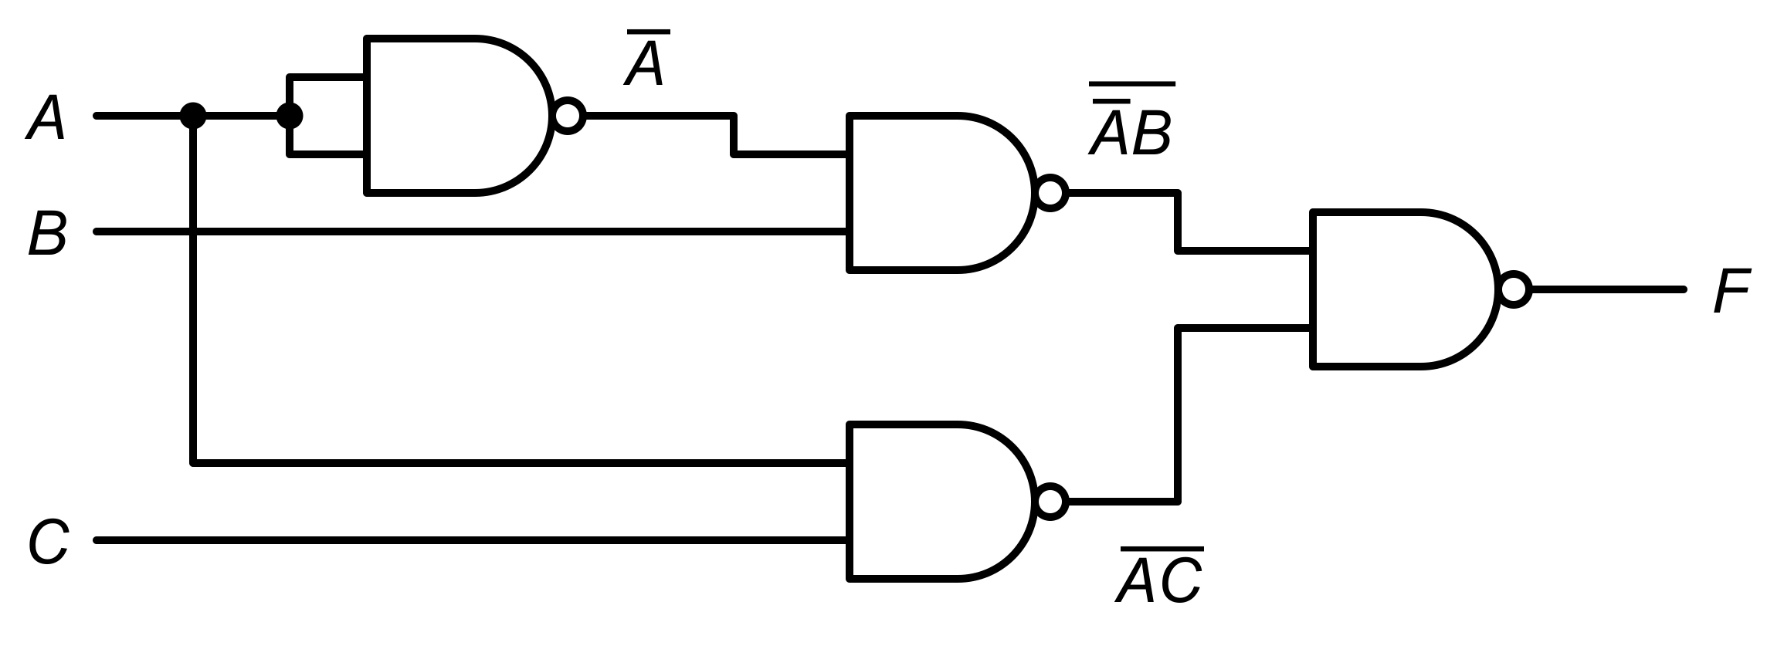
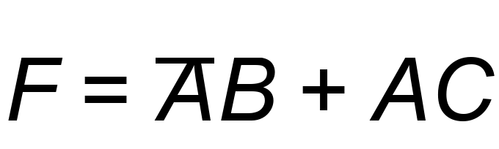
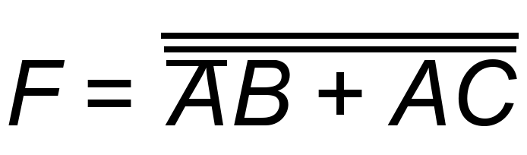
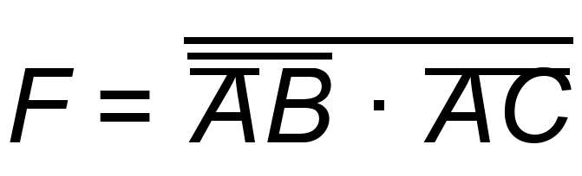
Example 2: A Complemented Input
Already in SOP form, but one term uses NOT A:
1
NOT A: NAND with tied inputs (1)
2
Product terms: two NANDs (2)
3
Output: one NAND (1)
Total: 4 NAND gates
Remember
Each complemented input costs one extra NAND (inputs tied together).
CSE208 — Digital Logic Design Laboratory
23 / 40

Slide 24
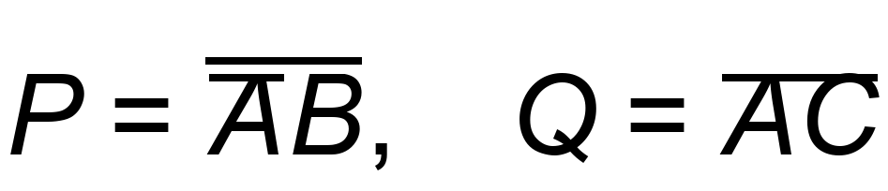









Let’s Verify Example 2
Suppose:
0
0
0
1
1
1
0
1
Inverter:
0
0
1
1
1
1
0
2
Gate P:
0
1
0
1
0
1
1
Gate Q:
0
1
1
1
0
1
1
3
1
0
0
0
1
1
0
4
Output:
1
0
1
0
1
0
1
5
Direct:
1
1
0
0
1
1
0
1
1
1
0
1
0
1
3 inputs → 2³ = 8 rows
CSE208 — Digital Logic Design Laboratory
24 / 40

Slide 25


Classwork: Implement using only NAND
Implement each function using ONLY NAND gates:
Problem 1
Problem 2
0
0
0
0
0
0
0
0
1
0
0
1
0
1
0
0
1
0
0
1
1
0
1
1
1
0
0
1
0
0
1
0
1
1
0
1
1
1
0
1
1
0
1
1
1
1
1
1
For each problem
1 Rewrite F in NAND-only form. 2 Draw the circuit. 3 Count the NAND gates. 4 Fill the truth table and verify in Logisim.
Watch for: the complemented input (NOT A), and the single-literal terms C and NOT C — a term that is just one variable.
Think
The two problems need a different number of gates. Why?
CSE208 — Digital Logic Design Laboratory
25 / 40

Slide 26







Classwork — Solution 1
1
NOT A:
2
Term:
0
0
0
0
3
NOT C:
0
0
1
1
Output:
0
1
0
1
4
0
1
1
1
Answer
1
0
0
0
4 NAND gates. C is a single-literal term — it has no first-level NAND, so nothing inverts it. Invert it yourself.
If the term were NOT C, you would wire C straight in: no extra gate.
1
0
1
1
1
1
0
0
1
1
1
1
CSE208 — Digital Logic Design Laboratory
26 / 40

Slide 27






Classwork — Solution 2
Two bars over C cancel, so C goes in directly.
0
0
0
1
1
Term:
0
0
1
0
0
1
0
1
2
Output:
0
1
1
0
1
0
0
1
Answer
1
0
1
0
Only 2 NAND gates. NOT C is a single-literal term that is already complemented — the two inversions cancel.
Compare with Problem 1, where C needed an extra NAND as an inverter.
1
1
0
1
1
1
1
1
CSE208 — Digital Logic Design Laboratory
27 / 40

Slide 28



Challenge: XOR using 4 NAND Gates
0
0
1
1
1
0
0
1
1
1
0
1
1
0
1
0
1
1
1
1
0
1
1
0
Your Task
Build it in the simulator and confirm the output is 1 only when the inputs are different.
CSE208 — Digital Logic Design Laboratory
28 / 40

Slide 29


Laboratory ICs: 7400 and 7402
7400 — Quad 2-input NAND
7402 — Quad 2-input NOR
Important
The pinouts are DIFFERENT! On the 7402 the output comes FIRST (pin 1 = 1Y). Pin 14 = VCC, pin 7 = GND on both.
CSE208 — Digital Logic Design Laboratory
29 / 40

Slide 30
Circuit Simulation
Using a Digital Logic Simulator
For example, in Logisim Evolution:
1
Create a new circuit.
2
Place input pins A and B.
3
Place ONLY NAND (or only NOR) gates.
4
Wire the universal-gate version.
5
Place an output pin / LED.
6
Try all input combinations.
7
Compare with the target gate’s truth table.
CSE208 — Digital Logic Design Laboratory
30 / 40

Slide 31
Common Laboratory Mistakes
1
Tied inputs: For NOT, BOTH inputs must go to A — not just one.
2
Floating inputs: Never leave a NAND / NOR input unconnected.
3
Wrong IC: 7400 is NAND, 7402 is NOR — check the chip label.
4
Pinout: The 7402 output is on pin 1, not pin 3.
5
Wrong order: For OR from NAND, invert the inputs, not the output.
6
Power: VCC to pin 14 and GND to pin 7.
Troubleshoot systematically — one gate at a time.
CSE208 — Digital Logic Design Laboratory
31 / 40

Slide 32
Quick Quiz #1
How many NAND gates are needed to build a NOT gate?
Hint: think about what happens when both inputs are the same.
CSE208 — Digital Logic Design Laboratory
32 / 40

Slide 33
Quick Quiz #1
How many NAND gates are needed to build a NOT gate?
Hint: think about what happens when both inputs are the same.
1
CSE208 — Digital Logic Design Laboratory
32 / 40

Slide 34


Quick Quiz #2
Both inputs of a NOR gate are connected to A.
If:
Then:
CSE208 — Digital Logic Design Laboratory
33 / 40

Slide 35
Quick Quiz #2
Both inputs of a NOR gate are connected to A.
If:
Then:
0
CSE208 — Digital Logic Design Laboratory
33 / 40

Slide 36
Quick Quiz #3
Which of these is a universal gate?
1
AND
2
OR
3
NAND
4
XOR
CSE208 — Digital Logic Design Laboratory
34 / 40

Slide 37
Quick Quiz #3
Which of these is a universal gate?
1
AND
2
OR
3
NAND
4
XOR
NAND
CSE208 — Digital Logic Design Laboratory
34 / 40

Slide 38
Quick Quiz #4
What is the minimum number of NAND gates
needed to build an OR gate?
Hint: invert A, invert B, then …
CSE208 — Digital Logic Design Laboratory
35 / 40

Slide 39
Quick Quiz #4
What is the minimum number of NAND gates
needed to build an OR gate?
Hint: invert A, invert B, then …
3
CSE208 — Digital Logic Design Laboratory
35 / 40

Slide 40


What Comes Next?
Class 03
Half Adder & Half Subtractor
We will use logic gates to construct arithmetic circuits. For a half adder:
Connection
XOR (4 NAND) + one more NAND as NOT gives a complete half adder from only 5 NAND gates!
CSE208 — Digital Logic Design Laboratory
36 / 40

Slide 41
Today’s Takeaways
1
A universal gate can implement any Boolean function.
2
NAND and NOR are the two universal gates.
3
NOT: tie both inputs of a NAND or NOR together.
4
Using NAND: AND = 2 gates, OR = 3 gates.
5
Using NOR: OR = 2 gates, AND = 3 gates.
6
De Morgan’s theorem links the NAND and NOR forms.
7
AND–OR circuits convert directly into NAND–NAND circuits.
CSE208 — Digital Logic Design Laboratory
37 / 40

Slide 42
Before You Leave
You should be able to answer:
1
What makes a gate “universal”?
2
How do you build a NOT gate from a NAND gate?
3
Why does OR need 3 NAND gates but only 2 NOR gates?
4
State both of De Morgan’s theorems.
5
How would you build Y = AB + CD using only NAND gates?
6
What is the difference between the 7400 and 7402 pinouts?
CSE208 — Digital Logic Design Laboratory
38 / 40

Slide 43
Lab Task — Experiment 02
Implementation of Basic Gates using Universal Gates
Construct and verify, using ONLY the given gate type:
Part A (NAND only)
Part B (NOR only)
Part C (NAND only)
NOT
NOT
Y = AB + CD
AND
OR
XOR (bonus)
OR
AND
Submit:
1
Circuit diagrams
4
Verification
2
Truth tables
5
Short conclusion
3
Experimental observations
CSE208 — Digital Logic Design Laboratory
39 / 40

Slide 44
One Gate Can Build Them All
NAND or NOR
Universal Gate → NOT, AND, OR → Any Digital Circuit
Let’s build everything from one gate!
CSE208 — Digital Logic Design Laboratory
40 / 40

