Slide 1

CSE208 · DIGITAL LOGIC DESIGN LABORATORY · CLASS 03
Adders: Half & Full
Adding bits with logic gates — the circuit at the heart of every processor
Munzer Mahmood
Lecturer, Department of Computer Science and Engineering
Presidency University

Slide 2
Recap · Class 02
Where We Are
Last class you learned
Last class
Universal gates: NAND and NOR
Gates → any Boolean function
NOT = 1 gate (tie the inputs together)
AND = 2 NAND, OR = 3 NAND
XOR = 4 NAND (the Challenge)
Any AND–OR circuit becomes NAND–NAND
Today
Gates → binary arithmetic
The three gates we need today: XOR, AND and OR.
CSE208 · Digital Logic Design Laboratory · Class 03
2
Notes:
Quick recap of universal gates. The three gates we actually need today are XOR, AND and OR.

Slide 3
Today's Learning Objectives
By the end of today's laboratory, you should be able to:
1
Apply the rules of binary addition, including the carry.
2
Define a half adder and derive its truth table.
3
Use minterms and the SOP method to derive its Sum and Carry.
4
Explain why a half adder is not enough for multi-bit addition.
5
Define a full adder and derive its Sum and Carry-out expressions.
6
Build a full adder using two half adders and an OR gate.
7
Verify adders using a simulator or the 7486, 7408 and 7432 ICs.
CSE208 · Digital Logic Design Laboratory · Class 03
3

Slide 4
Motivation
Why Do We Need Adders?
Addition is the most basic arithmetic operation inside every processor — almost everything else is built on top of it:
Subtraction
Multiplication
Counters & addresses
Add the 2's complement
Repeated, shifted addition
Add 1, or add an offset
Adder
ALU
CPU
Computer
Build a circuit that adds two single bits — then copy it to add numbers of any size.
Every arithmetic instruction a processor runs starts here.
CSE208 · Digital Logic Design Laboratory · Class 03
4
Notes:
The adder is the heart of the ALU. Subtraction is addition of the 2's complement; multiplication is repeated shifted addition.

Slide 5
The four cases
Binary Addition Rules
Adding two 1-bit numbers has only four cases:
0 + 0 = 0
0 + 1 = 1
1 + 0 = 1
1 + 1 = 10₂
Carry = 0
Carry = 0
Carry = 0
Carry = 1
Sum = 0
Sum = 1
Sum = 1
Sum = 0
Two outputs
Why 1 + 1 = 10
The result can need 2 bits: the right bit is the Sum (S), the left bit is the Carry (C).
In decimal 1 + 1 = 2, and 2 in binary is 10 — write 0, carry 1 to the next column.
Two inputs, two outputs — that is exactly a half adder.
CSE208 · Digital Logic Design Laboratory · Class 03
5
Notes:
Stress the fourth case: the result needs two bits. The right bit is the Sum, the left bit is the Carry.

Slide 6
Why one circuit is not enough
Adding Multi-bit Numbers
Carry
1
1
1
1
Rightmost column: A₀ + B₀ — only 2 bits, nothing carries in.
A
1
0
1
1
(11)
+ B
0
1
1
0
(6)
2
Every other column: A_{i} + B_{i} + carry-in — 3 bits.
Sum
1
0
0
0
1
(17)
3
Each column gives a Sum bit and a Carry into the next column.
3 bits in
2 bits in
2 inputs ⇒ Half Adder 3 inputs ⇒ Full Adder
One small circuit, repeated once per bit.
CSE208 · Digital Logic Design Laboratory · Class 03
6
Notes:
Work the example column by column on the board. The rightmost column has no carry-in; every other column has three inputs.

Slide 7
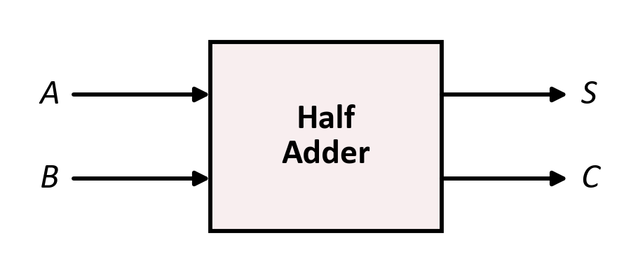
Topic 1 · Half adder
The Half Adder
Definition
A half adder is a combinational circuit that adds two 1-bit inputs, A and B, and produces two outputs: a Sum (S) and a Carry (C).
Inputs: A, B (2 bits)
Outputs: S (sum bit), C (carry bit)
Result: A + B = (C S)₂ — a 2-bit number
Why “half”?
It adds only two bits — there is no input for a carry coming from a previous column.
Every addition starts here: two bits in, two bits out.
CSE208 · Digital Logic Design Laboratory · Class 03
7

Slide 8


Topic 1 · Half adder
Half Adder — Truth Table
A
B
C
S
Look at column S
0
0
0
0
S = 1 when the inputs are different → XOR
0
1
0
1
1
0
0
1
1
1
1
0
Look at column C
C = 1 only when both inputs are 1 → AND
C S read together = A + B
Half adder = one XOR gate + one AND gate
Two gates. That is the whole circuit.
CSE208 · Digital Logic Design Laboratory · Class 03
8
Notes:
Read C and S together as a 2-bit binary number: it always equals A + B.

Slide 9
Vocabulary
Quick Note: What Is a Minterm?
Definition
A minterm is an AND term containing every input variable — it equals 1 for exactly one row of the truth table, and 0 for all the others.
A
B
Minterm
Symbol
The rule
0
0
A̅ B̅
m₀
variable is 1 → write it plain (A)
variable is 0 → write it complemented (A̅)
0
1
A̅ B
m₁
1
0
A B̅
m₂
1
1
A B
m₃
Why we need it
OR together the minterms of every row where the output is 1 — that is the SOP form.
Same idea as the theory lecture — here we apply it to the adder's Sum and Carry.
CSE208 · Digital Logic Design Laboratory · Class 03
9
Notes:
Bridge from the CSE207 theory lecture. A minterm is 1 for exactly one row, so ORing the minterms of the 1-rows reproduces the column.

Slide 10
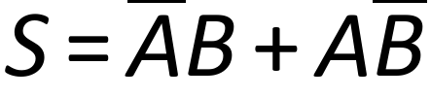

Technique · SOP
Deriving the Expressions
Use the Sum of Products (SOP) method:
S = 1 in rows 01 and 10
1
Write the minterm of every row where the output is 1.
2
OR those minterms together.
3
Simplify and recognise the gate.
C = 1 only in row 11
A̅B + AB̅ is exactly the XOR function — 1 when the inputs are different.
Recognising XOR saves four gates over the raw SOP circuit.
CSE208 · Digital Logic Design Laboratory · Class 03
10
Notes:
Show the SOP method here so students can reuse it for the full adder later.

Slide 11
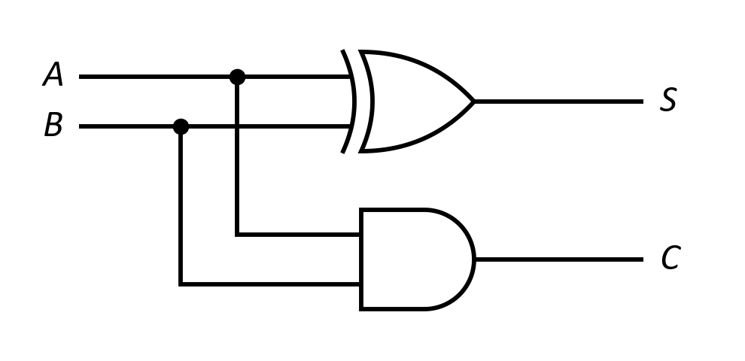
Topic 1 · Half adder
Half Adder — Logic Circuit
Boolean expressions
In the laboratory
One gate of the 7486 (XOR) and one gate of the 7408 (AND). A and B go to both gates.
Gates used: 1 XOR + 1 AND.
CSE208 · Digital Logic Design Laboratory · Class 03
11

Slide 12

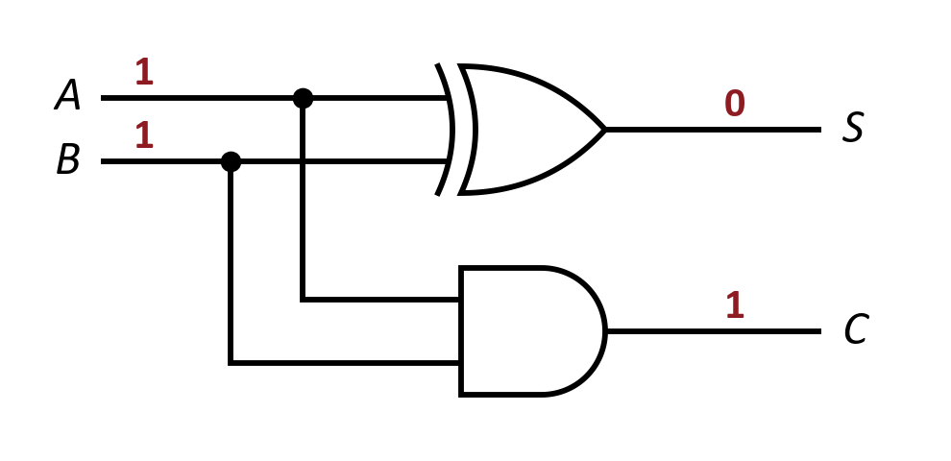


Worked example
Let's Trace It: Half Adder
Given the half adder circuit, suppose:
1
XOR:
2
AND:
3
Check:
Try it yourself
Repeat the trace for A = 0, B = 1. What are S and C?
CSE208 · Digital Logic Design Laboratory · Class 03
12

Slide 13
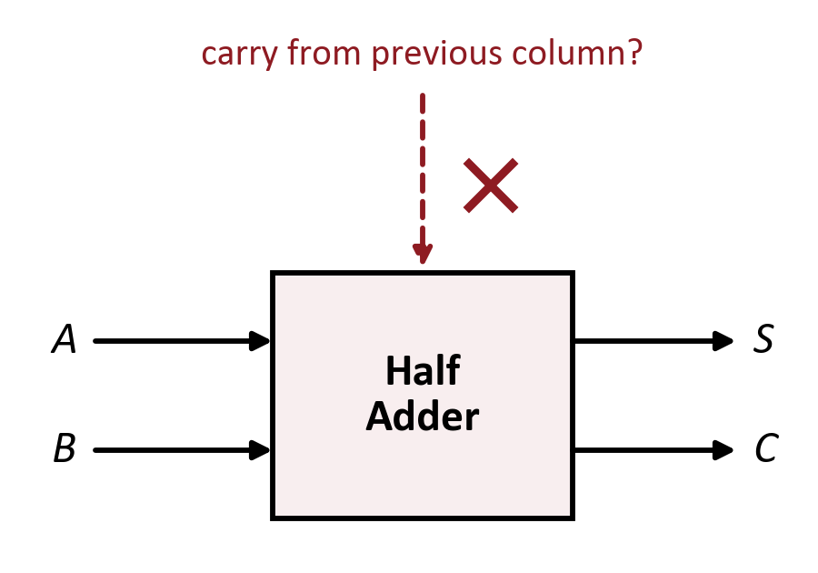
Topic 1 · Half adder
Limitation of the Half Adder
A half adder has only 2 inputs.
From the 2nd column on we must add 3 bits: A_{i}, B_{i} and the carry-in.
So it works only for the least significant bit.
Add a third input for the incoming carry → the Full Adder
One missing wire is the whole difference.
CSE208 · Digital Logic Design Laboratory · Class 03
13
Notes:
Go back to the column example: from the second column on, we must add three bits.

Slide 14
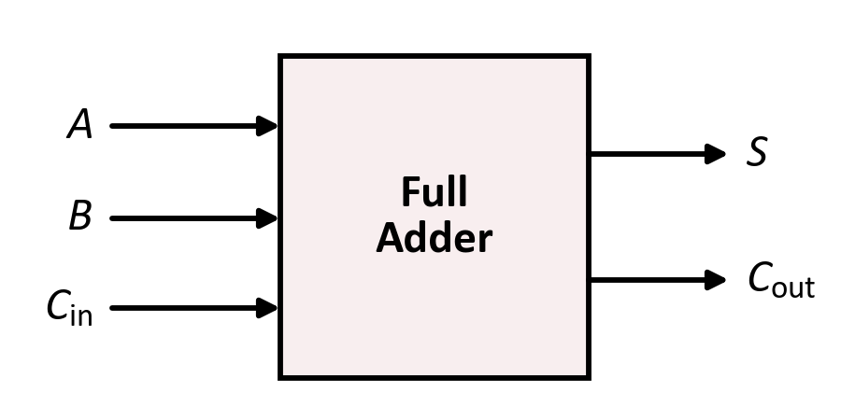
Topic 2 · Full adder
The Full Adder
Definition
A full adder adds three 1-bit inputs — A, B and a carry-in (C_{in}) — and produces a Sum (S) and a carry-out (C_{out}).
Inputs: A, B, C_{in} (3 bits)
Outputs: S, C_{out}
Largest result: 1 + 1 + 1 = 3 = 11₂ — still 2 bits
The chain
The C_{out} of one column becomes the C_{in} of the next column.
Three bits in, two bits out — enough for every column.
CSE208 · Digital Logic Design Laboratory · Class 03
14

Slide 15
Topic 2 · Full adder
Full Adder — Truth Table
A
B
C_{in}
Total
C_{out}
S
Look at column S
0
0
0
0
0
0
S = 1 when an odd number of inputs are 1.
0
0
1
1
0
1
0
1
0
1
0
1
0
1
1
2
1
0
Look at column C_{out}
1
0
0
1
0
1
C_{out} = 1 when two or more inputs are 1 (a majority).
1
0
1
2
1
0
1
1
0
2
1
0
S = Σm(1, 2, 4, 7)
C_{out} = Σm(3, 5, 6, 7)
1
1
1
3
1
1
Total = A + B + C_{in} written in decimal
Eight rows — verify every one of them in the lab.
CSE208 · Digital Logic Design Laboratory · Class 03
15
Notes:
Count the 1s in each row: an odd count gives S = 1, two or more gives Cout = 1.

Slide 16
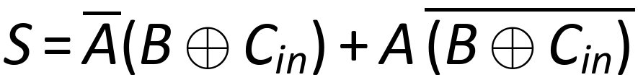

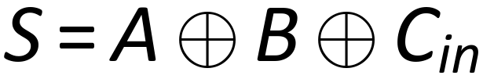
Topic 2 · Full adder
Full Adder — Deriving the Sum
minterms 1, 2, 4, 7
group by A
XOR and XNOR
the XOR pattern again
The Sum is a 3-input XOR — 1 when an odd number of inputs are 1.
No K-map needed — the pattern gives the answer directly.
CSE208 · Digital Logic Design Laboratory · Class 03
16
Notes:
Group by A: the bracket for A-bar is B XOR Cin, and the bracket for A is its complement, XNOR.

Slide 17
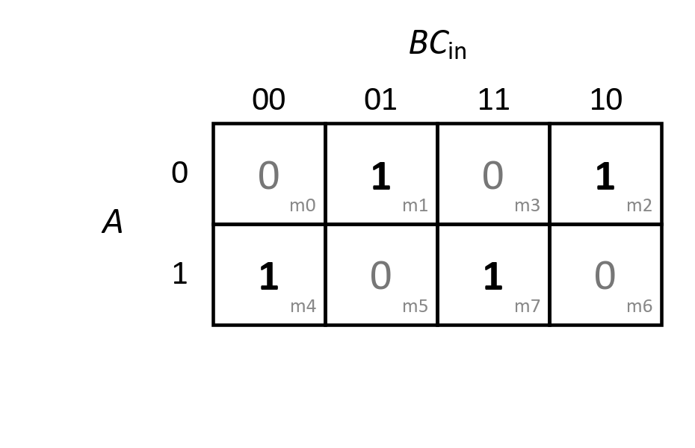
Topic 2 · K-map
Can We Simplify S?
The 1s form a checkerboard — no two 1s are adjacent.
No group of 2 or 4 is possible, so the SOP cannot be simplified.
Four 3-literal terms would need many gates → use XOR instead.
A checkerboard K-map is the signature of an XOR function.
Sometimes the K-map's answer is “leave it alone”.
CSE208 · Digital Logic Design Laboratory · Class 03
17

Slide 18
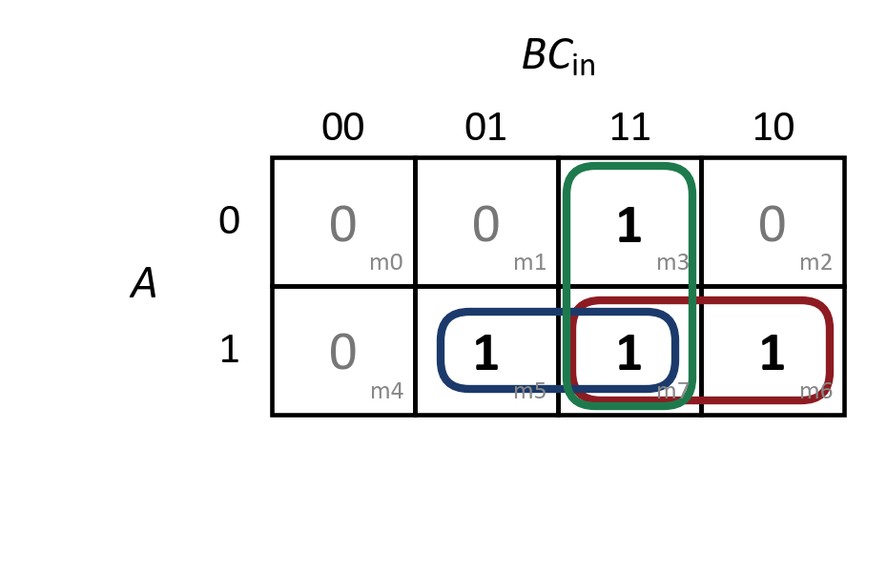
Topic 2 · K-map
Deriving C_{out} with a K-map
m6, m7
→
AB
m5, m7
→
AC_{in}
m3, m7
→
BC_{in}
C_{out} = AB + AC_{in} + BC_{in}
Note
m7 belongs to all three groups — overlapping groups are allowed in a K-map.
CSE208 · Digital Logic Design Laboratory · Class 03
18
Notes:
m7 is shared by all three groups, which is allowed. Each pair of cells eliminates one variable.

Slide 19



Topic 2 · Full adder
Another Form of C_{out}
minterms 3, 5, 6, 7
group the terms
complement law
Form 1 (from the K-map)
Form 2 (reuse the XOR)
3 AND + 1 three-input OR
2 AND + 1 OR
A ⊕ B is already built for the Sum — so reuse it and save a gate.
CSE208 · Digital Logic Design Laboratory · Class 03
19
Notes:
This second form reuses A XOR B from the Sum, which leads directly to the two-half-adder design.

Slide 20
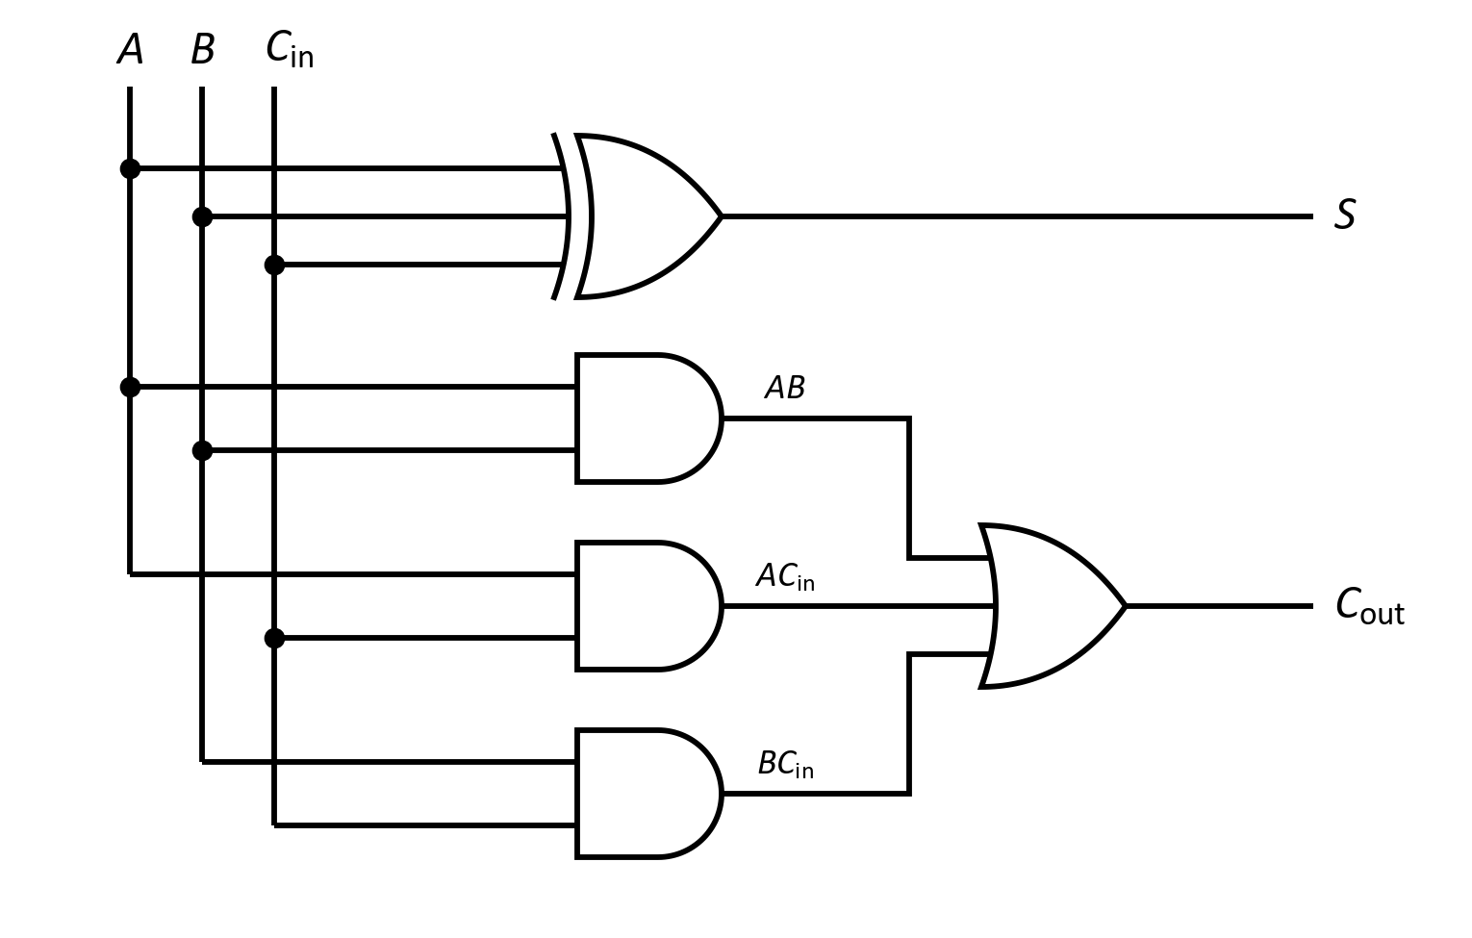


Topic 2 · Full adder
Full Adder — Logic Circuit (SOP Form)
Boolean expressions
In the laboratory
Make a 3-input XOR from two 2-input XOR gates.
Gates used: 2 XOR + 3 AND + 1 three-input OR.
CSE208 · Digital Logic Design Laboratory · Class 03
20

Slide 21
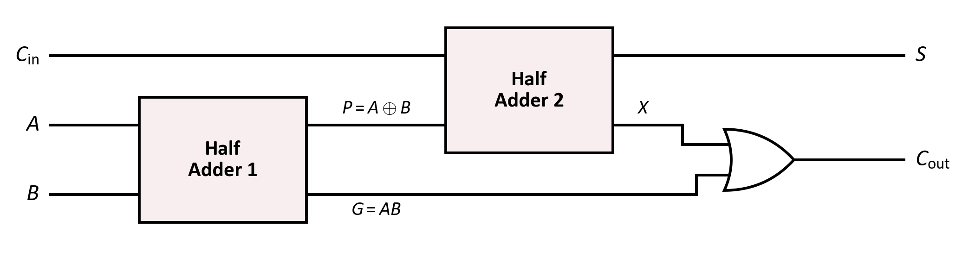
Topic 2 · Full adder
Full Adder from Two Half Adders
1
Half Adder 1 adds A and B → P = A ⊕ B, G = AB
2
Half Adder 2 adds P and C_{in} → S = P ⊕ C_{in}, X = P·C_{in}
3
OR gate combines the two carries → C_{out} = G + X
Full Adder = 2 Half Adders + 1 OR gate
CSE208 · Digital Logic Design Laboratory · Class 03
21
Notes:
G and X can never both be 1, so a plain OR is enough to combine the two carries.

Slide 22
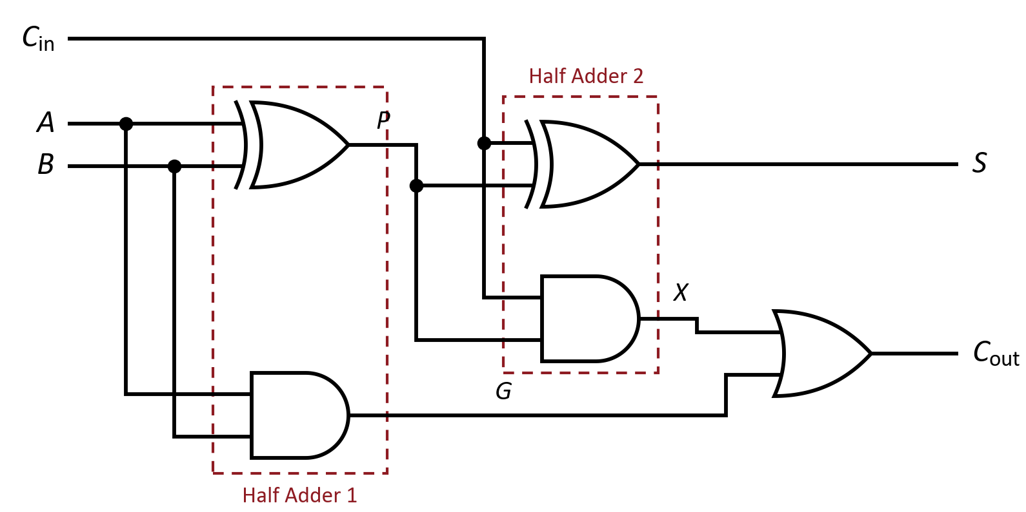




Topic 2 · Full adder
Full Adder — Gate-Level Circuit
Gates used: 2 XOR + 2 AND + 1 OR
Think
Can G and X both be 1 at the same time? (No — so the OR never has to add two carries.)
CSE208 · Digital Logic Design Laboratory · Class 03
22

Slide 23

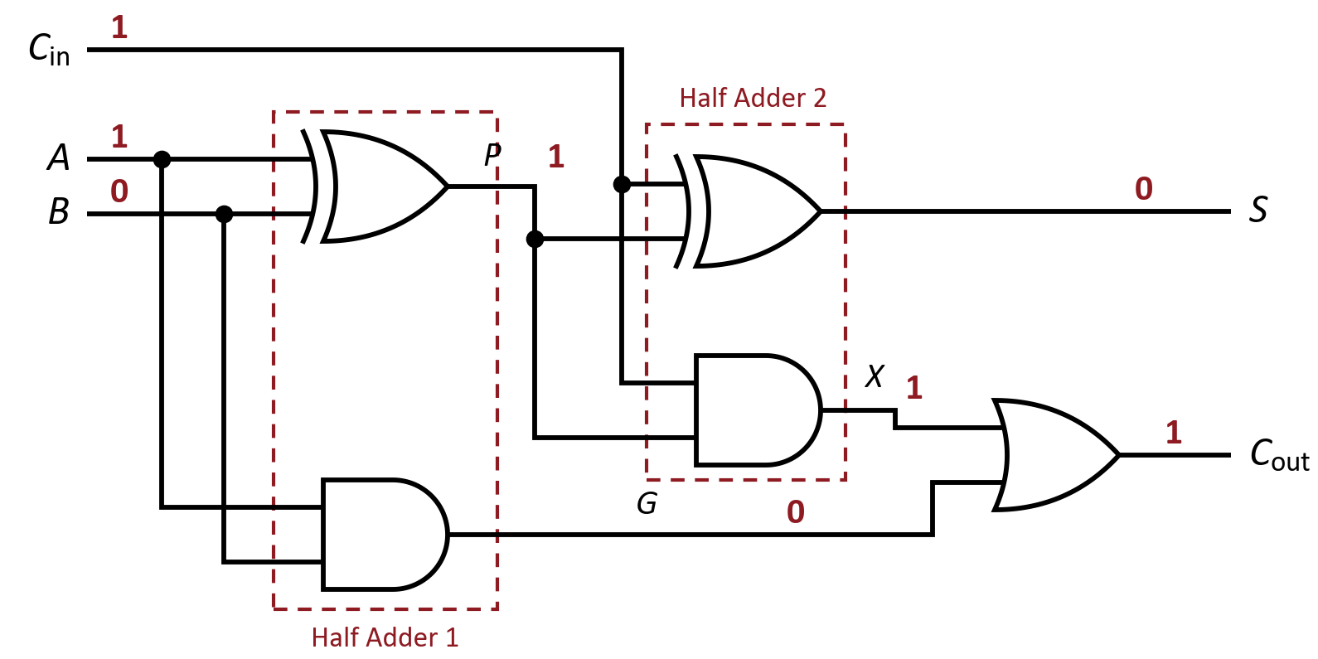


Worked example
Let's Trace It: Full Adder
Suppose:
1
HA 1:
2
HA 2:
3
OR:
4
Check:
Try it yourself
Trace A = 1, B = 1, C_{in} = 1. What are S and C_{out}?
CSE208 · Digital Logic Design Laboratory · Class 03
23

Slide 24
Summary
Half Adder vs Full Adder
Feature
Half Adder
Full Adder
Inputs
2 (A, B)
3 (A, B, C_{in})
Outputs
S, C
S, C_{out}
Sum
A ⊕ B
A ⊕ B ⊕ C_{in}
Carry
AB
AB + C_{in}(A ⊕ B)
Basic gates
1 XOR + 1 AND
2 XOR + 2 AND + 1 OR
Used for
The LSB only
Every bit position
A full adder with C_{in} = 0 behaves exactly like a half adder.
CSE208 · Digital Logic Design Laboratory · Class 03
24

Slide 25
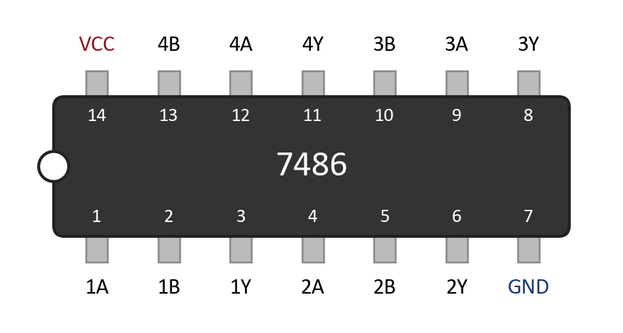


In the lab
Laboratory ICs: 7486, 7408 and 7432
7486
7408
7432
Quad 2-input XOR
Quad 2-input AND
Quad 2-input OR
Important
All three share the 7400 pinout: pin 14 = VCC, pin 7 = GND. They look identical — always read the chip label!
Bonus: the 7483 holds four full adders — a complete 4-bit adder — in one chip.
CSE208 · Digital Logic Design Laboratory · Class 03
25

Slide 26
Logisim Evolution
Circuit Simulation
Build the half adder once, then reuse it as a sub-circuit — twice.
1
Create a circuit named HalfAdder.
2
Place inputs A, B and outputs S, C.
3
Wire one XOR and one AND; test all 4 rows.
4
Create a second circuit, FullAdder.
One block, used twice
5
Place two HalfAdder sub-circuits and one OR.
6
Test all 8 input combinations.
7
Compare with the truth table.
A sub-circuit in the simulator is the same idea as one IC on the breadboard.
CSE208 · Digital Logic Design Laboratory · Class 03
26

Slide 27
Quiz
Quick Check #1
How many inputs and outputs does a half adder have?
Hint: which bits does it add, and what does it produce?
CSE208 · Digital Logic Design Laboratory · Class 03
27

Slide 28
Quiz
Quick Check #1
How many inputs and outputs does a half adder have?
Hint: which bits does it add, and what does it produce?
2 in, 2 out
CSE208 · Digital Logic Design Laboratory · Class 03
27

Slide 29
Quiz
Quick Check #2
A full adder has A = 1, B = 1, C_{in} = 1. What are S and C_{out}?
Hint: count the 1s — 1 + 1 + 1 = ?
CSE208 · Digital Logic Design Laboratory · Class 03
28

Slide 30
Quiz
Quick Check #2
A full adder has A = 1, B = 1, C_{in} = 1. What are S and C_{out}?
Hint: count the 1s — 1 + 1 + 1 = ?
S = 1, C_{out} = 1
CSE208 · Digital Logic Design Laboratory · Class 03
28

Slide 31
Quiz
Quick Check #3
Which gate produces the Sum output of a half adder?
AND
OR
1
2
XOR
NAND
3
4
CSE208 · Digital Logic Design Laboratory · Class 03
29

Slide 32
Quiz
Quick Check #3
Which gate produces the Sum output of a half adder?
AND
OR
1
2
XOR
NAND
3
4
XOR
CSE208 · Digital Logic Design Laboratory · Class 03
29

Slide 33
Quiz
Quick Check #4
How many half adders (plus one OR gate) make a full adder?
Hint: one for A + B, then one for the carry-in …
CSE208 · Digital Logic Design Laboratory · Class 03
30

Slide 34
Quiz
Quick Check #4
How many half adders (plus one OR gate) make a full adder?
Hint: one for A + B, then one for the carry-in …
2
CSE208 · Digital Logic Design Laboratory · Class 03
30

Slide 35

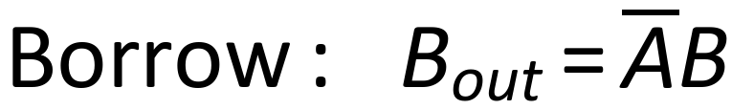
Class 04
What Comes Next?
Next class
Half Subtractor & Full Subtractor — the same ideas, applied to subtraction.
For a half subtractor (A − B):
The Difference is the same XOR as the Sum — only the borrow expression changes.
CSE208 · Digital Logic Design Laboratory · Class 03
31

Slide 36
Summary
Today's Takeaways
1
Binary addition: 1 + 1 = 10₂ → Sum 0, Carry 1.
2
Half adder adds 2 bits: S = A ⊕ B, C = AB.
3
A half adder has no carry-in, so it fits only the LSB.
4
Full adder adds 3 bits (A, B, C_{in}) and gives S and C_{out}.
5
S = A ⊕ B ⊕ C_{in} — 1 when an odd number of inputs are 1.
6
C_{out} = AB + AC_{in} + BC_{in} = AB + C_{in}(A ⊕ B).
7
Full adder = 2 half adders + 1 OR; chain them for n bits.
CSE208 · Digital Logic Design Laboratory · Class 03
32

Slide 37
Self-check
Before You Leave
You should be able to answer:
What is the difference between a half adder and a full adder?
Why is an XOR gate used for the Sum output?
1
2
Write the complete truth table of a full adder.
Derive C_{out} using a K-map.
3
4
How do you build a full adder from two half adders?
Which ICs do you need to build a full adder in the lab?
5
6
CSE208 · Digital Logic Design Laboratory · Class 03
33

Slide 38
Assessment
Lab Task — Experiment 03
Implementation of Half Adder and Full Adder
Construct the following circuits and verify every row of the truth table.
Part A — Half Adder
Part B — Full Adder
One XOR gate + one AND gate
Two half adders + one OR gate
ICs: 7486, 7408
ICs: 7486, 7408, 7432
Verify all 4 rows
Verify all 8 rows
Submit:
1
Circuit diagrams
2
Truth tables
3
Boolean expressions & K-maps
4
Experimental observations
5
Short conclusion
CSE208 · Digital Logic Design Laboratory · Class 03
34

Slide 39
Every Sum Starts with One Bit
1
Half adder — 2 bits in, Sum and Carry out
NEXT CLASS
Subtractors
2
Full adder — 3 bits in, adds the carry from the last column
Half and full subtractors — the same XOR, a different borrow.
3
Two half adders + OR — the standard full adder
4
Chain them — an n-bit adder, then an ALU, then a processor
Questions?

