Slide 1

CSE207 · DIGITAL LOGIC DESIGN · LECTURE 01
Welcome to the World of 0s and 1s
Switching circuits, truth tables, logic gates, Boolean algebra and simplification
Munzer Mahmood
Lecturer, Department of Computer Science and Engineering
Presidency University
Notes:
Welcome students. Today we start from the very bottom: how a simple switch becomes a 0 or a 1, and how we describe and simplify circuits built from them.

Slide 2
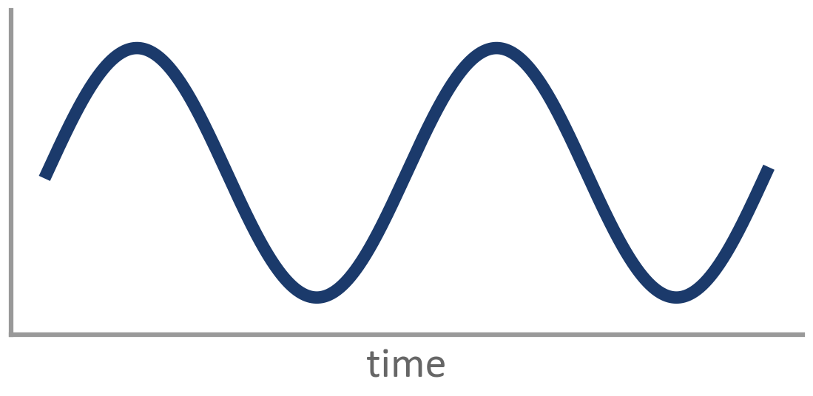
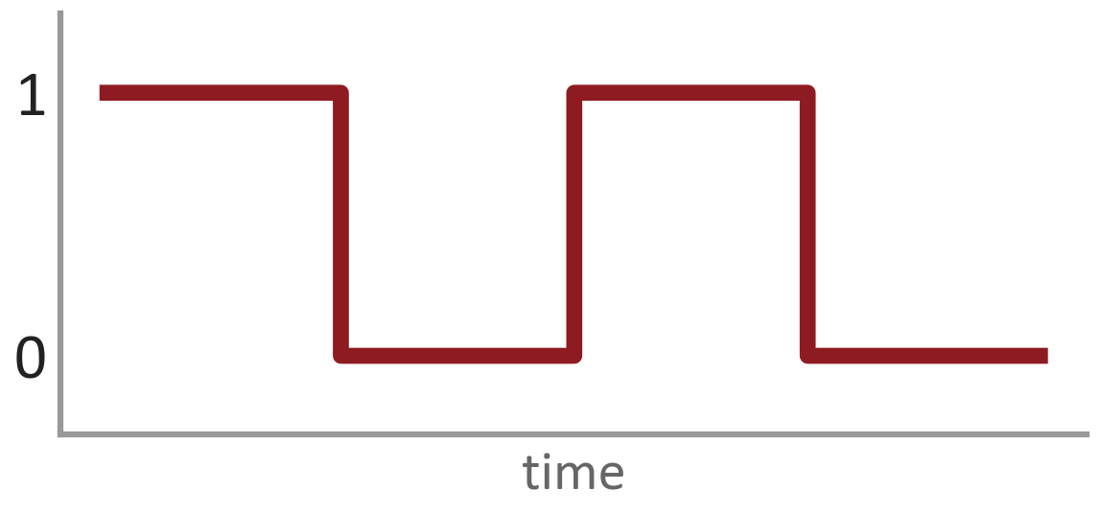
What is Digital Logic Design?
Digital Logic Design is about building circuits that work with only two values:
0 and 1
Analog Any value in a range, like a dimmer knob
You'll find digital logic inside:
Computers and smartphones
Calculators and digital watches
Traffic lights and elevators
Washing machines and microwaves
Digital Only 0 or 1, like a light switch
CSE207 · Digital Logic Design · Lecture 01
2
Notes:
Analog signals can take any value in a range (a dimmer). Digital signals take only two values (a light switch). Digital is used because two values are easy to tell apart even with noise, and easy to build with transistors.

Slide 3
Today's Roadmap
1
2
3
4
5
Switching Circuits
Truth Tables
Logic Gates
Boolean Algebra
Simplification
How a simple switch stands for a 0 or a 1
Writing down every possible input and its output
AND, OR, NOT and their friends
The math rules for 0 and 1
Making circuits smaller and cheaper
Each topic builds on the one before it.
CSE207 · Digital Logic Design · Lecture 01
3
Notes:
Five topics. Each one uses the one before it.

Slide 4
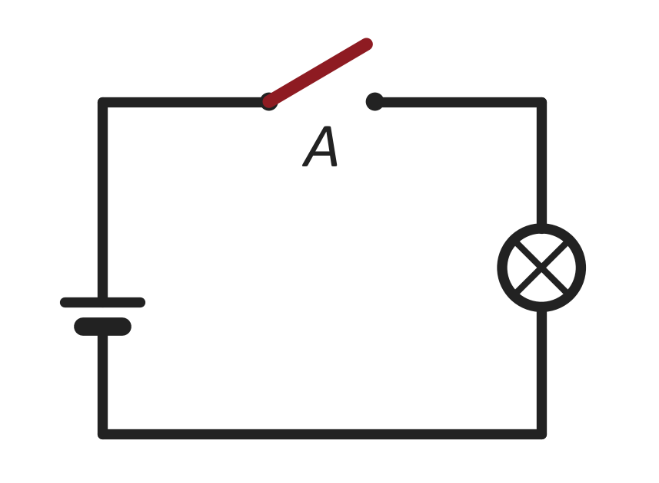
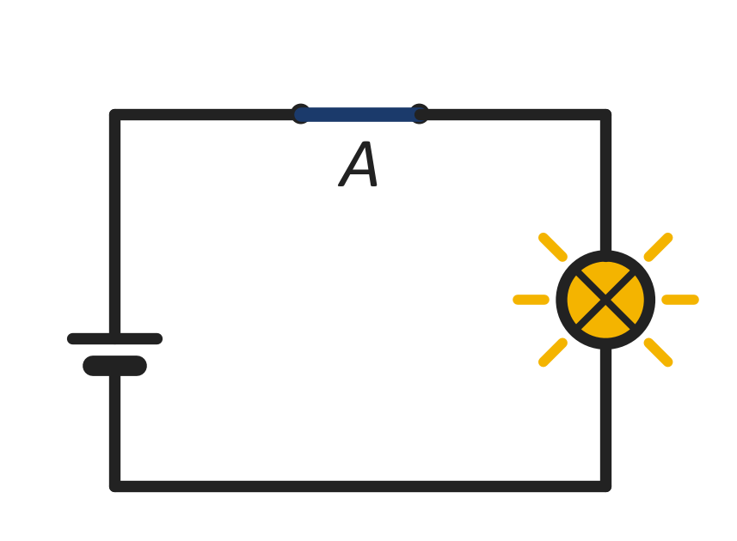
Topic 1 of 5 · Switching Circuits
1
A Switch Is a Bit
The simplest digital circuit is a battery, a switch and a lamp.
Switch OPEN → 0
No current flows · Lamp OFF
Switch CLOSED → 1
Current flows · Lamp ON
Inside every chip are billions of tiny switches called transistors, each one ON (1) or OFF (0).
CSE207 · Digital Logic Design · Lecture 01
4
Notes:
Simplest digital circuit: battery, switch, lamp. Open switch means no current, lamp off, we call it 0. Closed switch means current flows, lamp on, we call it 1. A transistor is just an electronic switch.

Slide 5
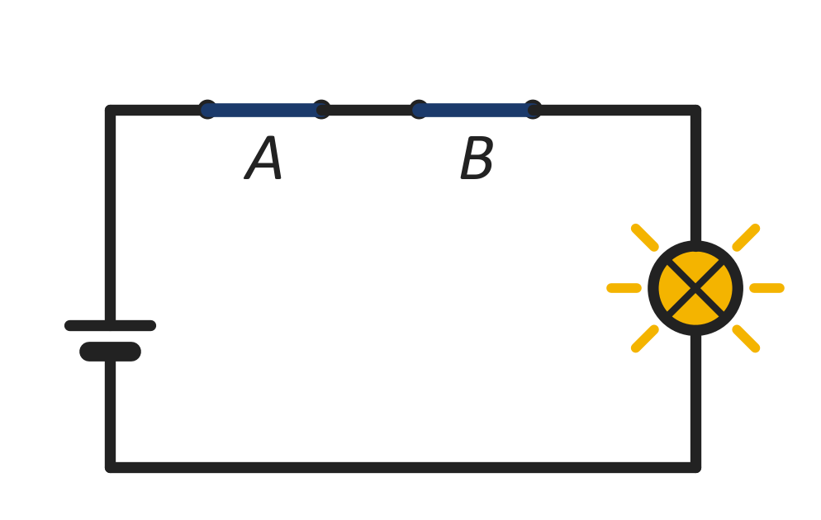
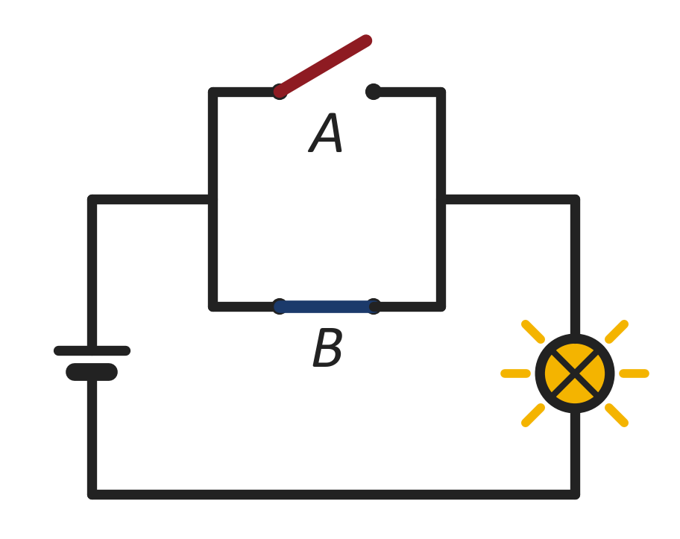
Topic 1 of 5 · Switching Circuits
1
Series = AND, Parallel = OR
Series connection
Parallel connection
Lamp is ON only if A AND B are both closed
Lamp is ON if A OR B (or both) is closed
Y = A · B
Y = A + B
CSE207 · Digital Logic Design · Lecture 01
5
Notes:
Series: current must pass through A and then B, so both must be closed. That is AND. Parallel: current can take either path, so one closed switch is enough. That is OR. In the picture, the parallel circuit has A open and B closed, and the lamp is still on.

Slide 6
Topic 2 of 5 · Truth Tables
2
Truth Table: List Every Possible Case
A truth table shows the output for every combination of inputs. Nothing is left out.
Example: the series (AND) circuit
A | B | Lamp Y
0 | 0 | 0
0 | 1 | 0
1 | 0 | 0
1 | 1 | 1
2
rows
1 input
4
rows
2 inputs
8
rows
3 inputs
Rule: n inputs → 2^{n} rows
The lamp is ON (1) only in the last row, when both switches are closed.
CSE207 · Digital Logic Design · Lecture 01
6
Notes:
A truth table has one row for every input combination. Each input can be 0 or 1, so every new input doubles the rows: 2, 4, 8, 16. Example: the series (AND) circuit.

Slide 7
Topic 2 of 5 · Truth Tables
2
Writing a Truth Table Without Missing a Row
Row | A | B | C
0 | 0 | 0 | 0
1 | 0 | 0 | 1
2 | 0 | 1 | 0
3 | 0 | 1 | 1
4 | 1 | 0 | 0
5 | 1 | 0 | 1
6 | 1 | 1 | 0
7 | 1 | 1 | 1
1
Count the rows: 3 inputs → 2³ = 8 rows
2
Column C (last): flip every row → 0 1 0 1 …
3
Column B: flip every 2 rows → 0 0 1 1 …
4
Column A (first): flip every 4 rows → 0000 1111
Shortcut: the rows are just 0 to 7 counted in binary!
CSE207 · Digital Logic Design · Lecture 01
7
Notes:
Trick for filling inputs: the last column flips every row, the next every 2 rows, the first every 4 rows. It is the same as counting 0 to 7 in binary.

Slide 8
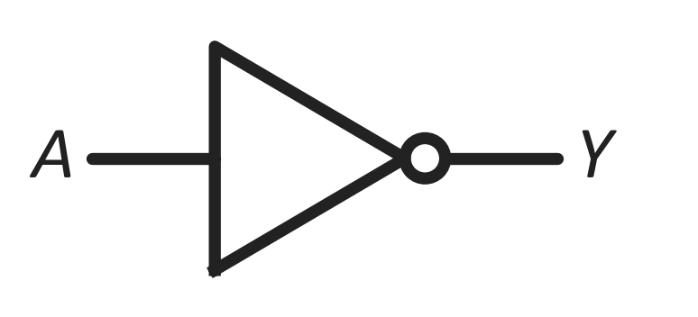
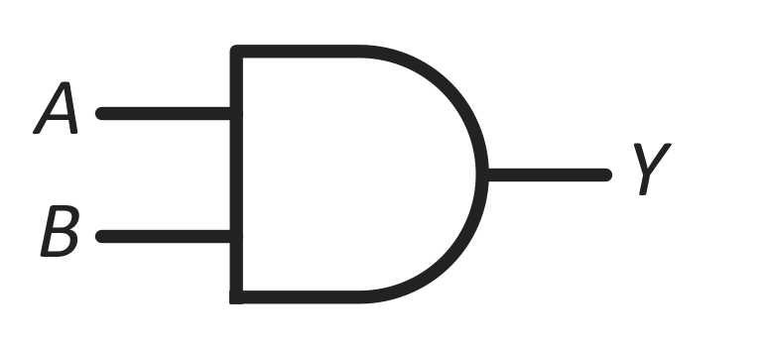
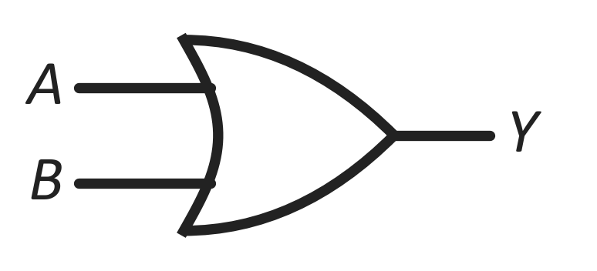
Topic 3 of 5 · Logic Gates
3
Logic Gates: The Basic Three
A logic gate is a tiny circuit: it takes 0/1 inputs and gives one 0/1 output.
NOT Y = A'
Flips the input
AND Y = A · B
1 only when ALL inputs are 1
OR Y = A + B
1 when ANY input is 1
A | Y
0 | 1
1 | 0
A | B | Y
0 | 0 | 0
0 | 1 | 0
1 | 0 | 0
1 | 1 | 1
A | B | Y
0 | 0 | 0
0 | 1 | 1
1 | 0 | 1
1 | 1 | 1
CSE207 · Digital Logic Design · Lecture 01
8
Notes:
A logic gate is a small circuit that follows one fixed rule. AND = all inputs must be 1. OR = at least one input is 1. NOT = flips the input.

Slide 9
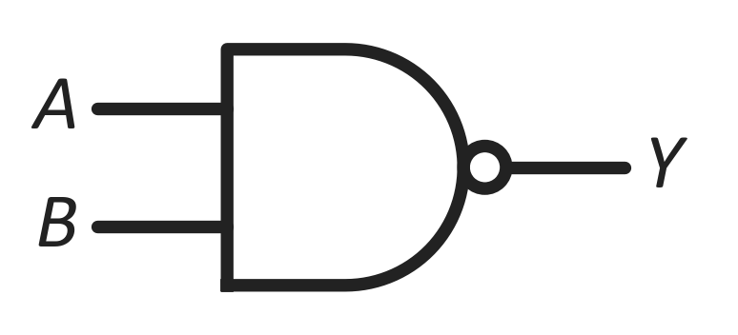
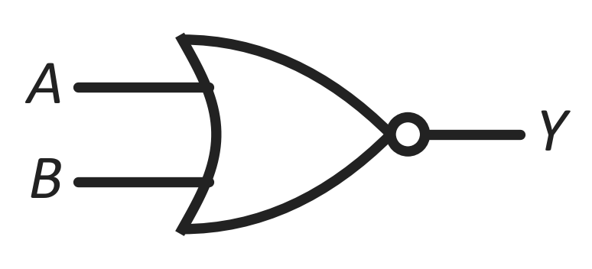
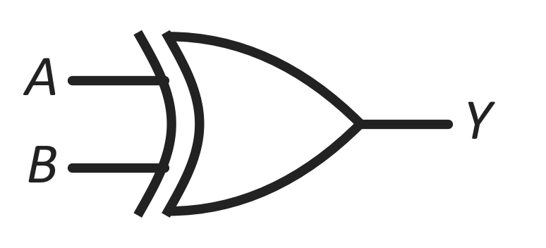
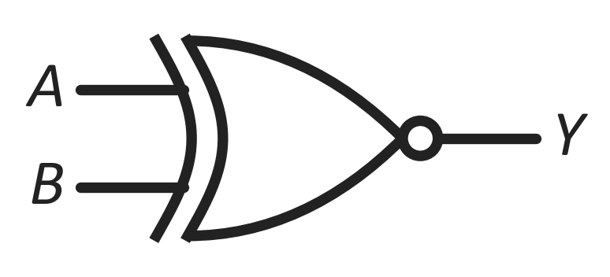
Topic 3 of 5 · Logic Gates
3
Four More Gates You'll Use Often
NAND Y = (A · B)'
AND + NOT. Output is 0 only when both inputs are 1.
Outputs (00, 01, 10, 11): 1 1 1 0
NOR Y = (A + B)'
OR + NOT. Output is 1 only when both inputs are 0.
Outputs (00, 01, 10, 11): 1 0 0 0
XOR Y = A ⊕ B
Output is 1 when the inputs are different.
Outputs (00, 01, 10, 11): 0 1 1 0
XNOR Y = (A ⊕ B)'
Output is 1 when the inputs are the same.
Outputs (00, 01, 10, 11): 1 0 0 1
CSE207 · Digital Logic Design · Lecture 01
9
Notes:
NAND is AND followed by NOT; NOR is OR followed by NOT (the small bubble means NOT). XOR: inputs different gives 1. XNOR: inputs same gives 1. Output strings are for inputs 00, 01, 10, 11.

Slide 10
Topic 3 of 5 · Logic Gates
3
NAND & NOR: The Universal Gates
A universal gate can build ANY other gate using only copies of itself.
Building the basic gates
Gate | Only NAND | Only NOR
NOT A | (A · A)' | (A + A)'
A · B | ((A · B)')' | (A' + B')'
A + B | (A' · B')' | ((A + B)')'
Why only these two?
AND and OR can't flip a value (no NOT)
NOT can't combine two inputs
NAND and NOR do both: combine AND flip
Example: to get NOT from a NAND, connect A to both of its inputs.
Any ' inside the table is itself made from the same gate.
XOR is not universal. It can't build AND or OR.
CSE207 · Digital Logic Design · Lecture 01
10
Notes:
Universal means you can build NOT, AND and OR, and so every circuit, using only that one gate type. NOT from NAND: tie both inputs together, (A·A)' = A'. AND from NAND: a NAND followed by a NAND-made NOT. OR from NAND: invert both inputs first, (A'·B')' = A + B by De Morgan. NOR is the mirror image. XOR is not universal: it can make NOT but never AND or OR.

Slide 11
Topic 4 of 5 · Boolean Algebra
4
Boolean Algebra: Math with 0 and 1
Every variable is either 0 or 1. There are only three operations:
A · B
AND (like ×)
1 · 1 = 1, everything else is 0
A + B
OR (like +)
0 + 0 = 0, everything else is 1
Careful: 1 + 1 = 1, not 2!
A'
NOT (complement)
0' = 1 and 1' = 0 (also written Ā)
Order of operations
NOT → AND → OR
(just like × before +)
Example: Y = A'·B + C with A = 0, B = 1, C = 0
Y = 1 · 1 + 0 = 1 + 0 = 1
CSE207 · Digital Logic Design · Lecture 01
11
Notes:
Boolean algebra is ordinary-looking algebra where every variable is 0 or 1. Important difference: in OR, 1 + 1 = 1, not 2. Precedence: NOT first, then AND, then OR.

Slide 12
Topic 4 of 5 · Boolean Algebra
4
Basic Laws of Boolean Algebra
Law | OR form | AND form
Identity | A + 0 = A | A · 1 = A
Null | A + 1 = 1 | A · 0 = 0
Idempotent | A + A = A | A · A = A
Complement | A + A' = 1 | A · A' = 0
Involution | (A')' = A
Commutative | A + B = B + A | A · B = B · A
Associative | A + (B + C) = (A + B) + C | A(BC) = (AB)C
Distributive | A + BC = (A + B)(A + C) | A(B + C) = AB + AC
Absorption | A + AB = A | A(A + B) = A
Check any law
Put A = 0, then A = 1. If both sides always match, the law is true.
Duality
Swap + with · and 0 with 1 to get each law's partner.
A + 0 = A ↔ A · 1 = A
CSE207 · Digital Logic Design · Lecture 01
12
Notes:
Most laws come in pairs: an OR form and an AND form. Note the second distributive law, A + BC = (A + B)(A + C), which is NOT true in normal math but is true in Boolean algebra. Students can check any law by trying A = 0 and A = 1.

Slide 13
Topic 4 of 5 · Boolean Algebra
4
De Morgan's Theorem
(A + B)' = A' · B'
NOT of an OR = AND of the NOTs
(A · B)' = A' + B'
NOT of an AND = OR of the NOTs
Proof with a truth table: (A · B)' = A' + B'
Memory trick
Break the bar, change the sign.
Put the NOT on each variable, and swap AND ↔ OR.
A | B | A · B | (A · B)' | A' | B' | A' + B'
0 | 0 | 0 | 1 | 1 | 1 | 1
0 | 1 | 0 | 1 | 1 | 0 | 1
1 | 0 | 0 | 1 | 0 | 1 | 1
1 | 1 | 1 | 0 | 0 | 0 | 0
CSE207 · Digital Logic Design · Lecture 01
13
Notes:
Two rules for pushing a NOT inside brackets. The truth table proves the second one: the highlighted columns (A·B)' and A' + B' are identical in every row.

Slide 14
Topic 5 of 5 · Simplification
5
Why Simplify a Boolean Function?
The same logic can be written the long way or the short way. Shorter means fewer gates.
BEFORE
F = AB + AB'
4 gates
2 AND · 1 OR · 1 NOT
AFTER
F = A
0 gates
Just a wire from A!
Cheaper
fewer parts
Faster
signals pass fewer gates
Cooler
uses less power
CSE207 · Digital Logic Design · Lecture 01
14
Notes:
Every symbol in an expression becomes real hardware. AB + AB' needs two ANDs, one NOT (for B') and one OR. After simplification it is just A: a plain wire. Next slide shows how.

Slide 15
Topic 5 of 5 · Simplification
5
Simplification: Step by Step
Example 1
F = AB + AB'
Example 2
F = A + A'B
Example 3
F = (A + B)(A + B')
= A(B + B')
Distributive law
= (A + A')(A + B)
Distributive law
= A + BB'
Distributive law
= A · 1
Complement law
= 1 · (A + B)
Complement law
= A + 0
Complement law
F = A
Identity law
F = A + B
Identity law
F = A
Identity law
Tip: look for a variable next to its complement (like B and B'). They often cancel out.
CSE207 · Digital Logic Design · Lecture 01
15
Notes:
All three follow the same pattern: use the distributive law to group, the complement law to make a 1 or a 0, then the identity law to finish. Example 2: A + A'B = (A + A')(A + B) uses the OR form of the distributive law.

Slide 16
Topic 5 of 5 · Simplification
5
Practice: Simplify These
Simplify each expression. Name the law you use at every step.
P1
P2
P3
F = A(A' + B)
F = AB + A'B
F = (AB)' + A
P4
P5
P6
F = (A + B')' + A'B'
F = A'B' + A'B + AB
F = ABC + ABC' + AB'C
CSE207 · Digital Logic Design · Lecture 01
16
Notes:
In-class practice, easiest first. Solve these on the board with the students.

Slide 17
Topic 5 of 5 · Simplification
5
Homework: Simplification
Simplify each expression. Show every step and write the law used.
H1
H2
H3
F = A + A'B'
F = (A + B)(A + C)
F = A'B + AB' + AB
H4
H5
H6
F = (A'B')' (A + B')
F = ABC + AB'C + A'BC
F = (A + B + C)(A + B + C')
(A + B')
CSE207 · Digital Logic Design · Lecture 01
17
Notes:
Homework problems.

Slide 18
Quick Check
1
Two switches are in parallel. A = 0 and B = 0. Is the lamp ON or OFF?
2
How many rows does a truth table with 4 inputs need?
3
Which gate gives 1 only when its two inputs are different?
4
Simplify: F = A + AB
CSE207 · Digital Logic Design · Lecture 01
18
Notes:
Answers: 1) OFF, both paths are open (0 + 0 = 0). 2) 2^4 = 16 rows. 3) XOR. 4) F = A + AB = A(1 + B) = A · 1 = A (Absorption law).

Slide 19
Today's Takeaways
1
A switch is a bit: open = 0, closed = 1.
NEXT LECTURE
Canonical & Standard Forms
Karnaugh Map (K-map) Method
A faster, visual way to simplify Boolean functions.
2
A truth table lists all 2^{n} input cases.
3
Gates: AND = all, OR = any, NOT = flip. NAND & NOR are universal.
4
Boolean laws let us rewrite expressions safely.
Questions?
5
Simpler expression → fewer gates → cheaper, faster circuit.
Notes:
Recap the five ideas. Next class: canonical and standard forms, then Karnaugh maps.

