Slide 1
Azure & Containers
Delivering modern cloud native applications with open source technologies on Azure

Slide 2



Containers 101
Azure Container Registry
Open source community
Azure Kubernetes Service (AKS)
Release automation tools
Containers 101
Getting started
Azure container technology
Open Service Broker for Azure (OSBA)
Customer success stories
Container orchestration
Azure Container Instances (ACI)

Slide 3
From traditional app to modern app
APP
Existing Application
Modern Infrastructure
rehost as VMs or refresh to modern container platform.
Containerize Applications
Re-architect apps for scale with containers.
Modern Microservices
Add new services or start peeling off services from monolithic code.
On-Premises
Infrastructure Platform
IaaS
Infrastructure Platform
“lift & shift”
Containers
Container Platform
PaaS
Application Platform
Serverless

Slide 4
What is a container?
Containers = operating system virtualization
Traditional virtual machines = hardware virtualization
OS
Application
VM
VM
VM
Applications
Container
Container
Container
App
App
App
Kernel
OS
OS
OS
OS
Hardware
Hardware

Slide 5
Virtualization versus containerization
Virtual machine
Container
Application XYZ
Application
App dependencies
Dependencies
Guest OS
C
C
C
C
C
VM
VM
VM
VM
VM
VM
Dependency 1
Dependency 2
Hypervisor 2
Docker Engine
Hypervisor 1
Host OS
Host OS
Hardware
Hardware
Hardware
Type 1
Type 2
Virtualization
Containerization

Slide 6
The container advantage
Traditional virtualized environment
VM
VM
Low utilization of container resources
Application
Con.
Con.
Application
Containerization of applications and their dependencies
Con.
Con.
Hypervisor 2
Host OS
Hardware

Slide 7
The container advantage
Containerized environment
Migrate containers and their dependencies to underutilized VMs for improved density and isolation
VM
VM
Con.
Con.
Decommission unused resources for efficiency gains and cost savings
Con.
Con.
Docker Engine
Host OS
Hardware

Slide 8

The container advantage
Fast iteration
Agile delivery
Immutability
Cost savings
Efficient deployment
Elastic bursting
For developers
For IT

Slide 9




Containers are gaining momentum
Does your organization currently use container technologies?¹
23%
My org. is evaluating container technologies
Yes, my org. currently uses container technologies
No, my org. is not using container technologies
Not sure
Not applicable
Larger companies are leading adoption.²
42%
~60%
25%
7%
Nearly 60% percent of organizations running 500 or more hosts are classiﬁed as container dabblers or adopters.
2%
The average company QUINTUPLES its container usage within 9 months.¹
Container hosts often run SEVEN containers at a time.¹
Containers churn 9 times FASTER than VMs.¹
5x
7x
9x
Source:
1: Datadog: 8 Surprising Facts About Real Docker Adoption; 2: DZone: The DZone Guide to Deploying and Orchestrating Containers

Slide 10


Industry analysts agree
“By 2020, more than 50% of enterprises will run mission-critical, containerized cloud-native applications in production, up from less than 5% today.”

Slide 11
Azure container technology
Azure Container Registry
Open source community
Azure Kubernetes Service (AKS)
Release automation tools
Containers 101
Getting started
Azure container technology
Open Service Broker for Azure (OSBA)
Customer success stories
Container orchestration
Azure Container Instances (ACI)

Slide 12
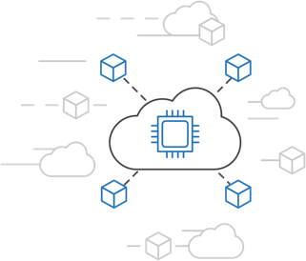
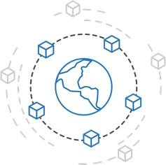
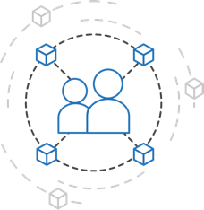
Azure container strategy
Embrace containers as ubiquitous
Support containers across the compute portfolio
Democratize container technology

Slide 13
Azure container ecosystem
OSBA
App Service
Azure Container Registry (ACR)
Partner services
Azure services
PaaS
OpenShift
SQL Database
Azure Kubernetes Service (AKS)
Service Fabric
Batch
Pivotal Cloud Foundry
Redis Cache
ACS Engine
Docker Enterprise Edition
CosmosDB
Virtual kubelet
Mesosphere DC/OS
And more!
Azure Container Instances (ACI)
Azure Virtual Machines
Virtual Machine Scale Sets (VMSS)
Azure
IaaS

Slide 14

Container orchestration
Azure Container Registry
Open source community
Azure Kubernetes Service (AKS)
Release automation tools
Containers 101
Getting started
Azure container technology
Open Service Broker for Azure (OSBA)
Customer success stories
Container orchestration
Azure Container Instances (ACI)

Slide 15
The elements of orchestration
Scheduling
Affinity/anti-affinity
Health monitoring
Failover
Scaling
Networking
Service discovery
Coordinated app upgrades

Slide 16
Kubernetes: the de-facto orchestrator
Portable
Public, private, hybrid, multi-cloud
Extensible
Modular, pluggable, hookable, composable
Self-healing
Auto-placement, auto-restart, auto-replication, auto-scaling

Slide 17
Kubernetes: empowering you to do more
Deploy your applications quickly and predictably
Scale your applications on the fly
Roll out new features seamlessly
Limit hardware usage to required resources only

